Slide 1
Strategy and Performance Board
Quarter 1 2023-24

Slide 2
Keeping Neighbourhoods Safe
All Crime
Beating Crime Plan
Residential Burglary
Neighbourhood Crime
Public Order
ASB
Roads Policing
Key Commitments
Reduce public order offences and anti-social behaviour, and the number of people who repeatedly carry out these acts.
Reduce acquisitive crime and repeat offenders.
Improve the safety of roads throughout Gwent.
Commission and invest in effective crime prevention initiatives.

Slide 3
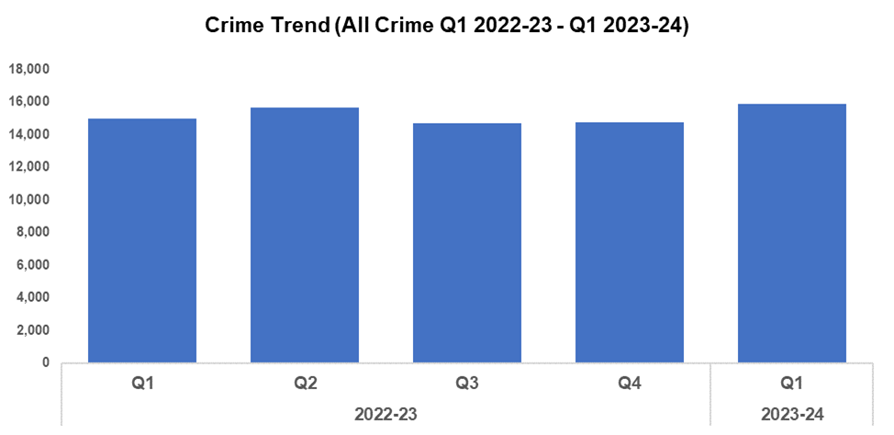
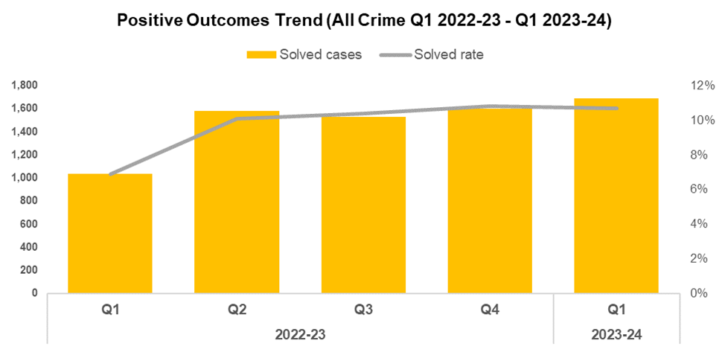
1. All Crime
Overview
Overall crime levels have increased by 7.3% during quarter one (Q1) of 2023-24 when compared to the quarter prior, with 1,079 additional offences recorded for a total of 15,861. This is the highest quarterly total recorded within the timeframe. A less prominent increase of 5.8% (876 additional offences) can be observed when comparing the current financial year to date (FYTD) against FYTD 2022-23.
The timeframe presented in this report has been limited to Q1 2022-23 onwards, excluding the financial years of 2020-21 and 2021-22 as they were anomalous due to the influence of COVID-19.
When compared to the previous quarter, the overall solved rate has fallen by 0.1 percentage points to 10.7%. This reduction, whilst minor, disrupts the upward trend which had been observed during the three quarters following Q1 2022-23. Whilst the solved rate has declined, the number of solved crimes has continued to increase, rising by 5.8% (92 additional solved crimes). This may indicate that the elevated volume of crime recorded during Q1 2023-24 has contributed to the decline in solved rate.
The solved rate for the current FYTD is 3.8 percentage points higher than that observed during FYTD 2022-23, although FYTD 2022-23 represents an outlier of poor performance in this regard.

Slide 4
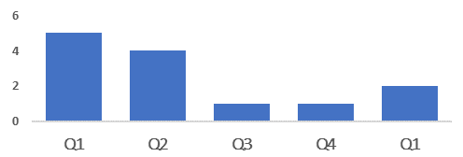
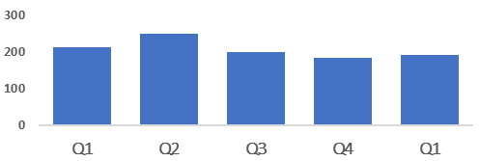
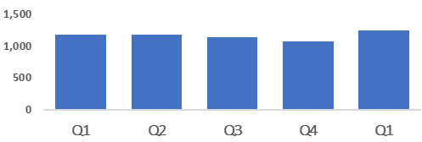
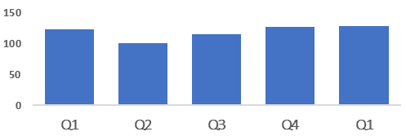
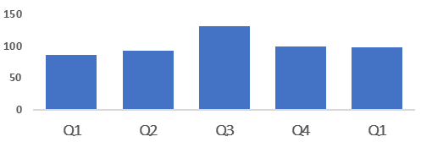
2. Beating Crime Plan
Crime Trend (Homicide Q1 2022-23 - Q1 2023-24)
A three year Homicide Prevention Strategy is in place, supported by a delivery plan, with the goal of furthering our understanding of the national and local themes and drivers that are likely to be precursors to Homicide.
The plan includes an examination of the enabling factors that contribute to Homicide (such as mental health, alcohol misuse, and weapons), with a view to early intervention and prevention. The links between Homicide and serious organised crime, domestic abuse, and the night-time economy have also been recognised.
This will be facilitated in part by improving our joint working and information sharing with partner agencies.
Homicide
Crime Trend (Serious Violence Q1 2022-23 - Q1 2023-24)
Gwent Police utilises a problem-solving, partnership based approach to preventing Serious Violence.
This approach is supported by a Serious Violence prevention strategy and delivery plan, which aim to reduce and where possible prevent harm to members of the community.
Particular focus has been placed on night-time economy related violence, knife related violence, robbery, drug related gang violence, and acid/corrosive substance attacks.
Tasking structures are in place to monitor active Organised Crime Groups (OCGs) and high-harm offenders.
Serious Violence
Crime Trend (Neighbourhood Crime Q1 2022-23 - Q1 2023-24)
The Neighbourhood Policing model is undergoing a review to improve its effectiveness and efficiency.
All officers working within neighbourhood policing are receiving a one day input on problem solving and prevention as part of the Gwent version of the All Wales Neighbourhood Policing Programme.
All response officers are having a training day input on problem solving and prevention. This has been adapted to include situational prevention and community prevention.
The Gwent Community Link (a police messaging service) will be launching in September.
Neighbourhood Crime
Crime Trend (Drugs Trafficking and Supply Q1 2022-23 - Q1 2023-24)
Proactive specialist support is available via the Drug Focus Desk.
We are working closely with partner agencies to provide signposting and treatment to reduce the number of repeat offenders.
An intelligence led approach is being used to identify and disrupt the crime groups presenting the highest risk.
We have a close working relationship with the Regional Organised Crime Unit (ROCU) and the National County Lines Coordinator, facilitating the early identification of offenders involved in the supply of drugs.
Drugs Trafficking
50/N Fraud Occurrences with a Cyber-Enabled Local Qualifier (Q1 2022-23 - Q1 2023-24)
A dedicated cyber ‘Digital Media Investigator’ has been provided to assist frontline officers, increasing the opportunities to identify and investigate cybercrimes.
Protect advice has been provided to all identified victims of cybercrime and cyber-enabled fraud, in an effort to prevent repeat victimisation.
Cyber-volunteers have been recruited to increase specialist knowledge and boost community engagement.
Cyber training was provided to all frontline officers, force control room operators and neighbourhood staff.
Cyber Crime

Slide 5
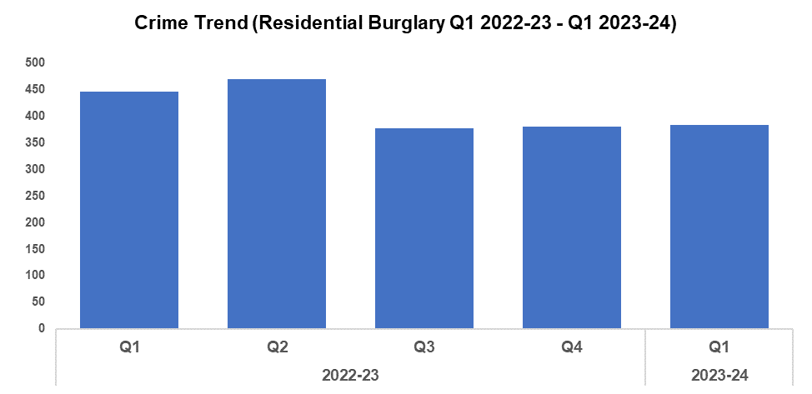
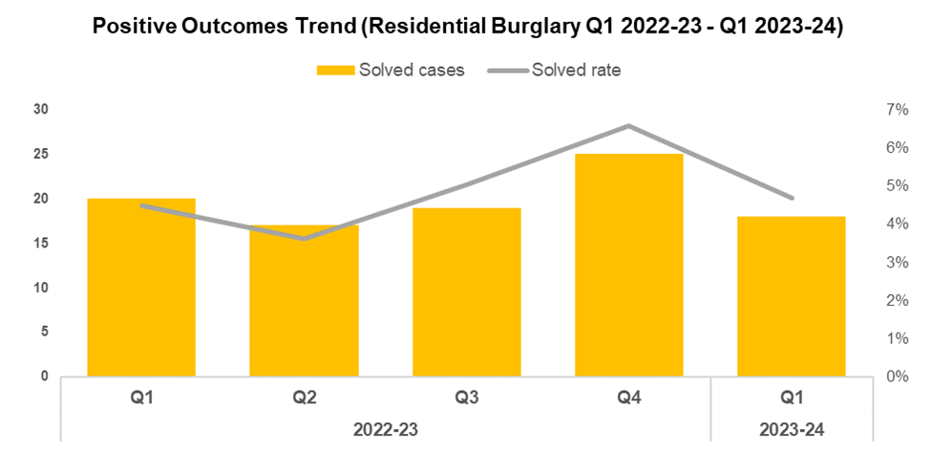
3. Residential Burglary
Overview
Residential Burglary offences saw a slight increase of 1.1% during Q1 2023-24 when compared to the quarter prior (four additional offences to 384). This increase, albeit minor, runs counter to the aims of the government’s Beating Crime Plan. Conversely, a reduction of 13.9% (62 fewer offences) can be observed when comparing the current FYTD against FYTD 2022-23.
Whilst a minor increase in offence volume was recorded during Q1 2023-24 when compared to the two previous quarters, these levels are notably lower than those recorded during the first two quarters of 2022-23, with this reduction appearing to be unaffected by seasonality. These reduced crime levels may indicate the long-term efficacy of the deterrence strategies employed as part of the ‘We Don’t Buy Crime’ (WDBC) initiative.
The solved rate for Residential Burglary offences fell by 1.9 percentage points to 4.7% during Q1 2023-24 when compared to the quarter prior, disrupting the upward trend in solved rate observed following Q2 2022-23. Despite this decline, the solved rate for the current FYTD remains 0.2 percentage points higher than that recorded during FYTD 2022-23.
August 2022 marked the commencement of the Burglary Response Improvement Pilot, an effort to increase the Residential Burglary solved rate via actions such as the consistent allocation of Crime Scene Investigators, as well as a focus on Golden Hour enquiries. January 2023 has seen the implementation of a second Burglary Pilot, focused around improving service to burglary victims and further increasing investigation quality. These pilots appear to have met with success, with attendance at Residential Burglaries rising to 94.9%, up from the 61.5% baseline.
Crime prevention kits are being rolled out to fifty houses in Alway, funded by the force’s successful Safer Streets bid. The packs include locks, ring doorbells, lighting, and SmartWater.

Slide 6
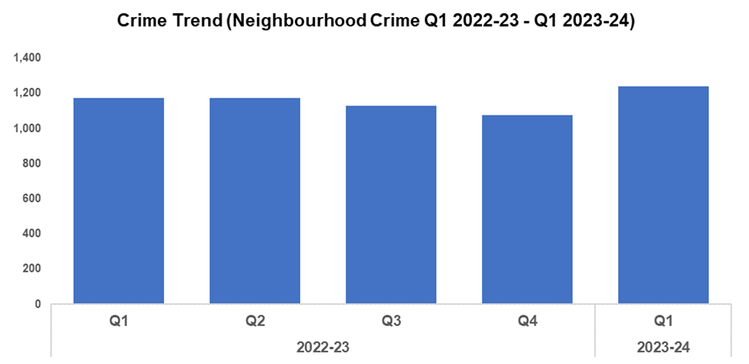
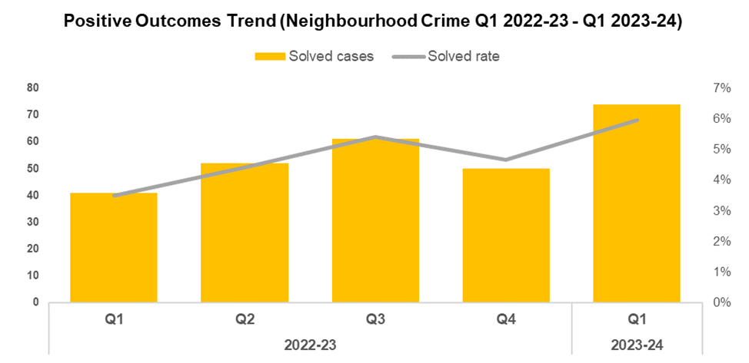
4. Neighbourhood Crime
Overview
Neighbourhood Crime offences have seen an increase of 15.3% during Q1 2023-24 when compared to the quarter prior (165 additional offences to 1,240). This runs counter to the objectives of the government’s Beating Crime Plan, in which it is a focus area for reduction. The increase in Neighbourhood Crime observed this quarter disrupts the downward trend in offence volume observed following Q2 2022-23, and represents the highest quarterly total within the timeframe. A less prominent increase of 5.8% (68 additional offences) can be observed when comparing the current FYTD against FYTD 2022-23.
When broken down by crime category, Vehicle Crime offences appear to be the primary driver behind the rise observed during Q1 2023-24, increasing in volume by 28.2% (159 additional crimes to 723) when compared to the quarter prior. As with Neighbourhood Crime as a whole, this is the largest quarterly total observed within the timeframe and accounts for 58.3% of all Neighbourhood Crime offences recorded during Q1 2023-24.
When compared to the previous quarter, the solved rate for Neighbourhood Crime has increased by 1.3 percentage points to 6.0%. This resumes the upward trend initially observed following Q1 2022-23, possibly indicating that the reduction in solved rate recorded during Q4 2022-23 represents an outlier in this regard. A larger increase of 2.5 percentage points can be observed when comparing the current FYTD against FYTD 2022-23, indicative of long-term improvement.
When broken down by crime category, Vehicle Crime offences also appear to be the primary contributor to the rise in solved rate observed during Q1 2023-24, seeing the largest increase of 3.6 percentage points to 6.4% (30 additional solved crimes to 46).
Notes:
Neighbourhood crime consists of personal robbery, residential burglary, theft from a vehicle, theft of a vehicle and theft from the person offences combined

Slide 7
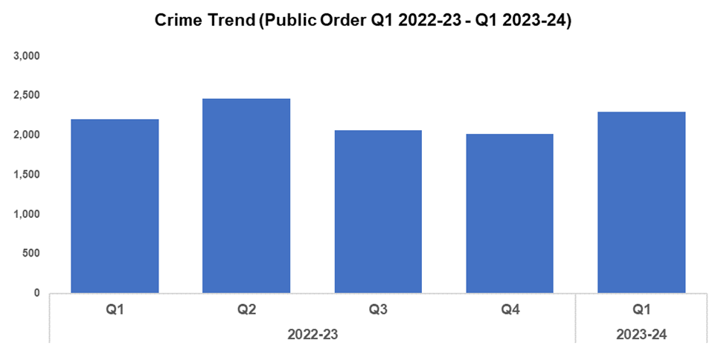
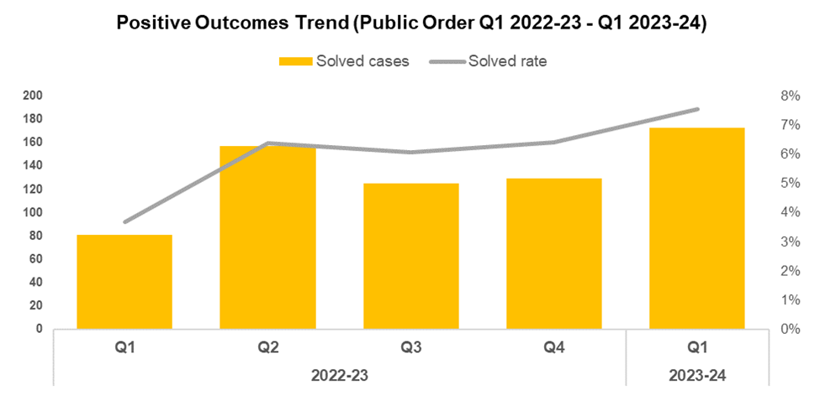
5. Public Order
Overview
Public Order Offences have increased by 13.9% (280 additional offences) when compared to the quarter prior, and currently stand at 2,292. As offences under Section 5 of the Public Order Act 1986 have been classified as non-notifiable by the Home Office, they have been retroactively removed from this dataset to facilitate more accurate data monitoring. Whilst the increase in crime volume seen during Q1 2023-24 disrupts the downward trend observed following Q2 2022-23, it appears to conform to seasonal trends. A less prominent increase of 3.9% (86 additional offences) can be observed when comparing the current FYTD against FYTD 2022-23.
When compared to the previous quarter, the solved rate for Public Order Offences (excluding Section 5) has increased by 1.1 percentage points to 7.5%. A more prominent increase can be observed when comparing the current FYTD against FYTD 2022-23, with the solved rate rising by 3.8 percentage points. However, FYTD 2022-23 represents an outlier of poor performance in this regard.
The volume of Public Order Offences resolved via community resolution has risen by 31.0% (18 additional offences to 76) when compared to the quarter prior.

Slide 8
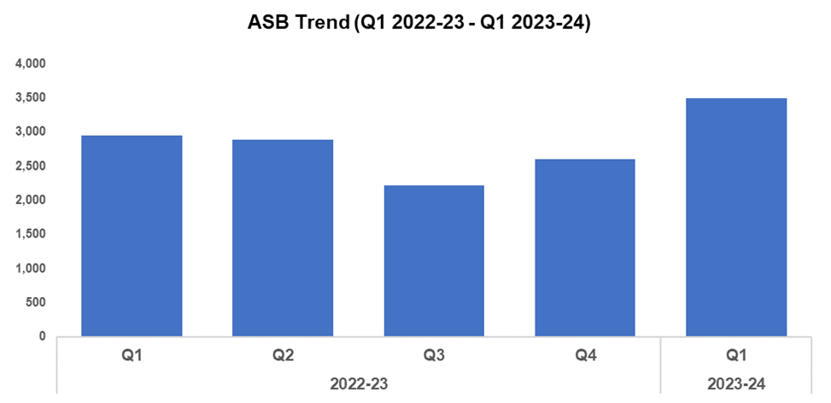
6. ASB
Overview
Levels of anti-social behaviour (ASB) in Gwent have increased by 34.3% (894 additional incidents) when compared to the previous quarter, with 3,500 incidents recorded. This continues the upward trend which began following Q3 2022-23. When comparing the current FYTD against FYTD 2022-23, a less prominent increase of 18.6% (550 additional incidents) can be observed.
Whilst substantial, the rise in ASB incident volume recorded during Q1 2023-24 appears to conform to seasonal trends, possibly influenced by warmer weather conditions. When assessed by closing category, incidents classified as ‘ASB - Nuisance’ appear to be the primary driver behind the rise in overall ASB volume, increasing by 43.0% (706 additional incidents) between Q4 2022-23 and Q1 2023-24. This accounts for 67.0% of all ASB incidents recorded during the quarter.
A portion of the £750,000 granted by the Home Office as a result of the force’s successful Safer Streets bid is being utilised to deter ASB through a range of diversionary tactics, such as educational youth outreach programmes delivered from new or refurbished youth shelters.
The Ringland Centre Problem Oriented Policing Plan commenced last year due to a rise in ASB. As a result of work undertaken alongside partner organisations, there has been a 30% reduction in the volume of reported ASB in the area when compared to the same period during the previous year. This work has recently been complimented by the commencement of a multi-agency walkabout and action plan, aimed at resolving environmental issues.
A ‘Believe’ programme has run for six weeks in Alway. This consists of sessions organised by Youth Justice and supported by the Neighbourhood Policing Team (NPT). These sessions are designed to educate local children on the impact of offences such as knife crime and ASB.
The data presented in this slide excludes incidents classified as ‘ASB – COVID 19’.

Slide 9
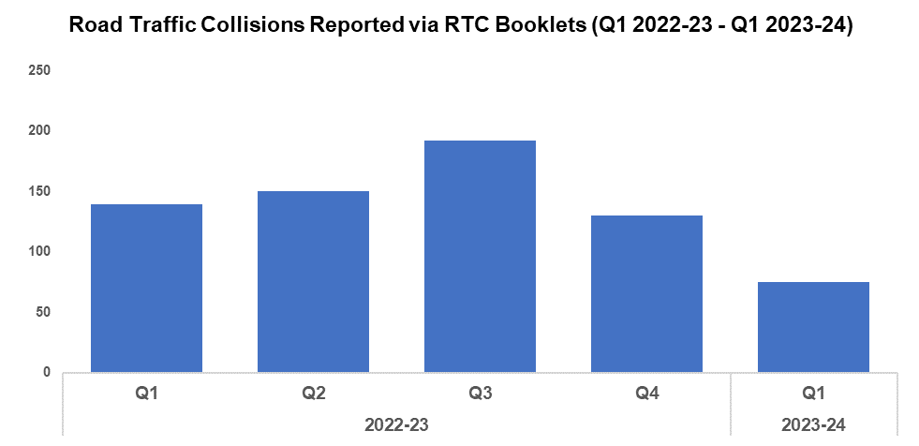
7. Roads Policing
Overview
During Q1 2023-24, 75 Road Traffic Collisions (RTCs) were reported via RTC booklets, a reduction of 42.3% (55 fewer incidents) when compared to the quarter prior. These reduced levels are likely influenced by a lag time between the incidents occurring and the RTC booklets being submitted, with 76 booklets currently marked as outstanding for the quarter. As such, the number of RTCs recorded for Q1 2023-24 is expected to increase going forward, which will be reflected in future reporting.
A total of 891 individuals were reported for one of the ‘Fatal Five’* factors during Q1 2023-24, a reduction of 13.8% (143 fewer reports) when compared to the previous quarter. The most commonly reported factor during Q1 2023-24 was not wearing a seatbelt, with 257 instances reported (28.8% of all reports). This was followed by drink/drug driving, with 225 instances reported (25.3% of all reports).
*The ‘Fatal Five’ refer to the five main causes of serious injury and death in RTCs. They consist of: careless driving, drink/drug driving, not wearing a seatbelt, using a mobile phone, and excessive speed.
Operation Harley continues to combat the inappropriate use of off-road motorbikes. A partnership operation across the West Local Policing Area (LPA) on Sunday the 30th of July saw seven vehicles seized and two persons arrested.
Roads Policing and Specialist Operations (RPSO) officers have targeted the specific issue of ‘Sur-Ron’ type e-motorbikes which are illegal on UK roads if not fully registered, insured, and subject to vehicle excise licence (tax). Furthermore, these bikes have been used by OCGs to convey controlled drugs. As a result of the recent enforcement activity in the Newport area:
One male was arrested following the rider failing to stop for officers. Tactical Pursuit and Containment (TPAC) tactics were employed which resulted in the bike being successfully ‘stung’. The offender will be charged with dangerous driving, no insurance and no licence offences, and the bike will be destroyed.
During a separate incident another male was observed riding and throwing rocks at police vehicles. Assistance from NPAS (National Police Air Service) was instrumental in observing the rider. The male was arrested and the bike seized.
RPSO officers have also worked collaboratively with the Newport East NPT. During one evening a further two bikes were recovered and one male was arrested for possession with the intent to supply Class A drugs, as well as driving offences.
RPSO officers carried out a stop-search of a vehicle, during which £150,000 of cash was seized and the individual was arrested for possession of criminal property.
In the course of another stop by RPSO officers 3 kg of heroin was recovered. Two individuals have subsequently been charged.

Slide 10
Combat Serious Crime
Combat Serious Crime
Most Serious Violence
Serious Violence
VAWG Domestic Priority Offences
VAWG Non Domestic Priority Offences
Drug Supply and Organised Crime
Key Commitments
Reduce the number of repeat victims of child criminal and sexual exploitation.
Increase disruption of serious organised crime, and reinvest assets seized back into communities.
Improve the overall criminal justice response to violence against women, domestic abuse and sexual violence.
Commission and invest in services that work with perpetrators of serious crime to prevent and reduce re-offending.

Slide 11
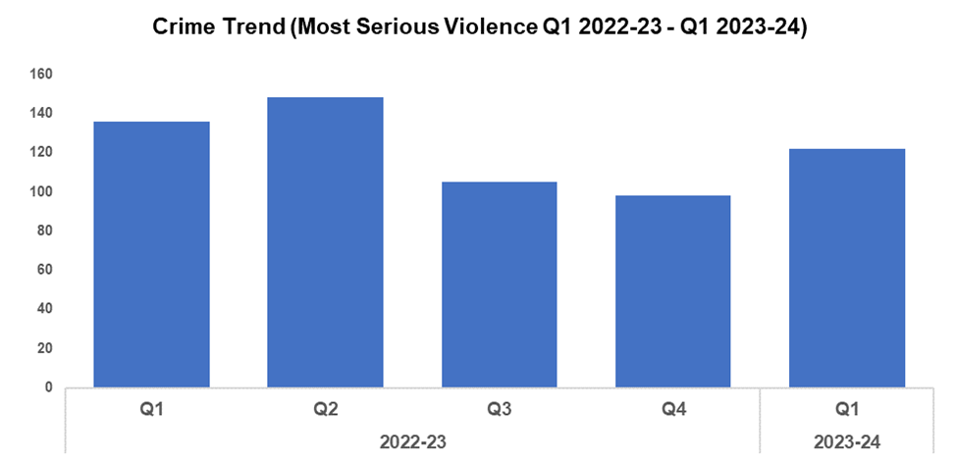
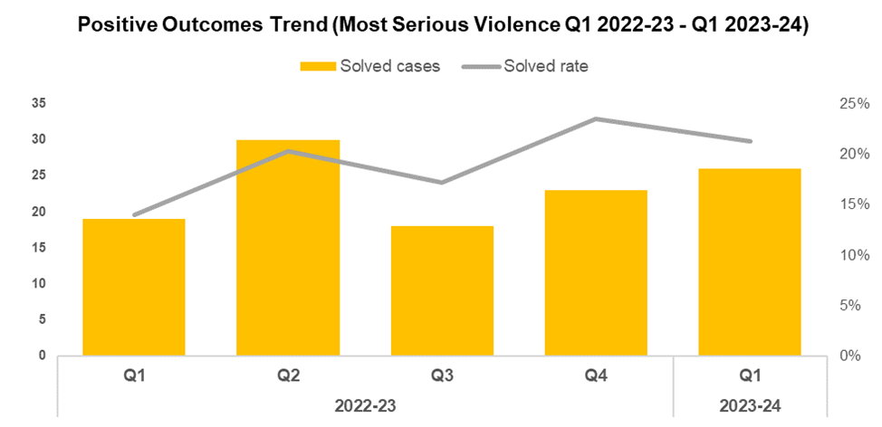
1. Most Serious Violence
Overview
Most Serious Violence offences consist of Homicide, Grievous Bodily Harm with Intent, and Causing Death by Dangerous Driving. Q1 2023-24 saw these offences increase in volume by 24.5% (24 additional offences to 122) when compared to the quarter prior, disrupting the downward trend in offence volume observed following Q2 2022-23. Grievous Bodily Harm with Intent offences account for 93.4% of this total, with 114 crimes recorded during Q1 2023-24. Despite this short-term increase, a reduction of 10.3% (14 fewer offences) can be observed when comparing offence volume for the current FYTD against FYTD 2022-23.
When compared to the previous quarter, the solved rate for Most Serious Violence has fallen by 2.2 percentage points to 21.3%. Conversely, the number of solved crimes has risen by 13.0% (three additional solved crimes to 26), continuing the upward trend observed following Q3 2022-23. The solved rate for the current FYTD is 7.3 percentage points higher than that observed during FYTD 2022-23.
Over the past three months the following investigations have been heard in court:
Rex v Webster, which relates to the death of Benjamin Lloyd. The defendant was sentenced to five years on the 6th of June
Rex v Silcox, which relates to the murder of Adell Cowan. The defendant entered a guilty plea and was sentenced to life with a minimum of 25 years on the 7th of July.
Rex v Southwood, which relates to the murder of Carl Ball. The defendant entered a guilty plea and was sentenced to life with a minimum of 20 years on the 20th of July.

Slide 12
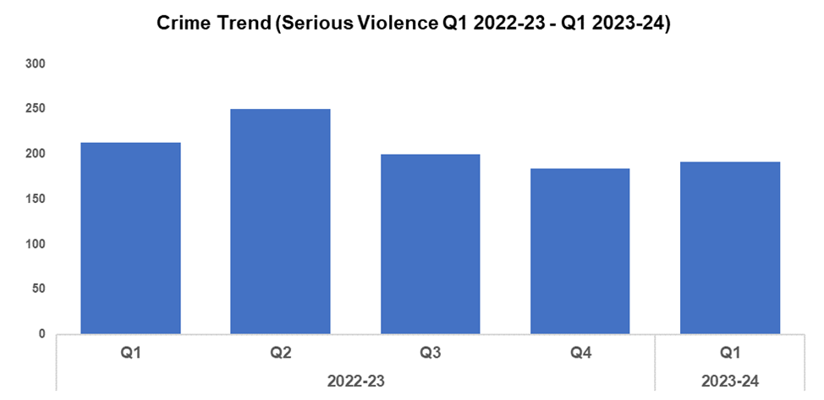
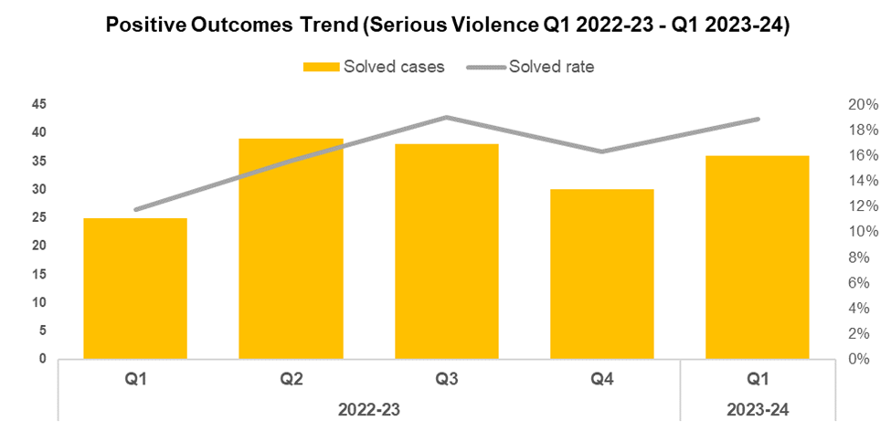
2. Serious Violence
Overview
Serious Violence crimes consist of Section 18 Grievous Bodily Harm with Intent, Section 20 Malicious Wounding without Intent, and Personal Robbery offences. Q1 2023-24 saw the volume of these offences increase by 3.8% (seven additional offences) when compared to the quarter prior, with 191 crimes recorded. Conversely, a reduction of 10.3% (22 fewer offences) can be observed when comparing the current FYTD against FYTD 2022-23.
When compared to the previous quarter, the solved rate for Serious Violence offences has increased by 2.5 percentage points to 18.8%. The number of solved crimes has also increased, rising by 20.0% (up six offences to 36). A more prominent increase of 7.1 percentage points can be observed when comparing the solved rate for the current FYTD against FYTD 2022-23.

Slide 13
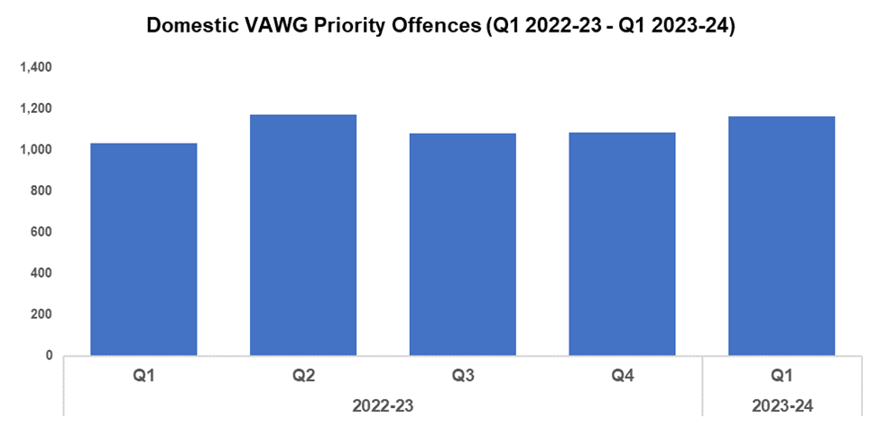
3. VAWG Domestic Priority Offences
Overview
The adjacent chart displays the number of combined Violence against Women and Girls (VAWG) priority offences with a domestic abuse qualifier, and which have at least one female victim linked.*
During Q1 2023-24, 1,164 of these offences were recorded. This represents an increase of 7.4% (80 additional offences) when compared to the quarter prior.
The current FYTD saw an increase of 12.9% (133 additional offences) when compared to FYTD 2022-23.
851 females have been a victim of more than one VAWG domestic priority offence in the last 12 months (up to the end of Q1 2023-24). 27 women and girls have been the victim in more than five separate offences.
In the last 12 months, there were 424 female offenders linked to domestic priority offences against females, 20.5% of which (87 individuals) are repeat offenders.
During the same period there were 2,616 male offenders linked to domestic priority crimes against females, 30.6% of which (801 individuals) are repeat offenders. 32 males were linked as the offender in more than five of these offences during the most recent 12 month period.
*Domestic priority areas combined cover Homicide, Violence with Injury, Stalking and Harassment, Public Fear , Alarm or Distress, Rape, Other Sexual Offences, and Modern Slavery.

Slide 14
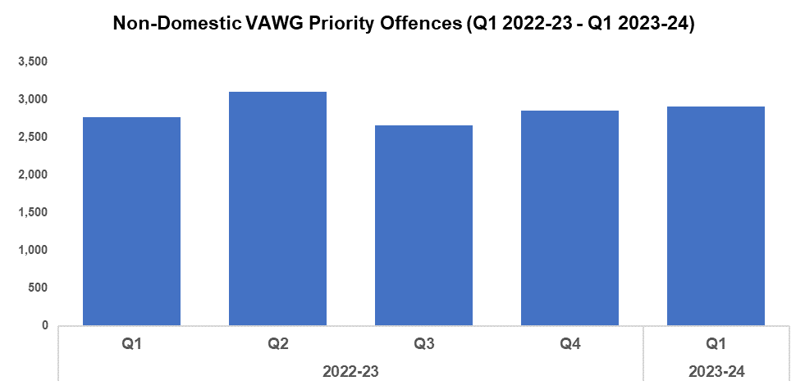
4. VAWG Non Domestic Priority Offences
Overview
The adjacent chart shows the number of combined VAWG priority offences that do not have a domestic abuse qualifier, and which have at least one female victim linked.*
During Q1 2023-24, 2,906 of these offences were recorded. This represents an increase of 1.9% (55 additional offences) when compared to the quarter prior.
The current FYTD saw an increase of 5.2% (143 additional offences) when compared to FYTD 2022-23.
1,833 females have been a victim of more than one VAWG non-domestic priority offence in the last 12 months (up to the end of Q1 2023-24). 97 women and girls have been the victim in five or more separate offences
In the last 12 months, there were 2,562 female offenders linked to non-domestic priority offences against females, 30.1% of which (771 individuals) are repeat offenders. 47 females were linked as the offender in more than five of these offences during the most recent 12 month period.
During the same period there were 3,493 male offenders linked to non-domestic priority offences against females, 23.9% of which (836 individuals) are repeat offenders. 42 males were linked as the offender in more than five of these offences during the most recent 12 month period.
*Non-domestic priority areas combined cover Homicide, Violence with Injury, Stalking and Harassment, Public Fear , Alarm or Distress, Rape, Other Sexual Offences, Modern Slavery, and Exploitation of Prostitution.

Slide 15
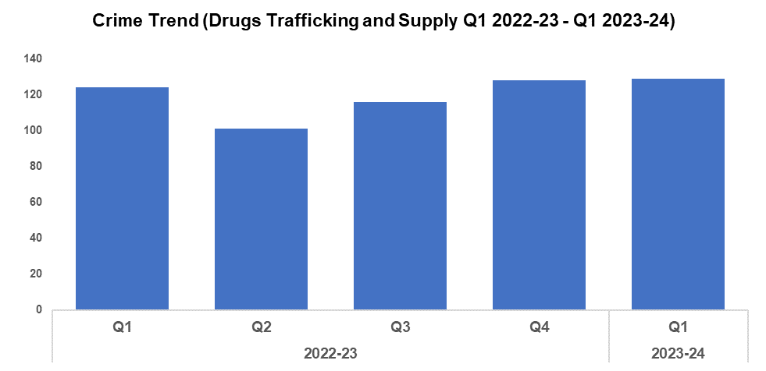
5. Drug Supply & Organised Crime
Overview
A slight increase of 0.8% (one additional offence to 129) has been recorded for Drug Trafficking and Supply offences during Q1 2023-24 when compared to the quarter prior. When comparing the current FYTD against FYTD 2022-23, a more prominent increase of 4.0% (five additional offences) has been recorded.
1,584 Drug Supply and Dealing intelligence logs were submitted during Q1 2023-24. This is an increase of 13.1% (183 additional logs) when compared to the quarter prior, which saw 1,401 logs submitted. An increase of 3.1% (47 additional logs) can be observed when comparing the current FYTD against FYTD 2022-23, which saw 1,537 logs submitted.
Thanks to the actions of the Blaenau Gwent NPT, three individuals have been sentenced to a total of 11 years for supplying Class A drugs throughout Abertillery and Tredegar.
Over the last three months the Organised Crime Unit have arrested nine suspects, seizing 4.5 kg of Cocaine, 40 kg of Paracetamol, and MDMA tablets worth over £25,000. Cash amounting to £100,000 was also seized.
During the same period the Newport Serious Organised Crime Team have charged seven people with drugs related offences. They have also seized items which include: £7,500 in cash; 1.6 kg of Class A drugs; three ‘Sur-Ron’ bikes; and high-value items valued in excess of £110,000.
An investigation was commenced after it became known that children within local schools had been hospitalised following their use of vapes. As a result of a robust multi-agency investigation, three suspects were identified and arrested. A total of approximately £6,000 was seized and 712 vapes were identified as being illegal in the UK (although not classified as prohibited drugs). Furthermore, another 1,200 boxes containing a combined total of 12,000 legal vapes were seized and are being treated as criminal property. All suspects have been bailed pending further enquiries. To date no further reports of concern have been identified following these disruption activities.

Slide 16
Support Victims and Protect the Vulnerable
Hate Crime
Rape
Domestic Related Crime
Domestic Abuse Repeat Victims/Offenders
Modern Day Slavery and Human Trafficking
Child Sexual Exploitation/Child Criminal Exploitation
Cyber Fraud
Victim Support/Repeat Victims
Key Commitments
Improve victim services and ensure that the needs of victims are identified and responded to appropriately through Connect Gwent and the Victim Care Unit.
Further improve our work with partners to protect those most vulnerable.
Increase the timeliness of police investigation updates provided to victims.
Commission and invest in specialist services to support victims throughout the criminal justice process.

Slide 17
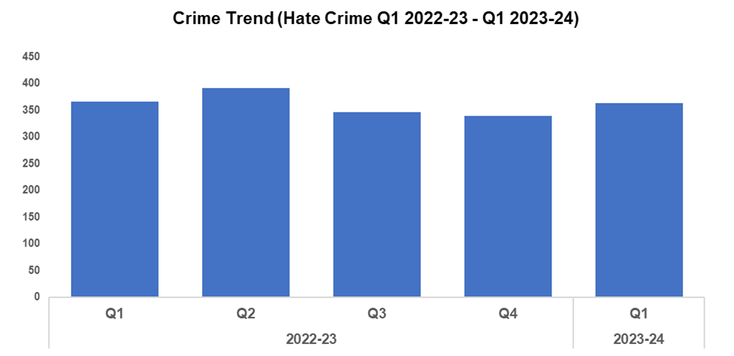
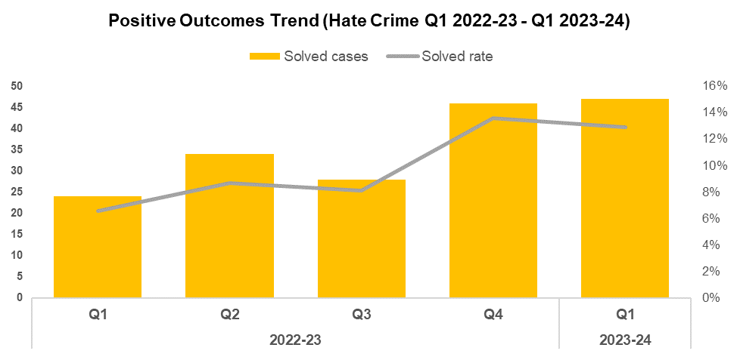
1. Hate Crime
Overview
The volume of recorded hate crime offences increased by 7.4% (25 additional offences) during Q1 2023-24 when compared to the quarter prior, for a total of 364 offences. This may suggest that victims are increasingly confident in reporting these crimes. A slight reduction of 0.5% (two fewer offences) can be observed when comparing the current FYTD against FYTD 2022-23.
The number of offences containing the disability hate strand rose to 93, an 35 additional offences when compared to the quarter prior. This is the highest quarterly figure within the timeframe.
The number of offences containing the homophobic hate strand increased by 13 to 56 this quarter. Despite this increase, it represents the second lowest quarterly figure within the timeframe.
The number of offences containing the racial hate strand has decreased to 195, 24 fewer offences than the quarter prior.
The number of offences containing the religious hate strand increased by six when compared to the previous quarter, for a total of nine.
The number of offences containing the transphobic hate strand fell to 16, a reduction of six when compared to the previous quarter and the joint lowest quarterly figure within the timeframe.
The solved rate for hate crime offences has fallen by 0.7 percentage points to 12.9% when compared to quarter prior, although it remains substantially higher than during the first three quarters of 2022-23. When comparing the current FYTD against FYTD 2022-23, the solved rate has risen by 6.3 percentage points.
Please note that one crime can have multiple hate strands. The overall hate crime trend is based on recorded crimes, whilst the breakdown by hate strand is based on the volume of each individual strand.

Slide 18
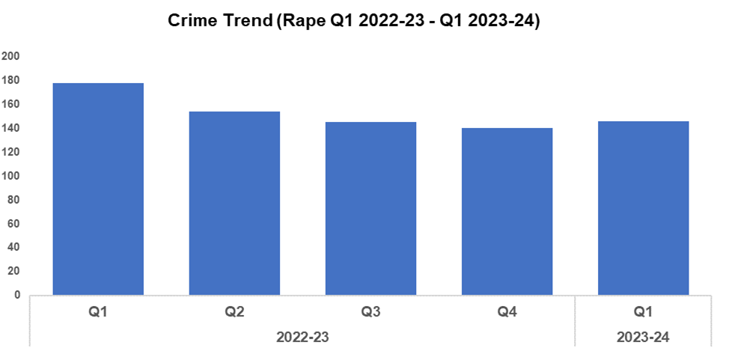
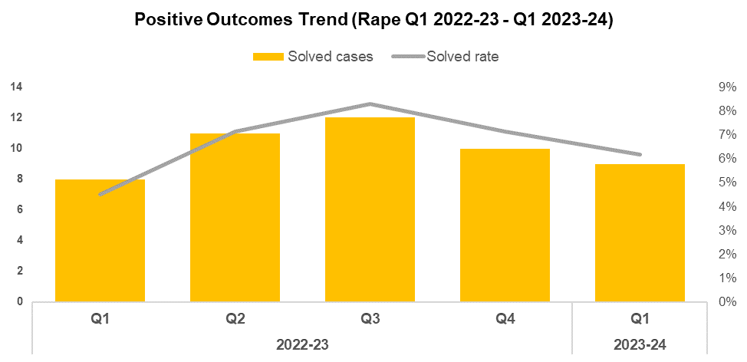
2. Rape
Overview
The volume of recorded Rape offences increased by 4.3% (six additional offences) during Q1 2023-24 when compared to the quarter prior, disrupting the downward trend in offence volume observed following Q1 2022-23. This rise is line with the increased reporting required as part of the government’s Beating Crime Plan, and consistent with the local priority to actively increase reporting for this historically under-reported offence category. When comparing the current FYTD against FYTD 2022-23, a reduction of 18.0% (32 fewer offences) can be observed.
The solved rate for Rape offences during Q1 2023-24 stands at 6.2%, a reduction of 0.9 percentage points when compared to the quarter prior. This continues the downward trend in solved rate observed following Q3 2022-23. Conversely, the solved rate has increased by 1.7 percentage points when comparing the current FYTD against FYTD 2022-23.

Slide 19
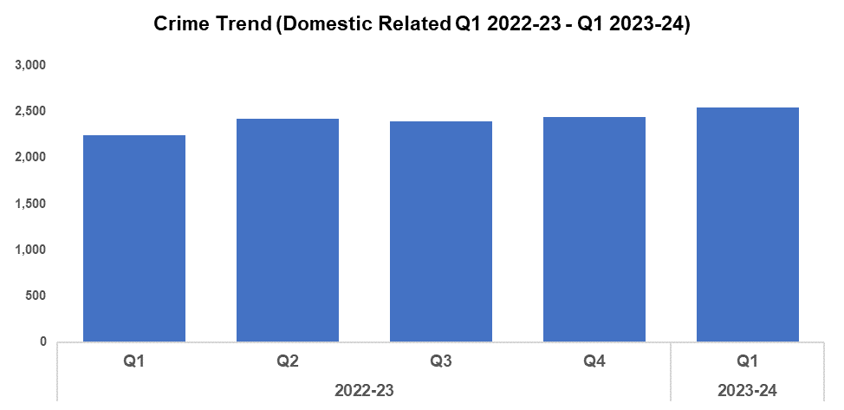
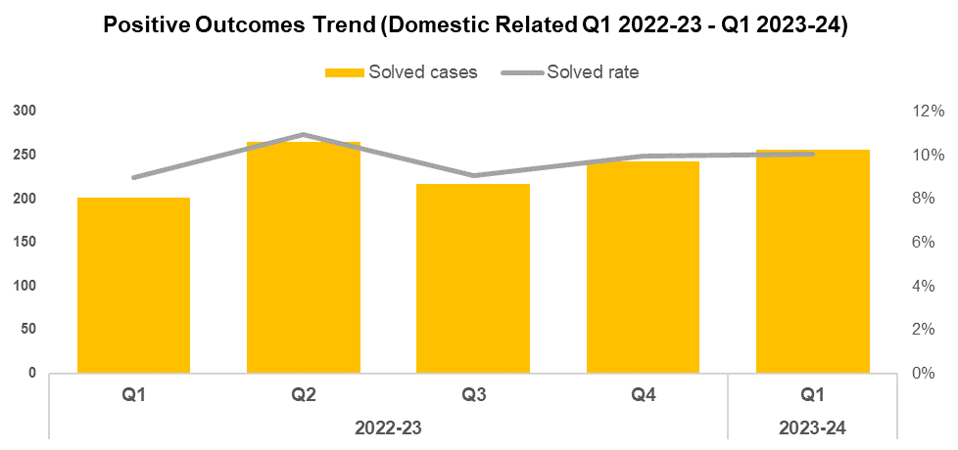
3. Domestic Related Crime
Overview
Domestic related offences have increased 4.4% (107 additional offences) when compared to the quarter prior, and currently stand at 2,544. When comparing the current FYTD against FYTD 2022-23, the volume of domestic related offences has increased by 13.6% (304 additional offences). These increases may be influenced by ongoing improvements to crime data integrity.
The solved rate for domestic related crime has increased by 0.1 percentage points when compared to the quarter prior, and currently stands at 10.1%. This represents the second consecutive increase in solved rate since Q3 2022-23. When comparing the current FYTD against FYTD 2022-23, the solved rate has risen by 1.1 percentage points.

Slide 20
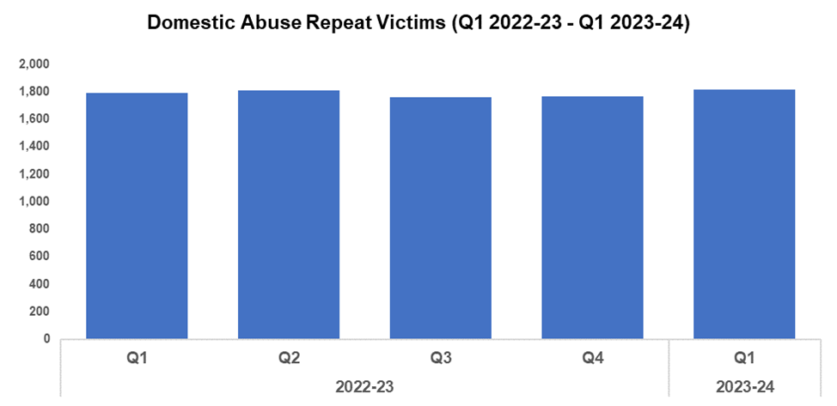
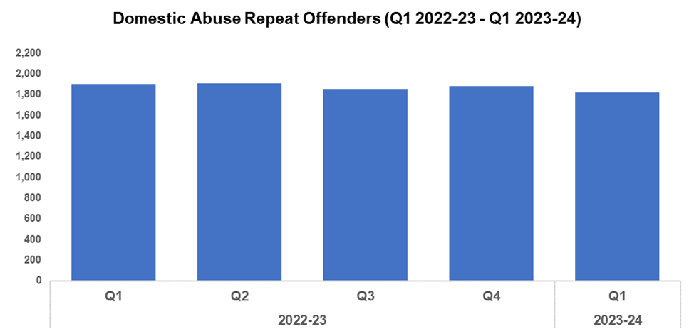
4. Domestic Abuse Repeat Victims/Offenders
Repeat Victims Overview
The number of repeat domestic abuse victims* has increased by 2.7% (47 additional repeat victims to 1,815) when compared to the quarter prior. When comparing the current FYTD against FYTD 2022-23, a less prominent increase of 1.2% (21 additional repeat victims) can be observed.
It may be that improvements to crime data integrity have contributed to the increase seen during this quarter. This rise may also indicate that victims of domestic abuse are increasingly willing to report subsequent offences, implying a certain level of victim satisfaction following their initial contact with Gwent Police.
*Based on rolling 12 months to the end of each quarter, where persons are linked to two or more crimes within this period.
Repeat Offenders Overview
The number of repeat domestic abuse offenders* has decreased by 3.4% (64 fewer repeat offenders to 1,818) when compared to the quarter prior. This contrasts with the rise in repeat victims observed during the same period. When comparing the current FYTD against FYTD 2022-23, the number of repeat offenders has fallen by 4.6% (87 fewer repeat offenders).
There is a Multi-Agency Tasking and Coordination (MATAC) process in place which focuses on identifying serial perpetrators of domestic abuse, in order to limit the risk of them reoffending. A range of interventions can be delivered via MATAC to safeguard victims and families, including support, prevention, diversion, disruption, and enforcement.
*Based on rolling 12 months to the end of each quarter, where persons are linked to two or more crimes within this period.

Slide 21
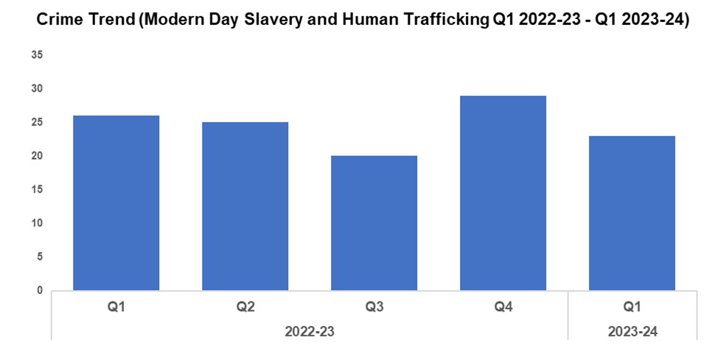
5. Modern Day Slavery and Human Trafficking
Overview
Modern Day Slavery and Human Trafficking (MDSHT) offences have seen a reduction of 20.7% (six fewer offences to 23) during Q1 2023-24 when compared to the quarter prior. A less prominent reduction of 11.5% (three fewer offences) can be observed when comparing the current FYTD against FYTD 2022-23.
Continued awareness training has been delivered to new starters, new Community Support Officers (CSOs), and trainee detectives. The number of National Referral Mechanisms submitted has also continued to increase.

Slide 22
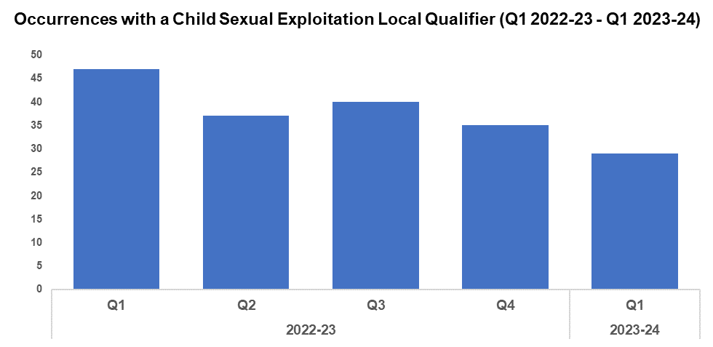
6. Child Sexual Exploitation/Child Criminal Exploitation
Overview
The number of crimes assigned a Child Sexual Exploitation (CSE) local qualifier has decreased by 17.1% (six fewer crimes) during Q1 2023-24 when compared to the quarter prior, and currently stands at 29. A more prominent reduction of 38.3% (18 fewer crimes) can be observed when comparing the current FYTD against FYTD 2022-23.
The offence most commonly assigned a CSE local qualifier during Q1 2023-24 was ‘Take/make indecent photographs/pseudo-photographs of children’, with 14 instances. This accounts for 48.3% of all crimes assigned a CSE local qualifier.
As a result of Operation Hayburn, Joel Gillard pleaded guilty to 12 sexual offences, with six children identified as victims. Gillard entered a guilty plea in court, and was sentenced to extended licence period, nine years and six months in prison, and a Sexual Harm Prevention Order that will last for 25 years.

Slide 23
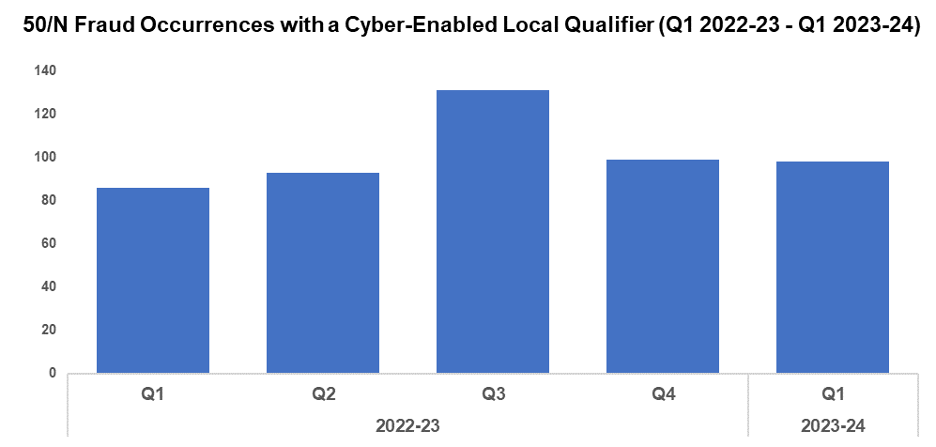
7. Cyber Fraud
Overview
Of the 1,072 fraud occurrences under 50/N recorded since Q1 2022-23, 47.3% (507 occurrences) have been assigned a cyber-enabled local qualifier.
Q1 2023-24 saw 98 50/N fraud occurrences assigned a cyber-enabled local qualifier, a reduction of 1.0% (one fewer occurrence) when compared to the quarter prior. This continues to downward trend observed following Q3 2022-23, with Q3 2022-23 itself standing as something of an outlier in this respect.
When comparing the FYTD against the FYTD 2022-23, an increase of 14.0% (12 additional occurrences) has been recorded.

Slide 24
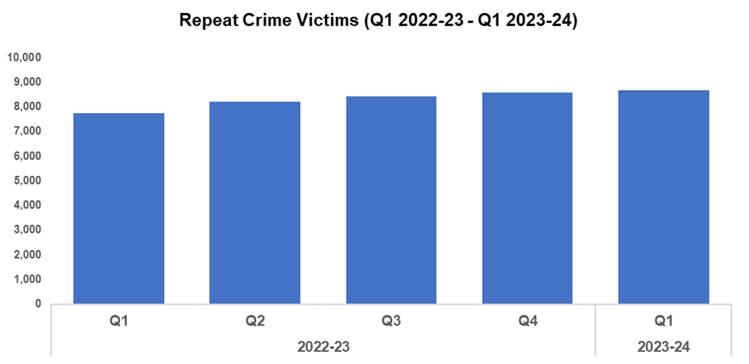
8. Victim Support/Repeat Victims
Overview
In this context, a repeat crime victim refers to an individual who has been linked as a victim in two or more crimes within a 12-month rolling period.
The number of repeat crime victims has increased by 1.1% (95 additional repeat victims) during Q1 2023-24* when compared to the quarter prior, and currently stands at 8,681. This is the highest level recorded within the timeframe, and continues the upward trend observed throughout. A more prominent increase of 12.2% (947 additional repeat victims) has been recorded when comparing the current FYTD against FYTD 2022-23.
The number of repeat crime victims has risen consistently throughout the timeframe, despite the fact that overall crime levels have fluctuated during this period. This may indicate that improvements to the process of identifying repeat victims (and to crime data integrity as a whole) are the primary contributors to this upward trend, rather than raw crime volume.
PC Robbie Higgins was recognised for outstanding victim support in response to a dog attack, resulting in the conviction of an offender who is awaiting sentencing.
*Based on the rolling 12 months to the end of the quarter.

Slide 25
Increase Community Confidence in Policing
Perceptions Survey: Local Concerns and Overall
Victim Satisfaction
Representative Workforce
Investigation Timeliness
Response Rates
999 Demand
101 Demand
Social Media and Single Online Home
Initiatives & Events
Key Commitments
Increase the effectiveness of officer and staff engagement with residents in their communities, and community confidence and trust in Gwent Police.
Improve the accessibility of neighbourhood police teams through a variety of contact channels that meet the needs of the public.
Increase reporting of crime by communities that are less likely to engage with the police.
Further increase officer and staff diversity to ensure our police service reflects the communities that we serve.

Slide 26
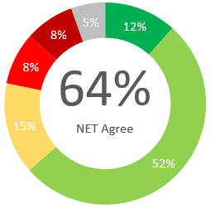
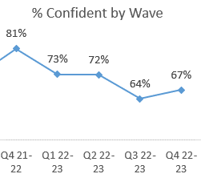
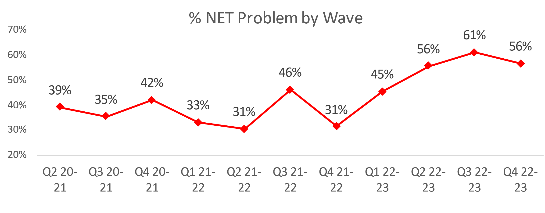
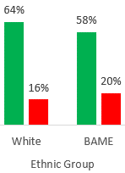
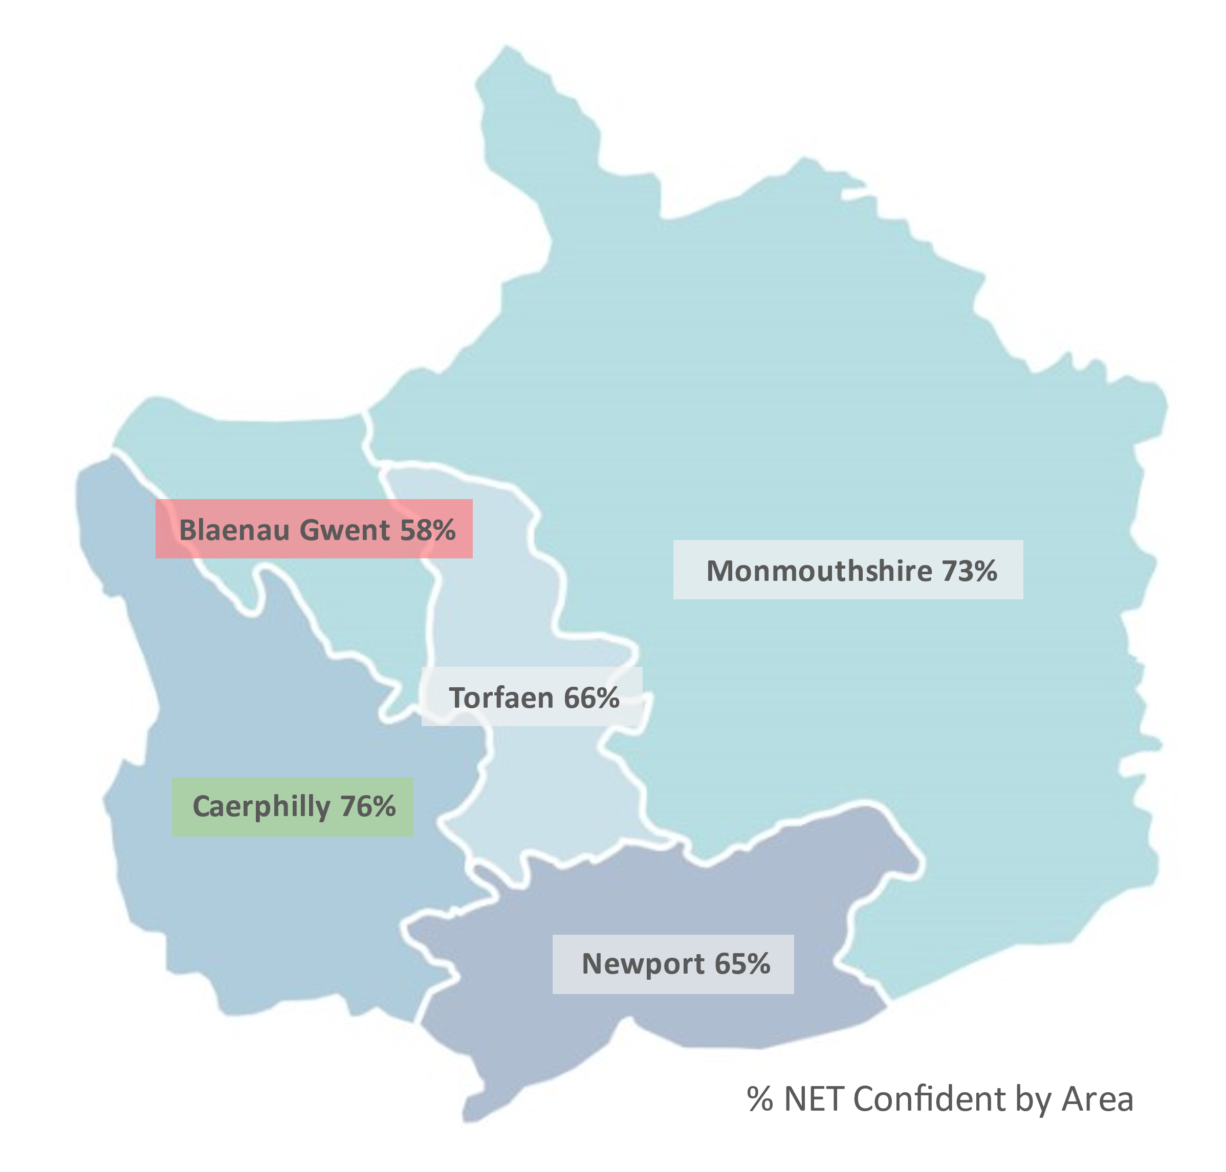
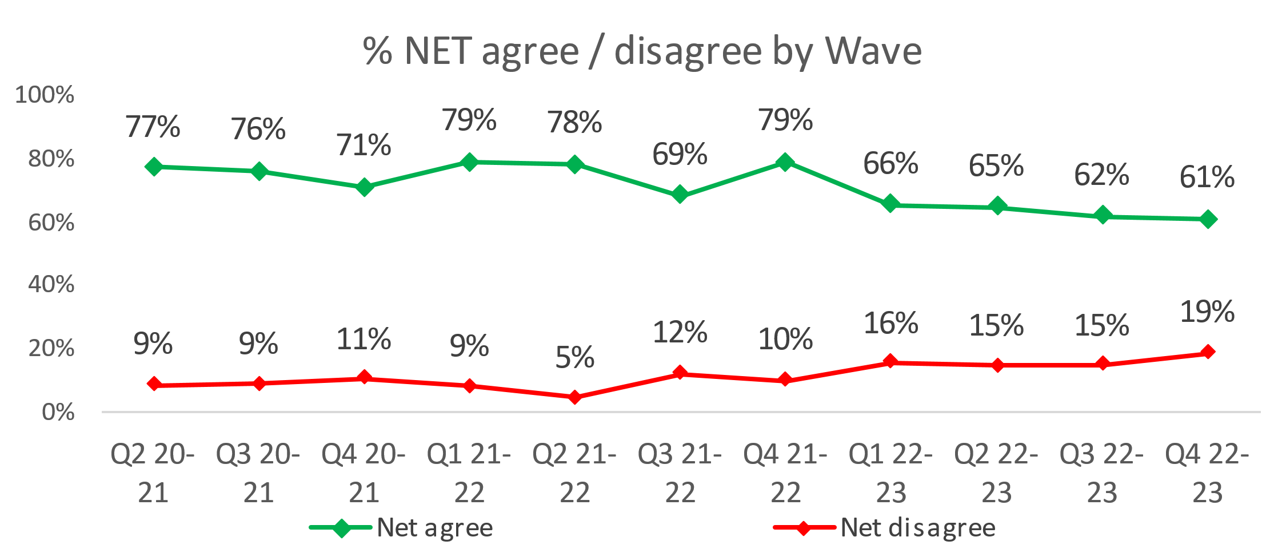
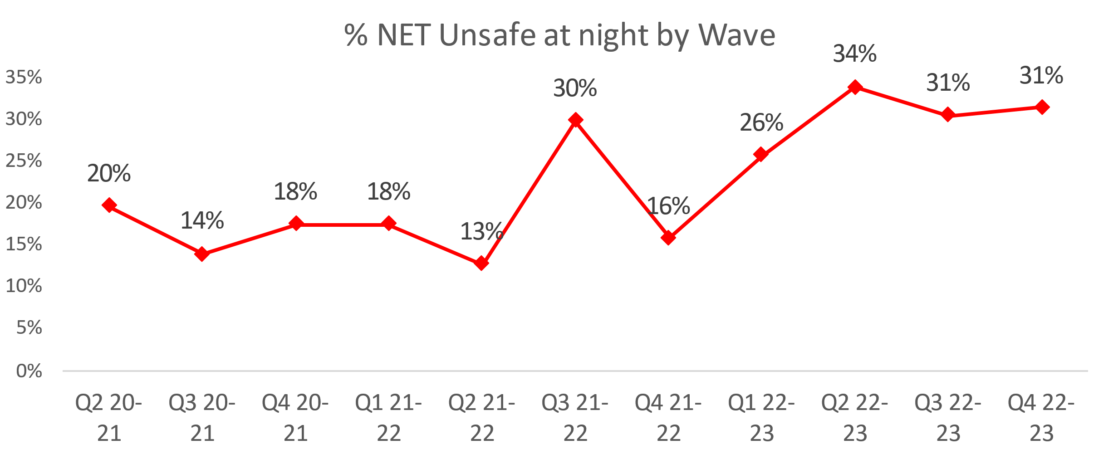
1. Perceptions Survey: Local Concerns and Overall
Overall Confidence in the Police
Local Concerns
Positive Experiences
“They were very sympathetic when we spoke to them, they seemed to appreciate that a lot of the people up our road are elderly and its very frightening having people kicking your door at night.”
“We had one incident with someone jumping in the hedge, but nothing major that we had to call the police about. In the past when things have gone on in the village the police have sorted it as far as I know.”
Nearly two thirds (64%) of people agree they have confidence in the police in their area. This is lowest in Blaenau Gwent (54%) and highest in Monmouthshire (71%).
More than half (55%) feel that crime and ASB are a problem in their area.
This metric remains high, having risen by 16.0 pp in the previous two quarters. Newport (67%) is the area of highest concern whereas Monmouthshire (25%) has the lowest perceived concern.
Two-thirds of residents are confident they could easily speak to police in their area, however this has reduced over the previous four quarters (67% in Q4 2022-23).
Ethnic minority groups have less confidence in this statement, with 58% agreeing they have confidence in police in their area.
There is a sustained rise in feeling unsafe at night, particularly in Newport (37%). Monmouthshire (14%) felt the safest. This trend follows the above trend relating to ASB and Crime in their area.
Lack of action
“I can see in my local area that the anti-social behaviour, drug misuse, vandalism and littering is not taken care of.”
“I think they have proven that they're never here when they're needed, it happens time and time again.”
“I don't see them dealing with anti-social behaviour from young people and travellers in the area. It's an ongoing issue that they are aware of but ignore.”
Minority
A downward trend is apparent, with overall confidence dropping from 79% in Q4 2021-22 through to 61% in Q4 2022-23.
An unsurpassed 19% disagree that they have confidence in the police in their area.
For the above statement, Blaenau Gwent had the lowest confidence (58%) whilst Caerphilly had the highest confidence (76%).
3.0% have been a victim of a crime and did not report it to Gwent Police. Applying this to the population of Gwent, this would equate to 17,631 individuals.
“All they do is give you a crime number and say they'll look into it, but they never do.”
Notes:
Based on the Gwent Police Perceptions Survey for Wave (Quarter) 4 2022-23, conducted by SMSR Research
Between October 2020 and March 2023, 6,004 residents across all 5 police districts were interviewed using random quota sampling designed to accurately represent the population size and demographics of Gwent. These slides highlight the main points from the latest results.

Slide 27
2. Victim Satisfaction
Percentage | Measure
Survey Number | Survey One | Survey Two |  |  |  | Survey Three
Metric | Satisfied with Initial Contact | Satisfied with Follow Up & Investigation | Satisfied with the service from the VCO | Satisfied with the service from the officer dealing with your case | Satisfied with being kept informed about your case | Satisfied with Post Charge
General Crime | 59% | 54% | 86% | 77% | 76% | 40%
Domestic Violence | 76% | 81% | 96% | 84% | 82% | 100%
Hate Crime | 100% | 67% | 100% | 100% | 100% | No Data
Sexual Violence | 100% | 80% | 100% | 80% | 100% | No Data
Baseline | N/A | N/A | 85% | 85% | 74% | N/A
Numeric | Measure
Survey Number | Survey One | Survey Two |  |  |  | Survey Three
Metric | Satisfied with Initial Contact | Satisfied with Follow Up & Investigation | Satisfied with the service from the VCO | Satisfied with the service from the officer dealing with your case | Satisfied with being kept informed about your case | Satisfied with Post Charge
General Crime | 517/881 | 50/92 | 42/49 | 34/44 | 35/46 | 2/5
Domestic Violence | 44/59 | 25/31 | 25/26 | 21/25 | 18/22 | 7/7
Hate Crime | 11/11 | 2/3 | 3/3 | 3/3 | 3/3 | No Data
Sexual Violence | 9/9 | 4/5 | 5/5 | 4/5 | 4/4 | No Data
Sample Size | 960 | 131 | The above questions can be answered with ‘N/A’. These responses have been removed from both the percentage and numeric calculations. As a result, the sample size will differ from that for ‘Satisfied with Follow Up & Investigation’. |  |  | 12
Notes:
Victim Satisfaction Survey
Notes (07/07/2023)
No measure rose or fell by more than 2% this month.
A total of 26 responses were received this month.
General Crime - Satisfied with Follow Up & Investigation fell from 56% to 54%.
- Satisfied with the service from the VCO rose from 85% to 86%.
- Satisfied with being kept informed about your case fell from 78% to 76%
Domestic Violence – Satisfied with Initial Contact rose from 74% to 76%
- Satisfied with Follow Up & Investigation rose from 80% to 81%
- Satisfied with the service from the officer dealing with your case rose from 83% to 84%

Slide 28
3. Representative Workforce
The following data is correct as of 30 June 2023
Overview
There is a gender disparity evident in the workforce for both officers and staff. For officers, females are underrepresented by approximately 14 percentage points (females account for 51% of the population in Gwent based on 2021 Census). However, females are overrepresented in the staff workstream area by approximately 17 percentage points.
There is also disparity in the minority ethnic representation within the workforce. In Census 2021, 8.6% of the Gwent population (5.6% in Census 2011) are from an ethnic minority background, which includes individuals in the following ethnic groups: Asian, black, mixed, other and white minorities. The above table groups this differently, with white including white minorities (Gypsy, Roma and Irish Traveller groups, Irish and any other white background). In Census 2021, 5.8% of the Gwent population (3.9% in Census 2011) are from an ethnic background other than white. For police officers, 3.6% are currently from an ethnic group other than white. Ethnic minority representation in staff is lower at 1.7%.
The wellbeing team won the mental health category at the national Oscar Kilo awards, on account of their outstanding contribution to improving the mental health and wellbeing of colleagues.
The wellbeing specialists have increased their presence in stations to provide support and hold focus groups in order to better understand the causes of stress throughout the force. 23 departments and 160 individuals have been spoken to so far. From this, a recommendation report will be drafted and shared.
Stress management inputs were created by the wellbeing team lead and the mental health nurse, which will be delivered to the Criminal Investigation Department as a matter of priority.
Discussions with Biostress have commenced, with the aim of using biometric data in the force control room to better understand the stresses faced by staff, and how to mitigate them.

Slide 29
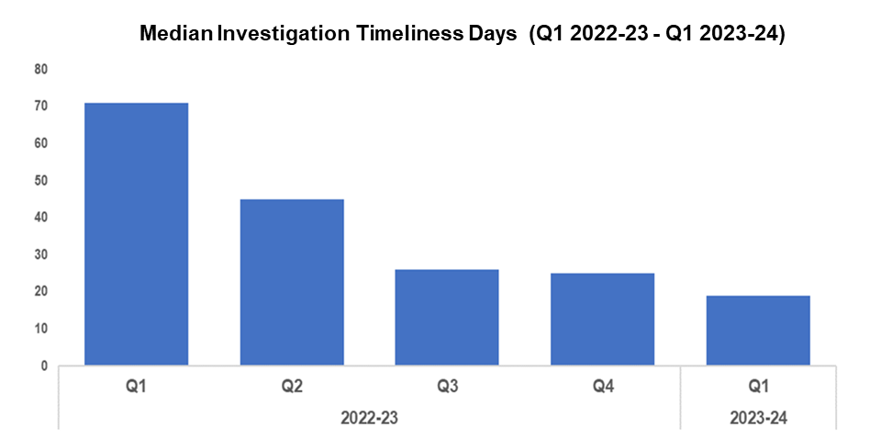
4. Investigation Timeliness
Overview
The median number of days within which an investigation is completed has continued to decline when compared to the previous quarter, falling by 24.0% (six fewer days) to 19. A consistent quarter-on-quarter improvement in median investigation timeliness has been recorded throughout the timeframe.
The median investigation length has fallen by 73.2% (52 fewer days) when comparing the current FYTD against FYTD 2022-23. This is due to the elevated investigation times recorded during quarter one and quarter two of 2022-23, on account of a backlog of occurrences which were awaiting finalisation by Crime Management Unit (CMU).
There are currently 16,327 crimes open and unfinalised (excluding pending finalisation), compared to the 15,608 open crimes reported during Q4 2022-23. This represents an increase of 4.6%, or 719 crimes. Of those currently unfinalised, 10,475 crimes have been open for less than six months, 3,612 have been open for between six and 12 months, and 2,240 have been for open for over 12 months.
Of those crimes which have been for open for over 12 months, Violence without Injury offences are the most common, accounting for 23.8% of the total (533 crimes), followed by Rape offences, which account for 13.7% of the total (306 crimes).

Slide 30
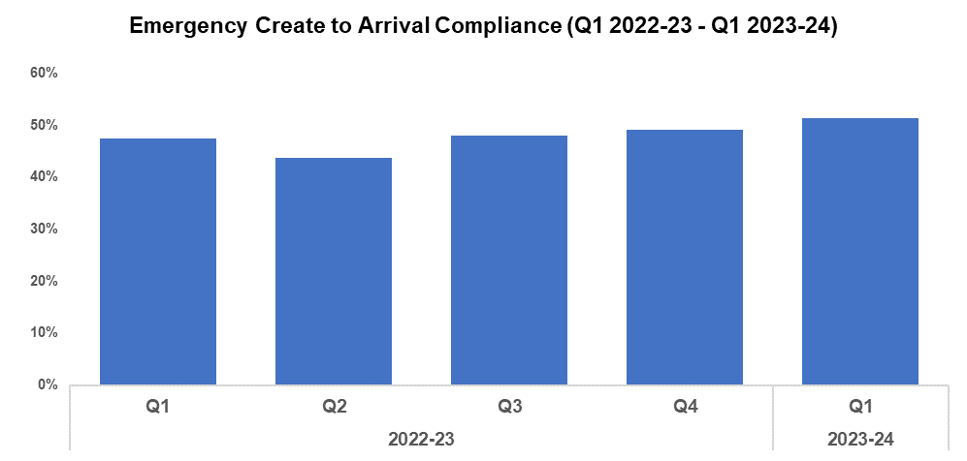
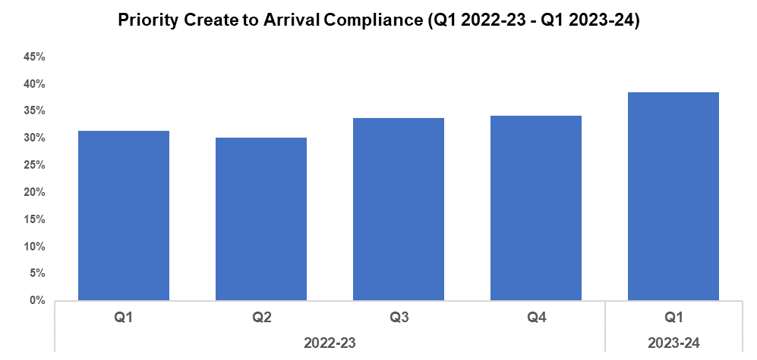
5. Response Rates
Overview
Based on the target arrival time of 15 minutes, emergency create to arrival compliance has increased by 2.4 percentage points during Q1 2023-24 when compared to the quarter prior, and currently stands at 51.4%. Seven of the nine Gwent sectors recorded improvements in compliance when compared to the previous quarter. Emergency response compliance has increased by 4.0 percentage points when comparing the current FYTD against FYTD 2022-23.
The median create to arrival time for emergency graded incidents during Q1 2023-24 was 14 minutes and 43 seconds, an improvement when compared to the 15 minutes and 16 seconds recorded during the quarter prior. Timings also improved when comparing the current FYTD against FYTD 2022-23, during which they stood at 15 minutes and 36 seconds.
Based on the target arrival time of one hour, priority create to arrival compliance has increased by 4.3 percentage points during Q1 2023-24 when compared to the quarter prior, and currently stands at 38.5%. All Gwent sectors recorded improvements in compliance when compared to the previous quarter. Priority response compliance has increased by 7.1 percentage points when comparing the current FYTD against FYTD 2022-23.
The median create to arrival time for priority graded incidents during Q1 2023-24 was one hour, 23 minutes and 44 seconds, an improvement when compared to the one hour, 44 minutes and eight seconds recorded during the previous quarter. Timings also improved when comparing the current FYTD against FYTD 2022-23, during which they stood at two hours, four minutes and 34 seconds.

Slide 31
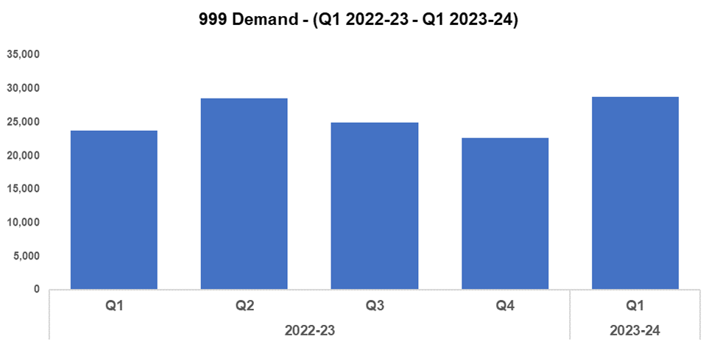
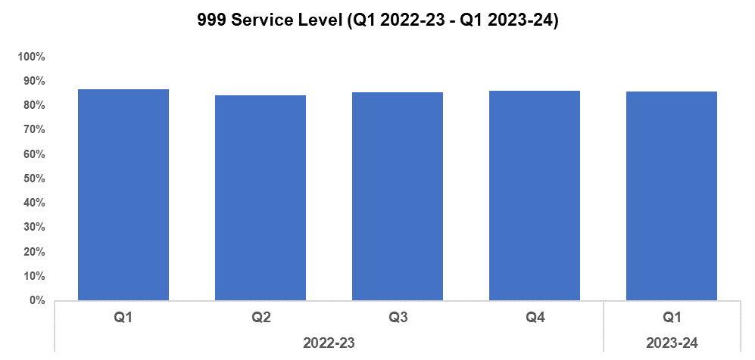
6. 999 Demand
Overview
999 demand increased significantly during Q1 2023-24 when compared to the quarter prior, rising by 26.7% (6,063 additional calls) to 28,737. This disrupts the downward trend in 999 call volume observed following Q2 2022-23, influenced by the elevated figures recorded during May and June. There has been a similar increase of 21.2% (5,017 additional calls) when comparing the current FYTD against FYTD 2022-23.
999 service level (the percentage of calls answered within 10 seconds) deteriorated slightly during Q1 2023-24 when compared against the quarter prior, falling by 0.2 percentage points to 85.9%. A more prominent decline of 0.9 percentage points can be observed when comparing the current FYTD against FYTD 2022-23.
The average answer speed for 999 calls has remained steady at 10 seconds during Q1 2023-24 when compared to the quarter prior, plateauing after the downward trend observed following Q1 2022-23. When comparing the current FYTD against FYTD 2022-23 the 999 average answer speed has improved by three seconds, down from 13.
999 Average Answer Speed
(Minutes/Seconds)
Following a Victim Services Assessment conducted by His Majesty's Inspectorate of Constabulary and Fire & Rescue Services (HMICFRS), a Threat, Harm, Risk, Investigation, Vulnerability and Engagement (THRIVE) script was introduced as a requirement for every call within the force. Since its introduction, THRIVE script performance and THRIVE compliance have improved significantly. At the end of Q1 2023-24 (June 2023), the percentage of eligible calls with a THRIVE script was 91.5%, and the THRIVE compliance rate stood at 89.9% (6,072 completed and 763 aborted). The THRIVE completion rate was positioned at 77.0%.

Slide 32
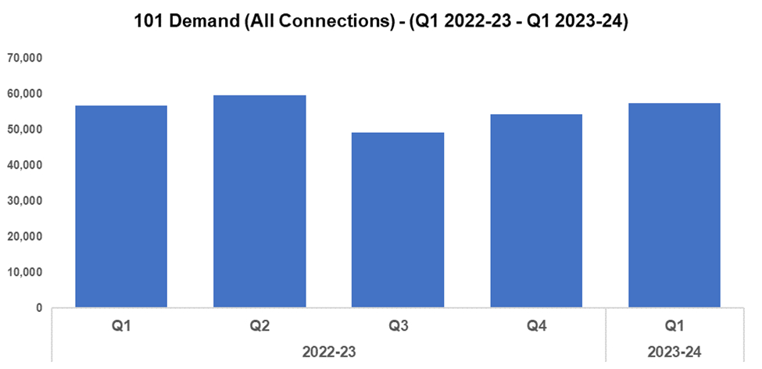
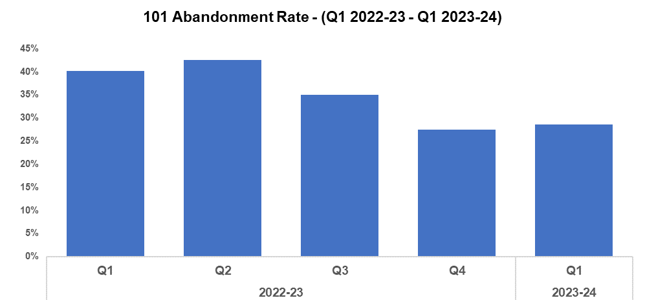
7. 101 Demand
Overview
101 demand (all connections) increased during Q1 2023-24 by 5.8% (3,170 additional calls) when compared to the quarter prior, for a total of 57,552. This rise was influenced by June 2023 recording the highest monthly 101 demand since August 2022. After decreasing during Q3 2022-23, demand has risen for the second consecutive quarter. Demand has also increased when comparing the current FYTD against FYTD 2022-23, by 1.2% (666 additional calls).
The 101 abandonment rate increased by 1.1 percentage points during Q1 2023-24 when compared to the quarter prior, and currently stands at 28.6%. This disrupts the downward trend observed for this metric following Q2 2022-23, influenced by a rise in 101 abandonment rate from 23.7% in April to 32.4% in June. However, 101 abandonment rate has improved significantly when comparing the current FYTD against FYTD 2022-23, having fallen by 11.6 percentage points.
101 Average Answer Speed
(Minutes/Seconds)
The average answer speed for 101 calls decreased by one minute and 18 seconds to six minutes and 29 seconds during Q1 2023-24 when compared to the quarter prior. This represents the second consecutive improvement in average answer speed performance.
It is likely that the improvement observed during Q1 2023-24 was influenced by the average answer speed of five minutes and 20 seconds recorded during April 2023, which marked it as the best performing month within the last four quarters. The average speed of answer has also decreased when comparing the current FYTD against FYTD 2022-23, by 24 seconds.

Slide 33
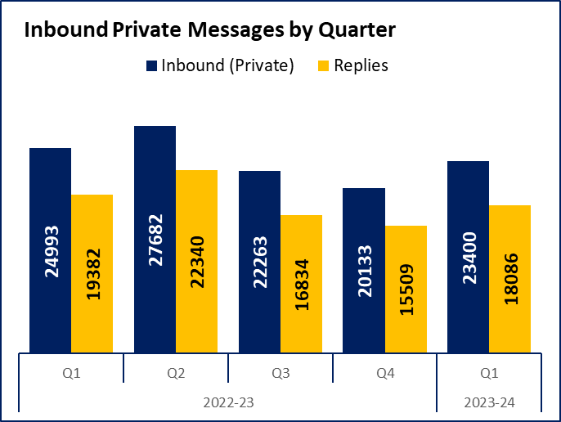
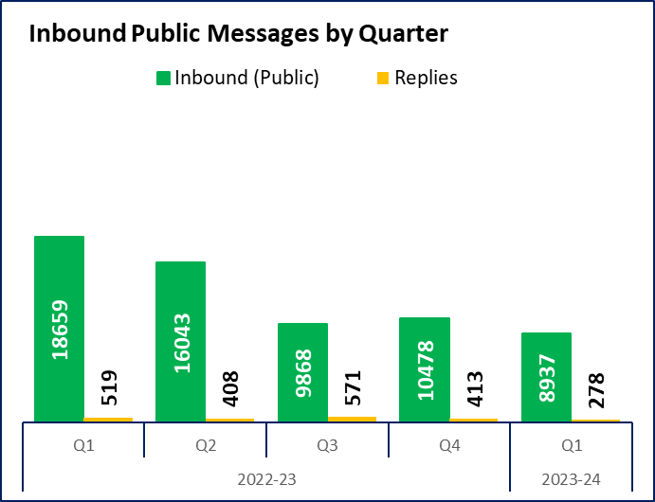
8. Social Media and Single Online Home
Overview
Inbound private messages received via Gwent Police’s social media platforms increased by 16.2% (3,267 additional messages) during Q1 2023-24 when compared to the quarter prior, for a total of 23,400. In terms of inbound private message sources, 92.3% (21,593 messages) were received through Facebook platforms. Fridays saw the highest volume of inbound private messages (3,557 messages).
Inbound public messages received via Gwent Police’s social media platforms decreased by 14.7% (1,541 fewer messages) during Q1 2023-24 when compared to the quarter prior, for a total of 8,937. In terms of inbound public message sources, 72.4% (6,467 messages) were received through Facebook platforms. Wednesdays saw the highest volume of inbound public messages (1,859 messages).
This digital contact data includes our English and Welsh Facebook and Twitter accounts.
Overview
3,548 Single Online Home (SOH) forms were submitted to Gwent during Q1 2023-24, a reduction of 3.3% (120 fewer forms) when compared to the quarter prior.
The adjacent chart presents these forms by category. The most numerous of these forms are crime reports (43.1% or 1,528 forms), followed by general ‘contact us’ messages (24.1% or 854 forms), and firearm licensing (11.7% or 416 forms). ‘Other’ includes forms with low volume, including events and processions, filming, fingerprints and IP licensing.
Notes:
Additional Demands
Next slide – Emergency and Priority Call Performance

Slide 34
9. Initiatives & Events
Overview
Operation Lead has been initiated in the Caerphilly Borough following engagement with local partners and elected officials. This project adopts national best practice to encourage responsible dog ownership, in order to minimise the harm caused by dangerous dogs.
Our dangerous dog liaison officer will continue to provide inputs for all our local neighbourhood teams, upskilling our workforce in relation to dog related incidents involving suspected banned breeds and dangerous dogs (i.e. XL Bullys). We will continue to reduce the opportunity of risk to the public and improve our range of tactics.
The Gwent Community Link (a police messaging service) will launch on the 11th of September.
The Maindee NPT are working alongside the Ethnic Minorities and Youth Support Team (EYST). EYST currently hold weekly drop-in sessions for children and young adults at Maindee primary school, and are very keen for police to attend in order to break down barriers. These sessions have been successful, and further collaboration will be taking place in the new school year.
A week-long Child Safety initiative took place at Glan Lyn primary school during June, arranged and organised by the NPT. This consisted of activities held at the school throughout the week, including a talk by CSOs, a community safety fair, and visit from the police dogs. There were also inputs from the fire service, as well as drug teams and cybercrime.
Exercise Dollhouse took place on the 11th and 12th of July. This was a national Counter Terrorism (CT) exercise run in Gwent to test regional Disaster Victim Identification (DVI) structures and examine the CT elements of DVI. A full Strategic Co-ordination Group was implemented with elements of the Mass Fatality Subgroup of the Local Resilience Forum, which included the senior coroner for Gwent, forensic pathologists, and other partners.

Slide 35
Professional Standards Department
PSD Total Recorded Complaint Allegations
PSD Schedule 3/Non Schedule 3 Complaint Cases
PSD Misconduct Cases
IOPC Timeliness
IOPC Reviews
Vetting

Slide 36
1. PSD Total Recorded Complaint Allegations
Overview
There has been a 3.0% increase in complaints received during Q1 2023-24 when compared to Q4 2022-23.
The three categories of complaint with the greatest volume remain as:
A1. Police action following contact 122
A4. General level of service 33
H3. Unprofessional attitude and disrespect 32
Within the sub categories notable increases and decreases compared to last Quarter are noted below;
A1 Decrease in Police action following contact (n=122) compared with (Q4 n=142)
A4 Increase in General level of service (n=33) compared with Q4 (n=7) however this relates to the level of service provided where none of the other sub-categories apply
H3 Increase in Unprofessional attitude and disrespect (n=32) compared with Q4 (n=19)
Please note that multiple allegations can be recorded by one complainant.

Slide 37
2. PSD Schedule 3 and Non-Schedule 3 Complaint Cases
Overview
From the 1st February 2020 the way complaints were dealt with changed and for recording purposes were classified in two separate categories:
Schedule 3 – Relates to complaints dealt with under the Police Reform Act 2002, whereby the complainant can request a review if they are not satisfied
Non-Schedule 3 – This allows complaints to be dealt with outside of the Police Reform Act 2002, previously regarded as ‘dissatisfaction’
During Q1 2023-24 there was a decrease in Schedule 3 cases (n=34) when compared with Q4 2022-23 (n=45).
Non Schedule 3 has shown a slight increase during Q1 2023-24 (n=131) when compared with Q4 2022-23 (n=125).
At the time the data was extracted there were 58 live Schedule 3 complaints and two live Non Schedule 3 complaints.
Figures will contain cases with multiple allegations.

Slide 38
3. PSD Misconduct Cases
Overview
The upward trend in Misconduct Cases is consistent with the pattern within policing in England and Wales.
A more proactive approach to misconduct and counter corruption intelligence gathering and investigation coupled with more confidence in the workforce to report has been the catalyst for this increase.
Within Q1 2023-24 there were a total of two misconduct hearings conducted, one being an accelerated hearing. There were also four misconduct meetings held.
Q1 2023-24 Misconduct Outcomes
Within quarter one, there was an accelerated misconduct hearing held for a former Police Constable relating to allegations concerning an assault against a member of public known to the officer whilst on a night out in Cardiff. The officer resigned before proceedings were held, however Chief Constable Kelly determined that the allegation was proven as gross misconduct, and that they would have been dismissed had they remained a serving officer.
There was a further accelerated hearing held for a former Police Constable for allegations concerning inappropriate, sexualised behaviour towards a colleague on a night out in Cardiff. The officer resigned shortly before proceedings were held, however Chief Constable Kelly determined that the allegations were proven as gross misconduct, and that they would have been dismissed had they remained a serving officer.

Slide 39
4. IOPC Timeliness
Overview
We are expecting the IOPC quarter one Police Complaints Information to be shared with forces in the next few weeks.
Once this has been received the data in the table opposite will be updated to reflect the latest position.
In the absence of this data at the time of submission the most recent available data (Quarter 4 2022-23) is displayed.

Slide 40
5. IOPC Reviews
Overview
We are expecting the IOPC Quarter one Police Complaints Information to be shared with forces in the next few weeks.
Once this has been received the data in the table above will be updated to reflect the latest position.
In the absence of this data at the time of submission the most recent available data (Quarter 4 2022-23) is displayed.

Slide 41
6. Vetting
Overview
Vetting figures are available from Q1 2021-22 onwards. Data is submitted a quarter behind, therefore Q1 2023-24 is not included.
Please note the continuing upward trend in vetting refusals across all measurable areas other than financial vulnerability.
The recent software upgrade should allow more in-depth vetting performance analysis in the next quarters reporting.

