Slide 1
Police and Crime Commissioner’s Statement of Accounts presentation 29 July 2019

Slide 2
Statement of Accounts Presentation
Statement of Accounts – 3/6/19 completion plan: update
Statement of Accounts – final position
Statement of Accounts – draft to final position
Accounts production – what went well
Accounts production – further improvement areas
Working balances update at 30 June 2019 (Q1):
Debtors
Creditors (including duplicate payments position)

Slide 3
Statement of Accounts – 3/6/19 completion plan: update
Outstanding information at 3 June 2019 now complete:
Final agreement of related party balances with South Wales Police
Benefits in Kind data for senior officer/staff remuneration
Further work is needed in w/c 3 June 2019 to correct items in the Movement in Reserves Statement, Cashflow Statement and the Expenditure Funding Analysis note
Timetable for completion:
WAO audit commences | 3 June 2019 | Complete
Audit completion | by 19 July 2019 | Complete
Final wash up meeting | TBC – 15 July 2019 | Complete
Final agreed adjustments to accounts | w/c 22 July 2019 | Complete
ACO-R/CFO final accounts review | by 26 July 2019 | Complete
Joint Audit Committee meeting | 29 July 2019 | today
2018/19 audited accounts signed by Commissioner, Chief Constable, ACOR and CFO, and published online | by 31 July 2019
Notes:
All outstanding items highlighted at the JAC meeting on 3/6/19 are now complete.
Assuming accounts are recommended for signature by JAC today, then Commissioner and Chief Constable will be able to sign and publish the accounts by 31/7/19 in line with statutory deadlines again.

Slide 4
Statement of Accounts – Final position CIES
Other Comprehensive (income) and expenditure relates to the re-measurement of the pension scheme.
The deficit on provision of services can be broken down as follows:
Statutory or funding adjustments £94,915k
Taken from usable reserves £2,403k
Total £97,907k
Notes:
£2.4m reduction in usable reserves to fund capital programme as planned.

Slide 5
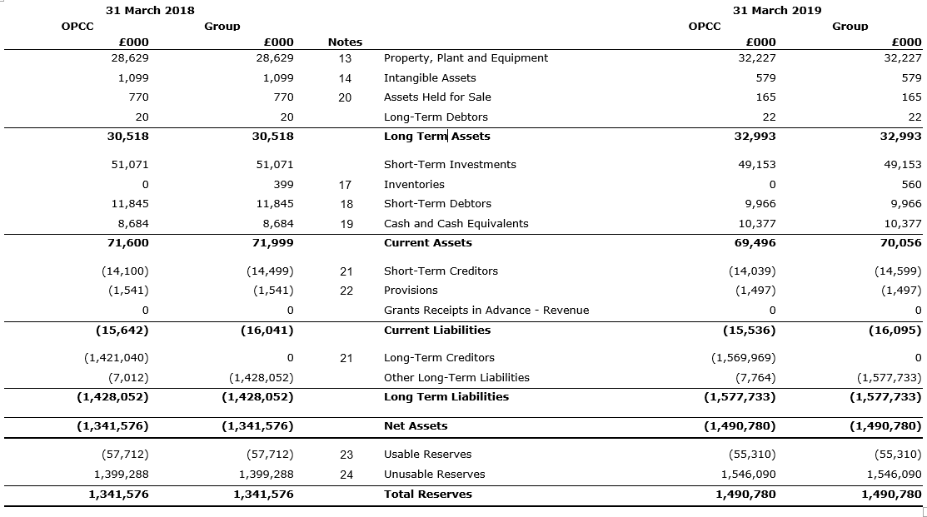
Statement of Accounts – Final position PCC Balance Sheet

Slide 6
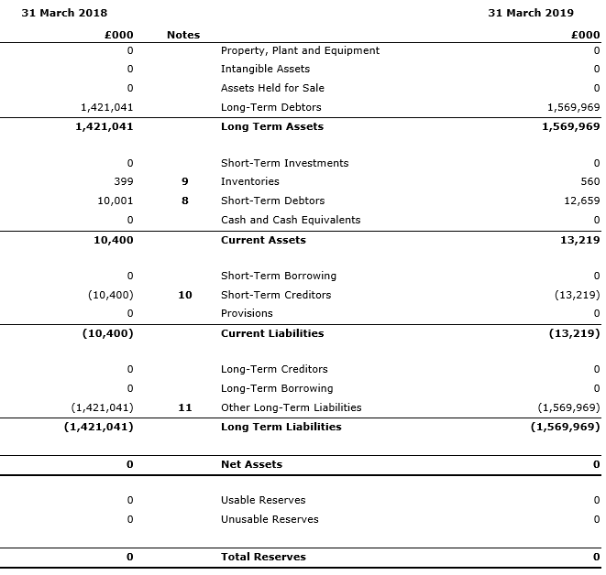
Statement of Accounts – Final position CC Balance Sheet

Slide 7
Statement of Accounts – Draft to final outturn
The table below summarises the differences in the CIES between the original draft (published 31 May 2019 and presented to JAC on 3 June 2019) and the final copy of the accounts.
The £62.7m adjustment is primarily the additional pension liability arising from the McCloud/Sargeant judgement. The Supreme Court denied the Home Office leave to appeal this judgement on 27 June 2019.
Notes:
McCloud/Sargeant – decision by Supreme Court after draft accounts published on 31 May 2019 means additional pension liabilities needed to be reflected in the accounts as a post balance sheet date adjustment.
Actuaries have provided updated information for both the police and local government pension schemes and these have been reflected in full in both sets of accounts.
Impact has been to increase the pension liabilities flowing through the CIES and balance sheet as part of the IAS19 adjustments. This is not a cash movement and there is no impact on the Commissioner’s usable reserves or the outturn for the year against £123.5m budget of £106k underspend.

Slide 8
Accounts production – What went well
Second year of using BRB:
Mapping much improved on 2017/18
Working paper outputs supported audit work
Confirmation of CIPFA Code compliant accounts
No material errors identified in the audit findings
Year end close down procedures working more effectively
Cross team involvement
Not reliant on one member of staff – increases resilience
Less stressful atmosphere within department
Much faster and smoother management accounts closedown
Version control and audit trail of final accounts and working papers continue to improve
Good working relationship with WAO
Notes:
We’ve been recording thoughts and feedback as we’ve gone through the accounts preparation process in April and May, and the audit in June and July.
These are the high level thoughts from those comments but we will be having a more detailed feedback session within the finance team once the accounts have been signed and published. We’ll then sit down with WAO to share those outputs and agree what both sides can do to improve the process for next year.
Given where we were last year with the introduction of BRB and significant changes in personnel within the department, we have made a lot of progress as highlighted in the action plan update we provided to the December 2018 meeting of JAC. We always knew this is a journey that wouldn’t get fixed completely in the first year and so while we know we have made good progress this year, there are more things we can do for next year’s audit.

Slide 9
Accounts production – Further improvement areas
As noted on 3 June 2019, significant work has been done to improve the 2018/19 accounts closure process.
A detailed team debrief of the accounts production and audit processes will be held in August/September and the outputs then discussed with WAO.
The initial areas identified for continued improvement in 2019/20 are:
Improvement area | Actions
Timeliness of closing the year end position – even more can be done earlier/ before year end | Identify what other work can be done regularly through the year and earlier e.g. before year end Stricter adherence to and enforcement of internal deadlines Use BRB for Quarterly reporting in 2019/20 Spread and consolidate the BRB knowledge more widely within the finance team

Slide 10
Accounts production – Further improvement areas
Improvement area | Actions
Formatting | Already built into the template but formatting BRB outputs still an issue To review again final formatting process for accounts
Team involvement | More personal ownership and responsibility for notes to the accounts - seeing through to the end Quarterly process – improve experience and knowledge of BRB, with better coordination
Responsiveness to audit queries | Review approach to exam and annual leave requests across Finance in May/June period Work with WAO to minimise number of and duplication of audit queries and information requests Provide BRB access to WAO

Slide 11
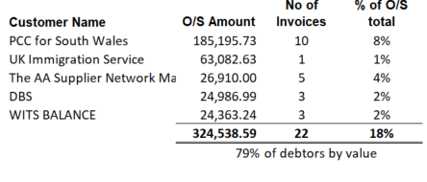
Working balances update - Debtors
Debtors
Total sales invoices unpaid at 30 June 2019 totalled £411k (31 March 2019: £930k), of which £343k (31 March 2019: £350k) was overdue. No debtors are identified for write off in Q1.
The top five debtors at 30 June 2019 make up 79% of this £411k total:

Slide 12
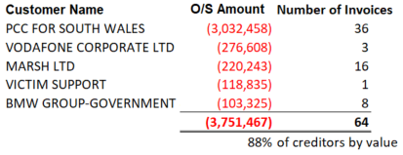
Working balances update - Creditors
Creditors
At 30 June 2019 there was £4,251k of creditors, of which £2,126k are overdue for payment.
Of the £4,251k total, £3,032k or 71.3% are invoices payable to PCC for South Wales primarily for collaborative activities accrued at year end.
The average age of an invoice paid within the quarter was 29.80 days which remains within the 30 day target.
Notes:
Q1 creditors are higher than at year end – 31/3/19 = £ .
Creditor days remain on target.

Slide 13
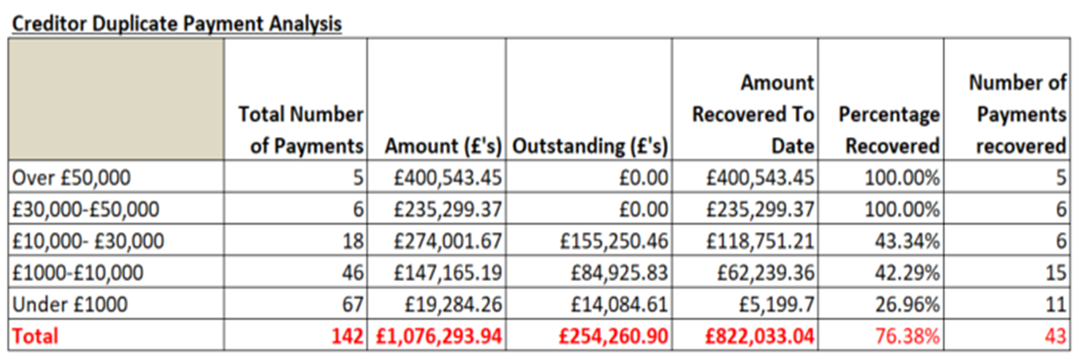
Working balances update – Duplicate creditors
The remaining duplicate creditor payments total £254k (23.6% of the original £1,076k total).
£56.5k has now been received from Police Mutual Assurance Ltd.
The largest suppliers with outstanding balances account for £122.3k (48%) of the £254k total outstanding and are regular suppliers:
BT = £82,973.14 (telephony)
All Star Business Solutions = £15,301.60 (fuel cards)
Vodafone = £12,185.27 (mobile phones)
PCC For West Yorkshire = £11,800.12 (services)
Credit notes are being raised for the remaining balance of £254k
Notes:
We’ve been able to recover some larger balances – Police Mutual Assurance £56k
NOTE: update JAC for BT position IF Jane has managed to get these back before 29/7/19
We’re now raising credit notes to offset current invoices for all active suppliers, again focussing on the larger balances first. To date credit notes with a value of £xxxxxxx (get update from Rose/Sam) have been raised.

Slide 14
Questions
Questions?

