Slide 1
Chief Delivery Plan progress report on proposed key activities 2022 - 2023
03/05/2023

Slide 2
Chief Constables Delivery plan progress slide 1
The Commissioners Police and Crime Plan has set five priorities for 2021-2025:
• Keeping Neighbourhoods Safe,
• Combat Serious Crime,
• Support Victims and Protect the Vulnerable,
• Increase Community Confidence in Policing,
• Drive Sustainable Policing.
This report provides concise progress updates on the proposed key activities under the 5 priorities set out in the Commissioners Police and Crime Plan through the forces work utilising the 11 priorities (below) in the Chief Constables delivery plan.
Improve public confidence
Violence Against Women & Girls
Reducing crime
Equality Diversity and Inclusion
Victims Services
Wellbeing
Crime Data Integrity
Operation Uplift
Technology & Innovation
Sustainability
Covid-19 recovery

Slide 3
Chief Constables Delivery Plan Progress slide 2
Progress dashboard:
Priority | Measures either delivered or consistently being managed through business-as-usual functions | Measures remain under development with planned delivery or showing improvement | Measures yet to be introduced or has concerns around development and improvement
Keeping Neighbourhoods Safe (13 measures) | 85% 11 measures | 15% 2 measures | 0% 0 measures
Combat Serious Crime (9 measures) | 67% 6 measures | 33% 3 measures | 0% 0 measures
Support Victims and Protect the Vulnerable (12 measures) | 58% 7 measures | 17% 2 measures | 25% 3 measures
Increase Community Confidence in Policing (12 measures) | 83% 10 measures | 17% 2 measures | 0% 0 measures
Drive Sustainable Policing (11 measures) | 55% 6 measures | 36% 4 measures | 9% 1 measure
Total (57 Measures) | 70% (40 measures) | 23% (13 measures) | 7% (4 measures)

Slide 4
Keeping Neighbourhoods Safe
Priority 1

Slide 5
Keeping Neighbourhoods Safe slide 1
Proposed key activity | Key activity progress | RAG
New Neighbourhood Policing Strategy | The force has created and embedded its Neighbourhood Policing Strategy since May 2022 focussing on seven key areas. The focus of our service is to build resilient, cohesive communities and protect the most vulnerable, creating innovative solutions to keep people safe. Our response to preventing and tackling neighbourhood crime and anti-social behaviour will ensure that our communities have trust and confidence in Gwent Police to provide an effective, evidence-based, problem-solving approach working closely with our strategic partners.
Neighbourhood policing governance | Through the Neighbourhood Policing Project Board, the force is looking to further enhance Neighbourhood Policing delivery considering the ‘Good’ grading in the recent HMICFRS inspection.
Focus on reducing the demand caused by repeat offenders through effective offender management | Integrated offender management teams work with probation to manage offenders who pose a high or very high risk of harm to victims, through Wales Integrated Serious and Dangerous Offender Management. Gwent Police is one of 19 forces participating in the pilot Acquisitive Crime GPS tagging project for serious offenders of theft, robbery and burglary who have been released from prison.
We will build on Multi Agency Tasking and Coordination protocol | The Multi-Agency Tasking and Co-ordination trial analyses the recency, frequency and gravity of domestic abuse crime and incidents. We can identify the domestic abuse perpetrators in each local policing area most likely to cause further or more serious harm to victims. The force has received funding from the Home Office for the next 2 years to staff this work. Through MATAC, perpetrators are now offered diversionary programmes intended to reduce their offending.

Slide 6
Keeping Neighbourhoods Safe slide 2
Proposed key activity | Key activity progress | RAG
We will expand our use of diversionary schemes to prevent re-offending. | We continue to engage with commissioning partners, such as the OPCC and SWP Police, SWP OPCC and HMPPS, to continue to maximise diversionary opportunities to prevent reoffending via a variety of fora. This has included an ongoing recommissioning process of the Women’s Pathfinder Whole System Approach and 18 – 25 Early Intervention and Prevention Service. A successful funding application to the Home Office DA Perpetrator Fund will enable us to commission a CARA based DA Perpetrator Early Intervention service. This will enable the force to attach a condition to attend interventions for offenders of standard risk DA as part of an OOCD.
We will take advantage of the opportunities provided by the Safer Streets project which provides funding for crime prevention improvements in key community areas | After acquiring HO funding, the force has purchased three-wheeled tuk-tuk vehicles to be placed in Newport and Abergavenny for the public to use as safe spaces and to report crime. Successful activity, such as an operation to tackle the sexual exploitation of adults, is fed back to the public, and crime and disorder partners.
We will meet the demands of Operation Uplift and increase the numbers of Police Officers to over 1500. | Our Uplift target was 1506 but we bid for an extra 15 to make 1521 but only must maintain 1506 for 2023/24. Our Target uplift number was 206 officers As at 31.03.23 we had 1547 officer including secondments and 1539 excluding secondments
We are committed to working with our Blue Light Partners to improve our response to the public | The force has established relationships and has agreed Ambulance Protocols for those involved in long waits at scenes. We have a direct line to clinicians for them to triage a patient at the scene to determine if it is safe to convey them to hospital.
We will work with the All-Wales Schools Liaison Programme and the Youth Offending Services to divert young people from offending behaviour. | Next-generation police community support officers have been deemed Innovative Practice by HMICFRS. They have commended the force for use of the game Minecraft to connect with and teach young people about online safety.

Slide 7
Keeping Neighbourhoods Safe slide 3
Proposed key activity | Key activity progress | RAG
We will successfully make the transition to the new bail management rules and procedures. | The legislation changes are embedded force wide and effective use of police bail in Gwent has meant closure of a police bail HMICFRS Area for improvement (April 2023)
We will continue to drive and embed our Joint Engagement & communication strategy | We use this to produce local plans to communicate with and provide policing services to the population of Gwent. Communications leads in each local policing area monitor public feedback, making sure that digital communication with communities is two-way.
We will develop a problem-solving structure that operates in our operational units and also provides central analytical support to our officers | Dedicated analysts within the problem-solving hub use a personal circumstance mapping tool based on police and partner agency (such as social services) information about factors that may influence a person’s risk of being involved in crime or being exploited. This allows neighbourhood policing teams to better understand and intervene quickly to reduce threats and risks posed by dangerous and vulnerable people in their area.
Ensure a tailored approach to repeat victims, suspects and locations through our Harm and Vulnerability Co-ordinators. | The harm and vulnerability co-ordinator has been working with the Alzheimer’s Society Cymru to offer enhanced support for people living with Alzheimer’s, dementia, or other neurological conditions. As a result of this collaboration, we now have access to Alzheimer’s Society Cymru’s referral portal and officers can put forward a referral via a straightforward process. All referrals are monitored so we can measure the impact of this process, including any reduction in demand.

Slide 8
Combat Serious Crime
Priority 2

Slide 9
Combat Serious Crime slide 1
Proposed key activity | Key activity progress | RAG
The force will continue to disrupt and dismantle Serious Organised Crime across the force area by utilising a cohort of officers to tackle and deter Organised Crime Groups and persistent street level drug criminality. | The Force maintains its organised crime unit capability and surveillance capacity within a centralised team who address the highest-level risks to the force from organised criminality. This is identified and prioritised through the Force tasking process. Gwent also ahs extensive links with the ROCU and works closely with them to enhance our response to organised crime and our ability to take action against this that perpetuate organised criminality. This includes access to specialist resources, skills and covert capabilities. Gwent maintains within the Specialist Crime command the Modern Day Slavery Team who work to prevent deter and disrupt organised criminality that perpetuates slavery and human trafficking. This team is taking the lead in our County Lines response as a form of human trafficking and exploitation.
We will continue to work in partnership to identify and target Organised Crime Groups | We are engaged with he regional SOC network and other Forces and at Force tasking and Serious and Organised Crime Governance meetings has attendees and contributors from the GAIN Network, the Prison Service, Probation, Regional Intelligence, and the National Crime Agency. The Force also ah an established Partnership Drug Threat Group with a focus on health, Drug Services, Drugs deaths and near misses and information sharing. In each of the Local policing areas there are Multi Agency Serious Organised Crime partnerships who meet regularly to share intelligence and information, discuss emerging threats and early intervention and prevention opportunities. Gwent is engaged with the regional Cyber, Slavery and Fraud Threat groups with an emphasis on identifying organised criminality which exploits vulnerable people. The Force assigns a financial investigator to every organised crime group and prioritises financial Suspicious Activity Reports linked to OCG’s or individuals within OCG.

Slide 10
Combat Serious Crime slide 2
Proposed key activity | Key activity progress | RAG
We will continue to work with partners to develop better integrated working practices that will tackle re-offending and address criminal behaviour. | There are a number of forums where exploited or vulnerable people are identified, and interventions and prevention opportunities are undertaken for those linked to offending or on the periphery of offending within SOC. These include the NRM joint initiative pilot being run in Newport. The MACE meeting mechanism is run in each LPA for identifying vulnerable and exploited people and they feature in the now formed Reducing Re-offending meeting Chaired by a Detective Chief Superintendent. There are also close links and working processes with the Safe-gaurding Hubs. This gives access to a range of interventions in each Local Authority area working with individuals and families. There has been considerable work over the last 12 months to ensure better integrated working practices that will tackle re-offending and address criminal justice behaviour: Reducing reoffending meeting, IOM refresh, MATAC, CJiW, WSA/ 1825 recommissioning and YOS.
We will focus our efforts on tackling violence against women and girls | The force has embedded governance and a VAWG action to maintain a focus in this area. The force has shared progress with HMICFRS in January 2022 where we await feedback, and the force has appointed a Chief Superintendent to lead the All-Wales portfolio.
We will introduce a dedicated Rape Investigation Team and participate in the national Operation Soteria programme. | Since September 2022, the force has a dedicated Rape Investigation Team and quality of delivery has seen improvements through independent internal audit of these investigations.

Slide 11
Combat Serious Crime slide 3
Proposed key activity | Key activity progress | RAG
We will work closely with key partners through Multi Agency Public Protection Arrangements (MAPPA) to protect communities by preventing registered sex offenders from re-offending | The force continues to work closely with partners as part of everyday business arrangements and has further enhanced management of registered sex offenders with investments in risk assessment technology and tools to identify where offenders are accessing indecent images of children.
Gwent Police works alongside other forces and national and regional partners to tackle threats and prevent activities of terrorists and domestic extremists. | We have a Force Counter Terrorism Policing team. Since April 2023 this team comes under the control and governance of Counter Terrorism Policing Wales. The Force maintains it’s Counter Terrorism prevent officer and delivery of the prevent agenda continues in Gwent.
We will review our approach to Firearms Licensing to ensure the public have confidence in our decision making. | In response to the Plymouth shootings, the force has a dedicated inspector in the Firearms Licensing department with an embedded governance and reporting structure. We have responded to increased capacity with improved resourcing. Gwent has made significant changes to vetting to comply ahead of statutory changes and the draft new APP. Social media checks are being conducted for all grant applications and are intelligence led for renewals and certificate holders who come to the attention of the police.
We will build a strong governance process to manage CID recruitment, retention and progression, supported by our CID Succession Planning meeting enabling us to monitor our gaps and flex to where risk is greatest. | The force has a CID Succession Planning Group (SPG) that is reported on monthly that feeds into higher governance. Our short term focus is to get all PPU departments, including RIT, to amber resource status by June 2023 and we will be providing them with TI’s, attachments and ISO’s to achieve this. We also report on medium and long term goals into SPG.

Slide 12
Support Victims and Protect the Vulnerable
Priority 3

Slide 13
Support Victims and Protect the Vulnerable slide 1
Proposed key Activity | Key activity progress | RAG
We will continue to maintain strong partnerships to intervene early where all forms of abuse or exploitation is suspected | The force has an established dedicated team of officers to protect children and vulnerable adults from being sexually or criminally exploited. This feeds into vulnerability governance process. This role has been positively commented upon by HMICFRS in 2023.
We will continue to improve the lives of victims and witnesses using through our Connect Gwent multi-agency victim's hub, which hosts a range of partnership agencies Age Cymru, New Pathways, Umbrella Cymru, Victim Support provide support tailored to suit the needs of each victim. | Over the last financial year Connect Gwent have supported 2413 victims or people affected by crime. Referrals are received into Connect Gwent from police, statutory agencies, fellow partners and by victims/people affected by crime themselves. Of the total referrals, 1584 victims/witnesses reported they were ‘better able to cope and build resilience to move forward with daily life’ after receiving intervention from the services. To ensure a collaborative and effective approach to victim care a weekly ‘Case Management Meeting’ was created to discuss complex cases where a variety of agencies/expertise are required.
Our Victim Care Unit will provide inclusive support and increased services to those targeted due to their protected characteristics. | The force conducts surveys to understand how satisfied victims of crime are with their experience of each stage of the investigation process. Survey results are then considered in governance meetings to enhance service delivery to victims and thus improve training provision.
We are engaging with victims through our Survivor Network and using our Survivor Engagement co-ordinator to better understand their experiences and improve our services. | The SEC role continues to engage with victims and has been recognised as Innovative practice in the College of Policing Practice bank March 2023.

Slide 14
Support Victims and Protect the Vulnerable slide 2
Proposed key activities | Key activity progress | RAG
We will ensure there is a comprehensive approach to victim care throughout the victim journey and regularly benchmark ourselves utilising HMICFRS’s Victim Service Methodology. | The force has an improvement plan as it works to address HMICFRS findings in recent PEEL report and to enhance this the force conducts internal VSA audits using staff that are independently based in our Assurance team and we use an independent consultant to advise our Force Control Centre service.
We will introduce dedicated teams to enhance our investigations and prosecution file quality. | The File Management Unit is now live. The force has also invested in an Investigation Quality Team to improve our approach to quality assurance processes. The force is subject to 4 recent AFI’s in the area of crime investigations and will be subject to further Victim Service Assessment inspection later in 2023.
We will ensure our supervision levels are appropriate and that supervisors ensure everything we do is of a high quality. | The force now tracks compliance and monitors quality of supervisor updates in investigations. Improvements are scrutinised through Victim Service Assessment DMM and VSA Qlikview dashboards. Internal audit for January 2023 has not shown significant improvement and we are subject to a recent HMICFRS AFI in this area.
We will introduce a Virtual Response Team to allow us to quickly speak to victims through a video link and investigate their crimes remotely where appropriate. | VRT has been introduced and it has enhanced our communication pathways with victims through use of GoodSam technology. The team takes initial demand from frontline and we continue to review and enhance this provision.

Slide 15
Support Victims and Protect the Vulnerable slide 3
Proposed key activity | Key activity progress | RAG
Our MH Professionals will provide clear, professional advice to our officers to ensure they select the right care path for those in crisis with key partners in delivering the ‘Whole system’ approach. | Through our monthly performance reports – we continue to track the number of incidents we deal with and as one of our key performance indicators that reports on the number of times we are involved in facilitating someone in crisis getting the appropriate follow up. The Mental triage report provides added insight into operational demand so appropriate service can be delivered to callers and victims.
We will increase our use of community resolutions, to enable victims to have more of a say in the outcomes of their crimes | This year we have introduced the ability for officers to issue Community Resolutions via iPatrol and their handheld devices, rather than via physical paper work or within NICHE, the aim of this is to streamline the process and reduce administration demands on officers. A CR Pilot has been agreed for the Blaenau Gwent & Caerphilly area to focus on learning of use, barriers and opportunities to increase use of CR’s.
We will continue to provide resilience and crime prevention advice through our First Point of Contact Staff | To support FCC resources in delivering Crime Prevention advice, we are continuing to develop Safe-Guarding advice/ relevant call-scripts including general crime . The default text message within storm regarding the incident number has now been updated to also include a link to the Crime Prevention advice on the Gwent police website . This ensures our victims have the right details should they need to recontact regarding the incident and provides them with access to valuable crime prevention advice too regardless of the nature of the incident reported. We continue to develop this, the activity is currently subject to a Cause of concern.
Vulnerability governance and accountability | As of December 2022, the force has adopted the National Vulnerability Action Plan (NVAP) and has a DCI leading the response. This is monitored through vulnerability governance processes. The force is subject to a recent AFI in this area.

Slide 16
Increase Community Confidence in Policing
Priority 4

Slide 17
Increase Community Confidence in Policing slide 1
Proposed key activity | Key activity progress | RAG
We will continue to engage with our communities through our Neighbourhood Teams and Community Support Officers. We will embed our new Neighbourhood Policing Strategy. We will identify and utilise IT solutions that help us better engage with our public. | Engagement CSOs are working in partnership with many key stakeholders such as the local authorities, local schools and colleges, charities, and many communities. One such example is a Community Support Officer provided support to Ukrainian refugees who had sought refuge in Newport, by providing support and guidance on the cultural differences and introduction to policing in Britain, this was supported by a hate crime officer.
We will use community groups, Independent Advisory Groups and Your Voice to demonstrate how our communities help to shape our service | We have deepened our commitment to support the Independent Advisory Group with a 25 % increase in membership. IAG members now assist in promotion interviews to ensure we have the right leaders taking the force forward.
We will continue to learn as an organisation when we fall below what the community expect of its police service and robustly tackle staff who abuse their position. | The force has an established learning the lessons meeting. We have robust Counter Corruption Unit processes and we have received recent positive comments from the HMICFRS CCU/ Vetting inspection and there is clear evidence of consistent Chief Officer messaging and action by CCU to stamp out unacceptable behaviours.

Slide 18
Increase Community Confidence in Policing slide 2
Proposed key activity | Key activity progress | RAG
We will continue to drive and embed our Joint Strategic Equality Plan (JSEP) and ensure through the JSEP our processes and decision-making are legitimate, transparent and evidence-based through: • Supporting Vulnerable People • Legitimacy and Fairness • Access, Engagement and Inclusion • Creating an Inclusive Workforce and Promoting Fairness. | We actively review our current JSEP and it shows more than 70% of actions are either complete or part of business as usual. The force has reviewed EDI material delivered through PEQF/DHEP/PCDA and working to improve material delivered to student officers. Greater partnership working to support community events i.e Newport City, Newport County Borough Council. We have improved representation at local and national steering groups relating to EDI policing activity i.e Hate and Tension Forum, SEWEN, EDI Consortium. We continue to review and deliver findings from the national Purple Spaces Report, with a sight on reaccreditation. We have improved support for local community events through more inclusive sponsorship and we have delivered a cultural calendar to assist officers and staff embrace true equality, diversity and inclusion.
The force is working to make the demographic of its officers and staff better reflect the community by continuing to encourage people from under-represented groups to join the organisation. The force is working to ensure everyone employed in Gwent Police is treated fairly and does not suffer discrimination. | The force has an established positive action team in place with a comprehensive positive action programme and wide community engagement to reach under representative groups. Through operation uplift our ethnic minority officers have increased 28 to 53 officers. We have increase the percentage of female officers to 36.19% which is above the national average of female officers. Our percentage of CSO's from ethnic minorities 7.64%. We have been awarded as a disability confident employer and work in partnership to support candidates with reasonable adjustments.

Slide 19
Increase Community Confidence in Policing slide 3
Proposed key activity | Key activity progress | RAG
Our new Citizens in Policing Strategy defines our vision to grow and enhance the contribution of our volunteers and community involvement. This strategy will oversee all volunteering, including sub-groups of the Special Constabulary (SC), Police Support Volunteers (PSV’s) Police Cadets and Heddlu Bach. | The strategy is now embedded. With 76 serving officers, the Special Constabulary (SC) has played an integral part of policing over the past 12 months. The value and importance of the Special Constabulary in Gwent has never been clearer - contributing a staggering 32,227 hours, delivered across 4454 duties, with an average of 35.3 hours per Special Constable - significantly exceeding the nationally asked minimum of 16 hours per month
We will identify and utilise IT solutions that help us better engage with our public. | The force has gone live with the Engagement and Consultation Activity portal. This enables the force to understand its engagement activity. We are working with South Wales Police to develop the digital performance framework and the problem solving team are developing two way communication tools to enhance engagement with the public that is currently at the business case stage.
We will continue to ensure our officers use powers (such as stop search and arrest) and force in ways that are proportionate and non-discriminatory; and which foster positive relations between communities and policing. | The force continues to enhance its ability to scrutinise itself through Coercive Powers governance internally and externally. Training in Use of force and Stop and search is being developed through Officer Safety training and Bite size training videos. We will continue to address the recent AFI from HMICFRS regarding reasonable grounds. The force continues to hold disproportionality in custody scrutiny meetings with IAG support.

Slide 20
Increase Community Confidence in Policing slide 4
Proposed key activity | Key activity progress | RAG
The force will ensure that its services respond to the views, experiences, and needs of people that identify with protected characteristics; and that the work it does promotes inclusion and cohesion. | Embedded a new equality impact assessment which better evidences the forces delivery under the public service equality duty. Improved scrutiny of hate crime and broader policing powers with lessons learned being actively fed into the organisation. Greater community engagement with under-serviced communities, leading to increased trust and confidence by key influencers. Establishment of local cohesion groups and broader tension meeting to better understand issues impacting local community.
The force will continue to ensure all crime is recorded ethically and in accordance with the Home Office Counting Rules. | Crime Data Integrity is a priority for the force and awareness is woven through training with a deepened understanding through CDI Champions who support the Force Crime Registrar. The force will continue to audit crime recording accuracy, timeliness and accuracy of outcomes.
We will continue to increase our service provision to Welsh language speakers and those who use British sign language. | Internal strategic meetings take place quarterly where data is scrutinised and departments report against their own bespoke plans where service improvement is identified and compliance monitored – WLS successfully embedded up from 598 to 693 in 2022. No complaints regarding lack of service were received in 2022 – 23. We continue to monitor Welsh Language skills seeing an increase in Level 1 due to mandatory training from 2034 to 2257 through 2022 – 23.
We have signed up to the All-Wales pledge to ensure that Wales becomes an Anti-Racist Wales by 2030. | We have established a local plan for delivering the NPCC Race Action Plan, Criminal Justice Board for Wales Anti-Racism Plan and the Welsh Government Anti-Racism Pledge. The force has a dedicated Chief Superintendent leading this work at All-Wales level.

Slide 21
Drive Sustainable Policing
Priority 5

Slide 22
Drive Sustainable Policing slide 1
Proposed key activity | Key activity progress | RAG
We will maximise the benefits of our new HQ and seek to replicate those benefits in other areas of our estates and in any new builds. We will continue to deliver our de-carbonisation plan in our aim to be net zero emissions by 2030. | New HQ benefits: Certified BREEAM excellent for the building design and construction, Increased security, reduced energy costs due to solar panels on the roof, improved officer and staff well being and work environment (better lighting, modern working facilities, canteen provision, etc), fit for purpose facility with increased technological capabilities in meeting rooms, training rooms, command room and force control room. The force has commenced the electric charger installation in April 2023 to be complete September 2023 providing a pay as you charge facility. 95% of the estate has LED lighting and solar panels continue to be installed across the force. The force has successfully achieved the zero waste to landfill target outlined in the Greener Gwent strategy. Electric Vehicle purchases continue to be commissioned through the coming financial year.
We will equip our staff with the right skills and professional development, embed an ethical culture, professionalise our service and encourage decision-making and risk-taking. We will monitor this through an effective PDR system. | PDR continues to be designed to encapsulate these topic areas and of April 2023 compliance and completion is at 87%. To enhance this it will be linked to force performance and ACC Hobrough is driving an action through Force Improvement Board where the Force Improvement
We will continue to utilise our established processes for understanding demand and implementing business changes. | Through our Business Change team, we continue to employ established processes to model demand in key areas of business. Most recently through MARAC and Claire’s Law functions in response to HMICFRS feedback.

Slide 23
Drive Sustainable Policing slide 2
Proposed key activity | Key activity progress | RAG
Operation Hampshire will be embedded within the organisation, with regular monitoring and opportunities for organisational learning. | Operation Hampshire continues to require supervisors to make sure that support is put in place for officers and staff who have been assaulted ensuring an appropriate and effective provision. This filters into People & Culture Board ensuring Chief Officer oversight.
Departmental support through HR Business Partners to monitor absence rates, trends and apply prevention and intervention to reduce absence. | There is a sustained drive to reduce sickness where sickness trends have continued to reduce by 15 staff members in Q4 (2023). We have lots to do and have heavily invested in Well-being provision, HR processes, supervisor awareness and sickness levels are heavily scrutinised through force governance processes.
We will invest in our culture and build capability in our people to ensure behaviours, decisions and actions build internal and external confidence. | The force has assigned a Culture lead and a programme of work is ongoing with internal and external stakeholders working the University of South Wales and the Hydra Foundation to better understand and improve culture in Gwent Police.
The force has a history of investing in technology and our commitment in this area continues. | The force has worked with South Wales Police and partner LBA to design a tailored IR3 telematics platform that is integrated into police systems so the force understands where its resources and assets are in order to understand and meet demand. This will be further improved as further schedules that include Briefing & Tasking tools are finalised and released. A program of work continues to be delivered in collaboration with South Wales Police through the Digital Services Division.

Slide 24
Drive Sustainable Policing slide 3
Proposed key activity | Key activity progress | RAG
We will implement ‘GoodSam’ technology and voice analytics to ensure our FCC is efficient. | GoodSam is routinely used in FCC and VRT. Voice Analytics software is close to rollout and the force works with partners to complete this work. This will enable our FCC further understand call demand.
We will procure a new Command and Control system in collaboration with South Wales Police. | The force is confident in its progress and implementation is on track for a 2024 release.
Departments will continue to move to SharePoint Online, improving our document management, file sharing and co-authoring capability. | The force continues to role out SharePoint and the force works with the Digital Services Division to train staff and also utilise the wider functionality of Microsoft 365. For example, the force maximising the functionality of the platform to transition Corporate Risk Register to Microsoft Lists.
We will continue to review our support functions to ensure they are sustainable and efficient. | The force continues to review key support functions and has recently reviewed Intel Phase 3, Operational Support Training, Neighbourhoods, Business Support, Mental Health Triage and Crime Data Integrity

Slide 25
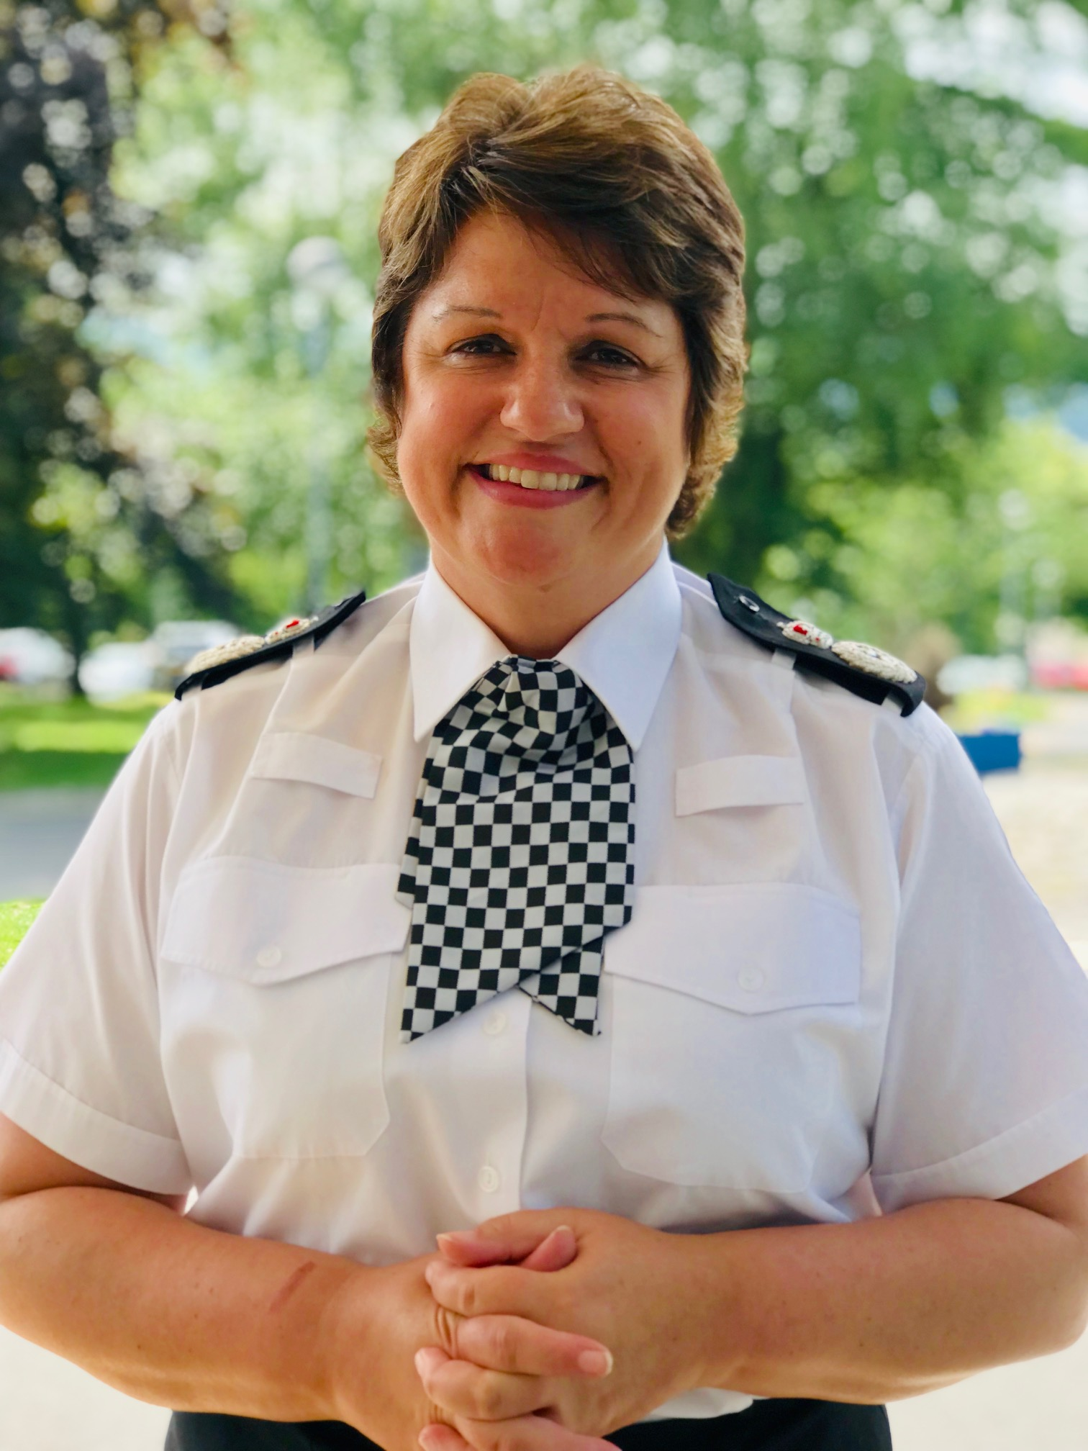
Next steps…
We will continue to review and progress the Chief Constables delivery plan,
We will look to enhance delivery of the plan by adding in new and emerging key activities highlighted in recent inspection feedback and feature in the national picture, that link to the Commissioner’s Police and Crime Plan five priorities,
We will continue to ensure that key strategic messages contained within these plans are shared with our staff so delivery is consistent, effective and efficient,
We will track this through Force Improvement Governance.

Slide 26
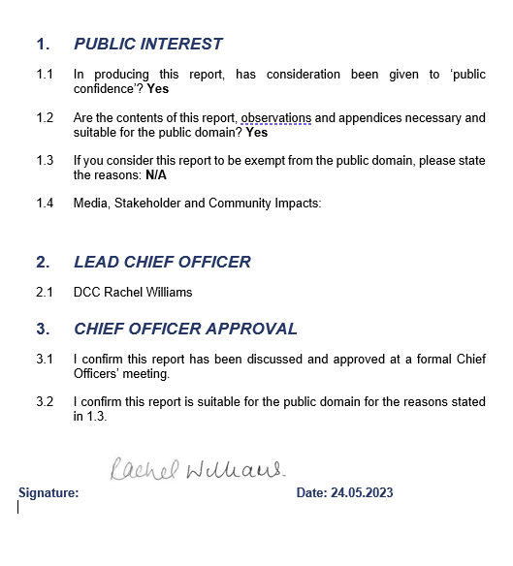
Authorisation

