Slide 1
Organisational Performance against the PCC Priorities Report to the Assurance and Accountability Board
Quarter 3 2025-26

Slide 2
Glossary of Terms
Common Terms:
Financial Year to Date (FYTD) – This date range encompasses the first quarter of the current financial year through to the end of the latest complete quarter (in this case comprising quarters one, two and three of the 2025-26 financial year).
Percentage Points (PP) – Percentage points are used to indicate the numeric difference between two percentages. For instance, moving from 10.0% to 12.0% is an increase of two percentage points.
Solved Crimes – For the purposes of this report, a crime is considered ‘solved’ if it has been finalised with a criminal justice outcome (outcomes 1-8, excluding 5). This includes out of court outcomes such as community resolutions and cautions, in addition to formal charges.
Solved Rate – The solved rate for a given quarter is calculated by dividing the number of crimes which were assigned a criminal justice outcome during that quarter by the number of crimes recorded during that quarter.
Graph Elements:
Average – For the purposes of this report, this graph element is calculated based on the mean value of the eight quarters preceding quarter three of the 2025-26 financial year.
Trendline – This graph element indicates the overall direction of the data within the graph. All 12 quarters represented within the graph are taken into account.
Upper and Lower Control Limits (Upper CL and Lower CL) – These graph elements mark the points beyond which a value is considered a special case, often implying the influence of one or more abnormal external factors. The upper control limit indicates that a value is higher than would be expected, whereas the lower control control limit indicates that the given value is below the expected level.

Slide 3
Pillar One - Preventing Crime and ASB
Representative Workforce
Sickness Rates
Quarterly Summary
Perceptions Survey - Engagement
Perceptions Survey – Local Concerns and Confidence
Overall Crime
Overall Incidents
Anti-Social Behaviour
Community Action Team
Preventing Crime and ASB – Emerging Issues

Slide 4
1. Representative Workforce
Employee Type | Establishment Numbers |  |  |  |  |  | Gender |  |  | Ethnicity
 | Finance Budget FTE | Establishment Budget FTE | Actual FTE | Actual FTE v Establishment FTE Variance | Headcount |  | Female | Male |  | Ethnic Heritage | Not Stated | Prefer Not to Say | White
Police Officer | 1506.0 | 1506.0 | 1539.1 | 33.1 | 1553 |  | 39.5% | 60.5% |  | 3.7% | 0.3% | 3.3% | 92.7%
Police Staff | 795.8 | 824.7 | 815.5 | -9.2 | 860 |  | 68.7% | 31.3% |  | 2.6% | 0.3% | 3.0% | 94.1%
PCSO | 135.0 | 144.0 | 134.8 | -9.2 | 139 |  | 51.1% | 48.9% |  | 7.9% | 0.0% | 1.4% | 90.6%
OPCC | 23.0 | 24.0 | 23.3 | -0.7 | 24 |  | 70.8% | 29.2% |  | 8.3% | 8.3% | 0.0% | 83.3%
Special Constable | - | 100 | - | -50 | 50 |  | 20.0% | 80.0% |  | 6.0% | 2.0% | 0.0% | 92.0%
Agency Worker | - | - | - | - | 10 |  | 50.0% | 50.0% |  | 0.0% | 0.0% | 0.0% | 100.0%
Cadets | - | - | - | - | 150 |  | 55.3% | 44.7% |  | 7.3% | 3.3% | 0.7% | 88.7%
Volunteers | - | - | - | - | 36 |  | 55.6% | 44.4% |  | 8.3% | 47.2% | 0.0% | 44.4%
Number of Officers by Operational Pillar
Crime | Neighbourhood | Response
389 | 186 | 568
These figures pertain to the numbers of Police Constables, Police Sergeants, Detective Constables, and Detective Sergeants assigned to departments within each operational pillar. At present, 275 officers operate outside of these pillars.
Operational Overview
There is a gender disparity evident in the workforce for both officers and staff. For officers, females are under-represented by approximately 11 percentage points (females account for 51% of the population in Gwent based on the 2021 Census). However, females are overrepresented in the staff workstream area by approximately 18 percentage points. There is also a disparity in ethnic heritage representation within the workforce. According to the 2021 Census, 5.8% of the Gwent population are people of ethnic heritage. As of December 2025, 3.7% of police officers are of ethnic heritage, whereas ethnic heritage representation in the staff workstream is lower, at 2.6%.
A representative workforce is crucial for fostering public trust, improving community relations and enhancing operational effectiveness. It is vitally important that Gwent Police mirrors the diversity of the community it serves, in order to better understand and address the unique needs and concerns of all residents. This can lead to greater public confidence in approaching officers for help, reporting incidents, or providing valuable information, as well as creating opportunities to build cohesion and forge stronger relationships. It is also important to recognise that officers from diverse backgrounds may be better equipped to handle specific situations involving vulnerable individuals or specific groups.
The force has recently been reorganised into three operational pillars – Crime, Neighbourhood, and Response. There are currently 389 officers working within the Crime Pillar, 186 within the Neighbourhood Pillar, and 568 within the Response Pillar. This new operating model has been designed to influence how the force works together to improve trust and confidence. Removing geographic barriers will put the community at the heart of everything the force does, working as one team to deliver on issues that matter to people. The model offers opportunities to bring consistency of approach to communities irrespective of the pillar or area of the force, notwithstanding local nuances which will require a tailored delivery dependent upon their needs.
The data on this slide is accurate as of December 2025. The Establishment Budget for Special Constables is a target headcount, aimed to be achieved over the next three years.
The Speedwatch volunteers are no longer working with the force, which has resulted in a significant reduction in volunteer establishment this quarter.

Slide 5
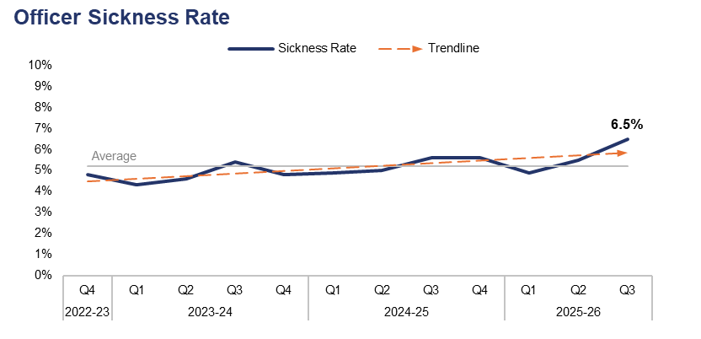
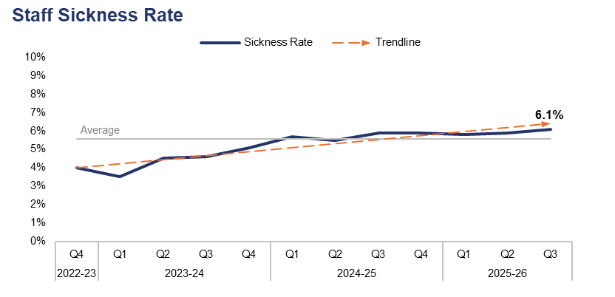
2. Sickness Rates
Financial Year | 21-22 | 22-23 | 23-24 | 24-25 |  | FYTD | 25-26 |  | Quarter | Q2 25-26 | Q3 24-25
Sickness Rate | - | 4.7% | 4.8% | 5.3% |  | Sickness Rate | 5.6% |  | PP Change | 1.0 | 0.9
Financial Year | 21-22 | 22-23 | 23-24 | 24-25 |  | FYTD | 25-26 |  | Quarter | Q2 25-26 | Q3 24-25
Sickness Rate | - | 4.9% | 4.4% | 5.7% |  | Sickness Rate | 5.9% |  | PP Change | 0.2 | 0.2
Operational Overview
During the third quarter of the 2025-26 financial year (Q3 2025-26), the sickness rate for police officers within the force stood at 6.5%. This is the highest quarterly figure within the three-year timeframe, representing an increase of 1.0 percentage point when compared to the quarter prior, and a similar increase of 0.9 percentage points when compared to the same quarter during the previous financial year.
The police staff sickness rate for the same period stands at 6.1%. This is also the highest quarterly figure within the timeframe, representing a slight increase of 0.2 percentage points when compared to both the quarter prior and the same quarter during the previous financial year.
In this context, the sickness rate is calculated by dividing the number of individuals who have taken a day or more of sick leave during the given period by the overall establishment figure for that group.

Slide 6
3. Quarterly Summary
Q3 2025-26 - Crime Volume and Solved Rate by Crime Category
Crime Category | Volume | Solved Rate
- | 6 | 33.3%
All Other Theft | 858 | 2.9%
Bicycle Theft | 35 | 2.9%
Commercial Burglary | 184 | 7.6%
Criminal Damage & Arson | 1,682 | 6.4%
Drug Offences | 474 | 54.6%
Homicide | 2 | 100.0%
Misc Crimes Against Society | 564 | 12.2%
Other Sexual Offences | 416 | 7.9%
Possession Of Weapons | 166 | 27.7%
Public Order Offences | 1,694 | 8.1%
Rape | 196 | 10.7%
Residential Burglary | 451 | 5.3%
Robbery | 104 | 12.5%
Shoplifting | 1,099 | 35.3%
Theft From The Person | 34 | 0.0%
Vehicle Crime | 797 | 1.6%
Violence With Injury | 1,555 | 13.6%
Violence Without Injury | 4,197 | 8.0%
Total | 14,514 | 11.7%
Crime Volumes in Red and Solved Rates in Green are above the eight-quarter rolling average.

Slide 7
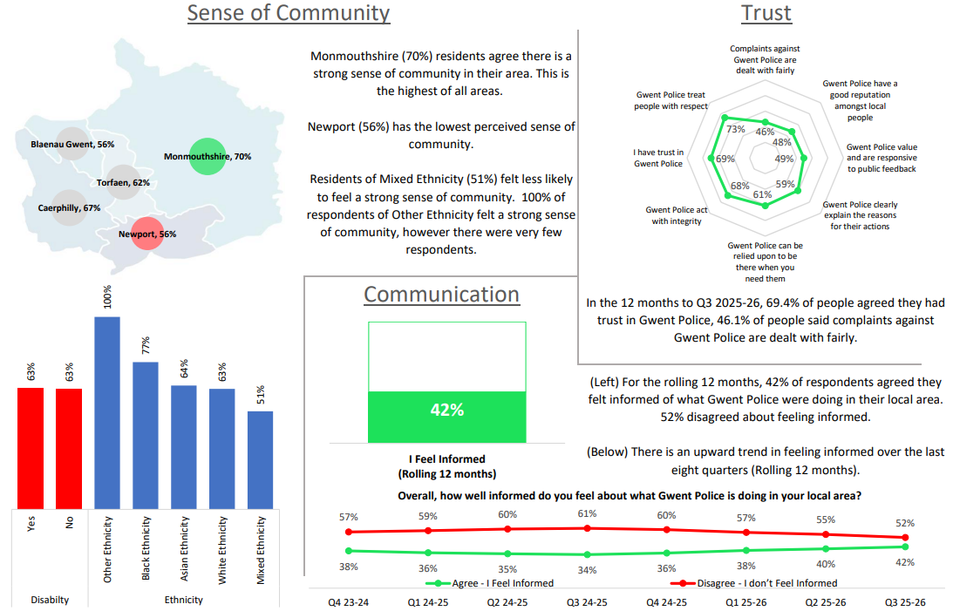
4. Perceptions Survey – Engagement

Slide 8
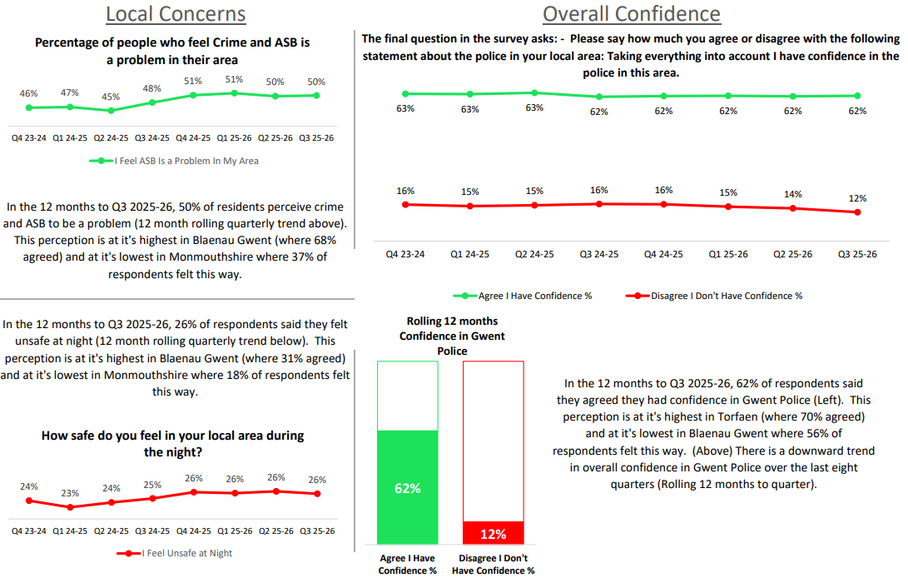
5. Perceptions Survey – Local Concerns and Confidence

Slide 9
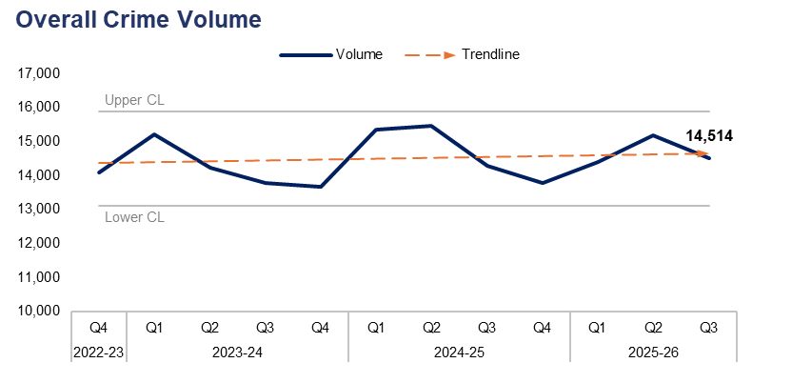
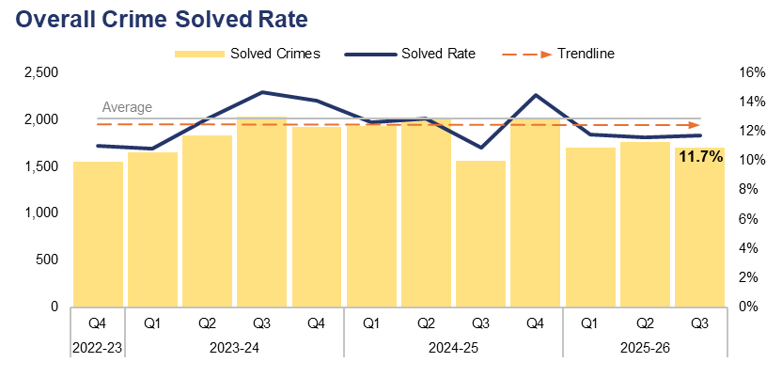
6. Overall Crime
Financial Year | 21-22 | 22-23 | 23-24 | 24-25 |  | FYTD | 25-26 |  | Quarter | Q2 25-26 | Q3 24-25
Volume | 52,781 | 57,940 | 56,902 | 58,891 |  | Volume | 44,078 |  | % Change | -4.4% | 1.5%
Financial Year | 21-22 | 22-23 | 23-24 | 24-25 |  | FYTD | 25-26 |  | Quarter | Q2 25-26 | Q3 24-25
Solved Rate | 11.0% | 9.6% | 13.1% | 12.7% |  | Solved Rate | 11.7% |  | PP Change | 0.1 | 0.8
Operational Overview
Overall, 14,514 crimes were recorded in Gwent during Q3 2025-26. This represents a reduction of 4.4% (663 fewer offences) when compared to the quarter prior, but an increase of 1.5% (217 additional offences) when compared to the same quarter during the previous financial year.
The overall solved rate for Q3 2025-26 stands at 11.7%, with 1,704 crimes solved. This is a slight increase of 0.1 percentage points when compared to the quarter prior, albeit with 60 fewer crimes solved. A more prominent increase of 0.8 percentage points can be observed when comparing Q3 2025-26 to the same quarter during the previous financial year, with 142 additional crimes solved.

Slide 10
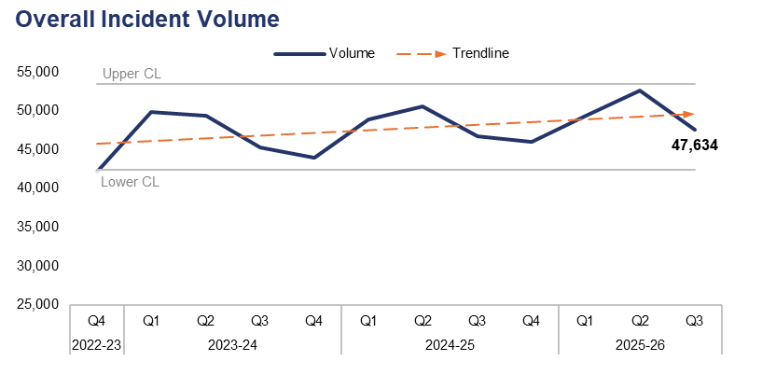
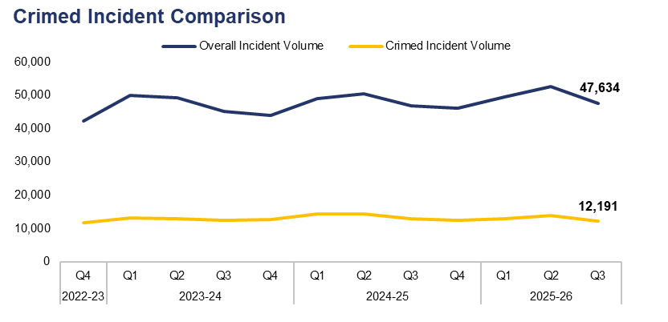
7. Overall Incidents
Financial Year | 21-22 | 22-23 | 23-24 | 24-25 |  | FYTD | 25-26 |  | Quarter | Q2 25-26 | Q3 24-25
Volume | 170,175 | 170,356 | 188,434 | 192,239 |  | Volume | 149,690 |  | % Change | -9.5% | 1.9%
Financial Year | 21-22 | 22-23 | 23-24 | 24-25 |  | FYTD | 25-26 |  | Quarter | Q2 25-26 | Q3 24-25
% Crimed | 26.6% | 28.8% | 27.2% | 28.0% |  | % Crimed | 26.1% |  | PP Change | -0.7 | -1.8
Operational Overview
Overall, 47,634 incidents were reported during Q3 2025-26. This represents a reduction of 9.5% (4,996 fewer incidents) when compared to the quarter prior, but an increase of 1.9% (876 additional incidents) when compared to the same quarter during the previous financial year.
Of the 47,634 incidents reported during Q3 2025-26, 12,191 were assigned a crime category, or ‘crimed’. This accounts for 25.6% of all incidents recorded during the quarter, representing a reduction of 0.7 percentage points when compared to the quarter prior. A further reduction of 1.8 percentage points can be observed when comparing Q3 2025-26 to the same quarter during the previous financial year.
Additional crimes can be created independently of incidents, accounting for the discrepancy between the number of crimed incidents and the overall crime volume for the quarter.

Slide 11
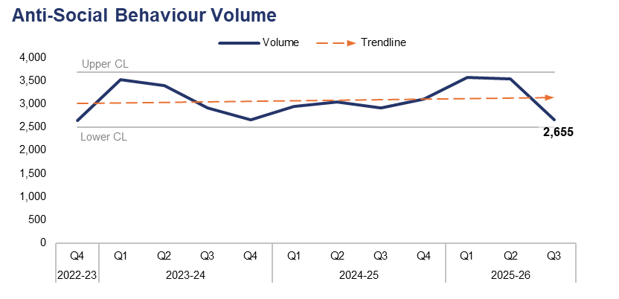
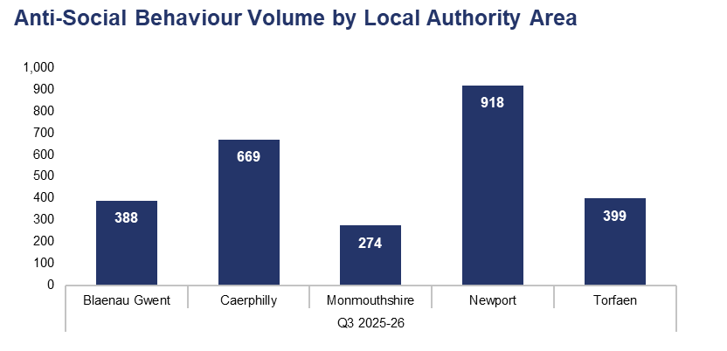
8. Anti-Social Behaviour
Financial Year | 21-22 | 22-23 | 23-24 | 24-25 |  | FYTD | 25-26 |  | Quarter | Q2 25-26 | Q3 24-25
Volume | 12,747 | 10,594 | 12,500 | 11,999 |  | Volume | 9,760 |  | % Change | -24.9% | -8.8%
Local Authority Area |  | Blaenau Gwent | Caerphilly | Monmouthshire | Newport | Torfaen
% of Total |  | 14.6% | 25.2% | 10.3% | 34.6% | 15.0%
Operational Overview
A total of 2,655 incidents classified as Anti-Social Behaviour (ASB) were reported during Q3 2025-26. This is a significant reduction of 24.9% (882 fewer incidents) when compared to the quarter prior, and represents the lowest quarterly figure recorded since Q4 2022-23. A less prominent reduction of 8.8% (256 fewer incidents) can be observed when comparing Q3 2025-26 to the same quarter during the previous financial year.
The upper-right graph displays ASB incident volume during Q3 2025-26 by Local Authority Area. The highest volume of incidents were reported in Newport, accounting for 34.6% of the force-wide total with 918 incidents. Conversely, the lowest volume of incidents were reported in Monmouthshire, comprising 10.3% of the force-wide total with 274 incidents.
Dedicated patrols continue to take place throughout the 37 identified hot-spots in Gwent. By the end Q3 2025-26, officers had undertaken 7,110 hours of dedicated overtime patrols in these areas, resulting in 68 arrests and 134 stop searches, during which 11 weapons were recovered. The force is on course to meet its Home Office target of 9,000 hours by the end of the financial year.
Proactive patrols were undertaken by neighbourhood teams throughout the force during Halloween and Bonfire Night. ASB volume fell by 42.0% during this ordinarily busy period when compared to the year prior.
During Q3 2025-26, seven ASB incidents were reported as having taken place outside of the force area, and have therefore been omitted from the Local Authority Area comparison.

Slide 12
9. Community Action Team
Community Action Team Activity – Q3 2025-26
Metric | Aberbargoed Team | Bettws Team | Ebbw Vale Team | Llantarnam Team | Overall
Offences Recorded | 37 | 28 | 23 | 37 | 125
Solved Rate | 43.2% | 78.6% | 43.5% | 97.3% | 67.2%
Arrests Made | 24 | 22 | 13 | 24 | 83
Stop Searches Performed | 41 | 41 | 17 | 29 | 128
Vehicles Seized | 20 | 16 | 12 | 6 | 54
Operational Overview
The Community Action Teams have been deployed in Aberbargoed, Bettws, Ebbw Vale, and Llantarnam since October 2025, and will remain in these wards until February 2026. During Q3 2025-26, the teams made a total of 83 arrests and seized 54 vehicles, primarily due to them being used or ridden in an anti-social manner. They also achieved a solved rate of 67.2% for crime investigations.
The teams continue to receive extremely positive feedback from local councillors and stakeholders in their areas of deployment. They have amplified their successes through posts on social media and other platforms, which have gained significant positive traction online. The Llantarnam team have supported their Torfaen neighbourhood colleagues in focusing on ASB and retail crime, and have been responsible for notable arrests, charges, and custodial sentences for some of Gwent’s most prolific shoplifters.

Slide 13
10. Preventing Crime and ASB – Emerging Issues
Operational Overview
Following the success of the Safer Streets Summer initiative which saw police and Community Safety Partnerships (CSPs) tackle ASB within town centres, the Home Office's Winter Campaign was launched in December. This took place between the 1st of December and the 31st of January, and focused on ASB, retail crime, and street crime. Newport has seen the resurgence of City Safe as part of this initiative, with an emphasis on ASB associated with the Night-time Economy in the area. The Office of the Police and Crime Commissioner (OPCC) has provided a further £50,000 to support the five CSPs in this venture.
The force is in the process of creating its ASB Action Plan and has been liaising with CSPs to ensure that governance arrangements, policing and partnership activity, problem-solving, data sharing, and effective communications form part of this and the tactical delivery plans. The plan is due for OPCC ratification by end of the financial year. As part of the plan, the force are introducing an ASB Risk Assessment Matrix which will assist in the effective management of repeat and high-risk offenders, as well as ensuring that the appropriate support and safeguarding are in place for repeat victims.
The messaging alert system Neighbourhood Matters is now moving from its implementation phase into operational 'business as usual’. Neighbourhood officers have received training and are now actively utilising the system. Over 5,000 individuals have been surveyed throughout Gwent in an attempt to identify, understand, and collaboratively address issues which adversely impact quality of life in local communities.
The number of school engagements undertaken as part of the Safer Schools Programme has dramatically increased during Q3 2025-26 when compared to the same quarter during the previous financial year, with an additional 1,255 engagements taking place throughout the 242 schools in Gwent. These engagements involve inputs to pupils on topics such as ASB, knife crime, hate crime, and online crime.

Slide 14
Pillar Two - Making Our Communities Safer
999 Demand
101 Demand
999 and 101 Average Answer Speed
Response Times
Most Serious Violence
Serious Violence
Knife Crime
Overall Drug Offences
Drug Possession
Drug Supply
Shoplifting
Residential Burglary
Robbery
Theft from the Person
Making Our Communities Safer – Emerging Issues

Slide 15
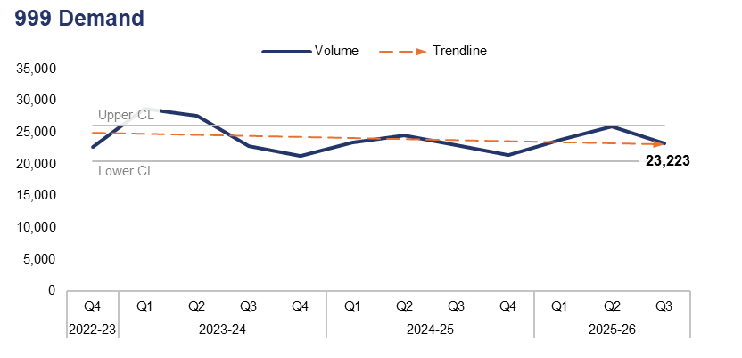
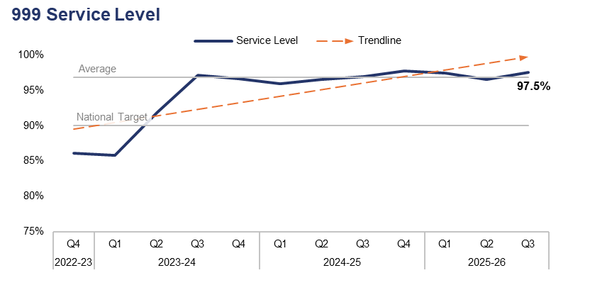
1. 999 Demand
Financial Year | 21-22 | 22-23 | 23-24 | 24-25 |  | FYTD | 25-26 |  | Quarter | Q2 25-26 | Q3 24-25
Volume | 87,259 | 99,891 | 100,469 | 92,275 |  | Volume | 72,929 |  | % Change | -10.4% | 1.1%
Financial Year | 21-22 | 22-23 | 23-24 | 24-25 |  | FYTD | 25-26 |  | Quarter | Q2 25-26 | Q3 24-25
Service Level | 89.5% | 85.7% | 92.4% | 97.0% |  | Service Level | 97.1% |  | PP Change | 1.0 | 0.6
Operational Overview
999 demand has fallen by 10.4% during Q3 2025-26 when compared to the quarter prior, with 2,691 fewer calls received for a total of 23,223. A slight increase of 1.1% (254 additional calls) can be observed when comparing Q3 2025-26 to the same quarter during the previous financial year.
999 service level (the percentage of 999 calls answered within 10 seconds) stands at 97.5% for Q3 2025-26. This represents an increase of 1.0 percentage point when compared to the quarter prior, and of 0.6 percentage points when compared to the same quarter during the previous financial year. 999 service level has remained above the national target of 90% for the last ten consecutive quarters.

Slide 16
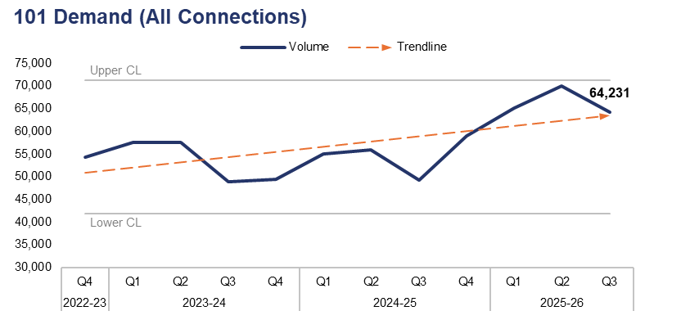
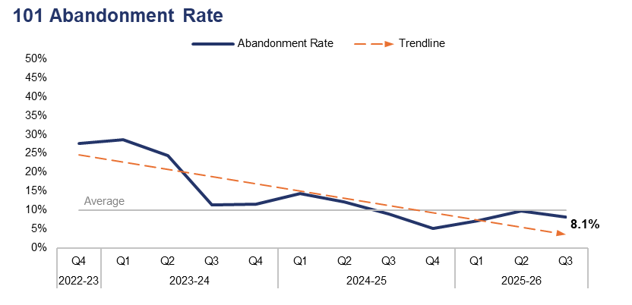
2. 101 Demand
Financial Year | 21-22 | 22-23 | 23-24 | 24-25 |  | FYTD | 25-26 |  | Quarter | Q2 25-26 | Q3 24-25
Volume | 241,738 | 220,342 | 213,356 | 219,010 |  | Volume | 199,453 |  | % Change | -8.3% | 30.6%
Financial Year | 21-22 | 22-23 | 23-24 | 24-25 |  | FYTD | 25-26 |  | Quarter | Q2 25-26 | Q3 24-25
Abandonment Rate | 26.7% | 36.3% | 19.5% | 9.1% |  | Abandonment Rate | 8.4% |  | PP Change | -1.7 | -0.9
Operational Overview
101 demand (all connections) has fallen by 8.3% during Q3 2025-26 when compared to the quarter prior, with 5,778 fewer calls received for a total of 64,231. Conversely, a substantial increase of 30.6% (15,032 additional calls) can be observed when comparing Q3 2025-26 to the same quarter during the previous financial year.
The abandonment rate for 101 calls during Q3 2025-26 was 8.1%. This is a reduction of 1.7 percentage points when compared to the quarter prior, and of 0.9 percentage points when compared to the same quarter during the previous financial year.
The 101 abandonment rate figure is calculated based on call options one and two only, which pertain to new incidents and incident updates respectively.

Slide 17
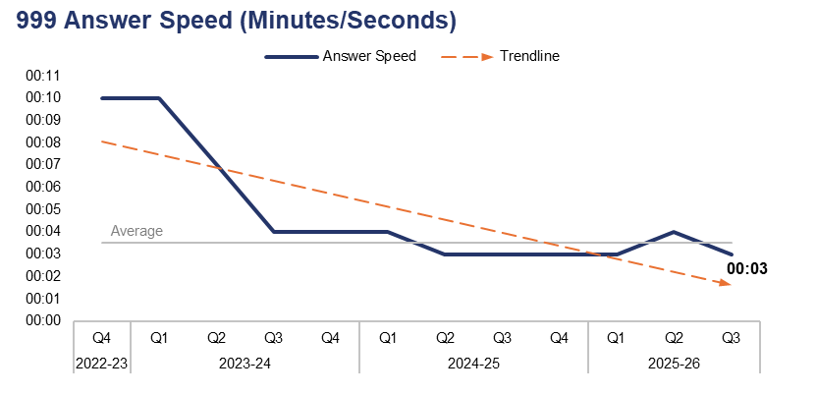
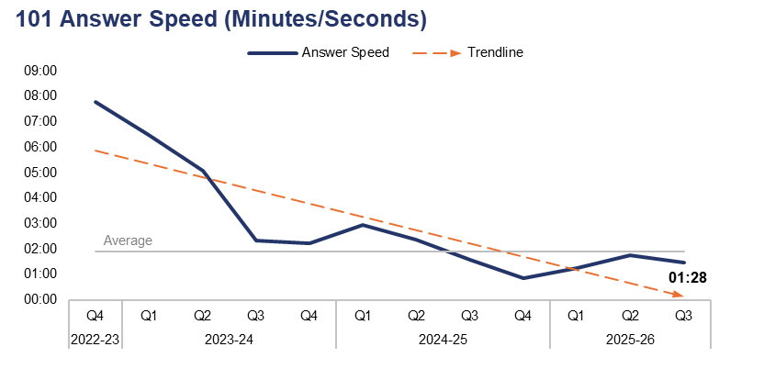
3. 999 and 101 Average Answer Speed
Financial Year | 21-22 | 22-23 | 23-24 | 24-25 |  | FYTD | 25-26 |  | Quarter | Q2 25-26 | Q3 24-25
Answer Speed | 00:09 | 00:11 | 00:06 | 00:04 |  | Answer Speed | 00:03 |  | Change | -00:01 | 00:00
Financial Year | 21-22 | 22-23 | 23-24 | 24-25 |  | FYTD | 25-26 |  | Quarter | Q2 25-26 | Q3 24-25
Answer Speed | 05:45 | 08:01 | 03:59 | 01:43 |  | Answer Speed | 01:30 |  | Change | -00:17 | -00:07
Operational Overview
The average answer speed for 999 calls during Q3 2025-26 was three seconds. This is an improvement of one second when compared to the quarter prior, and is equal to the same quarter during the previous financial year.
The average answer speed for 101 calls during Q3 2025-26 was one minute and 28 seconds. This is an improvement of 17 seconds when compared to the quarter prior, and of seven seconds when compared to the same quarter during the previous financial year.
The 101 average answer speed figure is calculated based on call options one and two only, which pertain to new incidents and incident updates respectively.

Slide 18
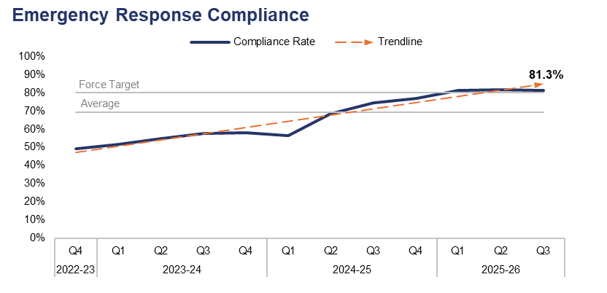
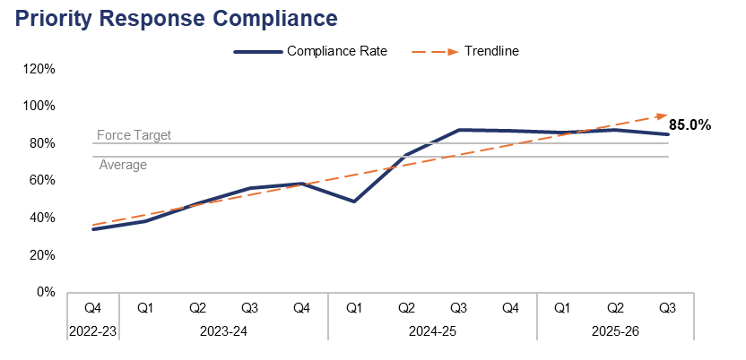
4. Response Times
Financial Year | 21-22 | 22-23 | 23-24 | 24-25 |  | FYTD | 25-26 |  | Quarter | Q2 25-26 | Q3 24-25
Compliance Rate | 47.5% | 47.0% | 55.4% | 68.7% |  | Compliance Rate | 81.5% |  | PP Change | -0.5 | 6.7
Financial Year | 21-22 | 22-23 | 23-24 | 24-25 |  | FYTD | 25-26 |  | Quarter | Q2 25-26 | Q3 24-25
Compliance Rate | 33.2% | 32.3% | 50.0% | 74.5% |  | Compliance Rate | 86.2% |  | PP Change | -2.3 | -2.6
Operational Overview
Based on the target arrival time of 15 minutes, the emergency create-to-arrival compliance rate for Q3 2025-26 stands at 81.3%. This is a reduction of 0.5 percentage points when compared to the quarter prior, but represents a notable increase of 6.7 percentage points when compared to the same quarter during the previous financial year. The compliance rate has exceeded the force target of 80.0% for a third consecutive quarter.
Based on the target arrival time of 60 minutes, the priority create-to-arrival compliance rate for Q3 2025-26 stands at 85.0%. This is a reduction of 2.3 percentage points when compared to the quarter prior, and a similar reduction of 2.6 percentage points when compared to the same quarter during the previous financial year. Despite this, the compliance rate has now exceeded the force target of 80.0% for five consecutive quarters.
In this context, ‘create-to-arrival’ refers to the time elapsed between the creation of a Storm Log for a given incident, and the arrival of officers at the scene.

Slide 19
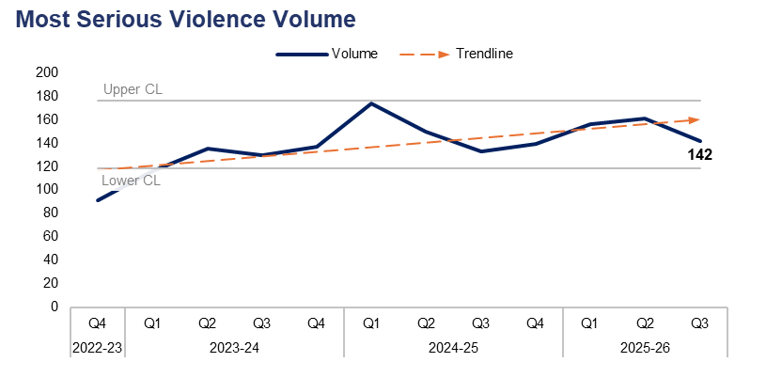
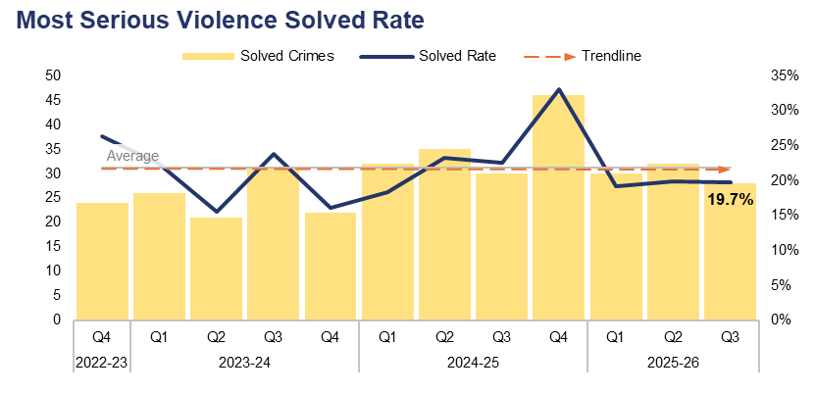
5. Most Serious Violence
Financial Year | 21-22 | 22-23 | 23-24 | 24-25 |  | FYTD | 25-26 |  | Quarter | Q2 25-26 | Q3 24-25
Volume | 435 | 474 | 518 | 596 |  | Volume | 459 |  | % Change | -11.8% | 6.8%
Financial Year | 21-22 | 22-23 | 23-24 | 24-25 |  | FYTD | 25-26 |  | Quarter | Q2 25-26 | Q3 24-25
Solved Rate | 16.3% | 19.0% | 19.3% | 24.0% |  | Solved Rate | 19.6% |  | PP Change | -0.2 | -2.9
Operational Overview
A total of 142 crimes classified as Most Serious Violence were recorded during Q3 2025-26. This represents a reduction of 11.8% (19 fewer offences) when compared to the quarter prior, but an increase of 6.8% (nine additional offences) when compared to the same quarter during the previous financial year.
The solved rate for Q3 2025-26 stands at 19.7%, with 28 crimes solved. This is a slight reduction of 0.2 percentage points when compared to the quarter prior, with four fewer crimes solved. A further reduction of 2.9 percentage points can be observed when comparing Q3 2025-26 to the same quarter during the previous financial year, with two fewer crimes solved.
The Homicide and Serious Violence meeting ensures appropriate oversight of investigations and is able to identify any changes in performance. Most Serious Violence is investigated by the Reactive Criminal Investigation Department (CID) who operate as part of the Crime Pillar. Scrutiny and the identification of patterns in offending allow for predicted demand analysis and the assignment of appropriate resources from the Crime Pillar. The management and oversight of meetings has seen strong relationships forged between the three pillars, with problem solving plans devised to prevent and detect Most Serious Violence. The Tasking and Proactive team identify and own any ongoing series and patterns in offending, in order to support further analysis and to bolster the organisation’s responsiveness to Most Serious Violence. This provides resilience and ensures outstanding public service for some of our most high-harm offending.
There were two homicide investigations during Q3 2025-26, both of which pertained to crimes involving the use of a knife. The suspects have been charged, remanded, and are awaiting trial.
Most Serious Violence offences consist of homicide, grievous bodily harm with intent, and causing death by dangerous driving.

Slide 20
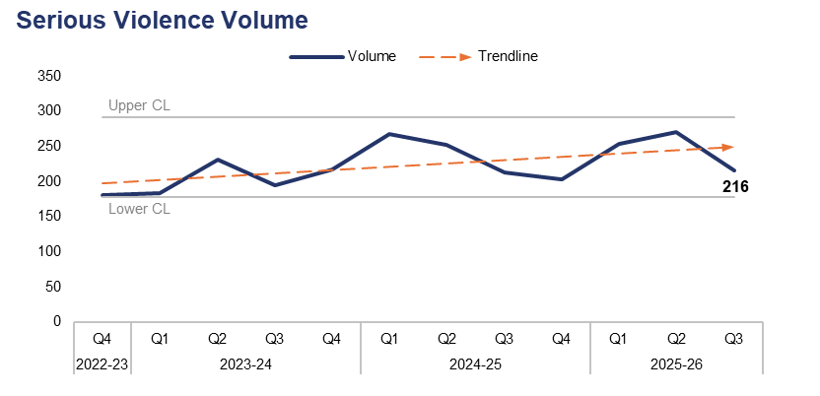
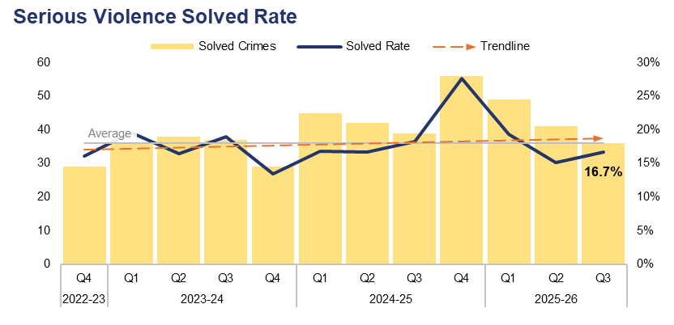
6. Serious Violence
Financial Year | 21-22 | 22-23 | 23-24 | 24-25 |  | FYTD | 25-26 |  | Quarter | Q2 25-26 | Q3 24-25
Volume | 729 | 843 | 827 | 936 |  | Volume | 741 |  | % Change | -20.3% | 1.4%
Financial Year | 21-22 | 22-23 | 23-24 | 24-25 |  | FYTD | 25-26 |  | Quarter | Q2 25-26 | Q3 24-25
Solved Rate | 16.2% | 15.5% | 16.9% | 19.4% |  | Solved Rate | 17.0% |  | PP Change | 1.6 | -1.6
Operational Overview
Overall, 216 crimes classified as Serious Violence were recorded during Q3 2025-26. This represents a significant reduction of 20.3% (55 fewer offences) when compared to the quarter prior, but a slight increase of 1.4% (three additional offences) when compared to the same quarter during the previous financial year.
The solved rate for Q3 2025-26 stands at 16.7%, with 36 crimes solved. This is an increase of 1.6 percentage points when compared to the quarter prior, albeit with five fewer crimes solved. Conversely, a reduction 1.6 percentage points can be observed when comparing Q3 2025-26 to the same quarter during the previous financial year, with three fewer crimes solved.
Although Serious Violence is discussed in the Homicide and Serious Violence meeting, an element of this also features in the Serious Organised Crime (SOC) meeting. Organised Crime Group (OCG) nominals involved in Serious Violence are identified within this meeting, in order to explore opportunities under a ‘4Ps’ approach (Pursue, Prevent, Protect, and Prepare).
Funding provided by the Home Office to tackle county lines has been used to prevent Serious Violence and bring offenders to justice through proactive policing and partnership operations.
Tarian have provided considerable support to tackle an OCG which used Serious Violence, leading to the arrest and conviction of offenders.
Services have been commissioned via Serious Violence Duty funding which aim to prevent violent crime and promote early intervention through the identification of effective local practices and prevention programmes. This is aligned to the Government’s Safer Streets mission, with interventions being delivered through the five CSPs.
Serious Violence offences consist of section 18 grievous bodily harm with intent, section 20 malicious wounding without intent, and personal robbery.

Slide 21
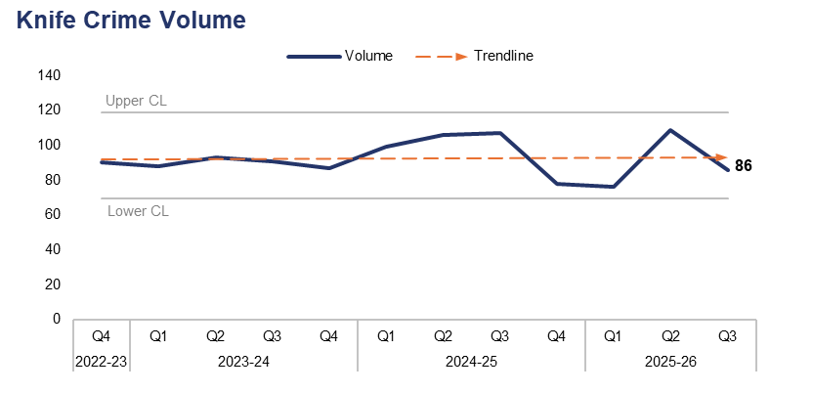
7. Knife Crime
Financial Year | 21-22 | 22-23 | 23-24 | 24-25 |  | FYTD | 25-26 |  | Quarter | Q2 25-26 | Q3 24-25
Volume | 283 | 370 | 359 | 390 |  | Volume | 271 |  | % Change | -21.1% | -19.6%
Operational Overview
A total of 86 offences recorded during Q3 2025-26 were classified as knife crimes, as defined by the Home Office’s National Data Quality Improvement Service (NDQIS) reporting system. This represents a reduction of 21.1% (23 fewer offences) when compared to the quarter prior. A similar reduction of 19.6% (21 fewer offences) can be observed when comparing Q3 2025-26 to the same quarter during the previous financial year.
The force continually encourages the appropriate use of stop and search as a proactive tactic to limit access to knives for criminals. Appropriate performance and oversight meetings ensure that stop and search is used proportionately, with accurate and reliable grounds for each search recorded.
SOC profiles are used to identify the top three wards in each local authority area based on Crime Severity Score. Within these wards, knife crimes and those linked to SOC have been highlighted and are discussed at the SOC partnership meetings. The Knife Crime Problem Profile has also been completed and was presented in November's violence meeting, to inform the policing and partnership response.
Gwent Police took part in the national Operation Sceptre week during Q3 2025-26, focused on prevention, education and enforcement. This included inputs by Fearless to schools and a discussion with students at Coleg Gwent about the consequences of knife crime.
In accordance with NDQIS reporting criteria, Possession of a Weapon and Homicide offences have been excluded from this dataset.

Slide 22
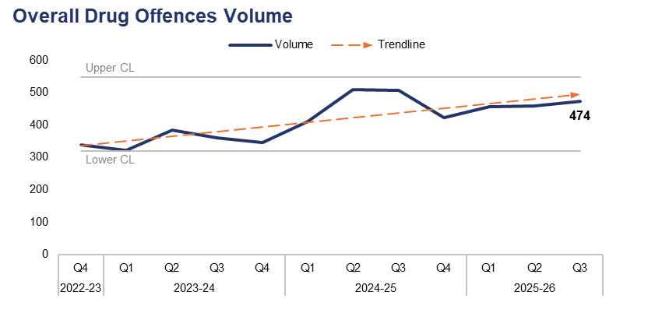
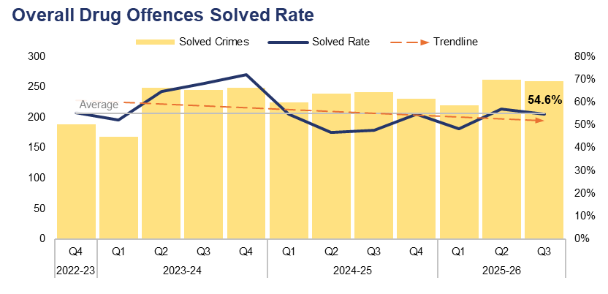
8. Overall Drug Offences
Financial Year | 21-22 | 22-23 | 23-24 | 24-25 |  | FYTD | 25-26 |  | Quarter | Q2 25-26 | Q3 24-25
Volume | 1,328 | 1,296 | 1,411 | 1,848 |  | Volume | 1,389 |  | % Change | 3.3% | -6.3%
Financial Year | 21-22 | 22-23 | 23-24 | 24-25 |  | FYTD | 25-26 |  | Quarter | Q2 25-26 | Q3 24-25
Solved Rate | 67.5% | 54.6% | 64.6% | 50.6% |  | Solved Rate | 53.3% |  | PP Change | -2.5 | 7.0
Operational Overview
Overall, 474 crimes classified as Drug Offences were recorded during Q3 2025-26. This represents an increase of 3.3% (15 additional offences) when compared to the quarter prior, but a reduction of 6.3% (32 fewer offences) when compared to the same quarter during the previous financial year.
The solved rate for Q3 2025-26 stands at 54.6%, with 259 crimes solved. This is a reduction of 2.5 percentage points when compared to the quarter prior, with three fewer crimes solved. Conversely, an increase of 7.0 percentage points can be observed when comparing Q3 2025-26 to the same quarter during the previous financial year, with 18 additional crimes solved.
The number of offences relating to the importation of drugs has fallen by 4.7% (two fewer offences) when compared to the quarter prior, for a total of 41. This is the lowest quarterly figure recorded since Q4 2023-24.
New processes have been implemented by Gwent Police to manage drug importation offences. These offences saw an increase due to an international rise in the use of the fast parcel service to import drugs, particularly from areas which have legalised cannabis. The processes provide effective management of importations, with a focus on disruption to prevent further offending.

Slide 23
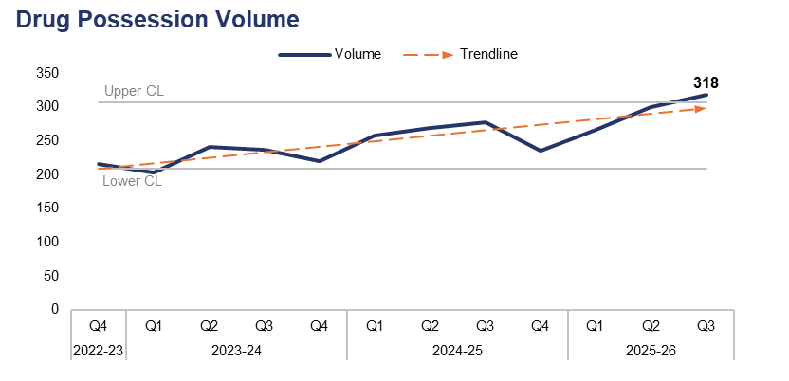
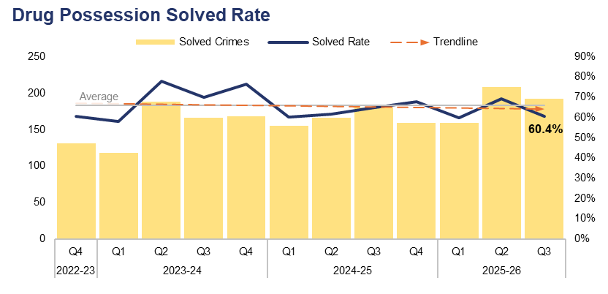
9. Drug Possession
Financial Year | 21-22 | 22-23 | 23-24 | 24-25 |  | FYTD | 25-26 |  | Quarter | Q2 25-26 | Q3 24-25
Volume | 948 | 828 | 901 | 1,040 |  | Volume | 884 |  | % Change | 6.0% | 14.4%
Financial Year | 21-22 | 22-23 | 23-24 | 24-25 |  | FYTD | 25-26 |  | Quarter | Q2 25-26 | Q3 24-25
Solved Rate | 70.0% | 60.9% | 71.0% | 63.5% |  | Solved Rate | 63.2% |  | PP Change | -8.9 | -4.3
Operational Overview
The volume of drug possession offences exceeded the upper control limit during Q3 2025-26, with 318 crimes recorded. This is the highest quarterly figure within the three-year timeframe, representing an increase of 6.0% (18 additional offences) when compared to the quarter prior, and a further increase of 14.4% (40 additional offences) when compared to the same quarter during the previous financial year.
The solved rate for Q3 2025-26 stands at 60.4%, with 192 crimes solved. This is a reduction of 8.9 percentage points when compared to the quarter prior, with 16 fewer crimes solved. A less prominent reduction of 4.3 percentage points can be observed when comparing Q3 2025-26 to the same quarter during the previous financial year, albeit with 12 additional crimes solved.
During Q3 2025-26, Gwent Police and partners have conducted proactive operations aimed at tackling ASB which often emanates from drug use. This has included the Clear Hold Build site in Rhymney and the deployment of the Community Action Teams in areas such as Bettws and Pill to address drugs supply, drug use, and associated ASB.
This slide pertains to possession offences for all controlled drugs, including Cannabis.

Slide 24
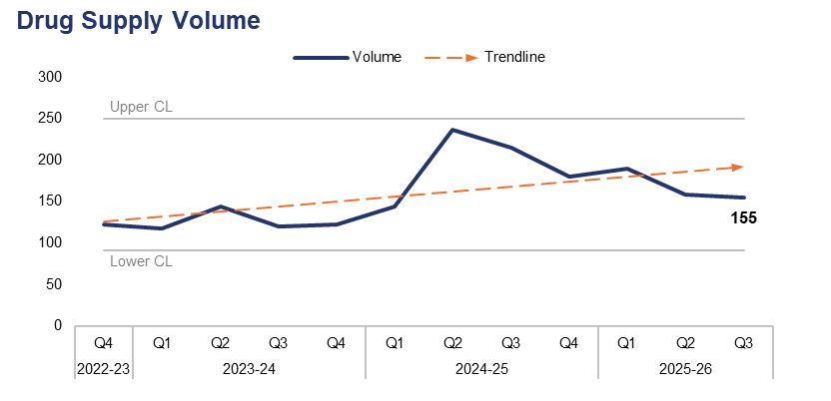
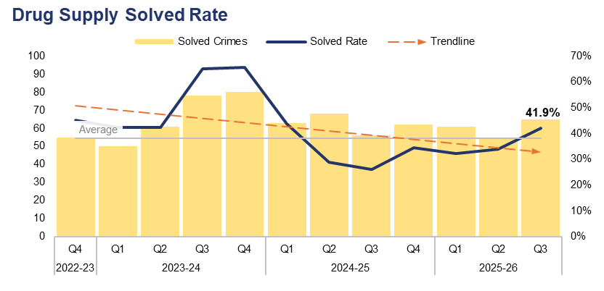
10. Drug Supply
Financial Year | 21-22 | 22-23 | 23-24 | 24-25 |  | FYTD | 25-26 |  | Quarter | Q2 25-26 | Q3 24-25
Volume | 378 | 461 | 504 | 776 |  | Volume | 504 |  | % Change | -2.5% | -27.9%
Financial Year | 21-22 | 22-23 | 23-24 | 24-25 |  | FYTD | 25-26 |  | Quarter | Q2 25-26 | Q3 24-25
Solved Rate | 61.4% | 43.4% | 53.4% | 32.1% |  | Solved Rate | 35.7% |  | PP Change | 7.9 | 15.9
Operational Overview
Overall, 155 drug supply offences were recorded during Q3 2025-26. This represents a reduction of 2.5% (four fewer offences) when compared to the quarter prior, and a significant reduction of 27.9% (60 fewer offences) when compared to the same quarter during the previous financial year.
The solved rate for Q3 2025-26 stands at 41.9%, with 65 crimes solved. This is an increase of 7.9 percentage points when compared to the quarter prior, with 11 additional crimes solved. A further increase of 15.9 percentage points can be observed when comparing Q3 2025-26 to the same quarter during the previous financial year, with nine additional crimes solved.
During Q3 2025-26, the resources from Gwent Police's Organised Crime Unit and Force Serious Organised Crime Team were used to support the two homicide investigations which took place during this period. This reduced the force’s capacity to conduct proactive operations targeting drug supply. In addition to supporting these homicide investigations, these teams focused on the highest threat drug supply investigations and the associated criminal justice processes, in order to achieve positive outcomes.
This slide includes all offences pertaining to the supply, importation, or production of controlled drugs.

Slide 25
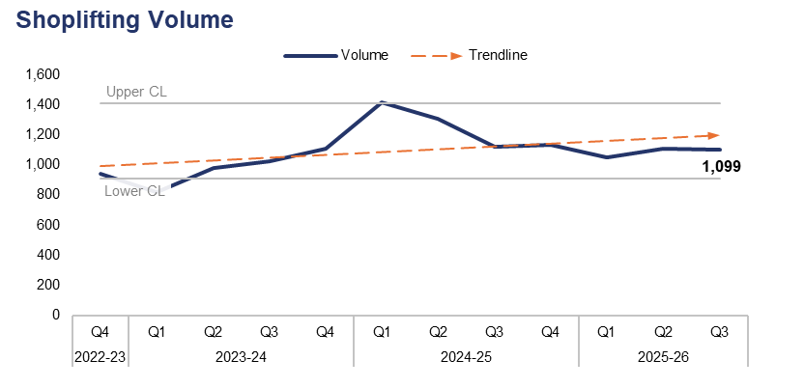
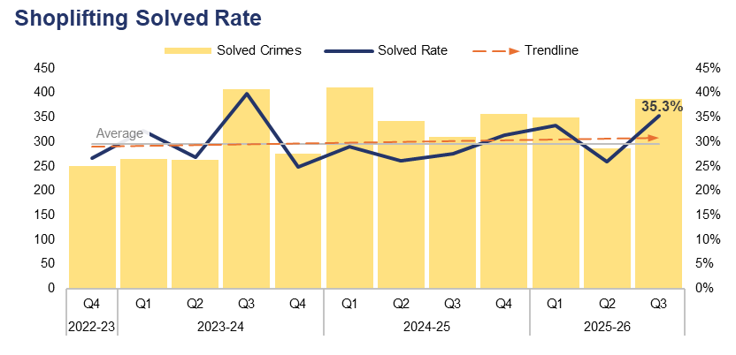
11. Shoplifting
Financial Year | 21-22 | 22-23 | 23-24 | 24-25 |  | FYTD | 25-26 |  | Quarter | Q2 25-26 | Q3 24-25
Volume | 2,186 | 2,973 | 3,925 | 4,981 |  | Volume | 3,258 |  | % Change | -1.0% | -2.1%
Financial Year | 21-22 | 22-23 | 23-24 | 24-25 |  | FYTD | 25-26 |  | Quarter | Q2 25-26 | Q3 24-25
Solved Rate | 27.7% | 23.7% | 30.8% | 28.5% |  | Solved Rate | 31.5% |  | PP Change | 9.4 | 7.8
Operational Overview
During Q3 2025-26, 1,099 Shoplifting offences were recorded. This represents a slight reduction of 1.0% (11 fewer offences) when compared to the quarter prior, and a similar reduction of 2.1% (24 fewer offences) when compared to the same quarter during the previous financial year.
The solved rate for Q3 2025-26 stands at 35.3%, with 388 crimes solved. This is the second-highest quarterly solved rate within the three-year timeframe, representing an increase of 9.4 percentage points when compared to the quarter prior, with 101 additional crimes solved. A similar increase of 7.8 percentage points can be observed when comparing Q3 2025-26 to the same quarter during the previous financial year, with 79 additional crimes solved.
Focus continues to be placed on retail crime through the Home Office Winter Campaign. This has led to increases in enforcement and diversionary activities undertaken by both police and partners/retailers in order to combat this crime type. Crime and Disorder Reduction Officers continue to successfully apply for Criminal Behaviour Orders which assist in effectively managing those prolific offenders within our communities.

Slide 26
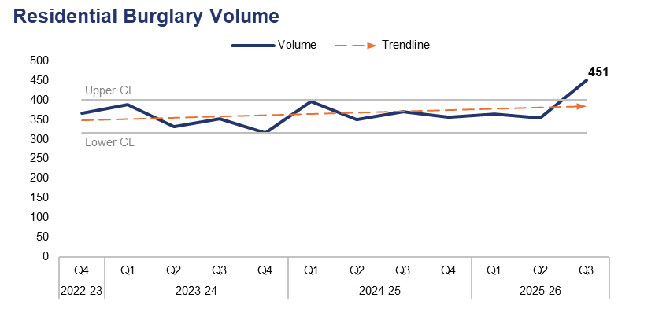
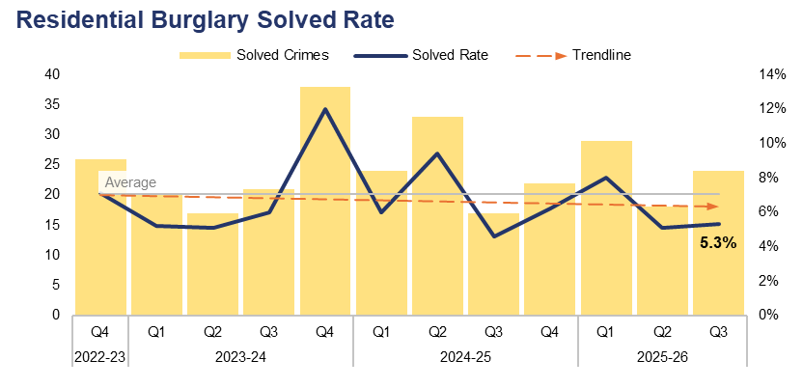
12. Residential Burglary
Financial Year | 21-22 | 22-23 | 23-24 | 24-25 |  | FYTD | 25-26 |  | Quarter | Q2 25-26 | Q3 24-25
Volume | 1,755 | 1,615 | 1,389 | 1,474 |  | Volume | 1,169 |  | % Change | 27.4% | 21.9%
Financial Year | 21-22 | 22-23 | 23-24 | 24-25 |  | FYTD | 25-26 |  | Quarter | Q2 25-26 | Q3 24-25
Solved Rate | 6.3% | 5.1% | 6.9% | 6.5% |  | Solved Rate | 6.1% |  | PP Change | 0.2 | 0.7
Operational Overview
The volume of Residential Burglary offences exceeded the upper control limit during Q3 2025-26, with 451 crimes recorded. This is the highest quarterly figure within the three-year timeframe, representing an increase of 27.4% (97 additional offences) when compared to the quarter prior, and an increase of 21.9% (81 additional offences) when compared to the same quarter during the previous financial year.
The solved rate for Q3 2025-26 stands at 5.3%, with 24 crimes solved. This is a slight increase of 0.2 percentage points when compared to the quarter prior, with six additional crimes solved. A similar increase of 0.7 percentage points can be observed when comparing Q3 2025-26 to the same quarter during the previous financial year, with seven additional crimes solved.
During Q3 2025-26, 91.5% of Residential Burglary of a Home incidents were attended by officers, with 55.3% of these attended within 60 minutes.
There is a notable disparity in solved rate between crimes classified as residential burglaries of homes and those classified as residential burglaries of unconnected buildings. The solved rate for residential burglaries of homes stands at 8.2% for the FYTD, whereas the solved rate for residential burglaries of unconnected buildings is lower, at 1.3%.
A second phase of the burglary app trial is due to be refreshed. The app has seen limited use across the force, with messaging and leadership sponsorship planned to increase its usage and subsequently improve service delivery.

Slide 27
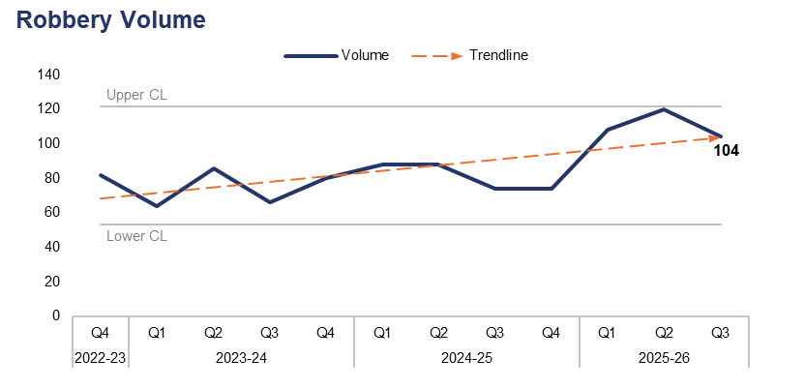
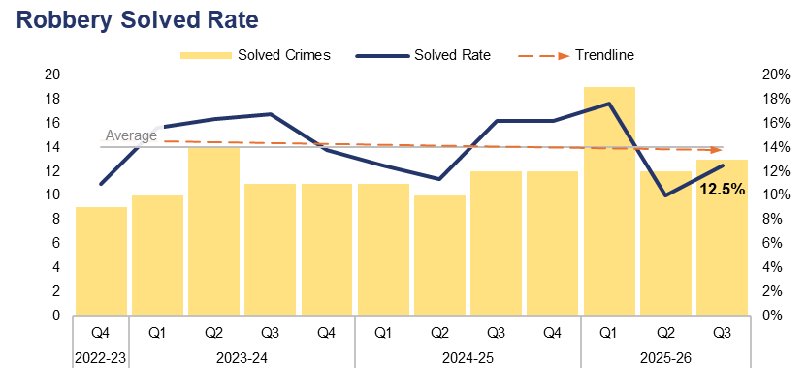
13. Robbery
Financial Year | 21-22 | 22-23 | 23-24 | 24-25 |  | FYTD | 25-26 |  | Quarter | Q2 25-26 | Q3 24-25
Volume | 266 | 332 | 296 | 324 |  | Volume | 332 |  | % Change | -13.3% | 40.5%
Financial Year | 21-22 | 22-23 | 23-24 | 24-25 |  | FYTD | 25-26 |  | Quarter | Q2 25-26 | Q3 24-25
Solved Rate | 18.8% | 12.3% | 15.5% | 13.9% |  | Solved Rate | 13.3% |  | PP Change | 2.5 | -3.7
Operational Overview
A total of 104 Robbery offences were recorded during Q3 2025-26. This represents a reduction of 13.3% (16 fewer offences) when compared to the quarter prior, but a significant increase of 40.5% (30 additional offences) when compared to the same quarter during the previous financial year.
The solved rate for Q3 2025-26 stands at 12.5%, with 13 crimes solved. This is an increase of 2.5 percentage points when compared the the quarter prior, with one additional crime solved. A reduction of 3.7 percentage points can be observed when comparing Q3 2025-26 to the same quarter during the previous financial year, albeit with one additional crime solved.
Offences pertaining to the robbery of personal property comprise the majority of those recorded during the current FYTD, representing 77.4% of the total with 257 crimes recorded. Robbery of business property offences account for the remaining 22.6%, with 75 crimes recorded. The solved rate for robbery of business property offences is higher at 20.0% (15 crimes solved), whereas the solved rate for robbery of personal property offences stands at 11.3% (29 crimes solved).
Force-wide performance regarding Robbery is tracked by the Homicide and Serious Violence Meeting. This highlights specific areas of concern and allows for the effective tasking of specialist resources to problem-solve and robustly investigate these offences. A daily process run by the CID ensures that all Robbery offences are correctly identified and owned by the appropriate investigative team. This is further supported by Level 1 tasking, where multiple departments come together to problem-solve any ongoing series of offences.
The data on this slide includes both personal and commercial Robbery offences.

Slide 28
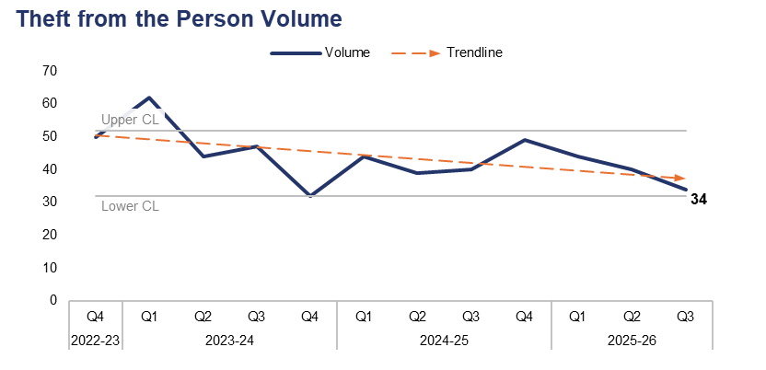
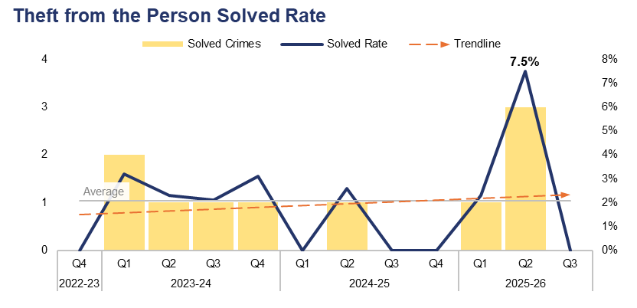
14. Theft from the Person
Financial Year | 21-22 | 22-23 | 23-24 | 24-25 |  | FYTD | 25-26 |  | Quarter | Q2 25-26 | Q3 24-25
Volume | 166 | 207 | 185 | 172 |  | Volume | 118 |  | % Change | -15.0% | -15.0%
Financial Year | 21-22 | 22-23 | 23-24 | 24-25 |  | FYTD | 25-26 |  | Quarter | Q2 25-26 | Q3 24-25
Solved Rate | 5.4% | 0.5% | 2.7% | 0.6% |  | Solved Rate | 3.4% |  | PP Change | -7.5 | 0.0
Operational Overview
During Q3 2025-26, 34 Theft from the Person offences were recorded. This represents a reduction of 15.0% (six fewer offences) when compared to both the quarter prior and the same quarter during the previous financial year.
The solved rate for Q3 2025-26 stands at 0.0%, with no crimes solved. This is a reduction of 7.5 percentage points when compared to the quarter prior, with three fewer crimes solved, and is equal to the same quarter during the previous financial year.
The majority of the outcomes recorded for Theft from the Person offences during Q3 2025-26 were classified as Outcome 18: Investigation complete – no suspect identified. This is likely due in part to the nature of these offences, which include pickpocketing and ‘snatch thefts’, in which the victim typically has very little (if any) direct interaction with the offender.

Slide 29
15. Making our Communities Safer – Emerging Issues
Operational Overview
Dangerous dog activity continues to present a complex and evolving risk within our communities, requiring sustained focus from local policing teams and dog‑handlers. A total of 141 dangerous dog crimes were recorded during Q3 2025-26. This represents an increase of 21.6% (25 additional offences) when compared to the quarter prior, and a similar increase of 23.7% (27 additional offences) when compared to the same quarter during the previous financial year. Whilst this remains an area of operational demand, recent performance indicators demonstrate meaningful progress. The number of seized dogs held by the force within kennels has reduced to 24, accompanied by a continued decrease in average holding times. This reflects more efficient case progression and improved decision‑making pathways.
Strategic oversight is maintained through fortnightly governance meetings, where every live investigation involving a seized dog is reviewed. These meetings are chaired at Specialist Operations Senior Management Team level, ensuring senior accountability and timely escalation. Joint Legal Services and the Dangerous Dog Administration Team provide integrated support, enabling the consistent application of legislation, risk assessment, and enforcement options.
The LEAD initiative continues to form a key component of our preventative strategy. Through promotion by local policing teams during community engagement activities, LEAD strengthens multi‑agency information sharing, encourages early reporting of concerns, and provides a structured mechanism for identifying and intervening with irresponsible dog owners. This approach supports a shift from reactive enforcement to early intervention and long‑term risk reduction.
The Virtual Decisions programmes have been refreshed, with meetings convened to discuss an extension of the licence. This innovative practise was highlighted in the recent His Majesty’s Inspectorate of Constabulary and Fire & Rescue Services (HMICFRS) SOC inspection debrief. In support of the force’s child centred approach to offending, the Reducing Reoffending working group is focusing on knife crime, specifically first-time offending and reoffending by children. This work is anticipated to reduce the number of first-time entrants into the system, complementing Operation Sceptre.

Slide 30
Pillar Three – Protecting the Vulnerable
Violence Against Women and Girls
Domestic Offences
Rape
Serious Sexual Offences
Stalking
Harassment
Hate Crime
Child Criminal and Sexual Exploitation
Missing Children
Action Fraud
Cybercrime
Protecting the Vulnerable – Emerging Issues

Slide 31
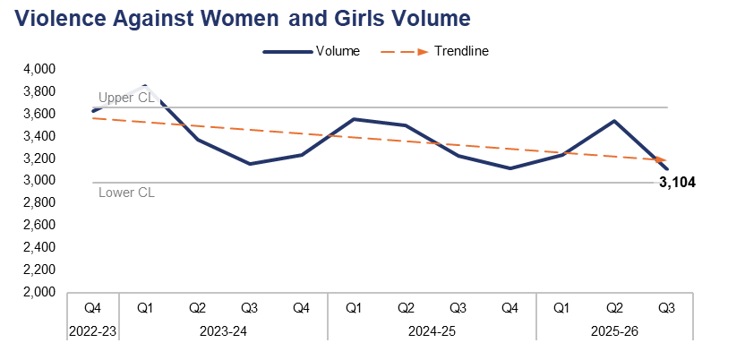
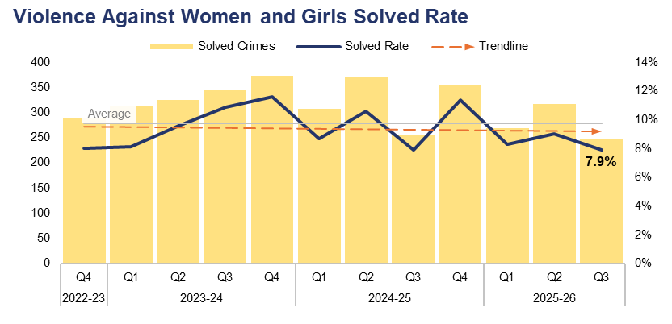
1. Violence Against Women and Girls
Financial Year | 21-22 | 22-23 | 23-24 | 24-25 |  | FYTD | 25-26 |  | Quarter | Q2 25-26 | Q3 24-25
Volume | 13,088 | 14,921 | 13,609 | 13,383 |  | Volume | 9,874 |  | % Change | -12.2% | -3.8%
Financial Year | 21-22 | 22-23 | 23-24 | 24-25 |  | FYTD | 25-26 |  | Quarter | Q2 25-26 | Q3 24-25
Solved Rate | 8.3% | 7.0% | 10.0% | 9.6% |  | Solved Rate | 8.4% |  | PP Change | -1.1 | 0.0
Operational Overview
A total of 3,104 crimes classified as Violence Against Women and Girls (VAWG) offences were recorded during Q3 2025-26. This represents a reduction of 12.2% (433 fewer offences) when compared to the quarter prior, and a less prominent reduction of 3.8% (121 fewer offences) when compared to the same quarter during the previous financial year.
The solved rate for Q3 2025-26 stands at 7.9%, with 246 crimes solved. This is a reduction of 1.1 percentage points when compared to the quarter prior, with 71 fewer crimes solved. No change in solved rate can be observed when comparing Q3 2025-26 against the same quarter during the previous financial year, although eight fewer crimes have been solved. Gwent Police are key partners in the Welsh Government’s Violence Against Women, Domestic Abuse & Sexual Violence (VAWDASV) strategy. As such, the force sits on the Gwent VAWDASV Strategy multi-agency subgroups in areas including protected communities and characteristics, communications, and tackling perpetration. The force also forms part of the VAWDASV Board.

Slide 32
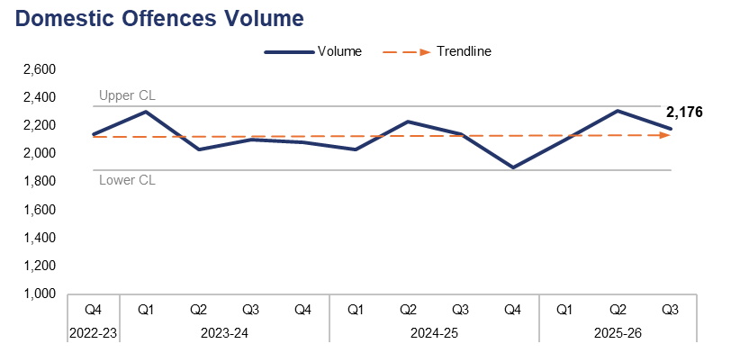
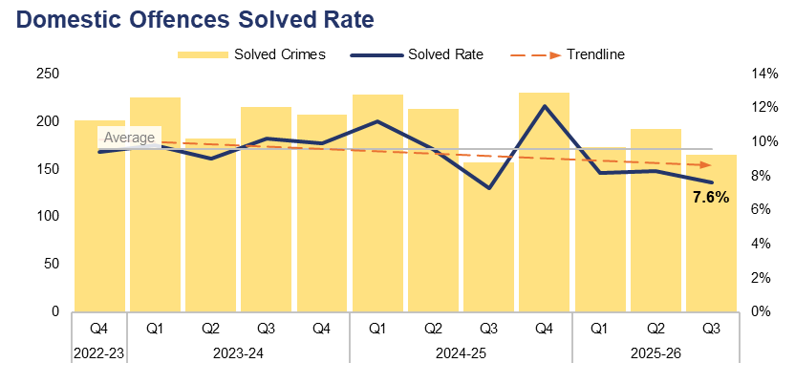
2. Domestic Offences
Financial Year | 21-22 | 22-23 | 23-24 | 24-25 |  | FYTD | 25-26 |  | Quarter | Q2 25-26 | Q3 24-25
Volume | 8,948 | 8,531 | 8,514 | 8,299 |  | Volume | 6,583 |  | % Change | -5.6% | 1.7%
Financial Year | 21-22 | 22-23 | 23-24 | 24-25 |  | FYTD | 25-26 |  | Quarter | Q2 25-26 | Q3 24-25
Solved Rate | 9.1% | 9.3% | 9.7% | 10.0% |  | Solved Rate | 8.1% |  | PP Change | -0.7 | 0.3
Operational Overview
Overall, 2,176 crimes classified as domestic offences were recorded during Q3 2025-26. This represents a reduction of 5.6% (128 fewer offences) when compared to the quarter prior, but an increase of 1.7% (37 additional offences) when compared to the same quarter during the previous financial year.
The solved rate for Q3 2025-26 stands at 7.6%, with 165 crimes solved. This is a reduction of 0.7 percentage points when compared to the quarter prior, with 27 fewer crimes solved. Conversely, a slight increase of 0.3 percentage points can be observed when comparing Q3 2025-26 to the same quarter during the previous financial year, with eight additional crimes solved.
For the purposes of this report, a domestic offence is defined as a crime which has been assigned a domestic abuse local qualifier and in which the victim and offender are both over 16 years of age, in accordance with the Domestic Abuse Act 2021. Offences assigned the qualifier but in which the age of the victim or offender has not been recorded have also been included, in order to prevent under-reporting.

Slide 33
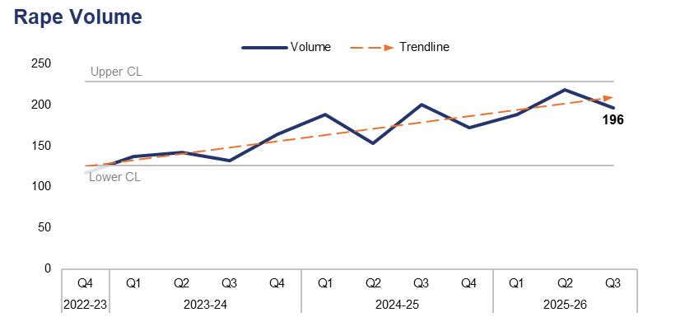
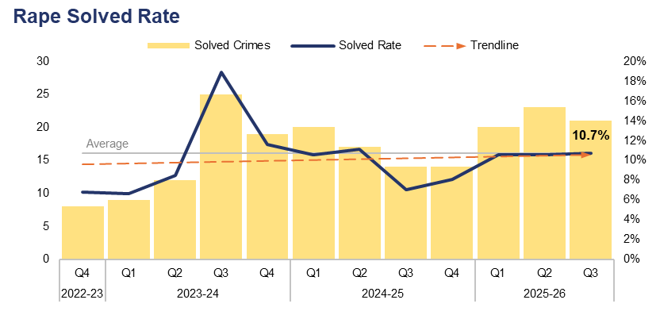
3. Rape
Financial Year | 21-22 | 22-23 | 23-24 | 24-25 |  | FYTD | 25-26 |  | Quarter | Q2 25-26 | Q3 24-25
Volume | 573 | 580 | 575 | 713 |  | Volume | 602 |  | % Change | -10.1% | -2.0%
Financial Year | 21-22 | 22-23 | 23-24 | 24-25 |  | FYTD | 25-26 |  | Quarter | Q2 25-26 | Q3 24-25
Solved Rate | 5.4% | 6.7% | 11.3% | 9.1% |  | Solved Rate | 10.6% |  | PP Change | 0.1 | 3.7
Operational Overview
During Q3 2025-26, 196 Rape offences were recorded. This represents a reduction of 10.1% (22 fewer offences) when compared to the quarter prior, and a less prominent reduction of 2.0% (four fewer offences) when compared to the same quarter during the previous financial year.
The solved rate for Q3 2025-26 stands at 10.7%, with 21 crimes solved. This is a slight increase of 0.1 percentage points when compared to the quarter prior, albeit with two fewer crimes solved. A more prominent increase of 3.7 percentage points can be observed when comparing Q3 2025-26 to the same quarter during the previous financial year, with seven additional crimes solved.
Whilst there is a recent upward trend in the reporting of Rape, analysis and operational oversight indicates that much of this increase is due to the reporting of non-recent crimes. This requires further examination.
There has been a consistent increase in Rape reports and investigative requirements nationally. Despite this, the force continues to improve outcomes. The force has invested in an uplift of staff in this area, and a further review is being undertaken to meet national requirements regarding rape investigation teams. This is in recognition of the increase in demand and need for additional resources, which is particularly important if investigation timeliness and quality are to be maintained or improved.

Slide 34
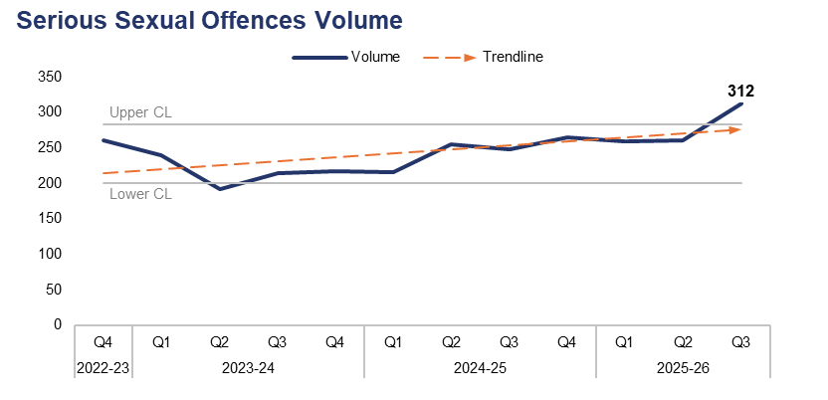
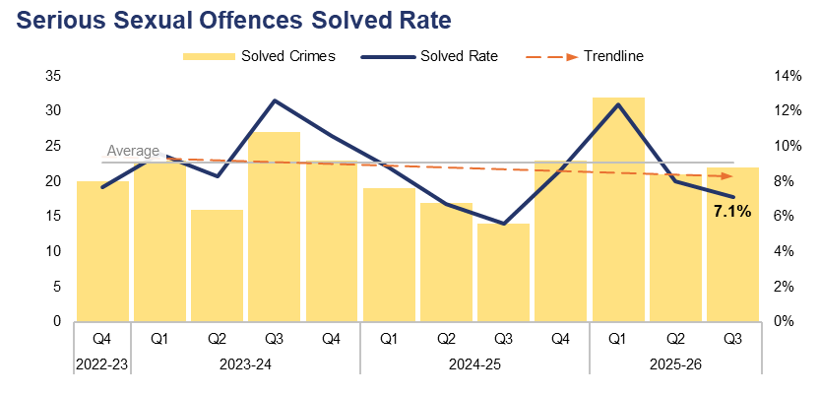
4. Serious Sexual Offences
Financial Year | 21-22 | 22-23 | 23-24 | 24-25 |  | FYTD | 25-26 |  | Quarter | Q2 25-26 | Q3 24-25
Volume | 923 | 999 | 862 | 984 |  | Volume | 832 |  | % Change | 19.5% | 25.8%
Financial Year | 21-22 | 22-23 | 23-24 | 24-25 |  | FYTD | 25-26 |  | Quarter | Q2 25-26 | Q3 24-25
Solved Rate | 6.3% | 6.4% | 10.3% | 7.4% |  | Solved Rate | 9.0% |  | PP Change | -0.9 | 1.5
Operational Overview
The volume of crimes classified as serious sexual offences exceeded the upper control limit during Q3 2025-26, with 312 offences recorded. This is the highest quarterly figure with the three-year timeframe, representing an increase of 19.5% (51 additional offences) when compared to the quarter prior, and a further increase of 25.8% (64 additional offences) when compared to the same quarter during the previous financial year.
The solved rate for Q3 2025-26 stands at 7.1%, with 22 crimes solved. This is a reduction of 0.9 percentage points when compared to the quarter prior, albeit with one additional crime solved. Conversely, an increase of 1.5 percentage points can be observed when comparing Q3 2025-26 to the same quarter during the previous financial year, with eight additional crimes solved.
The Rape and Serious Sexual Offences Scrutiny Panel reviews serious sexual offence investigations, identifying themes and areas of best practice within the force. In response to the Angiolini enquiry, Gwent Police has adopted a daily measure to identify non-contact sexual offending and ensure appropriate ownership based on risk. This is in recognition that non-contact offending can lead to escalating criminal sexual behaviours. The sustained focus on non-contact offending and increased training relating to stalking offences may have had an impact on the level of offences recorded during Q3 2025-26.
Rape offences have been excluded from this dataset.

Slide 35
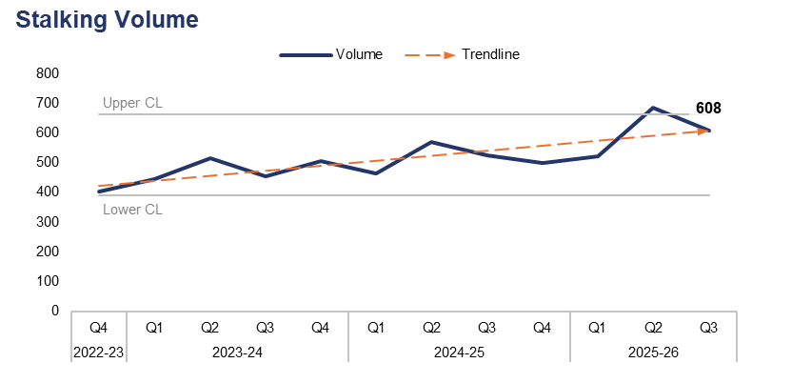
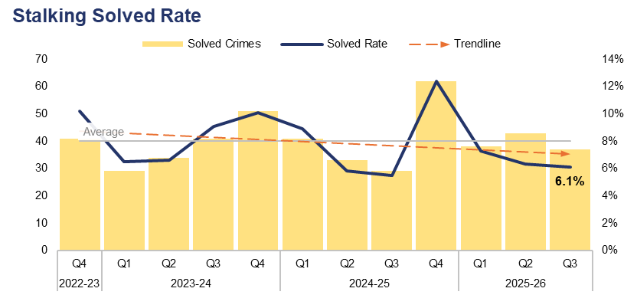
5. Stalking
Financial Year | 21-22 | 22-23 | 23-24 | 24-25 |  | FYTD | 25-26 |  | Quarter | Q2 25-26 | Q3 24-25
Volume | 1,440 | 1,551 | 1,920 | 2,058 |  | Volume | 1,813 |  | % Change | -11.1% | 15.6%
Financial Year | 21-22 | 22-23 | 23-24 | 24-25 |  | FYTD | 25-26 |  | Quarter | Q2 25-26 | Q3 24-25
Solved Rate | 7.6% | 8.3% | 8.1% | 8.0% |  | Solved Rate | 6.5% |  | PP Change | -0.2 | 0.6
Operational Overview
Overall, 608 offences classified as stalking were recorded during Q3 2025-26. This represents a reduction of 11.1% (76 fewer offences) when compared to the quarter prior, but an increase of 15.6% (82 additional offences) when compared to the same quarter during the previous financial year.
The solved rate for Q3 2025-26 stands at 6.1%, with 37 crimes solved. This is a reduction of 0.2 percentage points when compared to the quarter prior, with six fewer crimes solved. Conversely, an increase of 0.6 percentage points can be observed when comparing Q3 2025-26 to the same quarter during the previous financial year, with eight additional crimes solved.
Further training around stalking offences has been delivered and changes to the review processes for crime recording teams have been implemented. These measures have likely contributed to the increase in offence volume recorded during Q2 2025-26 and Q3 2025-26, as both officers and quality assurance processes are now better able to identify these crimes.
The force now recognises stalking and harassment as separate entities, and they are recorded as such. This recognises the gravity of both offences and the nuances of each with regards to investigation and prevention opportunities.

Slide 36
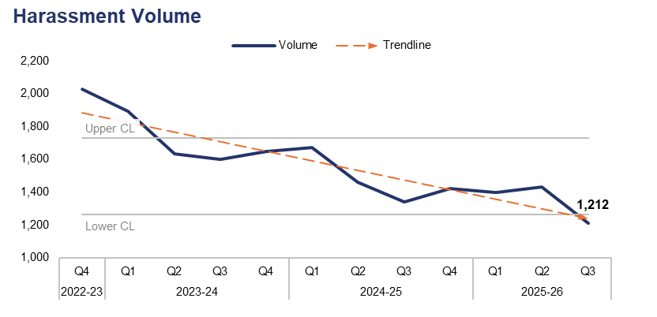
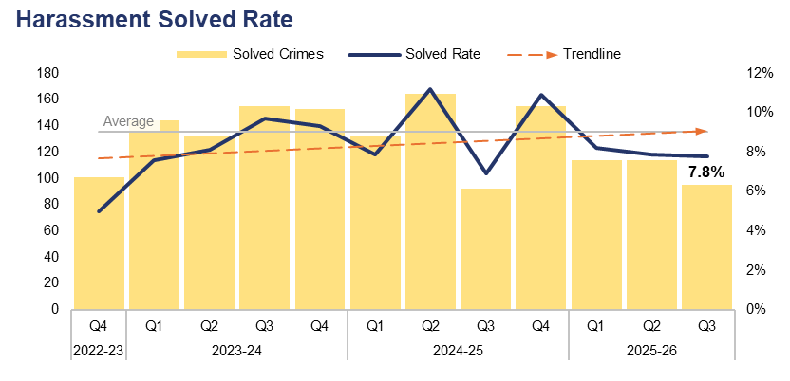
6. Harassment
Financial Year | 21-22 | 22-23 | 23-24 | 24-25 |  | FYTD | 25-26 |  | Quarter | Q2 25-26 | Q3 24-25
Volume | 6,513 | 7,500 | 6,774 | 5,900 |  | Volume | 4,043 |  | % Change | -15.5% | -9.7%
Financial Year | 21-22 | 22-23 | 23-24 | 24-25 |  | FYTD | 25-26 |  | Quarter | Q2 25-26 | Q3 24-25
Solved Rate | 7.8% | 5.5% | 8.6% | 9.2% |  | Solved Rate | 8.0% |  | PP Change | -0.1 | 0.9
Operational Overview
A total of 1,212 offences classified as harassment were recorded during Q3 2025-26. This is below the lower control limit, representing a reduction of 15.5% (222 fewer offences) when compared to the quarter prior, and a less prominent reduction of 9.7% (130 fewer offences) when compared to the same quarter during the previous financial year.
The solved rate for Q3 2025-26 stands at 7.8%, with 95 crimes solved. This is a slight reduction of 0.1 percentage points when compared to the quarter prior, with 19 fewer crimes solved. Conversely, an increase of 0.9 percentage points can be observed when comparing Q3 2025-26 to the same quarter during the previous financial year, with three additional crimes solved.
Work is ongoing to focus on 'golden hour' investigations in all areas, including harassment offences, in order to maximise evidence gathering opportunities.
The likely reason behind the decline observed during Q3 2025-26 is that offences which may have previously been recorded as harassment are now being correctly identified as stalking offences.

Slide 37
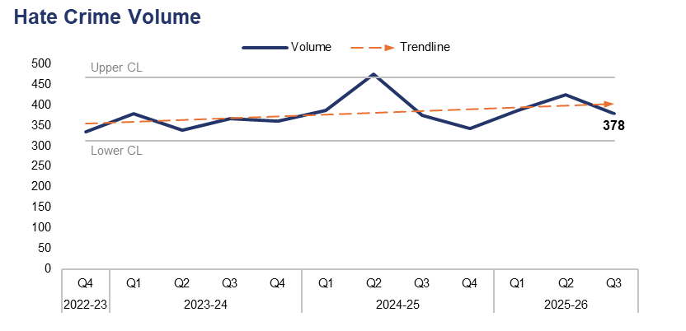

7. Hate Crime
Financial Year | 21-22 | 22-23 | 23-24 | 24-25 |  | FYTD | 25-26 |  | Quarter | Q2 25-26 | Q3 24-25
Volume | 1,418 | 1,445 | 1,443 | 1,577 |  | Volume | 1,189 |  | % Change | -11.1% | 1.1%
Financial Year | 21-22 | 22-23 | 23-24 | 24-25 |  | FYTD | 25-26 |  | Quarter | Q2 25-26 | Q3 24-25
Solved Rate | 11.6% | 9.3% | 14.8% | 14.4% |  | Solved Rate | 12.3% |  | PP Change | 0.9 | 2.8
Operational Overview
Overall, 378 offences which met the definition of a hate crime were recorded during Q3 2025-26. This represents a reduction of 11.1% (47 fewer offences) when compared to the quarter prior, but a slight increase of 1.1% (four additional offences) when compared to the same quarter during the previous financial year. Crimes assigned the racial hate strand were the most prevalent during Q3 2025-26, with 253 such offences recorded. Conversely, crimes assigned the transphobic hate strand were the least common, with 10 offences recorded.
The solved rate for Q3 2025-26 stands at 14.3%, with 54 crimes solved. This represents a slight increase of 0.9 percentage points when compared to the quarter prior, albeit with three fewer crimes solved. A further increase of 2.8 percentage points can be observed when comparing Q3 2025-26 to the same quarter during the previous financial year, with 11 additional crimes solved.
A single crime can be assigned multiple hate strands. The crime trend is based on recorded crimes, whilst the assessment of hate strands is based on the volume of each individual strand.

Slide 38


8. Child Criminal and Sexual Exploitation
Financial Year | 21-22 | 22-23 | 23-24 | 24-25 |  | FYTD | 25-26 |  | Quarter | Q2 25-26 | Q3 24-25
Volume | 1 | 20 | 21 | 42 |  | Volume | 23 |  | % Change | 85.7% | 30.0%
Financial Year | 21-22 | 22-23 | 23-24 | 24-25 |  | FYTD | 25-26 |  | Quarter | Q2 25-26 | Q3 24-25
Volume | 227 | 173 | 67 | 176 |  | Volume | 51 |  | % Change | 93.3% | -48.2%
Operational Overview
During Q3 2025-26, 13 offences were assigned a child criminal exploitation local qualifier. This represents an increase of 85.7% (six additional offences) when compared to the quarter prior, and a less prominent increase of 30.0% (three additional offences) when compared to the same quarter during the previous financial year.
A total of 29 offences were assigned a child sexual exploitation local qualifier during Q3 2025-26. This is an increase of 93.3% (14 additional offences) compared to the quarter prior, but a reduction of 48.2% (27 fewer offences) compared to the same quarter during the previous financial year. It has been identified that this qualifier may have been incorrectly applied in the past.
The force is working to review Equality, Diversity, and Inclusion, data recording, and the use of flags and qualifiers, given that these factors have a significant impact on our understanding of this area of risk. The force is engaged with the National Child Sexual Exploitation Taskforce (formerly Operation Hydrant) and the National Crime Agency, following the government response and the Cassey Audit Review, whilst they develop an approach for the review of non-recent child sexual exploitation investigations – notably group-based offending.
The force is also reviewing its own data and risk recognition in this area, with the data quality issue for this crime category forming part of the Chief Superintendent-led force data quality meeting. There is also governance and reporting on child sexual abuse and exploitation through the Regional Threat Group and Strategic Governance Group in order to provide a regional overview and understanding, as these patterns and issues are reflected nationally.
Use of the Child Criminal Exploitation local qualifier commenced during 2022, limiting the scope of the currently available dataset.

Slide 39

9. Missing Children
Financial Year | 21-22 | 22-23 | 23-24 | 24-25 |  | FYTD | 25-26 |  | Quarter | Q2 25-26 | Q3 24-25
Volume | 2,780 | 3,276 | 4,359 | 4,387 |  | Volume | 3,800 |  | % Change | -1.4% | 32.5%
Operational Overview
During Q3 2025-26, 1,312 missing person reports were created which pertained to a child. This represents a slight reduction of 1.4% (18 fewer reports) when compared to the quarter prior. Conversely, a significant increase of 32.5% (322 additional reports) can be observed when comparing Q3 2025-26 to the same quarter during the previous financial year.
The management of missing children has been greatly improved through a multi-agency response and weekly Missing Meetings. The force has equipped frontline staff with a greater understanding of risk through use of the Philomena Protocol. During 2024-25 there was a marked decline in missing children and missing episodes. However, a subsequent rise in reports pertaining to out-of-county children has resulted in additional instances being recorded, and has therefore increased police demand.
The Missing Children Team manage Missing Meetings to review all missing children and ensure that debriefs are completed. Trends regarding missing children are escalated via the Operational and Strategic Missing Meetings. Links between missing children and exploitation are mitigated through the Multi-Agency Child Exploitation Team. The missing child lead has worked with care homes to increase risk awareness and encourage earlier reporting, in order to mitigate risks.
A missing person report is created each time an individual is reported as missing. Several reports can be created for the same individual if they are reported as missing on multiple occasions.

Slide 40

10. Action Fraud
Financial Year | 21-22 | 22-23 | 23-24 | 24-25 |  | FYTD | 25-26 |  | Quarter | Q2 25-26 | Q3 24-25
Volume | 788 | 923 | 968 | 867 |  | Volume | 656 |  | % Change | -9.0% | 5.7%
Operational Overview
Overall, 222 action fraud occurrences were reported to Gwent Police via the National Fraud Intelligence Bureau during Q3 2025-26. This represents a reduction of 9.0% (22 fewer occurrences) when compared to the quarter prior, but an increase of 5.7% (12 additional occurrences) when compared to the same quarter during the previous financial year.
During Q3 2025-26, £73,031 of victim’s money was safeguarded by fraud investigations in Gwent. The total for the current FYTD stands at £313,871.

Slide 41

11. Cybercrime
Offences Most Commonly Classified as Cybercrime by Volume – Q3 2025-26
Offence Title | Volume | % of Total
Protection from Harassment Act Section 2 | 260 | 17.7%
Pursue course of conduct which amounts to stalking | 255 | 17.3%
Take/make indecent photographs/ pseudo-photographs of children | 120 | 8.2%
Putting people in fear of violence | 118 | 8.0%
Sending letters etc with intent to cause distress or anxiety | 90 | 6.1%
Quarter | Q2 24-25 | Q3 24-25 | Q4 24-25 | Q1 25-26 | Q2 25-26 | Q3 25-26 |  | Quarter | Q2 25-26 | Q3 24-25
Volume | 1,234 | 1,201 | 1,422 | 1,538 | 1,711 | 1,472 |  | % Change | -14.0% | 22.6%
Operational Overview
A total of 1,472 offences recorded during Q3 2025-26 were classified as cybercrime, as defined by the NDQIS reporting system. This represents a reduction of 14.0% (239 fewer offences) when compared to the quarter prior, but a significant increase of 22.6% (271 additional offences) when compared to the same quarter during the previous financial year.
During Q3 2025-26, three of the five offences which were most commonly classified as cybercrime can be defined as harassment offences, with a fourth defined as a stalking offence. Overall, crimes classified as either a harassment offence or a stalking offence accounted for 58.7% of all cybercrime recorded during the quarter, with a total of 864 offences reported. This is an increase of 0.7 percentage points when compared to the quarter prior (albeit with 129 fewer offences recorded).
.
Cybercrime reporting via the NDQIS system was first adopted by the force during June 2024, limiting the scope of the currently available dataset.

Slide 42
12. Protecting the Vulnerable – Emerging Issues
Operational Overview
The force participated in research in conjunction with the University of the West of England regarding the role of the Sex Worker Liaison Officer, and is looking to develop this to improve engagement with this hard-to-reach community. There is an intention to build on this further by developing a risk assessment tool for sex workers, to ensure a bespoke risk recognition approach to this high-harm area of vulnerability and VAWG.
COM and COM networks have been identified nationally and regionally as an emerging risk. In addition to regional meetings, the Regional Organised Crime Unit host the Regional Threat Delivery Group, in which this is discussed. Currently, scoping is taking place both regionally and in-force to understand the scale and nature of this type of offending, and to mitigate the associated risks. This is a collaborative approach between departments, and Safeguarding Board members have also been made aware of these emerging issues. Internal communications and training will be developed and disseminated to improve awareness and operational effectiveness.
Harmful Sexual Behaviour has been raised as an emerging issue by the Welsh Government and there will be requirements for a standardised multi-agency approach. Local Authorities are leading on this and ensuring that there is correlation between matters reported to social care and those reported to police. Additional training for officers has been identified and will be incorporated into existing structures.

Slide 43
Pillar Four – Putting Victims First
Investigation Timeliness
Victims and Repeat Victims
Victim Satisfaction
Putting Victims First – Emerging Issues

Slide 44

1. Investigation Timeliness
Financial Year | 21-22 | 22-23 | 23-24 | 24-25 |  | FYTD | 25-26 |  | Quarter | Q2 25-26 | Q3 24-25
Median Timeliness | 25 | 41 | 22 | 31 |  | Median Timeliness | 44 |  | % Change | 19.0% | 28.2%
Operational Overview
During Q3 2025-26, the median investigation length was 50 days. This is the highest quarterly figure within the three-year timeframe, representing an increase of 19.0% (eight additional days) when compared to the quarter prior, and a further increase of 28.2% (11 additional days) when compared to the same quarter during the previous financial year.
It is recognised that whilst investigation timeliness is key for victims, an investigation also has to be proportionate and effective. A balance must be struck between investigation quality and timeliness. This messaging forms part of the Quality of Investigation and Victim Care framework. To further support this messaging, victim inputs have been delivered at force training days and are provided to all new recruits. These focus on maintaining victim updates, updating victims at key stages, ensuring the victim’s right to receive specialist support is met, and providing a Victim Impact Statement.
Gwent Police are participating in the Domestic Abuse Charging Pilot, which is intended to improve investigation timeliness by allowing police to charge non-remand guilty anticipated plea domestic abuse cases. The earlier charging process is designed to enable immediate safeguarding measures, secure quicker access to protective orders, and potentially reduce victim attrition. This will support a more efficient investigative procedure and faster case progression within the justice system. In support of this, a new initiative between the police and Crown Prosecution Service (CPS) has introduced Real Time Case Conversations. This is initially being trialled for domestic abuse investigations and is intended to streamline the process of obtaining a charging decision for these cases.

Slide 45


2. Victims & Repeat Victims
Financial Year | 21-22 | 22-23 | 23-24 | 24-25 |  | FYTD | 25-26 |  | Quarter | Q2 25-26 | Q3 24-25
Volume | 30,547 | 32,037 | 32,840 | 33,066 |  | Volume | 25,506 |  | % Change | -4.0% | 0.6%
Financial Year | 21-22 | 22-23 | 23-24 | 24-25 |  |  |  |  | Quarter | Q2 25-26 | Q3 24-25
Volume | 7,476 | 8,260 | 7,267 | 7,212 |  |  |  |  | % Change | -0.4% | -3.1%
Operational Overview
Overall, 9,769 unique victims were linked to crimes recorded during Q3 2025-26. This represents a reduction of 4.0% (402 fewer victims) when compared to the quarter prior, but a slight increase of 0.6% (54 additional victims) when compared to the same quarter during the previous financial year.
During the 12 months to the end of Q3 2025-26, 7,032 victims were linked in this capacity to two or more separate offences, classifying them as repeat victims. This is a slight reduction of 0.4% (28 fewer repeat victims) when compared to the 12 months to the end of the quarter prior, and a further reduction of 3.1% (224 fewer repeat victims) when compared to the 12 months to the end of the same quarter during the previous financial year.
The ‘Victim Care’ guiding principle of the Quality of Investigations and Victim Care Change Programme aims to improve understanding and recording principles, in order to ensure that appropriate and tailored services are delivered to victims of crime.
The Gwent Police Victim Care Unit (VCU) continue to work collaboratively alongside Victim Support, a service commissioned by the OPCC to deliver ongoing assistance to victims. The VCU supports Daily Management Meeting processes, ensuring that victims of high threat/harm/risk investigations are identified much sooner and signposted to appropriate support.
For the purposes of this report, a repeat victim is defined as an individual who has been linked in this capacity to two or more separate offences within a 12-month period.

Slide 46
3. Victim Satisfaction
Victim Satisfaction Survey Data: Q3 2024-25 – Q3 2025-26
Survey Question | Percentage of Respondents Satisfied | Quarter-on-Quarter Difference |  | Number of Respondents Satisfied | Total Responses Received
How satisfied are you with the ease of initial contact with the Police? | 76.8% | - | à | 252 | 328
How satisfied are you with the response time to your contact? (e.g. how long it took for your call to be answered) | 77.7% | +1.5pp | á | 255 | 328
Overall, how satisfied are you with your experience of the first point of contact with the police? | 77.7% | +2.5pp | á | 255 | 328
If an officer attended, how satisfied are you with the time it took for them to arrive? | 83.2% | -2.2pp | â | 144 | 173
How satisfied are you with the actions taken by the attending officer/s? | 73.3% | -1.0pp | â | 132 | 180
Thinking about your overall experience, how satisfied are you with the treatment you have received from Gwent Police? | 65.0% | +0.7pp | á | 212 | 326
Overview
A total of 332 respondents have engaged with the victim satisfaction survey between Q3 2024-25 and Q3 2025-26 inclusive. Of those who replied to the given question, 83.2% of respondents were satisfied with the time it took for officers to attend, whereas only 65.0% of respondents were satisfied with the overall treatment they received from Gwent Police. When compared to the same period for the quarter prior (Q2 2024-25 – Q2 2025-26), the percentage of satisfied respondents has either increased or remained steady for the majority of the questions above.
Improving the trust and confidence of victims is a core part of how Gwent Police seeks to deliver its services. It is recognised that the initial satisfaction rates regarding contact and attendance are much higher than overall satisfaction rates following interaction with investigators. This will serve as a benchmark of performance for the Quality of Investigations and Victim Care Change Programme, and is an area of business that is likely to see improvements through the delivery of this programme. The victim satisfaction survey is currently under review, with the support of Victim Services and the OPCC. This review has identified a new question set and the opportunity to utilise the Citizens First project to amplify victim’s feedback.
All questions within the survey are optional, which may result in a disparity between the number of responses received for each question.

Slide 47
4. Putting Victims First – Emerging Issues
Operational Overview
The change programme seeks to implement improvements in how all investigators care for victims, seeking to embed meaningful and purposeful interactions with victims at every stage of the investigation. Work is progressing to fully understand operational practices and seek feedback from frontline practitioners. This not only puts victim care at the forefront of everything we do, but ensures that those who deliver the service continue to improve the trust and confidence of our communities by delivering a connected service that cares about getting it right and doing the right thing.
Governance arrangements in the force ensure that victim’s voices are at the forefront of the priorities of policy makers, investigators, and Victim Services. The Survivor Engagement Coordinator brings together the collective voices of a committed advisory group, acting as a stakeholder group who are willing to advise and challenge Gwent Police on the services it delivers. This group has recently met with the safeguarding minister to identify best practice in Gwent and highlight areas requiring improvement. This feedback has been recognised by the organisation, with a plan put in place to address the concerns from the Survivor Reference Group.
The Head of Victim Services has worked with other Welsh leads to deliver consistent Victims' Code of Practice reporting metrics, in order to create a common language and performance framework for all Welsh forces. The Head of Victim Services and an analyst are also engaged with the Ministry of Justice Analytical Working Group, a forum to provide insights to help develop the national framework for the Victims’ Code compliance metrics. Due to challenges at a national level, Gwent Police have been asked to hold off on making any wholesale system changes to collecting and reviewing this data for the time being.

Slide 48
Pillar Five – Reducing Reoffending
Offenders and Repeat Offenders
Young Offenders and First-Time Entrants
Children in Police Custody
Reducing Reoffending – Emerging Issues

Slide 49


1. Offenders & Repeat Offenders
Financial Year | 21-22 | 22-23 | 23-24 | 24-25 |  | FYTD | 25-26 |  | Quarter | Q2 25-26 | Q3 24-25
Volume | 19,424 | 20,030 | 20,547 | 20,828 |  | Volume | 15,859 |  | % Change | -8.9% | -5.8%
Financial Year | 21-22 | 22-23 | 23-24 | 24-25 |  |  |  |  | Quarter | Q2 25-26 | Q3 24-25
Volume | 6,408 | 6,998 | 7,463 | 7,051 |  |  |  |  | % Change | -1.6% | -3.5%
Operational Overview
Overall, 6,265 unique offenders were linked to crimes recorded during Q3 2025-26. This is the lowest quarterly figure within the three-year timeframe, representing a reduction of 8.9% (615 fewer offenders) when compared to the quarter prior, and a reduction of 5.8% (383 fewer offenders) when compared to the same quarter during the previous financial year.
During the 12 months to the end of Q3 2025-26, 6,777 offenders were linked in this capacity to two or more separate offences, classifying them as repeat offenders. This is again the lowest quarterly figure within the timeframe, representing a reduction of 1.6% (107 fewer repeat offenders) when compared to the 12 months to the end of the quarter prior, and a further reduction of 3.5% (248 fewer repeat offenders) when compared to the 12 months to the end of the same quarter during the previous financial year.
The organisation has recognised a need to standardise its identification of suspects, with a view to enhancing its understanding and drive towards timely intervention from law enforcement. This has been discussed within a gold group and is due to impact operationally during Q4 2025-26.
For the purposes of this report, a repeat offender is defined as an individual who has been linked in this capacity to two or more separate offences within a 12-month period. This does not necessarily mean that they have been charged with or found guilty of the offence in question.

Slide 50


2. Young Offenders and First-Time Entrants
Financial Year | 21-22 | 22-23 | 23-24 | 24-25 |  | FYTD | 25-26 |  | Quarter | Q2 25-26 | Q3 24-25
Volume | 3,232 | 3,548 | 3,697 | 3,625 |  | Volume | 2,578 |  | % Change | -0.7% | -13.5%
Financial Year | 21-22 | 22-23 | 23-24 | 24-25 |  | FYTD | 25-26 |  | Quarter | Q2 25-26 | Q3 24-25
Volume | 2,092 | 2,111 | 2,048 | 2,008 |  | Volume | 1,347 |  | % Change | 2.4% | -19.3%
Operational Overview
A total of 1,073 unique offenders under the age of 18 were linked to crimes recorded during Q3 2025-26. This is the lowest quarterly figure within the three-year timeframe, representing slight reduction of 0.7% (eight fewer young offenders) when compared to the quarter prior, and a further reduction of 13.5% (168 fewer young offenders) when compared to the same quarter during the previous financial year.
Of these young offenders, 434 (40.4% of the quarterly total) have been identified as first-time entrants into the criminal justice system within Gwent. This represents an increase of 2.4% (10 additional entrants) when compared to the quarter prior, but a significant reduction of 19.3% (104 fewer entrants) when compared to the same quarter during the previous financial year.
The force is striving to ensure that young offenders are seen as children and dealt with appropriately, with a focus on restorative processes to divert them from future offending and the criminal justice process. The force is leading an approach to standardising processes between the four Welsh forces and their Youth Justice Services, focusing on child-centric procedures and out of court disposals. Governance arrangements into the Wales Youth Justice Advisory Panel and the Criminal Justice Board provide accountability, supported by the Youth Justice Board. Force metrics regarding children, such as levels of offending and re-offending, are tracked by Superintendent-led performance meetings. These then report into the Operational Effectiveness Board.
The age of the offenders included in this dataset has been calculated based on the committed date of the offence they were linked to. This does not necessarily mean that they have been charged with or found guilty of the offence in question. The dataset used to identify first-time entrants is limited to offences committed within Gwent from 2018 onwards. Offences committed outside of Gwent or prior to 2018 are not included in this calculation.

Slide 51

3. Children in Police Custody
Financial Year | 21-22 | 22-23 | 23-24 | 24-25 |  | FYTD | 25-26 |  | Quarter | Q2 25-26 | Q3 24-25
Volume | 520 | 541 | 613 | 751 |  | Volume | 410 |  | % Change | -17.2% | -28.1%
Operational Overview
During Q3 2025-26, 120 custody records were created which had a juvenile subject. This represents a reduction of 17.2% (25 fewer custody records) when compared to the quarter prior, and a further reduction of 28.1% (47 fewer custody records) when compared to the same quarter during the previous financial year.
Where juvenile suspects are involved, greater focus has been placed on avoiding contact with custody processes and units in which the adverse experience is heightened. Voluntary attendance and available diversion outside of the criminal justice system ensures positive outcomes for both victims and the children who have offended.
Significant daily scrutiny is in place around children in custody, to ensure that any time spent in custody is necessary and proportionate to the offences being investigated. There is also now governance in place regarding the Children and Young Persons Strategy published by the National Police Chiefs Council. ‘Children as Offenders’ and ‘Children and Coercive Police Powers’ comprise two of the four strands of this strategy, ensuring that any issues in relation to diversion and reducing offending are properly managed. Children in police custody also features as a theme in the Local Criminal Justice Board, chaired by the OPCC.
The above figures are based on custody footfall, which is the number of custody records with an arrival time within the specified timeframe. As such, if a subject came into custody on multiple occasions, they will be counted upon each arrival.

Slide 52
4. Reducing Reoffending – Emerging Issues
Operational Overview
Legislative changes allowing for eligible offenders to be released after serving one third of their sentence represent an emerging issue for policing, specifically the Integrated Offender Management (IOM) team and probation services. This is currently being reviewed by statutory agencies in order to understand the impact and scale of the additional demand that could be placed on services. The independent sentencing review is likely to gain royal assent in February 2026. The IOM team are working towards a multi-agency plan to manage the incoming demand and are seeking to improve processes for identifying individuals who are suitable for removal from the cohort due to consistent positive qualifiers, as per the IOM doctrine.
The Reducing Reoffending Subgroup continues to meet and work towards a multi-agency plan for reducing reoffending. The group is focusing their efforts on three main crime categories: drugs importation and supply, violence, and theft. The group have met to agree a consistent definition of ‘reoffending’ and further break down the crime categories into specific crime types which are most prevalent within the cohort of individuals who reoffend. Their progress is being reported to the Local Criminal Justice Board.

