Slide 1
Strategy Performance Board
Quarter 1 2022/23

Slide 2
Keeping Neighbourhoods Safe
All Crime Trend
Arrest Rates
Repeat Crime Victims
Residential Burglary Trend
Neighbourhood Crime Trend
Public Order Offences Trend
Shoplifting Trend
ASB Trend
Roads Policing
Key commitments
• Reduce public order offences and anti-social
behaviour, and the number of people who
repeatedly carry out these acts
• Reduce acquisitive crime and repeat offenders
• Improve the safety of roads throughout Gwent
• Commission and invest in effective crime
prevention initiatives

Slide 3
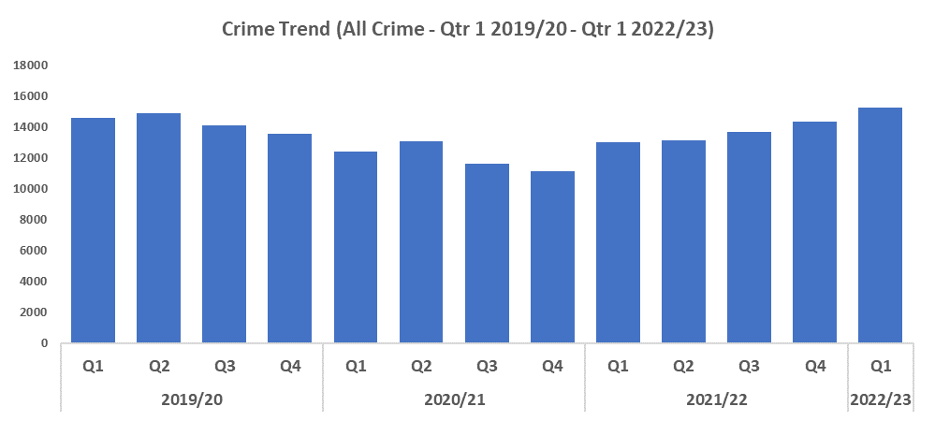
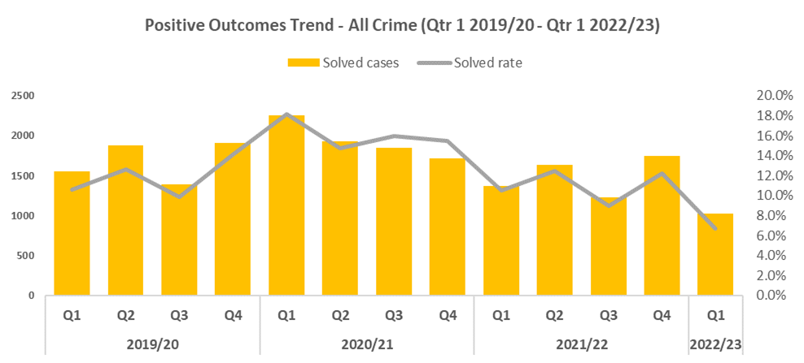


All Crime
Overview
Quarter 1 2022/23 has recorded a 4.6% increase in all crime (675 more offences to 15,270) when compared to quarter one 2019/20 (Pre-Covid year). Quarter 1 2022/23 has also seen an increase of 6.6% (945 additional crimes) when compared to Quarter 4 2021/22.
Although included throughout this presentation, direct comparisons with 2020/21 are not practical due to the exceptional circumstances of the Covid lockdown across the country.
Compared to last quarter, positive outcomes decreased by 5.5 percentage points (to 6.7%) and they were also 3.9 percentage points down when compared to Quarter 1 2019/20.
Last year was an exceptional year due to the Covid lockdown, meaning a reduced amount of crime coupled with a purge on a backlog of outcomes, led to an inflated level of positive outcomes. Therefore, it is more appropriate to compare 2022/23 to 2019/20 where positive outcomes are more in line, but this quarters figure still shows signs of deterioration.
It should be noted there is ongoing work to improve Gwent Police Crime Data Integrity which has influenced overall crime numbers within the past 12 months.

Slide 4
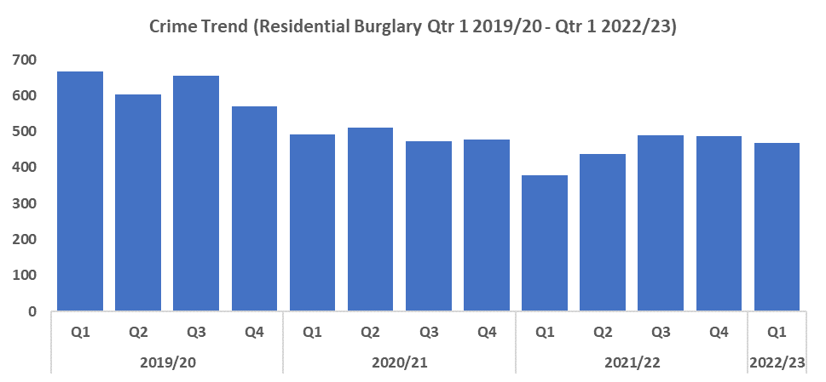
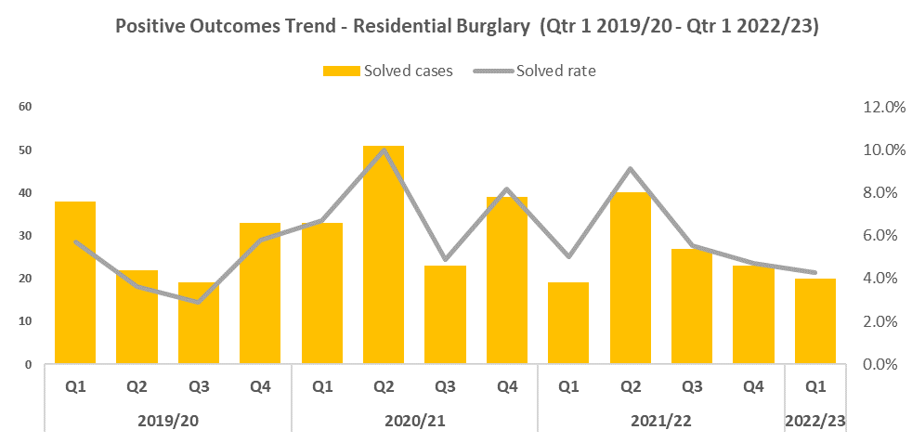


Residential Burglary
Overview
Between Quarter 4 last year and Quarter 1 2022/23 offences have decreased to 467 crimes, a reduction of 4.3%. This reduction aligns with the aims of the government’s Beating Crime Plan.
Quarter 1 of 2022/23 has also seen a larger reduction when compared with the same quarter during 2019/20 of 29.9%. This decline in Residential Burglary offences may indicate the efficacy of the deterrence strategies employed as part of the investment in the ‘We Don’t Buy Crime’ initiative.
Compared to the previous quarter, positive outcomes for Residential Burglary fell by 0.4 percentage points to 4.3%. The decline in solved rate observed here may be influenced by the rise in the overall crime trend this quarter, and it’s effect on officers’ workloads.
A new Residential Burglary operation has been established to compliment the reduction work of the ‘We Don’t Buy Crime’ team. Specifically concentrating on victim service, investigation quality, and timeliness, with a view to improve solved rates across all areas of the force. This will be achieved through a number of measures, including reviewing existing policies and procedures, as well as increased scrutiny around forensic evidence gathering and submissions to identify offenders at an early stage.
Following a report of a house burglary in Newport a suspect vehicle was identified and found to be displaying false number plates. The vehicle had been identified triggering ANPR cameras throughout the evening and was believed to have been involved in a make-off without payment from a garage. After an extensive search the vehicle was sighted travelling Southbound on the A470 towards the M4. Tactical Pursuit and Containment (TPaC) measures were used to bring it to a controlled halt. The driver was arrested for Burglary, Theft, Making-off without Payment, Dangerous Driving, No Insurance and Driving whilst under the Influence of Drugs.

Slide 5
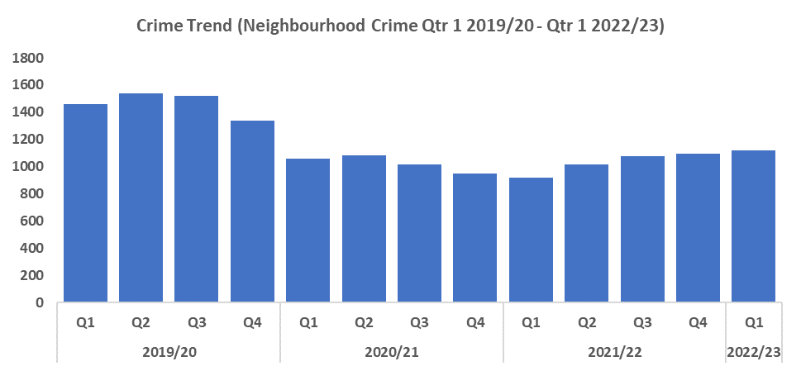
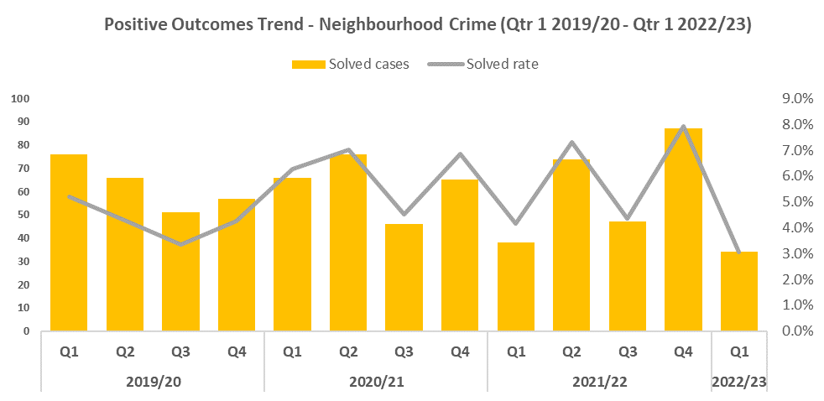


Neighbourhood Crime
Overview
Neighbourhood Crime has seen a slight increase when compared to the previous quarter of 1.8% (20 additional crimes). This runs counter to the goals of the government’s Beating Crime Plan, in which it is a focus area for reduction. Theft from the Person offences are now included in this category, in line with Home Office guidance. When comparing the current quarter to Quarter 1 of 2019/20 a reduction of 23.6% (344 fewer offences) can be observed.
Compared to the last quarter, positive outcomes for Neighbourhood Crime saw a significant decline of 4.9 percentage points to 3.0%. This continues the trend seen since Quarter 2 of 2020/21 of peaks and troughs in alternating quarters.
As a result of the rise, particularly in vehicle crime, the ‘We Don’t Buy Crime’ team have been tasked to increase scrutiny and focus within this area over the coming month in order to better identify high density locations and offenders.
Targeted support for victims of these crime types has continued over the last quarter, with 450 support and prevention packs provided, including tailored crime prevention advice, deterrent signage and forensic marking, as well as free marking events for bikes and motorbikes, with over 100 being marked in the last quarter.
Longer term preventative work is also being carried out surrounding neighbourhood crime types, involving analytical profiling, daily review of offences, membership of national working groups, constant liaison with neighbouring forces and agencies, problem solving plans and effective horizon scanning.

Slide 6
Neighbourhood Crime – continued
Overview
In May a report was received from a CCTV security monitoring company that persons were tampering with equipment at a building site located on the canal bank at Cross Keys. Whilst officers were enroute to the incident, further information was received that the suspects had left prior to local officers arriving. The police dog was deployed and found a track along the canal towpath. He followed the scent for approximately half a mile at which point they located two subjects who were detained by local officers.
Officers responded to a report from a member of the public that two people had attempted to enter and steal her vehicle. When they failed to start the car they took her handbag instead. The two suspects fled the scene through the Bettws Estate and the police dog was tasked with tracking the offenders through multiple streets. After a detailed search and track they located the male and female involved and pursued them. A challenge was given by the dog handler and the two suspects stopped. When other officers arrived on the scene the suspects were identified and subsequently arrested.
Torfaen has secured funding to launch Allotment Watch following a number of theft offences. So far 25 allotments out of 42 in the area have signed up. All these sites have had a police visit and been provided with smart water packs, signage and crime prevention advice. Also, 595 crime prevention packs have been given out to plot holders and plans have been made to roll this initiative out across the force in all suitable locations.

Slide 7
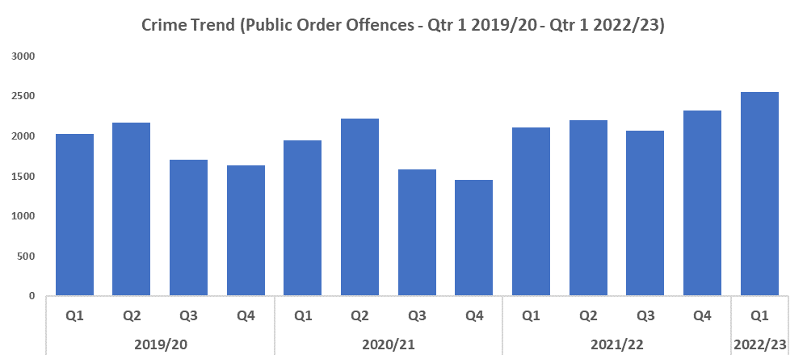
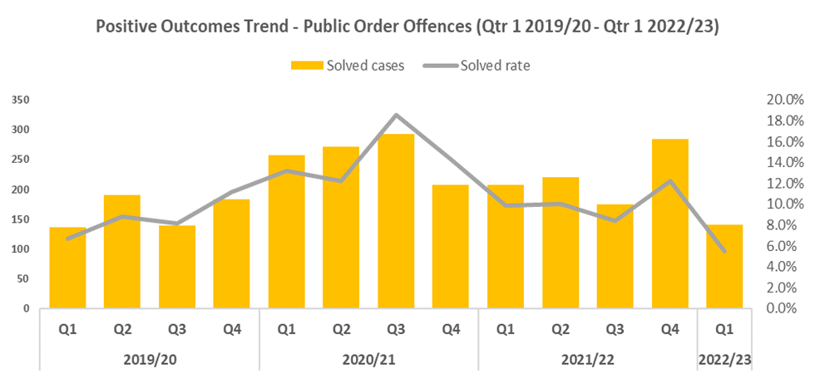


Public Order
Overview
Quarter 1 2022/23 has recorded the highest number of Public Order Offences in the timeframe, increasing by 26.1% compared with Quarter 1 2019/20.
The 5.5% of positive outcomes recorded in Quarter 1 2022/23 is thee lowest amount recorded within the timeframe despite a spike in positive outcomes during the previous quarter.
When compared to Quarter 1 2019/20 positive outcomes decreased by 1.2 percentage points. For the 12 months to April 2022, Gwent had a solved rate of 9.8%. Community resolutions also saw an increase in quarter four 2021/22 but have since seen a decrease during Quarter 1 2022/23.
Officers received a report that a male had barricaded himself into his attic after being sought by police for assaulting an officer and affray. There was a suggestion that the male had access to a rope in the attic which led to a real concern that he would attempt to hang himself. Officers had no way of observing the male so in order to allow officers to view the male a hole was cut in the ceiling. They were then able to observe him with a rope around his neck. An officer immediately climbed through the hatch to secure the male. After receiving initial first aid he regained consciousness and was conveyed to hospital where he made a full recovery, before being dealt with for the original offences

Slide 8
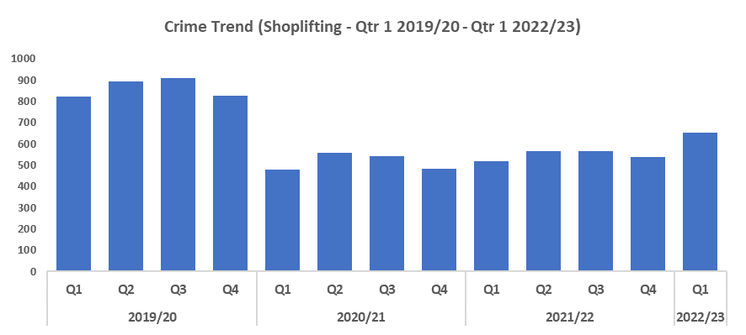
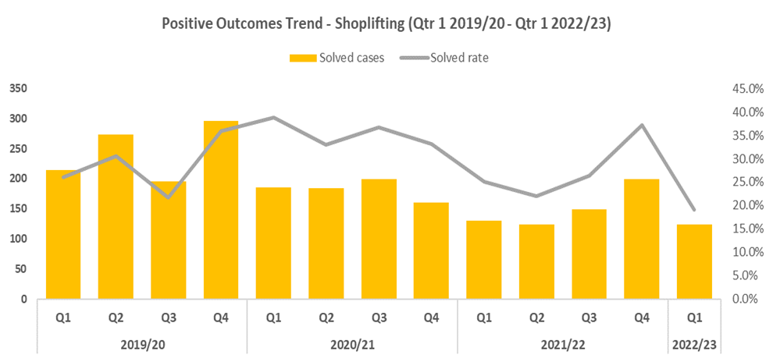

Shoplifting
Overview
Shoplifting saw an increase of 21.2% in Quarter 1 2022/23, when compared to the previous quarter. This is the highest number of Shoplifting offences recorded since Quarter 4 2019/20.
Quarter 1 2022/23 has recorded a 20.9% reduction (172 less offences) when compared to Quarter 1 2019/20 (Pre-COVID year).
Compared to the previous quarter positive outcomes for Shoplifting saw a large decrease of 18.2 percentage points.
Positive outcomes have decreased when comparing Quarter 1 for the past three financial years, and are 26% below the same quarter in 2019/20.

Slide 9
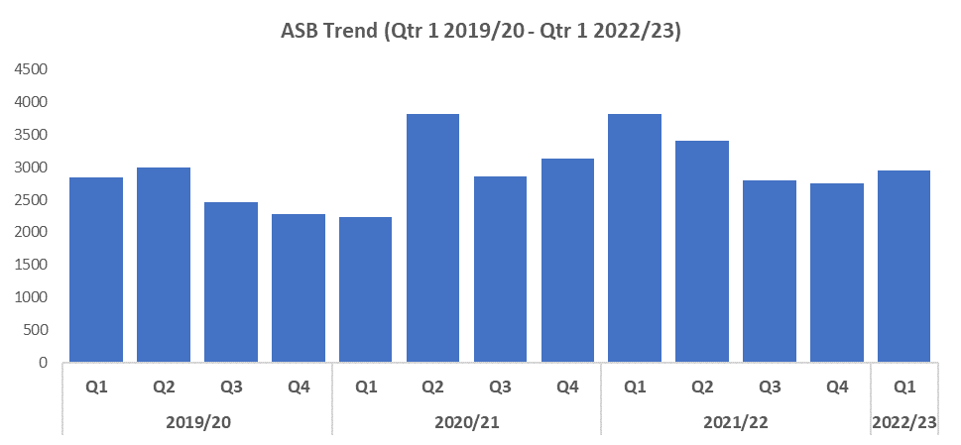

ASB
Overview
Levels of anti-social behaviour (ASB) in Gwent have increased when compared to the previous quarter, by 6.9%.
When compared to Quarter 1 of 2019/20, ASB rose by 4.0%.
The rise in ASB levels observed during the most recent quarter is not unexpected, as the first two quarters of a given financial year generally see higher levels of ASB than the latter two, perhaps owing in part to better weather conditions. This trend was only disrupted during 2020/21, likely due to the impact of Covid-19.
Due to the recent increases in incident levels, a plan is to be put in place to help address this rise. This will include resource allocation to identified hotspot areas to establish what the issues are, and then target these issues through the utilisation of the recently acquired Safer Streets funding.
A sharp increase in ASB and damage offences caused by young people was also seen within Blackwood, causing significant concern to the local community and interest from local elected members. In response to this an effective POP plan was implemented with a full partnership, engagement and comms structure. A robust enforcement and reassurance plan utilising tasking budgets was also created making effective use of dispersal powers and a new ‘Townsafe’ initiative.
Officers received a tasking request from the East LPA in relation to reports of anti-social ‘racers’ at the Severn Bridge Industrial Estate in Chepstow. Five vehicles attended, located a gathering of vehicles and issued a number of tickets for vehicle modification and excess speed offences. One vehicle was seized for having no tax and a driver was arrested for drug driving. Officers also pursued a suspected drug dealer seen leaving the site who was then located and arrested. His vehicle was seized and he has been prosecuted for drug drive and other offences.

Slide 10
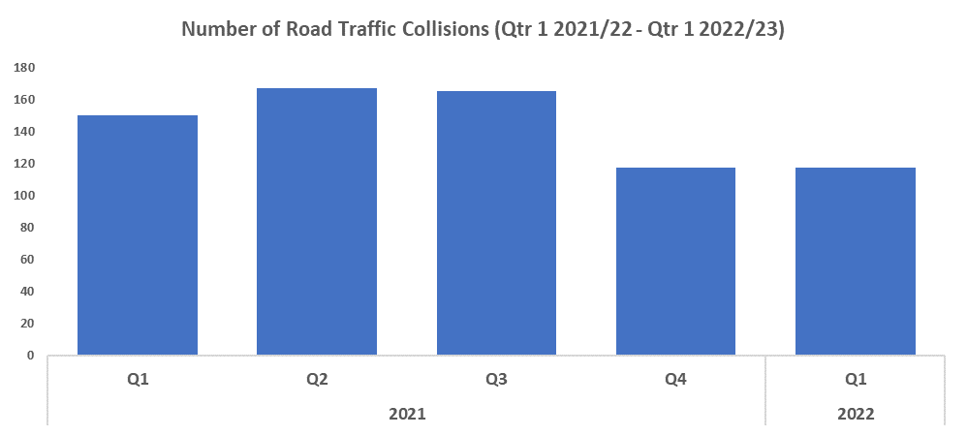

Roads Policing
Overview
During Quarter 1 2022/23, 117 Road Traffic Collisions (RTCs) were reported via RTC booklets. This remains consistent when compared to Quarter 4 2021/22, which also saw 117 RTCs reported.
A total of 317 persons were reported for one of the ‘Fatal Five’* factors during Quarter 1 2022/23, 82 fewer than during Quarter 4 2021/22. The most commonly reported factor during both quarters was drink/drug driving, with 154 instances reported during Quarter 1 2022/23 (48.6%), and 203 instances reported during Quarter 4 2021/22 (50.9%).
*’The Fatal Five’ refer to the five main causes of serious injury and death in RTCs. They are: careless driving, drink/drug driving, not wearing a seatbelt, using a mobile phone, and excessive speed.
The Operational Support Department has developed and circulated a new Roads Policing Strategy (2022-25) for the Force that focuses on the PCCs Priorities and their links to Roads Policing, and is consistent with the NPCC National Roads Policing Strategy. The Force’s strategic objectives for Roads Policing are set out under the headings: Casualty Reduction; Disrupting Criminality on the Road Network and Improving our Service to those Involved in Road Traffic Collisions.
The Force has investigated 10 fatalities on the roads of Gwent during the current reporting period. Each of these enquiries require the appointment of an Senior Investigating Officer (SIO) and specialist officers. Gwent Police continues to improve and streamline its investigation processes with the continued professionalisation of the Serious Collision Investigation Unit (SCIU), who work closely with RPSO officers and the Coroners office in each case.
The Force received a number of complaints regarding unsafe driving and excess speed on the A4048 between Blackwood and Tredegar. These complaints originated from local Councillors, the Neighbourhood Policing Team and the local MP, as well as directly from members of the public. In response the GoSafe Camera Vans were deployed in line with the problem profile to ‘Nightowl’ (after dark) and ‘Earlybird’ (morning) operations in the key locations. As a result of this targeted enforcement 124 speeding offences were identified and processed. Positive feedback was received from the local communities, NPT and Councillors and speed complaints for that location significantly reduced.

Slide 11
Roads Policing - continued
Together with partner agencies officers carried out vehicle stop checks over three days in May at the Coldra, Cwmbran Stadium and Abergavenny. In total 47 Traffic Offence Reports were issued for a variety of offences including mobile phone use whilst driving, insecure loads on vehicles, defective tyres, failure to wear seatbelts and incorrect number plates. Forty five vehicles were immediately taken off the road for being too unsafe and a further 27 were given delayed prohibitions which meant that they needed to have defects fixed within a few days. A further five vehicles were seized for no insurance or licence, and two were seized for having no tax.
In July RPSO officers conducted Op Utah at The Coldra in Newport. These regular operations involve Roads Policing officers working in partnership with the Local Authority, Trading Standards, Customs & Excise and Road Casualty Reduction to target unsafe vehicles and dangerous driving habits in order to promote road safety. On the day of the operation 48 vehicles were identified as potentially being used in an unsafe manner on the motorway and directed to the examination site. A range of offences were identified including unsafe loads, excess weight, failure to have a HGV operator licence, failure to comply with driving hours regulations, no insurance, no driving licence, number plate offences and driving whilst disqualified.

Slide 12
  Combat Serious Crime
Combat Serious Crime
Key commitments
• Reduce the number of repeat victims of child
criminal and sexual exploitation
• Increase disruption of serious organised crime,
and reinvest assets seized back into communities
• Improve the overall criminal justice response
to violence against women, domestic abuse and
sexual violence
• Commission and invest in services that work
with perpetrators of serious crime to prevent
and reduce re-offending
Violence with Injury Trend
VAWG Domestic and Non-Domestic Priority Offences
VAWG Repeat Victims and Offenders
Drugs Supply
OCG

Slide 13
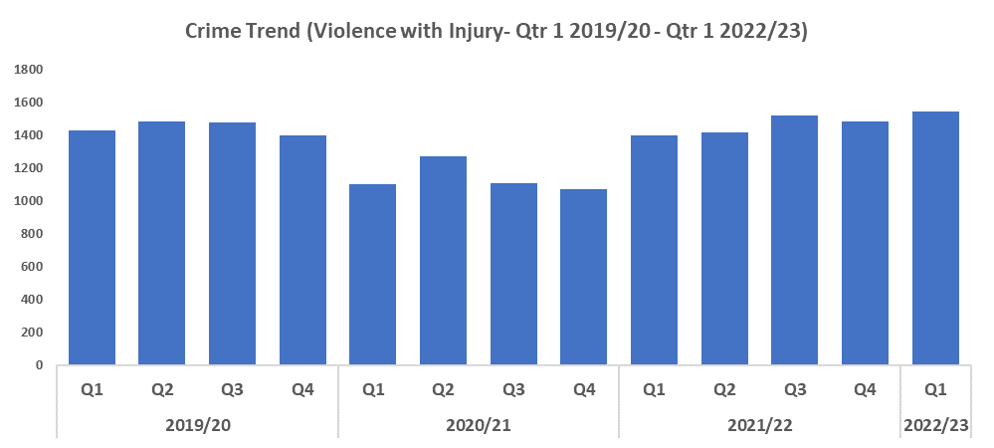
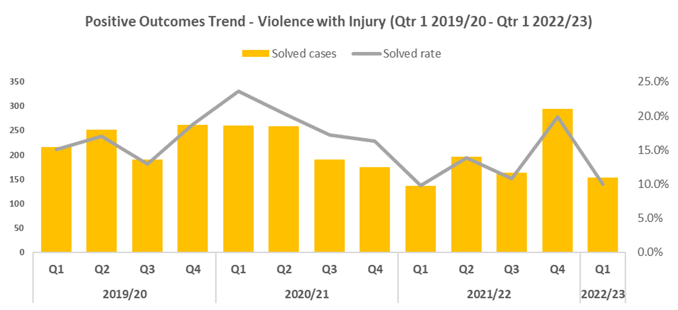


Violence with Injury
Overview
Violence with Injury offences have seen an upward trend from Quarter 4 2020/21, with numbers having increased this quarter to 1,546.
Quarter 1 2022/23 saw an 8.1% increase when compared to Quarter 1 2019/20 (Pre-Covid year).
This rise in Quarter 1 is mainly attributed to a rise in Grievous Bodily Harm with Intent, with Quarter 1 2022/23 being 26.6% higher than Quarter 1 2019/20.
Compared to the previous quarter positive outcomes for Violence with Injury have seen a substantial reduction of 9.9 percentage points to 10.0%. They are also 5.1 percentage points below the same quarter in 2019/20.
The force has developed a serious violent crime strategy delivery plan which is aimed at better understanding serious violence within a night time economy, knife related violence, robbery, drug related gang violence, and acid/corrosive substance attacks. A force serious violent crime meeting has been established to oversee the implementation of the serious violent crime delivery plan.

Slide 14
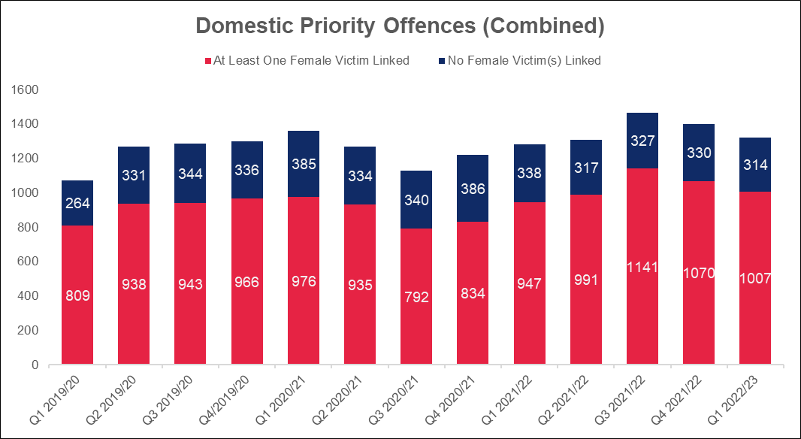
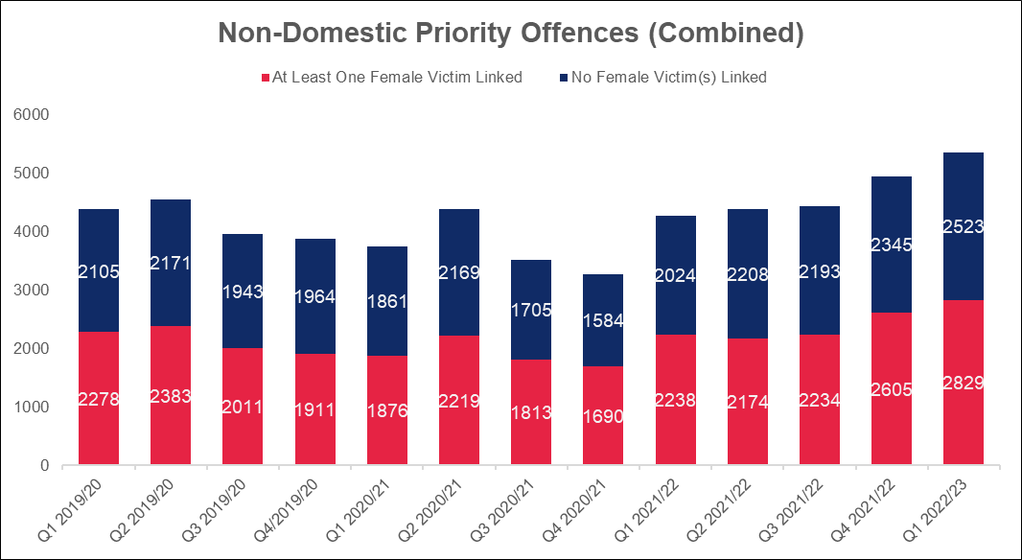
VAWG Domestic and Non-Domestic Priority Offences
Domestic Priority Offences
The adjacent chart shows the number of combined VAWG priority offences~ with a domestic abuse qualifier and the number of crimes that have at least one female victim linked.
Compared with last quarter there were 63 fewer Domestic Priority Offences with at least one female victim linked, which represents a 5.9% decrease.
In Quarter 1 2019/20, 75.4% (n=809) of these crimes had at least one female victim.
In Quarter 1 2022/23, 76.2% (n=1007) of these crimes had at least one female victim.
The biggest contributor to Domestic Priority Offences is Stalking and Harassment which accounts for over half of the offences (57.4%) in Quarter 1 2022/23.
Non-Domestic Priority Offences
The chart below shows the number of combined VAWG priority offences+ with no domestic abuse qualifier and the number of crimes that have at least one female victim linked.
Compared with last quarter an increase of 224 Non-Domestic Priority Offences with at least one female victim linked was observed, which represents an 8.6% deterioration.
In Quarter 1 2019/20, 52.0% (n=2278) of these crimes had at least one female victim.
In Quarter 1 2022/23, 52.9% (n=2829) of these crimes had at least one female victim.
The biggest contributors to Non-Domestic Priority Offences are Stalking and Harassment, and Public Fear, Alarm and Distress which between them accounted for 68.9% during Quarter 1 2022/23.
~Domestic Priority Areas Combined covers Homicide, Violence with Injury, Stalking and Harassment, Public Fear , Alarm or Distress, Rape, Other Sexual Offences, and Modern Slavery.
+Non-Domestic Priority Areas Combined covers Homicide, Violence with Injury, Stalking and Harassment, Public Fear , Alarm or Distress, Rape, Other Sexual Offences, and Modern Slavery and Exploitation of Prostitution.
Notes:
Violence Against Women and Girls
Sections are based on the scope provided by the NPCC Violence Against Women and Girls (VAWG) Taskforce
Next slide - Methodology

Slide 15
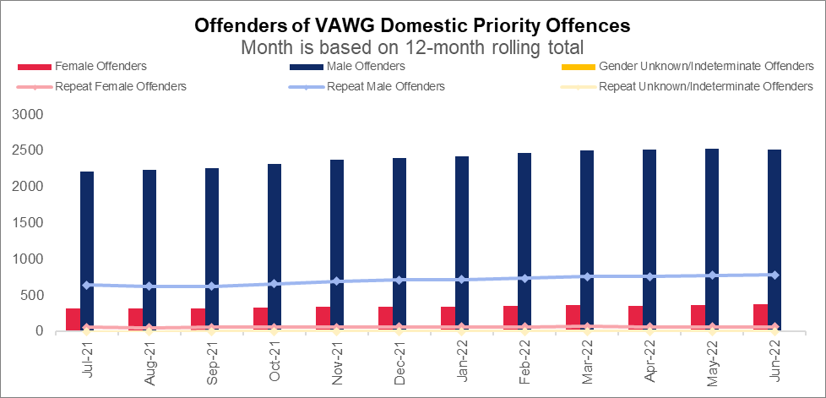
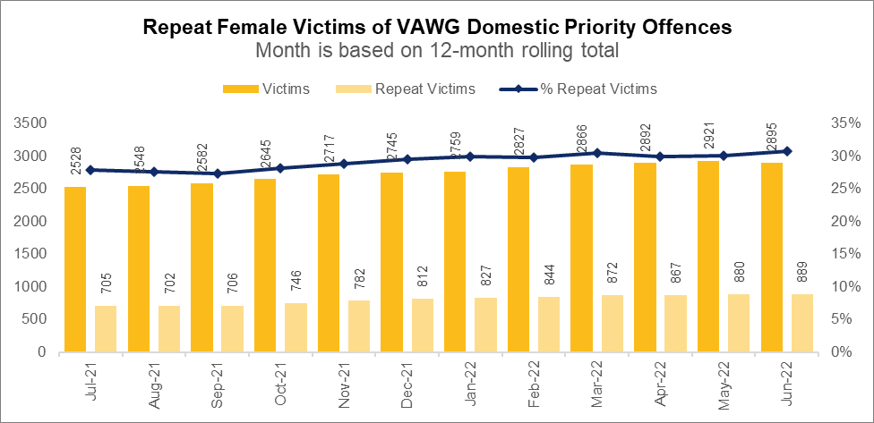
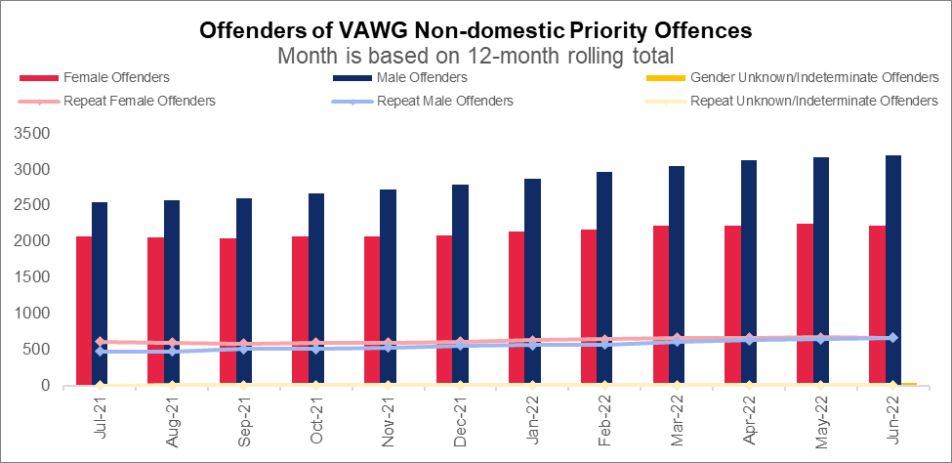
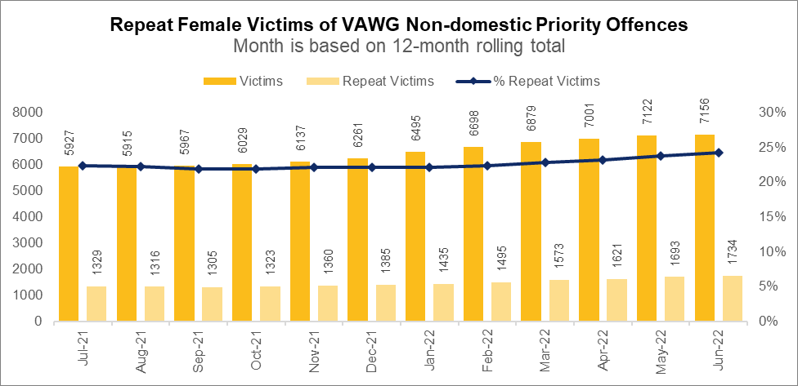
VAWG Repeat Victims and Offenders
Repeat Victims and Offenders Domestic Priority Offences
Repeat Victims
889 females have been a victim of more than one VAWG Domestic priority offence~ in the last 12 months. 17 women and girls have been the victim in more than five separate offences.
Repeat Offenders
In the 12 months to June 2022, there are 375 female offenders of domestic crimes~ against females, 17.1% (n=64) of which committed more than one offence in the last year.
There were 2,508 male offenders of domestic crimes~ against females, 31.1% (n=781) of which are repeats. 19 males were linked as the offender in more than five VAWG offences~ in the last year.
Repeat Victims and Offenders Non-Domestic Priority Offences
Repeat Victims
1,734 females have been a victim of more than one VAWG Non-Domestic priority offence+ in the last 12 months. 80 women and girls have been the victim in more than five separate offences.
Repeat Offenders
In the 12 months to June 2022, there are 2,223 female offenders of non-domestic crimes+ against females, 29.9% (n=665) of which committed more than one offence in the last year.
There were 3,199 male offenders of non-domestic crimes+ against females, 20.7% (n=661) of which are repeats. 22 males were linked as the offender in more than five VAWG offences+ in the last year.
Please note all charts do not include crimes without a linked offender.
~Domestic Priority Areas Combined covers Homicide, Violence with Injury, Stalking and Harassment, Public Fear , Alarm or Distress, Rape, Other Sexual Offences, and Modern Slavery.
+Non-Domestic Priority Areas Combined covers Homicide, Violence with Injury, Stalking and Harassment, Public Fear , Alarm or Distress, Rape, Other Sexual Offences, and Modern Slavery and Exploitation of Prostitution.
Notes:
Violence Against Women and Girls
Sections are based on the scope provided by the NPCC Violence Against Women and Girls (VAWG) Taskforce
Next slide - Methodology

Slide 16
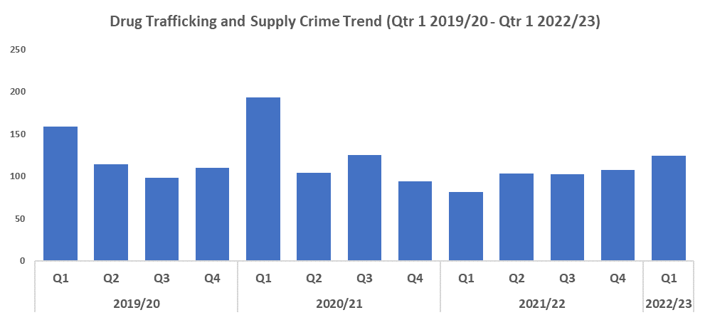

Drug Supply & Organised Crime
Overview
Quarter 1 2022/23 has recorded a 22.0% decrease in Drug Trafficking and Supply offences (35 fewer offences to 124) when compared to Quarter 1 2019/20 (Pre-Covid year). However, Quarter 1 2022/23 has seen an increase of 53.1% (30 additional crimes) when compared to Quarter 4 2021/22.
1,537 Drug Supply and Dealing intelligence logs were submitted during Quarter 1 2022/23. This is an increase of 106 logs when compared to Quarter 4 of 2021/22, which saw 1,431 logs submitted, and a decrease of 179 logs when compared to Quarter 1 of 2019/20 (Pre-Covid year), during which 1,716 logs were submitted.
Over the last quarter Gwent’s Organised Crime Unit has been involved in a number of covert operations.
Operation Beacon has been the primary focus of the team. This involved an organised crime group supplying wholesale quantities of cocaine and cannabis throughout the South West region together with an associated money laundering operation. Enforcement took place at the end of May and involved vehicle stops, search warrants and arrests at a number of addresses across the Force. The key suspects have been charged and remanded and over £200,000 worth of assets has been seized in the form of Rolex watches, designer clothing, vehicles and bank account freezing orders. Substantial custodial sentences are anticipated.
The principal suspect involved in Operation Draco has pleaded guilty to conspiracy to supplying multi kilos of cocaine during which he used encrypted devices to orchestrate the complex criminal operation. A sentence of over 10 years is anticipated.
Work has continued with national agencies such as OPAL and NavCIS regarding the identification of upcoming trends and any Organised Crime Groups (OCGs) who may be operating in relation to these. A recent example related to large scale waste oil thefts and the identification of a Bulgarian OCG working out of London who were arrested for offences within Gwent.
During the last quarter confiscation orders have been issued to two individuals, one for £31,197 and the second for £1,032. Six individuals have also received custodial sentences totalling 23 years for offences including Class A Drug Supply, Robbery and burglary.

Slide 17
Drug Supply & Organised Crime - continued
In line with the 10-year drug plan ‘From harm to hope’ a review of drug investigations within Gwent has been carried out. It has been identified that there is a need for a drugs focus desk within Gwent to improve effectiveness and efficiency of drug supply investigations. A drugs focus desk will reduce the amount of people being released under investigation and bail for drug related offences, improve the knowledge and skills of inexperienced investigators and supervisors and should decrease drug related violence. The Drug Focus Desk is in the process of being implemented with support from JSIU and CPS.

Slide 18
Financial Investigation Unit (FIU)
Overview
During the last quarter the Gwent FIU processed 31 cash detentions totalling £428,602 and finalised 8 forfeitures totalling £184,060. They also had a further 5 notices of forfeitures without a Court order amounting to £89,638 that are currently progressing through the various forfeiture proceedings (such as the objection / appeals process).
The Asset Recovery Incentivisation Scheme (ARIS) payment (i.e. money paid back to the force following the conclusion of Proceeds Of Crime Application investigations) for the 2021/22 financial year was £510,057, compared to £123,305 for 2020/21. This meant Gwent were the highest ARIS paid Welsh force in 2021/22:
The teams Financial Investigators are currently supporting 27 OCG’s across the force.
From a fraud outcome perspective, Gwent remains in the top 5 across the country with a judicial outcome rate of 8% compared to the national average of 4.1%.
The Fraud Triage team continues to scrutinise all referrals/logs coming into the force and then provide suggested investigation plans. The fraud DC’s continue to review frauds that aren’t seemingly going anywhere and offer their expertise and help with interviews.
One particular fraud investigation undertaken by the team was a report made involving the finance manager of an engineering company within the Torfaen area who had been transferring funds from the company bank account to her own. She was subsequently arrested by the FIU in April and has since been charged with fraud by abuse of position to the sum of over £1.3m.

Slide 19
Support Victims and Protect the Vulnerable
Key commitments
• Improve victim services and ensure that the
needs of victims are identified and responded to
appropriately through Connect Gwent and the
Victim Care Unit
• Further improve our work with partners to
protect those most vulnerable
• Increase the timeliness of police investigation
updates provided to victims
• Commission and invest in specialist services to
support victims throughout the criminal justice
process
Hate Crime Trend
Rape Crime Trend
Domestic Related Crime Trend
Domestic Abuse Repeat Victims
Domestic Abuse Repeat Offenders
Modern Day Slavery and Human Trafficking Trend
Investigation Timeliness
Cyber Fraud
Victim Support
Preventative Support Initiatives

Slide 20
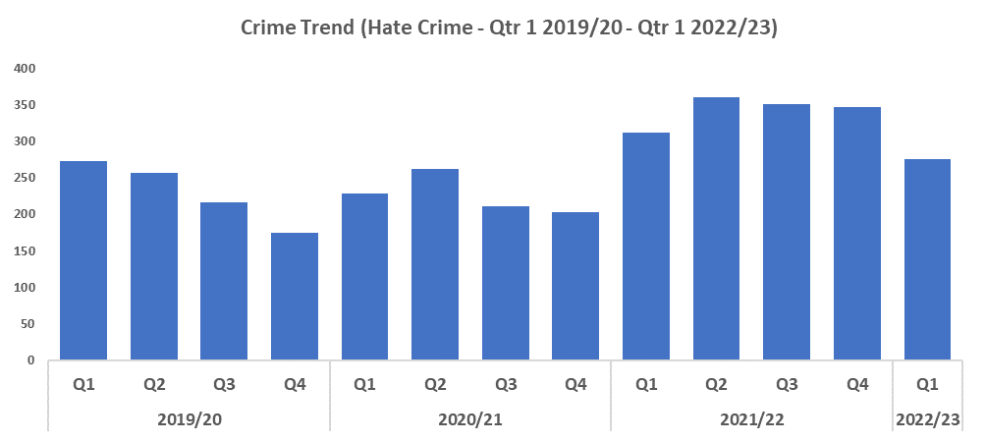
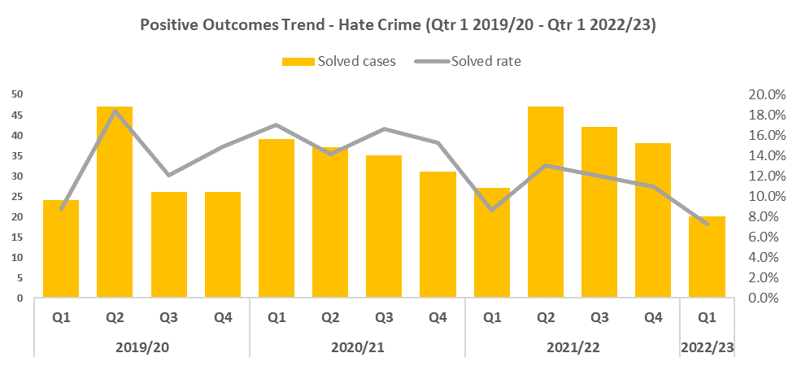


Hate Crime
Overview
Quarter 1 of 2022/23 saw a reduction in offences when compared to the previous quarter, down 20.5%. However, when compared to Quarter 1 of 2019/20, hate crime increased by 1.1%.
After a notable increase last quarter in homophobic hate crime to 80 offences, levels fell to 52 in the latest quarter, the lowest seen since Quarter 4 2020/21. Racial hate crime also continued on a downward trend since Quarter 2 2021/22 to 154. Transphobic hate crime peaked in Quarter 3 and 4 of 2021/22, however dropped this quarter to 13 offences.
Positive outcomes fell during this quarter when compared to the previous quarter by 3.8 percentage points. This quarter saw the lowest solved rate within in the timeframe. Figures were also 1.6 percentage points below the same quarter in 2019/20.

Slide 21
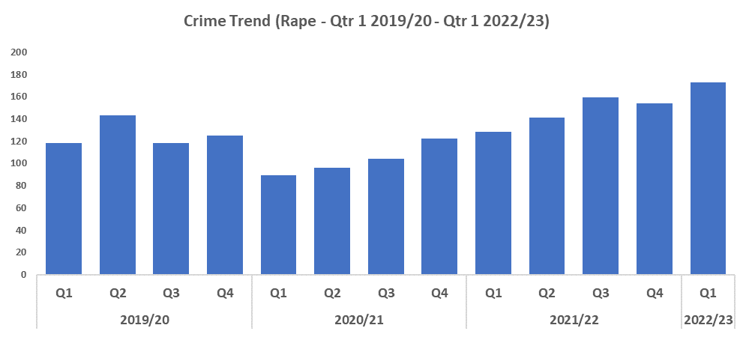
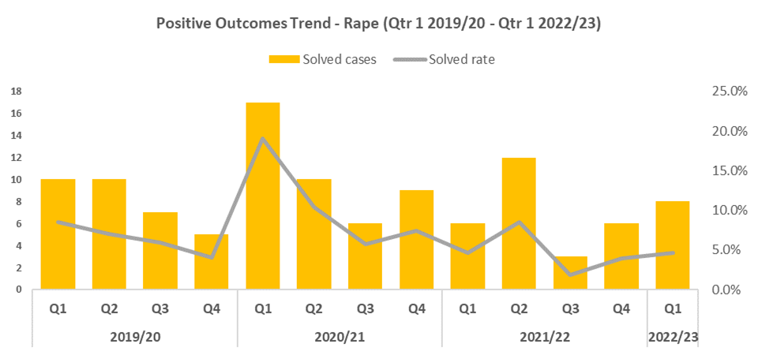


Rape Crime
Overview
The reporting of Rape offences has seen an upward trend since the start of 2020/21. This increase is in line with the government’s Beating Crime Plan, and consistent with the local priority to actively increase reporting in this historically under reported offence category. Compared to Quarter 1 of 2019/20, Rape Offences increased by 46.6% (n=55).
Rape positive outcomes increased by 0.7 percentage points to 4.6% compared to the previous quarter. However, when compared to Quarter 1 2019/20 there was a 3.9 percentage point decrease.
An early intervention initiative has been undertaken by Crime and Disorder Reduction Officers throughout the force aimed at engaging with school children concerning ‘what are inappropriate relationships?’ and how to report any inappropriate behaviour at an early stage.
A response plan is also currently being formulated following a successful application to Operation Soteria. As an early adopter Gwent Police will aim to improve victim engagement, identification of repeat and serial offenders and overall investigation quality.

Slide 22
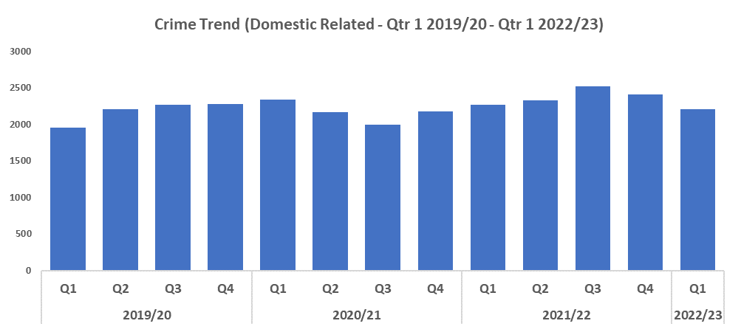
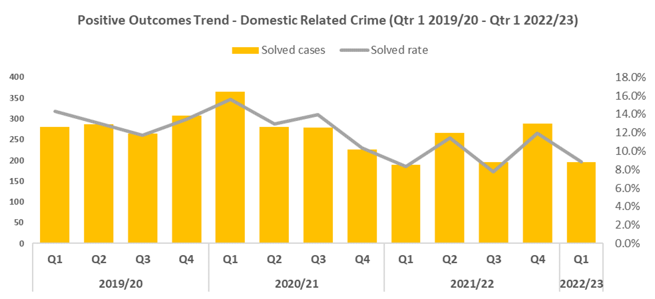


Domestic Related Crime
Overview
Quarter 1 of 2022/23 recorded a reduction in offences when compared to the previous quarter, down by 8.5%. This quarter recorded the lowest number of crimes since Quarter 4 2020/21.
Compared to Quarter 1 of 2019/20, domestic related offences increased by 12.9%.
Violence with Injury, Violence without Injury, Public Order Offences and Criminal Damage & Arson are the main crime categories reported under domestic abuse. All of these crime groups saw a reduction when compared to the previous quarter, suggesting an overall reduction in offences and not just within a particular crime category.
Positive outcomes for domestic related crime have decreased by 3.1 percentage points, to 8.8%, when compared to the previous quarter. When compared to quarter one 2019/20, positive outcomes fell by 5.5 percentage points.

Slide 23
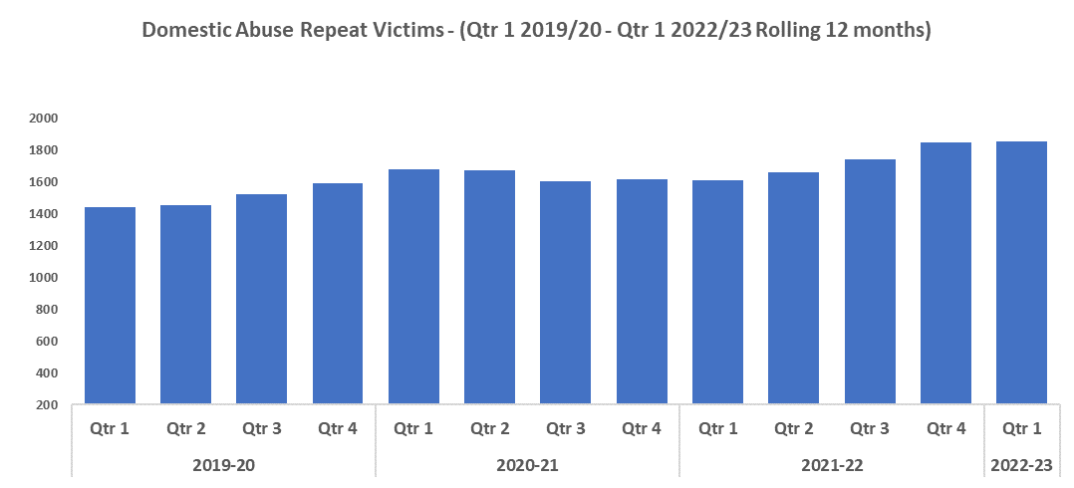
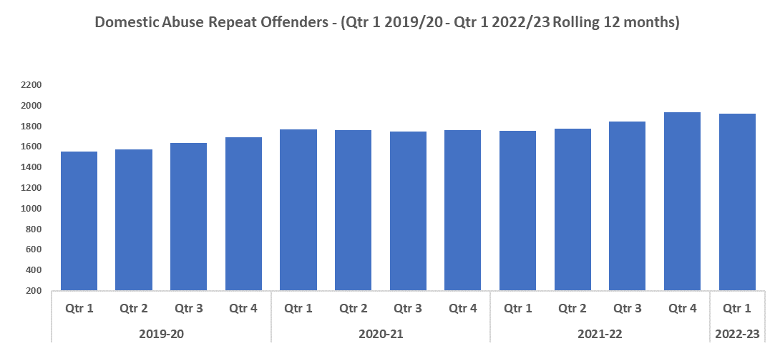


Domestic Abuse Repeat Victims/Offenders
Repeat Victims Overview
The amount of repeat domestic crime victims (based on rolling 12 months) has continued to increase when compared to previous quarters, with this quarter reporting the highest level in the timeframe with 1,851 repeat victims.
Compared to last quarter, there were six more repeat victims, a small increase of 0.3%.
Compared to Quarter 1 of 2019/20, there were 413 more repeat victims, an increase of 28.7%.
It may be that increased scrutiny on Crime Data Integrity has led to an increase in repeat victims in this crime area. It may also indicate that victims are increasingly willing to report subsequent offences, implying a certain level of victim satisfaction following their initial contact with Gwent Police.
Repeat Offenders Overview
The number of repeat domestic crime offenders (based on rolling 12 months) has decreased slightly from last quarter with 16 fewer repeat offenders. However, this quarter still remains high and is the second highest recorded in the timeframe.
Compared to quarter one of 2019/20, there were 367 more repeat offenders, an increase of 23.7%.
It may be that increased scrutiny on Crime Data Integrity has led to an increase in repeat offenders in this crime area. The number of repeat offenders in this area has remained high despite a decrease in the overall domestic crime trend.

Slide 24
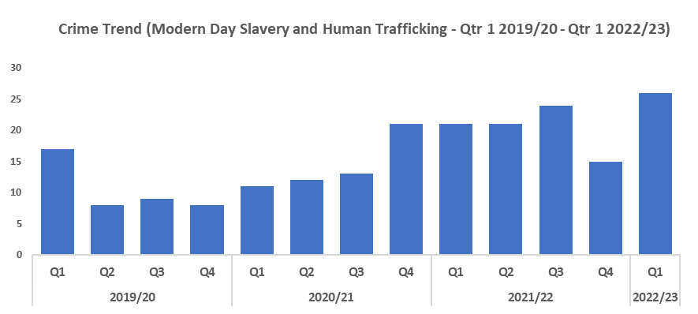

Modern Day Slavery and Human Trafficking
Overview
The number of Modern Day Slavery and Human Trafficking crimes rose during this quarter to 26 offences, the highest within the timeframe.
The overall increase in crimes of this nature being reported is possibly attributed to an increased awareness of this crime type.
The MDS team continue to be extremely busy. During Operation Aident the team worked closely with other agencies as they focussed on labour exploitation at car washes, and offered safeguarding to nearly 40 foreign nationals working at car washes across the force area.
‘Wales On line’ accompanied the team during these visits and observed the arrest of one man in Caerphilly who was wanted in Hungary for Modern Day Slavery offences. The activity was well publicised by Wales Online and The South Wales Argus, with one piece being viewed by over 80,000 people within two days of being published.

Slide 25
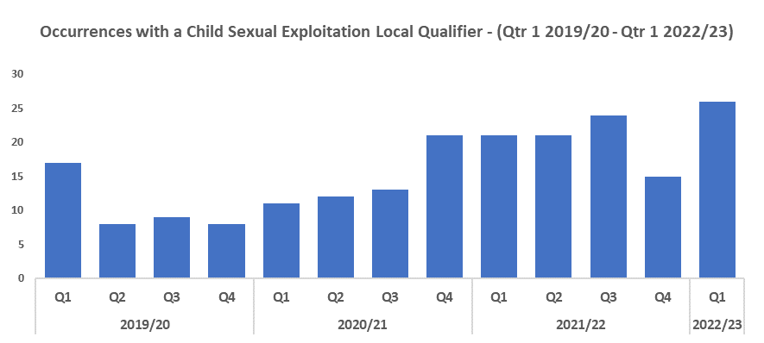
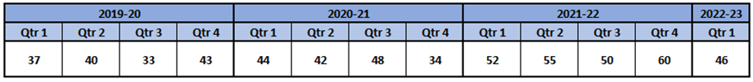
Child Sexual Exploitation (CSE)/Child Criminal Exploitation (CCE)
Overview
Quarter 1 2022/23 has recorded a 24.3% increase in crimes with a Child Sexual Exploitation (CSE) local qualifier when compared to Quarter 1 2019/20 (Pre-Covid year). Quarter 1 2022/23 has seen a decrease of 23.3% (14 fewer crimes) when compared to Quarter 4 2021/22.
The offence most commonly assigned a CSE local qualifier in Quarter 1 of 2022/23 was ‘Take/make indecent photographs/pseudo-photographs of children’, with 11 instances. This is followed by ‘Arrange or facilitate travel of another person with a view to exploitation’, with nine instances.
The Exploitation Team are continuing to engage and support vulnerable children subject to exploitation. Recently they have identified a child prostitution (potentially group based CSE) investigation which has yielded positive engagement and intervention with the teenage victim and others potentially at risk. This investigation has demonstrated the merit of collaborative working both internally and externally and has resulted in positive interventions and safeguarding.
Recently a 39-year-old male was convicted for grooming children and committing sexual acts with a young victim. Not only was this a positive outcome in terms of criminal justice, and public confidence but the Crown Court Advocate and Judge commented upon the calibre of the investigation and how Gwent Police obtained best evidence from the victim support shown to the victim by the officer.

Slide 26
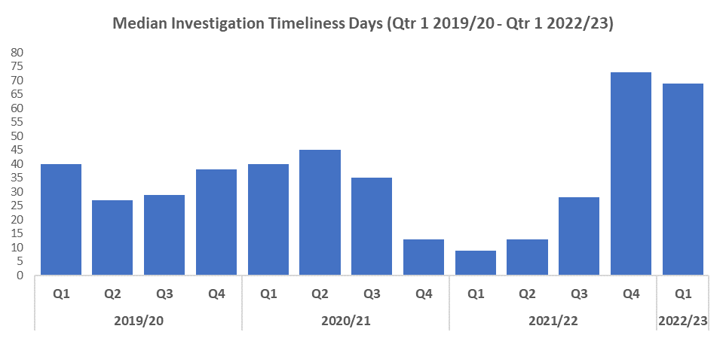

Investigation Timeliness
Overview
The median number of days in which an investigation is completed has decreased slightly when compared to the previous quarter, from 73 to 69 days. Despite this reduction, it remains the second highest value within the timeframe by a significant margin.
When compared to Quarter 1 in 2019/20 the median investigation length has increased by 72.5% (29 days).
Data recording systems have been updated recently, in order to provide more accurate figures for this metric. Despite this, investigation timeliness is difficult to measure in its current form due to the number of tasks awaiting finalisation by the Crime Management Unit (CMU).
Although a modest reduction has been observed this quarter, median investigation length remains abnormally high, likely influenced by the rise in overall crime level as well as CMU demand.
Improvements in this metric have been observed within the last three months, with a spike in April being followed by considerably lower investigation times during May and June. If this trend continues, a further reduction in median investigation length is likely to be seen during the next quarter.
The introduction of a forcewide released under investigation (RUI) working group has added extra scrutiny to investigations. This has already brought reductions in RUI numbers and will allow investigations to be finalised at an earlier stage.
Gwent Police have invested in officer training to improve better use of technology, allowing more timely download of phone data, which has historically adversely effected the length of investigations.

Slide 27
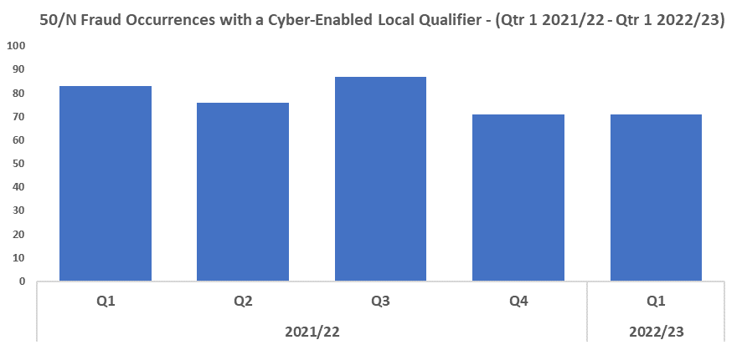

Cyber
Overview
Of the 916 reports under 50/N, 42.4% (n=388) have a cyber-enabled local qualifier.
Between 20th and 30th June the wider cybercrime team assisted POLIT with Operation Burdale. This was a force wide intensification period which involved actioning 14 intelligence packages linked to possession and distribution of Indecent Images of Children [IIOC].
During the operation:
91 digital devices were seized
16 children directly at risk of harm were safeguarded
12 arrests were made for possession / making / distribution of IIOC
2 high risk suspects were charged and remanded into custody;
[i] Suspect was engaging with UCOL and were attempting to arrange the commission of a child sexual offence on a 12 year-old boy. Charged with sexual communication and facilitation offences.
[ii] Suspect was a Teacher and charged with possession and distribution of IIOC

Slide 28
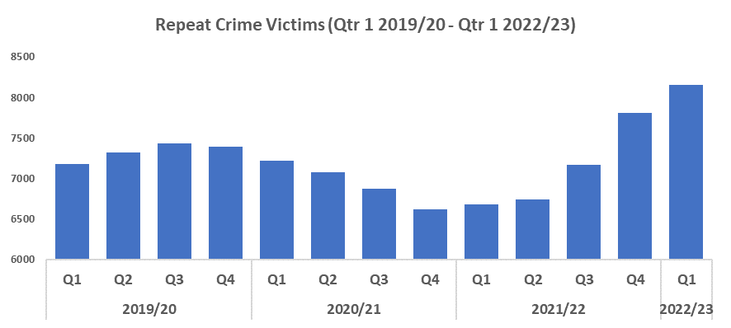

Victim Support/Repeat Victims
Overview
The number of repeat crime victims (a victim of two or more crimes in a 12 month rolling period) has increased significantly in quarter one of 2022/23 (8,151). This is the highest level within the timeframe, indicative of a rising crime trend.
There has been a notable increase when comparing this quarter to the same quarter over the last three years, with increases of 13.6%, 13% and 21.9% respectively.
This increase may be due in part to increased confidence in reporting by these repeat victims, potentially indicating an improvement in victim satisfaction in their first contact with Gwent Police.
The number of repeat crime victims may rise further going into quarter two of 2022/23, as the complete relaxation of all Covid restrictions and improving weather may result in an increasing crime trend.
To better support front line policing, Victim Services are piloting a restructure that will improve the working relationship with the LPA’s and provide a locality specific approach to supporting victims and witnesses of crime. Staff can effectively collaborate with the LPA’s and specific projects within to become experts in the crimes, responses and intervention processes within each area.
During the last quarter the Victim Care Unit has seen 13,749 victims referred into the unit. There have been 7,461 victim information packs sent, along with 1,365 successful initial phone calls informing victims of their rights and the support available. There were also 1,164 detailed needs assessments were completed with victims to ensure a bespoke support package could be created where needed.
The Witness Care Unit have supported a monthly average of 6,792 victims, ensuring they have the support and information needed to help achieve their best evidence in court. Of the victims and witnesses warned to attend court by the unit, following instruction from the CPS, the Witness Care Unit enabled the following attendance rates for the quarter:
Crown Court – 95%; Magistrates – 94%
Finally, the filming of Survivor video’s to be used for training front line officers and staff have begun. Understanding victim’s feelings, thought processes and decision making will help improve the forces response, ensuring we remain person centred and aware of any potential barriers for the victim.

Slide 29
Preventative Support Initiatives
Overview
The local neighbourhood policing team in Abertillery ran a football event in conjunction with the ‘Tidy butt’ charity who aim to educate, empower and support people to better understand their mental health and wellbeing. The event was organised as a result of two recent suicides involving young persons from the local community. Through successful positive impact funding and in collaboration with local businesses and clubs, it proved to be an extremely valuable event whereby numerous young people took part. Each young person was given a specially designed T-shirt and received an input about mental health and the importance of such. The event received extremely favourable feedback while also enhancing relationships between the young community and our officers.
Gwent Police along with five other forces have been made an expansion force in relation to Drug Testing On Arrest (DTOA). A total of £200,000 has been offered by the Home Office to increase the force’s capacity to drug test on arrest as part of a comprehensive strategy to tackle the misery caused by drug misuse and to cut crime. Drug testing on arrest is a powerful tool for identifying drug-misuse in offenders. A positive test ensures that the detainee has a gateway to access treatment and other support to tackle their drug-related offending. The detainee will also be referred for treatment and drug awareness courses to tackle the problem at its root and reduce the prevalence of drug misuse across society.
The current DTOA process has been reviewed and a number of recommendations have been made to improve our service delivery. Gwent Police will be introducing the testing of detainees for VAWG offences and Serious Violence. Gwent will also be working towards the introduction of testing juveniles (14+ years) after charge under the DTOA process. This will enable us to identify drug misuse at an early juncture and provide a gateway to early intervention.
Counter Terrorism PREVENT referrals into CTP Wales have increased. The referrals are progressed by the Team where opportunities are identified to prevent individuals (often vulnerable) from being radicalised. In May, CTP Wales Gwent Field Team also hosted a Teams webinar with a guest speaker on the subject of extreme right-wing terrorism, and how to spot the signs of persons being radicalised by it. It was well attended, feedback was excellent with all respondents rating it as either excellent or very good.
There has been training delivered to all Public Service Boards in Gwent in relation to vulnerability and exploitation. This has included guidance being provided to organisations and businesses aimed at increasing awareness of how to spot exploitation and vulnerability and how to report this. These businesses include hotels, housing providers and support organisations.

Slide 30
Increase Community Confidence in Policing
Victim Satisfaction
Perceptions Survey: Police Effectiveness
Perceptions Survey: Fairness
Perceptions Survey: Engagement
Perceptions Survey: Local Concerns and Overall
Representative Workforce
Key commitments
• Increase the effectiveness of officer and staff
engagement with residents in their communities,
and community confidence and trust in Gwent
Police
• Improve the accessibility of neighbourhood
police teams through a variety of contact
channels that meet the needs of the public
• Increase reporting of crime by communities
that are less likely to engage with the police
• Further increase officer and staff diversity
to ensure our police service reflects the
communities that we serve

Slide 31
Victim Satisfaction
Percentage | Measure
Survey Number | Survey One | Survey Two |  |  |  | Survey Three
Metric | Satisfied with Initial Contact | Satisfied with Follow Up & Investigation | Satisfied with the service from the VCO | Satisfied with the service from the officer dealing with your case | Satisfied with being kept informed about your case | Satisfied with Post Charge
General Crime | 62% | 59% | 90% | 80% | 85% | 40%
Domestic Violence | 77% | 88% | 100% | 91% | 89% | 100%
Hate Crime | 100% | 67% | 100% | 100% | 100% | No Data
Sexual Violence | 100% | 67% | 100% | 67% | 100% | No Data
Baseline | N/A | N/A | 85% | 85% | 74% | N/A
Numeric | Measure
Survey Number | Survey One | Survey Two |  |  |  | Survey Three
Metric | Satisfied with Initial Contact | Satisfied with Follow Up & Investigation | Satisfied with the service from the VCO | Satisfied with the service from the officer dealing with your case | Satisfied with being kept informed about your case | Satisfied with Post Charge
General Crime | 225/371 | 29/49 | 28/31 | 24/30 | 22/26 | 2/5
Domestic Violence | 37/48 | 22/25 | 23/23 | 20/22 | 16/18 | 5/5
Hate Crime | 10/10 | 2/3 | 3/3 | 3/3 | 3/3 | No Data
Sexual Violence | 9/9 | 2/3 | 3/3 | 2/3 | 2/2 | No Data
Sample Size | 438 | 80 | The above questions can be skipped or answered with ‘N/A’. N/A responses have been removed from both the percentage and numeric calculations. As a result, the sample size will differ from that for ‘Satisfied with Follow Up & Investigation’. |  |  | 10

Slide 32
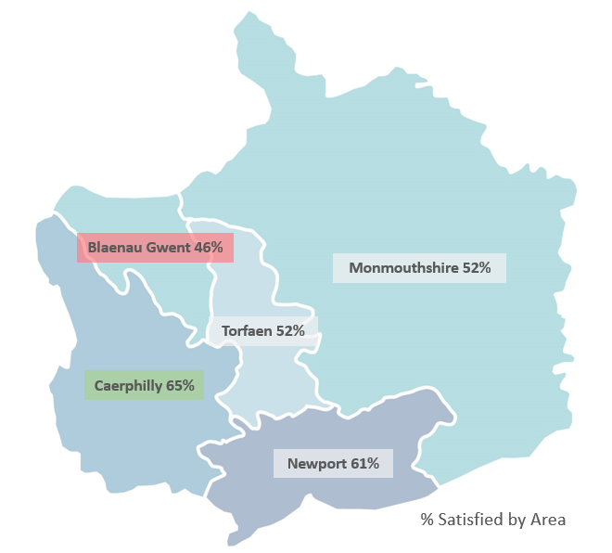
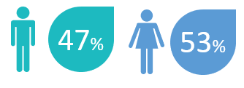
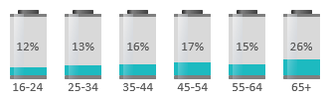
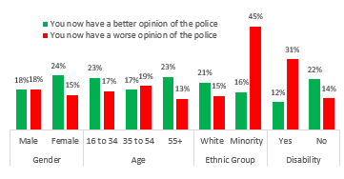
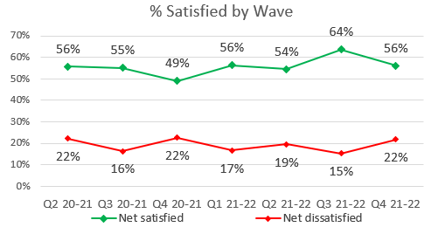







Perceptions Survey: Police Effectiveness
For levels of policing, Blaenau Gwent has a lower satisfaction rate than other areas of the force, with 46% of those spoken to saying they are satisfied. Caerphilly had the highest satisfaction rate at 65%.
Demographically, males (58%) are marginally more satisfied with policing levels than females (57%). Those in the 16-34 age group are also more satisfied than those over the age of 35.
Residents of white ethnicity are 58% satisfied with policing levels. This is higher for ethnic minority groups at 68%. However, following police contact, ethnic minorities are more likely to have a worse opinion (45%), indicative of a
low sample size for this
question (n=101).
Respondent Breakdown
% Better/Worse Opinion Following Police Contact,
by Demographic
Overall satisfaction dropped from 64% in Q3 to 56% in Q4.
The perception is that Gwent Police are best at Responding to Emergencies (76%) and Protecting the Vulnerable (73%), and least effective at Tackling SOC (57%), Supporting Victims & Witnesses (60%) and Dealing with ASB (60%).
Better Opinion
Worse Opinion
% NET Effective

Slide 33
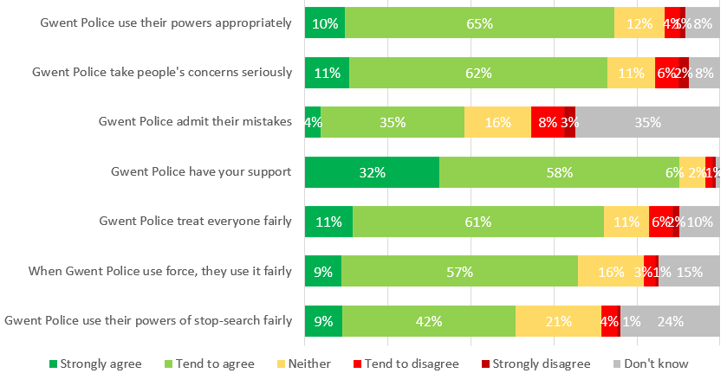
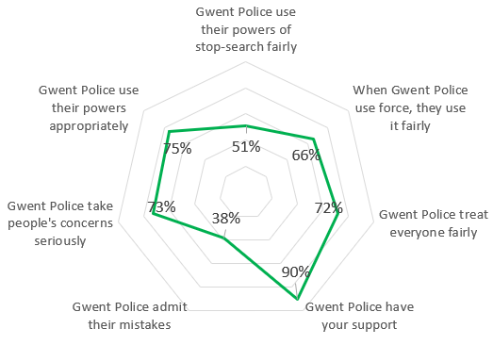
Perceptions Survey: Fairness
% NET Agree
Of those surveyed, 75% thought Gwent Police ‘use their powers appropriately’
66% thought when force is used, Gwent Police ‘use it fairly’ and 51% agree that they use their ‘powers of stop search fairly’
Overall, 90% of people said Gwent Police had their support, however only 39% of those surveyed thought they would ‘admit their mistakes’

Slide 34
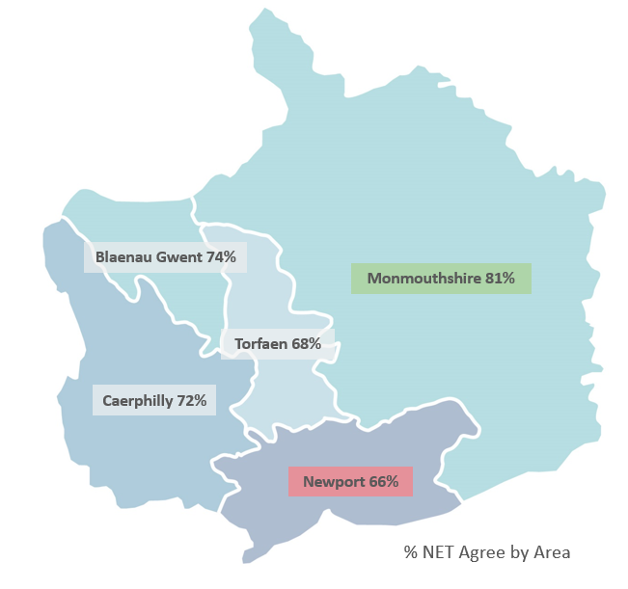

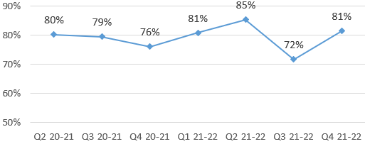


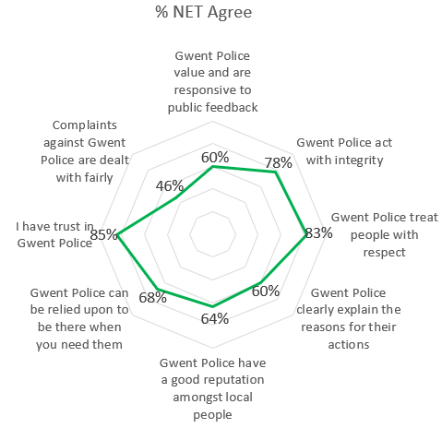

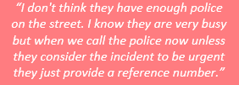
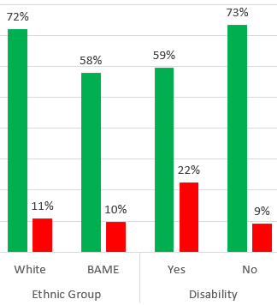
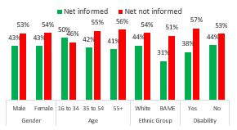
Perceptions Survey: Engagement
Key Verbatim Themes
Sense of community differs by area, highest in Monmouthshire (81%) and lowest in Torfaen (68%) and Newport (66%).
Those with a disability (59%) and ethnic minority residents (58%) less likely to feel a strong sense of community.
Four-fifths (81%) are confident they can easily speak to Gwent Police if needed. This declined in Q3 2021-22 to 72%.
Less than half of those surveyed thought that Gwent Police kept people informed of what was going on in their area, decreasing by 8 p.p. in Q4 2021-22 to 43%. This varies by demographic, with disabled residents (44%) and older people (41%) less likely to feel informed.
More than 8 out of 10 residents surveyed had trust in Gwent Police (85%). 46% feel that complaints against Gwent Police are dealt with fairly.
Minority

Slide 35
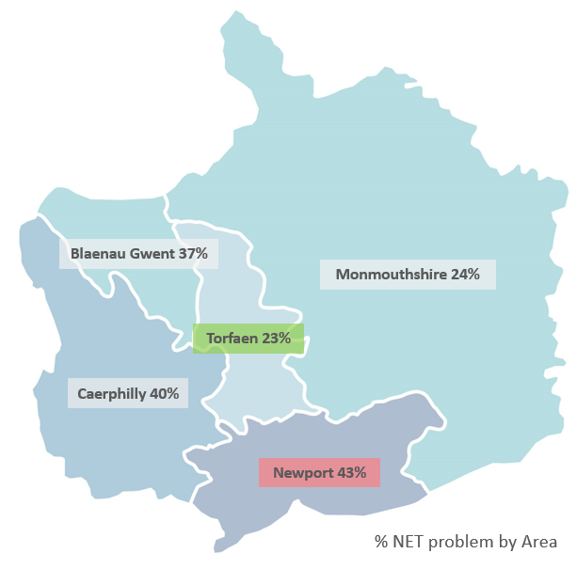
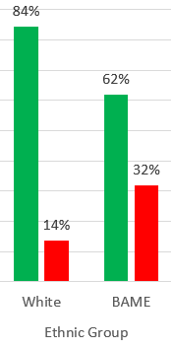












Perceptions Survey: Local Concerns and Overall
More than a third (35%) feel that crime and ASB are a problem in their area.
From Q3 to Q4 2021-22 this fell 15 percentage points to 31%. The overall figure is lowest in Torfaen (23%) and highest in Newport (43%)
Key Verbatim Themes
More than four fifths are confident they would receive a good service from Gwent Police if they had to report a crime or incident. 32% of individuals in a minority ethnic group surveyed disagree with this statement, higher than white individuals at 14%.
Three-fifths (63%) agree that Gwent Police are dealing with important issues in their community. This increased by 17 percentage points to 68% in Q4 2021-22. There is little variance between sectors, Monmouthshire (66%) being highest and Torfaen (61%) and Newport (61%) lowest.
Minority
2.0% have been a victim of crime and did not report to Gwent Police. Applying this to the population of Gwent, this would equate to 11,080 individuals.
Three-quarters of people agree they have confidence in the police in their area. This is lowest in Newport (74%) and highest in Monmouthshire (79%). Ethnic minority groups have less confidence in this statement, with 47% agreeing they have confidence in police in their area.
Minority

Slide 36

Representative Workforce
The following table is correct as at 31 June 2022
Overview
There is a gender disparity still evident within the workforce for both officers and staff. For officers, females are underrepresented by approximately 16 percentage points (current census data reveals that females make up 51% of the population in Gwent). However, females are overrepresented in the staff workstream area (by close to 16 percentage points).
Following on from the stats above, a successful campaign saw 43 new PC’s join the force in July which keeps Operation Uplift on track for the first quarter. It also increased representation of ethnic minorities to 3.6%. Also, the forces joining rate of ethnic minorities is currently at 5.3% for the last 12 months, above the representation of Gwent ( 3.9%)
With the decline in COVID cases, the force COVID Hub has now been closed. Going forward, line managers will be responsible for managing any positive COVID cases within their teams.

Slide 37




999 Demand
Overview
999 demand has risen when compared to the previous quarter by 10.1% (2,181 calls) to 23,720. This is the highest level seen during this timeframe.
999 demand has also increased in comparison to Quarter 1 in 2019/20, by 17.2%.
The reasons for this increase in demand are not entirely clear but may be linked in part to the rise in 101 abandonment rate, with callers from that service potentially becoming frustrated with lengthy wait times and instead electing to call 999 in order to receive a more prompt response.
The percentage of 999 calls answered within 10 seconds has deteriorated when compared to the previous quarter, by 0.8 percentage points, remaining below the national benchmark of 90%.
The average speed of answer has risen to 13 seconds during the most recent quarter, continuing the upward trend observed since Quarter 4 of 2020/21 and remaining above the 10 second national benchmark.
Unlike 101 calls, there does not appear to be a strong correlation between 999 demand and 999 service level or answer speed during the previous five quarters.

Slide 38





101 Demand
101 Average Answer Speed
Overview
101 demand (all connections) has increased when compared to the previous quarter by 10.5%. Demand has also increased when compared to Quarter 1 in 2019/20, up 2.5%.
When looking at the past three financial years, 101 demand appears to be greater during Quarter 1 and 2 of a given year than in subsequent quarters (with Quarter 4 of 2019/20 standing as an exception). As such, the rise in 101 demand observed during this quarter does not appear to be anomalous and conforms to seasonal trends.
The 101 abandonment rate has increased during Quarter 1 of 2022/2023 when compared to the previous quarter by 6.6 percentage points to 40.2%. Abandonment rate has also increased when compared to Quarter 1 of 2019/20 by 26.5 percentage points.
The average answer speed for 101 calls has increased by one minute and thirty-four seconds (29.5%) when compared to the previous quarter, and now stands at six minutes and fifty-three seconds.

Slide 39
Initiatives & Events
Overview
After several months of planning the flagship ‘Behind The Badge’ event took place on Sunday 3rd July. The focus for the day was firmly on positive public engagement and recruitment. Departments from across the Force took part with a range of stands and presentations engaging the crowds. Operational Support put on demonstrations of the work of Dog Handlers, Roads Policing & Specialist Operations, Public Order/Public Safety Policing and the Joint Firearms Unit. Approximately twenty thousand people attended the event over its duration and it received huge positive feedback in both the traditional media and via social media platforms.
During July the Force Planning Unit worked closely with the Royal Household to plan and undertake two protected Royal visits to Gwent. The first involving HRH the Duchess of Cornwall visiting Millbrook Primary School in Bettws and a Farm in Redbrook, and the second involving HRH The Princess Royal visiting the Caerphilly Council Offices. Each Royal visit required meticulous security assessments, event planning and coordination arrangements as well as a firearms command structure providing close protection and response capabilities. Recent changes to how the force plans and responds to such events have streamlined the processes and received positive feedback from the Principal Protection Officers attached to each protected person.
During July Gwent Police supplied officers on mutual aid to the Commonwealth Games in Birmingham. Officers were deployed in different cohorts and their transport, accommodation, pre-event briefings and welfare needs have all been arranged by the Force Planning Team.
NLEDS will see the replacement of both the Police National Computer and Police National Database, with the aim of enhancing the current functionality used by the forces and the wider law enforcement agencies. Gwent and South Wales Police have elected to be early adopters. The NLED Programme recognises that currently national data services do not meet the everyday needs of the users, are not adaptable to the changing demands seen in policing and are delivered on systems that are end of life, which means they are expensive to operate and change. The project has commenced with preparatory ICT works completed and recruitment of a project team from Home Office funding. The benefits of being early adopters is that the national team will provide project support and financial assistance to pioneer and early adopter forces throughout each module.

