Slide 1
Strategy Performance Board
Quarter 4 2022-23

Slide 2
Keeping Neighbourhoods Safe
All Crime
Residential Burglary
Neighbourhood Crime
Public Order
ASB
Roads Policing
Key Commitments
Reduce public order offences and anti-social behaviour, and the number of people who repeatedly carry out these acts
Reduce acquisitive crime and repeat offenders
Improve the safety of roads throughout Gwent
Commission and invest in effective crime prevention initiatives

Slide 3
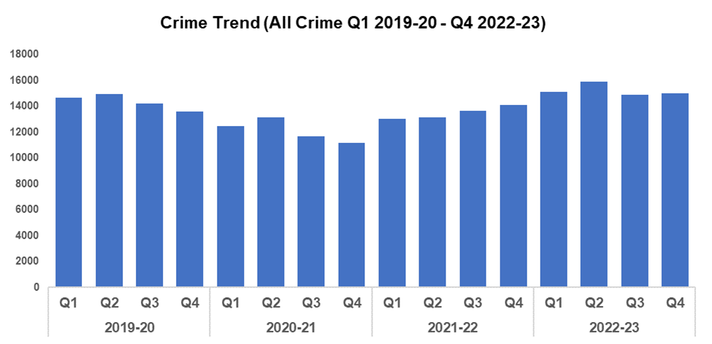
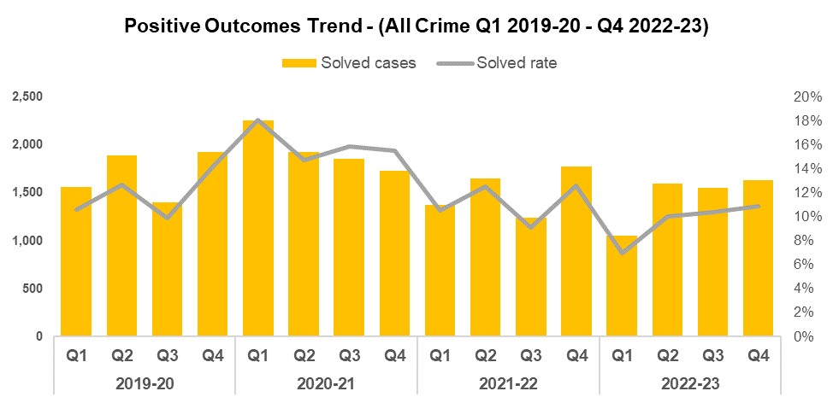
1. All Crime
Overview
Overall crime levels have increased by 0.7% during quarter 4 (Q4) 2022-23 when compared to the quarter prior, with 106 additional offences recorded for a total of 15,017. This is the highest volume of offences recorded during the fourth quarter of a financial year within the timeframe, with Q4 2022-23 recording a 10.4% increase in offence volume when compared to the same quarter during 2019-20 (1,410 additional offences). A less prominent increase of 6.0% (3,468 additional offences to 60,934) can be observed when comparing the financial year as a whole against financial year 2019-20.
Although data for these periods is included in this presentation, direct comparisons with 2020-21 and 2021-22 are not practical due to the exceptional circumstances of the Covid lockdowns.
When compared to the previous quarter, the overall positive outcome rate has increased by 0.5 percentage points to 10.9%. This represents the third consecutive increase in positive outcome rate since Q1 2022-23, implying consistent improvement throughout the financial year.
As with crime levels, 2020-21 and 2021-22 were exceptional due to Covid lockdowns. Reduced crime levels coupled with a purge on a backlog of outcomes led to inflated levels of positive outcomes. Therefore, it is more appropriate to compare the positive outcome rate for Q4 2022-23 with that seen during Q4 2019-20, against which it has declined by 3.3 percentage points (down from 14.2%). The positive outcome rate for the financial year as a whole has fallen by 2.2 percentage points when compared to financial year 2019-20, and currently stands at 9.6%.
It should be noted there is ongoing work to improve Gwent Police Crime Data Integrity which has influenced overall crime numbers within the past 12 months.

Slide 4
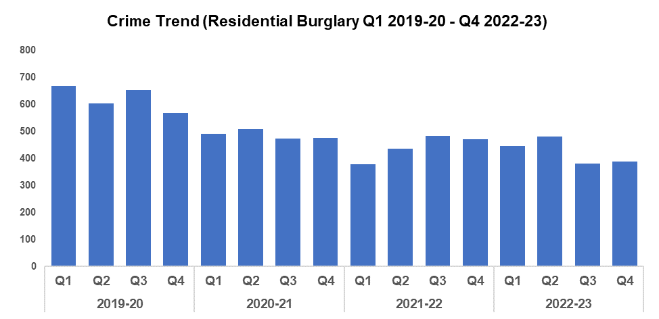
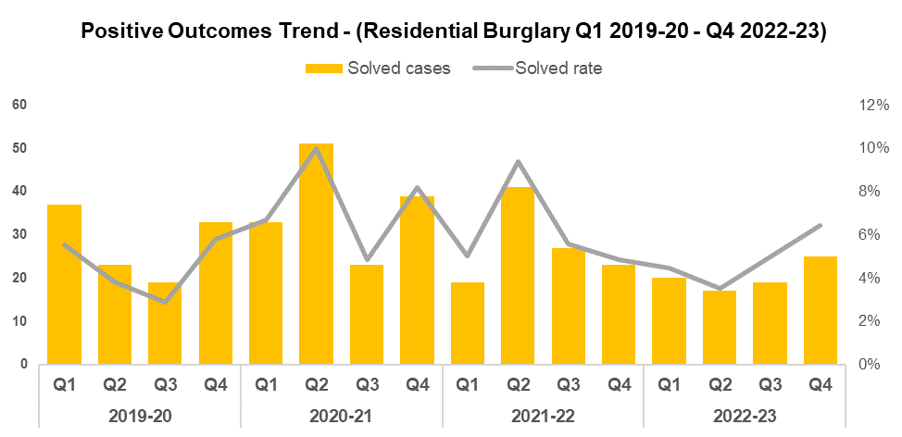
2. Residential Burglary
Overview
Residential Burglary offences saw a slight increase of 1.6% this quarter when compared to the quarter prior (six additional offences for a total of 388). This increase, although minor, runs counter to the aims of the government’s Beating Crime Plan. Q4 2022-23 has recorded a 31.8% reduction in offence volume when compared to the same quarter during 2019-20 (181 fewer offences). A similar reduction of 32.0% (798 fewer offences to 1,698) can be observed when comparing the financial year against 2019-20.
Whilst a minor increase in offence volume has been recorded this quarter when compared to the quarter prior, Residential Burglary offences are currently at the second-lowest level seen since Q1 2021-22, and the third lowest within the timeframe. These reduced crime levels may indicate the efficacy of the deterrence strategies employed as part of the ‘We Don’t Buy Crime’ (WDBC) initiative, such as the distribution of SmartWater.
When compared to the previous quarter, the positive outcome rate for Residential Burglary rose by 1.4 percentage points to 6.4%. This represents a second consecutive increase in positive outcome rate, with a comparable trend last observed between Q3 2019-20 and Q2 2020-21. The positive outcome rate for Q4 2022-23 is 0.6 percentage points higher than that observed during Q4 2019-20 (up from 5.8%). The positive outcome rate for the financial year has also increased (by 0.3 percentage points to 4.8%) when compared to 2019-20.
August 2022 marked the commencement of the Burglary Response Improvement Pilot, an effort to increase the Residential Burglary positive outcome rate via actions such as the consistent allocation of Crime Scene Investigators, as well as a focus on Golden Hour enquiries. January 2023 has seen the implementation of a second Burglary Pilot, focused around improving service to burglary victims and further increasing investigation quality. The rise in positive outcome rate observed during Q4 2022-23 may speak to the efficacy of these improvements.

Slide 5
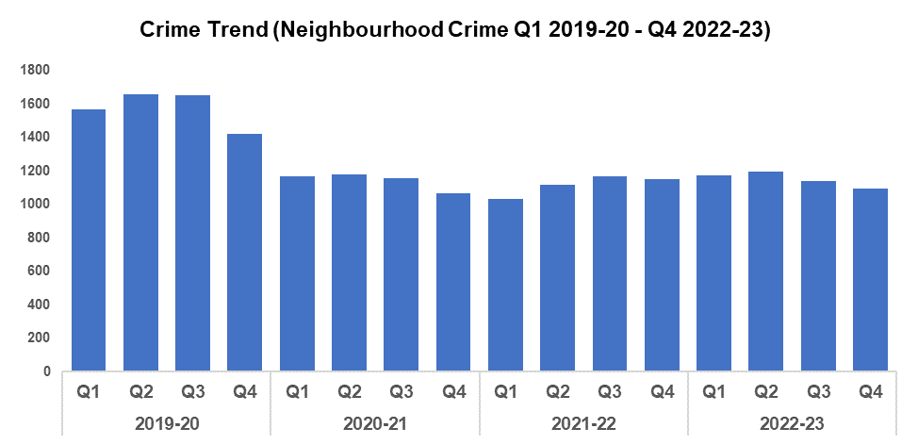
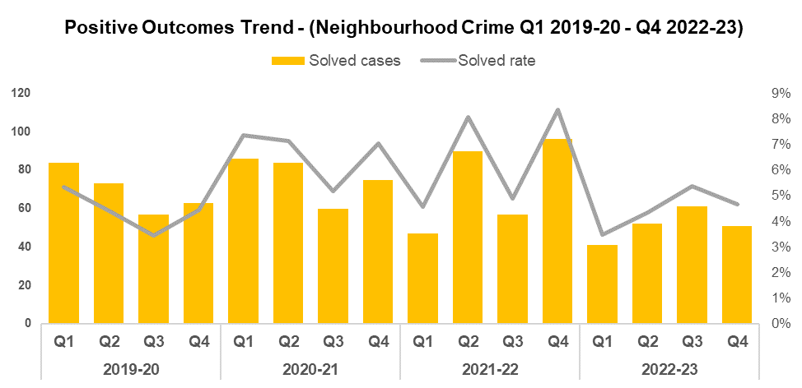
3. Neighbourhood Crime
Overview
Neighbourhood Crime has seen a decline of 3.9% when compared to the previous quarter (44 fewer offences to 1,093). This aligns with the objectives of the government’s Beating Crime Plan, in which it is a focus area for reduction. The decline in Neighbourhood Crime observed this quarter represents the second consecutive reduction in offence volume, conforming to the seasonal trend seen during 2019-20 and 2020-21. Q4 2022-23 has recorded a 23.1% reduction in offence volume when compared to the same quarter during 2019-20 (328 fewer offences). A similar reduction of 27.0% (1,703 fewer offences to 4,598) can be observed when comparing the financial year against 2019-20.
When compared to the previous quarter, the positive outcome rate for Neighbourhood Crime has declined by 0.7 percentage points to 4.7%. This disrupts the upward trend observed since Q1 2022-23, and runs counter to the seasonal trend of increases between Q3 and Q4 of a given financial year. When comparing Q4 2022-23 against the same quarter during 2019-20, the positive outcome rate has risen by 0.3 percentage points (up from 4.4%). A slight increase of 0.1 percentage points can also be observed when comparing the current financial year against 2019-20, with the positive outcome rate for 2022-23 currently standing at 4.5%.
The WDBC Coordinator and Support officer attended a multi-agency community afternoon organised by the Torfaen Neighbourhood Policing Team. They engaged with members of the community, raising awareness of the work carried out by the team, and provided crime prevention literature. Members of the Garndiffaith community were also pleased to receive purse bells, card defenders, handbag cords and personal alarms to help keep themselves and their personal belongings safe.
Notes:
Neighbourhood crime consists of personal robbery, residential burglary, theft from a vehicle, theft of a vehicle and theft from the person offences combined

Slide 6
Neighbourhood Crime Continued
The WDBC team supported a motorbike marking event in Abertillery where six motorbikes were security marked with Smart Water. The team also attended a Bicycle marking event in New Tredegar where bikes were security marked using Bike Register.
Operation Garnet is an operation run by WDBC and the Central Problem Solving Hub, funded by Safer Streets 4 which is in its infancy. The goal of the operation is to identify a high demand area for Burglary offences and provide enhanced security measures including window locks, internal light timers, door locks and exterior lighting. Following the pilot, the effectiveness of these measures will be assessed. If they prove successful, the WDBC team will collaborate with partners to roll out this initiative in other areas of the Force.
Op Merton is another ongoing operation run by the WDBC team, inspired by Merseyside Police who have been running ‘Op Castle’, an initiative allowing members of the public to upload ring doorbell footage of perceived suspicious activity to the NICE investigate system. They have an open appeal page within NICE investigate for members of public to upload their footage which can then be reviewed for evidence to support new or ongoing investigations.​ Merseyside Police have seen increases in their positive outcomes because of this initiative. It is hoped that this will also be the case in Gwent.
The WDBC Covert Field officer deployed a capture motorbike in Abertillery following an increase in vehicle thefts in Blaenau Gwent. The bike was stolen and tracked, with two males being arrested shortly afterwards. A third person was named during the interview and arrested two days later.​ All three persons were bailed pending further enquiries.​
As part of the Safer Neighbourhoods strategy and with support from the Safer Streets 4 initiative, the WDBC team are coordinating crime prevention work across Industrial Estates throughout the Force area. Business Crime Officers have registered and delivered 35 Business Support packs to companies located at the Felnex Industrial Estate in Newport. Businesses on industrial estates in Blaenau Gwent, Torfaen, and Caerphilly Central have already been signed up to the scheme.
Notes:
Neighbourhood crime consists of personal robbery, residential burglary, theft from a vehicle, theft of a vehicle and theft from the person offences combined

Slide 7
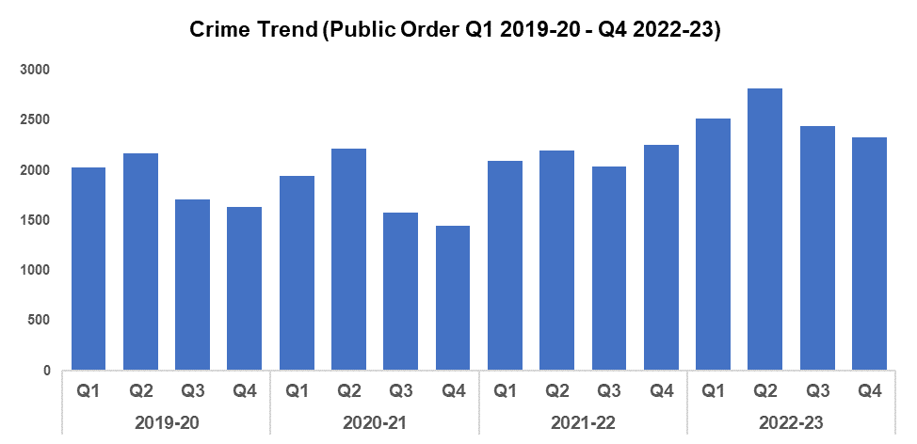
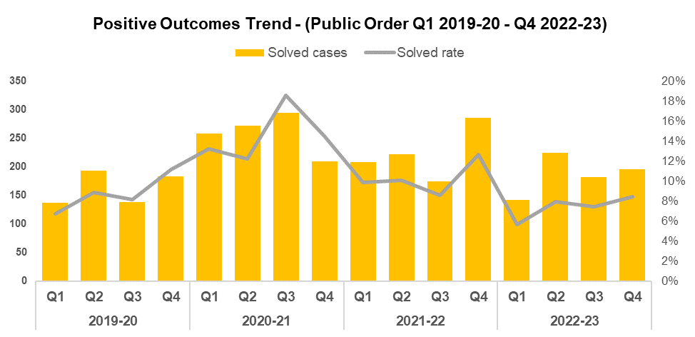
4. Public Order
Overview
Public Order Offences have declined by 4.6% (111 fewer offences) when compared to the quarter prior, and currently stand at 2,328. This represents the second consecutive reduction in offence volume, closely following the seasonal trend observed during 2019-20 and 2020-21. 2021-22 stands as something of an outlier in this regard, possibly due to the impact of COVID-19. Q4 2022-23 has recorded a 42.1% increase in offence volume when compared to the same quarter during 2019-20 (690 additional offences). A less prominent increase of 33.8% (2,554 additional offences to 10,100) can be observed when comparing the financial year against 2019-20.
When compared to the previous quarter, the positive outcome rate for Public Order Offences has increased by 0.9 percentage points to 8.4%. This represents the highest quarterly positive outcome rate of the financial year. When comparing Q4 2022-23 against the same quarter during 2019-20, the positive outcome rate has fallen by 2.8 percentage points (down from 11.2%). The positive outcome rate for the financial year has also declined (by 1.2 percentage points to 7.4%) when compared against 2019-20.
The volume of Public Order Offences resolved via community resolution has risen by 26.0% (13 additional offences to 63) when compared to the quarter prior.

Slide 8
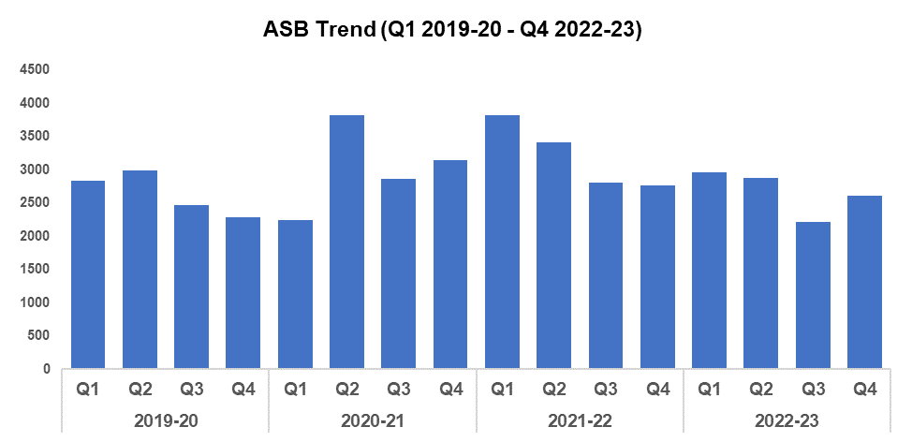
5. ASB
Overview
Levels of anti-social behaviour (ASB) in Gwent have increased by 17.9% (397 additional incidents) when compared to the previous quarter. This disrupts the downward trend which began following Q1 2022-23. When compared to Q4 2019-20, ASB levels have risen by 14.2% (325 additional incidents). A smaller increase of 0.9% (90 additional incidents to 10,667) can be observed when comparing levels for the financial year against 2019-20.
Whilst this quarter has recorded an increase in the volume of ASB incidents when compared to the quarter prior, it remains the second lowest figure recorded since Q1 2020-21. This may speak to the ongoing efficacy of several initiatives put in place to curb ASB levels, such as Operation Ashton, which aims to prevent re-offending via intervention courses. It may also indicate the impact of the £750,000 granted by the Home Office as a result of the force’s successful Safer Streets bid. A portion of this funding is being used to deter ASB through a range of diversionary tactics, such as educational youth outreach programmes delivered from new or refurbished youth shelters.
Data presented in this slide is based on non-COVID-19 ASB incidents only.

Slide 9
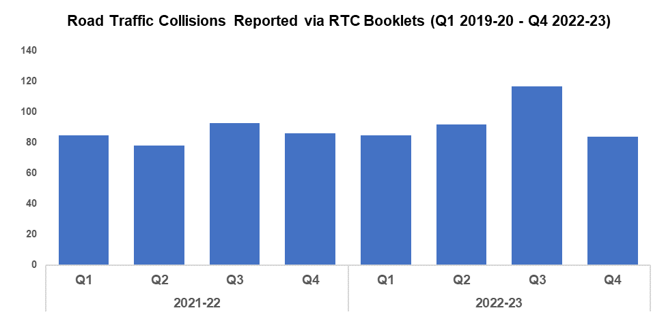
6. Roads Policing
Overview
During Q4 2022-23, 92 Road Traffic Collisions (RTCs) were reported via RTC booklets. Whilst this currently represents a decrease of 51.8% (99 fewer incidents) when compared to the previous quarter, these reduced levels are likely influenced by a lag time between the incidents occurring and RTC booklets being submitted, with 51 booklets currently marked as outstanding for the quarter. As such, the actual volume of RTCs for Q4 2022-23 is expected to increase going forward, which will be reflected in future reporting.
A total of 1,034 persons were reported for one of the ‘Fatal Five’* factors during Q4 2022-23, an increase of 40.7% (299 additional reports) when compared to the previous quarter. The most commonly reported factor during Q4 2022-23 was drink/drug driving, with 338 instances reported (32.7% of all reports). This is followed by excess speed, with 286 instances reported (27.7% of all reports).
*‘The Fatal Five’ refer to the five main causes of serious injury and death in RTCs. They are: careless driving, drink/drug driving, not wearing a seatbelt, using a mobile phone, and excessive speed.
Upon sighting a stolen vehicle, Roads Policing and Specialist Operations Unit (RPSO) officers worked with the National Police Air Service (NPAS) to follow and safely stop the offenders, before detaining and subsequently arresting them for theft, dangerous driving and other traffic offences.
As part of Operation Bismuth and owing to information received, RPSO officers worked with NPAS to stop a vehicle on the M4. The vehicle was safely stopped and the driver detained. Approximately £250,000 - £300,000 was seized from within the vehicle and the driver was subsequently arrested for possession of criminal property.
Scrutiny in relation to the Carriage of Dangerous Goods has improved in Gwent, owing to development of the policy and ongoing efforts by RPSO. RPSO officers stopped a heavy goods vehicle (HGV) which was operating under the dangerous goods regulations. This check resulted in an immediate prohibition on the vehicle for non-compliance issues that would have put emergency services at risk if they were required to deal with an incident involving the vehicle. Officers engaged with the depot manager to ensure the issues were rectified. A further vehicle was stopped and the same issues were identified. As a result, these matters have been reported into Traffic Commissioner for Wales and additional scrutiny will be implemented going forward.

Slide 10
Combat Serious Crime
Combat Serious Crime
Most Serious Violence
Serious Violence
Violence Against Women and Girls
Drug Supply and Organised Crime
Key commitments
Reduce the number of repeat victims of child criminal and sexual exploitation
Increase disruption of serious organised crime, and reinvest assets seized back into communities
Improve the overall criminal justice response to violence against women, domestic abuse and sexual violence
Commission and invest in services that work with perpetrators of serious crime to prevent and reduce re-offending

Slide 11
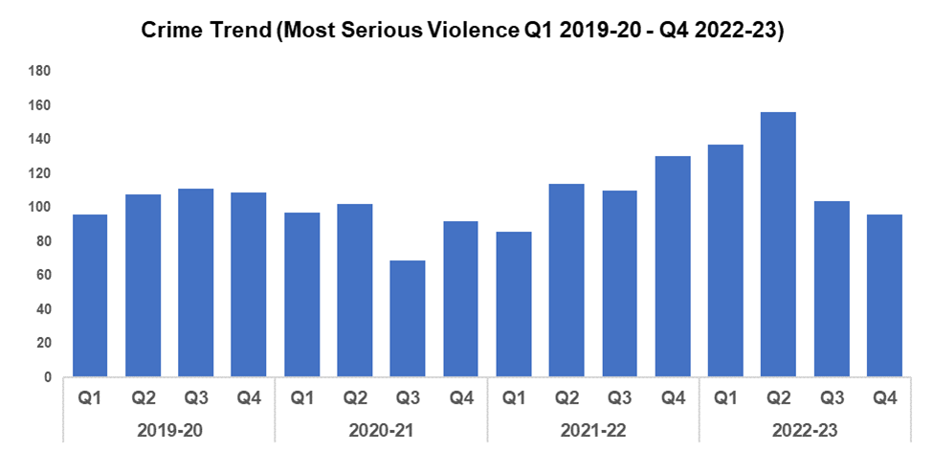
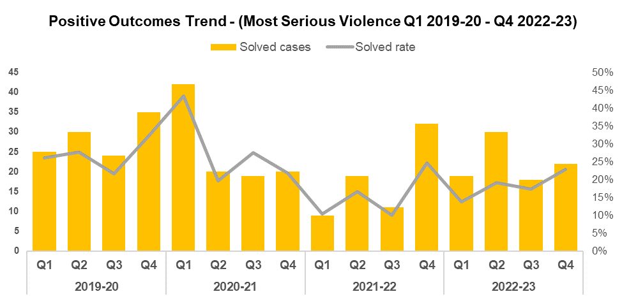
1. Most Serious Violence
Overview
Most Serious Violence offences consist of Homicide, Grievous Bodily Harm with Intent and Causing Death by Dangerous Driving. Following a significant reduction in recorded offences during the previous quarter, there was a further reduction of 7.7% (eight fewer offences) during Q4 2022-23. Prior to Q3 2022-23, these offences had demonstrated an upward trend since Q3 2020-21. Q4 2022-23 presents a reduction of 11.9% (13 fewer offences) when compared to Q4 2019-20, whereas the financial year as a whole presents a 16.3% increase (69 additional offences to 493) when compared to 2019-20.
When compared to the previous quarter, the positive outcome rate for Most Serious Violence has increased by 5.6 percentage points to 22.9%. This represents a 9.2 percentage point reduction in positive outcome rate when compared with Q4 2019-20 (down from 32.1%). A similar decline can be observed when comparing the financial year against 2019-20, with the positive outcome rate declining by 8.8 percentage points (25 fewer crimes solved) to 18.1%.
Jamie Garwood was sentenced to six years in prison on the 6th of April 2023 at Cardiff Crown Court for the Manslaughter of Richard Thompson in September 2022, with an additional 4 years extended licence due to the risk of him of reoffending and the risk to the public.

Slide 12
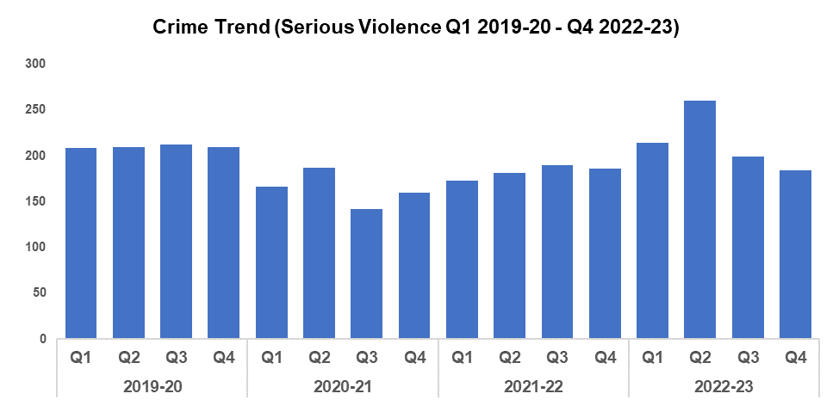
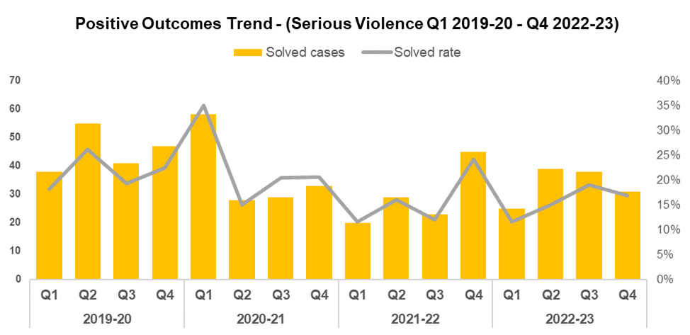
2. Serious Violence
Overview
Serious Violence crimes consist of S.18 Grievous Bodily Harm with Intent, S.20 Malicious Wounding no Intent and Personal Robbery offences. Q4 2022-23 saw the level of these offences reduce when compared to the previous quarter by 7.5% (15 fewer offences), with 184 crimes recorded. Q4 2022-23 also represents a 12.4% reduction (26 fewer offences) when compared to Q4 2019-20. Conversely, the financial year as a whole recorded an increase of 1.9% (16 additional offences to 857) when compared to 2019-20, likely owing to the spike observed during Q2 2022-23.
During Q4 2022-23 the Serious Violence positive outcome rate decreased by 2.3 percentage points when compared to the quarter prior, to 16.8%. Q4 2022-23 presents a 5.6 percentage point reduction in positive outcome rate for Serious Violence when compared to Q4 2019-20 (down from 22.4%). A similar decline can be observed when comparing the financial year against 2019-20, with the positive outcome rate falling by 6.0 percentage points to 15.5%.
Gwent Police is committed to making Newport City Centre a safer place for the community, as well as ensuring that all premises are working in partnership with the Police and local authority to achieve their licensing objectives and reduce violent crime in the City Centre at key times. Several pubs are currently been placed on action plans due to poor door management and incidents linked to these premises, however they are working with Gwent Police and improvements are being seen.

Slide 13
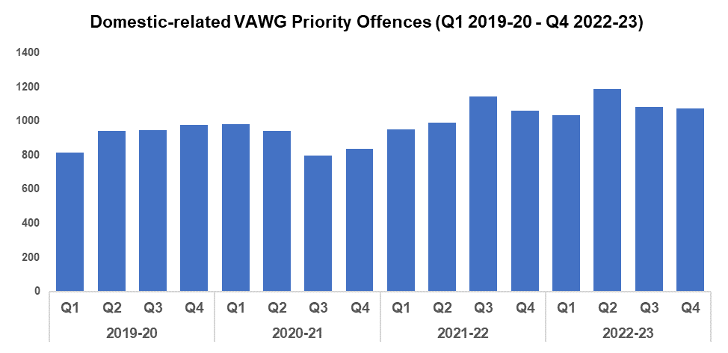
3. VAWG Domestic Priority Offences
Overview
The adjacent chart displays the number of combined Violence against Women and Girls (VAWG) priority offences~ with a domestic abuse qualifier, and which have at least one female victim linked.
Compared with the previous quarter there were eight fewer domestic priority offences with at least one female victim linked, which represents a reduction of 0.7%.
During Q4 2022-23 there were 1,075 domestic priority offences with a female victim linked. This is an increase of 10.1% (99 additional offences) when compared to Q4 2019-20, during which there were 976 domestic priority offences with at least one female victim linked.
The financial year as a whole saw these offences rise by 19.1% (an additional 701 offences to 4,379) when compared to 2019-20.
During financial year 2022-23, 939 females have been a victim of more than one VAWG domestic priority offence in the most recent 12 months. 45 women and girls have been the victim in five or more separate offences.
During financial year 2022-23, there were 2,952 offenders linked in domestic crimes~ against females, 30.1% (890) of which were repeat offenders. 41 offenders were linked in five or more VAWG offences.
~ Domestic Priority Areas Combined covers Homicide, Violence with Injury, Stalking and Harassment, Public Fear , Alarm or Distress, Rape, Other Sexual Offences, and Modern Slavery.

Slide 14
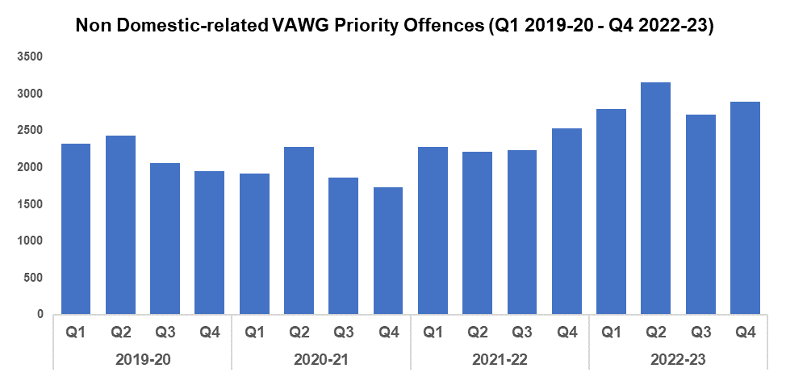
VAWG Non Domestic Priority Offences
Overview
The adjacent chart shows the number of combined VAWG priority offences+ that do not have a domestic abuse qualifier and which have at least one female victim linked.
Compared with the previous quarter there were 171 additional non-domestic priority offences with at least one female victim linked, which represents an increase of 6.2%.
During Q4 2022-23 there were 2,891 non-domestic priority offences in which a female victim was linked. This is a 48.0% increase (938 additional offences) when compared to Q4 2019-20 during which there were 1,953 non-domestic priority offences with at least one female victim linked.
The financial year as a whole saw these offences rise by 31.8% (an additional 2,785 offences to 11,556) when compared to 2019-20.
2,120 females have been a victim of more than one VAWG non-domestic priority offence in financial year 2022-23. 195 women and girls have been the victim in five or more separate offences.
In financial year 2022-23 there were 6,901 offenders linked in non-domestic crimes+ against females, 23.8% (1,645) of which are repeats. 149 offenders were linked in more than five VAWG offences.
+ Non-domestic Priority Areas Combined covers Homicide, Violence with Injury, Stalking and Harassment, Public Fear , Alarm or Distress, Rape, Other Sexual Offences, and Modern Slavery and Exploitation of Prostitution.

Slide 15
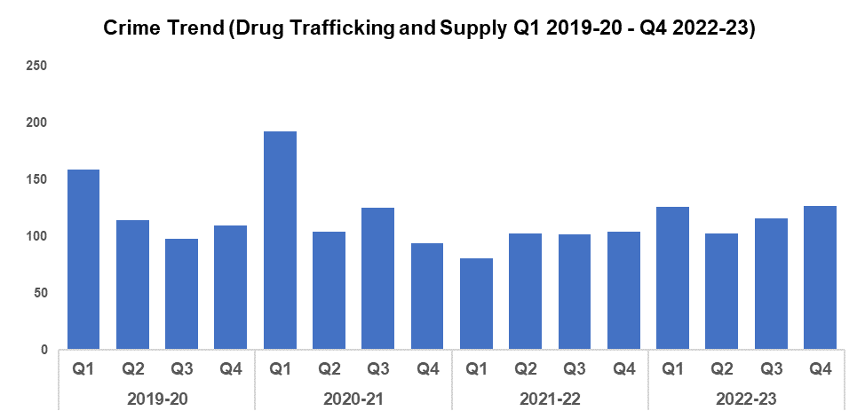
4. Drug Supply & Organised Crime
Overview
A 9.5% increase in Drug Trafficking and Supply offences (11 additional offences to 127) has been recorded during Q4 2022-23 when compared to the previous quarter, with an increase of 15.5% (17 additional offences) recorded when comparing against Q4 2019-20. When comparing the financial year against 2019-20, slight reduction of 1.9% (9 fewer offences to 472) has been recorded.
1,401 Drug Supply and Dealing intelligence logs were submitted during Q4 2022-23. This is a reduction of 2.1% (30 fewer logs) when compared to the quarter prior, which saw 1,431 logs submitted. An equivalent reduction can be seen when comparing Q4 2022-23 against Q4 2021-22, which also saw 1,431 logs submitted (data for 2019-20 currently unavailable).
The Drugs Focus Desk (DFD) continue to support frontline officers with drug investigations. Briefings have been carried out across the force in relation to the importance of taking positive action and refusing to take the path of least resistance. Officers are being encouraged to deal with offences of possession with intent to supply as opposed to simple possession when the evidence is available, with the support of the DFD in coordinating investigations.
A County Lines Intensification Week took place between the 27th of February and the 5th of March, during which 16 arrests were made and various items were seized, including a one kilo block of Heroin, nearly 500 cannabis vape pens, a cannabis oil press, fourteen mobile phones, four high-performance cars, two handguns, and £20,000 in cash. In addition to this, four county lines were de-activated.
As part of Operation Draco, the nine members of an organised crime group (OCG) were sentenced for conspiring to supply 70 kilos of cocaine using encrypted communications. Those involved in the leading roles of the conspiracy were sentenced to between 10 and 12 years. Serious Crime Prevention Order (SCPO) applications have been submitted and Proceeds of Crime Act (POCA) investigations are well under way in order to cause further financial disruption.
Over the last two months, 100 frontline officers have been trained to carry Nyxoid and have been provided with their own personal issue. Nyxoid can be used to provide emergency therapy in the case of a known or suspected opioid overdose. This roll out will continue over the coming months and refresher training will be incorporated into Officer Safety Training (OST) during October.
Gwent Police now drug test everyone arrested for a trigger offence, with each new arrest warranting a new test. This testing is being expanded to non trigger offences, specifically VAWG, domestic violence, and night-time economy offences. A mobile app has been rolled out for drugs testing on arrest to all officers in order to raise awareness of their roles and responsibilities in this area. Probationers are receiving training in drug testing on arrest and are provided with ‘Recognise and Respond’ training material. Gwent police have been provided further funding this year by the Home Office as an Expansion Force. This will be put towards expanding testing for non trigger offences and improving the recovery and treatment provided for cocaine users.

Slide 16
Drug Supply & Organised Crime Continued
Cannabis Cultivation investigations have been reviewed. A number of investigations highlighted gaps in our capabilities and areas for improvement. As a result of this a training package has been completed for frontline officers and a trigger plan has been developed. Existing documents have been updated and uploaded onto the intranet in order to guide officers through the golden hour enquiries.
Drug Safes have recently been reintroduced into night-time economy (NTE) premises following a lengthy period in which they were not being monitored.
Five men were charged as nearly 1,200 cannabis plants found after two warrants were carried out at properties in Blaenau Gwent. The grows were found at disused warehouses in Ebbw Vale and Tredegar at the beginning of April.

Slide 17
Support Victims and Protect the Vulnerable
Hate Crime
Rape
Domestic Related Crime
Domestic Abuse Repeat Victims/Offenders
Modern Day Slavery and Human Trafficking
Child Sexual Exploitation/Child Criminal Exploitation
Cyber Fraud
Victim Support/Repeat Victims
Key commitments
Improve victim services and ensure that the needs of victims are identified and responded to appropriately through Connect Gwent and the Victim Care Unit
Further improve our work with partners to protect those most vulnerable
Increase the timeliness of police investigation updates provided to victims
Commission and invest in specialist services to support victims throughout the criminal justice process

Slide 18
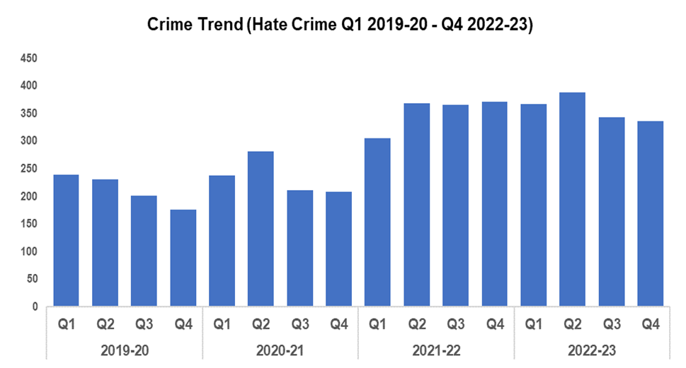
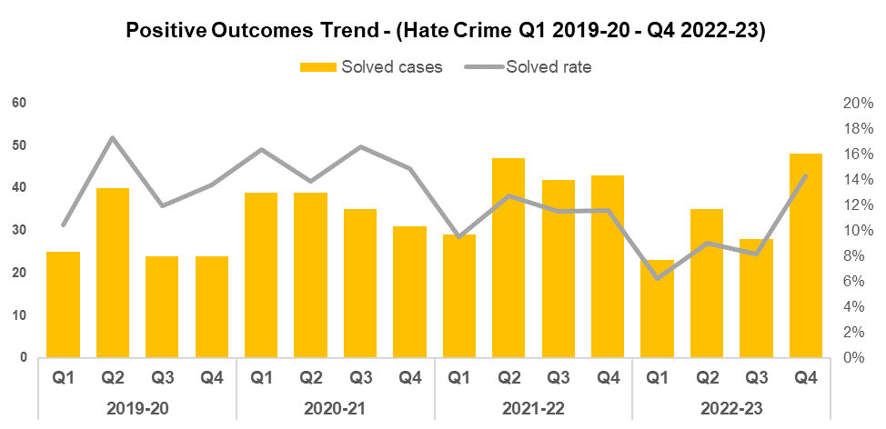
1. Hate Crime
Overview
The volume of recorded hate crime has decreased by 2.3% (8 fewer crimes) when comparing Q4 2022-23 against the quarter prior, and currently stands at 336 offences. When compared to Q4 2019-20 recorded hate crime has increased by 89.8% (an additional 159 offences), with an increase of 69.3% (588 additional offences to 1,437) observed when comparing the financial year against 2019-20. This suggests victims have increased confidence in reporting these crimes.
The number of offences containing the disability hate strand fell by 22 when compared to the quarter prior, with 56 offences recorded. This is the lowest value recorded since Q1 2021-22.
The number of offences containing the homophobic hate strand saw a reduction to 43 offences this quarter, the lowest value recorded since Q3 2020-21.
Offences containing the racial hate strand has increased significantly to 219, 50 additional offences when compared to the quarter prior. This figure is similar to those recorded during the first two quarters of 2022-23 (194 & 217 offences respectively).
Offences containing the religious hate strand fell significantly (by 21 offences) to three this quarter, the lowest level seen within the timeframe.
Offences containing the transphobic hate strand fell to 23, a slight reduction of three offences when compared to the quarter prior.
Please note one crime can have multiple hate strands. Overall hate crime trend is based on recorded crimes, whilst the breakdown by hate strand is the volume of each strand.
The positive outcome rate for hate crime rose by 6.2 percentage points to 14.3% when compared to the previous quarter. When compared to Q4 2019-20, the positive outcome rate increased by 0.7 percentage points (up from 13.6%). Conversely, the positive outcome rate has fallen by 4.0 percentage points to 9.3% when comparing the financial year against 2019-20.

Slide 19
Hate Crime Continued
The Equality, Diversity and Inclusion Team (EDI) have created a new referral pathway following PREVENT referrals, focusing on hate crime and hate speech. They have also implemented a quality review process using police efficiency, effectiveness and legitimacy (PEEL) assessment criteria, dip-sampling hate crimes across each hate strand and local policing area. In addition, a review of the hate crime strategy and action plan has been carried out, with more than 80% of the measures found to have been delivered.
The EDI have also part-funded and delivered a dedicated seminar at the Gwent Taxi Awards, focusing on hate crime and spotting the signs, as well as agreeing a new term of reference for a local Gypsy, Roma, and Traveller (GRT) forum, discussing key tensions impacting these communities.
Further initiatives run by the EDI include the development of an internally facing facts sheet on transgender rights as part of Trans Day of Visibility.
The EDI marked Stephen Lawrence Day by hosting a community-facing celebration at Gwent Police Headquarters, featuring tree donations to each local policing area and Maindee Primary School. As part of this important day, EDI have already delivered local lessons on Stephen Lawrence and anti-racism at Maindee Primary School. To help build knowledge of Stephen Lawrence with a growing young workforce, EDI facilitated internal workshops with community advocates discussing the pivotal role of Stephen’s legacy. Overall satisfaction with the workshop was measured at 97%, with 85% of learners stating that they improved their overall knowledge.
A review of current Joint Strategic Equality Plan (JSEP) shows that more than 70% of the plan has been delivered. EDI have created fast-change plans for each objective area which will be managed through the Legitimacy Board.

Slide 20
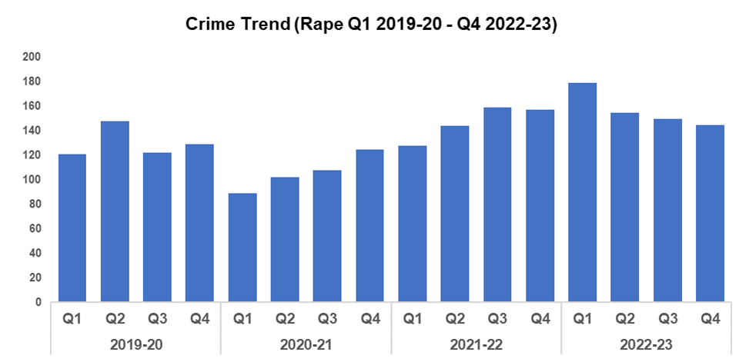
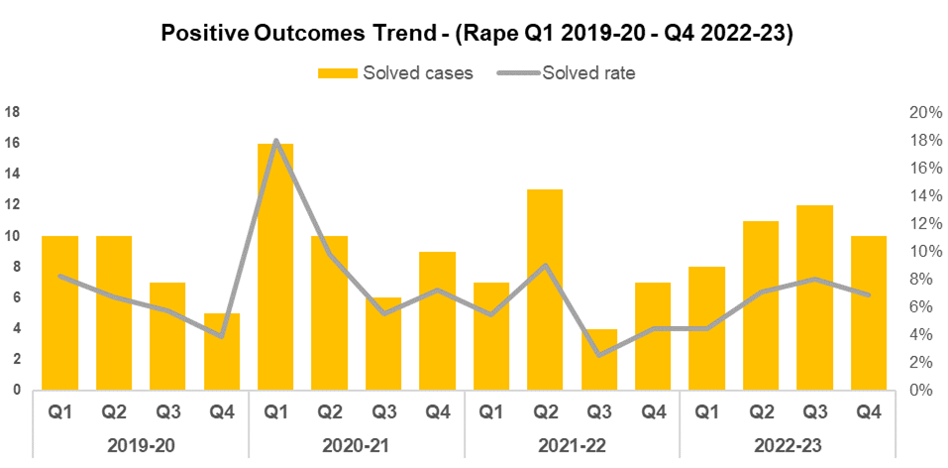
2. Rape
Overview
Rape offences saw a peak during Q1 2022-23, reaching the highest level within the timeframe at 179 offences. Since then, a steady decline in offence volume has been observed, with levels during Q4 2022-23 reducing by 3.3% to 145 (five fewer offences), when compared to the quarter prior. This downward trend in reporting shall be monitored going forward.
When compared to Q4 2019-20 Rape offences have increased by 12.4% (an additional 16 offences), with the financial year as a whole recording an increase of 21.0% (109 additional offences to 629) when compared to 2019-20. These rises are line with the increased reporting required as part of the government’s Beating Crime Plan, and consistent with the local priority to actively increase reporting in this historically under-reported offence category.
Since rising to 8.0% during Q3 2022-23, Rape positive outcome rates have seen a reduction of 1.1 percentage points to 6.9% this quarter. When compared to Q4 2019-20, an increase of 3.0 percentage points can be observed (up from 3.9%). A less prominent increase of 0.3 percentage points to 6.5% can be observed when comparing the financial year against 2019-20.

Slide 21
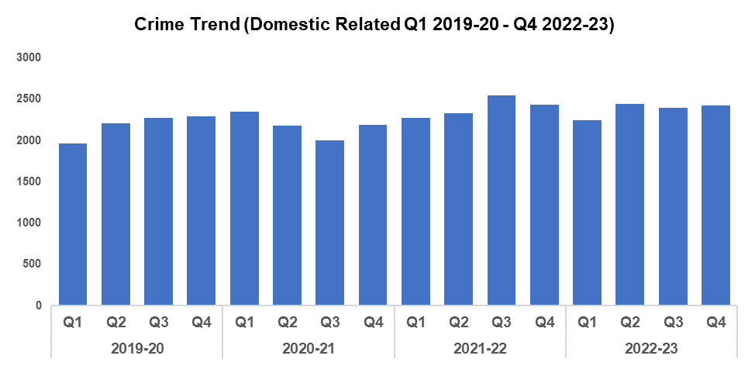
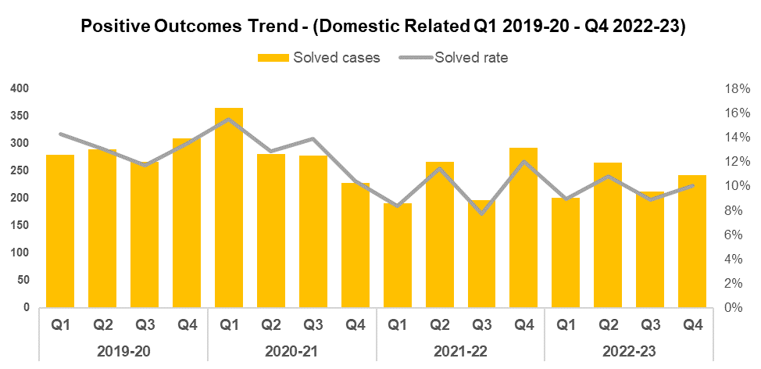
3. Domestic Related Crime
Overview
Domestic related offences have increased by 1.2% (28 additional offences) when compared to the quarter prior, and currently stand at 2,422. When compared to Q4 2019-20, the volume of domestic related offences has increased by 5.6% (additional 128 offences). A more significant increase of 8.7% (an additional 763 offences to 9,505) can be observed when comparing the financial year against 2019-20. These increases may be influenced by ongoing improvements in crime data integrity.
The positive outcome rate for domestic related crime has increased by 1.1 percentage points when compared to the previous quarter, and currently stands at 10.0%. This continues the trend of peaks and troughs that has been observed for this metric since Q4 2020-21. When comparing the current quarter to Q4 2019-20, the positive outcome rate has fallen by 3.5 percentage points (down from 13.5%). A similar reduction of 3.4 percentage points presents itself when comparing the financial year against 2019-20, with the positive outcome rate for 2022-23 currently standing at 9.7%.

Slide 22
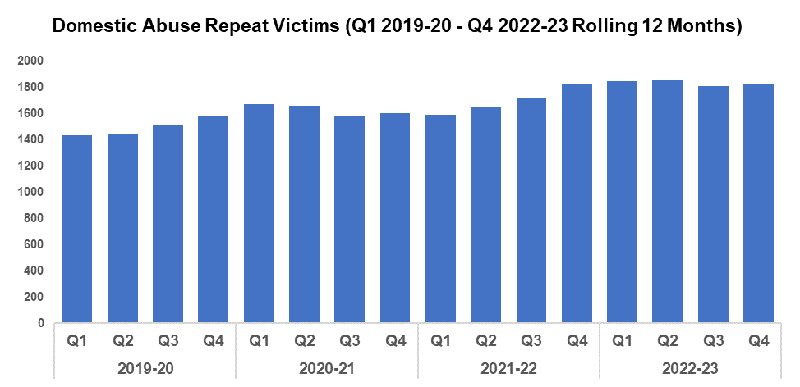
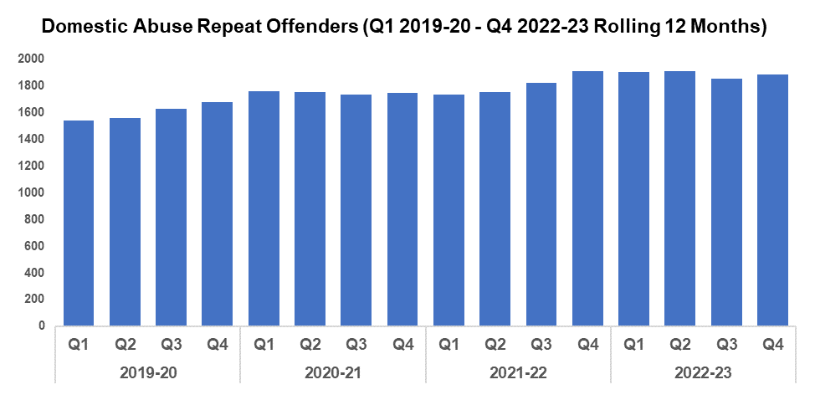
4. Domestic Abuse Repeat Victims/Offenders
Repeat Victims Overview
The amount of repeat domestic abuse victims* has increased by 0.7% (12 additional repeat victims to 1,825) when compared to the quarter prior. When compared to Q4 2019-20, there has been an increase of 15.8% in the number of repeat victims (an additional 249). This increase is more pronounced when comparing the financial year against 2019-20, at 23.1% (1,377 additional repeat victims to 7,348).
It may be that increased scrutiny on correctly recording crime has led to an increase in repeat victims in this crime area. It may also indicate that victims are increasingly willing to report subsequent offences, implying a certain level of victim satisfaction following their initial contact with Gwent Police.
*Based on rolling 12 months to the end of each quarter, where persons are linked to two or more crimes in the year.
Repeat Offenders Overview
The amount of repeat domestic crime offenders* has also risen slightly, increasing by 1.4% when compared to the quarter prior (26 additional repeat offenders to 1,882). When compared to Q4 2019-20 an increase of 12.2% has been recorded (an additional 204 repeat offenders), with a further increase of 17.9% (1,145 additional repeat offenders to 7,550) recorded when comparing the financial year against 2019-20.
There is a Multi-Agency Tasking and Coordination (MATAC) process in place which aims to focus on identifying serial perpetrators of domestic abuse in order to reduce reoffending of the most harmful and serial domestic abuse perpetrators, as well as safeguarding victims and families. A range of interventions can be delivered via MATAC, including support, prevention, diversion, disruption and enforcement, in order to reduce harm.
*Based on rolling 12 months to the end of each quarter, where persons are linked to two or more crimes in the year.

Slide 23
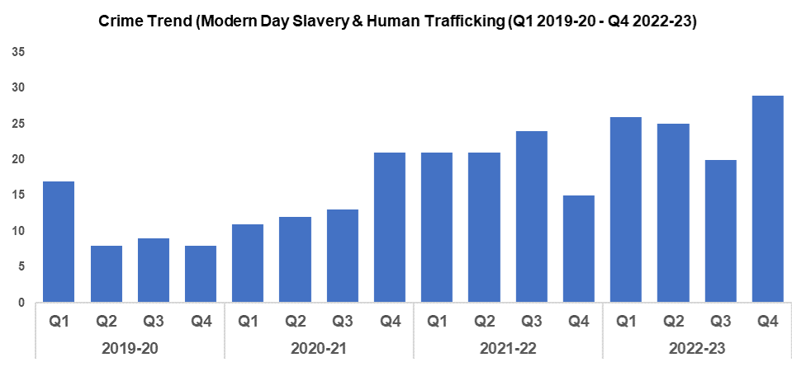
5. Modern Day Slavery and Human Trafficking
Overview
The number of Modern Day Slavery and Human Trafficking (MDSHT) crimes has increased by 45.0% (nine additional offences) when compared to the quarter prior, and currently stands at 29. This represents the highest quarterly total within the timeframe, perhaps indicative of the ongoing proactive work by the MDSHT team.
When compared to Q4 2019-20, the volume of recorded MDSHT crimes has increased by 262.5% (additional 21 offences). A smaller though still significant increase of 138.1% was recorded when comparing the financial year against 2019-20 (58 additional offences to 100).
Continued awareness training has been delivered to new starters, new CSOs, and trainee detectives. The number of National Referral Mechanisms submitted has also continued to increase.
PCSOs engaged with nearly 100 National Express passengers and drivers arriving in Newport to raise awareness of exploited victims using the buses for trafficking drugs into Gwent.

Slide 24
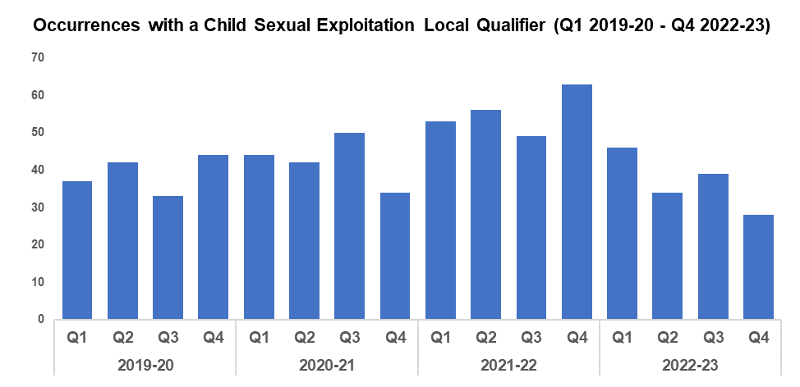
6. Child Sexual Exploitation/Child Criminal Exploitation
Overview
During Q4 2022-23, the volume of crimes assigned a Child Sexual Exploitation (CSE) local qualifier declined by 28.2% (11 fewer offences) when compared to the quarter prior, and currently stands at 28. A reduction of 36.4% (16 fewer offences) can be observed when comparing Q4 2022-23 against the same quarter during 2019-20, with a less prominent reduction of 5.8% (9 fewer offences to 147) observed when comparing the financial year against 2019-20.
The offence most commonly assigned a CSE local qualifier during Q4 2022-23 was ‘Take/make indecent photographs/pseudo-photographs of children’, with six instances.
As part of Operation Trinity, RPSO officers assisted the Public Protection Unit (PPU) with a number of pre-planned early morning warrants for the possession of indecent images and sexual offences involving children. Three warrants were executed, two in Gwent and one in the South Wales Police area. These lead to a number of arrests, preventing further offending and safeguarding children.
Following a national report around increases in child abuse offences, a detective constable was recognised with a national award for his role in investigating indecent images of children as part of a widespread enquiry into piracy and intellectual property offences.

Slide 25
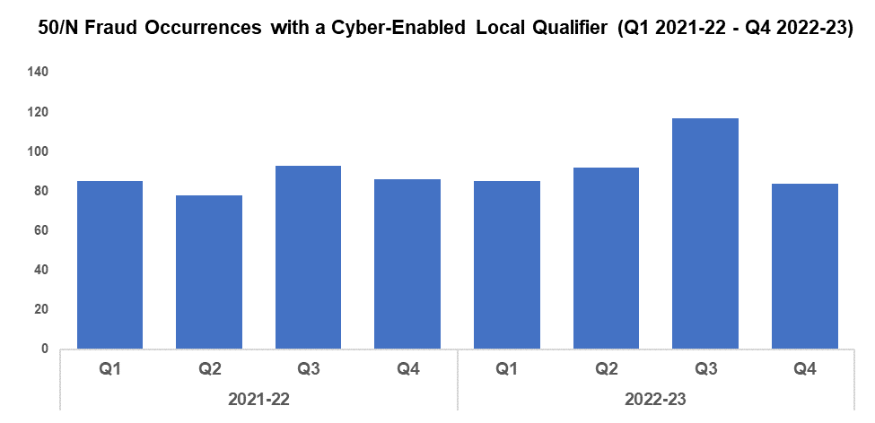
7. Cyber Fraud
Overview
Of the 1,557 fraud occurrences under 50/N recorded since April 2021, 46.2% (720) have a cyber-enabled local qualifier
After a number of members of an OCG were arrested and remanded for drug supply offences, the Officer in Case (OIC) conducted a review of prison phone calls. It was noted that the principle OCG made reference to owning Bitcoin. The OIC referred the case to the Cyber Crime Unit and a speculative request was submitted to Coinbase. The return evidenced that another OCG member had a significant amount of cryptocurrency. Further analysis of the transactions identified other account holders and additional suspects. In total, seven suspects were charged with cryptocurrency money laundering. In April, all seven entered guilty pleas to millions of pounds worth of money laundering via cryptocurrency, with the principle OCG likely to face a 20 year sentence.
A Community Support Officer (CSO) recently attended the Gwent Women’s Institute AGM to provide a bespoke Protect input. Following the well attended event, the CSO received excellent feedback from members who described it as the best talk they have been in receipt of. The Chair of Gwent Women’s Institute has contacted the Chief Constable directly to recognise the CSO’s good work.
The Financial Investigation Unit (FIU) has completed 36 civil detention orders, 14 civil forfeiture orders, and eight criminal confiscation orders this quarter as part of their Proceeds of Crime work, denying criminals a total of £575,658.15 in assets. In addition, Gwent Police received £109,948.68 from the Home Office as part of the Asset Recovery Incentivisation Scheme (ARIS).
In the same period, the FIU has made 42 safeguarding interventions resulting in £127,750.00 of vulnerable victims’ monies being safeguarded/returned. The team has also participated in five external events during the last quarter, raising public awareness of fraud. Four events were open to the general public and the other was aimed at trainee accountants working in the public sector.

Slide 26
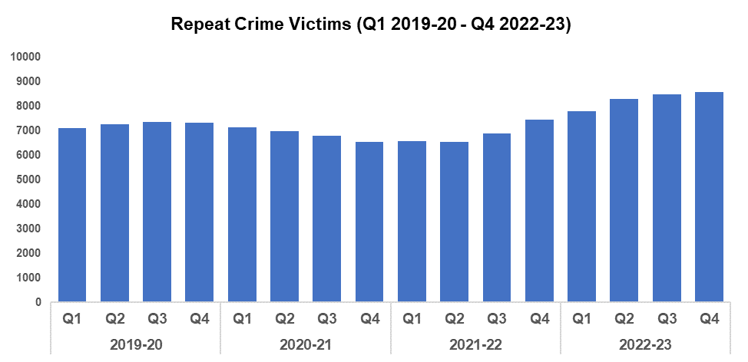
8. Victim Support/Repeat Victims
Overview
In this context, a repeat crime victim refers to an individual who has been linked as a victim in two or more crimes within a 12-month rolling period.
The number of repeat crime victims has increased by 2.0% (172 additional repeat victims) during Q4 2022-23* when compared to the quarter prior, and currently stands at 8,778. This is the highest level within the timeframe, continuing the upward trend which began following Q2 2021-22. An increase of 19.3% (1,421 additional repeat victims) can be observed when comparing Q4 2022-23 against Q4 2019-20, with a rise of 15.0% (4,384 additional repeat victims to 33,612) recorded when comparing the financial year against 2019-20.
Whilst overall crime volume has fallen following Q2 2022-23, levels of repeat crime victims continue to rise. This rise may be influenced by improvements in the identification of repeat victims. For instance, efforts have been made to increase the completion rate of the Threat, Harm, Risk, Investigation, Vulnerability and Engagement (THRIVE) script by control room staff, allowing them to quickly establish (amongst other factors) whether or not the caller is a repeat victim. The THRIVE completion rate currently stands at 73.2%, up from 49.4%.
*Based on rolling 12 months to the end of each quarter.
Officers attended an incident in which a male had attempted to take his own life using a pair of scissors, severing his jugular. The officers were able to apply pressure to the wound with bandages as the male fell in and out of consciousness and into shock, before being conveyed to hospital. The male survived, owing to the actions of the officers.
RPSO officers attended the second Severn Bridge following a report of a male acting suspiciously. The officers quickly identified that the male was suffering a mental health crisis. Officers engaged with the male and persuaded him to sit in the Police Vehicle, taking him away from the bridge. As mental health services did not admit him, the male was taken to the Grange University Hospital where officers remained with him until he received the support he required.
Suicide investigations have been reviewed and areas of learning identified. This learning has been shared by creating a checklist of actions that should be completed by every officer attending a report of suicide. This has been cascaded to frontline officers and shared on the intranet.
A new Victims Code of Practice framework has been created by Victim Services, tailored to individual areas and models of the organisation. This provides a clear directive of what the rights are, who is responsible for them, and how this is done. Changes have also been made to processes within Victim Services, in order to better support Force Control Room staff and help reduce demand. In addition, a detailed community mosaic of victim satisfaction within each LPA has been created; with Victim Services working closely with front line colleagues to tailor an improved response based on these findings and service recovery reports.

Slide 27
Victim Support/Repeat Victims
The Victim Care Unit reports that over the course of the quarter, 13,334 victims have been referred into the service. Continuous improvements are being made to ensure that victims of crime are assessed/referred for specialised support, with 963 detailed needs assessments completed. Regular updates have been provided to 2,701 victims in order to keep them informed throughout the criminal justice process, and 5,963 victims have been informed of their rights under the Victims Code of Practice.
The Witness Care Unit is currently supporting 6,438 victims and witnesses, with an average attendance rate of 87% for Magistrates Court and 97% for Crown.
The Survivor Engagement Co-Ordinator (SEC) continues to engage with survivors of sexual and domestic offences in order to gather feedback on their experience of reporting to Gwent Police, with themes and trends being reported through the governance structure to enable change. Survivor videos have been completed and plans are in place with Learning and Development, detailing the new training packages and how they will be delivered to front line colleagues. A review of non-penetrative sexual offences resulted with an Outcome 16 (Victim declines/withdraws support – named suspect identified) has been carried out, with examples of good work by officers being shared.
The Victim Reference Group continues to grow from strength to strength with their knowledge and input being used right across the Violence against Women, Domestic Abuse and Sexual Violence (VAWDASV) sector to ensure whole service improvement. One of the members has been successful in securing a place on the Welsh Government panel.
The Special Measures Advisor continues to provide quality assurance for the force by running a search for not guilty at plea (NGAP) domestic abuse and Rape and Serious Sexual Offences (RASSO) court cases. Once identified, the victims and witnesses are contacted to complete a tailored needs assessment that helps determine if special measures are required and which are most appropriate for them. The role is raising awareness of the remote evidence site and there has already been a significant increase in MG2 (witness assessment for special measures) forms requesting this being submitted.

Slide 28
Increase Community Confidence in Policing
Perceptions Survey
Victim Satisfaction
Representative Workforce
Investigation Timeliness
Response Rates
999 Demand
101 Demand
Social Media and Single Online Home
Initiatives & Events
Professional Standards Department: Complaint Allegations & Cases, IOPC Timeliness & Reviews, Vetting
Key commitments
Increase the effectiveness of officer and staff engagement with residents in their communities, and community confidence and trust in Gwent Police
Improve the accessibility of neighbourhood police teams through a variety of contact channels that meet the needs of the public
Increase reporting of crime by communities that are less likely to engage with the police
Further increase officer and staff diversity to ensure our police service reflects the communities that we serve

Slide 29
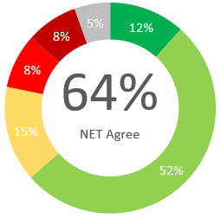
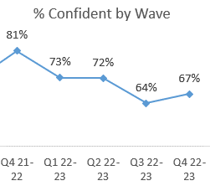
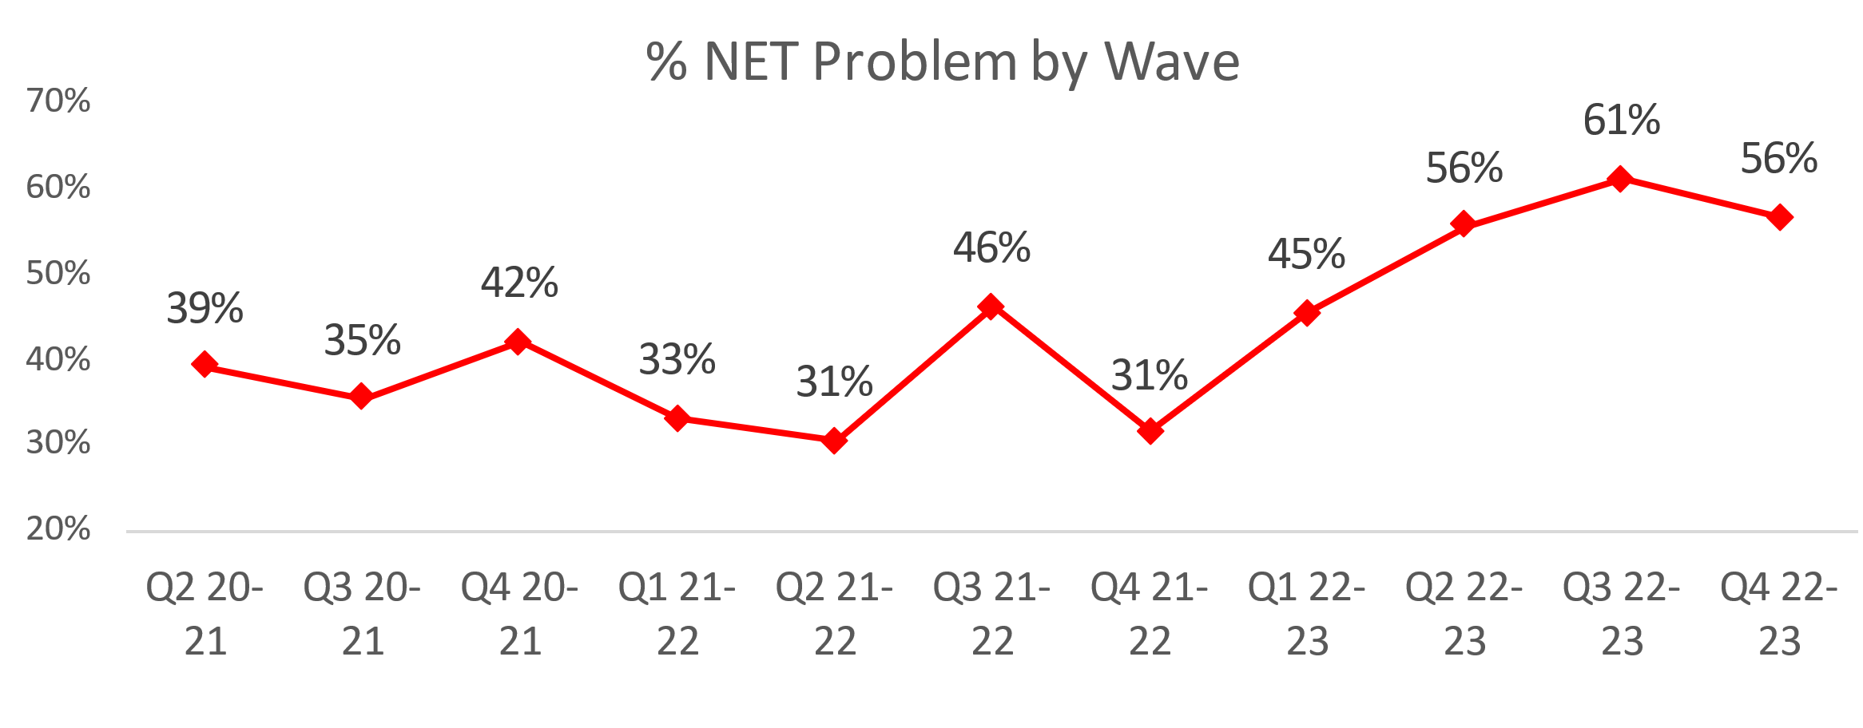
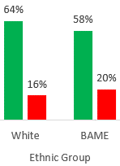
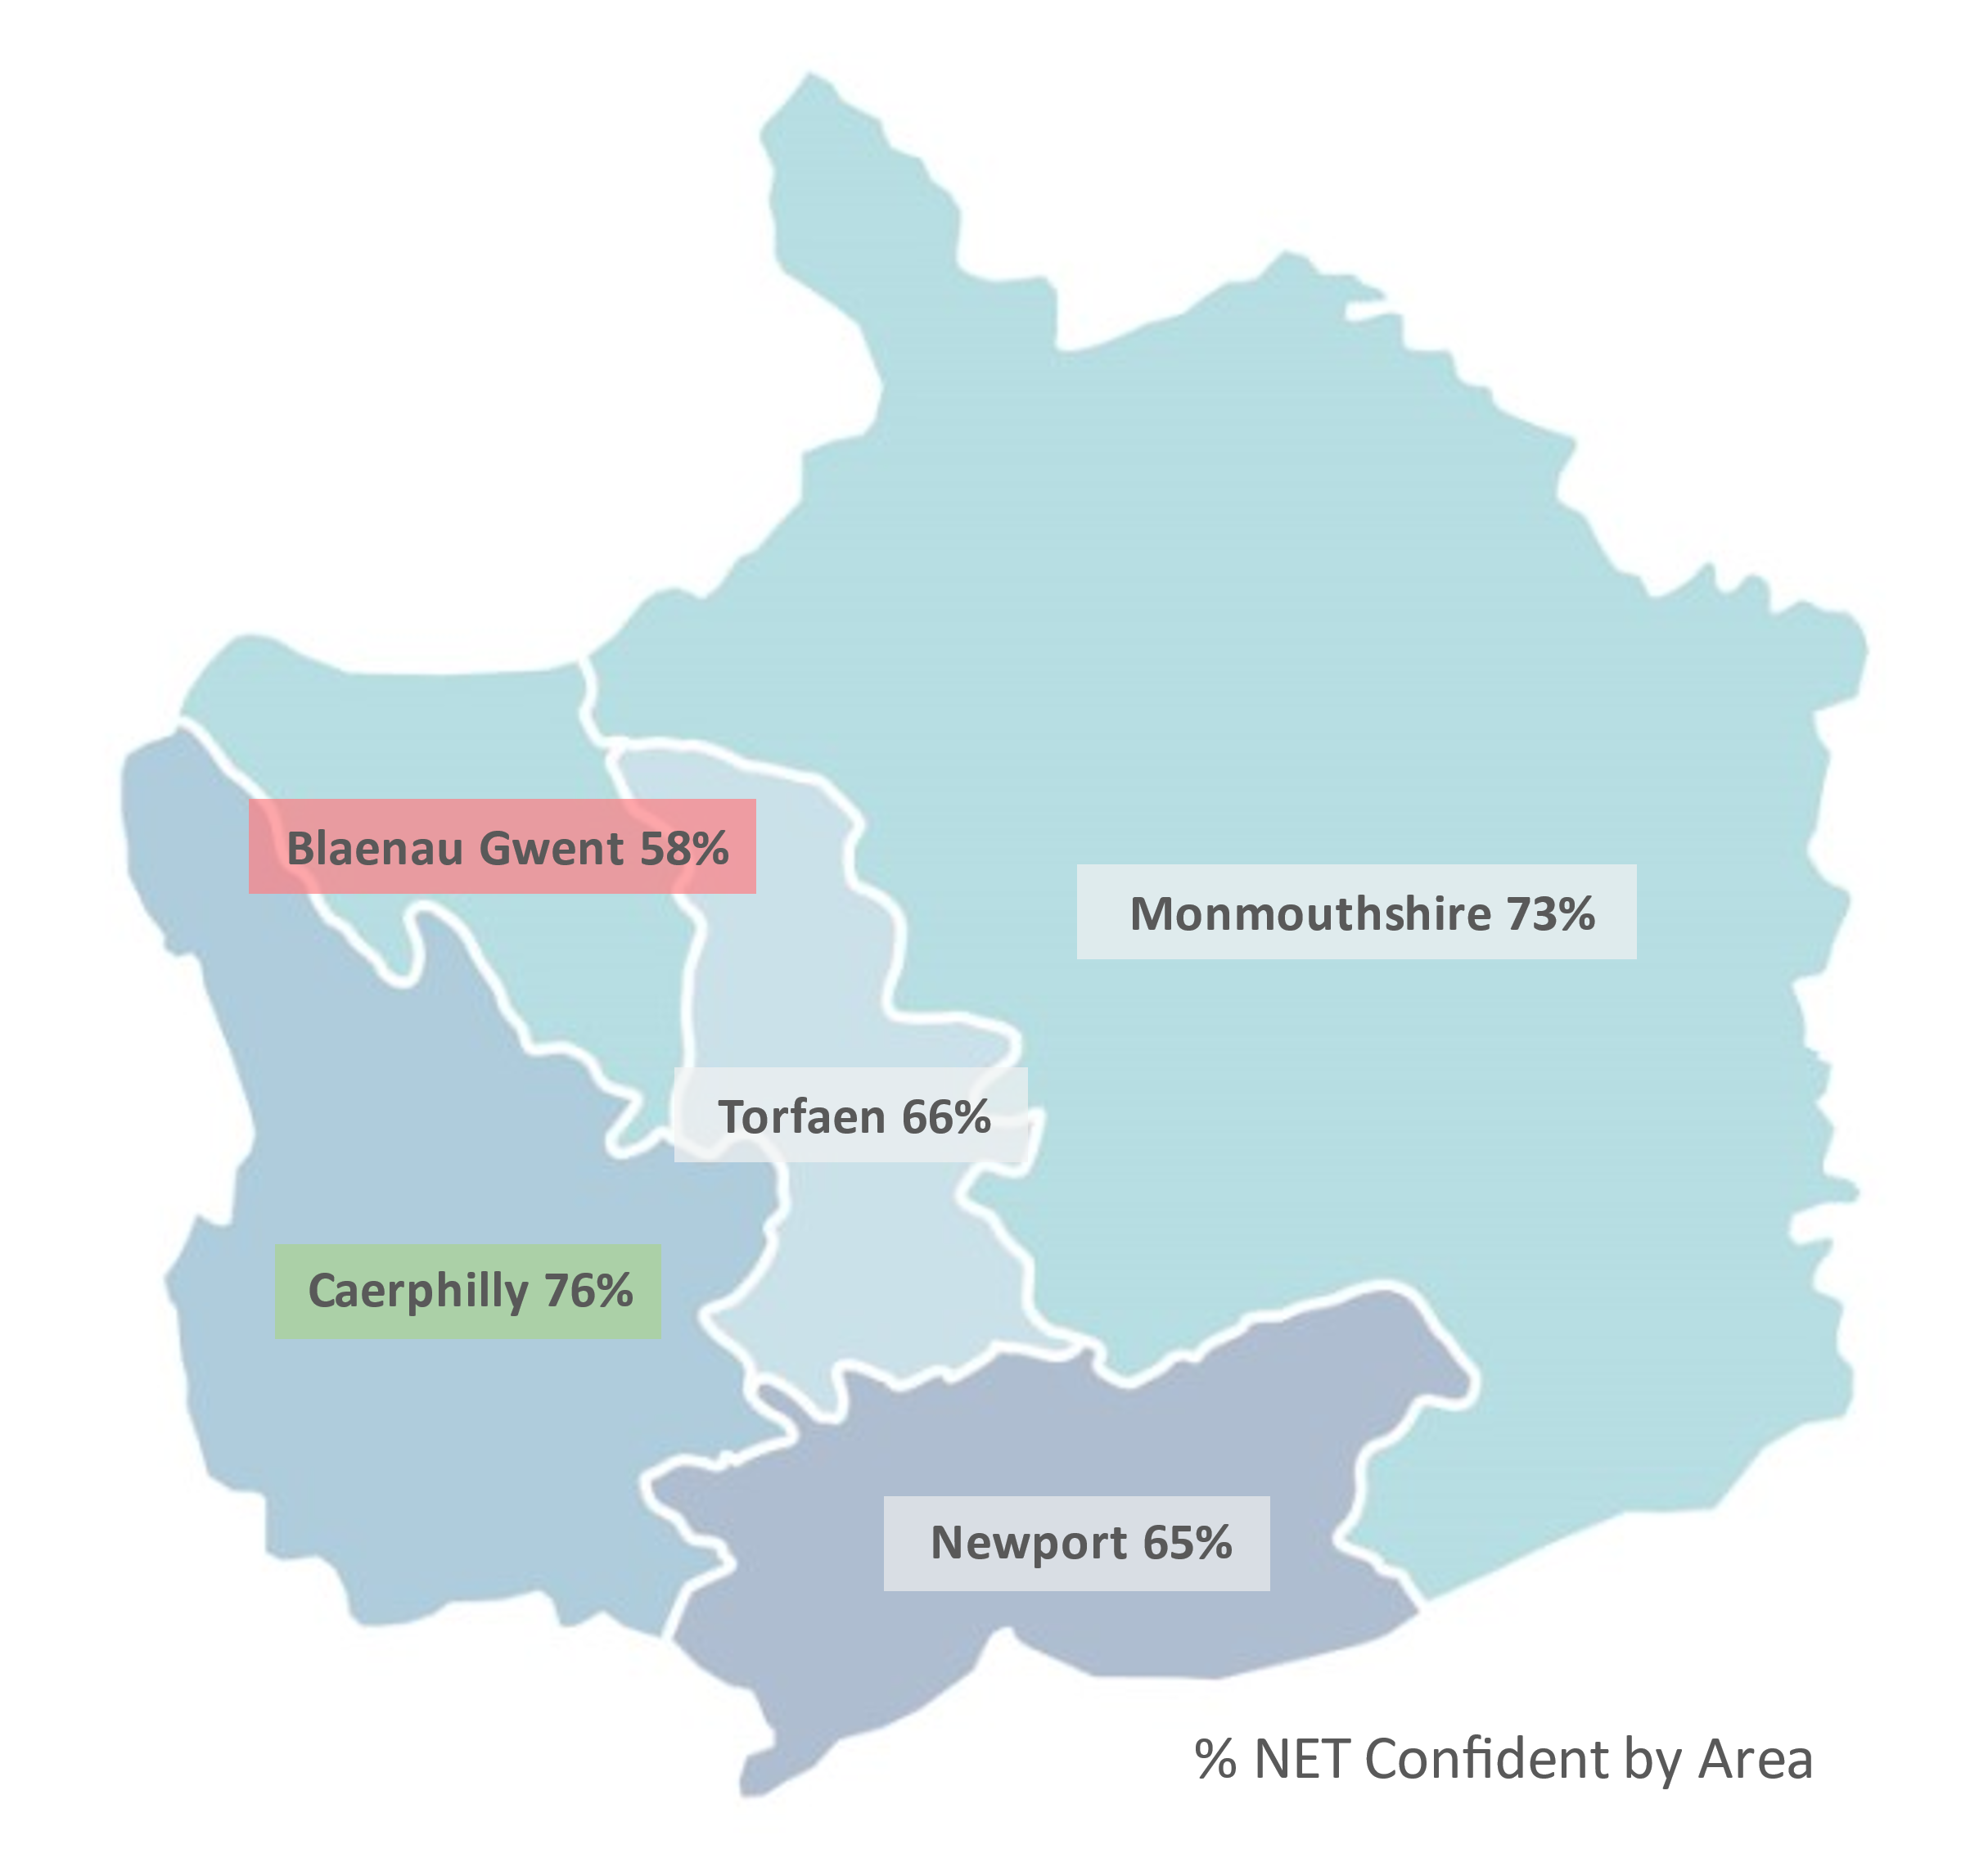
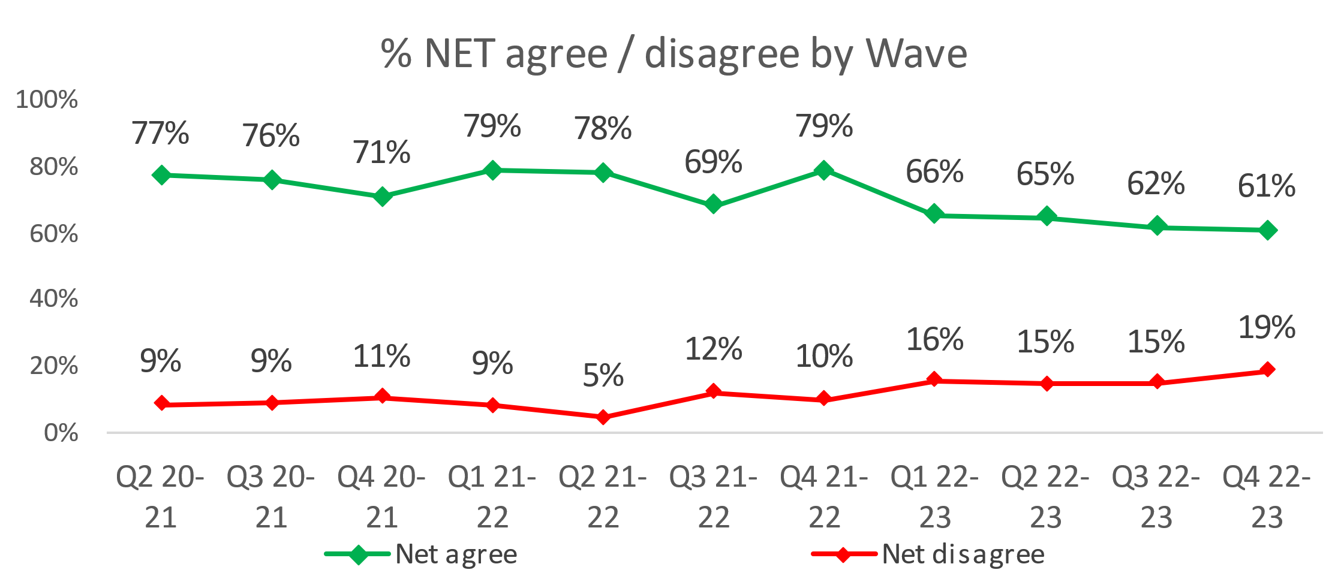
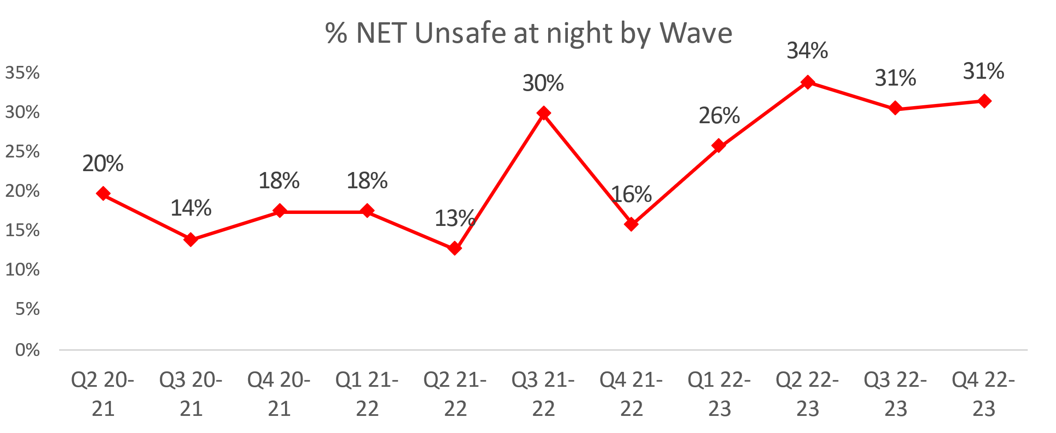
1. Perceptions Survey: Local Concerns and Overall
Overall Confidence in the Police
Local Concerns
Positive Experiences
“They were very sympathetic when we spoke to them, they seemed to appreciate that a lot of the people up our road are elderly and its very frightening having people kicking your door at night.”
“We had one incident with someone jumping in the hedge, but nothing major that we had to call the police about. In the past when things have gone on in the village the police have sorted it as far as I know.”
Nearly two thirds (64%) of people agree they have confidence in the police in their area. This is lowest in Blaenau Gwent (54%) and highest in Monmouthshire (71%).
More than half (55%) feel that crime and ASB are a problem in their area.
This metric remains high having risen by 16.0pp in the previous two quarters. Newport (67%) is the area of highest concern whereas Monmouthshire (25%) has the lowest perceived concern.
Two-thirds of residents are confident they could easily speak to police in their area, however this has reduced over the previous 4 quarters (67% in Q4 2022-23).
Ethnic minority groups have less confidence in this statement, with 58% agreeing they have confidence in police in their area.
There is a sustained rise in feeling unsafe at night, particularly in Newport (37%). Monmouthshire (14%) felt the safest. This trend follows the above trend relating to ASB and Crime in their area.
Lack of action
“I can see in my local area that the anti-social behaviour, drug misuse, vandalism and littering is not taken care of.”
“I think they have proven that they're never here when they're needed, it happens time and time again.”
“I don't see them dealing with anti-social behaviour from young people and travellers in the area. It's an ongoing issue that they are aware of but ignore.”
Minority
A downward trend is apparent with overall confidence dropping from 79% in Q4 2021-22 through to 61% in Q4 2022-23.
An unsurpassed 19% disagree that they have confidence in the police in their area
For the above statement, Blaenau Gwent had the lowest confidence (58%) whilst Caerphilly had the highest confidence (76%).
3.0% have been a victim of crime and did not report to Gwent Police. Applying this to the population of Gwent, this would equate to 17,631 individuals.
“All they do is give you a crime number and say they'll look into it, but they never do.”
Notes:
Based on the Gwent Police Perceptions Survey for Wave (Quarter) 4 2022-23, conducted by SMSR Research
Between October 2020 and March 2023, 6,004 residents across all 5 police districts were interviewed using random quota sampling designed to accurately represent the population size and demographics of Gwent. These slides highlight the main points from the latest results.

Slide 30
2. Victim Satisfaction
Percentage | Measure
Survey Number | Survey One | Survey Two |  |  |  | Survey Three
Metric | Satisfied with Initial Contact | Satisfied with Follow Up & Investigation | Satisfied with the service from the VCO | Satisfied with the service from the officer dealing with your case | Satisfied with being kept informed about your case | Satisfied with Post Charge
General Crime | 59% | 57% | 87% | 79% | 77% | 40%
Domestic Violence | 75% | 83% | 96% | 83% | 86% | 100%
Hate Crime | 100% | 67% | 100% | 100% | 100% | No Data
Sexual Violence | 100% | 80% | 100% | 80% | 100% | No Data
Baseline | N/A | N/A | 85% | 85% | 74% | N/A
Numeric | Measure
Survey Number | Survey One | Survey Two |  |  |  | Survey Three
Metric | Satisfied with Initial Contact | Satisfied with Follow Up & Investigation | Satisfied with the service from the VCO | Satisfied with the service from the officer dealing with your case | Satisfied with being kept informed about your case | Satisfied with Post Charge
General Crime | 461/786 | 49/86 | 40/46 | 33/42 | 34/44 | 2/5
Domestic Violence | 42/56 | 24/29 | 24/25 | 20/24 | 18/21 | 7/7
Hate Crime | 11/11 | 2/3 | 3/3 | 3/3 | 3/3 | No Data
Sexual Violence | 9/9 | 4/5 | 5/5 | 4/5 | 4/4 | No Data
Sample Size | 862 | 123 | The above questions can be answered with ‘N/A’. These responses have been removed from both the percentage and numeric calculations. As a result, the sample size will differ from that for ‘Satisfied with Follow Up & Investigation’. |  |  | 12
Notes:
Victim Satisfaction Survey
This is the latest update from the VSS.
The baselines are calculated out of the business benefits for the VCU and would have been taken out of satisfaction survey reports from before the new model was created

Slide 31
3. Representative Workforce
The following data is correct as of 31 March 2023
Overview
There is a gender disparity evident in the workforce for both officers and staff. For officers, females are underrepresented by approximately 15 percentage points (females account for 51% of the population in Gwent based on 2021 Census). However, females are overrepresented in the staff workstream area (by approximately 16 percentage points).
There is also disparity in the minority ethnic representation within the workforce. In Census 2021, 8.6% of the Gwent population (5.6% in Census 2011) are from an ethnic minority background, which includes individuals in the following ethnic groups: Asian, black, mixed, other and white minorities. The above table groups this differently, with white including white minorities (Gypsy, Roma and Irish Traveller groups, Irish and any other white background). In Census 2021, 5.8% of the Gwent population (3.9% in Census 2011) are from an ethnic background other than white. For police officers, currently 3.6% are from an ethnic group other than white. Ethnic minority representation in staff is lower at 1.9%.
The percentage of female police officers has risen to 36.6%, which is above the England and Wales average of 35.6%.
The EDI team have developed and delivered new equality impact assessments for all force policies and procedures, including a new quick start guide and dedicated surgeries to aid policy leads. They have also delivered and are overseeing the force’s local delivery plan to become an anti-racist organisation.
Gwent Police achieved Operation Uplift , as well as the stretched target of 1,521 officers by the 31st March 2023. The police officer establishment was 33 over the establishment of 1,506 by the 31st of March 2023 and 18 over the stretched target of 152. The Home Office has agreed to fund an additional 21 officers (providing £945,000). This is not an increase to the baseline budget. This funding is linked to the additional officers being in place at the end of September 2023 and March 2024.
15 New CSOs started with Gwent Police in February 2023 and a plan for two further intakes over 2023-24 is in place. Eight special constables started in April 2023 and a long term strategic recruitment plan is in place to increase special constables over the next three years

Slide 32
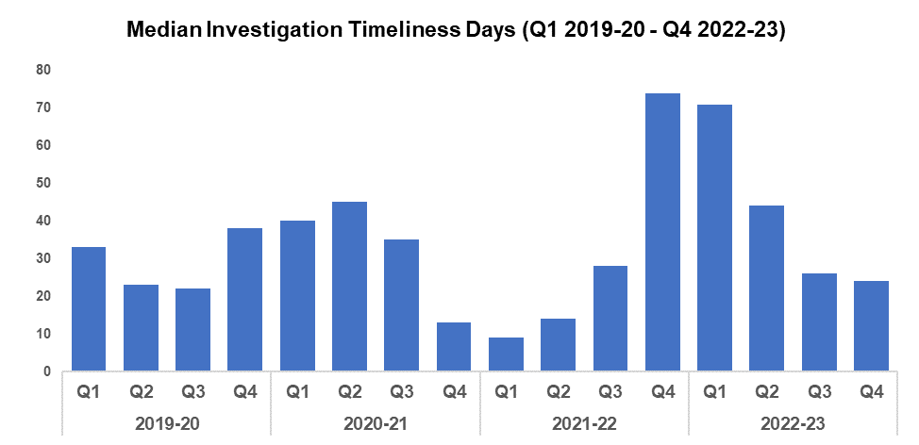
4. Investigation Timeliness
Overview
The median number of days in which an investigation is completed has continued to decrease when compared to the previous quarter, from 26 to 24 (a reduction of 7.7%, or 2 fewer days). When compared to Q4 2019-2020, median investigation length has seen a reduction of 36.8% (14 fewer days). An increase of 37.9% can be observed when comparing the financial year against 2019-20 (11 additional days to 40). This is due to the elevated investigation times seen during quarter one and quarter two of 2022-23, on account of a backlog of occurrences which were awaiting finalisation by the Crime Management Unit (CMU).
Investigation timeliness has improved when compared to the quarter prior for the fourth time in sequence, and is now below the levels recorded during the same quarter in 2019-20.
There are 15,608 crimes open and unfinalised (excluding pending finalisation), compared to the total of 14,346 open crimes reported during the quarter prior. This is an increase of 1,262 crimes, or 8.8%. Based on the crime recorded date to the date on which this data was collected (20/04/2023), of those currently unfinalised 9,892 have been open for less than 6 months, 3,473 have been open for between 6 and 12 months, and 2,243 have been for open for over 12 months. For those over 12 months old, Violence without Injury account for the majority at 22.4% (503 crimes), followed by Rape at 13.5% (304 crimes).
The Image Circulation Portal (ICP) will be implemented shortly. This is a web-based application that allows images of unknown suspects to be added by officers. These images are sent to the ID Unit who assess their suitability for facial recognition matching, or general circulation for statement identifications to be made. The portal replaces the need to task the ID Unit via NICHE, allows for better compliance with the principles of the Police and Criminal Evidence Act (PACE), and produces more successful results.

Slide 33
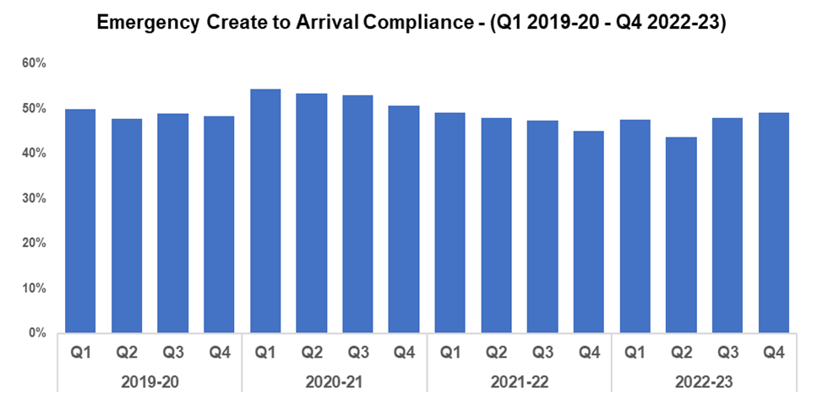
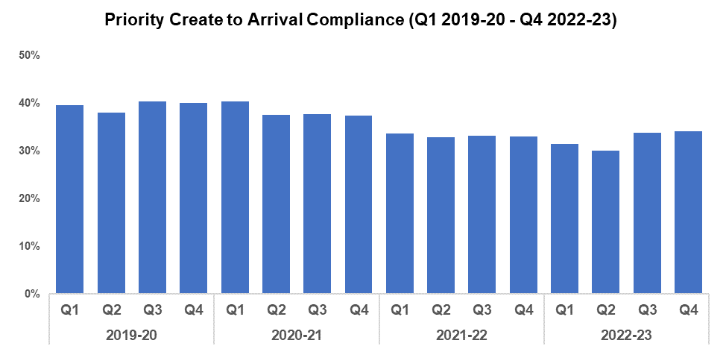
5. Response Rates
Overview
Based on the target arrival time of 15 minutes, emergency response compliance for the force has increased in Q4 2022-23 by 1.0 percentage point when compared to the previous quarter and currently stands at 49.0%. Emergency create to arrival compliance has increased by 0.7 percentage points in Q4 2022-23 when compared to the same quarter in 2019-20 (up from 48.3%). However, compliance decreased when comparing the financial year against 2019-20, by 1.8 percentage points to 46.9%.
The median create to arrival time for emergency graded incidents in Q4 2022-23 was 15 minutes and 16 seconds, this is a marginal improvement when compared to the previous quarter (15 minutes and 17 seconds). Timings were slightly faster when comparing Q4 2022-23 with the equivalent quarter in 2019-20, during which they stood at 15 minutes and 22 seconds.
Based on the target arrival time of one hour, priority response compliance for the force has increased in Q4 2022-23 by 0.4 percentage points when compared to the previous quarter and currently stands at 34.2%. Priority create to arrival compliance has decreased by 5.9 percentage points in Q4 2022-23 when compared to the same quarter in 2019-20 (down from 40.1%). This rate has also decreased when comparing the financial year against 2019-20, by 7.1 percentage points to 32.4%.
The median create to arrival time for priority graded incidents in Q4 2022-23 was 1 hour 44 minutes and 8 seconds, this is an improvement when compared to the previous quarter (1 hour 48 minutes and 50 seconds). However, timings were slower when compared with the equivalent quarter in 2019-20, during which they stood at 1 hour, 21 minutes and 9 seconds.
Training for the resource and demand management software IR3 has been completed by officers and staff of all ranks and grades, including Force Control Room (FCR) staff. This supports the efficient deployment of resources and the effective use of force vehicles.

Slide 34
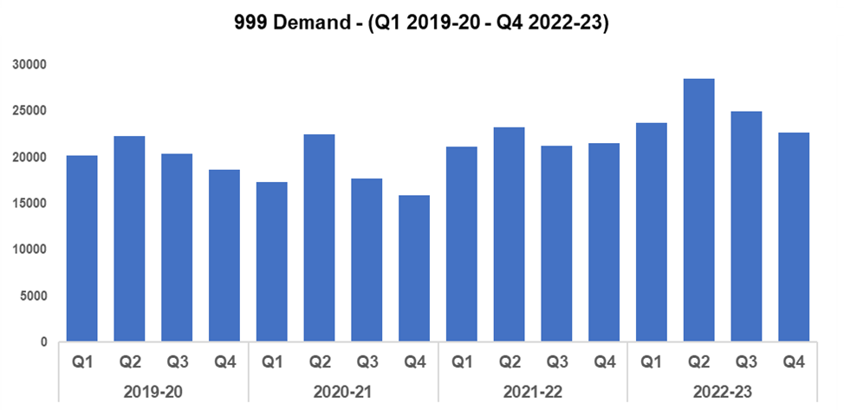
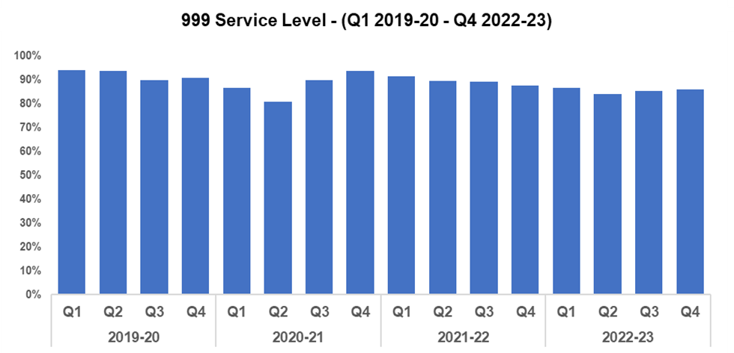
6. 999 Demand
Overview
999 demand has decreased in Q4 2022-23 when compared with the previous quarter by 9.1% (2,266 fewer calls). This is the second consecutive reduction in 999 call volume after an increase in demand for three consecutive quarters following Q3 2021-22. However, when comparing the figure seen in Q4 2022-23 to the same quarter in 2019-20, there has been an increase of 21.2% (an additional 3,960 calls). A similar increase is evident when comparing this financial year to 2019-20, with call volume rising by 22.4% (additional 18,262 calls to 99,891).
Apart from the higher call volumes, 999 trends for financial year 2022-23 have followed a very similar seasonal pattern to those observed during 2019-20 and 2020-21. These trends show 999 demand increase in quarter two from quarter one, before falling in both quarter three and quarter four.
The percentage of 999 calls answered within 10 seconds (service level) improved slightly in Q4 2022-23 when compared to the previous quarter, by 0.5 percentage points (up from 85.6% of calls to 86.1%). 999 service level decreased when comparing Q4 2022-23 to the same quarter during 2019-20 (down 4.9 percentage points from 91.0%). Similarly, service level decreased when comparing this financial year to 2019-20 (down 7.7 percentage points to 86.0%).
999 average speed of answer also improved slightly during Q4 2022-23 in comparison to the previous quarter, by 1 second (down from 11 seconds to 10 seconds). The average speed of answer during Q4 2019-20 was 6 seconds quicker, at 4 seconds.
The Digital Services Division continues to develop the NICE investigation system, including the implementation of the Redbox connector. This will make the vast majority of 101 and 999 calls available in NICE Investigate automatically, removing the need for officers to contact the Force Control Room and saving operators time that would otherwise be spent downloading evidence.

Slide 35
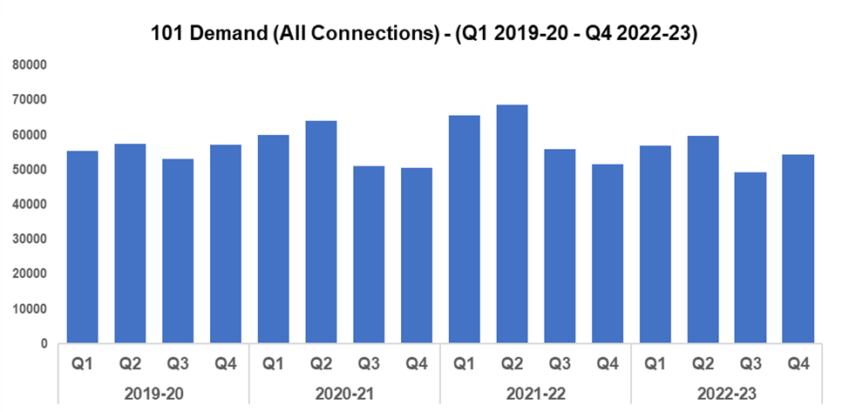
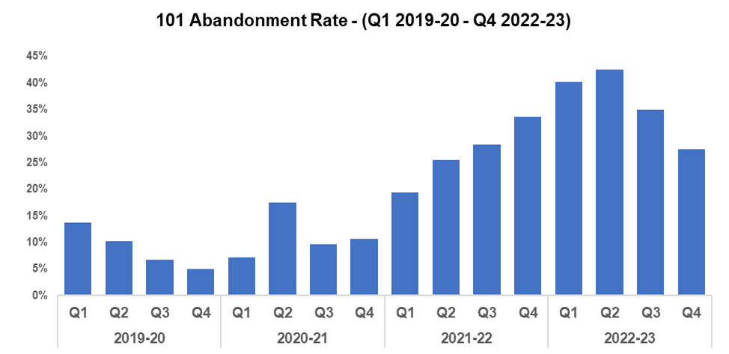
7. 101 Demand
101 Average Answer Speed
(Minutes/Seconds)
Overview
101 demand (all connections) for Q4 2022-23 increased in comparison to the previous quarter by 10.3% (5,068 additional calls). However, demand has decreased when compared to Q4 2019-20 by 4.8% (2,722 fewer calls). 101 demand for the financial year has decreased by 1.2% (2,676 fewer calls to 220,342) when compared to 2019-20.
The 101 abandonment rate has decreased in Q4 2022-23 by 7.5 percentage points when compared to the previous quarter and currently stands at 27.5%. This represents a second consecutive improvement in 101 abandonment performance. 101 abandonment rate has increased by 22.5 percentage points in Q4 2022-23 when compared to the equivalent quarter during 2019-20 (up from 5.0%), and by 26.9 percentage points (up to 36.3%) when comparing the financial year against 2019-20.
The average answer speed for 101 calls decreased by 1 minute and 54 seconds to 7 minutes and 47 seconds in Q4 2022-23 when compared to the previous quarter, but has increased when comparing this financial year to 2019-20 (up 6 minutes and 10 seconds to 7 minutes and 39 seconds).
Following a Victim Services Assessment conducted by HMICFRS a THRIVE script was introduced as a requirement for every call within the force. Since it’s introduction, THRIVE script performance and THRIVE compliance has been monitored and has evidenced a notable improvement. At the end of Q4 2022-23, the percentage of eligible calls with a THRIVE script was 93.3% and the THRIVE compliance rate was 90.5% (5,236 completed and 462 aborted). The THRIVE completion rate was positioned at 73.2%.

Slide 36
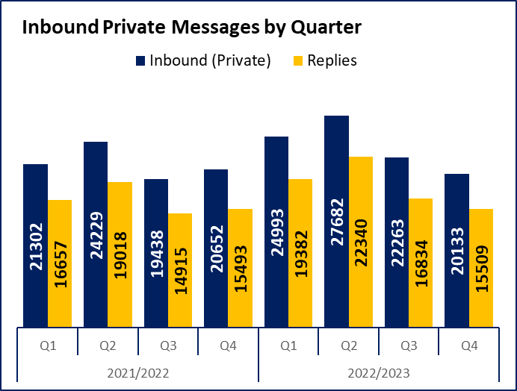
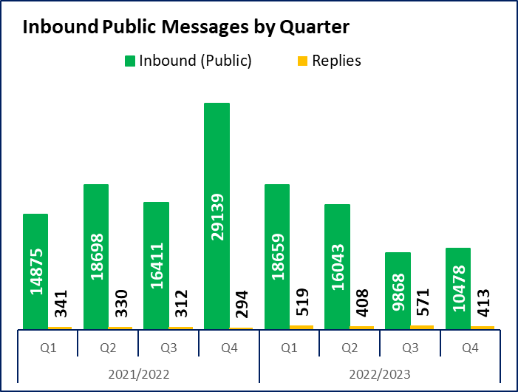
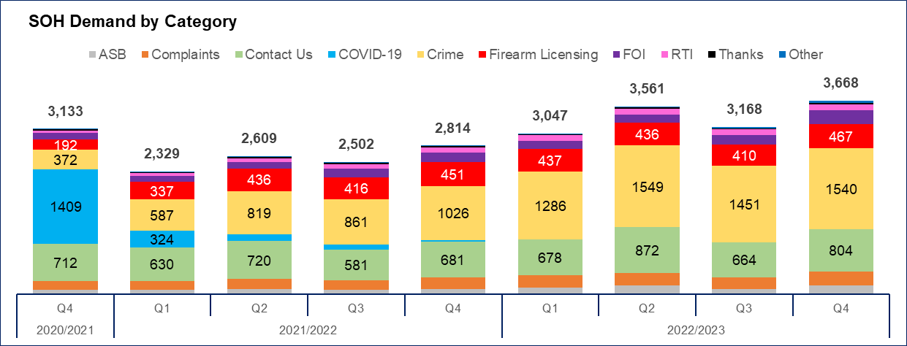
8. Social Media and Single Online Home
Key Points
Inbound private messages received via Gwent Police’s social media platforms decreased during Q4 2022-23 when compared to the quarter prior by 9.6% (2,130 fewer messages) to 20,133. In terms of inbound private message sources, 93.1% (18,734 messages) were received through Facebook platforms. Sundays saw the highest volume of inbound private messages (3,366).
Inbound public messages received via Gwent Police’s social media platforms increased during Q4 2022-23 when compared to the quarter prior by 6.2% (610 additional messages) to 10,478. In terms of inbound public message sources, 83.3% (8,728 messages) were received through Facebook platforms. Fridays saw the highest volume of inbound public messages (1,763).
This digital contact data includes our English and Welsh Facebook and Twitter accounts.
Key Points
3,668 Single Online Home (SOH) forms were submitted to Gwent during Q4 2022-23, an increase of 15.8% (500 additional forms) when compared to the quarter prior.
The adjacent chart presents these forms by category. The majority of these contacts are either crime reports (42.0% or 1,540 forms), general ‘contact us’ messages (21.9% or 804 forms) or firearm licensing (12.7% or 467 forms). ‘Other’ includes forms with low volume, including events and processions, filming, fingerprints and IP licensing.

Slide 37
9. Initiatives & Events
Overview
A dangerous dog policy has been written and implemented to provide the relevant guidance and legislation to staff, with a view to delivering a consistent approach to the community whilst keeping them safe, especially at a time when there has been increased media scrutiny around how the police deal with such incidents. The policy has been instrumental in helping staff navigate their way through both a proactive and proportionate response.
HR have concluded an Employee Opinion Survey. 90.4% of respondents stated they are encouraged to speak up when they identify breaches of professional standards or the criminal threshold, and 88.3% stated they felt able to challenge inappropriate behaviour in the workplace. The Sexual Harassment in the Workplace policy is current out for consultation.
A new starters questionnaire is now live and available for all new starters at six weeks and six months. The results will be presented at the Culture Board. Overall, new starters have a positive experience of recruitment, on-boarding and the induction programme.
The EDI are providing dedicated briefings for officers and staff on Andrew Tate, following increased risk identified by local schools. They have also held a number of events with the goal of increasing community confidence in policing, including:
Hosting the Welsh language commissioner as part of St David’s Day celebrations with our workforce and our communities.
Supporting a range of local events highlighting the important role women play across Gwent as part of International Women’s Day.
Effectively engaging with several local community groups as part of Ramadan, taking part in Iftar celebrations. Internally EDI also gifted advent calendars and other dietary items for those breaking their fast.
Delivering a series of internal training seminars in partnership with Sight Loss Cymru.
Hosting the Kurdish All Wales Association at Gwent Police HQ, with additional visits planned to focus on scrutiny.
Delivering a community consultation on the proposed plans for Newport Central Police Station with feedback feeding into the overall estates strategy.
Mental Health First Aid training has been offered to all 58 Wellbeing ambassadors. The first course has been run and 14 ambassadors have been trained up so far. Trauma risk management (TRIM) practitioners and Professional Standards Department (PSD) investigating officers will also be given this training.

Slide 38
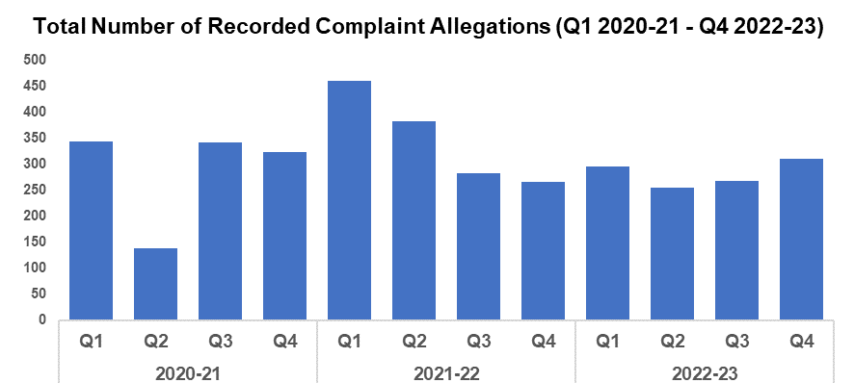
10. PSD Total Recorded Complaint Allegations
Overview
There has been a 16% increase in complaints received in Q4 2022-23 when compared to Q3. The reason for this notable quarterly increase in complaint allegations is due to some back record conversion complaints, as it had become evident that non-Schedule 3 complaints were not being recorded accurately. This has now been resolved therefore moving forward the numbers will be consistent.
The three categories of complaint with the greatest volume remain as:
A. Delivery of Duties and Service (n=184)
B. Police Powers, Policies, and Procedure (n=59)
H. Individual Behaviours (n=41)
Within the sub-categories, notable increases and decreases are noted below:
Increase in complaints relating to Police Action following contact (A1)
Increase in complaints relating to Detention in Police Custody (B5)
Increase in complaints relating to Power to Arrest and detain (B3)
Increase in complaints relating to Use of Force (B4)
Decrease in complaints relating to Unprofessional attitude and disrespect (H3)
Decrease in complaints relating to Information (A3)
Multiple allegations can be recorded by one complainant.

Slide 39
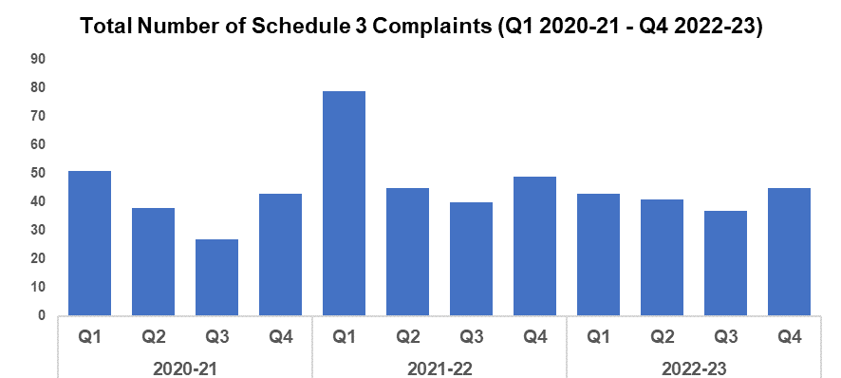
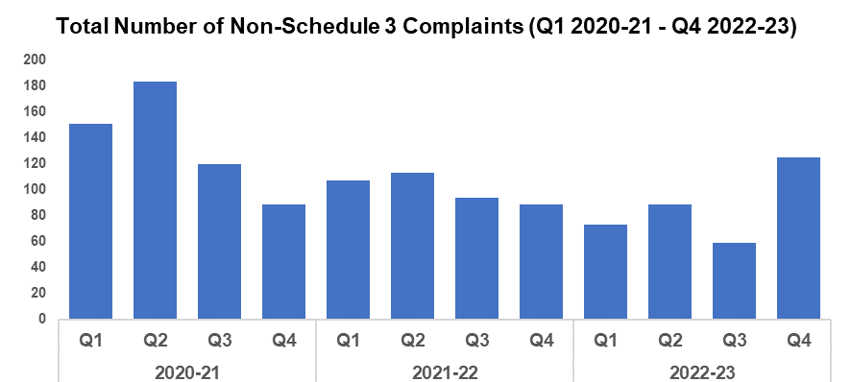
PSD Schedule 3 and Non-Schedule 3 Complaint Cases
Overview
From the 1st February 2020 the way complaints were dealt with changed and for recording purposes were classified in two separate categories:
Schedule 3 – Relates to complaints dealt with under the Police Reform Act 2002, whereby the complainant can request a review if they are not satisfied
Non-Schedule 3 – This allows complaints to be dealt with outside of the Police Reform Act 2002, previously regarded as ‘dissatisfaction’
It is worthy of note, that during quarter 4 there has been a significant increase in Non-Schedule 3 cases, the reason for this is due to the back record conversion of complaints as it had become evident that non-Schedule 3 recording criteria required some re-evalution.
At the time the data was extracted there were 50 live Schedule 3 complaints and two live Non-Schedule 3 complaints.
Figures will contain cases with multiple allegations.

Slide 40
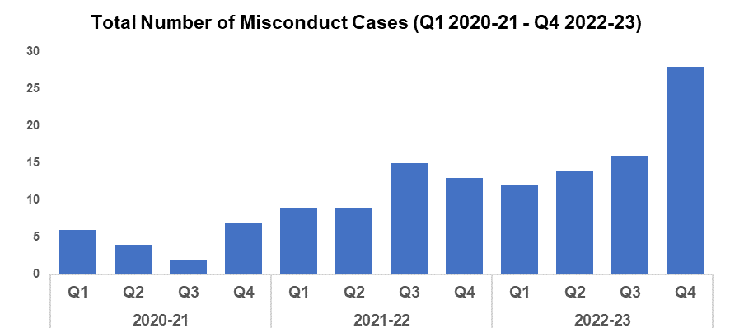
PSD Misconduct Cases
Overview
The upward trend in Misconduct Cases is consistent with pattern within policing in England and Wales.
A more proactive approach to misconduct and counter corruption intelligence gathering and investigation coupled with more confidence in the workforce to report has been the catalyst to this increase.
Within Q4 there were a total of three misconduct hearings conducted, one being an accelerated hearing. There were also four misconduct meetings held.
Q4 2022-23 Misconduct Outcomes
Within quarter 4, there was a gross misconduct hearing for a Staff Member relating to allegations concerning descretibale conduct. It was determined that the conduct amounted to misconduct and the staff member received a Final Written Warning. There was a misconduct meeting held for a Police Sergeant for allegations concerning inappropriate language used towards a member of the public. It was determined that the conduct did not amount to gross misconduct and the officer was subject of the Reflective Practice process. There was a misconduct meeting held for a Police Constable for allegations concerning inappropriate comments towards an ex-partner. It was determined that the conduct amounted to misconduct, and the officer received a Written Warning for 18 months. There was a gross misconduct hearing for a Staff Member relating to allegations concerning data protection breaches and honesty and integrity matters. It was determined that the conduct amounted to gross misconduct and the staff member was dismissed without notice. There was a misconduct meeting held for a Police Staff member for allegations concerning data protection breaches. It was determined that the conduct amounted to misconduct, and the staff member received a Final Written Warning for 18 months. There was a misconduct meeting held for a Police Staff member for allegations concerning inappropriate comments on social media. It was determined that the conduct amounted to misconduct, and the staff member received a Written Warning for 12 months. There was also an accelerated hearing for a former Police Constable for allegations concerning inappropriate sexualised behaviour towards a female colleague. Chief Constable Kelly determined that the matter amounted to gross misconduct and that the officer would have been dismissed had they remained a serving member of Gwent Police.

Slide 41
IOPC Timeliness
Overview
SPLY = Same Position Last Year
MSF Average = Most Similar Force Average.
Although timeliness is not an official performance measure it is a key aspect of Public Trust and Confidence within the Police Complaints and Conduct regime.
We are continuing to maintain a position of contacting complainants in under seven working days an improving position in comparison to Q4 21/22.
The data detailing the number of working days to log a complaint is still a significant national outlier. One unique factor that impacts on this figure is our central management of complaints and dissatisfaction with Complaints Assessors making initial contact with contact with complaints and ensuring correct recording. We will be completing an assessment of this process in 23/24 including benchmarking with other forces and seeking advice from IOPC.
The average number of days to finalise allegations has improved compared the our position last year across Schedule 3 and Non-Schedule 3 matters.
We are now finalising allegations quicker than the national average across all 3 measurable matrices. This is as a result of increased scrutiny and better data integrity measures introduced through this year.
Adjacent is based on IOPC Police Complaints Information Bulletin for 0104/2022 to 31/03/2023 (Quarter 4 2022-23).

Slide 42
IOPC Reviews
Overview
This data shows that 17% of the Schedule 3 finalised Complaint Cases resulted in reviews compared with 22% nationally. The reviews completed by the OPCC resulted in 20% (investigation) and 15 % (non-investigation) being found to be not reasonable and proportionate. This is less than the national average of 27% (investigation) and 19% (non-investigation). All of these reviews resulted in the OPCC making recommendations to the force.
Above is based on IOPC Police Complaints Information Bulletin for 0104/2022 to 31/03/2023 (Quarter 4 2022-23).

Slide 43
Vetting
Overview
Of note from these figures is the increase in Vetting refusals in Q3. Financial Vulnerability is a key contributor to this increase.
Vetting figures are available from Q1 2021-22 onwards. Data is submitted a quarter behind, therefore Q4 2022-23 is not included.

