Slide 1
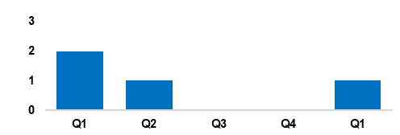
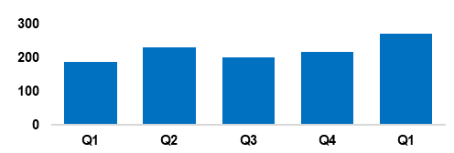
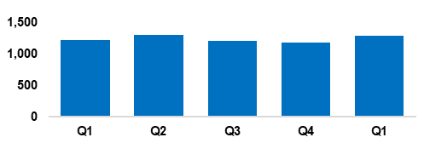
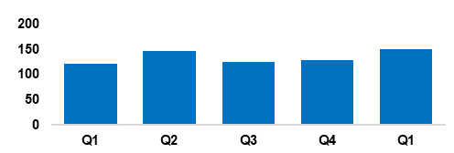
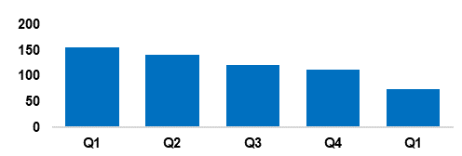
2. Beating Crime Plan
Crime Trend - Homicide (Q1 2023-24 – Q1 2024-25)
A three-year Homicide Prevention Strategy is in place, supported by a delivery plan, with the goal of furthering our understanding of the national and local themes and drivers that are likely to be precursors to Homicide.
The force is currently aligning the three-year Homicide Prevention Strategy with the Serious Violence Reduction Strategy, in order to complement the Serious Violence Duty.
This process is focused around improving our joint working and information sharing with partner agencies, as well as integration with the Serious Organised Crime (SOC) portfolio.
Homicide
Crime Trend - Serious Violence (Q1 2023-24 – Q1 2024-25)
Gwent Police utilises a problem-solving, partnership-based approach to preventing Serious Violence.
In the last six months the force’s Serious Violence governance and delivery has been reviewed, in order to integrate it with Homicide, and intervention and prevention.
Particular focus has been placed on night-time economy related violence, knife related violence, robbery, drug related gang violence, Organised Crime Groups (OCGs) and high-harm offenders.
Knife crime partnership initiatives have been launched in Pillgwenlly, Newport.
Serious Violence
Crime Trend - Neighbourhood Crime (Q1 2023-24 – Q1 2024-25)
The Neighbourhood Policing model is undergoing a review to improve its effectiveness and efficiency.
Residential Burglary is an area of focus, particularly regarding attendance times and forensics. A new burglary app is being developed to maximise golden hour and investigative opportunities, at the scene of and in response to burglary. Following an evaluation, this will be rolled out to robbery investigations.
Schools policing will now be embedded within Neighbourhood Policing Teams. Neighbourhood teams have been increased by an additional six police officers in order effectively deal with this additional demand.
Neighbourhood Crime
Crime Trend - Drug Trafficking and Supply (Q1 2023-24 – Q1 2024-25)
SOC partnership meetings have been established, with delivery to be driven by the new SOC Local Profile. East and West SOC partnerships are driving a 4P’s (pursue, protect, prevent and prepare) approach to drug supply.
Project Adder has been launched, consisting of fast-track processes for the investigation and forensics of suspected synthetic opioid deaths.
The force has a close working relationship with the regional Organised Crime Unit and the National County Lines Coordinator. Performance in this area has attracted national county lines surge funding for Gwent.
Drug Trafficking
Action Fraud Occurrences Assigned a Cyber-Enabled Local Qualifier (Q1 2023-24 – Q1 2024-25)
The fraud and cyber teams have been working closely together to prevent online fraud and provide education.
Cyber-volunteers are being embedded to increase specialist knowledge and boost community engagement relating to cyber crime.
The Digital Media Investigator role has been expanded, and they have been made more accessible.
Cyber awareness training has been provided to all frontline officers, force control room operators and neighbourhood staff.
Cyber Crime

