Slide 1
Strategy Performance Board
Quarter 1 2024-25

Slide 2
Keeping Neighbourhoods Safe
All Crime
Beating Crime Plan
Residential Burglary
Neighbourhood Crime
Public Order
Anti-Social Behaviour
Roads Policing
Key Commitments
Reduce public order offences and anti-social behaviour, and the number of people who repeatedly carry out these acts.
Reduce acquisitive crime and repeat offenders.
Improve the safety of roads throughout Gwent.
Commission and invest in effective crime prevention initiatives.

Slide 3
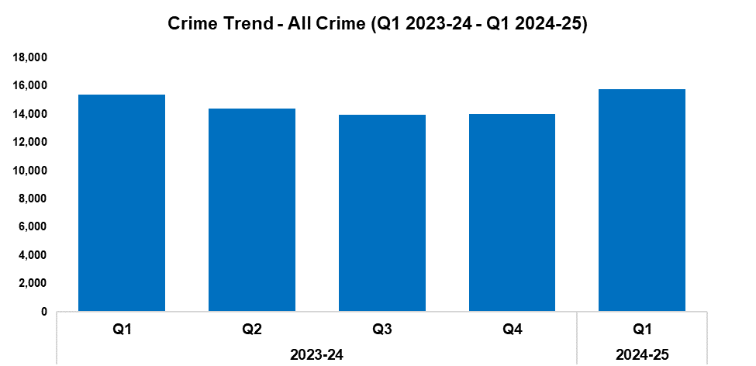
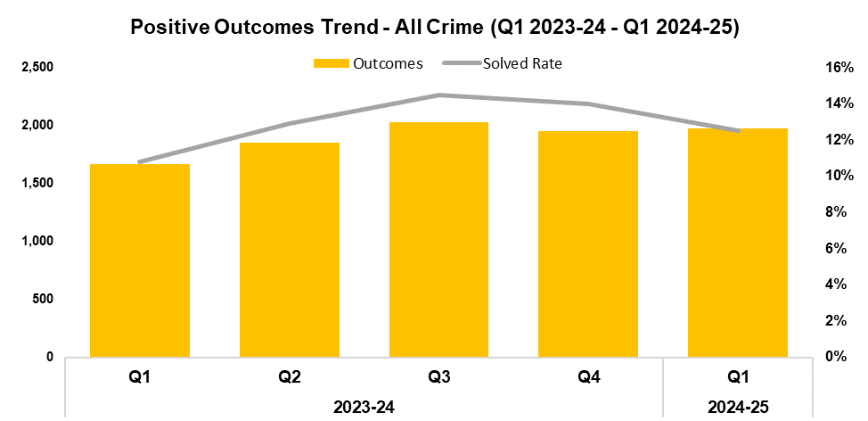
1. All Crime
2023-24 |  |  |  | 2024-25
Q1 | Q2 | Q3 | Q4 | Q1 | Q2 | Q3 | Q4
15,385 | 14,402 | 13,975 | 13,996 | 15,782 | - | - | -
2023-24 |  |  |  | 2024-25
Q1 | Q2 | Q3 | Q4 | Q1 | Q2 | Q3 | Q4
10.8% | 12.9% | 14.5% | 14.0% | 12.5% | - | - | -
Overview
Overall crime levels have risen by 12.8% during the first quarter of the 2024-25 financial year (Q1 2024-25) when compared the quarter prior, with 1,786 additional offences recorded for a total of 15,782. Whilst this represents the highest quarterly total within the time frame, the increase observed this quarter appears to conform to seasonal trends. A less prominent increase of 2.6% (397 additional offences) can be observed when comparing Q1 2024-25 against the same quarter during the previous financial year.
When compared to the quarter prior, the overall solved rate has fallen by 1.5 percentage points to 12.5%, albeit with 19 additional crimes solved for a total of 1,973. This implies that the elevated volume of crime recorded during Q1 2024-25 may have had a detrimental effect on the solved rate for the quarter. Conversely, the solved rate for Q1 2024-25 is 1.7 percentage points above that recorded for the same quarter during the previous financial year, with an additional 304 crimes solved.

Slide 4
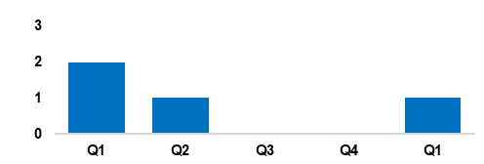
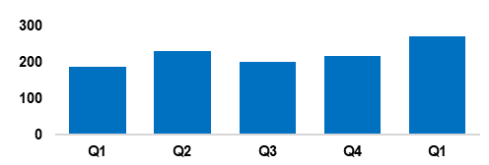
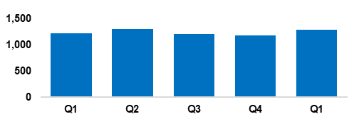
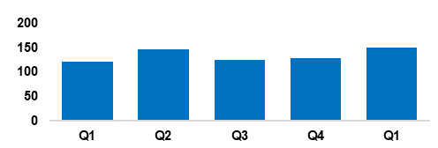
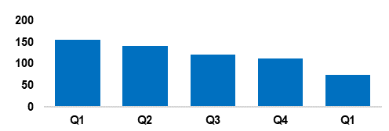
2. Beating Crime Plan
Crime Trend - Homicide (Q1 2023-24 – Q1 2024-25)
A three-year Homicide Prevention Strategy is in place, supported by a delivery plan, with the goal of furthering our understanding of the national and local themes and drivers that are likely to be precursors to Homicide.
The force is currently aligning the three-year Homicide Prevention Strategy with the Serious Violence Reduction Strategy, in order to complement the Serious Violence Duty.
This process is focused around improving our joint working and information sharing with partner agencies, as well as integration with the Serious Organised Crime (SOC) portfolio.
Homicide
Crime Trend - Serious Violence (Q1 2023-24 – Q1 2024-25)
Gwent Police utilises a problem-solving, partnership-based approach to preventing Serious Violence.
In the last six months the force’s Serious Violence governance and delivery has been reviewed, in order to integrate it with Homicide, and intervention and prevention.
Particular focus has been placed on night-time economy related violence, knife related violence, robbery, drug related gang violence, Organised Crime Groups (OCGs) and high-harm offenders.
Knife crime partnership initiatives have been launched in Pillgwenlly, Newport.
Serious Violence
Crime Trend - Neighbourhood Crime (Q1 2023-24 – Q1 2024-25)
The Neighbourhood Policing model is undergoing a review to improve its effectiveness and efficiency.
Residential Burglary is an area of focus, particularly regarding attendance times and forensics. A new burglary app is being developed to maximise golden hour and investigative opportunities, at the scene of and in response to burglary. Following an evaluation, this will be rolled out to robbery investigations.
Schools policing will now be embedded within Neighbourhood Policing Teams. Neighbourhood teams have been increased by an additional six police officers in order effectively deal with this additional demand.
Neighbourhood Crime
Crime Trend - Drug Trafficking and Supply (Q1 2023-24 – Q1 2024-25)
SOC partnership meetings have been established, with delivery to be driven by the new SOC Local Profile. East and West SOC partnerships are driving a 4P’s (pursue, protect, prevent and prepare) approach to drug supply.
Project Adder has been launched, consisting of fast-track processes for the investigation and forensics of suspected synthetic opioid deaths.
The force has a close working relationship with the regional Organised Crime Unit and the National County Lines Coordinator. Performance in this area has attracted national county lines surge funding for Gwent.
Drug Trafficking
Action Fraud Occurrences Assigned a Cyber-Enabled Local Qualifier (Q1 2023-24 – Q1 2024-25)
The fraud and cyber teams have been working closely together to prevent online fraud and provide education.
Cyber-volunteers are being embedded to increase specialist knowledge and boost community engagement relating to cyber crime.
The Digital Media Investigator role has been expanded, and they have been made more accessible.
Cyber awareness training has been provided to all frontline officers, force control room operators and neighbourhood staff.
Cyber Crime

Slide 5
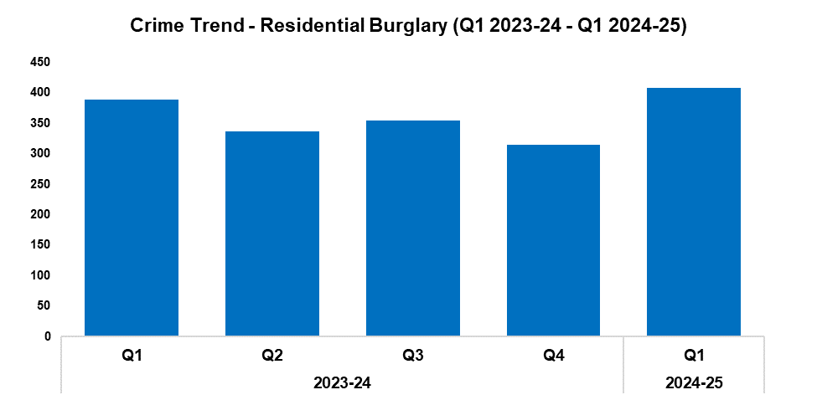
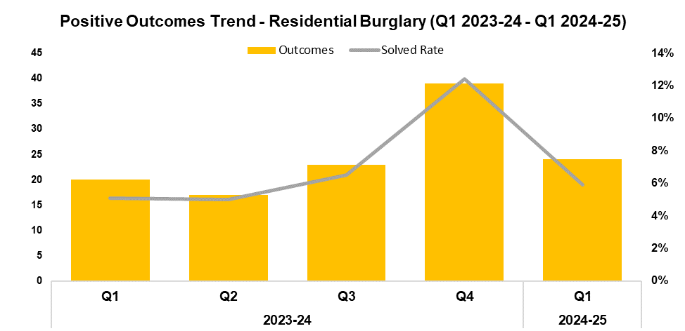
3. Residential Burglary
2023-24 |  |  |  | 2024-25
Q1 | Q2 | Q3 | Q4 | Q1 | Q2 | Q3 | Q4
389 | 337 | 354 | 314 | 408 | - | - | -
2023-24 |  |  |  | 2024-25
Q1 | Q2 | Q3 | Q4 | Q1 | Q2 | Q3 | Q4
5.1% | 5.0% | 6.5% | 12.4% | 5.9% | - | - | -
Overview
Residential Burglary offences have seen an increase of 29.9% during Q1 2024-25 when compared to the quarter prior, with 94 additional offences recorded for a total of 408. This represents the highest quarterly total within the timeframe, whilst appearing to conform to seasonal trends. A less prominent increase of 4.9% (19 additional offences) can be observed when comparing Q1 2024-25 against the same quarter during the previous financial year.
When compared to the quarter prior, the solved rate for Residential Burglary offences has fallen by 6.5 percentage points to 5.9%, with 15 fewer crimes solved for a total of 24. This disrupts the upward trend which had been observed following Q2 2023-24. Conversely, the solved rate for Q1 2024-25 is 0.8 percentage points above that recorded for the same quarter during the previous financial year, with a four additional crimes solved.
During Q1 2024-25, 91.9% of all incidents classified as Residential Burglary of a Home were attended. Of these incidents, 45.3% were attended within 60 minutes.
A security firm has installed devices in 394 homes across Maindee and Ebbw Vale, including doorbell cameras, CCTV cameras, and security lights. Smart water was also distributed, along with burglary packs containing window alarms, a shed alarm, a TV impersonator, and 24-hour segment timers. It is hoped this will assist in both preventing crime and identifying offenders.
Safer Streets events throughout Blaenau Gwent have been attended by members of the We Don’t Buy Crime (WDBC) team, who provided crime prevention advice and home security packs. They also attended the Cwmbran Big Event and a community event at Lighthouse Park in a similar capacity.

Slide 6
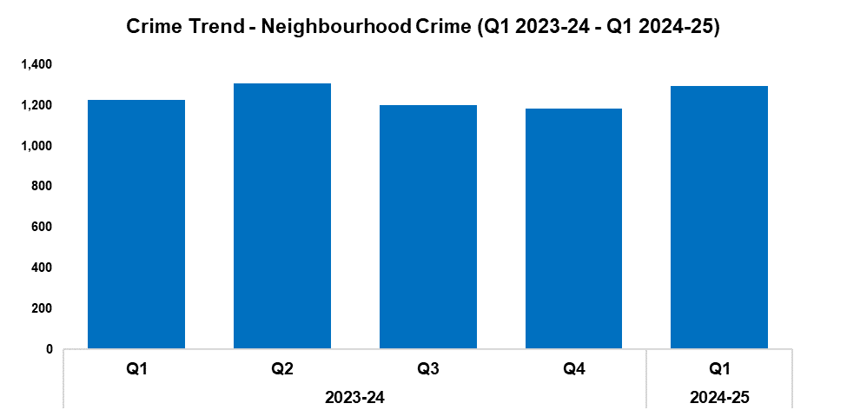
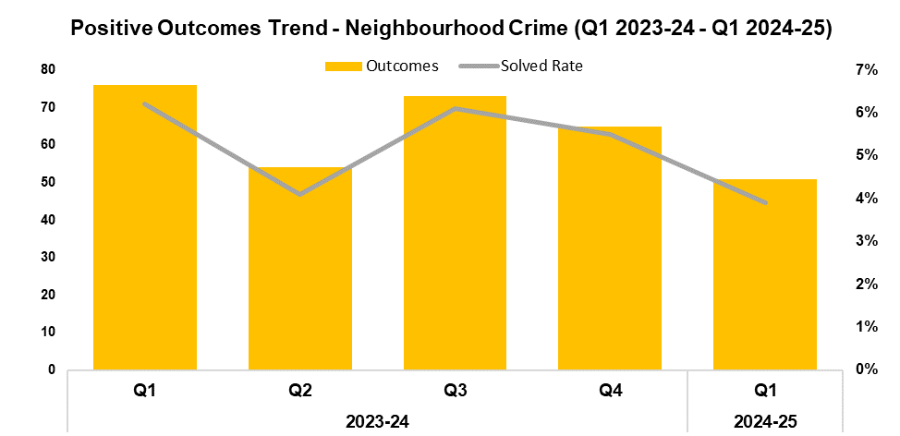
4. Neighbourhood Crime
2023-24 |  |  |  | 2024-25
Q1 | Q2 | Q3 | Q4 | Q1 | Q2 | Q3 | Q4
1,226 | 1,307 | 1,203 | 1,182 | 1,297 | - | - | -
2023-24 |  |  |  | 2024-25
Q1 | Q2 | Q3 | Q4 | Q1 | Q2 | Q3 | Q4
6.2% | 4.1% | 6.1% | 5.5% | 3.9% | - | - | -
Overview
Neighbourhood Crime offences have seen an increase of 9.7% when compared to the quarter prior, with 115 additional offences recorded for a total of 1,297. This disrupts the downward trend observed following Q2 2023-24. An increase of 5.8% (71 additional offences) can be observed when comparing Q1 2024-25 against the same quarter during the previous financial year.
Vehicle Crime offences continued to account for the majority of Neighbourhood Crime during Q1 2024-25, comprising 58.8% of the quarterly total with 763 offences recorded.
When compared to the quarter prior, the solved rate for Neighbourhood Crime offences has fallen by 1.6 percentage points to 3.9%, with 14 fewer crimes solved for a total of 51. This represents the lowest quarterly solved rate within the timeframe, continuing the downward trend observed following Q3 2023-24. A similar reduction of 2.3 percentage points can be observed when comparing the solved rate for Q1 2024-25 against that recorded for the same quarter during the previous financial year, with 25 fewer crimes solved.
The East Neighbourhood team has held five engagement events over the last quarter, during which crime prevention advice was issued and over 700 burglary packs were distributed.
A Crimestoppers zone has been established in the Alway ward, the first within Gwent. It is hoped that this will increase the flow of intelligence and allow officers to be more active in the area.
The WDBC team has conducted bike marking events at Alway and Llanmartin primary schools, as well as the Cwmcarn scenic drive.
The Rural Crime Team have attended events and visited victims of offences relating to the theft of agricultural machinery and quad bikes, providing advice and distributing security devices.

Slide 7
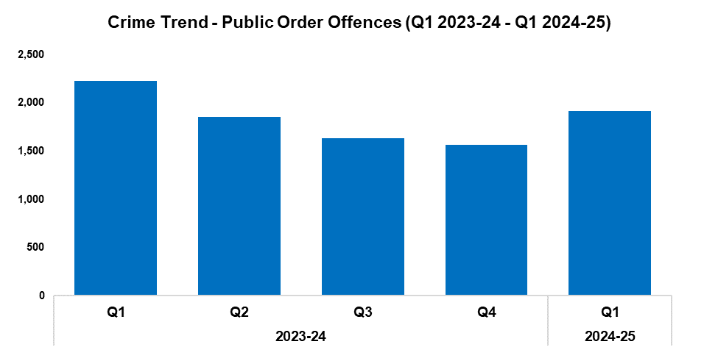
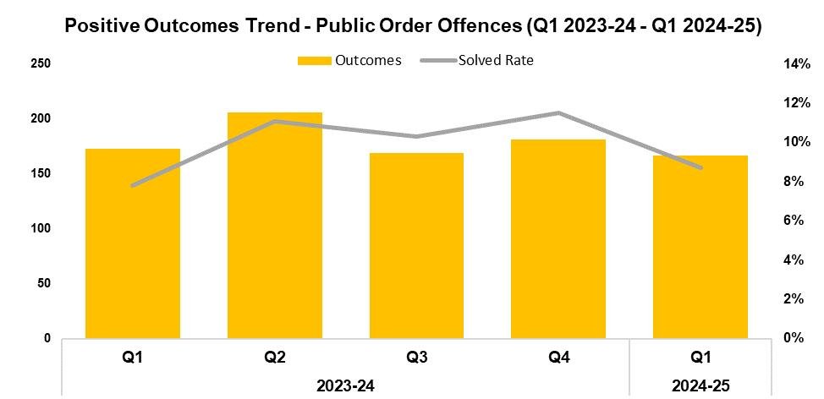
5. Public Order
2023-24 |  |  |  | 2024-25
Q1 | Q2 | Q3 | Q4 | Q1 | Q2 | Q3 | Q4
2,227 | 1,854 | 1,637 | 1,568 | 1,913 | - | - | -
2023-24 |  |  |  | 2024-25
Q1 | Q2 | Q3 | Q4 | Q1 | Q2 | Q3 | Q4
7.8% | 11.1% | 10.3% | 11.5% | 8.7% | - | - | -
Overview
Public Order Offences have seen an increase of 22.0% when compared to the quarter prior, with 345 additional offences recorded for a total of 1,913. This disrupts the downward trend observed following Q1 2023-24, with seasonality appearing to be a factor in this increase. Conversely, a reduction of 14.1% (314 fewer offences) can be observed when comparing Q1 2024-25 against the same quarter during the previous financial year.
As offences under Section 5 of the Public Order Act 1986 have been classified as non-notifiable by the Home Office, they have been retroactively removed from this dataset to facilitate the accurate monitoring of long-term trends.
When compared to the quarter prior, the solved rate for Public Order Offences has fallen by 2.8 percentage points to 8.7%, with 14 fewer crimes solved for a total of 167. This represents the lowest number of crimes solved within any quarter of the timeframe. Conversely, the solved rate for Q1 2024-25 is 0.9 percentage points above that recorded for the same quarter during the previous financial year, albeit with six fewer crimes solved.

Slide 8
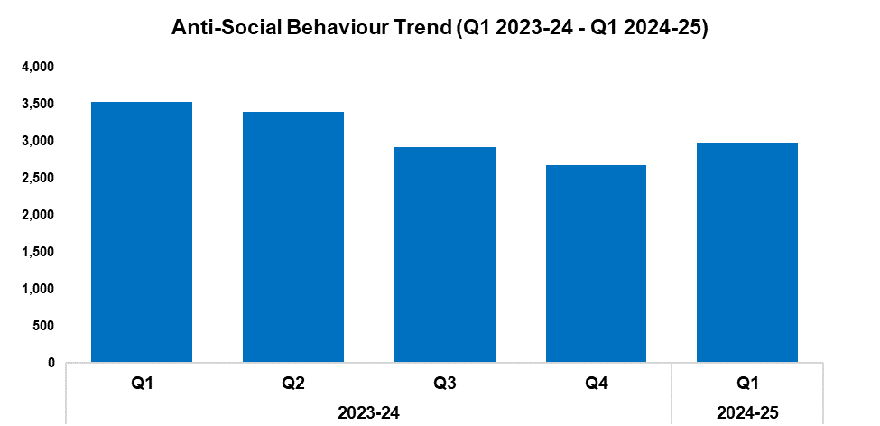
6. Anti-Social Behaviour
Overview
Levels of anti-social behaviour (ASB) in Gwent have risen by 11.4% during Q1 2024-25 when compared to the quarter prior, with 304 additional incidents recorded for a total of 2,975. This disrupts the downward trend observed following Q1 2023-24, whilst conforming to seasonal trends.
Conversely, a reduction of 15.7% (553 fewer incidents) can be observed when comparing Q1 2024-25 against the same quarter during the previous financial year.
When assessed by closing category, incidents classified as ‘ASB - Environmental’ and ‘ASB - Nuisance’ saw similar increases of 4.7% and 5.2% respectively when compared to the quarter prior. Incidents classified as ‘ASB – Personal’ saw a less prominent increase of 1.7%.
2023-24 |  |  |  | 2024-25
Q1 | Q2 | Q3 | Q4 | Q1 | Q2 | Q3 | Q4
3,528 | 3,400 | 2,918 | 2,671 | 2,975 | - | - | -
As part of the Safer Streets initiative, work has been completed alongside Blaenau Gwent Council to repair and replace 73 lampposts and streetlights in the Ebbw Vale area. It is hoped that this will increase public confidence and reduce the fear of crime.
The force has worked closely with Blaenau Gwent Council to assist with the appointment of two new Community Safety Wardens. A new reporting system has also been created, which will facilitate their deployment to problematic areas in order to help reduce ASB and reassure the public.
As part of Operation Lumley, officers are conducting a series of high-visibility patrols in pre-identified ‘hotspots’ within the force area, with the aim of disrupting ASB and other criminality in these locations whilst engaging with local residents.

Slide 9
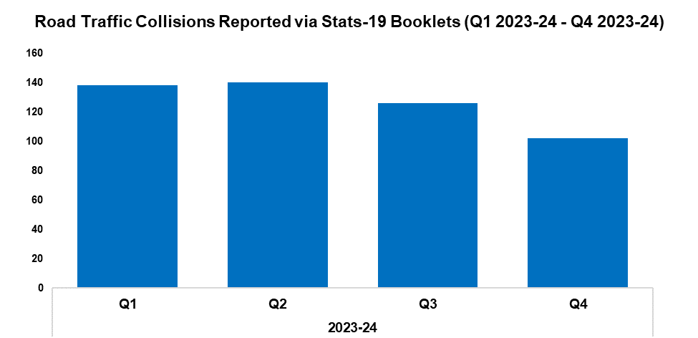
7. Roads Policing
Overview
During Q4 2023-24, 102 Road Traffic Collisions (RTCs) were reported via Stats-19 RTC booklets, a reduction of 19.0% (24 fewer RTCs) when compared to the quarter prior. A similar reduction of 20.9% (27 fewer RTCs) can be observed when comparing Q4 2023-24 against the same quarter during the previous financial year. Please note that this metric is now being reported a quarter in arrears, due to the lag time between incidents occurring and the corresponding Stats-19 booklets being submitted by officers. This should allow for a more accurate quarter-on-quarter account of RTC levels going forward.
A total of 544 individuals were reported for one of the ‘Fatal Five’* factors during Q1 2024-25, a reduction of 33.9% (279 fewer reports) when compared to the quarter prior. The most commonly reported factor during Q1 2024-25 was drink/drug driving, which accounted for 36.8% of all Fatal Five reports with 200 instances recorded. This was followed by not wearing a seatbelt, comprising 23.9% of Fatal Five reports with 130 instances recorded.
*The ‘Fatal Five’ refer to the five main causes of serious injury and death in RTCs. They consist of: careless driving; drink/drug driving; not wearing a seatbelt; using a mobile phone; and excessive speed.
2023-24 |  |  |  | 2024-25
Q1 | Q2 | Q3 | Q4 | Q1 | Q2 | Q3 | Q4
138 | 140 | 126 | 102 | - | - | - | -
Prolific offender Levi Edwards was charged with two counts of driving whilst disqualified and one count of driving without due care or attention. He was found guilty and disqualified from driving for a further 54 months, in addition to a 17-week custodial sentence (suspended for 12 months) and £200 in fines and costs.
The GoSafe team have conducted a number of cross-border partnership operations across the South Wales region, engaging with the public in a positive manner following the introduction of 20 mph speed limits. To date the team has engaged with 5,369 drivers, whereas approximately 159,000 have driven through operational areas and witnessed staff at the roadside. Compliance in these operational areas is around 97%, with less than 1% of drivers being issued with a fixed penalty notice. So far, 31 drivers have been reported for speeding offences.
Gwent officers have been engaging with cyclists and motorcyclists as part of the two-wheeled campaign coordinated by the National Police Chief’s Council. Officers have attended multiple locations across Gwent, including meeting with a group of over 30 cyclists who were on a charity bike ride in order to offer safety advice, and speaking to several motorcyclists regarding their exhausts and number plates. They also attended Tintern Abbey to coincide with an organised run in the area, advising motorcyclists to give consideration to the runners and to limit their speed in light of the event. In addition to this, the drivers of seven vehicles were stopped and given advice after they passed too close to cyclists. Enforcement also played a role in this campaign, with examples including: four motorcyclists found to have no insurance; two off-road bikes seized under Section 59; two individuals arrested for drug driving; and one individual arrested for dangerous driving following an RTC involving a motorcycle. Furthermore, a male was arrested for possession with intent to supply Class A drugs after he was caught carrying out a street deal whilst on a Suron electric bike. The male failed a drug wipe and was found to be in possession of 30 wraps of cocaine. A large quantity of cash was discovered during a subsequent search of his home, along with a Rolex watch worth approximately £40,000 which was recovered under the Proceeds of Crime Act. The offender was was charged and remanded for the offence.

Slide 10
  Combat Serious Crime
Combat Serious Crime
Most Serious Violence
Serious Violence
VAWG Domestic Priority Offences
Drug Supply and Organised Crime
Key Commitments
Reduce the number of repeat victims of child criminal and sexual exploitation.
Increase disruption of serious organised crime, and reinvest assets seized back into communities.
Improve the overall criminal justice response to violence against women, domestic abuse and sexual violence.
Commission and invest in services that work with perpetrators of serious crime to prevent and reduce re-offending.

Slide 11
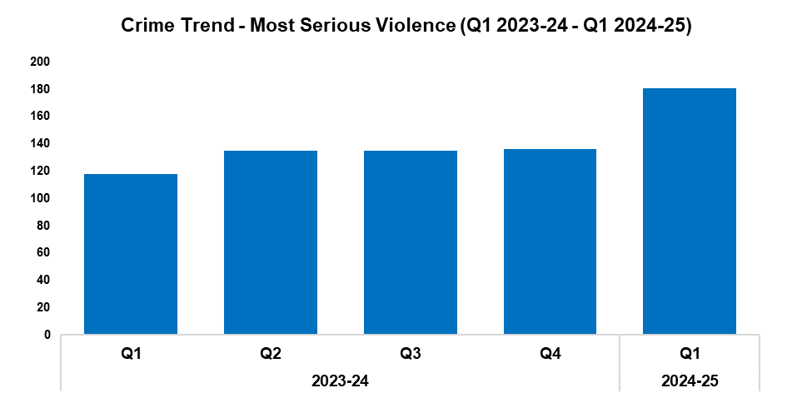
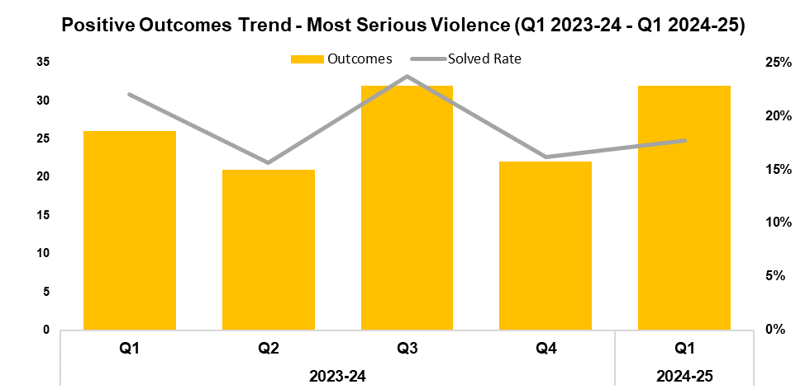
1. Most Serious Violence
2023-24 |  |  |  | 2024-25
Q1 | Q2 | Q3 | Q4 | Q1 | Q2 | Q3 | Q4
118 | 135 | 135 | 136 | 181 | - | - | -
2023-24 |  |  |  | 2024-25
Q1 | Q2 | Q3 | Q4 | Q1 | Q2 | Q3 | Q4
22.0% | 15.6% | 23.7% | 16.2% | 17.7% | - | - | -
Overview
Most Serious Violence offences consist of homicide, grievous bodily harm with intent, and causing death by dangerous driving. These offences have risen in volume by 33.1% during Q1 2024-25 when compared to the quarter prior, with 45 additional offences recorded for a total of 181. This represents the highest quarterly total within the timeframe. A more prominent increase of 53.4% can be observed when comparing Q1 2024-25 against the same quarter during the previous financial year, with 63 additional offences recorded.
When compared to the quarter prior, the solved rate for Most Serious Violence offences has risen by 1.5 percentage points to 17.7%, with ten additional crimes solved for a total of 32. This continues the trend of quarterly fluctuations observed for this metric following Q1 2023-24. The solved rate for Q1 2024-25 is 4.3 percentage points below that recorded for the same quarter during the previous financial year, albeit with six additional crimes solved.

Slide 12
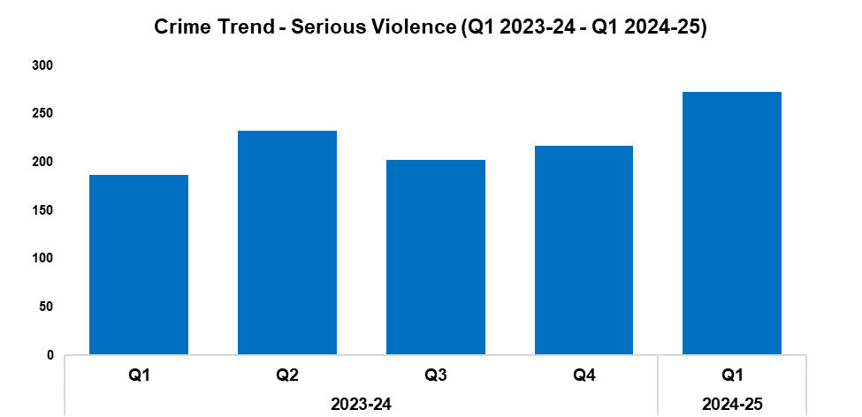
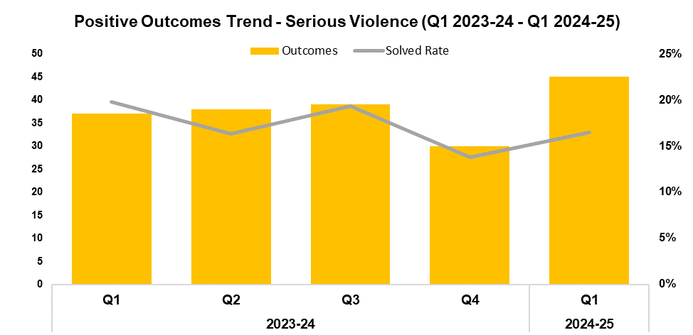
2. Serious Violence
2023-24 |  |  |  | 2024-25
Q1 | Q2 | Q3 | Q4 | Q1 | Q2 | Q3 | Q4
187 | 233 | 202 | 217 | 273 | - | - | -
2023-24 |  |  |  | 2024-25
Q1 | Q2 | Q3 | Q4 | Q1 | Q2 | Q3 | Q4
19.8% | 16.3% | 19.3% | 13.8% | 16.5% | - | - | -
Overview
Serious Violence offences consist of section 18 grievous bodily harm with intent, section 20 malicious wounding without intent, and personal robbery. These offences have risen in volume by 25.8% during Q1 2024-25 when compared to the quarter prior, with 56 additional offences recorded for a total of 273. This represents the highest quarterly total within the timeframe, continuing the upward trend observed following Q3 2023-24. A more prominent increase of 46.0% (86 additional offences) can be observed when comparing Q1 2024-25 against the same quarter during the previous financial year.
When compared to the quarter prior, the solved rate for Serious Violence offences has risen by 2.7 percentage points to 16.5%, with 15 additional crimes solved for a total of 45. This represents the highest number of crimes solved within any quarter of the timeframe. Conversely, the solved rate for Q1 2024-25 is 3.3 percentage points below that recorded for the same quarter during the previous financial year, albeit with eight additional crimes solved.

Slide 13
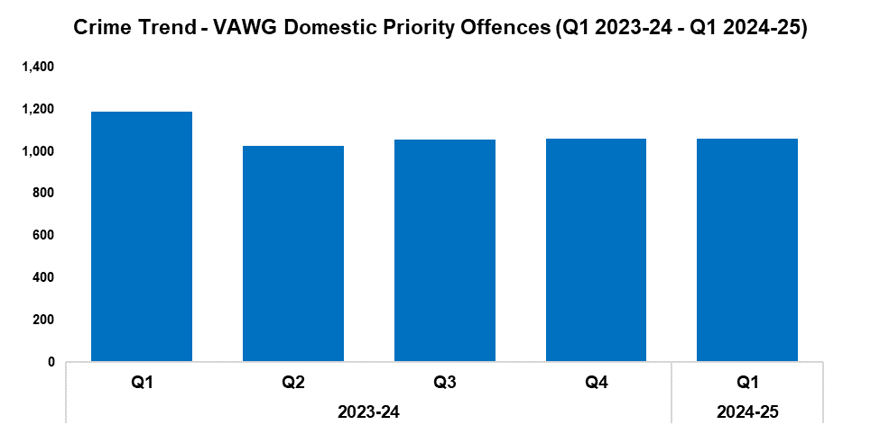
3. VAWG Domestic Priority Offences
Overview
The adjacent graph displays the number of Violence against Women and Girls (VAWG) priority offences which have been assigned a domestic abuse qualifier, and which have at least one female victim linked.*
During Q1 2024-25 1,060 of these offences were recorded, with levels remaining steady when compared to the quarter prior. A reduction of 10.7% (127 fewer offences) can be observed when comparing Q1 2024-25 against the same quarter during the previous financial year.
676 females have been linked as a victim in more than one VAWG domestic priority offence within the last 12 months,** whereas 14 females have been linked as a victim in five or more separate offences.
In the last 12 months,** there were 460 female offenders and 2,781 male offenders linked to domestic priority offences against women and girls.
*Domestic priority areas include Homicide, Violence with Injury, Stalking and Harassment, Public Fear, Alarm or Distress, Rape, Other Sexual Offences, and Modern Slavery.
**Up to the end of Q1 2024-25
2023-24 |  |  |  | 2024-25
Q1 | Q2 | Q3 | Q4 | Q1 | Q2 | Q3 | Q4
1,187 | 1,026 | 1,057 | 1,060 | 1,060 | - | - | -

Slide 14
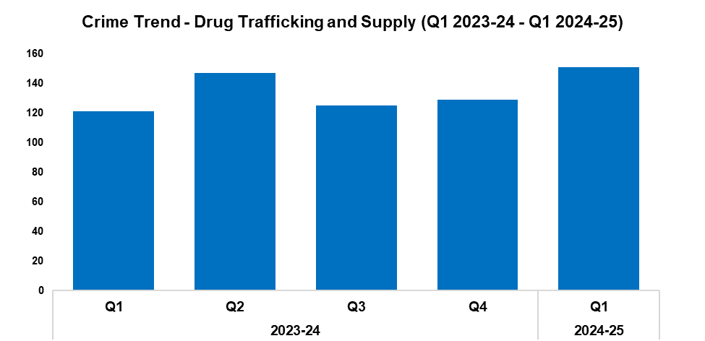
4. Drug Supply and Organised Crime
Overview
Drug Trafficking and Supply offences have risen by 17.1% during Q1 2024-25 when compared to the quarter prior, with 22 additional offences recorded for a total of 151. This represents the highest quarterly total within the timeframe, and continues the upward trend observed following Q3 2023-24. A more prominent increase of 24.8% (30 additional offences) can be observed when comparing Q1 2024-25 against the same quarter during the previous financial year.
1,953 Drug Supply and Dealing intelligence logs were submitted during Q1 2024-25. This is an increase of 10.4% (184 additional logs) when compared to the quarter prior, and represents the second-highest quarterly total within the timeframe. A more prominent increase of 23.1% (367 additional logs) can be observed when comparing Q1 2024-25 against the same quarter during the previous financial year.
2023-24 |  |  |  | 2024-25
Q1 | Q2 | Q3 | Q4 | Q1 | Q2 | Q3 | Q4
121 | 147 | 125 | 129 | 151 | - | - | -
During June, Andrew Morrish was arrested after members of the East SOC team witnessed a street deal whilst on proactive patrol in Maindee, Newport. A subsequent search of his home resulted in the discovery of 60 kg of cannabis and over £120,000 in cash, with an electric bike and several mobile phones also being seized. Amanda Wilkes was arrested after being found at the address. In interview, Morrish admitted his role in supplying cannabis but claimed he was doing so under duress, although he refused to provide any further details. Both Morrish and Wilkes have been charged and remanded for conspiracy to supply Class B (cannabis), supply of Class B (cannabis), and possession of criminal property.
Two men who ran the county line known as the ‘Boogie Line’ in Newport have been sentenced following their arrest as part of Operation Longford. Shane Smith was sentenced to eight years in prison, whereas Shane Price was sentenced to four years and six months. Both men were charged with being concerned in the supply of heroin and crack cocaine, with Shane Price also being charged with possession of cannabis.
As part of Operation Sceptre, officers conducted an intelligence led search operation in Pillgwenlly. A total of 14 knives and other bladed articles were seized, following a systematic search of locations used to stash or discard weapons. This served to prevent their use in any future criminality, safeguarding and reassuring local residents.
During April, officers were deployed across the rail network in South Wales as part of a two-day operation. They worked alongside several partner agencies to identify, intercept and protect individuals who were involved in, or at risk of, county lines exploitation. Over the course of the operation 90 stop searches were carried out, resulting in six arrests. Amongst these was a man from London who was found in possession of 1.5 kg of cannabis, and a 17-year-old from Cardiff who was found in possession of a knife. A total of three weapons were recovered, along with 3 kg of pills and nearly £10,000 in cash.

Slide 15
Support Victims and Protect the Vulnerable
Hate Crime
Rape
Domestic Related Crime
Domestic Abuse Repeat Victims/Offenders
Modern Day Slavery and Human Trafficking
Child Sexual Exploitation/Child Criminal Exploitation
Child Sexual Exploitation/Child Criminal Exploitation Continued
Cyber Fraud
Victim Support/Repeat Victims
Key Commitments
Improve victim services and ensure that the needs of victims are identified and responded to appropriately through Connect Gwent and the Victim Care Unit.
Further improve our work with partners to protect those most vulnerable.
Increase the timeliness of police investigation updates provided to victims.
Commission and invest in specialist services to support victims throughout the criminal justice process.

Slide 16
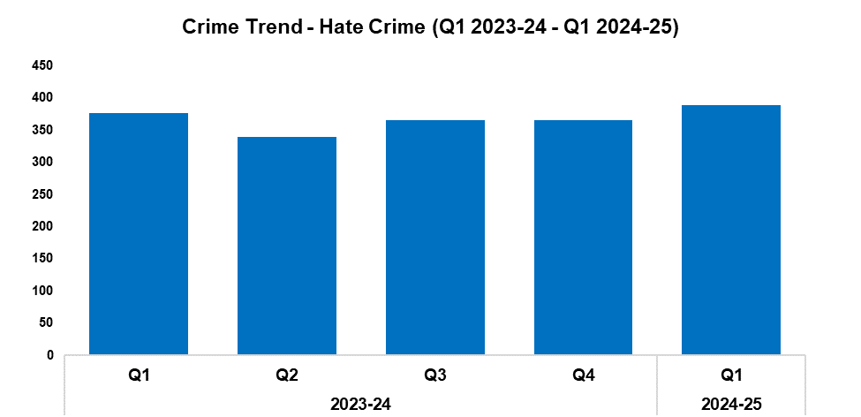
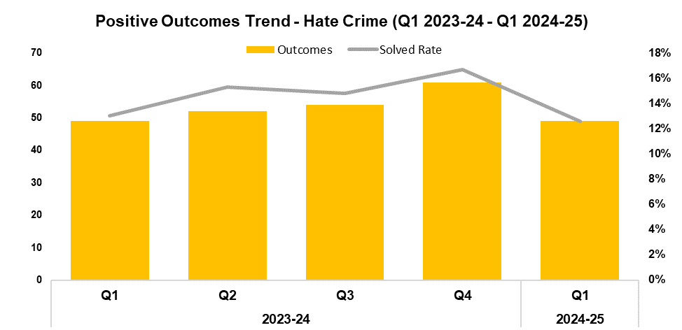
1. Hate Crime
2023-24 |  |  |  | 2024-25
Q1 | Q2 | Q3 | Q4 | Q1 | Q2 | Q3 | Q4
376 | 339 | 365 | 365 | 389 | - | - | -
2023-24 |  |  |  | 2024-25
Q1 | Q2 | Q3 | Q4 | Q1 | Q2 | Q3 | Q4
13.0% | 15.3% | 14.8% | 16.7% | 12.6% | - | - | -
Overview
The volume of offences classified as hate crimes has risen by 6.6% during Q1 2024-25 when compared to the quarter prior, with 24 additional offences recorded for a total of 389. This represents the highest quarterly total within the timeframe. A less prominent increase of 3.5% (13 additional offences) can be observed when comparing Q1 2024-25 against the same quarter during the previous financial year.
Offences containing the disability hate strand saw the largest increase when compared to the quarter prior, rising by 41.8% (28 additional crimes for a total of 95). Conversely, offences containing the transphobic hate strand saw the largest reduction, falling by 31.8% (seven fewer crimes for a total of 15).
When compared to the previous quarter, the solved rate has fallen by 4.1 percentage points to 12.6%, with 12 fewer crimes solved for a total of 49. This represents the lowest quarterly solved rate within the timeframe. The solved rate for Q1 2024-25 is 0.4 percentage points below that recorded for the same quarter during the previous financial year, with an equal number of crimes solved.
The Equality, Diversity and Inclusion (EDI) manager worked with the operational lead on hate crime and the Victim Care Unit (VCU) to refresh the force’s hate crime policy and process maps. The Hate Crime Scrutiny Panel has also been updated, and will resume its meetings.
A single crime can have multiple hate strands. The crime trend is based on recorded crimes, whilst the assessment of hate strands is based on the volume of each individual strand.

Slide 17
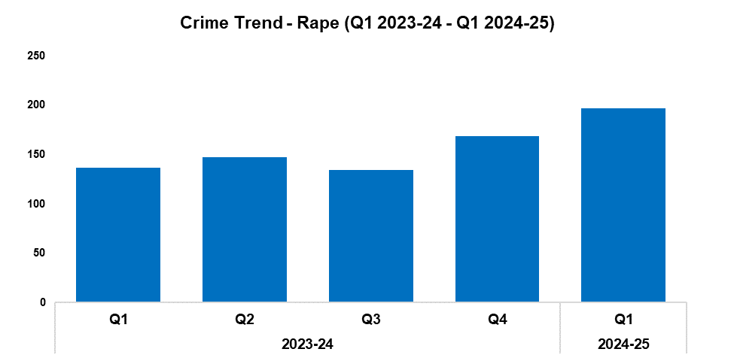
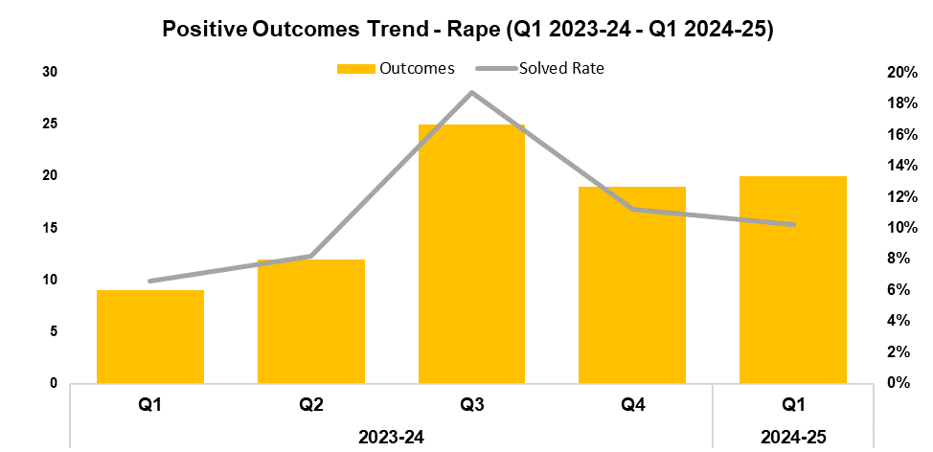
2. Rape
2023-24 |  |  |  | 2024-25
Q1 | Q2 | Q3 | Q4 | Q1 | Q2 | Q3 | Q4
137 | 147 | 134 | 169 | 197 | - | - | -
2023-24 |  |  |  | 2024-25
Q1 | Q2 | Q3 | Q4 | Q1 | Q2 | Q3 | Q4
6.6% | 8.2% | 18.7% | 11.2% | 10.2% | - | - | -
Overview
The volume of recorded Rape offences has increased by 16.6% during Q1 2024-25 when compared to the quarter prior, with 28 additional offences recorded for a total of 197. This represents the highest quarterly total within the timeframe, continuing the upward trend observed following Q3 2023-24 for this historically under-reported crime category. A more prominent increase of 43.8% (60 additional offences) can be observed when comparing Q1 2024-25 against the same quarter during the previous financial year.
When compared to the quarter prior, the solved rate for Rape offences has fallen by 1.0 percentage point to 10.2%, albeit with one additional crime solved for a total of 20. This continues the downward trend observed following Q3 2023-24. Conversely, an increase of 3.6 percentage points can be observed when comparing Q1 2024-25 against the same quarter during the previous financial year, with 11 additional crimes solved.

Slide 18
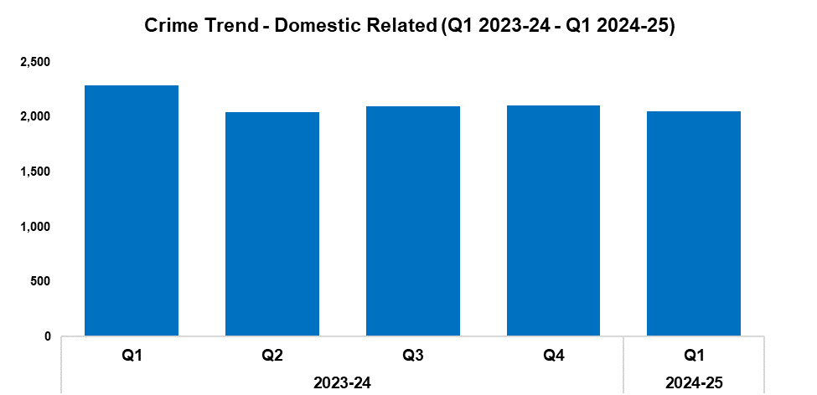
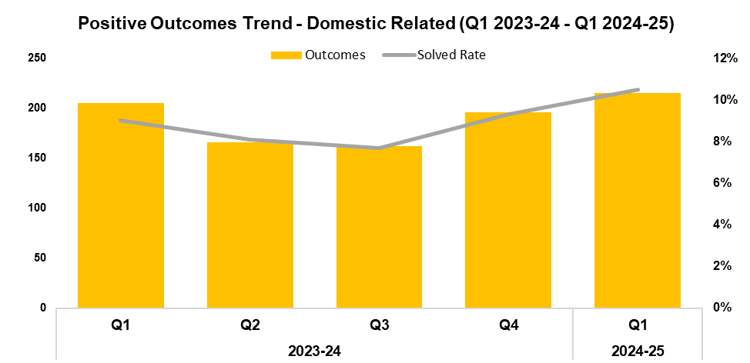
3. Domestic Related Crime
2023-24 |  |  |  | 2024-25
Q1 | Q2 | Q3 | Q4 | Q1 | Q2 | Q3 | Q4
2,287 | 2,048 | 2,098 | 2,105 | 2,050 | - | - | -
2023-24 |  |  |  | 2024-25
Q1 | Q2 | Q3 | Q4 | Q1 | Q2 | Q3 | Q4
9.0% | 8.1% | 7.7% | 9.3% | 10.5% | - | - | -
Overview
Domestic related offences have seen a reduction of 2.6% when compared to the quarter prior, with 55 fewer offences recorded for a total of 2,050. This represents the lowest quarterly total within the timeframe, disrupting the slight upward trend observed following Q2 2023-24. A more prominent reduction of 10.4% (237 fewer offences) can be observed when comparing Q1 2024-25 against the same quarter during the previous financial year.
When compared to the quarter prior, the solved rate for domestic related offences has risen by 1.2 percentage points to 10.5%, with 19 additional crimes solved for a total of 215. This represents the highest quarterly solved rate within the timeframe, continuing the upward trend observed following Q3 2023-24. A similar increase of 1.5 percentage points can be observed when comparing Q1 2024-25 against the same quarter during the previous financial year, with 10 additional crimes solved.
The process utilised by the VCU for domestic abuse cases has been changed. Contact is now initiated immediately, rather than following a Public Protection Notification review by the Domestic Abuse Safeguarding Team (DAST). This ensures that the victim receives intervention as soon as possible.
Victim Services has created a detailed information booklet that explains the legal process of a domestic abuse case, from initial reporting through to attending court. It also details the various avenues of support that are available to victims.
This data only includes offences in which the victim and offender were both aged 16 or over at the time of the offence, as specified in the Domestic Abuse Act 2021.

Slide 19
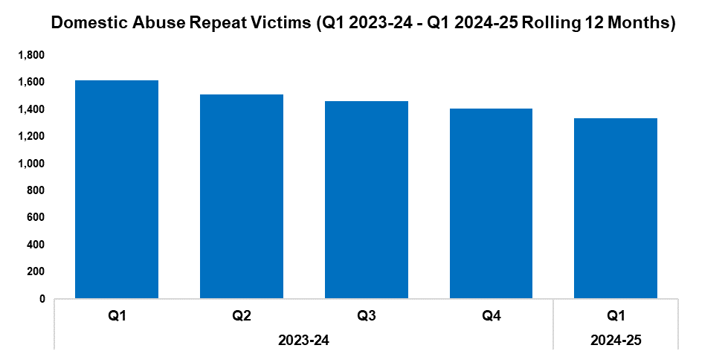
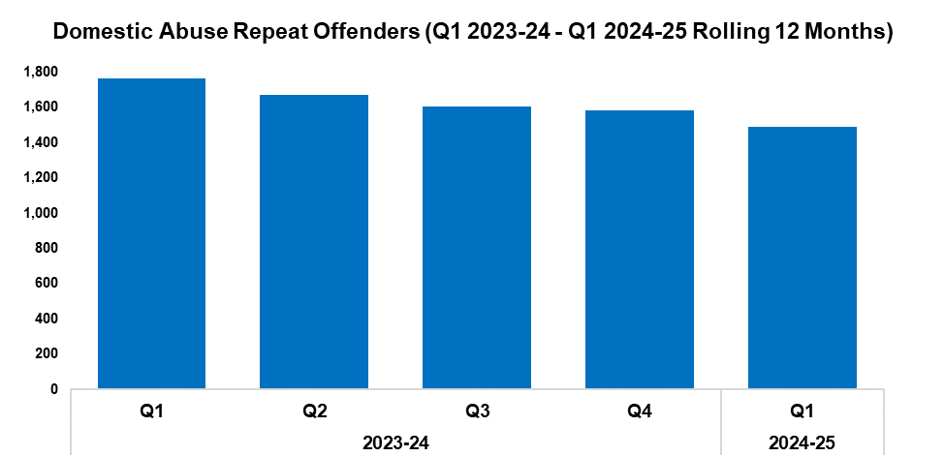
4. Domestic Abuse Repeat Victims/Offenders
2023-24 |  |  |  | 2024-25
Q1 | Q2 | Q3 | Q4 | Q1 | Q2 | Q3 | Q4
1,614 | 1,510 | 1,463 | 1,407 | 1,334 | - | - | -
2023-24 |  |  |  | 2024-25
Q1 | Q2 | Q3 | Q4 | Q1 | Q2 | Q3 | Q4
1,764 | 1,672 | 1,606 | 1,584 | 1,487 | - | - | -
Overview
The number of repeat domestic abuse victims* has decreased by 5.2% when comparing Q1 2024-25 against the quarter prior, with 73 fewer repeat victims recorded for a total of 1,334. This represents the lowest quarterly total within the timeframe, continuing the downward trend observed following Q1 2023-24. When comparing Q1 2024-25 against the same quarter during the previous financial year, a more prominent reduction of 17.3% (280 fewer repeat victims) can be observed.
The number of repeat domestic abuse offenders* has decreased by 6.1% when comparing Q1 2024-25 against the quarter prior, with 97 fewer repeat offenders recorded for a total of 1,487. As with repeat victims, this represents the lowest quarterly total within the timeframe and continues the downward trend observed following Q1 2023-24. When comparing Q1 2024-25 against the same quarter during the previous financial year, a more prominent reduction of 15.7% (277 fewer repeat offenders) can be observed.
There is a Multi-Agency Tasking and Coordination (MATAC) process in place which focuses on identifying serial perpetrators of domestic abuse, in order to limit the risk of them reoffending. A range of interventions can be delivered via MATAC to safeguard victims and families, including support, prevention, diversion, disruption, and enforcement.
This data only includes offences in which the victim and offender were both aged 16 or over at the time of the offence, as specified in the Domestic Abuse Act 2021.
*Based on rolling 12 months to the end of each quarter, where persons are linked in this capacity to two or more crimes within this period.

Slide 20
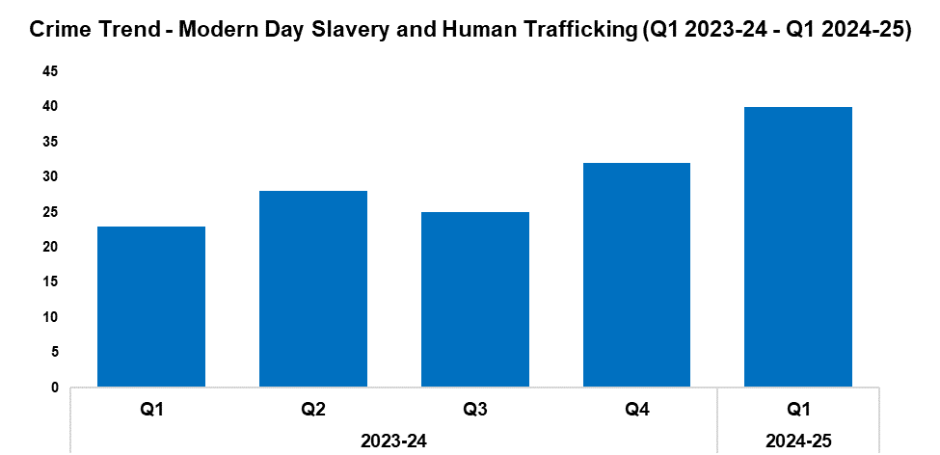
5. Modern Day Slavery and Human Trafficking
Overview
Modern Day Slavery and Human Trafficking offences have increased by 25.0% during Q1 2024-25 when compared to the quarter prior, with eight additional offences recorded for a total of 40. This represents the highest quarterly total within the timeframe, continuing the upward trend observed following Q3 2023-24. A significant increase of 73.9% (17 additional offences) has been recorded when comparing Q1 2024-25 against the same quarter during the previous financial year.
Awareness training is being delivered to new starters, new community support officers, and trainee detectives.
The number of National Referral Mechanisms (NRMs) submitted has risen by 20.6% during Q1 2024-25 when compared to the quarter prior, with seven additional referrals submitted for a total of 41. A significant increase of 95.2% can be observed when comparing Q1 2024-25 against the same quarter during the previous financial year, with 20 additional NRMs submitted.
2023-24 |  |  |  | 2024-25
Q1 | Q2 | Q3 | Q4 | Q1 | Q2 | Q3 | Q4
23 | 28 | 25 | 32 | 40 | - | - | -
The Modern Day Slavery (MDS) team identified and recovered a victim of sexual exploitation, following reports of her having been kidnapped and held at a known premises. An officer was in regular contact with the victim’s friend, who had voiced concerns about her wellbeing. The victim was located and rescued by the Joint Firearms Unit, supported by the MDS team. She has made limited disclosure and is receiving support from suitable agencies, including Gwent Police. This support includes a medication plan and assistance with accommodation, removing her from her previous exploitable lifestyle. As a result, she is making great strides towards recovery.
The MDS team took part in Operation Ampule, a British Transport Police led operation concerning county lines, along with Immigration Enforcement. They also provided support on a proactive warrant, following intelligence developments around the sale of vapes to school children.
A MDS app has been launched on all staff mobile phones. This provides officers with a direct link for submitting NRMs on site, as well as advice and guidance around Modern Day Slavery and Human Trafficking, county lines, the Section 45 Defence, organised immigration crime, and Operation Innerste.
The MDS team delivered a presentation to roughly 400 people involved in the care sector about modern slavery, highlighting the associated signs and indicators.
The MDS team has been working alongside Operation Quartz teams to promote the early identification and submission of NRM opportunities. As noted above, Gwent saw an increase in the number of NRM submissions during Q1 2024-25 when compared to the previous quarter, likely influenced by this initiative.

Slide 21
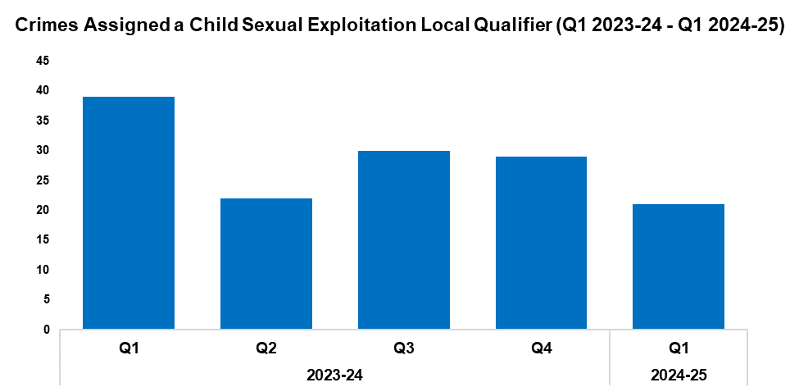
6. Child Sexual Exploitation/Child Criminal Exploitation
Overview
The number of crimes assigned a Child Sexual Exploitation (CSE) local qualifier has decreased by 27.6% during Q1 2024-25 when compared to the quarter prior, with eight fewer crimes recorded for a total of 21. This represents the lowest quarterly figure within the timeframe, continuing the downward trend observed following Q3 2023-24. A more prominent reduction of 46.2% (18 fewer crimes) can be observed when comparing Q1 2024-25 against the same quarter during the previous financial year.
The offence most commonly assigned a CSE local qualifier during Q1 2024-25 was ‘arrange or facilitate travel of another person with a view to exploitation’, with four instances recorded. This accounts for 19.0% of all crimes assigned a CSE local qualifier during the quarter.
2023-24 |  |  |  | 2024-25
Q1 | Q2 | Q3 | Q4 | Q1 | Q2 | Q3 | Q4
39 | 22 | 30 | 29 | 21 | - | - | -
The Police Online Investigation Team (POLIT) recently concluded a proactive investigation which commenced during August 2023. The team had received intelligence to indicate that the suspect had uploaded an indecent image of a child via Snapchat. A warrant was executed, and suspect’s devices were seized. In addition to the presence of indecent images, further examination of the seized devices identified more serious offending, wherein the suspect had been posing as a young child and requesting sexual images from other children. One of child victims was identified in Northern Ireland. The eleven-year-old victim was being blackmailed into sending sexual images and performing sexual acts on herself. She was also being encouraged to perform sexual acts on her four-year-old sister, as well as her dog. The suspect, who kept videos of the interactions on his phone, initially denied the offences. Further investigation by the officer in case and the digital forensic examiner evidenced the suspect’s attribution to the device and the offending account, and crucially put the device in his hand at the time of the offending. This was ultimately key to the guilty plea at court. In June, Matthew Brown (aged 30) pleaded guilty to all nine offences for which he had been charged, including causing a child to commit a sexual act, inciting a child to engage in sexual activity, sexual communication with a child, possession of indecent images of children, and possession of extreme pornography. He received a six-year prison sentence, was issued a Sexual Harm Prevention Order (SHPO), and will be on the sex offender register for life. The child victim in Northern Ireland has been safeguarded and referred for support. Her family were not aware that she was a victim, as she was too scared to tell anyone about what was happening. They have expressed their gratitude for the team’s intervention.
During April, a 77-year-old former teacher was found guilty of five counts of indecent assault and one count of buggery, following an investigation by the Organised Crime Unit into historic offences against students which took place between 1974 and 1976. He was sentenced to 17 years imprisonment, with an extended license period of three years, and is subject to an indefinite SHPO.

Slide 22
7. Child Sexual Exploitation/Child Criminal Exploitation Cont’d
The Public Protection Unit has concluded a number of investigations this quarter:
A male and his partner were convicted of intrafamilial sexual communication with a child and perverting the course of justice, with the male also convicted of sexual activity with a child. The male received a custodial sentence of 10 years, whereas the female was sentenced to nine months.
Another male was convicted of the intrafamilial rape of a child between the ages of six and eight. He was found guilty of four counts of rape of a girl under thirteen, and three counts of sexual touching with a child. As a result, he received a 20-year sentence (12 of which in custody), with a minimum term of eight years, and a license which will remain for the full 20 years.
A historical abuse investigation relating to sexual activity with a child which spanned international boundaries has been concluded. The victim was 13 years old when she was introduced to the defendant, who was 35 years old at the time. The abuse continued until she was 16 years old and involved penetrative offences. Through good collaborative and investigative work, the defendant was found guilty of 10 counts of indecent assault and was sentenced to nine years imprisonment.
A further investigation related to the intrafamilial sexual abuse of the defendant’s teenage stepdaughter via touching and penetrative offences. The defendant pleaded guilty at Cardiff Crown Court and was sentenced to three years imprisonment and an indefinite SHPO.
The defendant in another investigation committed two counts of sexual assault by touching of children under the age of 13, following them around Cwmbran in order to commit the offences. These offences were reported following police engagement with the children in question. The defendant was deemed unfit to enter a plea and stand trial but was sentenced to a 24-month supervision order and is required to register as a sex offender for five years.

Slide 23
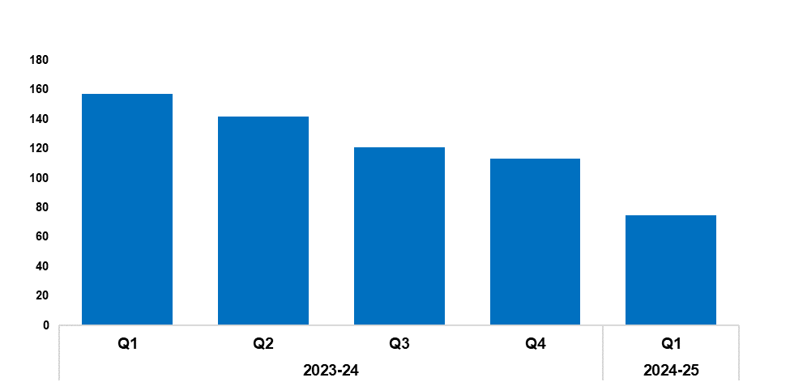
8. Cyber Fraud
Overview
Since Q1 2023-24, a total of 1,080 Action Fraud occurrences have been reported to Gwent Police via the National Fraud Intelligence Bureau. Of these, 56.3% (608 occurrences) have been assigned a cyber-enabled local qualifier.
When compared to the quarter prior, the number of Action Fraud occurrences assigned a cyber-enabled local qualifier has fallen by 33.6%, with 38 fewer occurrences reported for a total of 75. This represents the lowest quarterly figure within the timeframe, continuing the downward trend observed for this metric following Q1 2023-24. A more prominent reduction of 52.2% (82 fewer occurrences) can be observed when comparing Q1 2024-25 against the same quarter during the previous financial year.
The WDBC team attended a community event at Caerwent village hall, where they provided information and literature relating to fraud and scams in addition to general crime prevention advice and products.
2023-24 |  |  |  | 2024-25
Q1 | Q2 | Q3 | Q4 | Q1 | Q2 | Q3 | Q4
157 | 142 | 121 | 113 | 75 | - | - | -

Slide 24
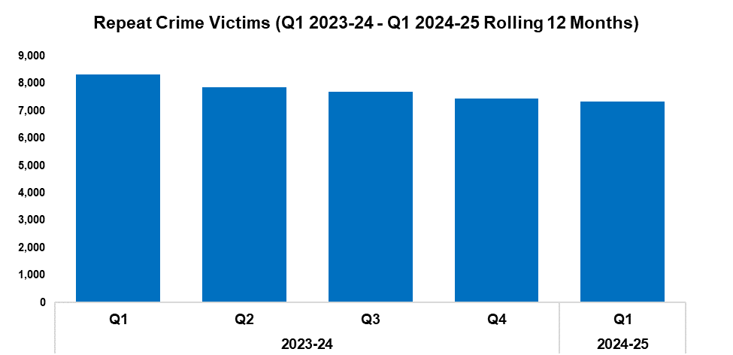
9. Victim Support/Repeat Victims
Overview
In this context, a repeat crime victim refers to an individual who has been linked as a victim in two or more crimes within a 12-month rolling period.
The number of repeat crime victims has fallen by 1.5% (114 fewer repeat victims) during Q1 2024-25* when compared to the quarter prior, with a total of 7,334 repeat victims recorded. This represents the lowest quarterly total within the timeframe, continuing the downward trend observed for this metric following Q1 2023-24.
A more prominent reduction of 11.9% (986 fewer repeat victims) can be observed when comparing Q1 2024-25 against the same quarter during the previous financial year.
*Based on the rolling 12 months to the end of the quarter.
2023-24 |  |  |  | 2024-25
Q1 | Q2 | Q3 | Q4 | Q1 | Q2 | Q3 | Q4
8,320 | 7,868 | 7,699 | 7,448 | 7,334 | - | - | -
The East Neighbourhood team works to identify vulnerable victims via the Victim Care Hub on a weekly basis, with 34 families identified since April. These families have been provided with a number of security measures, including doorbell and CCTV cameras, security lights, smart water, and burglary packs containing window alarms, a shed alarm, a TV impersonator, and 24-hour segment timers. In addition, 100 bespoke burglary packs (which include doorbell and CCTV cameras) have been delivered to victims of high-risk domestic violence, facilitated via ongoing liaison work with DAST.
The West Safeguarding Hub completed 284 strategy discussions throughout June. Amongst these were 182 relating to child protection, 75 relating to the protection of vulnerable adults, and nine relating to CSE or Child Criminal Exploitation. Collaborative work was undertaken with partners to assess and investigate criminal offences against vulnerable children and adults, and to address safeguarding concerns. This has resulted in 53 joint visits by police and social services.
Demand mapping and benchmarking exercises have been conducted by Victim Services to improve their service for victims and witnesses.
The Victim Services survivor group met with a doctor from accident and emergency to discuss policies around safe disclosure. Plans are in place for the Domestic Abuse Stalking Team to discuss stalking and harassment, and the regional Violence Against Women, Domestic Abuse, and Sexual Violence team to discuss digital awareness.
Given the success of the Domestic Abuse Triage meeting for Magistrates’ Court cases, Victim Services have now initiated the same process for Crown Court cases.
The WDBC team provided personal and home safety products to a vulnerable victim of domestic abuse.

Slide 25
Increase Community Confidence in Policing
Perceptions Survey: Levels of Policing
Perceptions Survey: Police Effectiveness
Perceptions Survey: Fairness
Perceptions Survey: Engagement
Perceptions Survey: Local Concerns and Overall
Victim Satisfaction
Representative Workforce
Investigation Timeliness
Response Rates
999 Demand
101 Demand
Social Media and Single Online Home
Initiatives & Events
Key Commitments
Increase the effectiveness of officer and staff engagement with residents in their communities, and community confidence and trust in Gwent Police.
Improve the accessibility of neighbourhood police teams through a variety of contact channels that meet the needs of the public.
Increase reporting of crime by communities that are less likely to engage with the police.
Further increase officer and staff diversity to ensure our police service reflects the communities that we serve.

Slide 26
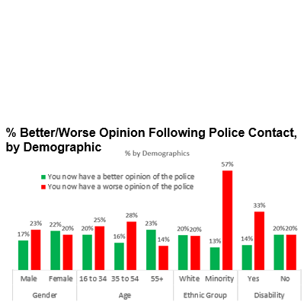
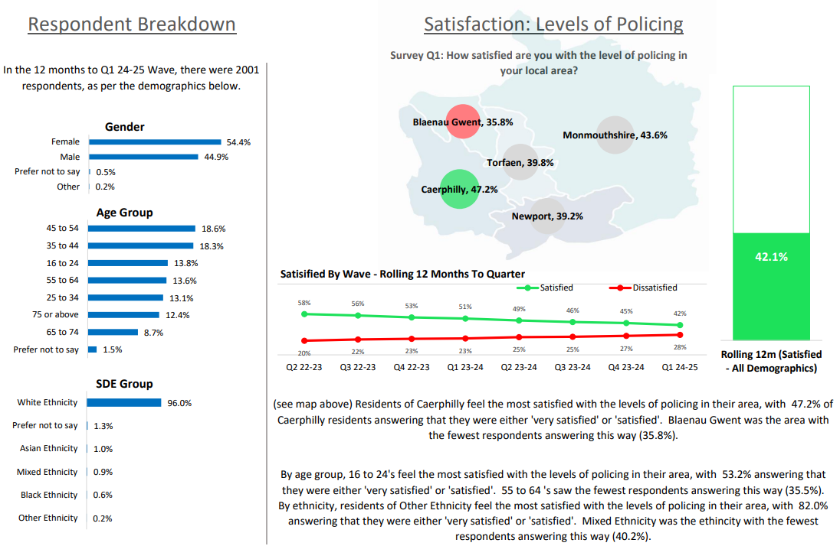
1. Perceptions Survey: Levels of Policing

Slide 27
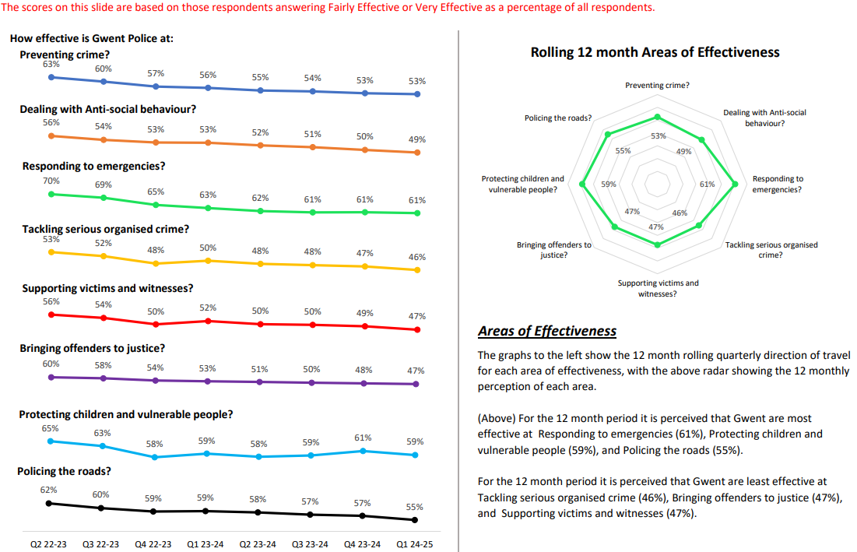
2. Perceptions Survey: Police Effectiveness

Slide 28
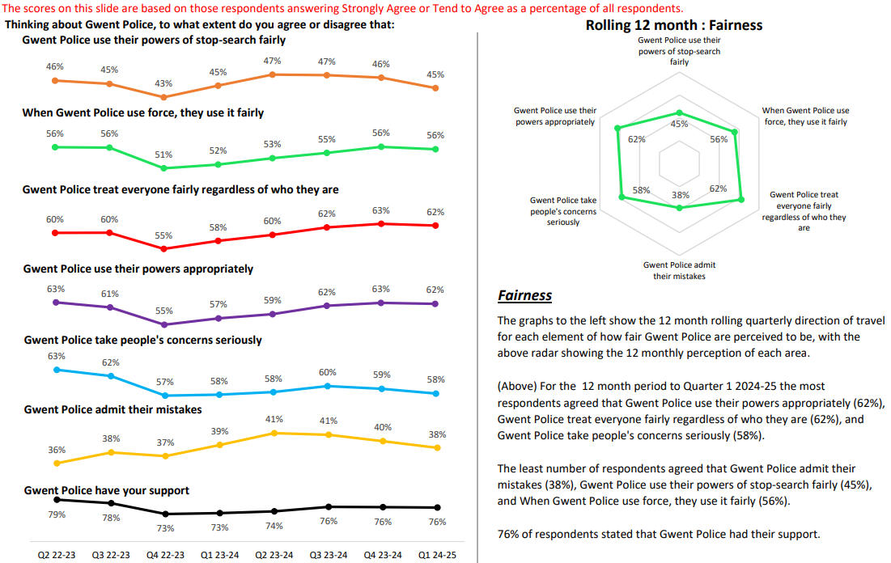
3. Perceptions Survey: Fairness

Slide 29
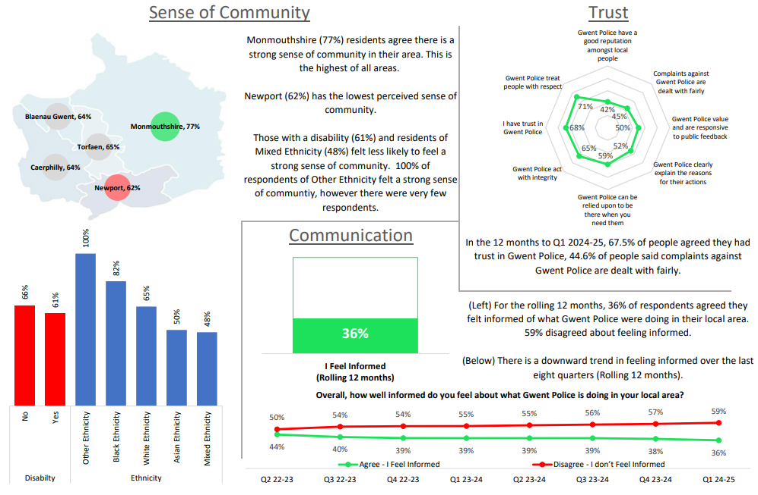
4. Perceptions Survey: Engagement

Slide 30
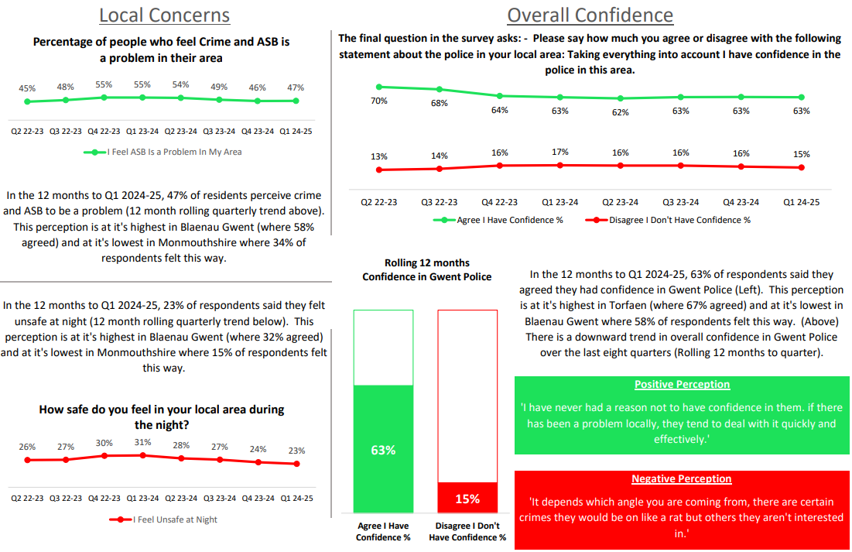
5. Perceptions Survey: Local Concerns and Overall

Slide 31
6. Victim Satisfaction
Percentage | Measure
Survey Number | Survey One | Survey Two |  |  |  | Survey Three
Metric | Satisfied with Initial Contact | Satisfied with Follow Up & Investigation | Satisfied with the service from the VCO | Satisfied with the service from the officer dealing with your case | Satisfied with being kept informed about your case | Satisfied with Post Charge
General Crime | 61% | 55% | 87% | 76% | 77% | 40%
Domestic Violence | 75% | 75% | 93% | 81% | 83% | 100%
Hate Crime | 100% | 67% | 100% | 100% | 100% | No Data
Sexual Violence | 100% | 80% | 100% | 80% | 100% | No Data
Baseline | N/A | N/A | 85% | 85% | 74% | N/A
Numeric | Measure
Survey Number | Survey One | Survey Two |  |  |  | Survey Three
Metric | Satisfied with Initial Contact | Satisfied with Follow Up & Investigation | Satisfied with the service from the VCO | Satisfied with the service from the officer dealing with your case | Satisfied with being kept informed about your case | Satisfied with Post Charge
General Crime | 791/1295 | 56/102 | 48/55 | 38/50 | 41/53 | 2/5
Domestic Violence | 45/60 | 27/36 | 26/28 | 22/27 | 19/23 | 7/7
Hate Crime | 11/11 | 2/3 | 3/3 | 3/3 | 3/3 | No Data
Sexual Violence | 9/9 | 4/5 | 5/5 | 4/5 | 4/4 | No Data
Sample Size | 1,402 | 146 | The above questions can be answered with ‘N/A’. These responses have been removed from both the percentage and numeric calculations. As a result, the sample size will differ from that for ‘Satisfied with Follow Up & Investigation’. |  |  | 12

Slide 32
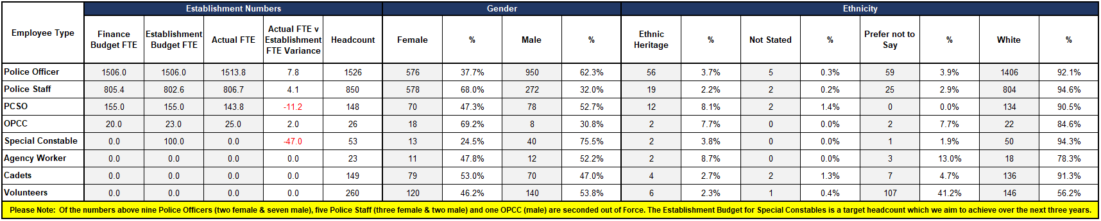
7. Representative Workforce
The below table is correct as of the 30th of June 2024
Key Points
There is a gender disparity evident in the workforce for both officers and staff. For officers, females are underrepresented by approximately 13 percentage points (females account for 51% of the population in Gwent based on the 2021 Census). However, females are overrepresented in the staff workstream area by approximately 17 percentage points.
There is also a disparity in ethnic heritage representation within the workforce. In Census 2021, people of ethnic heritage account for 5.8% of the population in Gwent. Currently 3.7% of police officers are of ethnic heritage, whereas ethnic heritage representation in the staff workstream is lower at 2.2%.
A successful recruitment open day event was held at Gwent Police Headquarters, opened by the Deputy Chief Constable. Over 60 people attended the event, with the feedback received being overwhelmingly positive.
An Employer Partnership Pledge has been established with Coleg Gwent, allowing for direct engagement with the organisation and students.

Slide 33
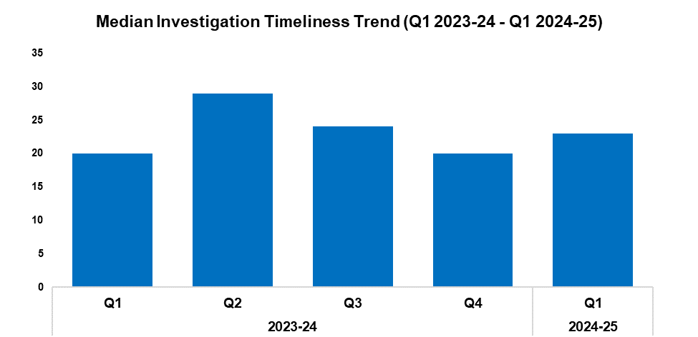
8. Investigation Timeliness
Overview
The median number of days within which an investigation is completed has risen by 15.0% when compared to the previous quarter, up by three days to 23. This disrupts the downward trend observed for this metric following Q2 2023-24. An equivalent rise of 15.0% can also be observed when comparing Q1 2024-25 against the same quarter during the previous financial year.
As of Q1 2024-25, there are 16,864 crimes classified as unfinalised (excluding pending finalisation). This represents an increase of 13.3% (1,986 additional crimes) when compared to the quarter prior.
Of the 16,864 unfinalised crimes, 12,177 are currently under investigation. Of these 8,562 crimes have been under investigation for less than six months, 1,668 have been under investigation for between six and 12 months, and 1,947 have been for under investigation for over 12 months.
Of those crimes which have been under investigation for over 12 months, Violence without Injury offences are the most common, accounting for 20.2% of the total with 393 crimes. This is followed by Rape offences, which comprise 15.7% of the total with 305 crimes.
2023-24 |  |  |  | 2024-25
Q1 | Q2 | Q3 | Q4 | Q1 | Q2 | Q3 | Q4
20 | 29 | 24 | 20 | 23 | - | - | -

Slide 34
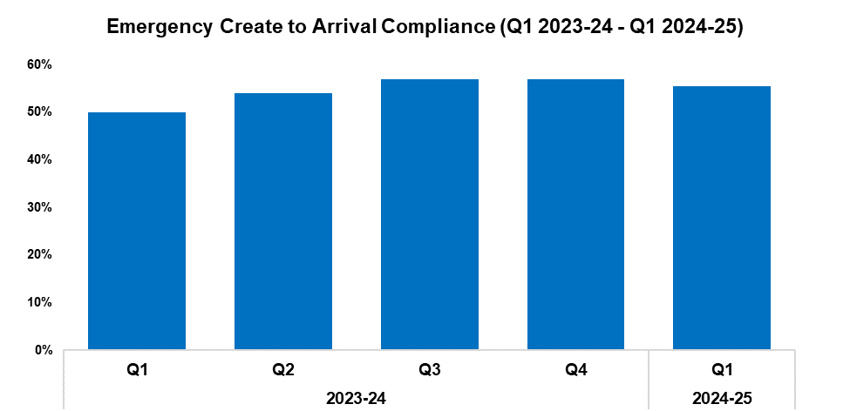
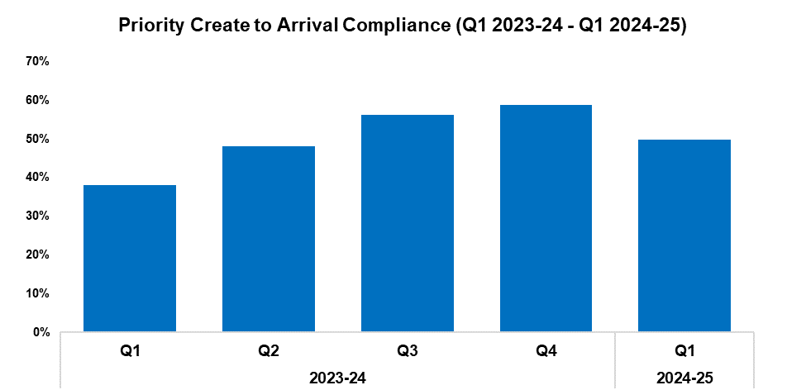
9. Response Rates
2023-24 |  |  |  | 2024-25
Q1 | Q2 | Q3 | Q4 | Q1 | Q2 | Q3 | Q4
50.0% | 54.1% | 56.9% | 57.0% | 55.5% | - | - | -
2023-24 |  |  |  | 2024-25
Q1 | Q2 | Q3 | Q4 | Q1 | Q2 | Q3 | Q4
38.0% | 48.1% | 56.1% | 58.8% | 49.7% | - | - | -
Overview
Based on the target arrival time of 15 minutes, emergency create to arrival compliance has decreased by 1.5 percentage points during Q1 2024-25 when compared to the quarter prior, and currently stands at 55.5%. This disrupts the upward trend observed for this metric following Q1 2023-24. Conversely, emergency response compliance has increased by 5.5 percentage points when comparing Q1 2024-25 against the same quarter during the previous financial year.
Based on the target arrival time of one hour, priority create to arrival compliance has decreased by 9.1 percentage points during Q1 2024-25 when compared to the quarter prior, and currently stands at 49.7%. As with emergency compliance, this disrupts the upward trend observed for this metric following Q1 2023-24. Conversely, priority response compliance has increased by 11.7 percentage points when comparing Q1 2024-25 against the same quarter during the previous financial year.

Slide 35
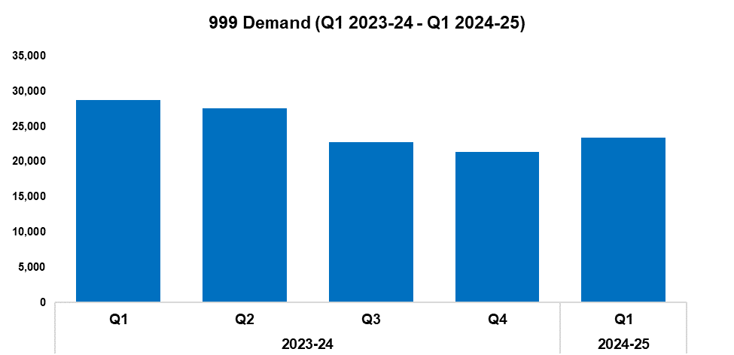
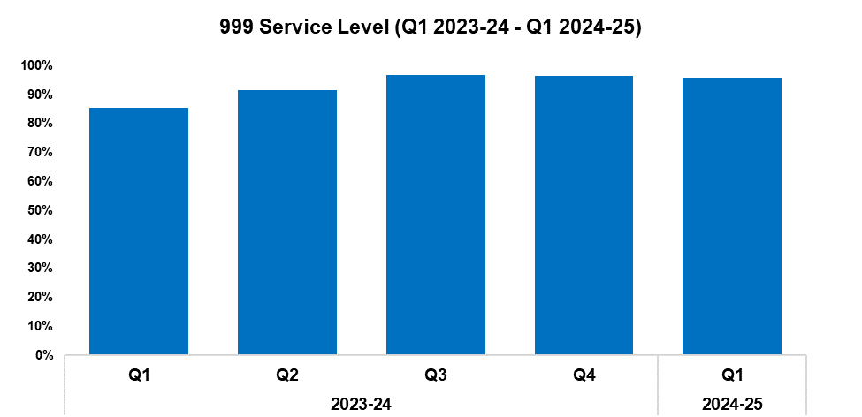
10. 999 Demand
2023-24 |  |  |  | 2024-25
Q1 | Q2 | Q3 | Q4 | Q1 | Q2 | Q3 | Q4
28,737 | 27,600 | 22,806 | 21,326 | 23,412 | - | - | -
2023-24 |  |  |  | 2024-25
Q1 | Q2 | Q3 | Q4 | Q1 | Q2 | Q3 | Q4
85.5% | 91.5% | 96.9% | 96.4% | 95.9% | - | - | -
Overview
999 demand has increased by 9.8% during Q1 2024-25 when compared to the quarter prior, with 2,086 additional calls received for a total of 23,412. This disrupts the downward trend observed for this metric following Q1 2023-24. Conversely, a reduction of 18.5% (5,325 fewer calls) can be observed when comparing Q1 2024-25 against the same quarter during the previous financial year.
999 service level (the percentage of 999 calls answered within 10 seconds) has declined during Q1 2024-25 when compared to the quarter prior, falling by 0.5 percentage points to 95.9%. This continues the slight downward trend observed for this metric following Q3 2023-24. Conversely, 999 service level has increased by 10.4 percentage points when comparing Q1 2024-25 against the same quarter during the previous financial year.
999 Average Answer Speed
(Minutes/Seconds)
2023-24 |  |  |  | 2024-25
Q1 | Q2 | Q3 | Q4 | Q1 | Q2 | Q3 | Q4
00:10 | 00:07 | 00:04 | 00:04 | 00:04 | - | - | -
The average answer speed for 999 calls during Q1 2024-25 was four seconds. This figure has remained steady for the last three quarters, and represents the joint-lowest value within the timeframe. 999 average answer speed has improved by six seconds when comparing Q1 2024-25 against the same quarter during the previous financial year.

Slide 36
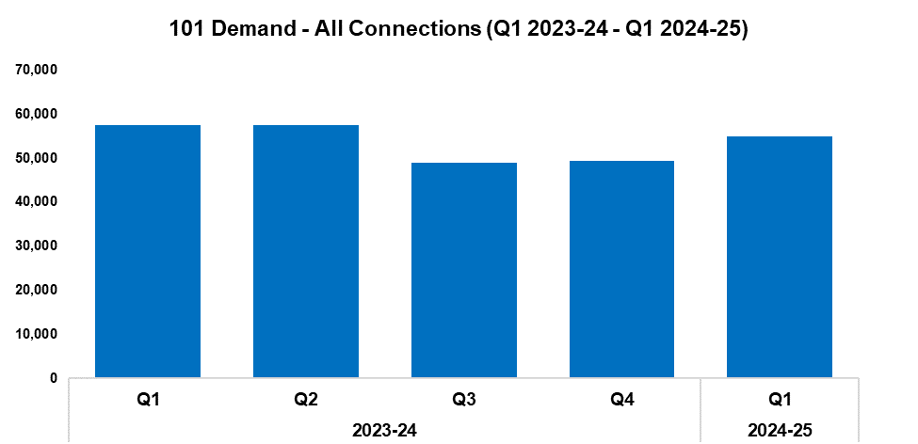
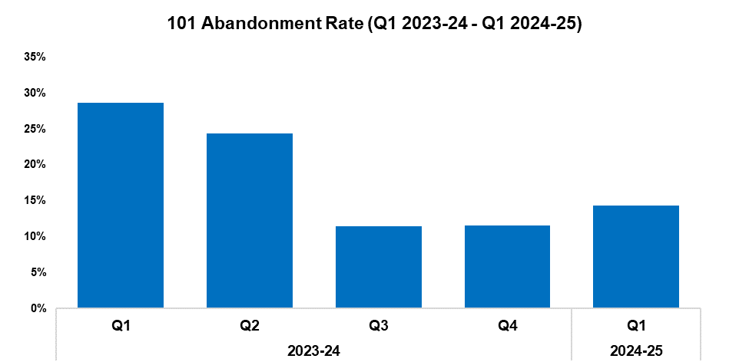
11. 101 Demand
2023-24 |  |  |  | 2024-25
Q1 | Q2 | Q3 | Q4 | Q1 | Q2 | Q3 | Q4
57,552 | 57,466 | 48,881 | 49,457 | 54,969 | - | - | -
2023-24 |  |  |  | 2024-25
Q1 | Q2 | Q3 | Q4 | Q1 | Q2 | Q3 | Q4
28.6% | 24.4% | 11.4% | 11.5% | 14.3% | - | - | -
Overview
101 demand (all connections) has increased by 11.1% during Q1 2024-25 when compared to the quarter prior, with 5,512 additional calls received for a total of 54,969. This continues the upward trend observed following Q3 2023-24. Conversely, a reduction of 4.5% (2,583 fewer calls) can be observed when comparing Q1 2024-25 against the same quarter during the previous financial year.
The 101 abandonment rate (for options one & two) has risen by 2.8 percentage points when compared to the quarter prior, and currently stands at 14.3%. This continues the upward trend observed following Q3 2023-24, and correlates with the rise in 101 demand recorded during Q1 2024-25. Conversely, a substantial reduction of 14.3 percentage points has been recorded when comparing Q1 2024-25 against the same quarter during the previous financial year.
101 Average Answer Speed
(Minutes/Seconds)
2023-24 |  |  |  | 2024-25
Q1 | Q2 | Q3 | Q4 | Q1 | Q2 | Q3 | Q4
06:29 | 05:05 | 02:20 | 02:14 | 02:57 | - | - | -
The average answer speed for 101 calls during Q1 2024-25 was two minutes and 57 seconds, an increase of 43 seconds when compared to the quarter prior. This disrupts the downward trend observed for this metric following Q1 2023-24, and again correlates with the increase in 101 demand recorded during Q1 2024-25.
Conversely, the average answer speed has improved by three minutes and 32 seconds when comparing Q1 2024-25 against the same quarter during the previous financial year.

Slide 37
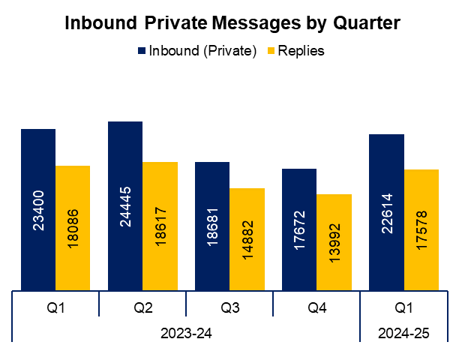
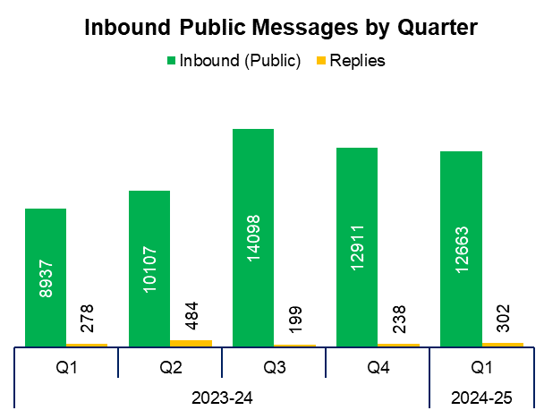
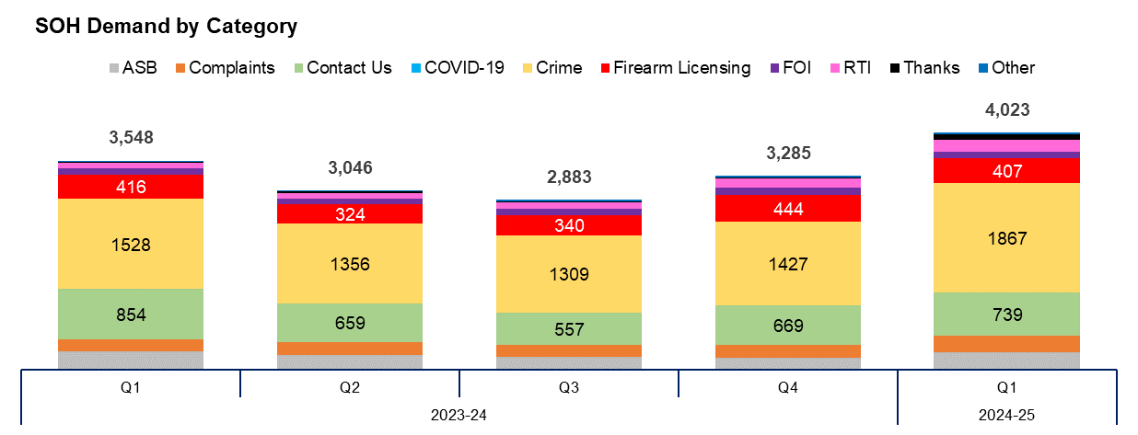
12. Social Media and Single Online Home
Overview
The volume of inbound private messages received via Gwent Police’s social media platforms has increased by 28.0% during Q1 2024-25 when compared to the quarter prior, with 4,942 additional messages received for a total of 22,614. Of these, 93.9% (21,245 messages) were received via Facebook platforms.
The volume of inbound public messages received via Gwent Police’s social media platforms has decreased by 1.9% during Q1 2024-25 when compared to the quarter prior, with 248 fewer messages received for a total of 12,663. Of these, 90.2% (11,420 messages) were received via Facebook platforms.
This digital contact data includes Gwent Police’s English and Welsh Facebook and X accounts.
4,023 Single Online Home (SOH) forms were submitted during Q1 2024-25, an increase of 22.5% (738 additional forms) when compared to the quarter prior. This represents the highest quarterly figure within the timeframe, continuing the upward trend observed for this metric following Q3 2023-24.
The adjacent chart presents these forms by category, with the most numerous being crime reports. These account for 46.4% of the total, with 1,867 forms submitted. They are followed by general ‘contact us’ messages (accounting for 18.4% of the total with 739 forms submitted), and firearms licensing (accounting for 10.1% of the total with 407 forms submitted). ‘Other’ includes forms with low volume, including events and processions, filming, fingerprints and IP licensing.

Slide 38
13. Initiatives & Events
Overview
The missing children team are undertaking collaborative work with partners in relation to the Philomena Protocol and Trigger Plan (PPTP). This is a police initiative to assist in locating and safely returning missing children as quickly as possible. The PPTP focuses on the multi-agency response to children who are reported missing and who may have additional needs or vulnerabilities that would be graded as medium or high risk. It is is an evidence based problem-solving initiative that seeks to address recurring missing episodes. This is primarily accomplished through a collaborative partnership between local policing, children’s care homes, parents/carers, and other provisions based on existing and accepted practice, but where meaningful engagement can be sustained long term. The basis of the scheme is for vital information to be collated, recorded, and stored in a document that is easily accessible, to assist with enquiries in the event that a child is reported missing.
Community Safety weeks have been held in Llanmartin, St Julians, and Alway primary schools.
Two Gwent officers were nominated for the Welsh Government St David Award for bravery, on account of their actions in the immediate aftermath of the dog attack which resulted in the tragic death of Jack Lis.
Corporate Communications have launched ‘The Brief’, an internal publication aimed at high-ranking officers and staff to promote the awareness of and engagement with key strategic messages across the force.
The Local Environmental Awareness on Dogs (LEAD) initiative has now been launched across the force area, following its successful implementation in Caerphilly since September. This initiative is focused on encouraging the responsible ownership of all dog breeds, with the aim of improving public safety, reducing ASB, and ensuring that dogs are looked after appropriately. LEAD aids the force in sharing intelligence and implementing a range of measures such as warning letters, acceptable behaviour contracts and, ultimately, enforcement action when appropriate.
The EDI team attended a number of key cultural events this quarter. During Ramadan, they attended the Iftar (breaking of the daily fast) at mosques across Gwent, presenting gifts of food at each. On Stephen Lawrence Day (22nd of April) the team attended Cwmffrwdoer Primary School alongside colleagues from the Office of the Police and Crime Commissioner and local council. The students were taught about Stephen’s legacy, and joined the EDI team in planting a tree to commemorate him. The team also attended a number of events during pride month, including Torfaen and Caerphilly pride, as well as Pride Cymru. Whilst in attendance, the team distributed engagement items and partook in trust-building conversations with the LGBTQ+ communities of Gwent.
In addition to attending these events, the EDI team held the quarterly Muslim leader’s meeting for Muslim community and mosque leaders in Newport. They also met with refugees and asylum seekers who had come to the UK under the Afghan Relocations and Assistance Policy, in order to help explain the UK approach to policing, and to break down barriers to trust. Additionally, the team has run workshops and assemblies on anti-racism and sexuality-based hate crime with young people in the west Local Policing Area. A cultural dress event was also held in Monmouth police station, involving members of the South Asian community.
The EDI manager worked with colleagues in the communications team to develop Gwent Police’s first allyship programme, the Pro Inclusion Network. The aim of this programme is to hold conversations about various aspects of diversity and inclusion in a safe learning environment.
The force’s suicide prevention and postvention policy was sent to the National Police Wellbeing Service for consultation. Their revised advice and guidance will be taken into consideration.
The Men’s Health Network and the Wellbeing team held a prostate cancer screening, which received positive feedback. 100 individuals were screened, with seven being referred to their GPs.

Slide 39
Professional Standards Department
PSD Total Recorded Complaint Allegations
PSD Schedule 3 and Non-Schedule 3 Complaint Cases
PSD Misconduct Cases
Vetting
Disproportionality

Slide 40

1. PSD Total Recorded Complaint Allegations
Overview
There has been a slight reduction of 1.7% in complaint allegations received during Q1 2024-25 when compared to the quarter prior, with five fewer complaints received for a total of 286.
The three categories of complaint with the greatest volume are as follows:
A1. Police action following contact 114
A3. Information 27
H3. Unprofessional attitude and disrespect 25
Within these sub-categories, the following changes have been observed:
There has been a minor increase in A1. Police action following contact when compared to the quarter prior, with two additional complaints recorded.
A3. Information has become the second most prevalent category, with nine additional complaints recorded when compared to the quarter prior. This displaces A4. General level of service.
There has been a slight decrease in H3. Unprofessional attitude and disrespect when compared with the quarter prior, with one fewer complaint recorded.
Please note that multiple allegations can be recorded by one complainant.
2022-23 |  |  |  | 2023-24 |  |  |  | 2024-25
Q1 | Q2 | Q3 | Q4 | Q1 | Q2 | Q3 | Q4 | Q1 | Q2 | Q3 | Q4
296 | 256 | 268 | 311 | 320 | 426 | 326 | 291 | 286 | - | - | -

Slide 41


2. PSD Schedule 3 and Non-Schedule 3 Complaint Cases
2022-23 |  |  |  | 2023-24 |  |  |  | 2024-25
Q1 | Q2 | Q3 | Q4 | Q1 | Q2 | Q3 | Q4 | Q1 | Q2 | Q3 | Q4
43 | 41 | 37 | 45 | 34 | 39 | 37 | 34 | 32 | - | - | -
2022-23 |  |  |  | 2023-24 |  |  |  | 2024-25
Q1 | Q2 | Q3 | Q4 | Q1 | Q2 | Q3 | Q4 | Q1 | Q2 | Q3 | Q4
73 | 89 | 59 | 125 | 131 | 260 | 149 | 124 | 155 | - | - | -
Overview
Schedule 3 relates to complaints dealt with under the Police Reform Act 2002, whereby the complainant can request a review if they are not satisfied.
Non-Schedule 3 allows complaints to be dealt with outside of the Police Reform Act 2002, previously regarded as ‘dissatisfaction’.
There has been a decrease of 5.9% in Schedule 3 cases during Q1 2024-25 when compared to the quarter prior, with two fewer complaints recorded for a total of 32. Conversely, Non-Schedule 3 cases have seen an increase of 25.0% when compared to the previous quarter, with an additional 31 complaints recorded for a total of 155.
At the time the data was extracted there were 46 live Schedule 3 complaints and five live Non-Schedule 3 complaints.
Figures will contain cases with multiple allegations.

Slide 42

3. PSD Misconduct Cases
Overview
Misconduct cases have seen a reduction of 31.8% during Q1 2024-25 when compared to the quarter prior, with seven fewer cases recorded for a total of 15.
A more proactive approach to misconduct and counter-corruption intelligence gathering and investigation, coupled with more confidence in the workforce to report, has been the catalyst for an increase in misconduct cases over the last four years. During the past four quarters of monitoring this appeared to have plateaued, whereas the figure for Q1 2024-25 is beginning to show a downward trend.
Gwent PSD have invested resources into both proactive and preventive work and have increased the support on offer for victims and witnesses of police misconduct.
2022-23 |  |  |  | 2023-24 |  |  |  | 2024-25
Q1 | Q2 | Q3 | Q4 | Q1 | Q2 | Q3 | Q4 | Q1 | Q2 | Q3 | Q4
12 | 14 | 16 | 28 | 22 | 25 | 23 | 22 | 15 | - | - | -
Q1 2024-25 Misconduct Outcomes
Two Police Officer Misconduct Meetings were held:
An officer had displayed discreditable conduct whilst off-duty and watching his son at a sporting event. The Chair found the allegation proven as misconduct and the officer received a written warning.
Two officers displayed aggressive behaviour whilst on an off-duty night out in the the South Wales Police area. The Chair found the allegations proven as misconduct for both officers, and both officers received a final written warning.

Slide 43


4. Vetting
Vetting Checks | 2022-23 |  |  |  | 2023-24
Q1 | Q1 | Q2 | Q3 | Q4 | Q1 | Q2 | Q3 | Q4
Police Staff/Officers | 165 | 173 | 148 | 162 | 132 | 107 | 136 | 54
Contractors/Outside Agency | 260 | 166 | 245 | 217 | 195 | 230 | 240 | 205
Vetting Health Checks | 35 | 42 | 47 | 45 | 39 | 49 | 45 | 47
National Security Vetting | 0 | 0 | 0 | 0 | 21 | 20 | 10 | 11
Total | 460 | 381 | 440 | 424 | 387 | 406 | 431 | 317
Vetting Refusals | 2022-23 |  |  |  | 2023-24
Q1 | Q1 | Q2 | Q3 | Q4 | Q1 | Q2 | Q3 | Q4
Residency | 0 | 0 | 0 | 0 | 0 | 0 | 0 | 0
PSD | 0 | 0 | 0 | 0 | 2 | 0 | 3 | 1
Convictions, Cautions & Impending Cases | 13 | 3 | 8 | 13 | 7 | 5 | 12 | 3
TAINT | 0 | 0 | 0 | 0 | 1 | 3 | 1 | 0
Intelligence & Non-conviction Data | 11 | 5 | 6 | 11 | 17 | 18 | 20 | 12
Open Source | 0 | 0 | 0 | 0 | 1 | 1 | 0 | 0
Associations | 1 | 2 | 7 | 8 | 2 | 3 | 4 | 3
Financial Integrity | 0 | 4 | 11 | 6 | 5 | 6 | 8 | 2
Integrity | 0 | 0 | 0 | 0 | 2 | 4 | 8 | 4
National Security and Terrorism | 0 | 0 | 0 | 0 | 0 | 0 | 0 | 0
Abuse of Position | 0 | 0 | 0 | 0 | 1 | 0 | 0 | 0
Total Vetting Refusals (There can be multiple reasons per refusal) | 28 | 16 | 32 | 42 | 32 | 25 | 35 | 17
Overview
Data is submitted a quarter behind, therefore Q1 2024-25 is not currently included.
Please note the new national categories for vetting refusals that will allow all forces to benchmark data and performance.

Slide 44
5. Disproportionality
Vetting Refusals Protected Characteristics Data (OLEEO cases only) |  | 2023-24
 |  | Q1 | Q2 | Q3 | Q4
Ethnic Heritage | Received | 3 | 10 | 6 | 3
 | Refused | 0 | 2 | 1 | 0
Sexual Orientation | Received | 11 | 15 | 8 | 3
 | Refused | 1 | 1 | 1 | 0
Disability | Received | 0 | 9 | 0 | 5
 | Refused | 0 | 1 | 0 | 0
Gender Reassignment | Received | 0 | 1 | 0 | 0
 | Refused | 0 | 0 | 0 | 0
Male | Received | 70 | 89 | 62 | 42
 | Refused | 7 | 10 | 2 | 4
Female | Received | 47 | 63 | 54 | 36
 | Refused | 5 | 2 | 2 | 1
Total Cases on OLEEO (There can be multiple protected characteristics per refusal) |  | 117 | 152 | 116 | 78
Appeal Panels Protected Characteristics Data |  | 2023-24
 |  | Q1 | Q2 | Q3 | Q4
Ethnic Heritage | Received | 0 | 0 | 0 | 0
 | Overturned | 0 | 0 | 0 | 0
Sexual Orientation | Received | 0 | 0 | 0 | 0
 | Overturned | 0 | 0 | 0 | 0
Disability | Received | 0 | 0 | 0 | 0
 | Overturned | 0 | 0 | 0 | 0
Gender Reassignment | Received | 0 | 0 | 0 | 0
 | Overturned | 0 | 0 | 0 | 0
Male | Received | 10 | 0 | 3 | 4
 | Overturned | 1 | 0 | 0 | 0
Female | Received | 3 | 0 | 1 | 1
 | Overturned | 1 | 0 | TBD | 1
Total Cases Heard at Appeal (There can be multiple protected characteristics per appeal) |  | 13 | 0 | 4 | 5
Overview
The vetting disproportionality data is a new measure that will allow the force to track vetting refusals and appeal panel decisions across all areas of protected characteristics. As more data is gathered this will allow us to benchmark our figures against other Home Office forces.

