Slide 1


Slide 2
PEEL 2021-22 Recommendations/Areas for improvement
Ref | Lead | Recommendation/AFI | Work ongoing - to be tested PEEL 2023-25 | Closed
27807 | Head of FPOC | Within three months, Gwent Police should: make sure a structured triage approach is used to assess risk and consider the needs of the victim;
27808 | Head of FPOC | Within three months, Gwent Police should: improve the process of risk assessing callers to identify those that are vulnerable or at risk;
27809 | Head of FPOC | Within three months, Gwent Police should: make sure that vulnerable and repeat callers are routinely identified, and that this is recorded;
27810 | Head of FPOC | Within three months, Gwent Police should: make sure that call takers give appropriate advice on the preservation of evidence and crime prevention.
27811 | Head of FPOC | Within six months, Gwent Police should: make sure it can answer a greater proportion of non-emergency 101 calls so that caller attrition levels are reduced and kept as low as possible.
27812 | Head of FPOC | Within six months, Gwent Police should: attend most calls within its published time frames and update victims if there is a delay.
27813 | Stop and Search/ Use of Force Lead | The force should improve its recording of reasonable grounds for stop and search, in compliance with force policy and the authorised professional practice.
27814 | Head of Crime | The force should make sure that it has the capacity and capability to effectively investigate crime on behalf of the public, and that its governance and scrutiny arrangements result in improved standards of investigation
27815 | Head of Crime | The force should make sure investigation plans are created where applicable, with supervisory oversight and direction throughout.
27816 | Head of Crime | The force should make sure investigations are completed without unnecessary delays and that all proportionate and relevant investigative opportunities are taken.
27817 | Head of Crime | Where a victim has decided to withdraw support for police action, the force should ensure that there is an auditable record of this decision. This should include the reason why the decision was made. The force should make sure it documents whether evidence-led prosecutions have been considered in all such cases.
27818 | Head of PPU | The force should make sure that its governance and scrutiny arrangements provide enough capacity and capability to effectively protect vulnerable people.
27819 | Head of PPU | The force needs to improve how effectively it meets national standards in relation to the use of the domestic violence disclosure scheme.
27820 | Head of PPU | The force should make sure it appropriately manages MARAC demand to reduce the risk of serious harm to high-risk victims of domestic abuse.
27821 | Head of HR | Gwent Police should demonstrate that it can use its understanding of factors contributing to sickness and absence to improve the well-being of the workforce.
27822 | Head of Continuous Improvement | The force should make sure it has an effective strategic planning framework to tackle important issues.
27823 | Head of Continuous Improvement | The force should make sure it can effectively manage current demand, with the resources available to it.
Notes:
All PEEL related AFIs and recommendations are categorised as Level 3 and for sign off by HMICFRS Force Liaison Lead (FLL).
PEEL inspection 23 – 25 starts in June 2024 with meeting observations, orientation meetings with leads, and focus groups.
Since PEEL report was received in April 2023, the force has had 4 recommendations and 4 AFIs discharged by HMICFRS.
HMICFRS FLL will be starting to test the above AFIs/ recommendations through continuous assessment phase of PEEL that will run up until February 2025.

Slide 3
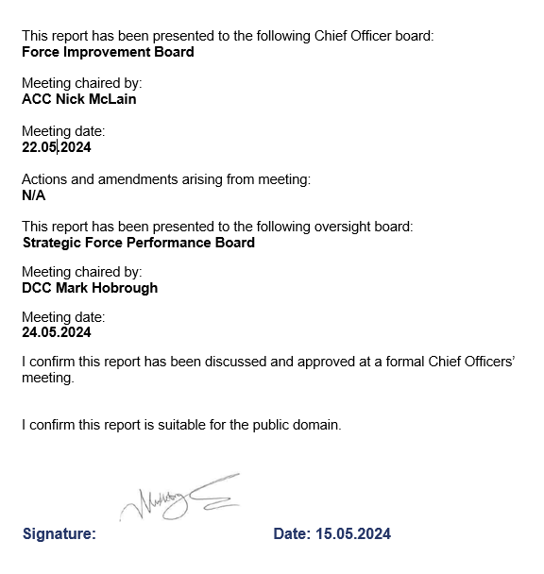
Governance board and Chief Officer Approval

