Slide 1
Strategy Performance Board
Quarter 4 2023-24
Notes:
Operational Performance Board

Slide 2
Keeping Neighbourhoods Safe
All Crime
Beating Crime Plan
Residential Burglary
Neighbourhood Crime
Public Order
Anti-Social Behaviour
Roads Policing
Key Commitments
Reduce public order offences and anti-social behaviour, and the number of people who repeatedly carry out these acts.
Reduce acquisitive crime and repeat offenders.
Improve the safety of roads throughout Gwent.
Commission and invest in effective crime prevention initiatives.

Slide 3
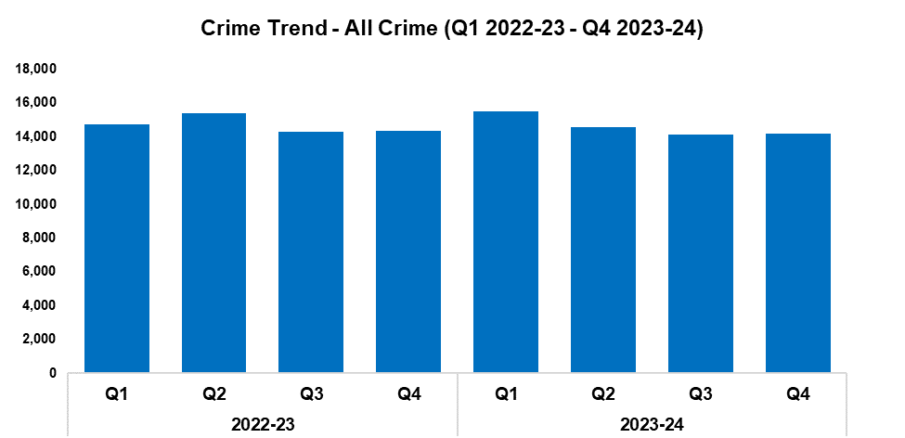
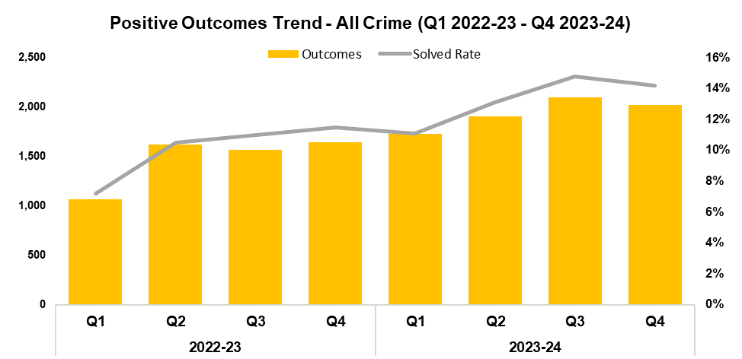
1. All Crime
2022-23 |  |  |  | 2023-24
Q1 | Q2 | Q3 | Q4 | Q1 | Q2 | Q3 | Q4
14,748 | 15,404 | 14,277 | 14,356 | 15,521 | 14,539 | 14,141 | 14,203
2022-23 |  |  |  | 2023-24
Q1 | Q2 | Q3 | Q4 | Q1 | Q2 | Q3 | Q4
7.2% | 10.5% | 11.0% | 11.5% | 11.1% | 13.1% | 14.8% | 14.2%
Overview
Overall crime levels have risen by 0.4% during the fourth quarter of the 2023-24 financial year (Q4 2023-24) when compared the quarter prior, with 62 additional offences recorded for a total of 14,203. Whilst this increase disrupts the downward trend observed for this metric following Q1 2023-24, it appears to conform to seasonal trends. Conversely, a reduction of 1.1% (153 fewer offences) can be observed when comparing Q4 2023-24 against the same quarter during the previous financial year. A similar reduction of 0.6% (381 fewer offences) has been recorded when comparing the most recent financial year against financial year 2022-23, for a total of 58,404 recorded offences.
The timeframe presented in this report has been limited to Q1 2022-23 onwards, excluding the financial years of 2020-21 and 2021-22 as they were anomalous due to the influence of COVID-19.
When compared to the previous quarter, the overall solved rate has fallen by 0.6 percentage points to 14.2%, with 74 fewer crimes solved for a total of 2,021. Whilst reductions have been recorded for both these metrics, they remain the second-highest figures within the timeframe. The solved rate for Q4 2023-24 is 2.7 percentage points above that recorded for the same quarter during the previous financial year, with an additional 377 crimes solved. Similarly, the solved rate for financial year 2023-24 as a whole is 3.3 percentage points higher than that recorded for the previous financial year, with an additional 1,856 crimes solved for a total of 7,749.

Slide 4
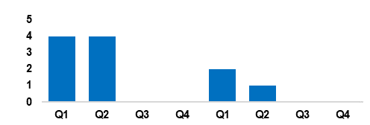
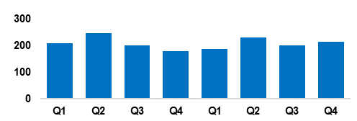
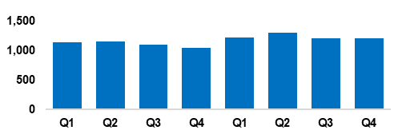
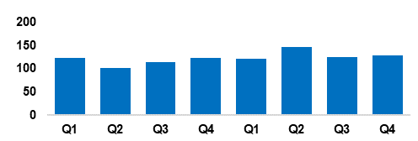
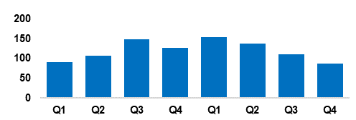
2. Beating Crime Plan
Crime Trend - Homicide (Q1 2022-23 – Q4 2023-24)
A three-year Homicide Prevention Strategy is in place, supported by a delivery plan, with the goal of furthering our understanding of the national and local themes and drivers that are likely to be precursors to Homicide.
The plan includes an examination of the enabling factors that contribute to Homicide (such as mental health, alcohol misuse, and weapons), with a view to early intervention and prevention. The links between Homicide and serious organised crime, domestic abuse, and the night-time economy have also been recognised.
This will be facilitated in part by improving our joint working and information sharing with partner agencies.
Homicide
Crime Trend - Serious Violence (Q1 2022-23 – Q4 2023-24)
Gwent Police utilises a problem-solving, partnership-based approach to preventing Serious Violence.
This approach is supported by a Serious Violence prevention strategy and delivery plan, which aims to reduce and where possible prevent harm to members of the community.
Particular focus has been placed on night-time economy related violence, knife related violence, robbery, drug related gang violence, and acid/corrosive substance attacks.
Tasking structures are in place to monitor active Organised Crime Groups (OCGs) and high-harm offenders.
Serious Violence
Crime Trend - Neighbourhood Crime (Q1 2022-23 – Q4 2023-24)
The Neighbourhood Policing model is undergoing a review to improve its effectiveness and efficiency.
All officers working within neighbourhood policing are receiving a one-day input on problem solving and prevention as part of the Gwent version of the All Wales Neighbourhood Policing Programme.
All response officers are having a training day input on problem solving and prevention. This has been adapted to include situational prevention and community prevention.
The Gwent Community Link (a police messaging service) launched in September.
Neighbourhood Crime
Crime Trend - Drug Trafficking and Supply (Q1 2022-23 – Q4 2023-24)
Proactive specialist support is available via the Drug Focus Desk.
We are working closely with partner agencies to provide signposting and treatment to help reduce the number of repeat offenders.
An intelligence led approach is being used to identify and disrupt the crime groups presenting the highest risk.
We have a close working relationship with the Regional Organised Crime Unit and the National County Lines Coordinator, facilitating the early identification of offenders involved in the supply of drugs.
Drug Trafficking
Action Fraud Occurrences Assigned a Cyber-Enabled Local Qualifier (Q1 2022-23 – Q4 2023-24)
A dedicated cyber ‘Digital Media Investigator’ has been provided to assist frontline officers, increasing the opportunities to identify and investigate cybercrimes.
Protect advice has been provided to all identified victims of cybercrime and cyber-enabled fraud, in an effort to prevent repeat victimisation.
Cyber-volunteers have been recruited to increase specialist knowledge and boost community engagement.
Cyber training was provided to all frontline officers, force control room operators and neighbourhood staff.
Cyber Crime

Slide 5
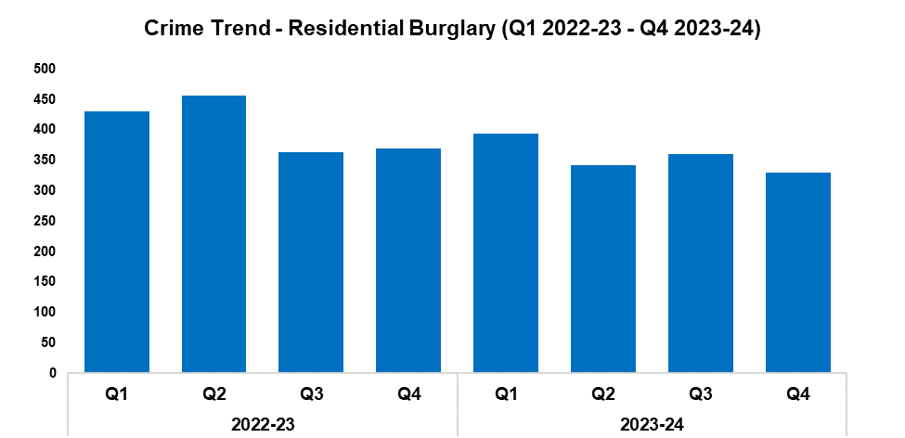
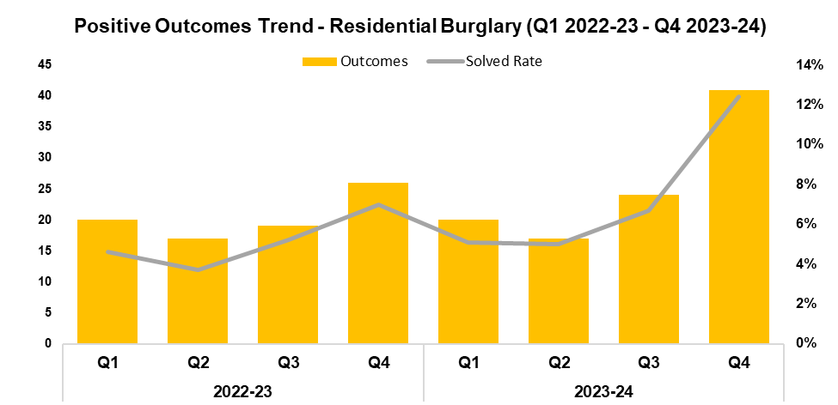
3. Residential Burglary
2022-23 |  |  |  | 2023-24
Q1 | Q2 | Q3 | Q4 | Q1 | Q2 | Q3 | Q4
431 | 456 | 364 | 369 | 394 | 342 | 360 | 330
2022-23 |  |  |  | 2023-24
Q1 | Q2 | Q3 | Q4 | Q1 | Q2 | Q3 | Q4
4.6% | 3.7% | 5.2% | 7.0% | 5.1% | 5.0% | 6.7% | 12.4%
Overview
Residential Burglary offences have seen a reduction of 8.3% during Q4 2023-24 when compared to the quarter prior, with 30 fewer offences recorded for a total of 330. This represents the lowest quarterly total within the timeframe, with this reduction conforming to the aims of the government’s Beating Crime Plan. A further reduction of 10.6% (39 fewer offences) can be observed when comparing Q4 2023-24 against the same quarter during the previous financial year, with a more prominent decline of 12.0% (194 fewer offences) recorded when comparing the most recent financial year against financial year 2022-23. This may indicate the long-term efficacy of the deterrence strategies employed as part of the ‘We Don’t Buy Crime’ initiative.
When compared to the previous quarter, the solved rate for Residential Burglary offences has risen by 5.7 percentage points to 12.4%, with 17 additional crimes solved for a total of 41. This represents the highest quarterly figure within the timeframe for both metrics by a significant margin. The solved rate for Q4 2023-24 is 5.4 percentage points above that recorded for the same quarter during the previous financial year, with an additional 15 crimes solved. A less prominent increase of 2.1 percentage points can be observed when comparing the solved rate for the most recent financial year against financial year 2022-23, with 20 additional crimes solved for a total of 102.
During Q4 2023-24, 89.8% of all incidents classified as Residential Burglary of a Home were attended.

Slide 6
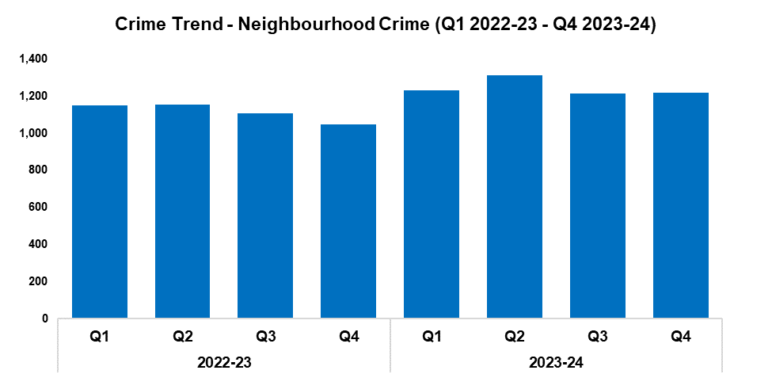
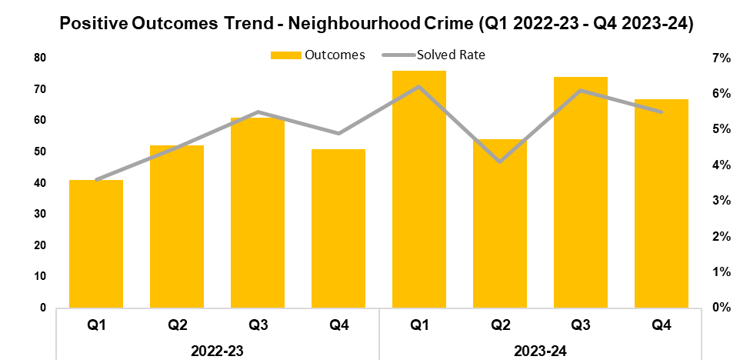
4. Neighbourhood Crime
2022-23 |  |  |  | 2023-24
Q1 | Q2 | Q3 | Q4 | Q1 | Q2 | Q3 | Q4
1,150 | 1,152 | 1,109 | 1,048 | 1,232 | 1,313 | 1,212 | 1,217
2022-23 |  |  |  | 2023-24
Q1 | Q2 | Q3 | Q4 | Q1 | Q2 | Q3 | Q4
3.6% | 4.5% | 5.5% | 4.9% | 6.2% | 4.1% | 6.1% | 5.5%
Overview
Neighbourhood Crime offences have seen a slight increase of 0.4% during Q4 2023-24 when compared to the quarter prior, with five additional offences recorded for a total of 1,217. Whilst minor, this increase runs counter to the aims of the government’s Beating Crime Plan. An increase of 16.1% (169 additional offences) can be observed when comparing Q4 2023-24 against the same quarter during the previous financial year, with a less prominent increase of 11.5% (515 additional offences) recorded when comparing the most recent financial year against financial year 2022-23.
Vehicle Crime offences continue to account for the majority of Neighbourhood Crime, comprising 64.1% of the quarterly total with 780 offences recorded. This represents an increase of 5.0% (37 additional offences) when compared to the quarter prior.
When compared to the previous quarter, the solved rate for Neighbourhood Crime offences has fallen by 0.6 percentage points to 5.5%, with seven fewer crimes solved for a total of 67. This continues the trend of quarterly fluctuations observed for these metrics following Q2 2022-23. Conversely, solved rate for Q4 2023-24 is 0.6 percentage points above that recorded for the same quarter during the previous financial year, with 16 additional crimes solved. A similar increase of 0.8 percentage points can be observed when comparing the solved rate for the most recent financial year against financial year 2022-23, with 66 additional crimes solved for a total of 271.
Following the force’s successful Safer Streets bid, 244 houses in Maindee have been visited and provided with Safer Streets kits.

Slide 7
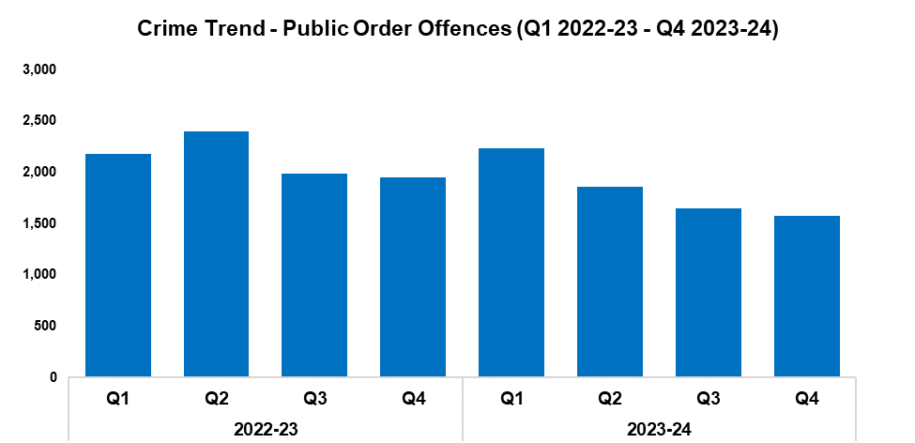
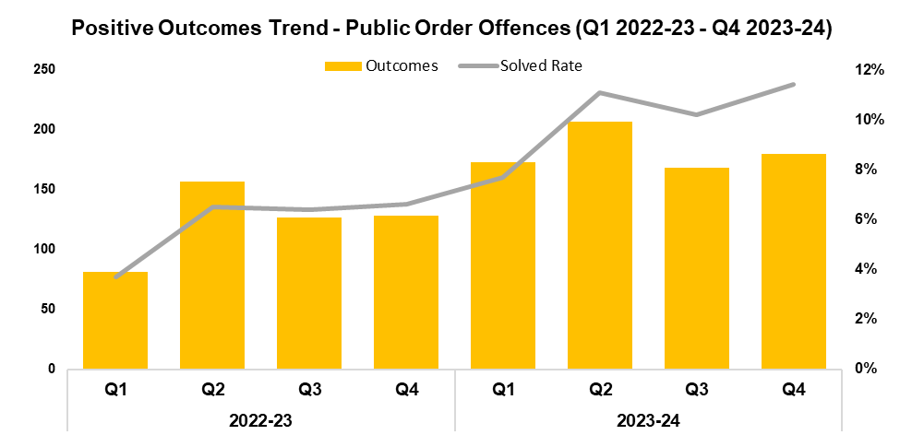
5. Public Order
2022-23 |  |  |  | 2023-24
Q1 | Q2 | Q3 | Q4 | Q1 | Q2 | Q3 | Q4
2,177 | 2,404 | 1,987 | 1,953 | 2,233 | 1,860 | 1,647 | 1,578
2022-23 |  |  |  | 2023-24
Q1 | Q2 | Q3 | Q4 | Q1 | Q2 | Q3 | Q4
3.7% | 6.5% | 6.4% | 6.6% | 7.7% | 11.1% | 10.2% | 11.4%
Overview
Public Order offences have seen a reduction of 4.2% when compared to the quarter prior, with 69 fewer offences recorded for a total of 1,578. This represents the lowest quarterly figure within the timeframe, continuing the downward trend observed for this metric following Q1 2023-24. A significant reduction of 19.2% (375 fewer offences) can be observed when comparing Q4 2023-24 against the same quarter during the previous financial year, with a less prominent reduction of 14.1% (1,203 fewer offences) recorded when comparing the most recent financial year against financial year 2022-23.
As offences under Section 5 of the Public Order Act 1986 have been classified as non-notifiable by the Home Office, they have been retroactively removed from this dataset to facilitate the accurate monitoring of long-term trends.
When compared to the previous quarter, the solved rate for Public Order offences has risen by 1.2 percentage points to 11.4%, with 12 additional crimes solved for a total of 180. This represents the highest quarterly solved rate within the timeframe, albeit with the second-highest volume of solved crimes. The solved rate for Q4 2023-24 is 4.8 percentage points above that recorded for the same quarter during the previous financial year, with 52 additional crimes solved. A similar increase of 4.1 percentage points can be observed when comparing the solved rate for the most recent financial year against financial year 2022-23, with 235 additional crimes solved for a total of 728.
An offender was arrested and charged with a Public Order offence after removing flowers from the graves in Caldicot cemetery, with a community protection notice also being issued. Local patrols have been increased in the area following this incident to reassure the community.

Slide 8
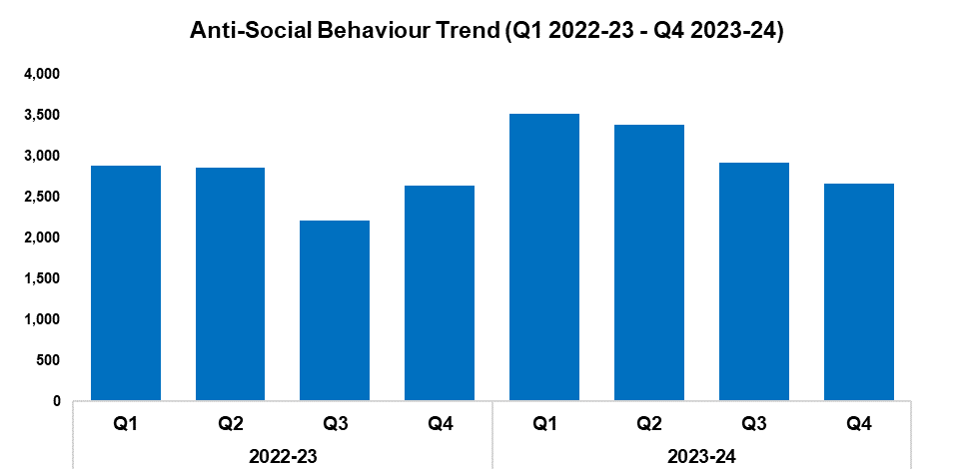
6. Anti-Social Behaviour
Overview
Levels of anti-social behaviour (ASB) in Gwent have fallen by 8.7% during Q4 2023-24 when compared to the quarter prior, with 253 fewer incidents recorded for a total of 2,661. This continues the downward trend observed for this metric following Q1 2023-24, contrasting with the quarter-on-quarter increase observed during the same period within the previous financial year.
Despite this, a slight increase of 1.0% (27 additional incidents) can be observed when comparing Q4 2023-24 against the same quarter during the previous financial year, with a more prominent increase of 17.9% (1,896 additional incidents) recorded when comparing the most recent financial year against financial year 2022-23.
When assessed by closing category, a decline in incidents classified as ‘ASB - Nuisance’ appears to be the primary driver behind the overall reduction in ASB volume recorded during Q4 2023-24. These incidents saw a reduction of 11.0% when compared to the quarter prior, with 229 fewer incidents recorded for a total of 1,844.
The data presented in this slide does not include incidents classified as ‘ASB – COVID 19’.
2022-23 |  |  |  | 2023-24
Q1 | Q2 | Q3 | Q4 | Q1 | Q2 | Q3 | Q4
2,878 | 2,859 | 2,215 | 2,634 | 3,521 | 3,386 | 2,914 | 2,661
During February and March, a plain clothes operation took place in Monmouth in response to reports of ASB and violence around the town centre. A known offender was identified and is now being processed through the criminal justice system. Three other youths have received youth cautions with conditions of engagement, which are progressing well. As a result, reports of ASB in the area have decreased.
A problem-oriented policing plan was created to address ASB and shoplifting at Morrisons and the town centre in Abergavenny. A multi-agency meeting was held to identify the offenders, leading to the creation of an action plan which included regular patrols at key times. As a result, police presence in the area has increased, providing reassurance to the community and leading to fewer reports of criminality.
Several Surron electric bikes have been seized across the force area, following their use or suspected use in ASB and criminal activity.
A number of Section 59 warnings have been issued in Chepstow and Caldicot, following reports of anti-social driving in these areas.

Slide 9
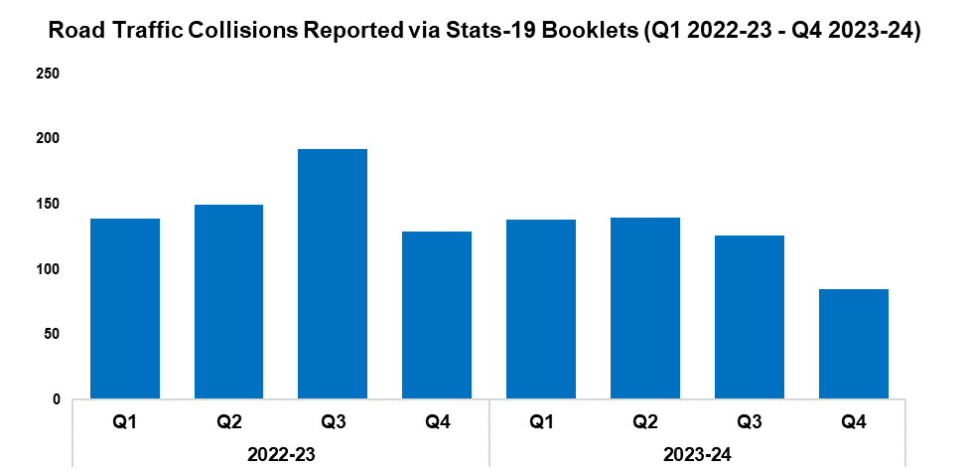
7. Roads Policing
Overview
During Q4 2023-24, 85 Road Traffic Collisions (RTCs) were reported via Stats-19 RTC booklets, a reduction of 32.5% (41 fewer RTCs) when compared to the quarter prior. These reduced levels are likely influenced by a lag time between the incidents occurring and the corresponding RTC booklets being submitted, with 49 booklets currently marked as outstanding for the quarter. As such, the number of RTCs recorded for Q4 2023-24 is expected to increase going forward, which will be reflected in future reporting.
A total of 823 individuals were reported for one of the ‘Fatal Five’* factors during Q4 2023-24, an increase of 80.1% (366 additional individuals) when compared to the quarter prior. The most commonly reported factor during Q4 2023-24 was drink/drug driving, which accounted for 32.2% of all Fatal Five reports with 265 instances reported. This was followed by use of a mobile phone, which accounted for 21.0% of all Fatal Five reports with 173 instances reported.
*The ‘Fatal Five’ refer to the five main causes of serious injury and death in RTCs. They consist of: careless driving; drink/drug driving; not wearing a seatbelt; using a mobile phone; and excessive speed.
2022-23 |  |  |  | 2023-24
Q1 | Q2 | Q3 | Q4 | Q1 | Q2 | Q3 | Q4
139 | 150 | 192 | 129 | 138 | 140 | 126 | 85
On the 4th of January, Roads Policing officers attended a report of a male on the wrong side of a motorway bridge attempting to commit suicide. Upon arriving at the scene, the officers found the male actively attempting to jump, along with two other males struggling to restrain him. The officers were subsequently required to hold the male by his feet to prevent his death, as he was already headfirst over the edge. The male was eventually restrained, along with his brother who was endangering himself in an attempt to save his sibling. South Wales Fire and Rescue Service have then attended and were able to assist in moving the male to the right side of the bridge using specialist rope equipment, where he was detained under the Mental Health Act in order to ensure he received the appropriate care.
The Serious Collision Investigation Unit saw two cases resolved this quarter. The first of these was Rex v Symons, in which the defendant pleaded guilty to causing death by dangerous driving. They were sentenced to four years and eight months in custody (reduced from seven years on account of a guilty plea) and were disqualified from driving for seven years. The second case was Rex v Methuen/Wall. Both defendants pleaded guilty to causing serious injury by dangerous driving. Methuen was sentenced to three years in custody and was disqualified from driving for five years and six months. Wall was sentenced to six months in custody (suspended for 12 months) and was disqualified from driving for two years.
Officers attended a public meeting regarding dangerous parking in Magor Square. A joint patrol strategy was implemented to address this, with officers working alongside local authority parking enforcement. Ticketing and advisory notices were utilised to highlight and promote public safety in the local community.
A pop-up surgery was held in Chepstow following the theft of several motorbikes, which provided crime prevention advice and support to the public.

Slide 10
  Combat Serious Crime
Combat Serious Crime
Most Serious Violence
Serious Violence
VAWG Domestic Priority Offences
VAWG Non-Domestic Priority Offences
Drug Supply and Organised Crime
Drug Supply and Organised Crime continued
Key Commitments
Reduce the number of repeat victims of child criminal and sexual exploitation.
Increase disruption of serious organised crime, and reinvest assets seized back into communities.
Improve the overall criminal justice response to violence against women, domestic abuse and sexual violence.
Commission and invest in services that work with perpetrators of serious crime to prevent and reduce re-offending.

Slide 11
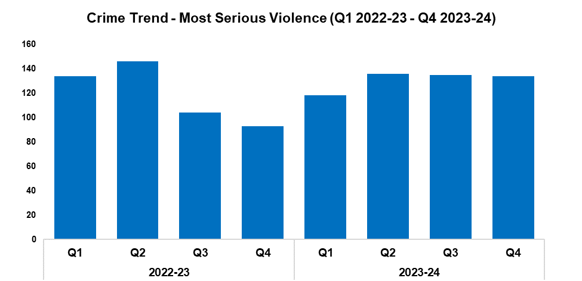
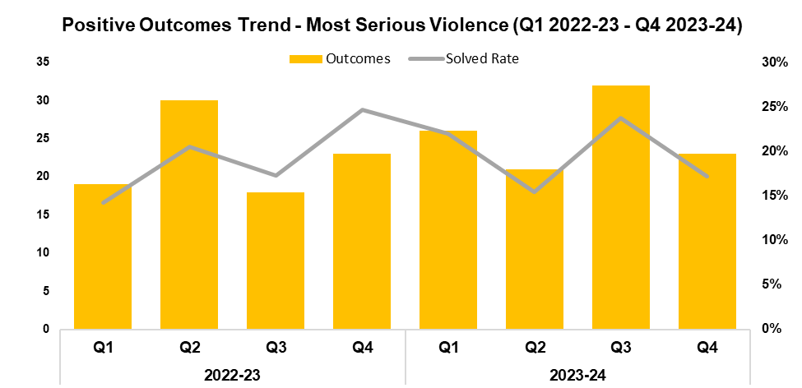
1. Most Serious Violence
2022-23 |  |  |  | 2023-24
Q1 | Q2 | Q3 | Q4 | Q1 | Q2 | Q3 | Q4
134 | 146 | 104 | 93 | 118 | 136 | 135 | 134
2022-23 |  |  |  | 2023-24
Q1 | Q2 | Q3 | Q4 | Q1 | Q2 | Q3 | Q4
14.2% | 20.5% | 17.3% | 24.7% | 22.0% | 15.4% | 23.7% | 17.2%
Overview
Most Serious Violence offences consist of Homicide, Grievous Bodily Harm with Intent, and Causing Death by Dangerous Driving. These offences have seen a reduction of 0.7% during Q4 2023-24 when compared to the quarter prior, with one fewer offence recorded for a total of 134. Conversely, a significant increase of 44.1% (41 additional offences) can be observed when comparing Q4 2023-24 against the same quarter during the previous financial year, with a less prominent increase of 9.6% (46 additional offences) recorded when comparing the most recent financial year against financial year 2022-23.
When compared to the previous quarter, the solved rate for Most Serious Violence offences has fallen by 6.5 percentage points to 17.2%, with nine fewer crimes solved for a total of 23. This continues the trend of quarterly fluctuations observed for this metric following Q1 2023-24. The solved rate for Q4 2023-24 is 7.5 percentage points below that recorded for the same quarter during the previous financial year, albeit with an equal number of crimes solved. Conversely, an increase of 0.6 percentage points can be observed when comparing the solved rate for the most recent financial year against financial year 2022-23, with 12 additional crimes solved for a total of 102. This increase implies a long-term improvement, despite the quarterly variance observed for this metric throughout the financial year.

Slide 12
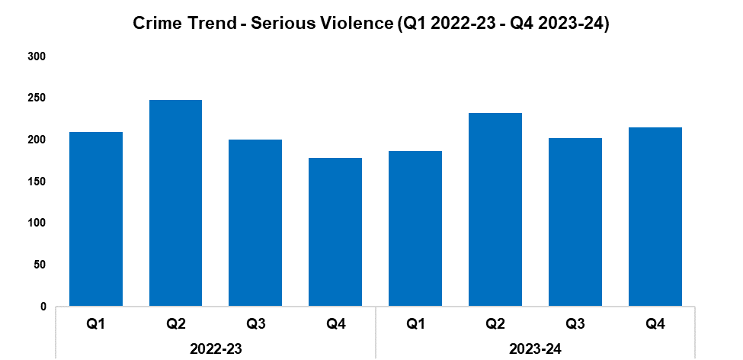
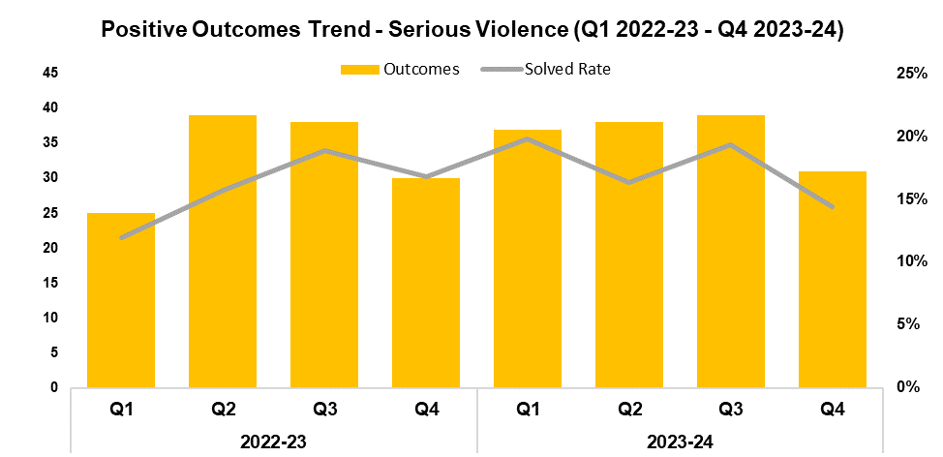
2. Serious Violence
2022-23 |  |  |  | 2023-24
Q1 | Q2 | Q3 | Q4 | Q1 | Q2 | Q3 | Q4
210 | 248 | 201 | 179 | 187 | 233 | 202 | 215
2022-23 |  |  |  | 2023-24
Q1 | Q2 | Q3 | Q4 | Q1 | Q2 | Q3 | Q4
11.9% | 15.7% | 18.9% | 16.8% | 19.8% | 16.3% | 19.3% | 14.4%
Overview
Serious Violence offences consist of Section 18 Grievous Bodily Harm with Intent, Section 20 Malicious Wounding without Intent, and Personal Robbery. These offences have risen by 6.4% during Q4 2023-24 when compared to the quarter prior, with 13 additional offences recorded for a total of 215. A more prominent increase of 20.1% (36 additional offences) can be observed when comparing Q4 2023-24 against the same quarter during the previous financial year, whereas a slight reduction of 0.1% (one fewer offence) has been recorded when comparing the most recent financial year against financial year 2022-23.
When compared to the previous quarter, the solved rate for Serious Violence offences has fallen by 4.9 percentage points to 14.4%, with eight fewer crimes solved for a total of 31. This represents the second-lowest quarterly solved rate within the timeframe. The solved rate for Q4 2023-24 is 2.4 percentage points below that recorded for the same quarter during the previous financial year, albeit with one additional crime solved. Conversely, an increase of 1.5 percentage points can be observed when comparing the solved rate for the most recent financial year against financial year 2022-23, with 13 additional crimes solved for a total of 145. This increase may be due in part to the outlier of poor performance recorded during Q1 2022-23.

Slide 13
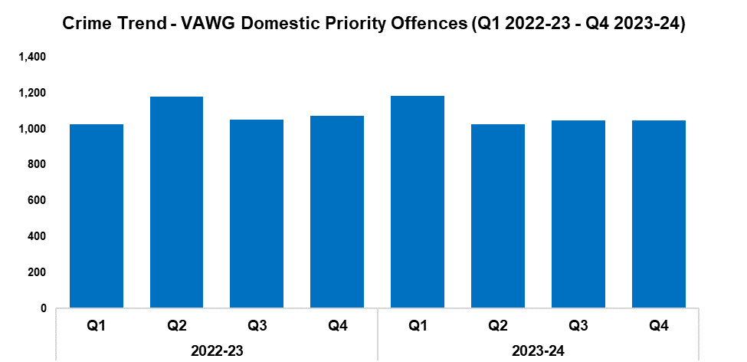
3. VAWG Domestic Priority Offences
Overview
The adjacent chart displays the number of Violence against Women and Girls (VAWG) priority offences which have been assigned a domestic abuse qualifier, and which have at least one female victim linked.*
During Q4 2023-24 1,046 of these offences were recorded, with levels remaining steady when compared to the quarter prior. A reduction of 2.6% (28 fewer offences) can be observed when comparing Q4 2023-24 against the same quarter during the previous financial year, with a less prominent reduction of 0.6% (27 fewer offences) recorded when comparing the most recent financial year against financial year 2022-23.
720 females have been linked as a victim in more than one VAWG domestic priority offence within the last 12 months,** whereas 23 females have been linked as a victim in five or more separate offences.
In the last 12 months,** there were 449 female offenders and 2,775 male offenders linked to domestic priority offences against women and girls.
*Domestic priority areas include Homicide, Violence with Injury, Stalking and Harassment, Public Fear, Alarm or Distress, Rape, Other Sexual Offences, and Modern Slavery.
**Up to the end of Q4 2023-24
2022-23 |  |  |  | 2023-24
Q1 | Q2 | Q3 | Q4 | Q1 | Q2 | Q3 | Q4
1,025 | 1,179 | 1,050 | 1,074 | 1,182 | 1,027 | 1,046 | 1,046

Slide 14
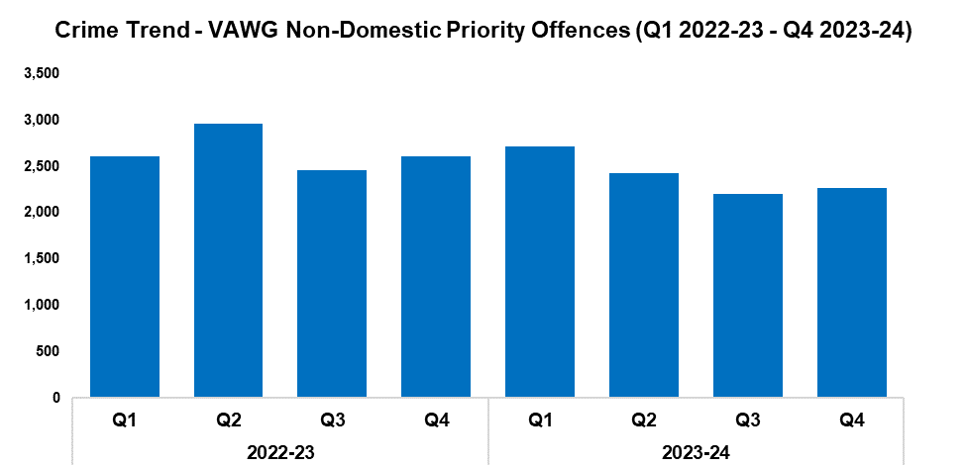
4. VAWG Non-Domestic Priority Offences
Overview
The adjacent chart shows the number of VAWG priority offences which have not been assigned a domestic abuse qualifier, and which have at least one female victim linked.*
During Q4 2023-24, 2,269 of these offences were recorded. This represents an increase of 3.1% (68 additional offences) when compared to the quarter prior. Conversely, a reduction of 13.1% (342 fewer offences) can be observed when comparing Q4 2023-24 against the same quarter during the previous financial year, with a less prominent reduction of 9.6% (1,023 fewer offences) recorded when comparing the most recent financial year against financial year 2022-23.
1,407 females have been linked as a victim in more than one VAWG non-domestic priority offence within the last 12 months,** whereas 70 females have been linked as a victim in five or more separate offences.
In the last 12 months,** there were 2,595 female offenders and 3,295 male offenders linked to non-domestic priority offences against women and girls.
*Non-domestic priority areas include Homicide, Violence with Injury, Stalking and Harassment, Public Fear , Alarm or Distress, Rape, Other Sexual Offences, Modern Slavery, and Exploitation of Prostitution.
**Up to the end of Q4 2023-24
2022-23 |  |  |  | 2023-24
Q1 | Q2 | Q3 | Q4 | Q1 | Q2 | Q3 | Q4
2,609 | 2,956 | 2,455 | 2,611 | 2,712 | 2,426 | 2,201 | 2,269

Slide 15
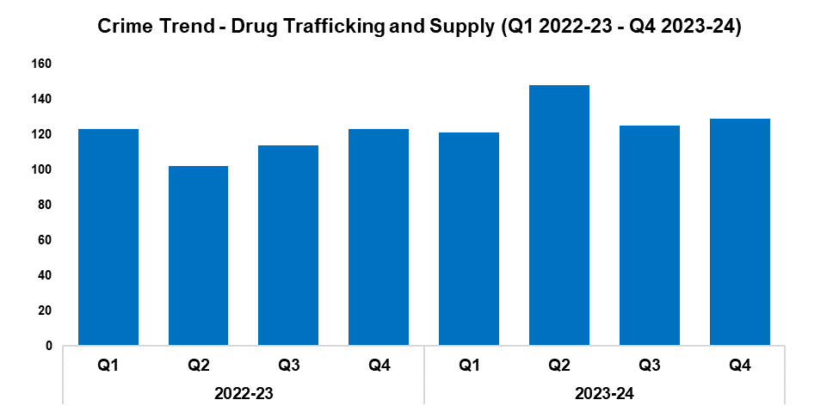
5. Drug Supply and Organised Crime
Overview
Drug Trafficking and Supply offences have risen in volume by 3.2% during Q4 2023-24 when compared to the quarter prior, with four additional offences recorded for a total of 129. A similar increase of 4.9% (six additional offences) can be observed when comparing Q4 2023-24 against the same quarter during the previous financial year. A more prominent increase of 13.2% (61 additional offences) has been recorded when comparing the most recent financial year against financial year 2022-23, influenced by the elevated levels reported during Q2 2023-24.
1,770 Drug Supply and Dealing intelligence logs were submitted during Q4 2023-24. Whilst this represents a reduction of 14.6% (303 fewer logs) when compared to the quarter prior, it remains the second-highest quarterly total within the timeframe. An increase of 26.3% (369 additional logs) can be observed when comparing Q4 2023-24 against the same quarter during the previous financial year, with a less prominent increase of 18.3% (1,090 additional logs) recorded when comparing the most recent financial year against financial year 2022-23.
2022-23 |  |  |  | 2023-24
Q1 | Q2 | Q3 | Q4 | Q1 | Q2 | Q3 | Q4
123 | 102 | 114 | 123 | 121 | 148 | 125 | 129
A number of drug-related operations and seizures have been carried out within the force area during Q4 2023-24:
Operation Stanley was an investigation into the supply of Class A drugs across Newport and South Wales. On the 25th of January, a warrant was executed at an address in St Julians, Newport during which two individuals were arrested. Six mobile phones, 748g of cocaine and 135g of cannabis were seized from the address, in addition to £15,805 in cash and numerous items of high value designer clothing. The owner of the address was subsequently arrested and has since been charged and remanded.
A further warrant was executed at the Royal Albert Public House in Maindee, during which Samuel Hudacek was arrested for the possession of half a kilo of cocaine. Through subsequent mobile phone analysis, evidence was obtained of drug dealing and animal cruelty. Hudacek has pleaded guilty to being concerned in the supply of cocaine and causing unnecessary suffering to a protected animal. He was sentenced to three years in custody. His co-defendant Troy Bowyer admitted causing unnecessary suffering to a protected animal and was sentenced to a two-year community order.
Operation Biggin was an investigation into the supply of Class A drugs across Newport, with links to Operation Stanley. Seven individuals were arrested following a series of warrants and the proactive stop/search of a vehicle co-ordinated with West Mercia Police, with the principal subject and controller of the drugs line amongst them. Six of these individuals have been charged with conspiracy to supply Class A (cocaine), with one individual also being charged with offences relating to the aforementioned seizure of half a kilo of cocaine as part of Operation Stanley. A hydraulic press and several zombie style knives were also recovered. Five of the individuals have pleaded guilty and are awaiting sentence, whereas one individual has elected for a trial.

Slide 16
6. Drug Supply and Organised Crime continued
Neighbourhood officers conducted a joint operation with Trading Standards in Newport, acting against premises selling illegal vapes. Over the course of the operation, the following items were seized: 13,100 suspected illegal cigarettes; 2,305 illegal disposable vapes; 123 pouches of illegal Shisha; 165 bottles of alcohol; and suspected nitrous oxide cannisters.
The Organised Crime Unit carried out a number of proactive operations. During January, two males were arrested in Newport with 1kg of heroin in their possession. Both have been charged and remanded in custody. During February, another male was arrested in the West Local Policing Area (LPA) with 2kg of cocaine and £200,000 in cash. He has also been charged and remanded in custody.
Officers detained a male who had fled from a vehicle after reacting to officers carrying out a traffic stop. The male was arrested for driving offences and searched, with 79.9g of cannabis and 1g of cocaine being found on his person, along with cash and mobile phones which were linked to drug supply. The male was subsequently charged and remanded for a number of drug-related offences.
During Operation Bergen, a subject was found in possession of £35,000 worth of heroin. They were subsequently found guilty of possession with intent to supply Class A – heroin, as well as burglary. The subject was sentenced to four years and 10 months in custody.
A County Lines Intensification Week took place in March. During this week officers from all departments across Gwent conducted pro-active operations and preventative initiatives to combat and raise awareness of county lines. As a result, 14 individuals were arrested, with £100,000 worth of Class A drugs recovered and £23,950 in cash seized. Additionally, 12 vulnerable addresses in which individuals were being ‘cuckooed’ were visited, 3,900 people attended community engagement events, and preventative engagement was conducted with schools, business, and hotels.
During County Lines Intensification Week, the stop and search of a vehicle led to the recovery of a valuable drug dealing line and the arrest of its controllers in East LPA. The principal offender was charged and remanded. A series of connected search warrants were then executed in quick succession, leading to further arrests together with the recovery of a drugs press and zombie knives. Additionally, a cannabis cultivation was uncovered in the East LPA. A large number of plants were seized, and an individual was arrested.
Operation Enstone was an operation with Home Office funding intended to tackle county lines. This was a forcewide response which supplemented other operations over the financial year, the results of which were returned to the Home Office during March. These results include: 29 county lines closed; 166 individuals arrested (of which 99 were charged); and 94 individuals safeguarded. Numerous seizures were also completed, including: 6.1kg of heroin; 4.7kg of cocaine; £216,293 in cash; 27 vehicles; 8,925 plants; 21.2kg of amphetamine; 3,000 tablets (MDMA and Valium); and £75,000 of designer goods.
During the serious organised crime week of action, community support officers provided several group discussions and surgeries in Monmouth and Abergavenny to promote awareness of this rising crime trend.
Five members of an OCG which supplied Class A and Class B drugs across Gwent, South Wales and Gloucestershire were arrested as part of Operation Florence. Eight warrants were carried out over the course of the two-year long investigation, resulting in the seizure of more than £50,000 worth of drugs and over £40,000 in cash. During January, the five defendants were sentenced to a combined total of more than 30 years in prison, with all defendants pleading guilty to a number of drug-related offences.

Slide 17
Support Victims and Protect the Vulnerable
Hate Crime
Rape
Domestic Related Crime
Domestic Abuse Repeat Victims/Offenders
Modern Day Slavery and Human Trafficking
Child Sexual Exploitation/Child Criminal Exploitation
Cyber Fraud
Victim Support/Repeat Victims
Key Commitments
Improve victim services and ensure that the needs of victims are identified and responded to appropriately through Connect Gwent and the Victim Care Unit.
Further improve our work with partners to protect those most vulnerable.
Increase the timeliness of police investigation updates provided to victims.
Commission and invest in specialist services to support victims throughout the criminal justice process.

Slide 18
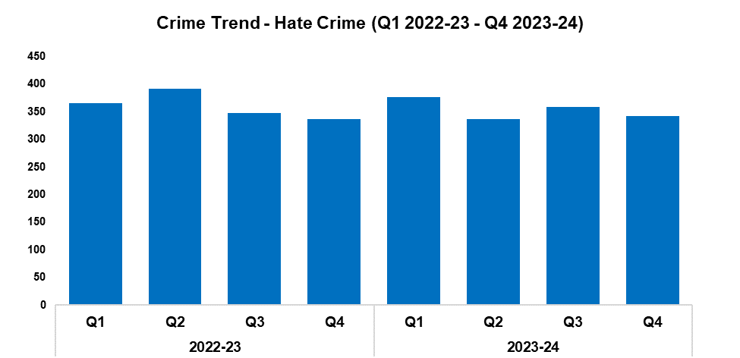
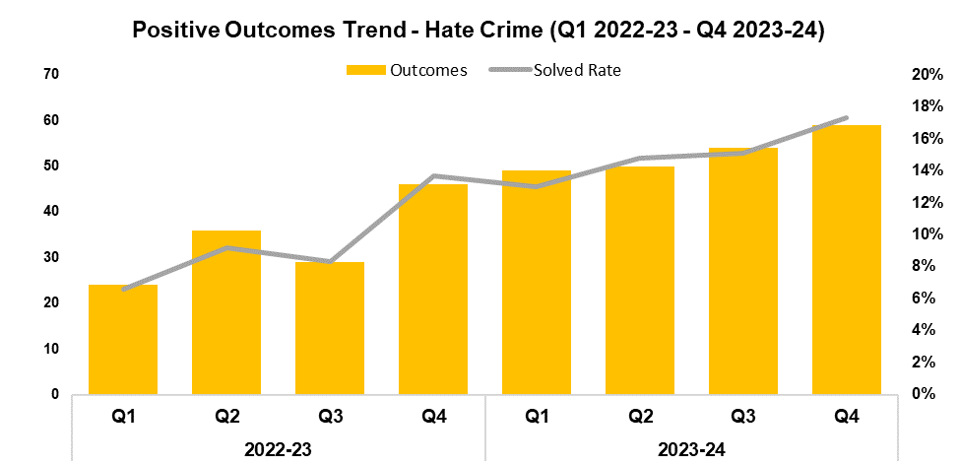
1. Hate Crime
2022-23 |  |  |  | 2023-24
Q1 | Q2 | Q3 | Q4 | Q1 | Q2 | Q3 | Q4
365 | 391 | 348 | 336 | 377 | 337 | 358 | 342
2022-23 |  |  |  | 2023-24
Q1 | Q2 | Q3 | Q4 | Q1 | Q2 | Q3 | Q4
6.6% | 9.2% | 8.3% | 13.7% | 13.0% | 14.8% | 15.1% | 17.3%
Overview
The volume of offences classified as hate crimes has fallen by 4.5% during Q4 2023-24 when compared to the quarter prior, with 16 fewer offences recorded for a total of 342. An increase of 1.8% (six additional offences) can be observed when comparing Q4 2023-24 against the same quarter during the previous financial year, whereas a reduction of 1.8% (26 fewer offences) has been recorded when comparing the most recent financial year against financial year 2022-23.
Offences containing the disability hate strand decreased by 22.2% when compared to the quarter prior, with 18 fewer crimes recorded for a total of 63.
Offences containing the homophobic hate strand have decreased by 12.7% when compared to the quarter prior, with seven fewer crimes recorded for a total of 48.
Offences containing the racial hate strand have increased by 3.1% when compared to the quarter prior, with six additional crimes recorded for a total of 202.
Offences containing the religious hate strand have decreased by 33.3% when compared to the quarter prior, with seven fewer crimes recorded for a total of 14.
Offences containing the transphobic hate strand have increased by 46.7% when compared to the quarter prior, with seven additional crime recorded for a total of 22.
When compared to the quarter prior, the solved rate has increased by 2.2 percentage points to 17.3%, with five additional crimes solved for a total of 59. This represents the highest quarterly solved rate within the timeframe. The solved rate for Q4 2023-24 is 3.6 percentage points above that recorded for the same quarter during the previous financial year, with 13 additional crimes solved. An increase of 5.6 percentage points can be observed when comparing the most recent financial year against financial year 2022-23, with 77 additional crimes solved.
A single crime can have multiple hate strands. The crime trend is based on recorded crimes, whilst the breakdown by hate strand is based on the volume of each individual strand.

Slide 19
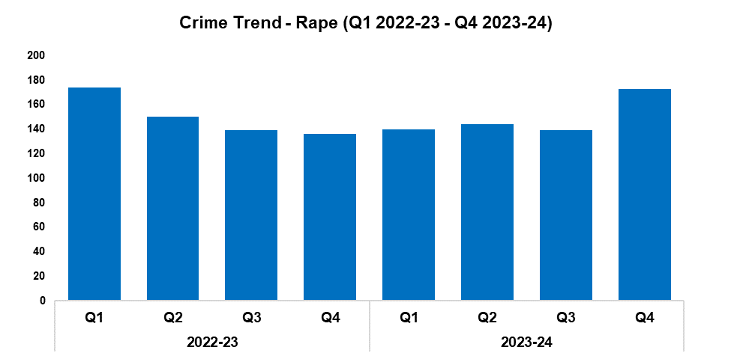
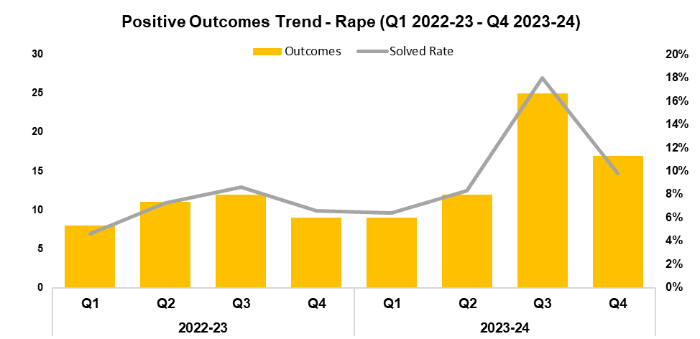
2. Rape
2022-23 |  |  |  | 2023-24
Q1 | Q2 | Q3 | Q4 | Q1 | Q2 | Q3 | Q4
174 | 150 | 139 | 136 | 140 | 144 | 139 | 173
2022-23 |  |  |  | 2023-24
Q1 | Q2 | Q3 | Q4 | Q1 | Q2 | Q3 | Q4
4.6% | 7.3% | 8.6% | 6.6% | 6.4% | 8.3% | 18.0% | 9.8%
Overview
The volume of recorded Rape offences has increased by 24.5% during Q4 2023-24 when compared to the quarter prior, with 34 additional offences recorded for a total of 173. This rise aligns with the goal of increased reporting stipulated in the government’s Beating Crime Plan. A similar increase of 27.2% (37 additional offences) can be observed when comparing Q4 2023-24 against the same quarter during the previous financial year. Conversely, a slight reduction of 0.5% (three fewer offences) has been recorded when comparing the most recent financial year against financial year 2022-23.
When compared to the previous quarter, the solved rate for Rape offences has fallen by 8.2 percentage points to 9.8%, with eight fewer crimes solved for a total of 17. Despite the reduction observed this quarter, this remains the second-highest quarterly figure within the timeframe. An increase of 3.2 percentage points can be observed when comparing Q4 2023-24 against the same quarter during the previous financial year, with eight additional crimes solved. A similar increase of 3.9 percentage points has been recorded when comparing the most recent financial year against financial year 2022-23, with 23 additional crimes solved.
Rhodri Griffiths was jailed for 10 years and six months during February after pleading guilty to sexual communication with a child, Rape, and other sexual offences against a girl he met on Snapchat. As it is believed that Griffiths may have had other victims, Gwent Police is appealing for anyone who believes they may have been a victim to make contact, so that they can receive the appropriate support.

Slide 20
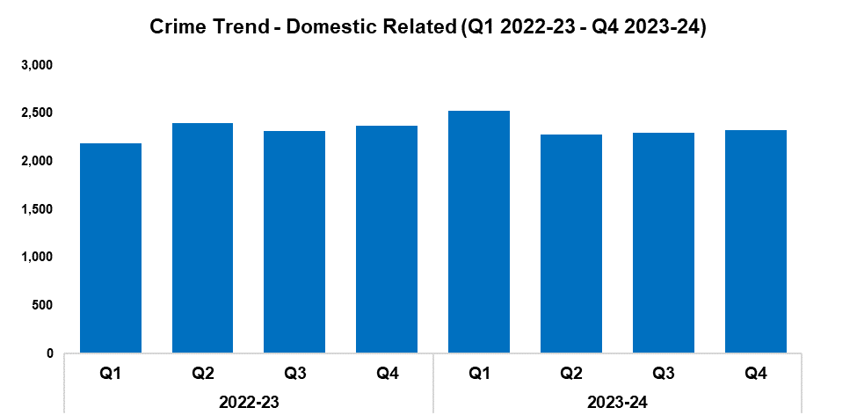
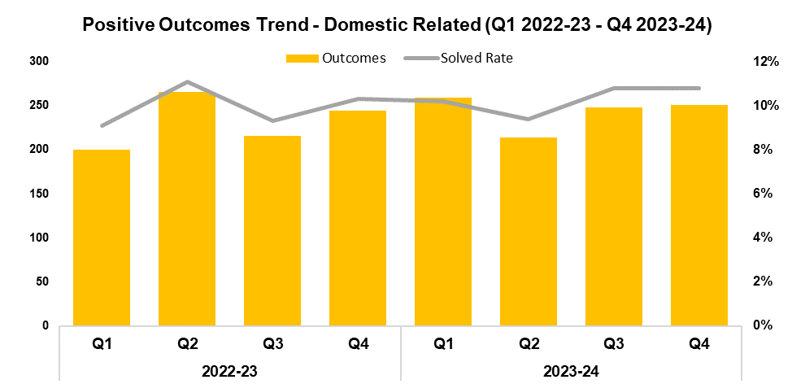
3. Domestic Related Crime
2022-23 |  |  |  | 2023-24
Q1 | Q2 | Q3 | Q4 | Q1 | Q2 | Q3 | Q4
2,192 | 2,403 | 2,316 | 2,369 | 2,530 | 2,285 | 2,302 | 2,323
2022-23 |  |  |  | 2023-24
Q1 | Q2 | Q3 | Q4 | Q1 | Q2 | Q3 | Q4
9.1% | 11.1% | 9.3% | 10.3% | 10.2% | 9.4% | 10.8% | 10.8%
Overview
Domestic related offences have seen a slight increase of 0.9% when compared to the quarter prior, with 21 additional offences recorded for a total of 2,323. A reduction of 1.9% (46 fewer offences) can be observed when comparing Q4 2023-24 against the same quarter during the previous financial year. Conversely, an increase of 1.7% (160 additional offences) has been recorded when comparing the most recent financial year against financial year 2022-23, influenced by the elevated levels observed during Q1 2023-24.
When compared to the previous quarter, the solved rate for domestic related offences has remained steady at 10.8%, albeit with three additional crimes solved for a total of 251. An increase of 0.5 percentage points can be observed when comparing Q4 2023-24 against the same quarter during the previous financial year, with seven additional crimes solved. A similar increase of 0.3 percentage points has been recorded when comparing the most recent financial year against financial year 2022-23, with 46 additional crimes solved.

Slide 21
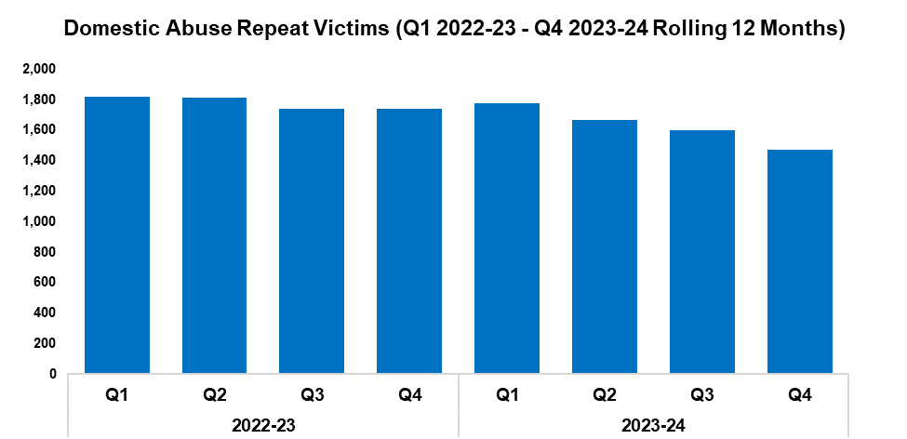
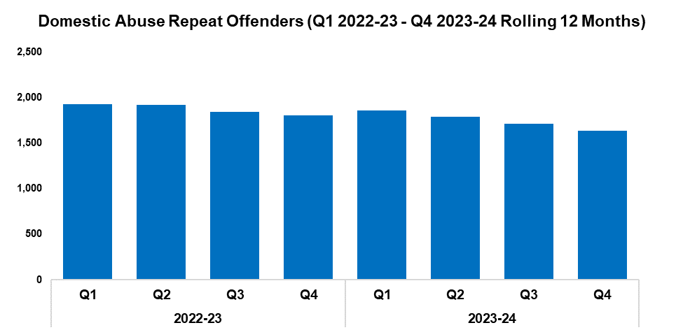
4. Domestic Abuse Repeat Victims/Offenders
2022-23 |  |  |  | 2023-24
Q1 | Q2 | Q3 | Q4 | Q1 | Q2 | Q3 | Q4
1,821 | 1,815 | 1,742 | 1,741 | 1,774 | 1,664 | 1,598 | 1,474
2022-23 |  |  |  | 2023-24
Q1 | Q2 | Q3 | Q4 | Q1 | Q2 | Q3 | Q4
1,926 | 1,918 | 1,843 | 1,805 | 1,862 | 1,787 | 1,714 | 1,632
Overview
The number of repeat domestic abuse victims* has decreased by 7.8% when comparing Q4 2023-24 against the quarter prior, with 124 fewer repeat victims recorded for a total of 1,474. This represents the lowest quarterly total within the timeframe, continuing the downward trend observed following Q1 2023-24. When comparing Q4 2023-24 against the same quarter during the previous financial year, a reduction of 15.3% (267 fewer repeat victims) can be observed. A less prominent reduction of 8.6% (609 fewer repeat victims) has been recorded when comparing the quarterly totals for the most recent financial year against those for financial year 2022-23.*
The number of repeat domestic abuse offenders* has decreased by 4.8% when comparing Q4 2023-24 against the quarter prior, with 82 fewer repeat offenders recorded for a total of 1,632. As with repeat victims, this represents the lowest quarterly total within the timeframe and continues the downward trend observed following Q1 2023-24. When comparing Q4 2023-24 against the same quarter during the previous financial year, a reduction of 9.6% (173 fewer repeat offenders) can be observed. A less prominent reduction of 6.6% (497 fewer repeat offenders) has been recorded when comparing the quarterly totals for the most recent financial year against those for financial year 2022-23.*
There is a Multi-Agency Tasking and Coordination (MATAC) process in place which focuses on identifying serial perpetrators of domestic abuse, in order to limit the risk of them reoffending. A range of interventions can be delivered via MATAC to safeguard victims and families, including support, prevention, diversion, disruption, and enforcement.
*Based on rolling 12 months to the end of each quarter, where persons are linked to two or more crimes within this period.

Slide 22
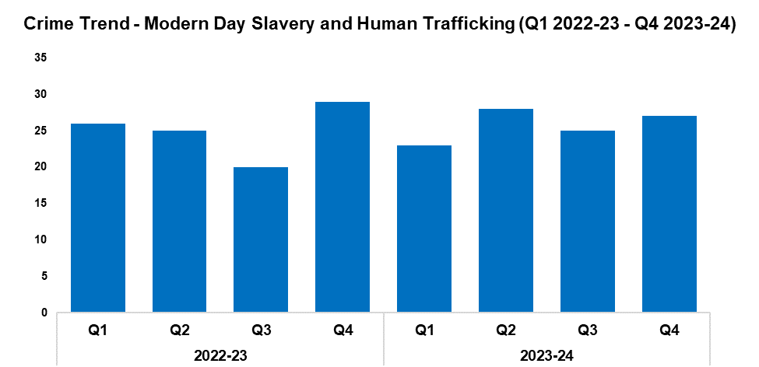
5. Modern Day Slavery and Human Trafficking
Overview
Modern Day Slavery and Human Trafficking offences have increased in volume by 8.0% during Q4 2023-24 when compared to the quarter prior, with two additional offences recorded for a total of 27. A reduction of 6.9% (two fewer offences) can be observed when comparing Q4 2023-24 against the same quarter during the previous financial year, whereas an increase of 3.0% (three additional offences) has been recorded when comparing the most recent financial year against financial year 2022-23.
Awareness training is being delivered to new starters, new community support officers, and trainee detectives.
The number of National Referral Mechanisms submitted has risen by 7.7% during Q4 2023-24 when compared to the quarter prior, with two additional referrals submitted for a total of 28. Conversely, a reduction of 8.0% can be observed when comparing the most recent financial year against financial year 2022-23, with nine fewer referrals submitted for a total of 104.
During February 2024, officers from the Modern Day Slavery and RPSO teams worked alongside Immigration Enforcement officers and the Driver and Vehicle Standards Agency (DVSA) in checking hauliers suspected to be involved in organised immigration crime. As a result, a migrant driver was arrested and removed. There were also several positive DVSA results relating to faults on vehicles, for which a number of fines were issued. In addition, over 300 awareness-raising sessions were conducted with drivers, discussing the illegal facilitation and smuggling of migrants from France in heavy goods vehicles. This operation also enabled the sharing of best practise with South Wales Police and Devon and Cornwall Police, to assist in their own roadside operations, as well as enhancing working relationships with a number of partner agencies to support future operational activity.
2022-23 |  |  |  | 2023-24
Q1 | Q2 | Q3 | Q4 | Q1 | Q2 | Q3 | Q4
26 | 25 | 20 | 29 | 23 | 28 | 25 | 27

Slide 23
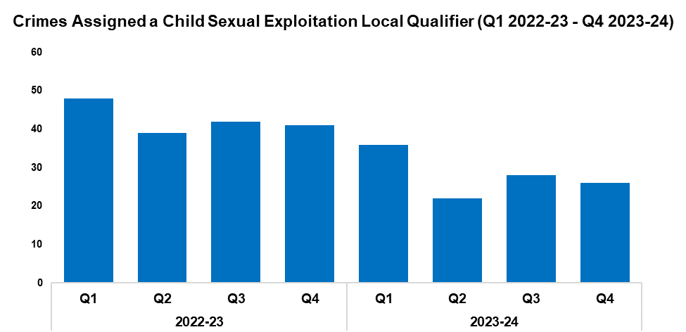
6. Child Sexual Exploitation/Child Criminal Exploitation
Overview
The number of crimes assigned a Child Sexual Exploitation (CSE) local qualifier has decreased by 7.1% during Q4 2023-24 when compared to the quarter prior, with two fewer crimes recorded for a total of 26. This represents the second-lowest quarterly figure within the timeframe. A substantial reduction of 36.6% (15 fewer crimes) can be observed when comparing Q4 2023-24 against the same quarter during the previous financial year, with a similar reduction of 34.1% (58 fewer crimes) recorded when comparing the most recent financial year against financial year 2022-23.
The offence most commonly assigned a CSE local qualifier during Q4 2023-24 was Take/Make Indecent Photographs/Pseudo-photographs of Children, with nine instances. This accounts for 34.6% of all crimes assigned a CSE local qualifier during the quarter.
During March, a male was convicted of eight counts of sexual activity with a child under 13, one count of sexual assault of a child by penetration, one count of possession of indecent images of children, and one count of possession of extreme pornography. This complex investigation related to the intrafamilial abuse of a child over several years, and involved collaborative work with partners to manage effective safeguarding for the victim. The defendant was sentenced to eight and a half years in custody, with an additional four years on licence.
2022-23 |  |  |  | 2023-24
Q1 | Q2 | Q3 | Q4 | Q1 | Q2 | Q3 | Q4
48 | 39 | 42 | 41 | 36 | 22 | 28 | 26

Slide 24
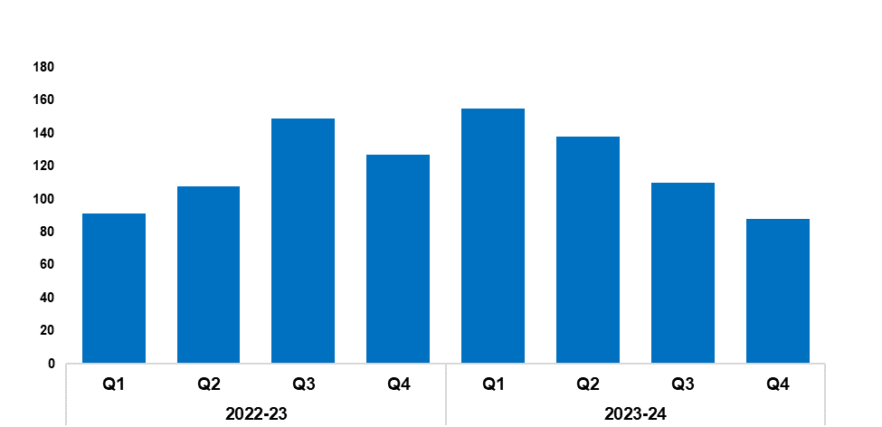
7. Cyber Fraud
Overview
Since Q1 2022-23, a total of 1,731 Action Fraud occurrences have been reported to Gwent Police via the National Fraud Intelligence Bureau. Of these, 55.8% (966 occurrences) have been assigned a cyber-enabled local qualifier.
When compared to the quarter prior, the number of Action Fraud occurrences assigned a cyber-enabled local qualifier has fallen by 20.0%, with 22 fewer occurrences reported for a total of 88. This represents the lowest quarterly figure within the timeframe, continuing the downward trend observed for this metric following Q1 2023-24. A more prominent reduction of 30.7% (39 fewer occurrences) can be observed when comparing Q4 2023-24 against the same quarter during the previous financial year. Conversely, an increase of 3.4% (16 additional occurrences) has been recorded when comparing the most recent financial year against financial year 2022-23, influenced by the elevated levels observed during Q1 2023-24.
A romance fraud awareness campaign was run during February in order to coincide with Valentine’s Day. The tactics used to commit this type of fraud were explained to make them more easily recognisable, and victims were encouraged to come forward so that they could receive support.
2022-23 |  |  |  | 2023-24
Q1 | Q2 | Q3 | Q4 | Q1 | Q2 | Q3 | Q4
91 | 108 | 149 | 127 | 155 | 138 | 110 | 88

Slide 25
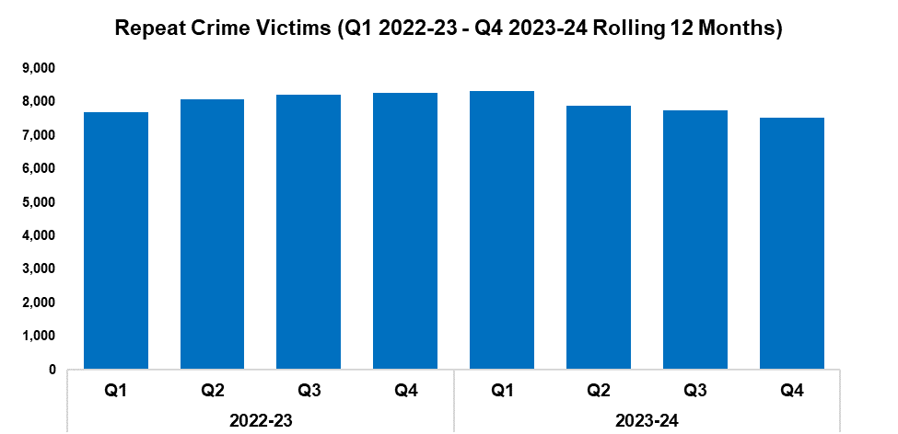
8. Victim Support/Repeat Victims
Overview
In this context, a repeat crime victim refers to an individual who has been linked as a victim in two or more crimes within a 12-month rolling period.
The number of repeat crime victims has fallen by 3.0% during Q4 2023-24* when compared to the quarter prior, with 231 fewer repeat victims recorded for a total of 7,522. This continues the downward trend observed following Q1 2023-24.
A reduction of 9.2% (760 fewer repeat victims) can be observed when comparing Q4 2023-24 against the same quarter during the previous financial year. A less prominent reduction of 2.4% (784 fewer repeat victims) has been recorded when comparing the quarterly totals for the most recent financial year against those for financial year 2022-23.
A series of reassurance visits have been provided to a repeat victim of racial hate crime. The victim was issued with a security camera and light to serve as a deterrent, with focused patrols also implemented. No further issues have been reported since.
*Based on the rolling 12 months to the end of the quarter.
2022-23 |  |  |  | 2023-24
Q1 | Q2 | Q3 | Q4 | Q1 | Q2 | Q3 | Q4
7,700 | 8,069 | 8,227 | 8,282 | 8,331 | 7,888 | 7,753 | 7,522

Slide 26
Increase Community Confidence in Policing
Perceptions Survey: Local Concerns and Overall
Victim Satisfaction
Representative Workforce
Investigation Timeliness
Response Rates
999 Demand
101 Demand
Social Media and Single Online Home
Initiatives & Events
Key Commitments
Increase the effectiveness of officer and staff engagement with residents in their communities, and community confidence and trust in Gwent Police.
Improve the accessibility of neighbourhood police teams through a variety of contact channels that meet the needs of the public.
Increase reporting of crime by communities that are less likely to engage with the police.
Further increase officer and staff diversity to ensure our police service reflects the communities that we serve.

Slide 27
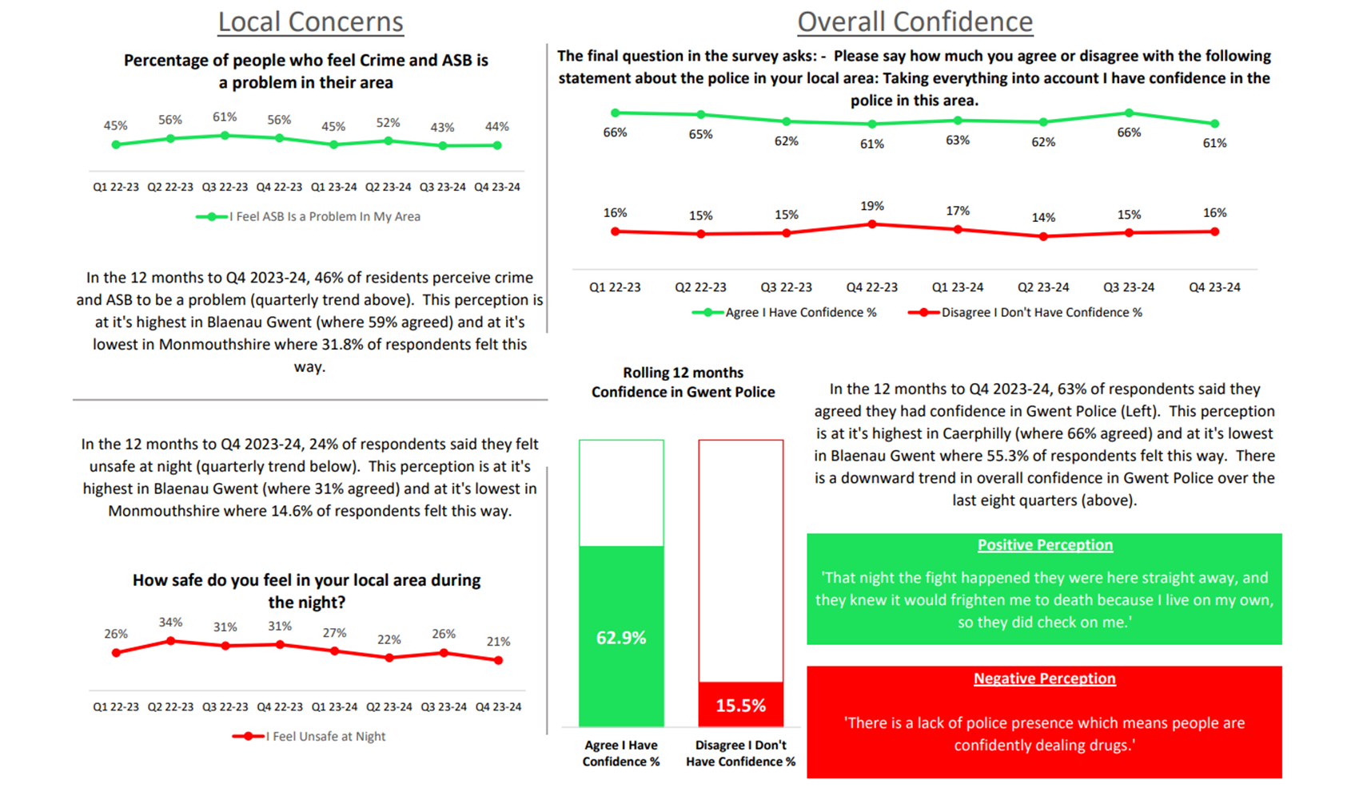
1. Perceptions Survey: Local Concerns and Overall

Slide 28
2. Victim Satisfaction
Percentage | Measure
Survey Number | Survey One | Survey Two |  |  |  | Survey Three
Metric | Satisfied with Initial Contact | Satisfied with Follow Up & Investigation | Satisfied with the service from the VCO | Satisfied with the service from the officer dealing with your case | Satisfied with being kept informed about your case | Satisfied with Post Charge
General Crime | 61% | 56% | 87% | 76% | 76% | 40%
Domestic Violence | 75% | 74% | 93% | 81% | 83% | 100%
Hate Crime | 100% | 67% | 100% | 100% | 100% | No Data
Sexual Violence | 100% | 80% | 100% | 80% | 100% | No Data
Baseline | N/A | N/A | 85% | 85% | 74% | N/A
Numeric | Measure
Survey Number | Survey One | Survey Two |  |  |  | Survey Three
Metric | Satisfied with Initial Contact | Satisfied with Follow Up & Investigation | Satisfied with the service from the VCO | Satisfied with the service from the officer dealing with your case | Satisfied with being kept informed about your case | Satisfied with Post Charge
General Crime | 749/1233 | 56/100 | 48/55 | 38/50 | 39/51 | 2/5
Domestic Violence | 45/60 | 26/35 | 25/27 | 21/26 | 19/23 | 7/7
Hate Crime | 11/11 | 2/3 | 3/3 | 3/3 | 3/3 | No Data
Sexual Violence | 9/9 | 4/5 | 5/5 | 4/5 | 4/4 | No Data
Sample Size | 1,339 | 143 | The above questions can be answered with ‘N/A’. These responses have been removed from both the percentage and numeric calculations. As a result, the sample size will differ from that for ‘Satisfied with Follow Up & Investigation’. |  |  | 12

Slide 29
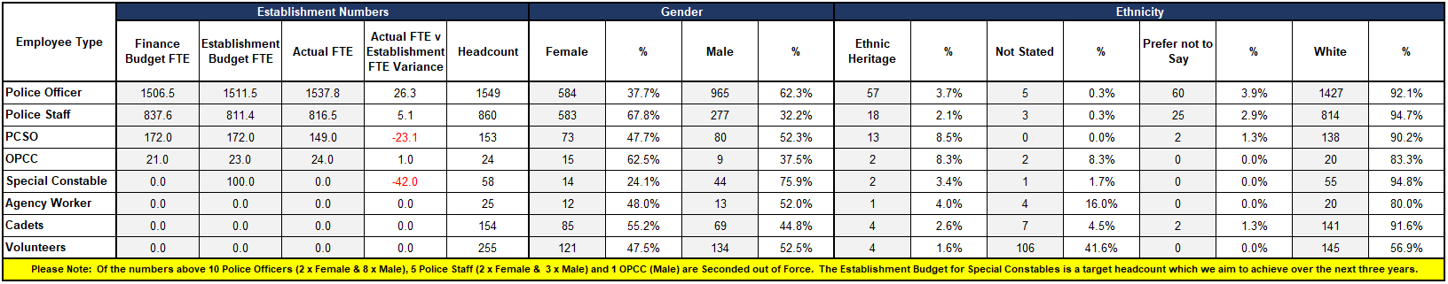
3. Representative Workforce
The below table is correct as of 31 March 2024
Key Points
There is a gender disparity evident in the workforce for both officers and staff. For officers, females are underrepresented by approximately 13 percentage points (females account for 51% of the population in Gwent based on 2021 Census). However, females are overrepresented in the staff workstream area (by approximately 17 percentage points). During financial year 2023-24, the joining rate of female police officers was 41.8%, resulting in the percentage of female officers overall rising by just over one percent.
There is also disparity in ethnic heritage representation within the workforce. In Census 2021, 5.8% of the Gwent population are people of ethnic heritage. Currently 3.7% of police officers are of ethnic heritage, whereas ethnic heritage representation in staff is lower at 2.1%. During financial year 2023-24, the joining rate of officers of ethnic heritage was 6.4%, which should contribute to an increase in representation going forward.
Operational uplift numbers have been maintained, with an additional 21 Home Office funded officers employed through the over-recruitment scheme. 27 officers successfully passed the sergeants promotion process during the quarter.
Police officer attrition levels (excluding retirement types) have reduced by 0.5 percentage points between March 2023 and March 2024, from 5.3% to 4.8%. The rolling national resignation rate stands at 3.5%. Student officer attrition has been a focus, with significant work undertaken to reduce student officer attrition levels from their peak of 9.0% to 5.4%.
In line with other many other forces, Gwent has faced a particular challenge in increasing the establishment of investigators and detective constables, particularly in high-risk areas such as the Public Protection Unit and the Rape Investigation Team. Through enhanced governance and oversight the force has increased recruitment and establishment significantly, achieving a vacancy fill level of 95%, with 100% expected by the end of May.

Slide 30
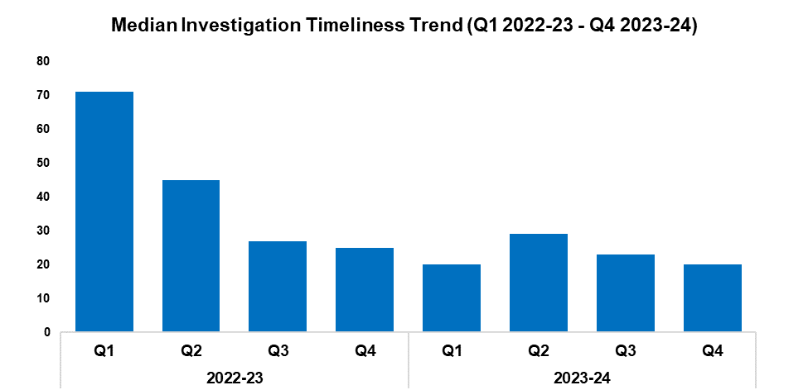
4. Investigation Timeliness
Overview
The median number of days within which an investigation is completed has fallen by 13.0% when compared to the previous quarter, down by three days to 20. A more prominent decline of 20.0% (five fewer days) can be observed when comparing Q4 2023-24 against the same quarter during the previous financial year.
A substantial reduction of 43.9% (18 fewer days) has been recorded when comparing the most recent financial year against financial year 2022-23. This is due to the elevated investigation times observed during quarter one and quarter two of 2022-23, on account of a backlog of occurrences which were awaiting finalisation by the Crime Management Unit.
As of Q4 2023-24, there are 14,878 crimes classified as unfinalised (excluding pending finalisation). This represents an increase of 3.0% (438 additional crimes) when compared to the quarter prior.
Of the 14,878 unfinalised crimes, 11,700 are currently under investigation. Of these 7,693 crimes have been open for less than six months, 1,872 have been open for between six and 12 months, and 2,135 have been for open for over 12 months.
Of those crimes which have been for open for over 12 months, Violence without Injury offences are the most common, accounting for 18.0% of the total (417 crimes). This is followed by Rape offences, which account for 13.5% of the total (312 crimes).
2022-23 |  |  |  | 2023-24
Q1 | Q2 | Q3 | Q4 | Q1 | Q2 | Q3 | Q4
71 | 45 | 27 | 25 | 20 | 29 | 23 | 20

Slide 31
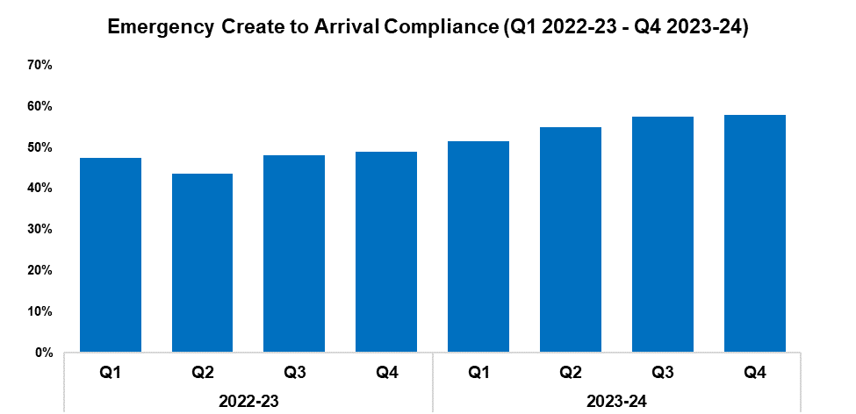
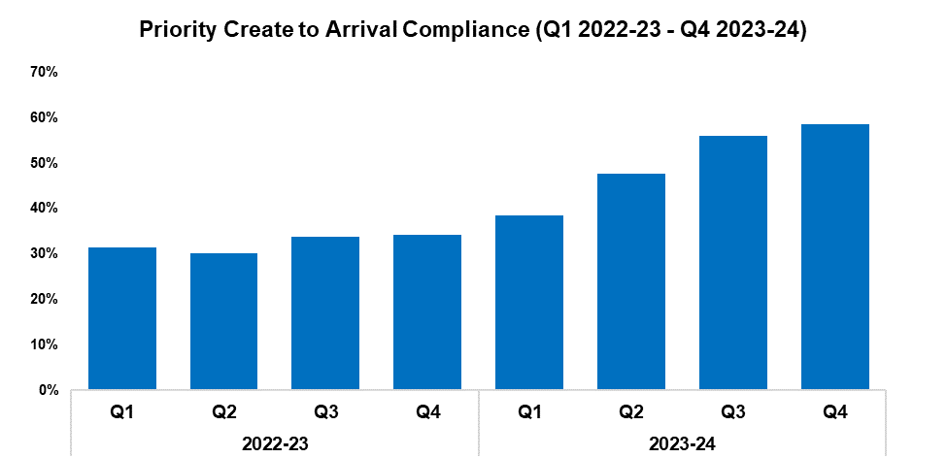
5. Response Rates
2022-23 |  |  |  | 2023-24
Q1 | Q2 | Q3 | Q4 | Q1 | Q2 | Q3 | Q4
47.4% | 43.7% | 48.0% | 49.0% | 51.4% | 54.9% | 57.4% | 57.9%
2022-23 |  |  |  | 2023-24
Q1 | Q2 | Q3 | Q4 | Q1 | Q2 | Q3 | Q4
31.4% | 30.1% | 33.8% | 34.2% | 38.5% | 47.7% | 56.0% | 58.5%
Overview
Based on the target arrival time of 15 minutes, emergency create to arrival compliance has increased by 0.5 percentage points when compared to the quarter prior and currently stands at 57.9%. This represents the highest quarterly figure within the timeframe, continuing the upward trend observed for this metric following Q2 2022-23. Emergency response compliance has increased by 8.9 percentage points when comparing Q4 2023-24 against the same quarter during the previous financial year, and by 8.4 percentage points to 55.4% when comparing the most recent financial year against financial year 2022-23.
Based on the target arrival time of one hour, priority create to arrival compliance has increased by 2.5 percentage points when compared to the quarter prior and currently stands at 58.5%. As with emergency compliance, this represents the highest quarterly figure within the timeframe and continues the upward trend observed for this metric following Q2 2022-23. Priority response compliance has increased by 24.3 percentage points when comparing Q4 2023-24 against the same quarter during the previous financial year, and by 17.7 percentage points to 50.0% when comparing the most recent financial year against financial year 2022-23.

Slide 32
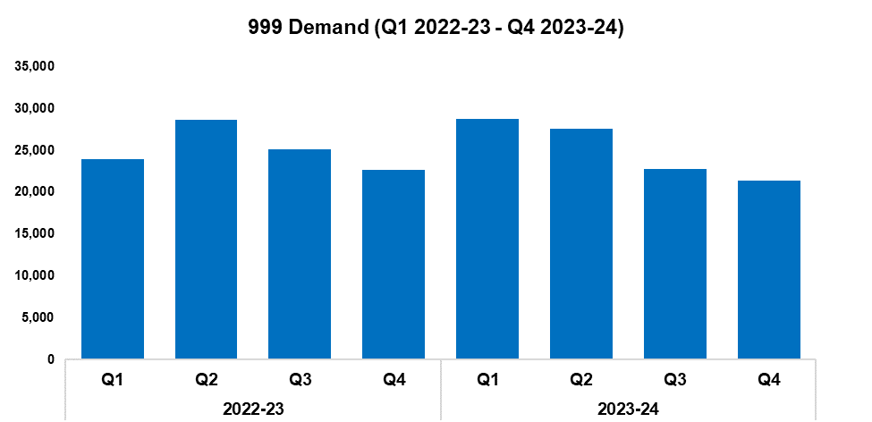
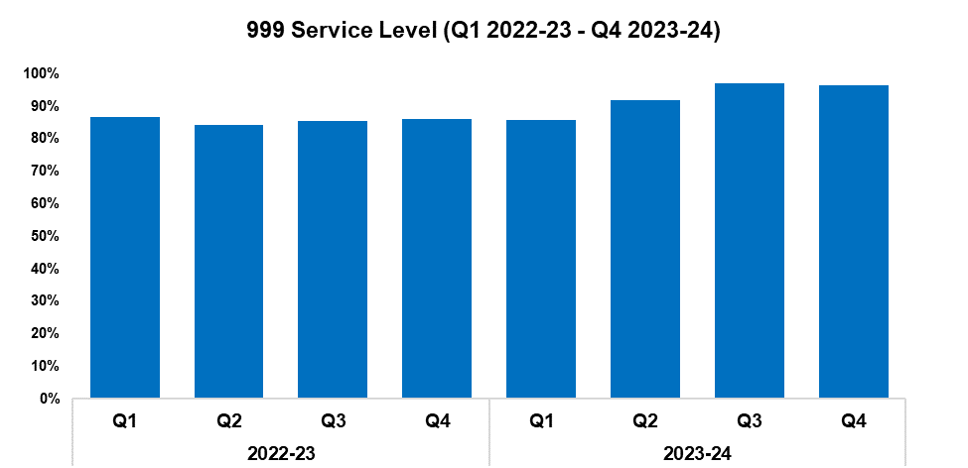
6. 999 Demand
2022-23 |  |  |  | 2023-24
Q1 | Q2 | Q3 | Q4 | Q1 | Q2 | Q3 | Q4
23,910 | 28,601 | 25,091 | 22,691 | 28,737 | 27,600 | 22,806 | 21,326
2022-23 |  |  |  | 2023-24
Q1 | Q2 | Q3 | Q4 | Q1 | Q2 | Q3 | Q4
86.3% | 84.0% | 84.7% | 85.7% | 85.5% | 91.5% | 96.9% | 96.4%
Overview
999 demand has decreased by 6.5% during Q4 2023-24 when compared to the quarter prior, with 1,480 fewer calls received for a total of 21,326. This continues the downward trend observed for this metric following Q1 2023-24. A similar reduction of 6.0% (1,365 fewer calls) can be observed when comparing Q4 2023-24 against the same quarter during the previous financial year. Conversely, a slight increase of 0.2% (176 additional calls) has been recorded when comparing the most recent financial year against financial year 2022-23.
999 service level (the percentage of 999 calls answered within 10 seconds) has declined during Q4 2023-24 when compared to the quarter prior, falling by 0.5 percentage points to 96.4%. Whilst this represents a reduction when compared to the previous quarter, it remains the second-highest quarterly figure within the timeframe. 999 service level has increased by 10.7 percentage points when comparing Q4 2023-24 against the same quarter during the previous financial year, and by 7.0 percentage points to 92.1% when comparing the most recent financial year against financial year 2022-23.
999 Average Answer Speed
(Minutes/Seconds)
2022-23 |  |  |  | 2023-24
Q1 | Q2 | Q3 | Q4 | Q1 | Q2 | Q3 | Q4
00:13 | 00:12 | 00:11 | 00:10 | 00:10 | 00:07 | 00:04 | 00:04
The average answer speed for 999 calls during Q4 2023-24 was four seconds. This is equal to the quarter prior, representing the joint-lowest quarterly figure within the timeframe. 999 average answer speed has improved by six seconds when comparing Q4 2023-24 against the same quarter during the previous financial year, with improvements also noted when comparing the most recent financial year against financial year 2022-23.

Slide 33
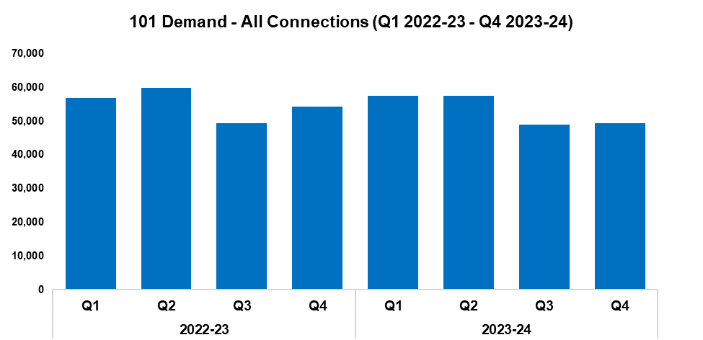
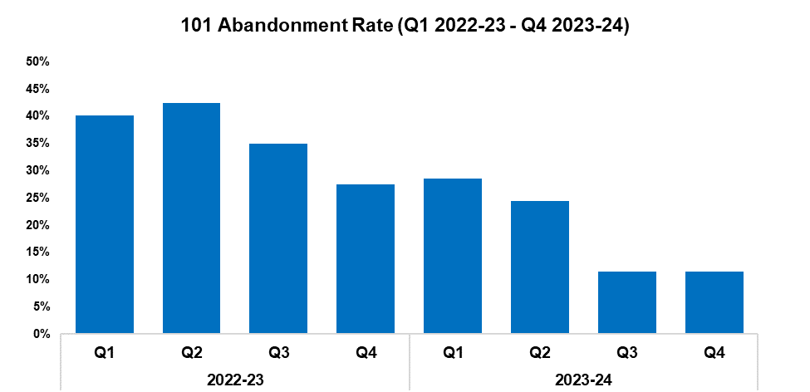
7. 101 Demand
2022-23 |  |  |  | 2023-24
Q1 | Q2 | Q3 | Q4 | Q1 | Q2 | Q3 | Q4
56,886 | 59,760 | 49,314 | 54,382 | 57,552 | 57,466 | 48,881 | 49,457
2022-23 |  |  |  | 2023-24
Q1 | Q2 | Q3 | Q4 | Q1 | Q2 | Q3 | Q4
40.2% | 42.5% | 35.0% | 27.5% | 28.6% | 24.4% | 11.4% | 11.5%
Overview
101 demand (all connections) has increased by 1.2% during Q4 2023-24 when compared to the quarter prior, with 576 additional calls received for a total of 49,457. This disrupts the downward trend observed for this metric following Q1 2023-24. A reduction of 9.1% (4,925 fewer calls) can be observed when comparing Q4 2023-24 against the same quarter during the previous financial year, with demand falling by 3.2% (6,986 fewer calls) when comparing the most recent financial year against financial year 2022-23.
The 101 abandonment rate has risen by 0.1 percentage points when compared to the quarter prior, and currently stands at 11.5%. Whilst this represents a slight quarter-on-quarter increase, it remains the second-lowest quarterly figure within the timeframe by a significant margin. The 101 abandonment rate has improved substantially when comparing Q4 2023-24 against the same quarter during the previous financial year (down 16.0 percentage points), with a similar improvement recorded when comparing the most recent financial year against financial year 2022-23 (down 16.8 percentage points to 19.5%).
101 Average Answer Speed
(Minutes/Seconds)
2022-23 |  |  |  | 2023-24
Q1 | Q2 | Q3 | Q4 | Q1 | Q2 | Q3 | Q4
06:53 | 07:45 | 09:41 | 07:47 | 06:29 | 05:05 | 02:20 | 02:14
The average answer speed for 101 calls during Q4 2023-24 was two minutes and 14 seconds, an improvement of six seconds when compared to the quarter prior. This represents the fifth consecutive improvement in performance, and the lowest quarterly figure with the timeframe.
The average answer speed has improved by five minutes and 33 seconds when comparing Q4 2023-24 against the same quarter during the previous financial year. When comparing the most recent financial year against financial year 2022-23, the average answer speed has improved by three minutes and 40 seconds, down to three minutes and 59 seconds.

Slide 34
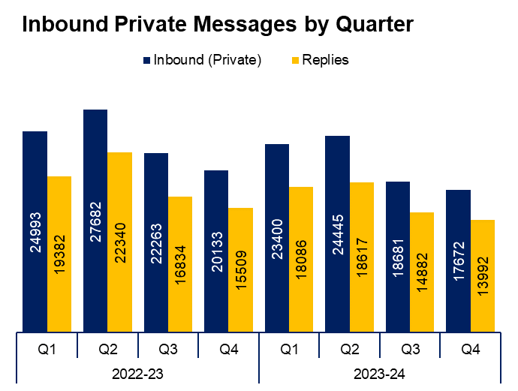
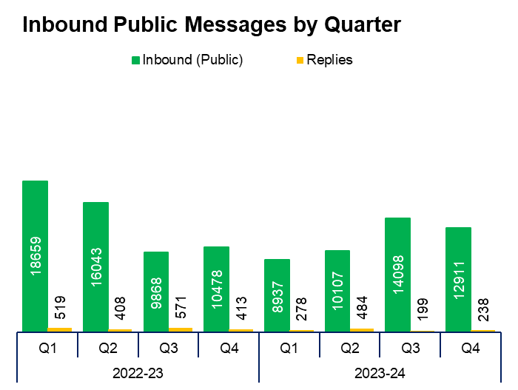
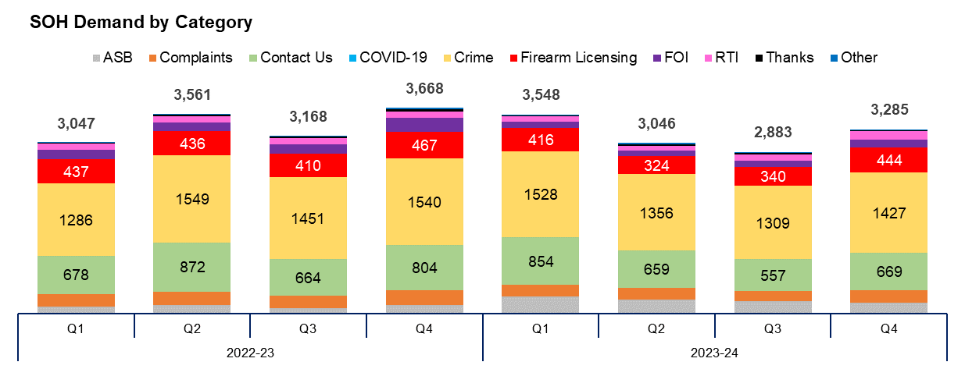
8. Social Media and Single Online Home
Overview
Inbound private messages received via Gwent Police’s social media platforms decreased by 5.4% during Q4 2023-24 when compared to the quarter prior, with 1,009 fewer messages received for a total of 17,672. In terms of inbound private message sources, 94.1% (16,630 messages) were received via Facebook platforms.
Inbound public messages received via Gwent Police’s social media platforms decreased by 8.4% during Q4 2023-24 when compared to the quarter prior, with 1,187 fewer messages received for a total of 12,911. In terms of inbound public message sources, 91.7% (11,841 messages) were received via Facebook platforms.
This digital contact data includes Gwent Police’s English and Welsh Facebook and X accounts.
3,285 Single Online Home (SOH) forms were submitted during Q4 2023-24, an increase of 13.9% (402 additional forms) when compared to the quarter prior. The disrupts the downward trend observed for this metric following Q4 2022-23.
The adjacent chart presents these forms by category, with the most numerous being crime reports (43.4% or 1,427 forms), followed by general ‘contact us’ messages (20.4% or 669 forms), and firearm licensing (13.5% or 444 forms). ‘Other’ includes forms with low volume, including events and processions, filming, fingerprints and IP licensing.

Slide 35
9. Initiatives & Events
Overview
Cuckoo Watch has now launched in Gwent. This initiative relates to information around people being exploited or ‘cuckooed’ in their own homes. Agencies such as housing associations often hold valuable information on exploited individuals and can share or report such intelligence via this system. Partners can complete a partner referral form and send this to representatives, who then work alongside the Neighbourhood Policing Teams to solve any problems identified. This may include use of civil orders, housing association efforts, or criminal prosecutions.
Through BioStress research within Force Contact and Control, the force has gained an improved understanding of the factors which contribute to stress and how they are perceived.
A Suicide Postvention procedure is currently in development, which will allow the force to offer sensitive and effective support following a death by suicide.
Benenden, a provider of low-cost private health care for the individual, has been made available within the force. To date 10% of the workforce have joined. This initiative aims to support the physical health of staff by facilitating the early identification of issues and providing treatment, thereby contributing to reductions in sickness absence and improving wellbeing. Linking in with the Police Covenant, 188 family members have joined to date.
Welsh language issues have been moved from high to low risk, following the work of the Welsh Language Policy lead.
The Newport Central neighbourhood policing team identified and arrested several key offenders prior to a series of high-profile football games. Partnerships with Rodney Parade and Bar Amber, along with the use of media, have resulted in a de-escalation of football related incidents.
Over 1,000 local residents have signed up to the Gwent Community Link, following its launch in Blaenau Gwent. This free police messaging service allows residents to sign up and receive email updates from their neighbourhood policing team on recent incidents in their area, appeals for information, crime prevention advice, and more. It is hoped that the service will be rolled out across additional counties and boroughs in the force area going forward.
As part of the On The Beat initiative Deputy Chief Constable Rachel Williams has joined the neighbourhood policing teams in several areas within Gwent, including Abertillery, Bettws, Maindee and Rhymney. This initiative aims to improve community engagement by allowing the Deputy Chief Constable and other officers to liaise directly with members of the public, in order to better understand their concerns and receive feedback on how the police service can best support them.

Slide 36
Professional Standards Department
PSD Total Recorded Complaint Allegations
PSD Schedule 3 and Non-Schedule 3 Complaint Cases
PSD Misconduct Cases
Vetting
Disproportionality
Quarterly Update

Slide 37
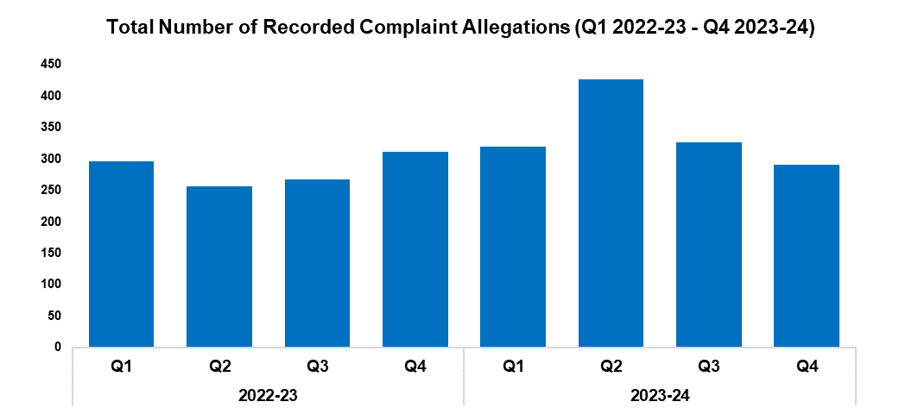
1. PSD Total Recorded Complaint Allegations
Overview
Please note that multiple allegations can be recorded by one complainant.
There has been an 11.0% decrease in complaint allegations received during Q4 2023-24 (n=291) when compared to the quarter prior (n=326). There is a decreasing trend in complaint allegations for this quarter following some of the data quality assurance work undertaken during Q2. Despite this reduction there is the caveat that due to some resourcing matters within the PSD Administration Team there is a greater backlog in the recording and logging of complaints on the Centurion database.
The three categories of complaint with the greatest volume are as follows:
A1. Police action following contact 112
A4. General level of service 30
H3. Unprofessional attitude and disrespect 26
The most notable differences compared to Q3 2023-24 can be seen below;
There has been a decrease in A1. Police action following contact (n=112) when compared with the quarter prior (n=148).
There has been an increase in A4. General Level of Service (n=30) when compared with the quarter prior (n=7).
2022-23 |  |  |  | 2023-24
Q1 | Q2 | Q3 | Q4 | Q1 | Q2 | Q3 | Q4
296 | 256 | 268 | 311 | 320 | 426 | 326 | 291

Slide 38
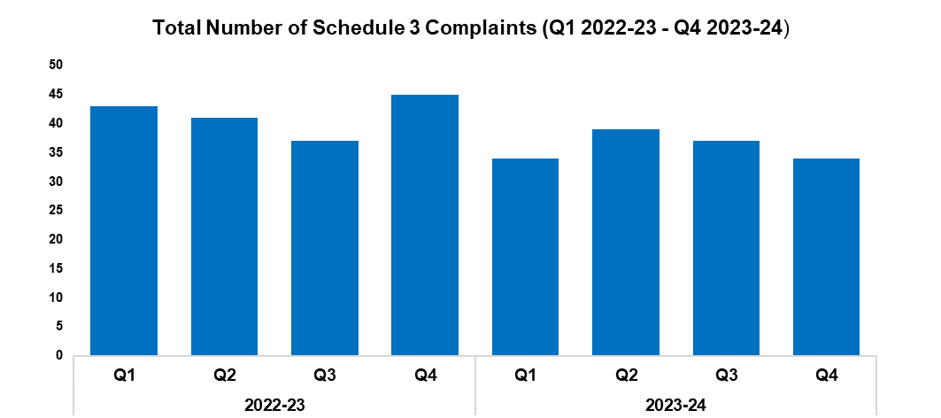
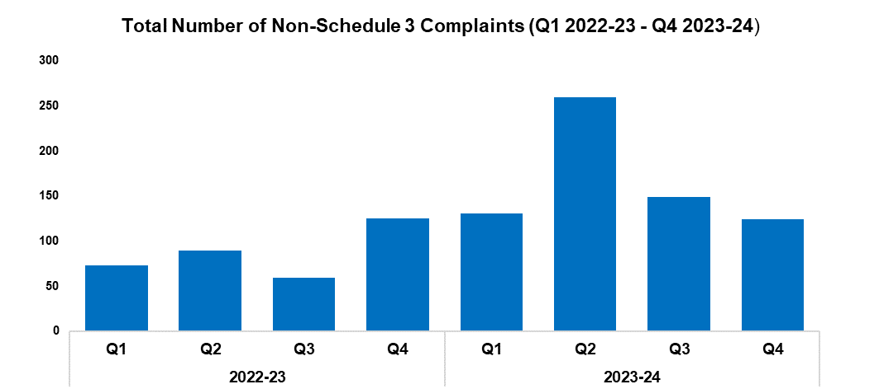
2. PSD Schedule 3 and Non-Schedule 3 Complaint Cases
2022-23 |  |  |  | 2023-24
Q1 | Q2 | Q3 | Q4 | Q1 | Q2 | Q3 | Q4
43 | 41 | 37 | 45 | 34 | 39 | 37 | 34
2022-23 |  |  |  | 2023-24
Q1 | Q2 | Q3 | Q4 | Q1 | Q2 | Q3 | Q4
73 | 89 | 59 | 125 | 131 | 260 | 149 | 124
Overview
1) Schedule 3 - which relate to complaints dealt with under the Police Reform Act 2002, whereby the complainant can request a review if they are not satisfied.
2) Non-Schedule 3 - This allows complaints to be dealt with outside of the Police Reform Act 2002, previously regarded as ‘dissatisfaction’.
There was a very slight decrease in Schedule 3 cases during Q4 2023-24 (n=34) when compared to the quarter prior (n=37), but the recording of these Schedule 3 complaints has remained at a consistent level throughout financial year 2023-24. Non-Schedule 3 cases show a more significant reduction (n=124) when compared with the previous quarter (n=149). It would appear these numbers are returning to the baseline figures seen prior to the data quality assurance work undertaken during Q2.
At the time the data was extracted there were 48 ongoing Schedule 3 complaints and seven ongoing Non-Schedule 3 complaints. Although difficult to measure with data sets, this quarter has seen a number of complex and sensitive complaint investigations.
Figures will contain cases with multiple allegations.

Slide 39
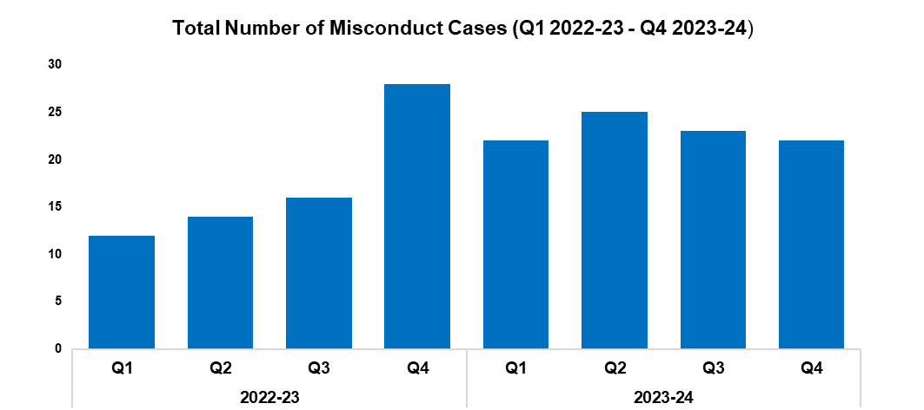
3. PSD Misconduct Cases
Overview
The upward trend in Misconduct Cases is consistent with the pattern within policing in England and Wales.
A more proactive approach to misconduct and counter-corruption intelligence gathering and investigation, coupled with more confidence in the workforce to report, has been the catalyst for this increase.
Gwent PSD have invested resources into both preventive work and support for victims and witnesses to police misconduct.
The total number of misconduct cases has remained consistent across the last four quarters of monitoring, which may show that a new baseline has been set.
2022-23 |  |  |  | 2023-24
Q1 | Q2 | Q3 | Q4 | Q1 | Q2 | Q3 | Q4
12 | 14 | 16 | 28 | 22 | 25 | 23 | 22
Q4 2023-24 Misconduct Outcomes
Within Q4 2023-24, there were three Accelerated Misconduct Hearings held; the details for which are below:
A Police Inspector resigned prior to the hearing and subsequently did not attend the hearing. Chief Constable Kelly determined that the allegation was proven as gross misconduct, and that they would have been dismissed without notice had they remained serving.
A Police Constable resigned prior to the hearing and subsequently did not attend the hearing. Chief Constable Kelly determined that the allegation was proven as gross misconduct, and that they would have been dismissed without notice had they remained serving.
A Detective Constable resigned prior to the hearing and subsequently did not attend the hearing. Chief Constable Kelly determined that the allegation was proven as gross misconduct, and that they would have been dismissed without notice had they remained serving.
A gross misconduct hearing was held for a Police Constable who resigned prior to the hearing and subsequently did not attend. The Panel found all allegations proven as gross misconduct and determined that the officer would have been dismissed had they not resigned.
Four Misconduct Meetings were held concerning four officers of varying rank for allegations relating to inappropriate communications in a private WhatsApp group. Three officers received a written warning for proven allegations amounting to misconduct. One officer received reflective practice after it was found that their conduct did not amount to misconduct.

Slide 40


4. Vetting
Vetting Checks | 2022-23 |  |  |  | 2023-24
Q1 | Q1 | Q2 | Q3 | Q4 | Q1 | Q2 | Q3
Police Staff/Officers | 165 | 173 | 148 | 162 | 132 | 107 | 136
Contractors/Outside Agency | 260 | 166 | 245 | 217 | 195 | 230 | 240
Vetting Health Checks | 35 | 42 | 47 | 45 | 39 | 49 | 45
National Security Vetting | 0 | 0 | 0 | 0 | 21 | 20 | 10
Total | 460 | 381 | 440 | 424 | 387 | 406 | 431
Vetting Refusals | 2022-23 |  |  |  | 2023-24
Q1 | Q1 | Q2 | Q3 | Q4 | Q1 | Q2 | Q3
Residency | 0 | 0 | 0 | 0 | 0 | 0 | 0
PSD | 0 | 0 | 0 | 0 | 2 | 0 | 3
Convictions, Cautions & Impending Cases | 13 | 3 | 8 | 13 | 7 | 5 | 12
TAINT | 0 | 0 | 0 | 0 | 1 | 3 | 1
Intelligence & Non-conviction Data | 11 | 5 | 6 | 11 | 17 | 18 | 20
Open Source | 0 | 0 | 0 | 0 | 1 | 1 | 0
Associations | 1 | 2 | 7 | 8 | 2 | 3 | 4
Financial Integrity | 0 | 4 | 11 | 6 | 5 | 6 | 8
Integrity | 0 | 0 | 0 | 0 | 2 | 4 | 8
National Security and Terrorism | 0 | 0 | 0 | 0 | 0 | 0 | 0
Abuse of Position | 0 | 0 | 0 | 0 | 1 | 0 | 0
Total Vetting Refusals (There can be multiple reasons per refusal) | 28 | 16 | 32 | 42 | 32 | 25 | 35
Overview
Data is submitted a quarter behind, therefore Q4 2023-24 is not currently included.
There continues to be a high number of refusals for “Convictions, cautions and impending cases” and “Intelligence and non-conviction data” categories. This shows the diligence and inquisitive nature of the Vetting team and the checks they complete.

Slide 41
5. Disproportionality
Vetting Refusals Protected Characteristics Data (OLEEO cases only) |  | 2023-24
 |  | Q1 | Q2 | Q3
Ethnic Heritage | Received | 3 | 10 | 6
 | Refused | 0 | 2 | 1
Sexual Orientation | Received | 11 | 15 | 8
 | Refused | 1 | 1 | 1
Disability | Received | 0 | 9 | 0
 | Refused | 0 | 1 | 0
Gender Reassignment | Received | 0 | 1 | 0
 | Refused | 0 | 0 | 0
Male | Received | 70 | 89 | 62
 | Refused | 7 | 10 | 2
Female | Received | 47 | 63 | 54
 | Refused | 5 | 2 | 2
Total Cases on OLEEO (There can be multiple protected characteristics per refusal) |  | 117 | 152 | 116
Appeal Panels Protected Characteristics Data |  | 2023-24
 |  | Q1 | Q2 | Q3
Ethnic Heritage | Received | 0 | 0 | 0
 | Overturned | 0 | 0 | 0
Sexual Orientation | Received | 0 | 0 | 0
 | Overturned | 0 | 0 | 0
Disability | Received | 0 | 0 | 0
 | Overturned | 0 | 0 | 0
Gender Reassignment | Received | 0 | 0 | 0
 | Overturned | 0 | 0 | 0
Male | Received | 10 | 0 | 3
 | Overturned | 1 | 0 | 0
Female | Received | 3 | 0 | 1
 | Overturned | 1 | 0 | TBD
Total Cases Heard at Appeal (There can be multiple protected characteristics per appeal) |  | 13 | 0 | 4
Overview
The vetting disproportionality data is a new measure that will allow the force to track vetting refusals and appeal panel decisions across all areas of protected characteristics. As more data is gathered this will allow us to benchmark our figures against other Home Office forces.

Slide 42
6. Quarterly Update
Overview
The Professional Standards Department continues to proactively promote the importance of high professional standards and an ethical culture within the organisation. They continue to provide a bespoke input to all new starters within the organisation, covering current themes in police complaints and misconduct.
Subject matter leads within the department remain engaged on a national level with the proposed changes to police complaint and misconduct legislation/procedure and vetting authorised professional practice that will be implemented over the next year.
There continues to be significant demand within misconduct investigations, including a number of complex and sensitive cases.

Slide 43


