Slide 1


National Police and Crime Measures Report
Quarter 2 2023 / 2024

Slide 2
REDUCE MURDER AND OTHER HOMICIDE
Gwent Police action against this measure
A three year Homicide Prevention Strategy is in place, supported by a delivery plan, with the goal of furthering our understanding of the national and local themes and drivers that are likely to be precursors to Homicide. ​
The plan includes an examination of the enabling factors that contribute to Homicide (such as mental health, alcohol misuse, and weapons), with a view to early intervention and prevention. The links between Homicide and serious organised crime, domestic abuse, and the night-time economy have also been recognised.​
This will be facilitated in part by improving our joint working and information sharing with partner agencies.
Gwent PCC Comments
After the unusual spike in homicide in 22/23, the rate has thankfully come down, albeit we would always aim to have no crime involving a death. We continue to work with community safety partners and others, for example reviewing Domestic Homicide Reviews, and factoring any recommendations into our scrutiny of Gwent Police.
Local Measures | Trend / Outlook
Homicide offences | Medium term increasing / Short term decreasing

Slide 3
REDUCE SERIOUS VIOLENCE
Gwent Police action against this measure
Serious Violence crimes consist of Section 18 Grievous Bodily Harm with Intent, Section 20 Malicious Wounding without Intent, and Personal Robbery offences. Q2 2023-24 saw the volume of these offences increase by 25.9% when compared to the quarter prior, with 49 additional offences recorded for a total of 238. This continues the upward trend in offence volume observed following Q4 2022-23, with seasonality likely playing a role in this increase.
Gwent Police utilises a problem-solving, partnership based approach to preventing Serious Violence.
This approach is supported by a Serious Violence prevention strategy and delivery plan, which aim to reduce and where possible prevent harm to members of the community.
Particular focus has been placed on night-time economy related violence, knife related violence, robbery, drug related gang violence, and acid/corrosive substance attacks.
Tasking structures are in place to monitor active Organised Crime Groups (OCGs) and high-harm offenders.
Gwent PCC Comments
Serious violence offences have only risen slightly in Q2, which is following the ‘normal’ seasonal increase that is seen for this crime type, and similar to levels seen last year.
Development of a new Serious Violence Duty Strategy and Strategic Needs Assessment are fully under way across Gwent, supported by the OPCC. Some additional funding provided by the Home Office will be used by community safety partners to develop interventions to reduce serious violence. The OPCC will be monitoring this partnership response.
National Measures | Trend / Outlook
Firearm offences | stable
Bladed object offences | decreasing
Local Measures | Trend / Outlook
Serious Violence | Stable
Assault intent rob (Personal property) | Decreasing
Grievous Bodily Harm WITH INTENT | Increasing
Malicious Wounding S.20 – no intent | Decreasing
Robbery (Personal property) | Decreasing

Slide 4
DISRUPT DRUG SUPPLY AND COUNTY LINES
Gwent Police action against this measure
Proactive specialist support is available via the Drug Focus Desk.
We are working closely with partner agencies to provide signposting and treatment to help reduce the number of repeat offenders.
An intelligence led approach is being used to identify and disrupt the crime groups presenting the highest risk.
We have a close working relationship with the Regional Organised Crime Unit and the National County Lines Coordinator, facilitating the early identification of offenders involved in the supply of drugs.
A total of six cannabis factories have been dismantled after being located within disused premises in Newport City Centre. The street value of the growths is currently believed to be in excess of £5 million. Five arrests have been made, with all subjects remanded into custody.
Enforcement for Operation Silver took place during the early hours of the 13th of September. This is an investigation into an organised crime group involved in the supply of Class A drugs. 80 firearms officers and over 100 unarmed officers were involved in synchronised warrants at five addresses in Newport and Cardiff. Three men were charged and remanded for conspiring to supply cocaine, heroin and MDMA. The investigation remains ongoing.
A series of operations took place between the 9th and 15th of October as part of a national County Lines Intensification Week. As a result: two cannabis farms were dismantled; 4,500 cannabis plants were seized; 18 kilograms of amphetamine were recovered; 14 people were arrested; two people at risk of exploitation were safeguarded; and £1,400 in cash was seized.
Gwent PCC Comments
Drug offences continue to rise in the past few quarters, which is a concerning trend. We are pleased with the proactive work undertaken by Gwent Police as evidenced above.
In general, the PCC invests heavily with partners in treatment services to support those stuck in the cycle of addiction and crime, including a significant contribution to the Gwent Drug and Alcohol Service.
Local Measures | Trend / Outlook
No of Drug Disruptions | Not known
No of County Lines Disrupted | Not known
No of Drug supply Offences | Increasing

Slide 5
REDUCE NEIGHBOURHOOD CRIME
Gwent Police action against this measure
Neighbourhood Crime offences have seen an increase of 6.3% when compared to the quarter prior, with 79 additional offences recorded for a total of 1,331 This increase runs counter to the aims of the government’s Beating Crime Plan, in which it is a focus area for reduction, and represents the highest quarterly total within the timeframe.
When assessed by crime category, Vehicle Crime offences appear to be the primary contributor to the rise observed during Q2 2023-24, increasing by 18.9% when compared to the quarter prior (136 additional offences for a total of 854). This is the highest quarterly total within the timeframe, and accounts for 64.2% of all Neighbourhood Crime offences recorded during Q2 2023-24.
The Neighbourhood Policing model is undergoing a review to improve its effectiveness and efficiency.
All officers working within neighbourhood policing are receiving a one day input on problem solving and prevention as part of the Gwent version of the All Wales Neighbourhood Policing Programme.
All response officers are having a training day input on problem solving and prevention. This has been adapted to include situational prevention and community prevention.
The Gwent Community Link (a police messaging service) launched in September.
Gwent PCC Comments
Neighbourhood crime in Gwent has started to go in the wrong direction, particularly vehicle crime and we will continue to review this situation. There are some signs the cost of living may be driving up some of these offences. However, the volumes remain lower than before the Covid pandemic, which is positive. In particular burglary remains lower.
Local Measures | Trend / Outlook
Vehicle Crime | Increasing
Residential Burglary | Stable
Theft from the person | Increasing
Personal robbery | Decrease

Slide 6
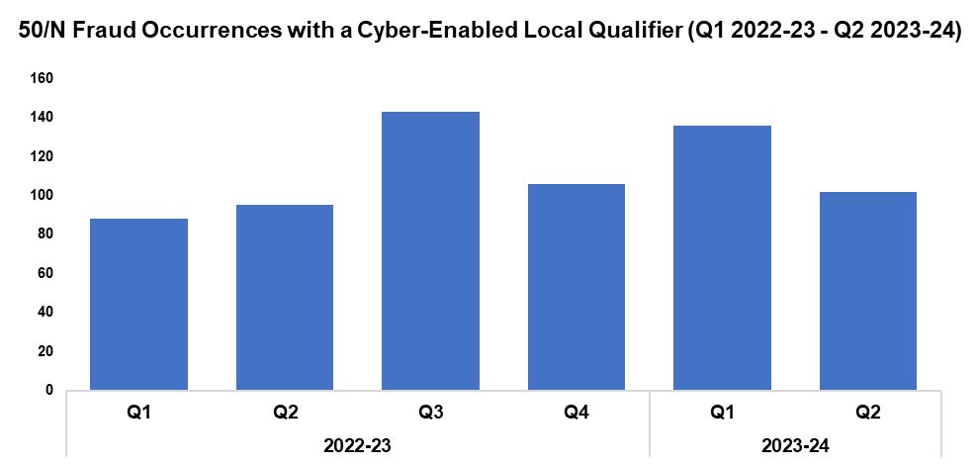
TACKLE CYBERCRIME
Gwent Police action against this measure
Of the 1,316 fraud occurrences under 50/N recorded since Q1 2022-23, 50.9% (670 occurrences) have been assigned a cyber-enabled local qualifier.
Q2 2023-24 saw 102 50/N fraud occurrences assigned a cyber-enabled local qualifier, a reduction of 25.0% (34 fewer occurrences) when compared to the quarter prior. Conversely, an increase of 7.4% (seven additional occurrences) can be observed when comparing Q2 2023-24 against the same quarter during the previous financial year. A further increase of 30.1% (55 additional occurrences) has been recorded when comparing the current FYTD against FYTD 2022-23, owing to the elevated levels recorded during Q1 2023-24.
A dedicated cyber ‘Digital Media Investigator’ has been provided to assist frontline officers, increasing the opportunities to identify and investigate cybercrimes.
Protect advice has been provided to all identified victims of cybercrime and cyber-enabled fraud, in an effort to prevent repeat victimisation.
Cyber-volunteers have been recruited to increase specialist knowledge and boost community engagement.
Cyber training was provided to all frontline officers, force control room operators and neighbourhood staff.
Gwent PCC Comments
We are pleased that cyber based fraud has reduced in Q2 23/24.
We encourage all victims to report these crimes to Action Fraud to ensure there is an accurate picture about how much of this crime is taking place across Gwent. We will report more information from Action Fraud on all cyber based frauds reported from Gwent, when available.
Local Measures | Trend / Outlook
Fraud with Cyber offences (50/N Occurrences) | Stable

Slide 7
IMPROVE VICTIM SATISFACTION WITH A FOCUS ON DOMESTIC ABUSE
Gwent Police action against this measure
A clear focus from Gwent Police is on Victim Satisfaction rates. A range of improvement plans are being put in place from the control room all the way through to criminal justice and court teams.
The introduction of the Victim Care Unit in late 2021 has seen satisfaction of victims improve in relation to support they are provided and updates given.
There is a Multi-Agency Tasking and Coordination (MATAC) process in place which aims to focus on identifying serial perpetrators of domestic abuse to reduce reoffending of the most harmful and serial domestic abuse perpetrators and to safeguard victims and families. A range of interventions can be delivered via MATAC, including support, prevention, diversion, disruption and enforcement, in order to reduce harm.
Funding has been secured to expand the MATAC team and also introduce a new diversion scheme (Cautioning And Relationship Abuse) for perpetrators of low level domestic abuse.
Gwent PCC Comments
Although the sample sizes for the table to the left are not large, they give an indicator of where performance is. Ultimately, there is more work to be done. The PCC will be focusing on this in the coming year, not just with Gwent Police but also wider Criminal Justice partners. The current victim services contract is being evaluated with the expectation to go out to tender next year. This is informed by a victim needs assessment that was funded by the PCC earlier this year that identified some improvements.
Local Measures | Trend / Outlook
Domestic Abuse Related flagged crime | Increasing
 | Measure​ of those surveyed *
Survey Number​ | Survey One​ | Survey Two​ |  |  |  | Survey Three​
Metric​ | Satisfied with Initial Contact​ | Satisfied with Follow Up & Investigation​ | Satisfied with the service from the VCO​ | Satisfied with the service from the officer dealing with your case​ | Satisfied with being kept informed about your case​ | Satisfied with Post Charge​
General Crime​ | 58%​ | 56%​ | 87%​ | 76%​ | 76%​ | 40%​
Domestic** Violence​ | 75%​ | 81%​ | 96%​ | 84%​ | 82%​ | Not Stat Sig​
* The survey is cumulative from the start of the victim care unit in 2022
** The sample size is very small, so this is an indicator ONLY

