Slide 1
Strategy Performance Board
Quarter 3 2023-24
Notes:
Operational Performance Board

Slide 2
Keeping Neighbourhoods Safe
All Crime
Beating Crime Plan
Residential Burglary
Neighbourhood Crime
Public Order
Anti-Social Behaviour
Roads Policing
Key Commitments
Reduce public order offences and anti-social behaviour, and the number of people who repeatedly carry out these acts.
Reduce acquisitive crime and repeat offenders.
Improve the safety of roads throughout Gwent.
Commission and invest in effective crime prevention initiatives.

Slide 3
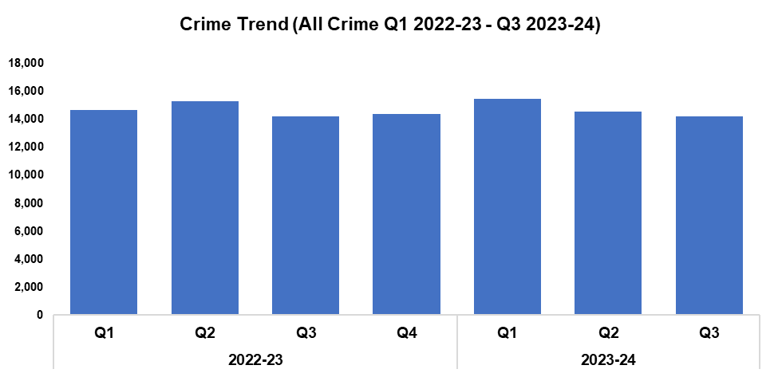
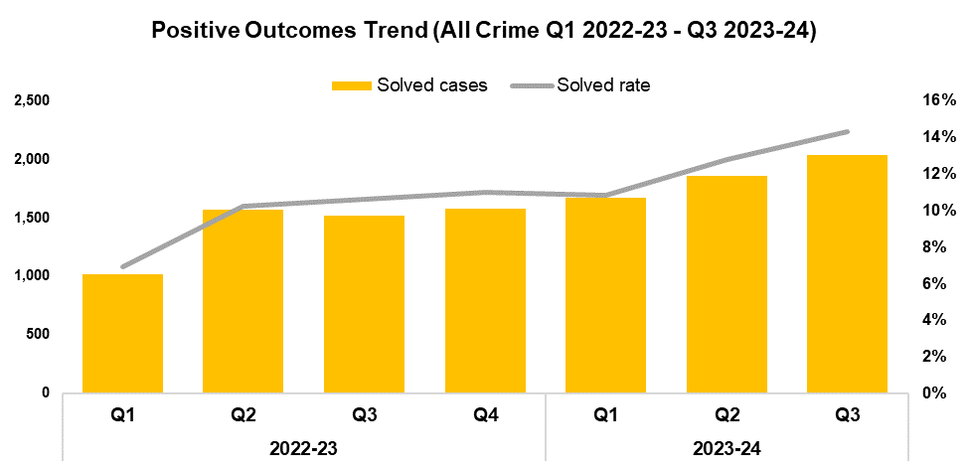
1. All Crime
Overview
Overall crime levels have fallen by 2.1% during the third quarter of the 2023-24 financial year (Q3 2023-24) when compared the quarter prior, with 312 fewer offences recorded for a total of 14,229. A slight increase of 0.1% (nine additional offences) can be observed when comparing Q3 2023-24 against the same quarter during the previous financial year. A minor increase of less than 0.1% (nine additional offences) has been recorded when comparing the current financial year to date (FYTD) against FYTD 2022-23.
The timeframe presented in this report has been limited to Q1 2022-23 onwards, excluding the financial years of 2020-21 and 2021-22 as they were anomalous due to the influence of COVID-19.
When compared to the previous quarter, the overall solved rate has risen by 1.5 percentage points to 14.3%, the highest quarterly figure within the timeframe. With the exception of Q1 2023-24, a quarter-on-quarter increase in solved rate can be observed throughout the recording period. The number of solved crimes has also increased when compared to the quarter prior, rising by 9.6% (179 additional solved crimes) for a total of 2,034. This represents the highest quarterly total within the timeframe, continuing the upward trend for this metric observed following Q3 2022-23.
The solved rate for Q3 2023-24 is 3.7 percentage points above that recorded for the same quarter during the previous financial year, with an additional 520 crimes solved. Similarly, the solved rate for the current FYTD is 3.3 percentage points higher than that observed during FYTD 2022-23, with an additional 1,463 crimes solved.

Slide 4
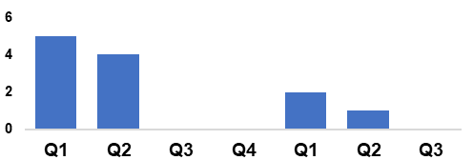
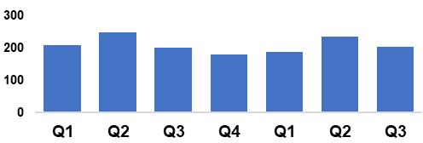
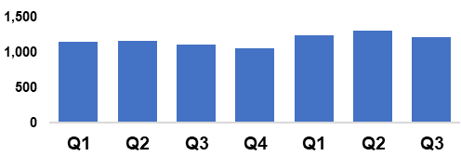
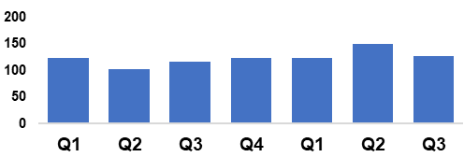
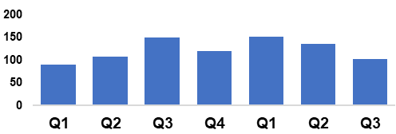
2. Beating Crime Plan
Crime Trend (Homicide Q1 2022-23 – Q3 2023-24)
A three-year Homicide Prevention Strategy is in place, supported by a delivery plan, with the goal of furthering our understanding of the national and local themes and drivers that are likely to be precursors to Homicide.
The plan includes an examination of the enabling factors that contribute to Homicide (such as mental health, alcohol misuse, and weapons), with a view to early intervention and prevention. The links between Homicide and serious organised crime, domestic abuse, and the night-time economy have also been recognised.
This will be facilitated in part by improving our joint working and information sharing with partner agencies.
Homicide
Crime Trend (Serious Violence Q1 2022-23 – Q3 2023-24)
Gwent Police utilises a problem-solving, partnership-based approach to preventing Serious Violence.
This approach is supported by a Serious Violence prevention strategy and delivery plan, which aim to reduce and where possible prevent harm to members of the community.
Particular focus has been placed on night-time economy related violence, knife related violence, robbery, drug related gang violence, and acid/corrosive substance attacks.
Tasking structures are in place to monitor active Organised Crime Groups (OCGs) and high-harm offenders.
Serious Violence
Crime Trend (Neighbourhood Crime Q1 2022-23 – Q3 2023-24)
The Neighbourhood Policing model is undergoing a review to improve its effectiveness and efficiency.
All officers working within neighbourhood policing are receiving a one-day input on problem solving and prevention as part of the Gwent version of the All Wales Neighbourhood Policing Programme.
All response officers are having a training day input on problem solving and prevention. This has been adapted to include situational prevention and community prevention.
The Gwent Community Link (a police messaging service) launched in September.
Neighbourhood Crime
Crime Trend (Drug Trafficking and Supply Q1 2022-23 – Q3 2023-24)
Proactive specialist support is available via the Drug Focus Desk.
We are working closely with partner agencies to provide signposting and treatment to help reduce the number of repeat offenders.
An intelligence led approach is being used to identify and disrupt the crime groups presenting the highest risk.
We have a close working relationship with the Regional Organised Crime Unit and the National County Lines Coordinator, facilitating the early identification of offenders involved in the supply of drugs.
Drug Trafficking
Action Fraud Occurrences Assigned a Cyber-Enabled Local Qualifier (Q1 2022-23 – Q3 2023-24)
A dedicated cyber ‘Digital Media Investigator’ has been provided to assist frontline officers, increasing the opportunities to identify and investigate cybercrimes.
Protect advice has been provided to all identified victims of cybercrime and cyber-enabled fraud, in an effort to prevent repeat victimisation.
Cyber-volunteers have been recruited to increase specialist knowledge and boost community engagement.
Cyber training was provided to all frontline officers, force control room operators and neighbourhood staff.
Cyber Crime

Slide 5
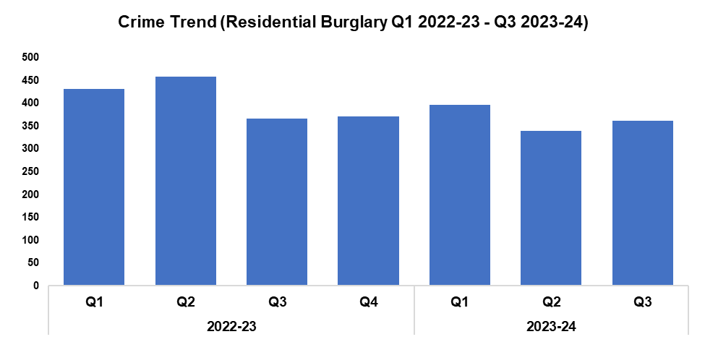
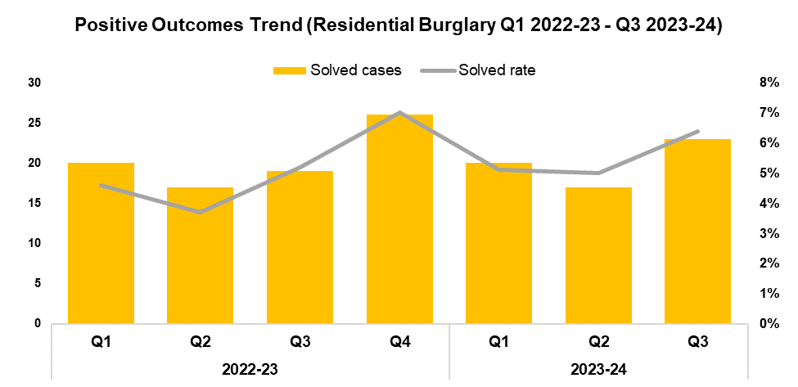
3. Residential Burglary
Overview
Residential Burglary offences have increased by 6.5% when compared to the quarter prior, with an additional 22 offences recorded for a total of 362. Whilst this increase runs counter to the aims of the government’s Beating Crime Plan, the levels recorded during Q3 2023-24 remain the second-lowest within the timeframe. A slight reduction of 1.1% (four fewer offences) can be observed when comparing Q3 2023-24 against the same quarter during the previous financial year, with a more prominent reduction of 12.5% (157 fewer offences) recorded when comparing the current FYTD against FYTD 2022-23.
Whilst the volume of Residential Burglary offences has increased when compared to the quarter prior, a significant reduction can still be observed when comparing the current FYTD against FYTD 2022-23. This may indicate the long-term efficacy of the deterrence strategies employed as part of the ‘We Don’t Buy Crime’ initiative.
When compared to the previous quarter the solved rate for Residential Burglary offences has risen by 1.4 percentage points to 6.4%, with six additional crimes solved for a total of 23. This disrupts the downward trend observed for these metrics following Q4 2022-23. The solved rate has risen by 1.2 percentage points when comparing Q3 2023-24 against the same quarter during the previous financial year and by 1.0 percentage point when comparing the current FYTD against FYTD 2022-23, with four additional crimes solved in both instances.

Slide 6
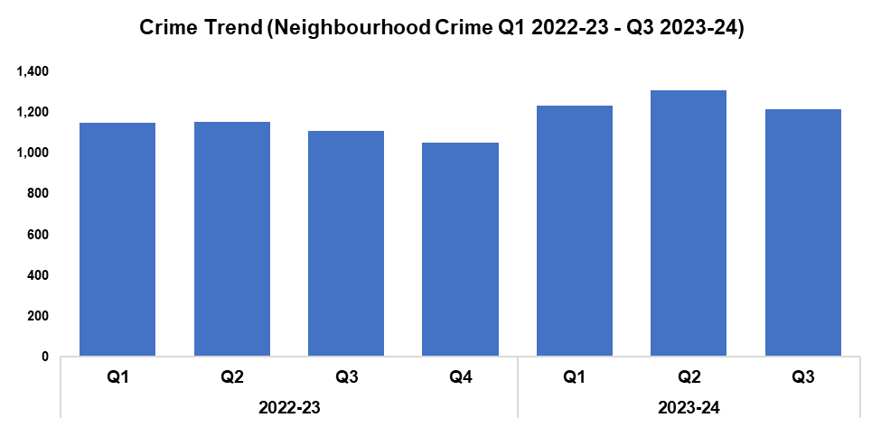
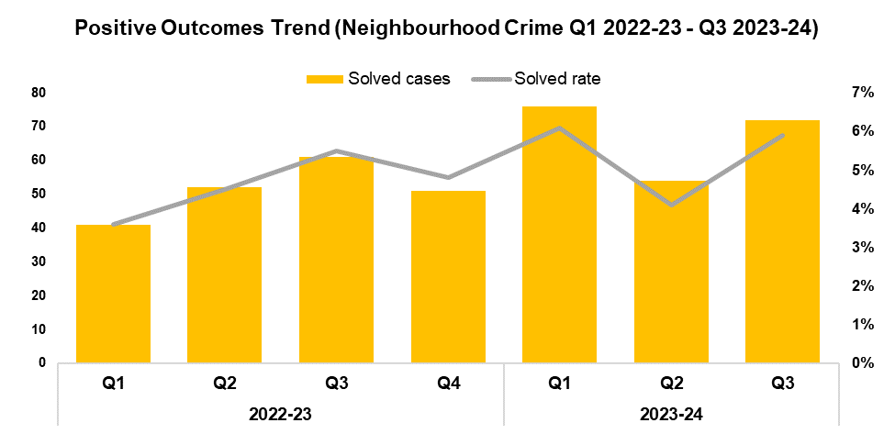
4. Neighbourhood Crime
Overview
Neighbourhood Crime offences have seen a reduction of 7.1% when compared to the quarter prior, with 93 fewer offences recorded for a total of 1,218. This reduction conforms with the aims of the government’s Beating Crime Plan, and disrupts the upward trend which had been observed for this metric following Q4 2022-23. An increase of 9.6% (107 additional offences) can be observed when comparing Q3 2023-24 against the same quarter during the previous financial year, with a similar increase of 10.2% (348 additional offences) recorded when comparing the current FYTD against FYTD 2022-23. Vehicle Crime offences accounted for 61.3% of all Neighbourhood Crime during Q3 2023-24, with 747 offences recorded.
When compared to the previous quarter, the solved rate for Neighbourhood Crime offences has risen by 1.8 percentage points to 5.9%, with 18 additional crimes solved for a total of 72. This continues the trend of peaks and troughs observed for these metrics following Q2 2022-23. The solved rate for Q3 2023-24 is 0.4 percentage points above that recorded for the same quarter during the previous financial year, with 11 additional crimes solved. An increase of 0.9 percentage points can be observed when comparing the solved rate for the current FYTD against FYTD 2022-23, with 48 additional crimes solved.

Slide 7
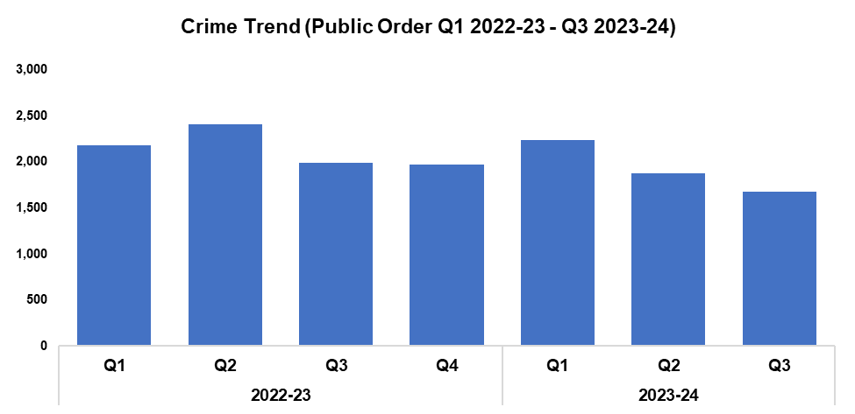
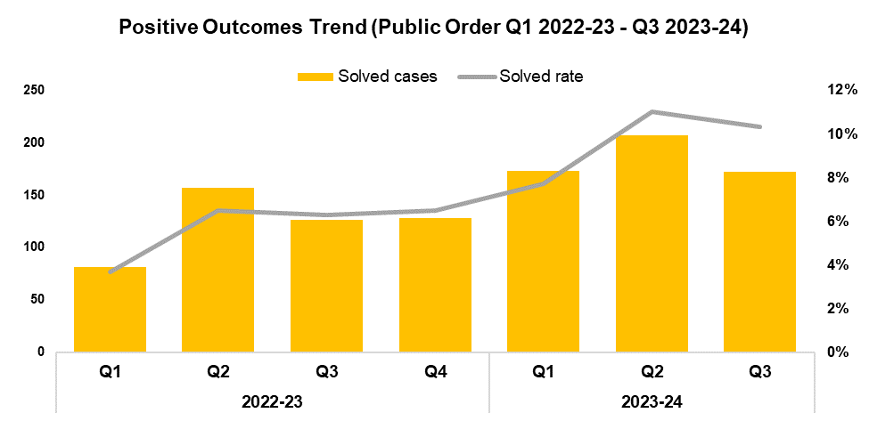
5. Public Order
Overview
Public Order offences have seen a reduction of 10.8% when compared to the quarter prior, with 202 fewer offences recorded for a total of 1,675. This represents the lowest quarterly figure within the timeframe, continuing the downward trend observed following Q1 2023-24. A reduction of 15.9% (317 fewer offences) can be observed when comparing Q3 2023-24 against the same quarter during the previous financial year, with a less prominent reduction of 12.0% (787 fewer offences) recorded when comparing the current FYTD against FYTD 2022-23.
As offences under Section 5 of the Public Order Act 1986 have been classified as non-notifiable by the Home Office, they have been retroactively removed from this dataset to facilitate the accurate monitoring of long-term trends.
When compared to the previous quarter, the solved rate for Public Order offences has fallen by 0.7 percentage points to 10.3%, with 35 fewer crimes solved for a total of 172. This disrupts the upward trend which had observed for these metrics following Q3 2022-23. The solved rate for Q3 2023-24 is 4.0 percentage points above that recorded for the same quarter during the previous financial year, with 46 additional crimes solved. An equivalent increase of 4.0 percentage points can be observed when comparing the solved rate for the current FYTD against FYTD 2022-23, with 188 additional crimes solved.

Slide 8
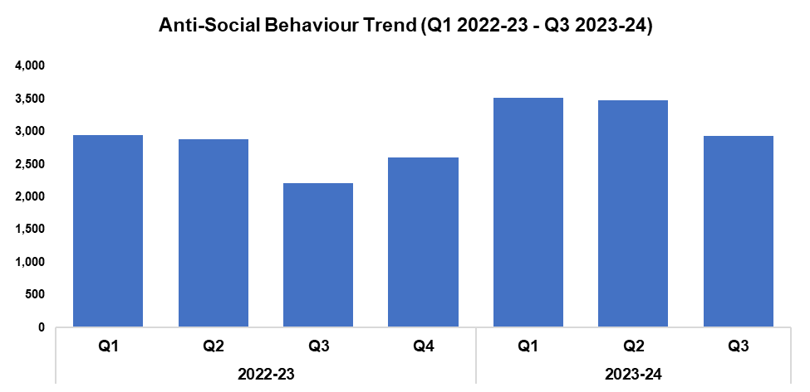
6. Anti-Social Behaviour
Overview
Levels of anti-social behaviour (ASB) in Gwent have fallen by 15.7% when compared to the quarter prior, with 545 fewer incidents recorded for a total of 2,928. This continues the downward trend observed for this metric following Q1 2023-24, whilst appearing to conform to seasonal trends.
A significant increase of 32.2% (714 additional incidents) can be observed when comparing Q3 2023-24 against the same quarter during the previous financial year, with a less prominent increase of 23.2% (1,868 additional incidents) recorded when comparing the current FYTD against FYTD 2022-23.
When assessed by closing category, a decline in incidents classified as ‘ASB - Nuisance’ appears to be the primary driver behind the overall reduction in ASB volume recorded during Q3 2023-24, with levels falling by 18.6% (422 fewer incidents to 1,851) when compared to the quarter prior.
The data presented in this slide does not include incidents classified as ‘ASB – COVID 19’.

Slide 9
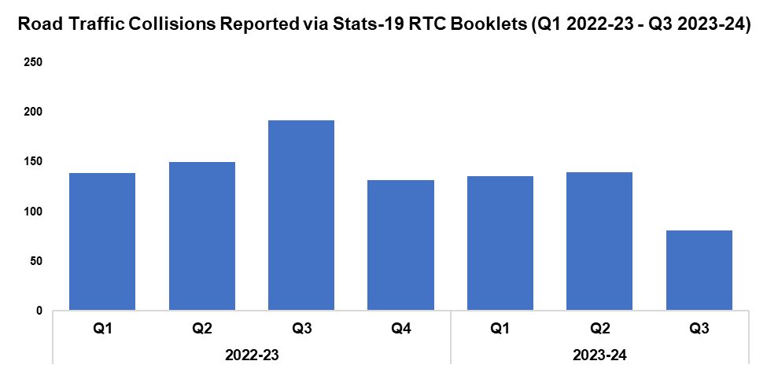
7. Roads Policing
Overview
During Q3 2023-24, 81 Road Traffic Collisions (RTCs) were reported via Stats-19 RTC booklets, a reduction of 42.1% (59 fewer RTCs) when compared to the quarter prior. These reduced levels are likely influenced by a lag time between the incidents occurring and the corresponding RTC booklets being submitted, with 37 booklets currently marked as outstanding for the quarter. As such, the number of RTCs recorded for Q3 2023-24 is expected to increase going forward, which will be reflected in future reporting.
A total of 452 individuals were reported for one of the ‘Fatal Five’* factors during Q3 2023-24, a reduction of 14.7% (78 fewer individuals) when compared to the previous quarter. The most commonly reported factor during Q3 2023-24 was drink/drug driving, accounting for 47.8% of all Fatal Five reports with 216 instances reported. This was followed by speeding, which accounted for 19.5% of Fatal Five reports with 88 instances reported.
*The ‘Fatal Five’ refer to the five main causes of serious injury and death in RTCs. They consist of: careless driving; drink/drug driving; not wearing a seatbelt; using a mobile phone; and excessive speed.
During December 2023 Gwent Police took part in a winter drink and drug drive campaign organised by the National Police Chiefs Council, in conjunction with the other Welsh forces. The aim of this initiative was to tackle drink and drug driving over the festive period, when they are most prevalent. During the campaign 1,152 vehicles were stopped, with 84 individuals arrested for drink driving offences. A further 81 individuals were arrested for drug driving offences, of which over a third were under 25 years of age. Initiatives such as this are of great importance, as tragically 28 people lost their lives in RTCs on the roads of Gwent during 2023. In many cases drink and/or drug driving was a significant contributing factor. Gwent Police remain committed to improving overall road safety by ensuring we have the capacity and capability to focus on roads policing, by changing minds through educational initiatives, and by driving technology and innovation. There are currently eight officers undergoing an advanced driving course. Upon its completion they will join the RPSO department, bolstering the force’s road policing capabilities.
PC Bird of the RPSO team was named Police Officer of the Year during November 2023. PC Bird has continuously set high standards in proactive policing with her approach to tackling drug drivers as part of the Fatal Five road safety campaign, arresting more drug drivers than any other officer in Gwent. To date she has arrested 129 offenders for 197 offences, with a positive outcome rate of 59.3%. Not only is she a fantastic role model to others who aspire to pursue a career in roads policing, she is also instrumental in improving road safety across Gwent.
On the 9th of December 2022 Charlotte Symmons collided with a pedestrian, 66-year-old Sandra Chamberlain, whilst driving her vehicle in Markham. Sandra was taken to hospital but tragically died of her injuries. On the 9th of January 2024 Charlotte Symmons pleaded guilty to causing death by dangerous driving, and was sentenced to four years and eight months in custody. She was also disqualified from driving for seven years.
On the 8th of November 2023 Matthew Jones pleaded guilty to causing death by careless driving whilst unfit through drink and drugs, following a fatal RTC on the A472 near Swffryd. He was sentenced to four years and four months in custody, and was disqualified from driving for eight years and two months.

Slide 10
Combat Serious Crime
Combat Serious Crime
Most Serious Violence
Serious Violence
VAWG Domestic Priority Offences
VAWG Non-Domestic Priority Offences
Drug Supply and Organised Crime
Key Commitments
Reduce the number of repeat victims of child criminal and sexual exploitation.
Increase disruption of serious organised crime, and reinvest assets seized back into communities.
Improve the overall criminal justice response to violence against women, domestic abuse and sexual violence.
Commission and invest in services that work with perpetrators of serious crime to prevent and reduce re-offending.

Slide 11
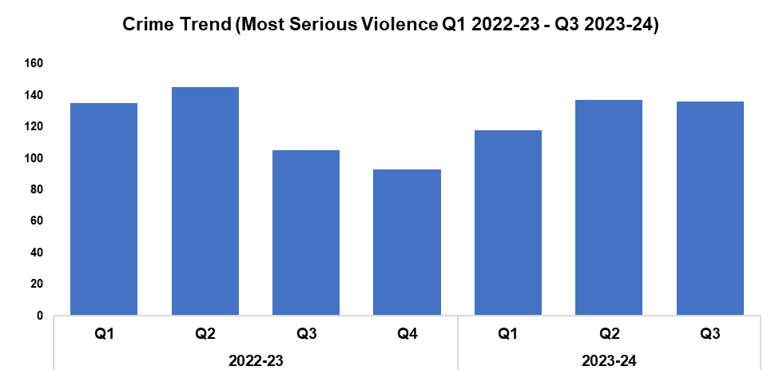
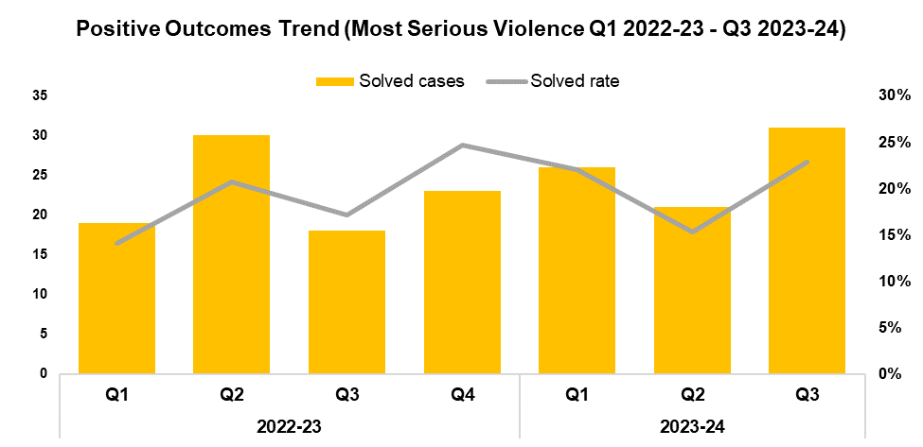
1. Most Serious Violence
Overview
Most Serious Violence offences consist of Homicide, Grievous Bodily Harm with Intent, and Causing Death by Dangerous Driving. These offences have seen a reduction of 0.7% when compared to the quarter prior, with one fewer offence recorded for a total of 136. Conversely, an increase of 29.5% (31 additional offences) can be observed when comparing Q3 2023-24 against the same quarter during the previous financial year, with a less prominent increase of 1.6% (six additional offences) recorded when comparing the current FYTD against FYTD 2022-23.
When compared to the previous quarter, the solved rate for Most Serious Violence offences has risen by 7.5 percentage points to 22.8%, with 10 additional crimes solved for a total of 31. The solved rate for Q3 2023-24 is 5.7 percentage points above that recorded for the same quarter during the previous financial year, with 13 additional crimes solved. An increase of 2.5 percentage points can be observed when comparing the solved rate for the current FYTD against FYTD 2022-23, with 11 additional crimes solved.
The investigation into the tragic death of Kelly Pitt concluded during November 2023. Kelly’s son Lewis Bush was sentenced to 16 years imprisonment for her murder.

Slide 12
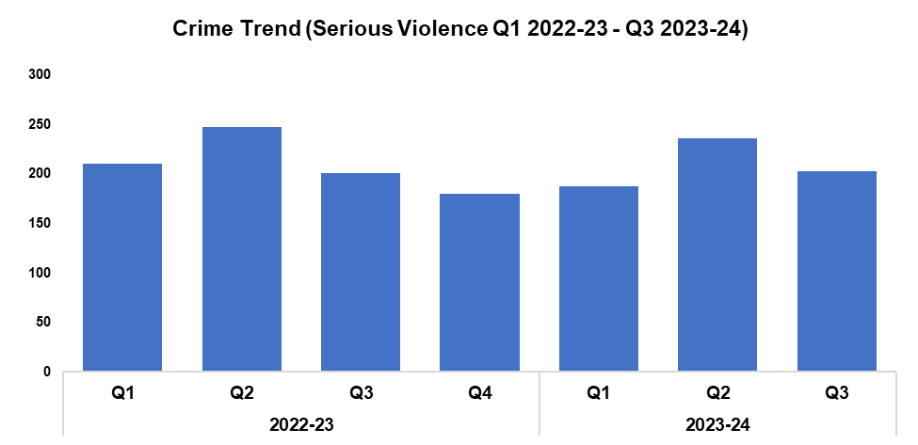
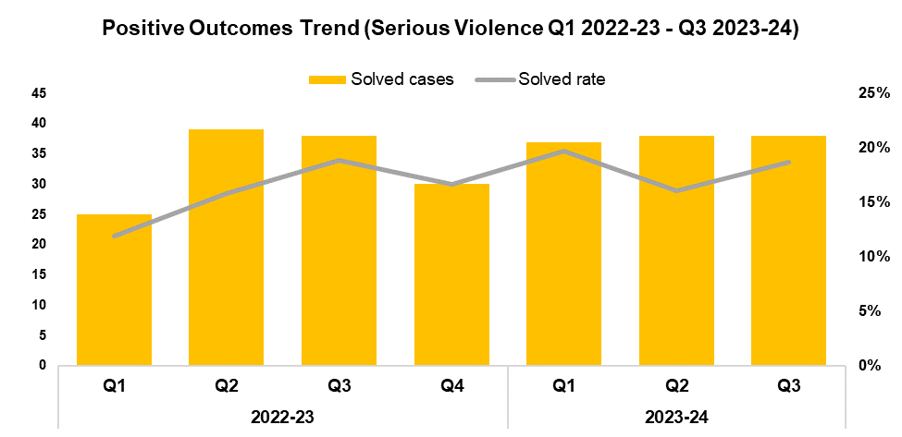
2. Serious Violence
Overview
Serious Violence offences consist of Section 18 Grievous Bodily Harm with Intent, Section 20 Malicious Wounding without Intent, and Personal Robbery. These offences have seen a reduction of 14.0% when compared to the quarter prior, with 33 fewer offences recorded for a total of 203. This decline disrupts the upward trend in offence volume observed following Q4 2022-23. A slight increase of 1.0% (two additional offences) can be observed when comparing Q3 2023-24 against the same quarter during the previous financial year, whereas a reduction of 4.7% (31 fewer offences) has been recorded when comparing the current FYTD against FYTD 2022-23.
When compared to the previous quarter, the solved rate for Serious Violence offences has increased by 2.6 percentage points to 18.7%, albeit with an equal number of crimes solved at 38. The solved rate for Q3 2023-24 has fallen by 0.2 percentage points when compared to the same quarter during the previous financial year, again with an equal number of crimes solved. Conversely, an increase of 2.5 percentage points can be observed when comparing the solved rate for the current FYTD against FYTD 2022-23, with 11 additional crimes solved.

Slide 13
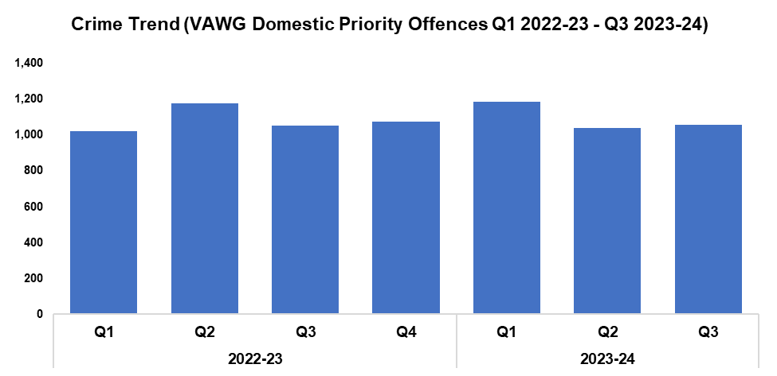
3. VAWG Domestic Priority Offences
Overview
The adjacent chart displays the number of combined Violence against Women and Girls (VAWG) priority offences with a domestic abuse qualifier, and which have at least one female victim linked.*
During Q3 2023-24, 1,057 of these offences were recorded. This represents an increase of 1.5% (16 additional offences) when compared to the quarter prior.
An increase of 0.6% (six additional offences) can be observed when comparing Q3 2023-24 against the same quarter during the previous financial year, with a similar increase of 1.0% (33 additional offences) recorded when comparing the current FYTD against FYTD 2022-23
728 females have been linked as a victim in more than one VAWG domestic priority offence within the last 12 months,** whereas 16 females have been linked as a victim in five or more separate offences.
In the last 12 months,** there were 415 female offenders and 2,695 male offenders linked to domestic priority offences against females.
*Domestic priority areas include Homicide, Violence with Injury, Stalking and Harassment, Public Fear , Alarm or Distress, Rape, Other Sexual Offences, and Modern Slavery.
**Up to the end of Q3 2023-24

Slide 14
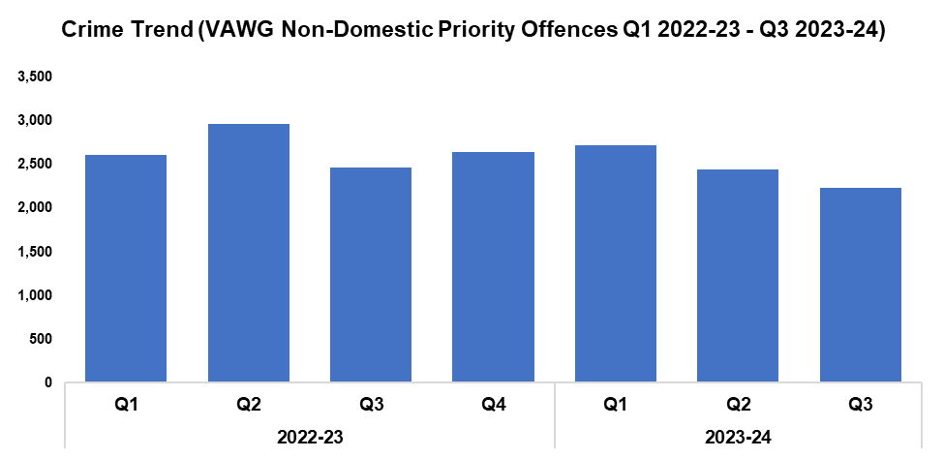
4. VAWG Non-Domestic Priority Offences
Overview
The adjacent chart shows the number of combined VAWG priority offences that do not have a domestic abuse qualifier, and which have at least one female victim linked.*
During Q3 2023-24, 2,236 of these offences were recorded. This represents a reduction of 8.3% (203 fewer offences) when compared to the quarter prior.
A reduction of 9.3% (230 fewer offences) can be observed when comparing Q3 2023-24 against the same quarter during the previous financial year, with a similar reduction of 8.0% (644 fewer offences) recorded when comparing the current FYTD against FYTD 2022-23.
1,463 females have been linked as a victim in more than one VAWG non-domestic priority offence within the last 12 months,** whereas 63 females have been linked as a victim in five or more separate offences.
In the last 12 months,** there were 2,559 female offenders and 3,355 male offenders linked to non-domestic priority offences against females.
*Non-domestic priority areas include Homicide, Violence with Injury, Stalking and Harassment, Public Fear , Alarm or Distress, Rape, Other Sexual Offences, Modern Slavery, and Exploitation of Prostitution.
**Up to the end of Q3 2023-24

Slide 15
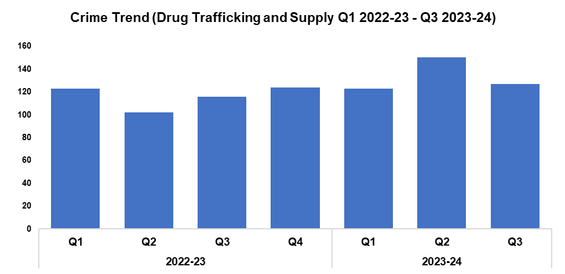
5. Drug Supply and Organised Crime
Overview
Drug Trafficking and Supply offences have seen a reduction of 15.3% when compared to the quarter prior, with 23 fewer offences recorded for a total of 127.
Conversely, an increase of 9.5% (11 additional offences) can be observed when comparing Q3 2023-24 against the same quarter during the previous financial year. A more prominent increase of 17.3% (59 additional offences) has been recorded when comparing the current FYTD against FYTD 2022-23, owing to the elevated levels reported during Q2 2023-24.
2,073 Drug Supply and Dealing intelligence logs were submitted during Q3 2023-24. This is an increase of 29.0% (466 additional logs) when compared to the quarter prior, and represents the highest quarterly total within the timeframe.
An increase of 44.8% (641 additional logs) can be observed when comparing Q3 2023-24 against the same quarter during the previous financial year, with a less prominent increase of 15.9% (721 additional logs) recorded when comparing the current FYTD against FYTD 2022-23.
Operation Forester commenced in the East Local Policing Area (LPA), following the discovery of several cannabis cultivations within disused buildings in Newport City Centre. To date, 14 cannabis cultivations have been located, which are estimated to have caused the National Grid a loss of £1.5 million. Nine investigations are currently ongoing, and 17 arrests have been made. 11,400 plants have been recovered so far, with the total value of recovered assets estimated to be between £2.5 million and £7.5 million.
A warrant was executed in Ringland, Newport, which resulted in two arrests and the seizure of a large amount of heroin. Both suspects have since been charged and remanded for drug offences. Another warrant under the Misuse of Drugs Act was executed at an address in Caldicot, Monmouthshire, resulting in the location of a cannabis cultivation. A male was arrested, charged, and has pleaded guilty to drug production offences. On the 18th of January he was sentenced to 28 months imprisonment.
The Organised Crime Unit have conducted a number of robust investigations over the the last quarter, resulting in significant seizures of controlled drugs and assets. These include:
Operation Silver, the dismantling of an OCG which was completed during December 2023. A total of 13 suspects were charged in relation to the supply of heroin, cocaine and MDMA from several addresses across Gwent, with nine suspects being placed on remand. One suspect was arrested in Cambodia for an unconnected matter, with arrangements in hand to extradite them back to the UK.
Operation Mayland, a large-scale enforcement operation which took place on the 5th of December 2023. This resulted in four men being charged and remanded for conspiracy to supply wholesale quantities of cocaine, along with the seizure of £242,000 in cash. The principal offender was also charged with being concerned in the supply of 28kg of cocaine and 17kg of heroin.

Slide 16
Support Victims and Protect the Vulnerable
Hate Crime
Rape
Domestic Related Crime
Domestic Abuse Repeat Victims/Offenders
Modern Day Slavery and Human Trafficking
Child Sexual Exploitation/Child Criminal Exploitation
Cyber Fraud
Victim Support/Repeat Victims
Key Commitments
Improve victim services and ensure that the needs of victims are identified and responded to appropriately through Connect Gwent and the Victim Care Unit.
Further improve our work with partners to protect those most vulnerable.
Increase the timeliness of police investigation updates provided to victims.
Commission and invest in specialist services to support victims throughout the criminal justice process.

Slide 17
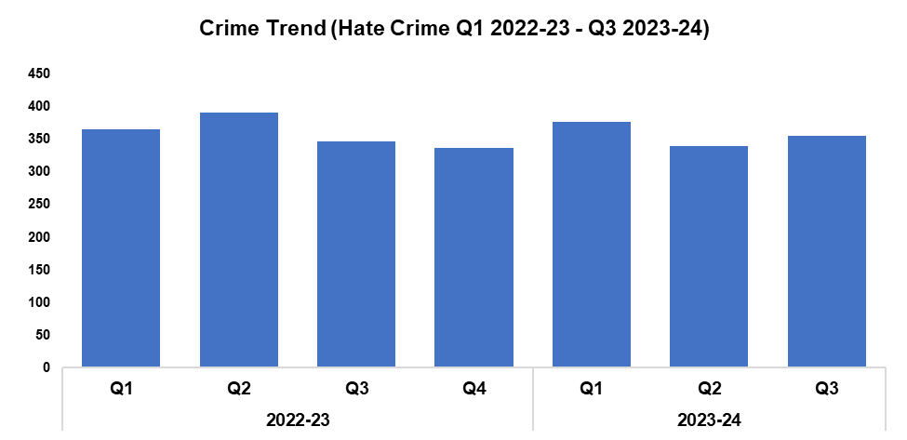
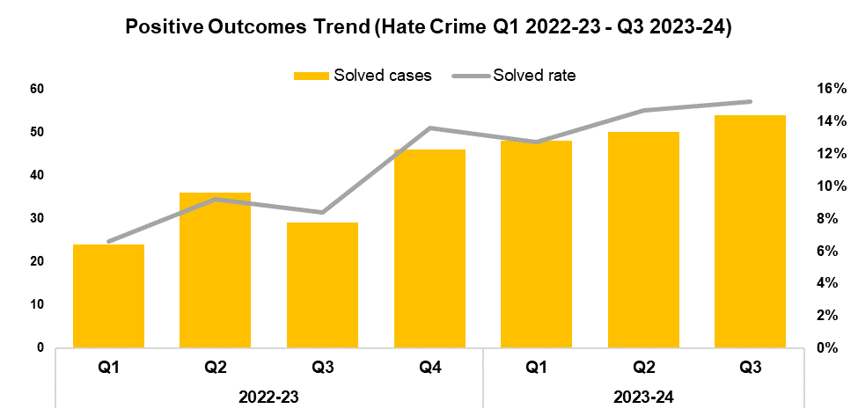
1. Hate Crime
Overview
The volume of offences classified as hate crimes has risen by 4.4% when compared to the quarter prior, with 15 additional offences recorded for a total of 355. An increase of 2.3% (eight additional offences) can be observed when comparing Q3 2023-24 against the same quarter during the previous financial year, whereas a reduction of 2.8% (31 fewer offences) has been recorded when comparing the current FYTD against FYTD 2022-23.
Offences containing the disability hate strand increased by 39.7% when compared to the quarter prior, with 23 additional crimes recorded for a total of 81.
Offences containing the racial hate strand have increased by 2.1% when compared to the quarter prior, with four additional crimes recorded for a total of 194.
Offences containing the religious hate strand have increased by 66.7% when compared to the quarter prior, with eight additional crimes recorded for a total of 20.
Offences containing the transphobic hate strand increased by 8.3% when compared to the quarter prior, with one additional crime recorded for a total of 13.
Offences containing the homophobic hate strand have decreased by 3.5% when compared to the quarter prior, with two fewer crimes recorded for a total of 56.
When compared to the quarter prior, the solved rate for offences classified as hate crimes has increased by 0.5 percentage points to 15.2%, with four additional crimes solved for a total of 54. This represents the highest quarterly solved rate within the timeframe. The solved rate for Q3 2023-24 is 6.8 percentage points above that recorded for the same quarter during the previous financial year, with 25 additional crimes solved. A rise of 6.1 percentage points can be observed when comparing the current FYTD against FYTD 2022-23, with 63 additional crimes solved.
A single crime can have multiple hate strands. The crime trend is based on recorded crimes, whilst the breakdown by hate strand is based on the volume of each individual strand.

Slide 18
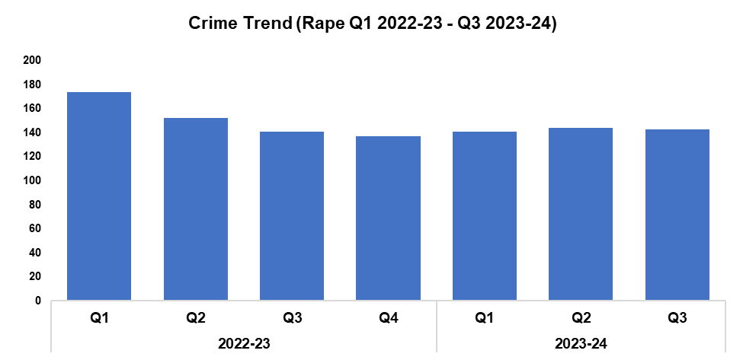
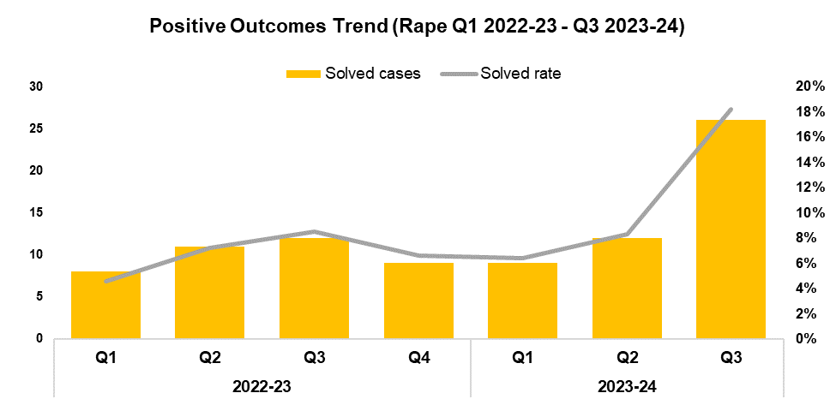
2. Rape
Overview
Rape offences have seen a reduction of 0.7% when compared to the quarter prior, with one fewer offence recorded for a total of 143. Whilst minor, this reduction disrupts the upward trend in offence volume observed following Q4 2022-23, and runs counter to the goal of increased reporting stipulated in the government’s Beating Crime Plan. An increase of 1.4% (two additional offences) can be observed when comparing Q3 2023-24 against the same quarter during the previous financial year. Conversely, a reduction of 8.4% (39 fewer offences) has been recorded when comparing the current FYTD against FYTD 2022-23, owing to the elevated levels observed during Q1 2022-23.
When compared to the previous quarter the solved rate for Rape offences has risen by 9.9 percentage points to 18.2%, with 14 additional crimes solved for a total of 26. This represents the highest quarterly solved rate within the timeframe by a significant margin. A similar increase of 9.7 percentage points (14 additional crimes solved) can be observed when comparing Q3 2023-24 against the same quarter during the previous financial year, with a less prominent increase of 4.4 percentage points recorded when comparing the current FYTD against FYTD 2022-23 (16 additional crimes solved).

Slide 19
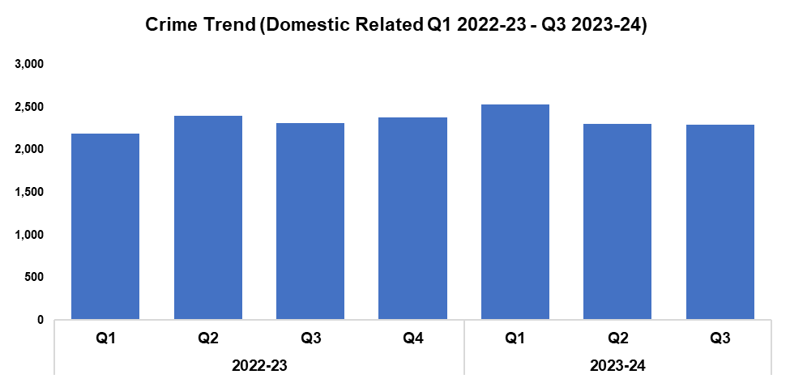
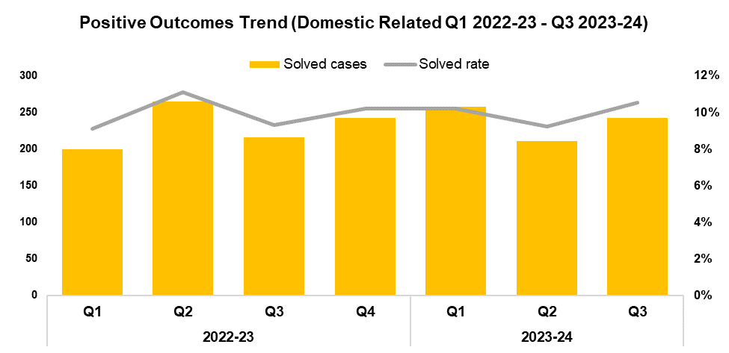
3. Domestic Related Crime
Overview
Domestic related offences have seen a reduction of 0.3% when compared to the quarter prior, with seven fewer offences recorded for a total of 2,295. A similar reduction of 0.9% (21 fewer offences) can be observed when comparing Q3 2023-24 to the same quarter during the previous financial year. Conversely, an increase of 3.2% (224 additional offences) has been recorded when comparing the current FYTD against FYTD 2022-23, owing to the elevated levels observed during Q1 2023-24.
When compared to the previous quarter the solved rate for domestic related offences has increased by 1.3 percentage points to 10.5%, with 31 additional crimes solved. An increase of 1.2 percentage points (26 additional crimes solved) can be observed when comparing Q3 2023-24 against the same quarter during the previous financial year, with a less prominent increase of 0.1 percentage points (30 additional crimes solved) recorded when comparing the current FYTD against FYTD 2022-23.
The Domestic Abuse (DA) champions initiative was re-launched in January 2024, following an intensive training programme based around the DA Matters course offered by SafeLives. This is a voluntary role, with all candidates signing a pledge of commitment. All DA champions are issued a lanyard, pin badge and epaulettes where available, in order to make them readily recognisable. There are currently 81 DA champions in the force, with an additional 822 staff receiving the DA Matters training. This training has generated further interest in the initiative, with two additional DA champions training days being populated, and 48 candidates currently on a waiting list. As a result, it is likely that the initial goal of 100 DA champions will be exceeded. A space has been established for the DA champions to maximise their continuous professional development, share experiences, and ask questions of both trainers and colleagues. It is hoped that a similar space will be established with SafeLives. The initiative has been met with a positive response from our partners, including BAWSO, Cyfannol, and Llamau, who are supportive of Gwent Police’s approach to DA, and have gone as far as to volunteer the use of their offices in Newport as a safe space in which officers can meet with victims.

Slide 20
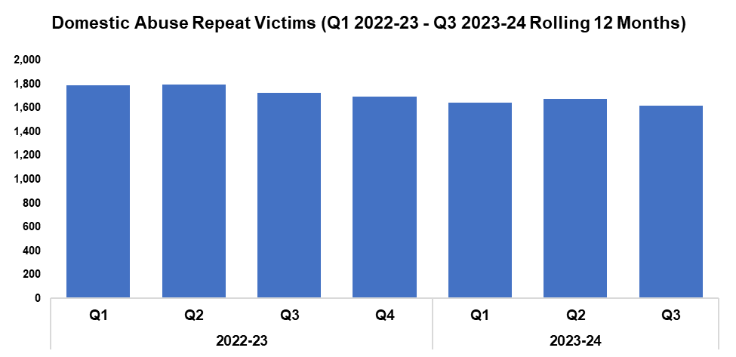
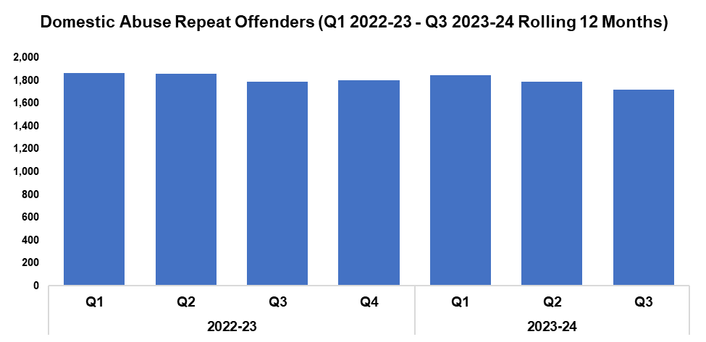
4. Domestic Abuse Repeat Victims/Offenders
Repeat Victims Overview
The number of repeat domestic abuse victims* has decreased by 3.3% when compared to the quarter prior, with 56 fewer repeat victims recorded for a total of 1,621. This represents the lowest quarterly total within the timeframe. When comparing Q3 2023-24 against the same quarter during the previous financial year, a reduction of 6.1% (106 fewer repeat victims) can be observed, with a similar reduction of 7.0% (370 fewer repeat victims) recorded when comparing the current FYTD against FYTD 2022-23.
*Based on rolling 12 months to the end of each quarter, where persons are linked to two or more crimes within this period.
Repeat Offenders Overview
The number of repeat domestic abuse offenders* has decreased by 3.9% when compared to the quarter prior, with 70 fewer repeat offenders recorded for a total of 1,721. This represents the lowest quarterly total within the timeframe. When comparing Q3 2023-24 against the same quarter during the previous financial year, a reduction of 3.7% (66 fewer repeat offenders) can be observed. A similar reduction of 2.7% (150 fewer repeat offenders) has been recorded when comparing the current FYTD against FYTD 2022-23.
There is a Multi-Agency Tasking and Coordination (MATAC) process in place which focuses on identifying serial perpetrators of domestic abuse, in order to limit the risk of them reoffending. A range of interventions can be delivered via MATAC to safeguard victims and families, including support, prevention, diversion, disruption, and enforcement.
*Based on rolling 12 months to the end of each quarter, where persons are linked to two or more crimes within this period.

Slide 21
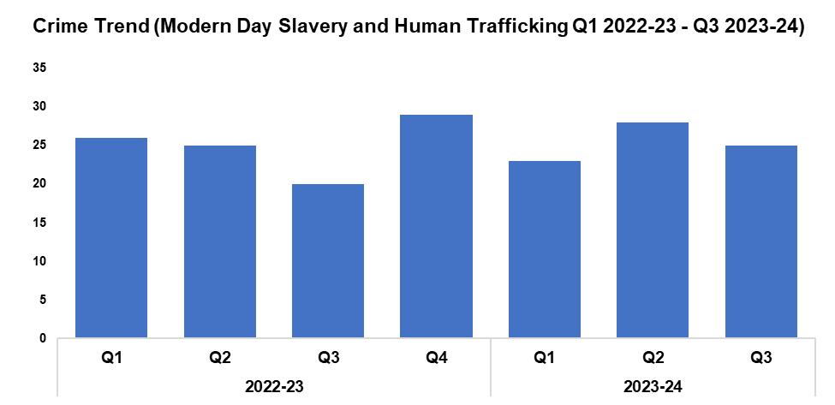
5. Modern Day Slavery and Human Trafficking
Overview
Modern Day Slavery and Human Trafficking offences have seen a reduction of 10.7% when compared to the quarter prior, with three fewer offences recorded for a total of 25. Conversely, an increase of 25.0% (five additional offences) can be observed when comparing Q3 2023-24 against the same quarter during the previous financial year, with a less prominent increase of 7.0% (five additional offences) recorded when comparing the current FYTD against FYTD 2022-23.
Awareness training is being delivered to new starters, new community support officers, and trainee detectives.
The number of National Referral Mechanisms submitted has fallen by 10.3% during Q3 2023-24 when compared to the quarter prior, with three fewer referrals submitted for a total of 26. A further reduction of 10.6% can be observed when comparing the current FYTD against FYTD 2022-23, with nine fewer referrals submitted for a total of 76.
Project Terminus is a Home Office funded initiative that seeks to disrupt organised immigration crime committed by users of road networks, who smuggle or traffic clandestine migrants into the UK from Europe by targeting lorry drivers and haulage companies. The Modern Day Slavery Team secured funding from the Home Office to conduct five proactive, high visibility deployments. They were supported in this by RPSO officers, as well as representatives from Immigration Enforcement and staff from the Driver and Vehicle Standards Agency. Further applications for funding have been made to the Home Office, in order to facilitate additional deployments. The aim of these deployments is to identify and arrest the facilitators and perpetrators of people smuggling and trafficking, disrupting as yet unidentified OCGs whilst also safeguarding victims.
The five deployments resulted in 231 lorries being stopped, the vast majority of which were foreign-registered cabs and trailers. Each driver was spoken with and had their documents checked. They were also reminded of the dangers and penalties they would face should they agree to transport people into the UK illegally in exchange for money. Their trailers were examined for any indication of tampering, with the drivers also opening the trailers to check for the presence of migrants. The vast majority of drivers have seemingly welcomed the interest.
One driver was arrested for working in the UK illegally and returned to Romania the following day. A subsequent investigation has been launched, as he was employed by a UK based agency.
Clandestine migrants can be individuals or family units, and Gwent Police have previously encountered, men, women, and children of all ages. Some were in very poor physical condition, potentially due to existing health problems, but in any event these were exacerbated by being hidden within a lorry trailer. Some migrants are concealed within curtain-sided trailers with access to fresh air and small amounts of room to move, whereas others may be concealed in metal containers or in refrigerated units where the availability of air is very limited. In any event, it is extremely dangerous for the people being moved.

Slide 22
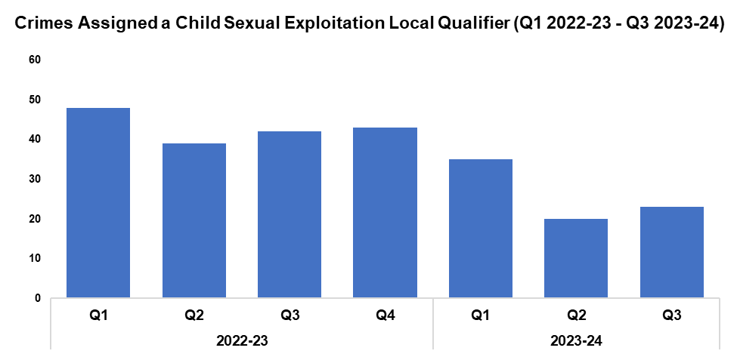
6. Child Sexual Exploitation/Child Criminal Exploitation
Overview
The number of crimes assigned a Child Sexual Exploitation (CSE) local qualifier has increased by 15.0% when compared to the quarter prior, with three additional crimes recorded for a total of 23. Whilst this disrupts the downward trend in offence volume observed following Q4 2022-23, it remains the second-lowest quarterly figure within the timeframe. A substantial reduction of 45.2% (19 fewer crimes) can be observed when comparing Q3 2023-24 against the same quarter during the previous financial year, with a similar reduction of 39.5% (51 fewer crimes) recorded when comparing the current FYTD against FYTD 2022-23.
The offence most commonly assigned a CSE local qualifier during Q3 2023-24 was Take/make indecent photographs/pseudo-photographs of children, with 11 instances. This accounts for 47.8% of all crimes assigned a CSE local qualifier during the quarter.
As with other forces, Gwent Police have seen an increase in reports of students vaping tetrahydrocannabinol (THC) in an education establishment. This has resulted in sickness, and on occasion loss of consciousness and hospitalisation. The majority of reports have indicated that the child has had no knowledge of the vape containing any form of illegal substance. In light of this the spiking protocol has been followed, with positive action taken against the offender.
Gwent Police are aware that these vapes are being utilised as a tool for exploitation. As such, all recent cases of spiking via vape have been brought to the attention of the Exploitation Team. Operation Quartz has sought to ensure that urgent action has been taken to safeguard children against the risks associated with obtaining controlled drugs, with disruption tactics being utilised against offenders to remove their capability to supply these drugs to children. In addition to this, school liaison officers have been tasked with identifying a single point of contact within education establishments, in order to assist in delivering a Prevent/Protect/Prepare response to any suspected drug supply.
During Operation Chestnut the Public Protection Unit worked alongside the Serious Organised Crime Team to disrupt criminal exploitation, following an incident in which a 12-year-old was admitted to hospital after suffering adverse effects from a THC-laced vape in an education establishment. The ensuing investigation was led by the Exploitation Team and highlighted a drugs line, along with the exploitation of other children, with links throughout the West LPA and Newport. As a result, two adults were arrested and a warrant was executed at their home address. Both subjects were subsequently charged with 19 drug related offences, with one offender being remanded in custody.

Slide 23
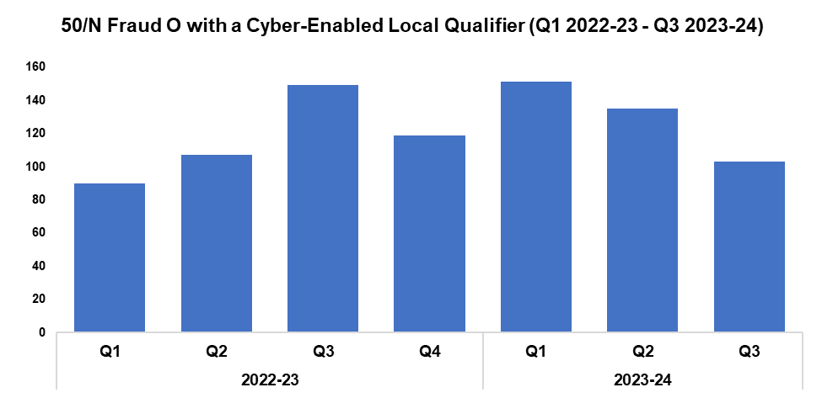
7. Cyber Fraud
Overview
Of the 1,538 Action Fraud occurrences reported to Gwent Police via the National Fraud Intelligence Bureau since Q1 2022-23, 55.5% (854 occurrences) have been assigned a cyber-enabled local qualifier.
When compared to the quarter prior, the number of Action Fraud occurrences assigned a cyber-enabled local qualifier has fallen by 23.7%, with 32 fewer occurrences reported for a total of 103. This continues to downward trend observed for this metric following Q1 2023-24. A more prominent reduction of 30.9% (46 fewer occurrences) can be observed when comparing Q3 2023-24 against the same quarter during the previous financial year. Conversely, an increase of 12.4% (43 additional occurrences) has been recorded when comparing the current FYTD against FYTD 2022-23.

Slide 24
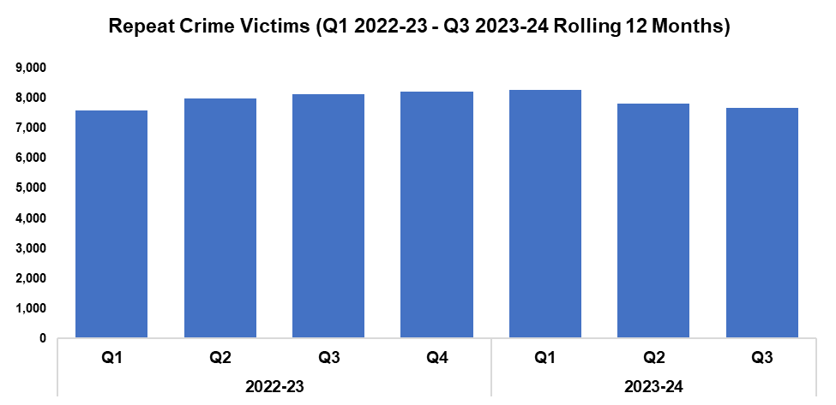
8. Victim Support/Repeat Victims
Overview
In this context, a repeat crime victim refers to an individual who has been linked as a victim in two or more crimes within a 12-month rolling period.
The number of repeat crime victims has fallen by 1.8% during Q3 2023-24* when compared to the quarter prior, with 138 fewer repeat victims recorded for a total of 7,673.
A more prominent reduction of 5.8% (473 fewer repeat victims) can be observed when comparing Q3 2023-24 against the same quarter during the previous financial year. Conversely, a slight increase of 0.2% (36 additional repeat victims) has been recorded when comparing the current FYTD against FYTD 2022-23.
The West LPA safeguarding hub completed 761 strategy discussions during Q3 2023-24, including 177 urgent strategy discussions. This had led to 214 strategy meetings, and 150 joint visits completed by officers.
*Based on the rolling 12 months to the end of the quarter.

Slide 25
Increase Community Confidence in Policing
Perceptions Survey: Local Concerns and Overall
Victim Satisfaction
Representative Workforce
Investigation Timeliness
Response Rates
999 Demand
101 Demand
Social Media and Single Online Home
Initiatives & Events
Key Commitments
Increase the effectiveness of officer and staff engagement with residents in their communities, and community confidence and trust in Gwent Police.
Improve the accessibility of neighbourhood police teams through a variety of contact channels that meet the needs of the public.
Increase reporting of crime by communities that are less likely to engage with the police.
Further increase officer and staff diversity to ensure our police service reflects the communities that we serve.

Slide 26
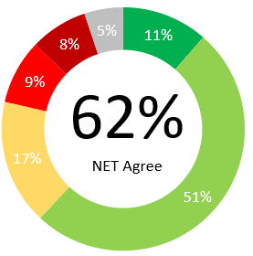
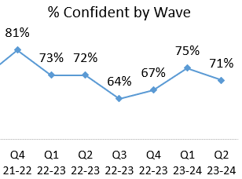
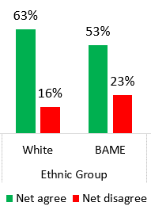
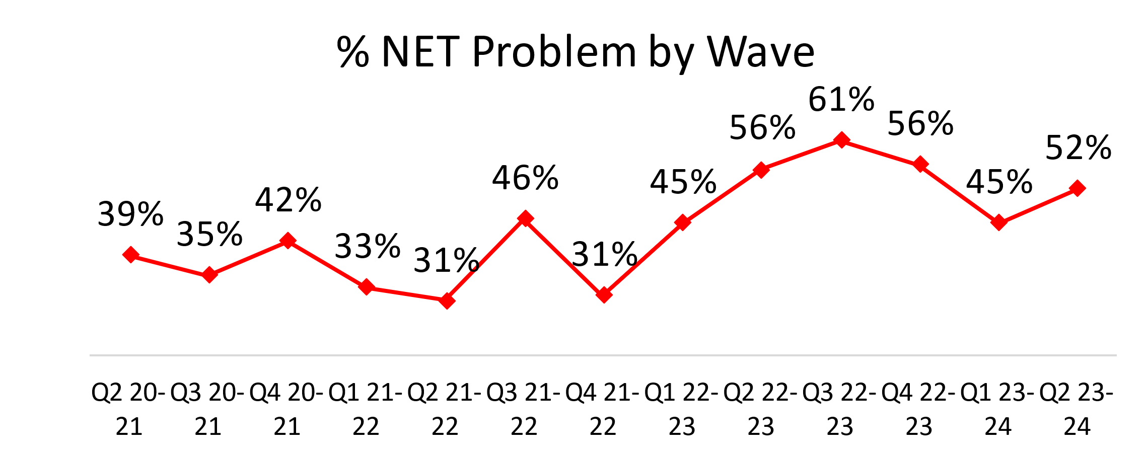
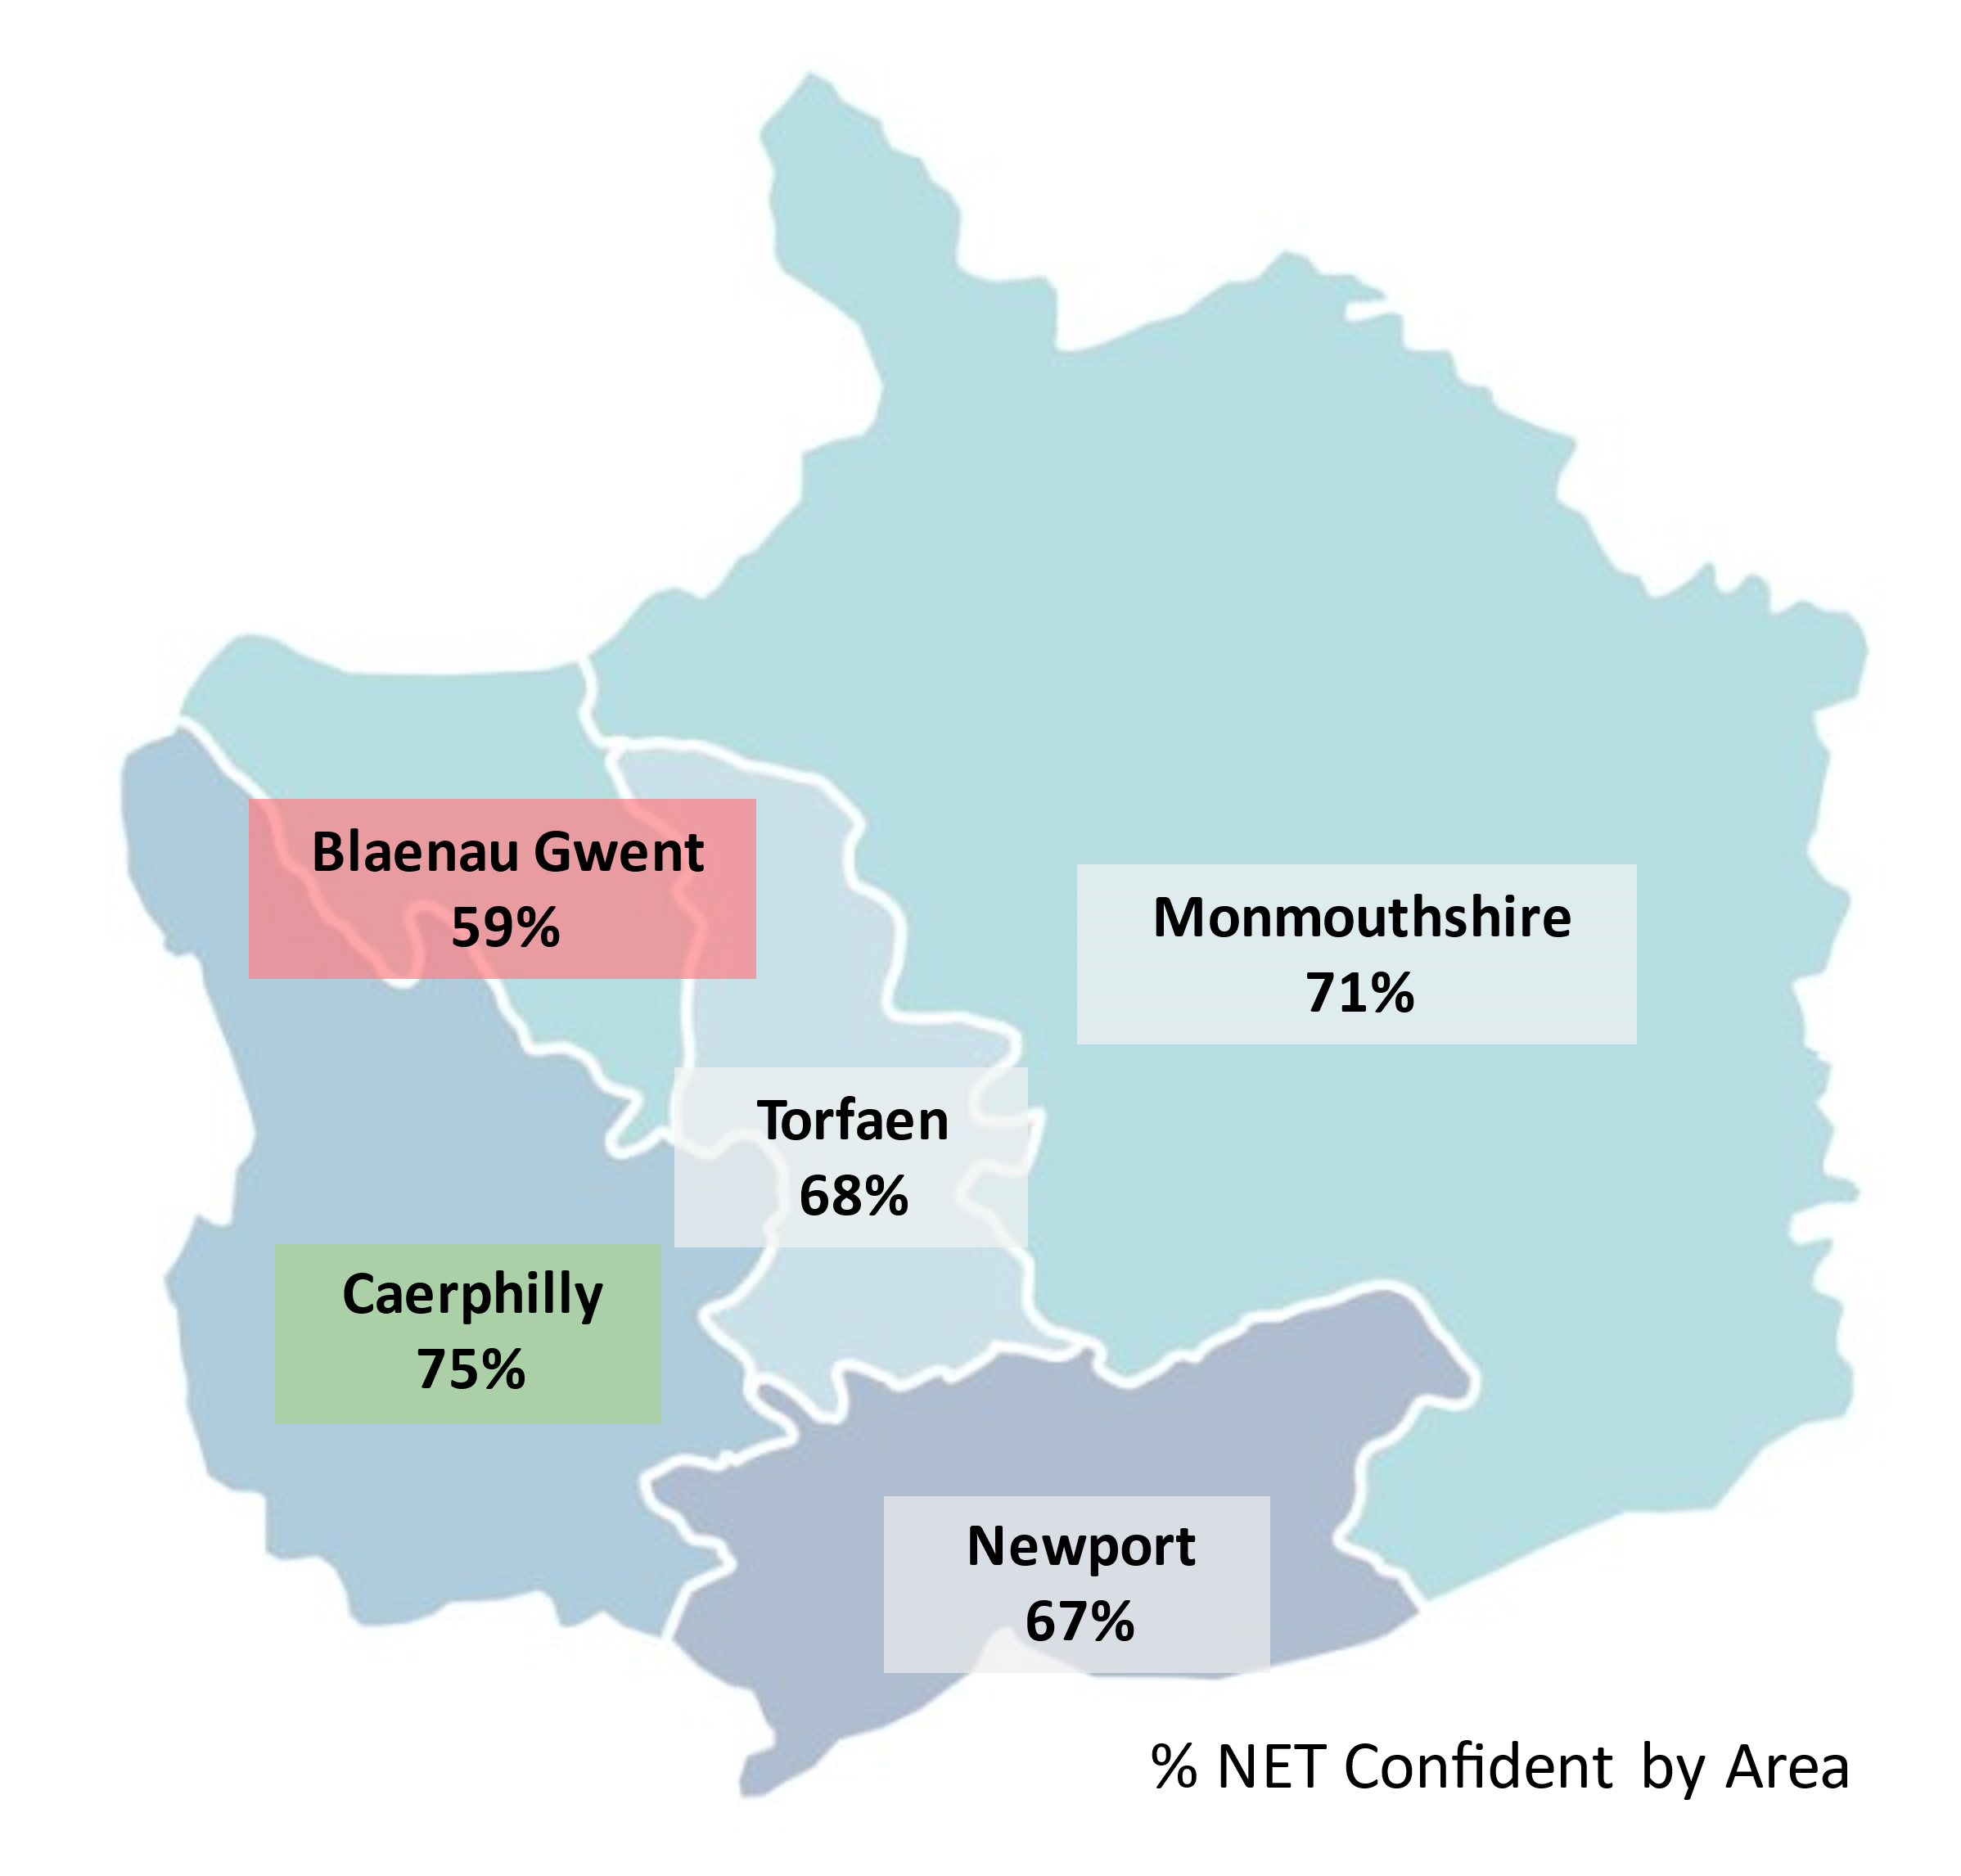
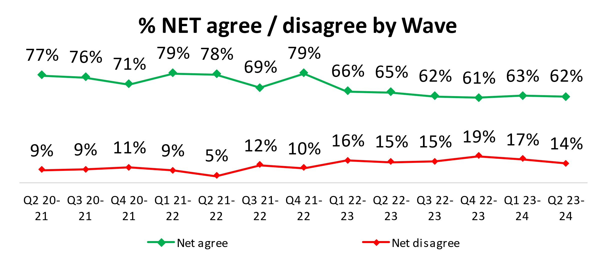
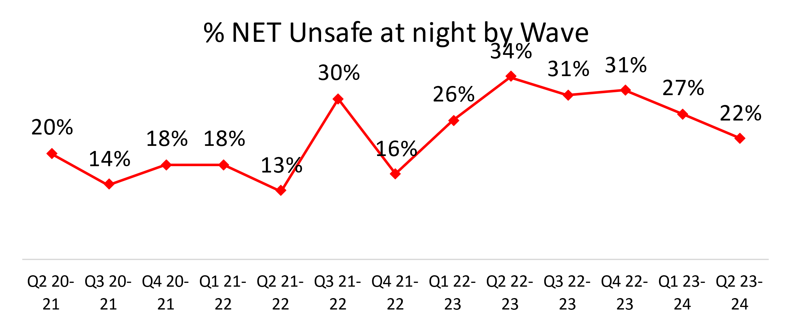
1. Perceptions Survey: Local Concerns and Overall
Overall Confidence in the Police
Local Concerns
Positive Experiences
“I think they are because when there have been issues the police were here asking questions and making sure we are all ok.”
“Because when they have been called, they are very effective.”
“Recently they got rid of the drug dealing which I think is a good start to improving the area.”
Nearly two thirds (62%) of people agree they have confidence in the police in their area. This is lowest in Blaenau Gwent (50%) and highest in Caerphilly (67%).
Just over half of residents (52%) feel that crime and ASB are a problem in their area.
This metric has seen an increase after a reduction across two consecutive quarters. Caerphilly (62%) is the area of highest concern whereas Monmouthshire (31%) has the lowest perceived concern.
Over two thirds of residents are confident they could easily speak to police in their area, reducing by four percentage points on the previous quarter.
Ethnic minority groups have less confidence in this statement, with 53% agreeing they have confidence in police in their area.
Lack of action
“They are aware of issues but do nothing about it because they don't have the manpower to do it.”
“I never see the police in this area so I don't know how they can know about issues or be dealing with them.”
“Every time I call the police about something nothing gets done and the issue doesn't get resolved.”
Minority
22% of residents felt unsafe at night. Blaenau Gwent (33%) and Caerphilly (31%) felt the most unsafe, whereas Monmouthshire (15%) felt the safest. This geographic trend is similar to the level of concern regarding ASB and Crime.
A downward trend is apparent, with overall confidence dropping from 79% in Q4 2021-22 through to 62% in Q2 2023-24.
14% disagree that they have confidence in the police in their area.
For the above statement, Blaenau Gwent had the lowest confidence (59%) whilst Caerphilly had the highest confidence (75%).
3.0% have been a victim of crime and did not report to Gwent Police. If applied across the population of Gwent, this would equate to 17,631 individuals.
“Because I was afraid of the consequences.”

Slide 27
2. Victim Satisfaction
Percentage | Measure
Survey Number | Survey One | Survey Two |  |  |  | Survey Three
Metric | Satisfied with Initial Contact | Satisfied with Follow Up & Investigation | Satisfied with the service from the VCO | Satisfied with the service from the officer dealing with your case | Satisfied with being kept informed about your case | Satisfied with Post Charge
General Crime | 60% | 56% | 87% | 76% | 76% | 40%
Domestic Violence | 75% | 79% | 96% | 84% | 83% | 100%
Hate Crime | 100% | 67% | 100% | 100% | 100% | No Data
Sexual Violence | 100% | 80% | 100% | 80% | 100% | No Data
Baseline | N/A | N/A | 85% | 85% | 74% | N/A
Numeric | Measure
Survey Number | Survey One | Survey Two |  |  |  | Survey Three
Metric | Satisfied with Initial Contact | Satisfied with Follow Up & Investigation | Satisfied with the service from the Victim Care Officer | Satisfied with the service from the officer dealing with your case | Satisfied with being kept informed about your case | Satisfied with Post Charge
General Crime | 684/1149 | 56/100 | 48/55 | 38/50 | 39/51 | 2/5
Domestic Violence | 45/60 | 26/33 | 25/26 | 21/25 | 19/23 | 7/7
Hate Crime | 11/11 | 2/3 | 3/3 | 3/3 | 3/3 | No Data
Sexual Violence | 9/9 | 4/5 | 5/5 | 4/5 | 4/4 | No Data
Sample Size | 1,251 | 141 | The above questions can be answered with ‘N/A’. These responses have been removed from both the percentage and numeric calculations. As a result, the sample size will differ from that for ‘Satisfied with Follow Up & Investigation’. |  |  | 12

Slide 28
3. Representative Workforce
The following data is correct as of 31st December 2023
Actual FTE v Establishment FTE Variance is calculated by subtracting the Actual FTE From the Establishment Budget FTE, except for Special Constable, Agency Worker, Cadets and Volunteers which are calculated by subtracting Establishment Budget FTE from Headcount.
Overview
There is a gender disparity evident in the workforce for both officers and staff. For officers, females are underrepresented by approximately 14 percentage points (females account for 51% of the population in Gwent based on the 2021 Census). However, females are overrepresented in the staff workstream area by approximately 17 percentage points.
There is also a disparity in the minority ethnic representation within the workforce. In Census 2021, 8.6% of the Gwent population (5.6% in Census 2011) are from an ethnic minority background, which includes individuals in the following ethnic groups: Asian, black, mixed, other, and white minorities. The above table groups this differently, with white including white minorities (Gypsy, Roma and Irish Traveller groups, Irish and any other white background). In Census 2021, 5.8% of the Gwent population (3.9% in Census 2011) are from an ethnic background other than white. For police officers, currently 3.6% are from an ethnic group other than white. Ethnic minority representation in staff is lower at 1.9%.

Slide 29
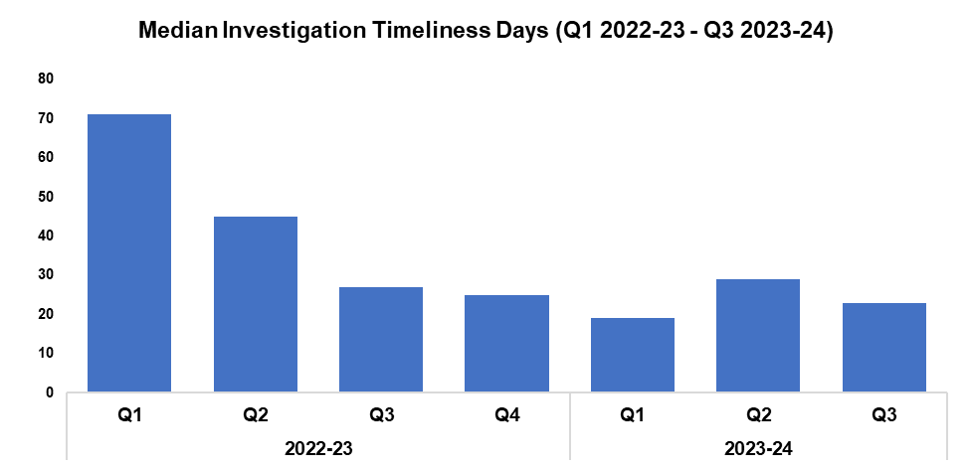
4. Investigation Timeliness
Overview
The median number of days within which an investigation is completed has fallen by 20.7% when compared to the previous quarter, down by six days to 23. A less prominent reduction of 14.8% (four fewer days) can be observed when comparing Q3 2023-24 against the same quarter during the previous financial year.
A substantial reduction of 50.3% (72 fewer days) has been recorded when comparing the current FYTD against FYTD 2022-23. This is due to the elevated investigation times observed during quarter one and quarter two of 2022-23, on account of a backlog of occurrences which were awaiting finalisation by the Crime Management Unit.
As of Q3 2023-24, there are 14,440 crimes classified as open and unfinalised (excluding pending finalisation). This represents a reduction of 5.3% (816 fewer crimes) when compared to the quarter prior.
Of the 14,440 open and unfinalised crimes, 11,913 are currently under investigation. Of these 7,600 crimes have been open for less than six months, 2,100 have been open for between six and 12 months, and 2,213 have been for open for over 12 months.
Of those crimes which have been for open for over 12 months, Violence without Injury offences are the most common, accounting for 20.2% of the total (448 crimes), followed by Rape offences, which account for 13.9 % of the total (308 crimes).

Slide 30
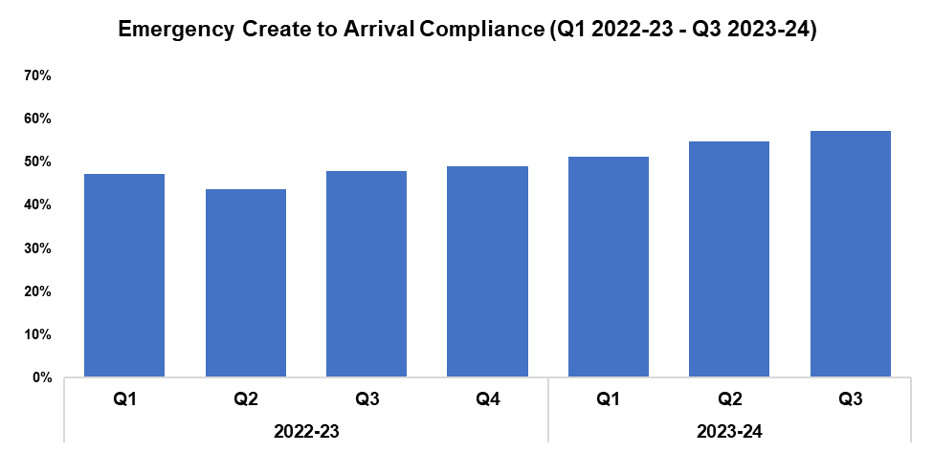
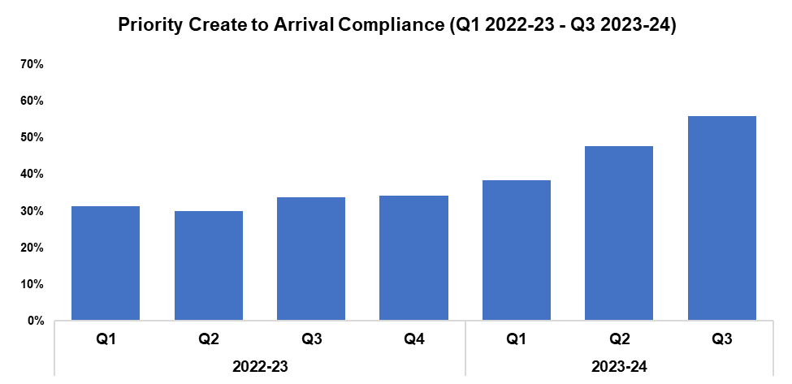
5. Response Rates
Overview
Based on the target arrival time of 15 minutes, emergency create to arrival compliance has increased by 2.5 percentage points when compared to the quarter prior, and currently stands at 57.4%. This represents the highest quarterly figure within the timeframe, continuing the upward trend observed for this metric following Q2 2022-23. Eight of the nine Gwent sectors recorded improvements in compliance when compared to the quarter prior. Emergency response compliance has increased by 9.4 percentage points when comparing Q3 2023-24 against the same quarter during the previous financial year, and by 8.2 percentage points to 54.6% when comparing the current FYTD against FYTD 2022-23.
Based on the target arrival time of one hour, priority create to arrival compliance has increased by 8.3 percentage points when compared to the quarter prior, and currently stands at 56.0%. This represents the highest quarterly figure within the timeframe, continuing the upward trend observed for this metric following Q2 2022-23. All Gwent sectors recorded improvements in compliance when compared to the quarter prior. Priority response compliance has increased by 22.2 percentage points when comparing Q3 2023-24 against the same quarter during the previous financial year, and by 15.6 percentage points to 47.3% when comparing the current FYTD against FYTD 2022-23.

Slide 31
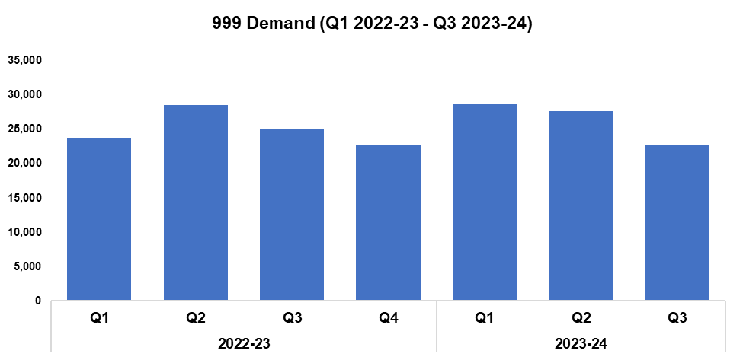
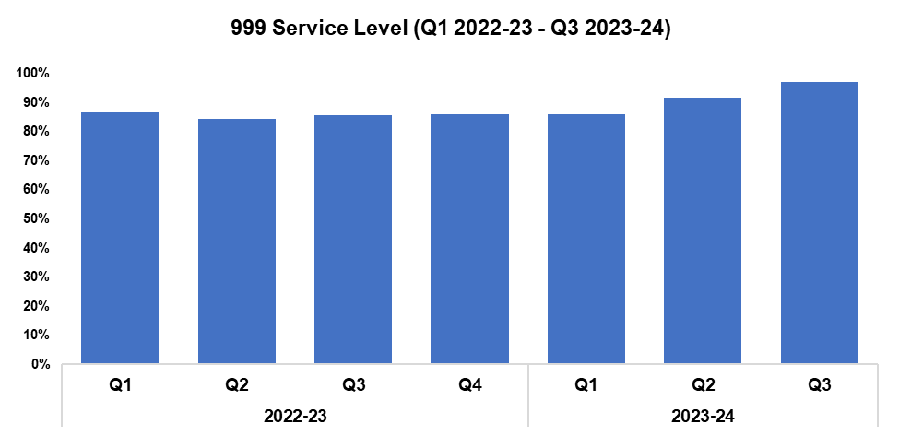
6. 999 Demand
Overview
999 demand has decreased by 17.3% when compared to the quarter prior, with 4,777 fewer calls received for a total of 22,823. A less prominent reduction of 8.5% (2,117 fewer calls) can be observed when comparing Q3 2023-24 against the same quarter during the previous financial year. Conversely, an increase of 2.5% (1,943 additional calls) has been recorded when comparing the current FYTD against FYTD 2022-23.
999 service level (the percentage of calls answered within 10 seconds) has improved when compared to the quarter prior, rising by 5.3 percentage points to 97.1%, the highest quarterly figure within the timeframe. A more prominent increase of 11.5% can be observed when comparing Q3 2023-24 against the same quarter during the previous financial year, whilst the service level has risen by 5.3% to 91.2% when comparing the current FYTD against FYTD 2022-23.
999 Average Answer Speed
(Minutes/Seconds)
The average answer speed for 999 calls during Q3 2023-24 was four seconds. This is an improvement of three seconds when compared to the quarter prior, and represents the lowest quarterly figure within the timeframe. 999 average answer speed has improved by seven seconds when comparing Q3 2023-24 against the same quarter during the previous financial year, with improvements also noted when comparing the current FYTD against FYTD 2022-23.

Slide 32
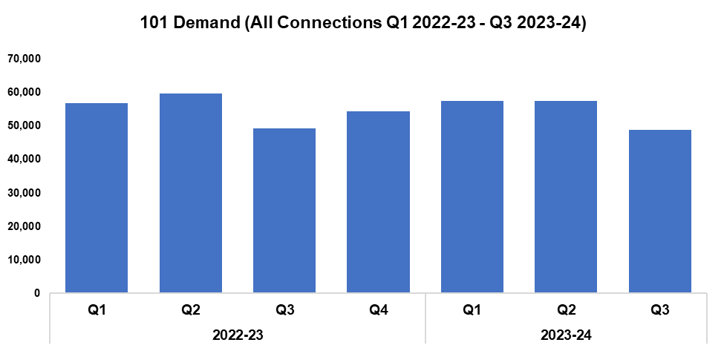
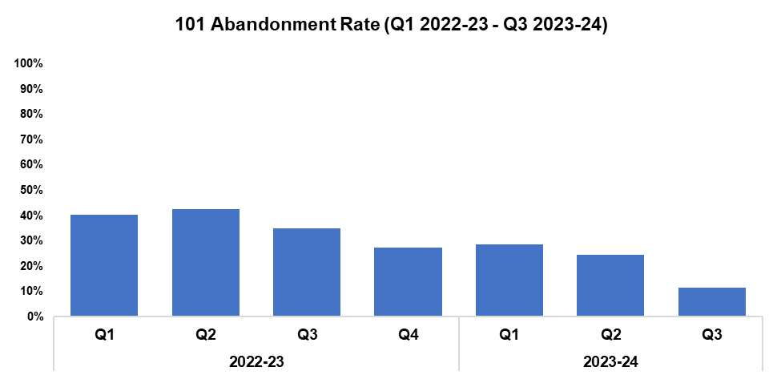
7. 101 Demand
Overview
101 demand (all connections) has decreased by 14.9% when compared to the quarter prior, with 8,585 fewer calls received for a total of 48,881. This represents the lowest quarterly figure within the timeframe. A less prominent reduction of 0.9% (433 fewer calls) can be observed when comparing Q3 2023-24 against the same quarter during the previous financial year, with demand falling by 1.2% (2,061 fewer calls) when comparing the current FYTD against FYTD 2022-23.
The 101 abandonment rate has decreased by 13.0 percentage points when compared to the quarter prior, and currently stands at 11.4%. This represents the lowest quarterly figure within the timeframe. The 101 abandonment rate has also improved significantly when comparing Q3 2023-24 against the same quarter during the previous financial year (down 23.6 percentage points), and when comparing the current FYTD against FYTD 2022-23 (down 17.5 percentage points to 21.9%).
101 Average Answer Speed
(Minutes/Seconds)
The average answer speed for 101 calls during Q3 2023-24 was two minutes and 20 seconds, an improvement of two minutes and 45 seconds when compared to the quarter prior. This represents the fourth consecutive improvement in performance, and the lowest quarterly figure with the timeframe.
The average speed of answer has improved by seven minutes and 21 seconds when comparing Q3 2023-24 against the same quarter during the previous financial year. When comparing the current FYTD against FYTD 2022-23, the average answer speed has improved by three minutes and 18 seconds, down to four minutes and 35 seconds.

Slide 33
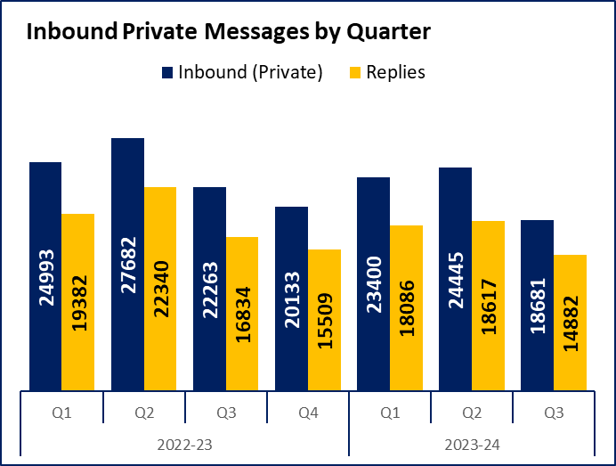
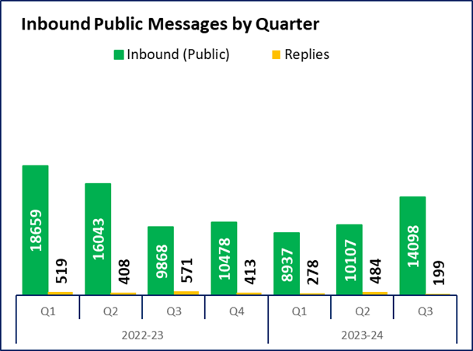
8. Social Media and Single Online Home
Overview
Inbound private messages received via Gwent Police’s social media platforms decreased by 23.6% during Q3 2023-24 when compared to the quarter prior, with 5,764 fewer messages received for a total of 18,681. In terms of inbound private message sources, 93.3% (17,432 messages) were received via Facebook platforms. Sundays saw the highest volume of inbound private messages, with a total of 2,912 received.
Inbound public messages received via Gwent Police’s social media platforms increased by 39.5% during Q3 2023-24 when compared to the quarter prior, with 3,991 additional messages received for a total of 14,098. In terms of inbound public message sources, 89.8% (12,657 messages) were received via Facebook platforms. Thursdays saw the highest volume of inbound public messages, with a total of 2,898 received.
This digital contact data includes our English and Welsh Facebook and X accounts.
2,883 Single Online Home (SOH) forms were submitted during Q3 2023-24, a reduction of 5.4% (163 fewer forms) when compared to the quarter prior. The continues the downward trend observed for this metric following Q4 2022-23.
The adjacent chart presents these forms by category, with the most numerous being crime reports (45.4% or 1,309 forms), followed by general ‘contact us’ messages (19.3% or 557 forms), and firearm licensing (11.8% or 340 forms). ‘Other’ includes forms with low volume, including events and processions, filming, fingerprints and IP licensing.

Slide 34
9. Initiatives & Events
Overview
The missing persons team have conducted a review of their practises, with changes being made to improve internal processes and provide a more effective and efficient service to communities.
A missing person fact sheet has been developed to assist practitioners and communities in understanding the roles and responsibilities of the police when a child or adult is reported missing. This fact sheet will be provided by front line officers to members of the community, along with a record of the occurrence number and the contact details of organisations and charities that may be able to provide support and guidance when needed.
A truancy procedure is being implemented to ensure that missing children correctly identified and classified. Work has been ongoing alongside the force control room and frontline supervisors to ensure that the correct classifications are applied. Collaborative work has been undertaken alongside representatives from education, with a guide being jointly devised and provided to practitioners. This guide details the expectations around actions to be completed prior to reporting a child missing.
A weekly missing meeting is held with the local authorities of Newport and Blaenau Gwent, attended by representatives from Gwent Police, social services, and education. During the meeting, a discussion is held concerning each child that has been reported missing that week, with subsequent monitoring continuing over a three-week period. The meeting is dynamic, looking to address any threat, risk or harm that has arisen during the week. The aim of the meeting is to break the cycle of missing incidents at an early juncture by recognising when a child is in crisis and needs support. This support can then be provided by utilising the appropriate referral pathway, or by allocating police resources to certain areas for disruption purposes. This work is ongoing, with the aim of providing the same service to the other three local authorities within Gwent over the coming weeks.
A retail crime operation was implemented in the East LPA between the 6th of November 2023 and the 24th of December 2023. A small, dedicated team of officers dealt with 392 incidents during this time, accounting for ten percent of all reported crime in the LPA and thus reducing the demand for front-line response officers. The operation contributed to a reduction in crime levels during December and an increase in criminal justice outcomes, with a total of 38 arrests made and 156 charges applied. It also led to increased victim engagement and satisfaction, as well as allowing the officers involved to further develop their investigative skills and their experience in working alongside key partner agencies.
Gwent Police are continuing to support the Mutual Aid to London on a regular basis as part of Operation Brocks. Significant planning is required to order to ensure that the required resources are deployed, whilst maintaining business as usual within Gwent.
Three consecutive football matches have been held within Gwent, attracting significant numbers of both home and away supporters to Newport City Centre. An unprecedented level of planning was required in order to support these events whilst keeping communities safe, minimising disruption, and maintaining business as usual across the force. The management of the first of these matches was particularly complex due a Pro-Palestinian protest, which was managed extremely well from resourcing, deployment, and community perspectives.

Slide 35
Professional Standards Department
PSD Total Recorded Complaint Allegations
PSD Schedule 3 and Non-Schedule 3 Complaint Cases
PSD Misconduct Cases
Vetting
Disproportionality

Slide 36
1. PSD Total Recorded Complaint Allegations
Overview
There has been a 23.0% reduction in complaint allegations received during Q3 2023-24 (n=326) when compared to Q2 2023-24 (n=426). This represents a significant decrease in complaint allegations when compared to the quarter prior.
The three categories of complaint with the greatest volume are as follows:
A1. Police action following contact 148
H3. Unprofessional attitude and disrespect 33
A3. Information 25
Within these sub-categories, notable reductions have been recorded when compared to the previous quarter:
There has been a decrease in A1. Police action following contact (n=148) when compared with the quarter prior (n=201).
There has been a decrease in H3. Unprofessional attitude and disrespect (n=33) when compared with the quarter prior (n=44).
There has been a decrease in A3. Information (n=25), when compared with the quarter prior (n=33).
Please note that multiple allegations can be recorded by one complainant.

Slide 37
2. PSD Schedule 3 and Non-Schedule 3 Complaint Cases
Overview
1) Schedule 3 - which relate to complaints dealt with under the Police Reform Act 2002, whereby the complainant can request a review if they are not satisfied.
2) Non-Schedule 3 - This allows complaints to be dealt with outside of the Police Reform Act 2002, previously regarded as ‘dissatisfaction’.
There was a slight decrease in Schedule 3 cases during Q3 2023-24 (n=37) when compared to the quarter prior (n=39). Non-Schedule 3 cases show a more significant reduction (n=149) when compared with the previous quarter (n=260) This decrease was expected, following the data cleansing and recalibration work undertaken during Q2 2023-24.
At the time the data was extracted there were 58 live Schedule 3 complaints and 23 live Non-Schedule 3 complaints. This is an increase when compared to the average live cases over the previous 12 months, attributable to some resourcing issues within the team throughout Q2 2023-24 and Q3 2023-24. The team is currently fully resourced and working through these cases.
Figures will contain cases with multiple allegations.

Slide 38
3. PSD Misconduct Cases
Overview
The upward trend in Misconduct Cases is consistent with the pattern within policing in England and Wales.
A more proactive approach to misconduct and counter-corruption intelligence gathering and investigation, coupled with more confidence in the workforce to report, has been the catalyst for this increase.
Gwent PSD have invested resources into both preventive work and support for victims and witnesses to police misconduct.
The total number of misconduct cases has remained consistent across the last four quarters of monitoring.
Q3 2023-24 Misconduct Outcomes
Within quarter three, there was an accelerated misconduct hearing held for a police constable who was convicted during a criminal investigation of six offences, namely; Coercive and Controlling Behaviour x 3, Stalking, and Threatening to Disclose an Intimate Photograph x 2. The officer did not attend proceedings. Chief Constable Kelly determined that the allegation was proven as gross misconduct, and that they would be dismissed without notice.
A gross misconduct hearing was held for a police constable who was alleged to have used excessive force against a detainee whilst in custody. The panel determined that the allegations were proven as gross misconduct, and the officer was dismissed without notice. The officer has since lodged an appeal under the Police Appeal Tribunals which is currently in its early stages.
A number of Misconduct Hearings and Meetings are scheduled to take place during the quarter four reporting period.

Slide 39
4. Vetting
Overview
Vetting figures are available from Q1 2021-22 onwards. Data is submitted a quarter behind, therefore Q3 2023-24 is not currently included.
Please note the new national categories for vetting refusals that will allow all forces to benchmark data and performance.

Slide 40
5. Disproportionality
Overview
The vetting disproportionality data is a new measure that will allow the force to track vetting refusals and appeal panel decisions across all areas of protected characteristics. As more data is gathered this will allow us to benchmark our figures against other Home Office forces.

