Slide 1
Organisational Performance against the PCC Priorities Report to the Assurance and Accountability Board
Quarter 2 2025-26

Slide 2
Glossary of Terms
Common Terms:
Financial Year to Date (FYTD) – This date range encompasses the first quarter of the current financial year through to the end of the latest complete quarter (in this case comprising quarters one and two of the 2025-26 financial year).
Percentage Points (PP) – Percentage points are used to indicate the numeric difference between two percentages. For instance, moving from 10.0% to 12.0% is an increase of two percentage points.
Solved Crimes – For the purposes of this report, a crime is considered ‘solved’ if it has been finalised with a criminal justice outcome (outcomes 1-8, excluding 5). This includes out of court outcomes such as community resolutions and cautions, in addition to formal charges.
Solved Rate – The solved rate for a given quarter is calculated by dividing the number of crimes which were assigned a criminal justice outcome during that quarter by the number of crimes recorded during that quarter.
Graph Elements:
Average – For the purposes of this report, this graph element is calculated based on the mean value of the eight quarters preceding quarter two 2025-26.
Trendline – This graph element indicates the overall direction of the data within the graph. All 12 quarters represented within the graph are taken into account.
Upper and Lower Control Limits (Upper CL and Lower CL) – These graph elements mark the points beyond which a value is considered a special case, often implying the influence of one or more an abnormal external factors. The upper control limit indicates that a value is higher than would be expected, whereas the lower control control limit indicates that the given value is below the expected level.

Slide 3
Pillar One - Preventing Crime and ASB
Representative Workforce
Quarterly Summary
Perceptions Survey - Engagement
Perceptions Survey – Local Concerns and Confidence
Overall Crime
Overall Incidents
Anti-Social Behaviour
Community Action Team
Preventing Crime and ASB – Emerging Issues

Slide 4
1. Representative Workforce
Employee Type | Establishment Numbers |  |  |  |  |  | Gender |  |  | Ethnicity
 | Finance Budget FTE | Establishment Budget FTE | Actual FTE | Actual FTE v Establishment FTE Variance | Headcount |  | Female | Male |  | Ethnic Heritage | Not Stated | Prefer Not to Say | White
Police Officer | 1506.0 | 1506 | 1551.9 | 45.9 | 1566 |  | 38.8% | 61.2% |  | 3.8% | 0.3% | 3.6% | 92.3%
Police Staff | 795.8 | 811.1 | 799.1 | -12.0 | 843 |  | 68.1% | 31.9% |  | 2.4% | 0.5% | 3.1% | 94.1%
PCSO | 135 | 135 | 127.8 | -7.2 | 132 |  | 49.2% | 50.8% |  | 9.1% | 0.0% | 1.5% | 89.4%
OPCC | 23 | 23 | 22.8 | -0.2 | 24 |  | 66.7% | 33.3% |  | 8.3% | 8.3% | 0.0% | 83.3%
Special Constable | 0 | 100 | 0 | -45 | 55 |  | 23.6% | 76.4% |  | 5.5% | 1.8% | 0.0% | 92.7%
Agency Worker | 0 | 0 | 0 | 0 | 18 |  | 44.4% | 55.6% |  | 5.6% | 11.1% | 0.0% | 83.3%
Cadets | 0 | 0 | 0 | 0 | 119 |  | 51.3% | 48.7% |  | 6.7% | 3.4% | 0.8% | 89.1%
Volunteers | 0 | 0 | 0 | 0 | 277 |  | 46.9% | 53.1% |  | 2.2% | 45.1% | 0.4% | 52.3%
Number of Officers by Operational Pillar
Crime | Neighbourhood | Response
385 | 185 | 568
These figures pertain to the numbers of Police Constables, Police Sergeants, Detective Constables, and Detective Sergeants assigned to departments within each operational pillar. A number of officers operate outside of these pillars.
Operational Overview
There is a gender disparity evident in the workforce for both officers and staff. For officers, females are under-represented by approximately 12 percentage points (females account for 51% of the population in Gwent based on the 2021 Census). However, females are overrepresented in the staff workstream area by approximately 17 percentage points. There is also a disparity in ethnic heritage representation within the workforce. According to the 2021 Census, 5.8% of the Gwent population are people of ethnic heritage. As of July 2025, 3.8% of police officers are of ethnic heritage, whereas ethnic heritage representation in the staff workstream is lower, at 2.4%.
A representative workforce is crucial for fostering public trust, improving community relations and enhancing operational effectiveness. It is vitally important that Gwent Police mirrors the diversity of the community it serves, in order to better understand and address the unique needs and concerns of all residents. This can lead to greater public confidence in approaching officers for help, reporting incidents, or providing valuable information, as well as creating opportunities to build cohesion and forge stronger relationships. It is also important to recognise that officers from diverse backgrounds may be better equipped to handle specific situations involving vulnerable individuals or specific groups.
The force has recently been reorganised into three operational pillars – Crime, Neighbourhood, and Response. There are currently 385 officers working within the Crime Pillar, 185 within the Neighbourhood Pillar, and 568 within the Response Pillar. This new operating model has been designed to influence how the force works together to improve trust and confidence. Removing geographic barriers will put the community at the heart of everything the force does, working as one team to deliver on issues that matter to people. The model offers opportunities to bring consistency of approach to communities irrespective of the pillar or area of the force, notwithstanding local nuances which will require a tailored delivery dependent upon their needs.
Establishment data is accurate as of July 2025. The Establishment Budget for Special Constables is a target headcount, aimed to be achieved over the next three years.
Officers by Operational Pillar data is accurate as of October 2025.

Slide 5
2. Quarterly Summary
Quarter 2 2025-26 - Crime Volume and Solved Rate by Crime Category
Crime Category | Volume | Solved Rate
- | 12 | 8.3%
All Other Theft | 966 | 2.9%
Bicycle Theft | 68 | 0.0%
Commercial Burglary | 172 | 9.9%
Criminal Damage & Arson | 1,931 | 6.5%
Drug Offences | 461 | 56.6%
Fraud | 0 | 0.0%
Homicide | 0 | 0.0%
Misc Crimes Against Society | 538 | 15.6%
Non-Notifiable Offences | 28 | 0.0%
Other Sexual Offences | 357 | 9.0%
Possession Of Weapons | 138 | 39.9%
Public Order Offences | 2,000 | 9.4%
Rape | 218 | 10.6%
Residential Burglary | 364 | 4.9%
Robbery | 120 | 10.0%
Shoplifting | 1,111 | 25.8%
Theft From The Person | 40 | 7.5%
Vehicle Crime | 687 | 1.5%
Violence With Injury | 1,656 | 13.9%
Violence Without Injury | 4,475 | 8.6%
Total | 15,342 | 11.5%
Crime Volumes in Red and Solved Rates in Green are above the eight-quarter rolling average.

Slide 6
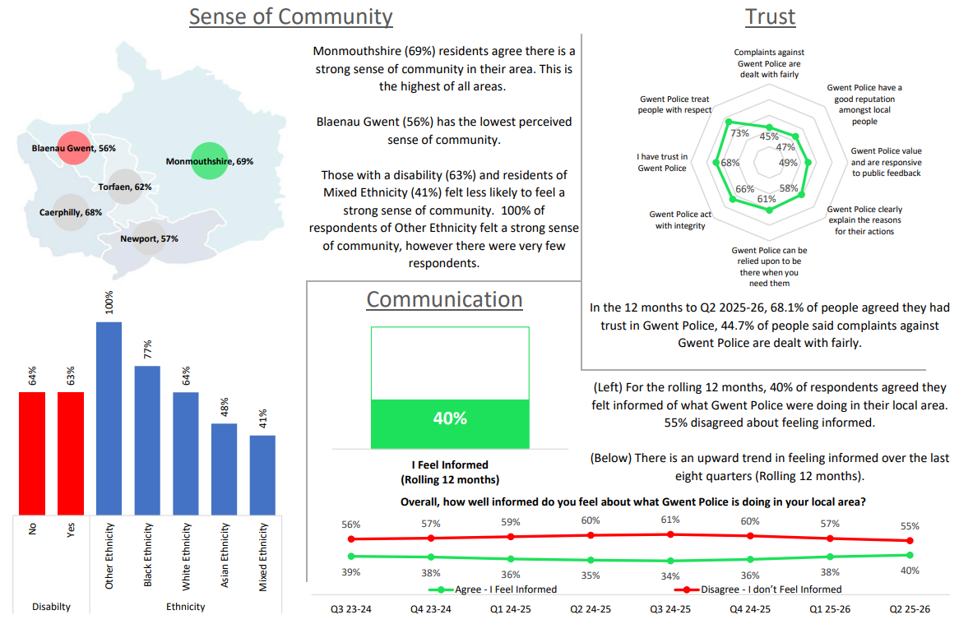
3. Perceptions Survey – Engagement

Slide 7
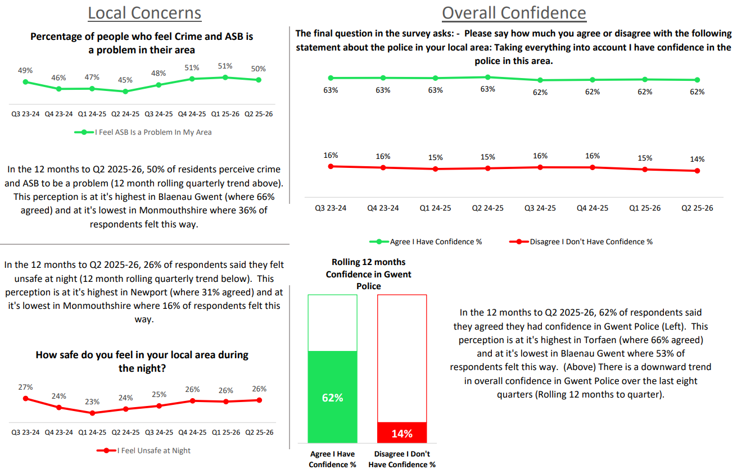
4. Perceptions Survey – Local Concerns and Confidence

Slide 8
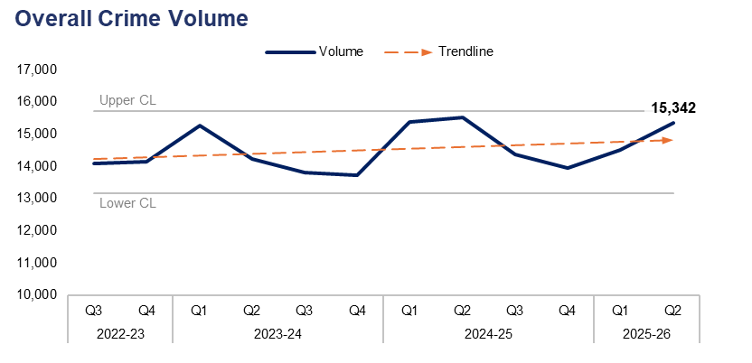
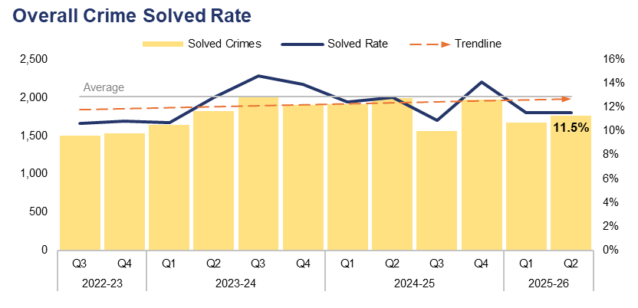
5. Overall Crime
Financial Year | 21-22 | 22-23 | 23-24 | 24-25 |  | FYTD | 25-26 |  | Quarter | Q1 25-26 | Q2 24-25
Volume | 52,945 | 58,089 | 57,021 | 59,197 |  | Volume | 29,855 |  | % Change | 5.7% | -1.1%
Financial Year | 21-22 | 22-23 | 23-24 | 24-25 |  | FYTD | 25-26 |  | Quarter | Q1 25-26 | Q2 24-25
Solved Rate | 11.0% | 9.5% | 12.9% | 12.5% |  | Solved Rate | 11.5% |  | PP Change | 0.0 | -1.3
Operational Overview
Overall, 15,342 crimes were recorded in Gwent during the second quarter of the 2025-26 financial year (Q2 2025-26). This represents an increase of 5.7% (829 additional offences) when compared to the quarter prior, but a reduction of 1.1% (170 fewer offences) when compared to the same quarter during the previous financial year.
The overall solved rate for Q2 2025-26 stands at 11.5%, with 1,761 crimes solved. This is equal to the previous quarter, albeit with 87 additional crimes solved. The solved rate has fallen by 1.3 percentage points when compared to the same quarter during the previous financial year, with 228 fewer crimes solved.
A Quality Investigation and Victim Care Change Programme is underway. The principal leads are currently researching and progressing benefits assessments of proposed activity. The project aligns with the force’s Investigation Standards Plan and includes the introduction of a functional role to provide 24-hour scrutiny on investigation standards, particularly when suspects are brought into custody. Supervisors are currently being supported through the transition to these new functional roles. It is believed that this level of scrutiny will contribute to positive outcomes being secured for victims earlier in the investigative journey.
The changes to the operating model continue to facilitate cross-pillar collaboration, including close links between the Response Pillar and the Investigation Hub (which forms part of the Crime Pillar). The Investigation Hub consistently manage prisoner demand and offer a bridging position between the Response and Crime Pillars in handling complex priority and volume crime investigations. The team recorded a positive outcome rate of 59.9% during Q2 2025-26, an increase of 18.8 percentage points when compared to the quarter prior.

Slide 9
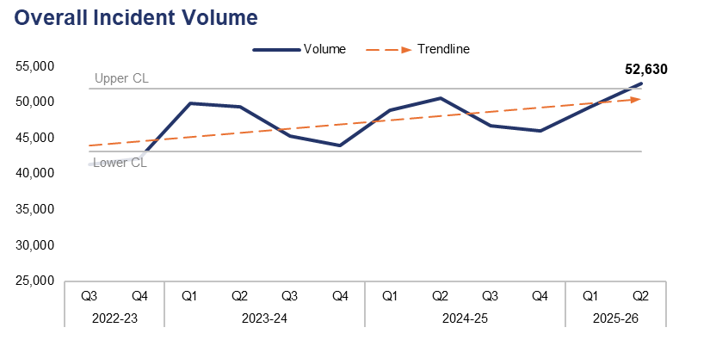
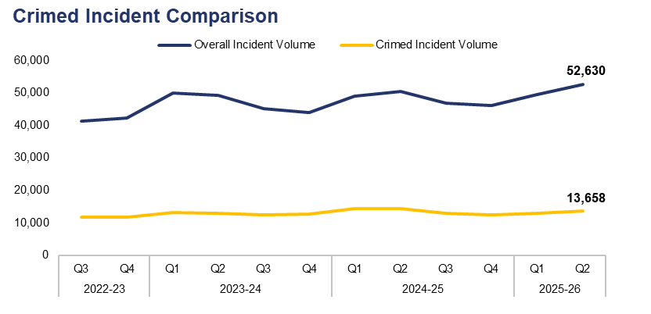
6. Overall Incidents
Financial Year | 21-22 | 22-23 | 23-24 | 24-25 |  | FYTD | 25-26 |  | Quarter | Q1 25-26 | Q2 24-25
Volume | 170,175 | 170,356 | 188,434 | 192,239 |  | Volume | 102,056 |  | % Change | 6.5% | 4.1%
Financial Year | 21-22 | 22-23 | 23-24 | 24-25 |  | FYTD | 25-26 |  | Quarter | Q1 25-26 | Q2 24-25
% Crimed | 26.6% | 28.8% | 27.2% | 28.0% |  | % Crimed | 26.1% |  | PP Change | -0.3 | -2.3
Operational Overview
Overall, 52,630 incidents were reported during Q2 2025-26. This exceeds the upper control limit, representing an increase of 6.5% (3,204 additional incidents) when compared to the quarter prior, and a less prominent increase of 4.1% (2,067 additional incidents) when compared to the same quarter during the previous financial year.
Of the 52,630 incidents reported during Q2 2025-26, 13,658 were assigned a crime category, or ‘crimed’. This accounts for 26.0% of the overall incident volume during the quarter, representing a slight reduction of 0.3 percentage points when compared to the quarter prior. A further reduction of 2.3 percentage points can be observed when comparing Q2 2025-26 to the same quarter during the previous financial year.
Additional crimes can be created independently of incidents, accounting for the discrepancy between the number of crimed incidents and the overall crime volume for the quarter.

Slide 10
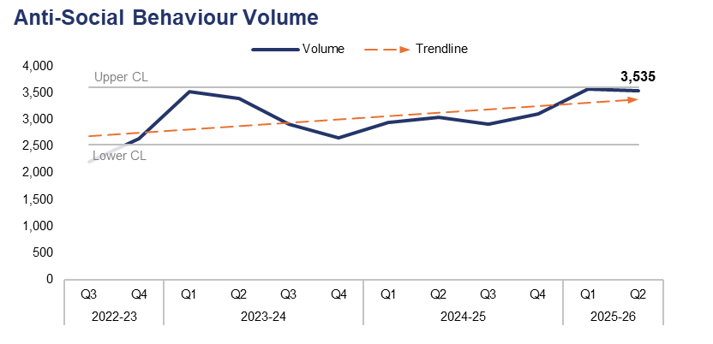
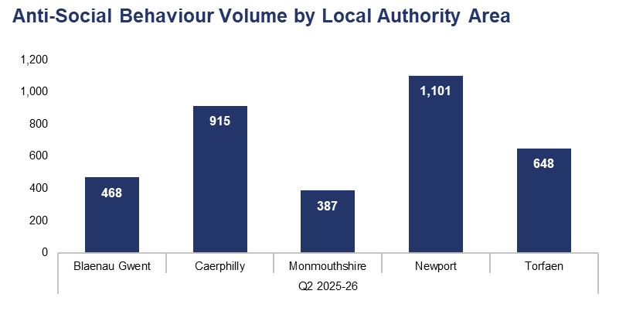
7. Anti-Social Behaviour
Financial Year | 21-22 | 22-23 | 23-24 | 24-25 |  | FYTD | 25-26 |  | Quarter | Q1 25-26 | Q2 24-25
Volume | 12,747 | 10,594 | 12,500 | 11,999 |  | Volume | 7,103 |  | % Change | -0.9% | 16.5%
Local Authority Area |  | Blaenau Gwent | Caerphilly | Monmouthshire | Newport | Torfaen
% of Total |  | 13.2% | 25.9% | 10.9% | 31.1% | 18.3%
Operational Overview
A total of 3,535 incidents classified as Anti-Social Behaviour (ASB) were reported during Q2 2025-26, near the upper control limit. This represents a slight reduction of 0.9% (33 fewer incidents) when compared to the quarter prior, but a notable increase of 16.5% (500 additional incidents) when compared to the same quarter during the previous financial year.
The upper-right graph displays ASB incident volume during Q2 2025-26 by Local Authority Area. The highest volume of incidents were reported in Newport, accounting for 31.1% of the force-wide total with 1,101 incidents. Conversely, the lowest volume of incidents were reported in Monmouthshire, comprising 10.9% of the force-wide total with 387 incidents.
Local teams continue to respond to incidents of ASB, using innovative approaches to seize vehicles which have been used in an anti-social manner. This included the deployment of a fixed wing plane in Newport for five hours during September. Specifically aimed at addressing vehicle-related ASB, this deployment paid significant dividends in the arrest and seizure of persons and vehicles, which generated a sizeable online footprint. Similarly, the local team in Blaenau Gwent worked alongside the force's proactive policing team in seizing 10 off-road bikes in a single evening.
ASB and crime hotspot patrols continued throughout the 37 hotspots identified within Gwent. During Q2 2025-26 there were a total of 2,286 hours of visible patrols within these areas, resulting in 11 arrests and 27 stop searches.
During Q2 2025-26, 16 ASB incidents were reported as having taken place outside of the force area, and have therefore been omitted from the Local Authority Area comparison.

Slide 11
8. Community Action Team
Community Action Team Activity – Q2 2025-26
Metric | Alway Team | Blackwood Team | Llantarnam Team | Tredegar Team | Overall
Offences Recorded | 31 | 57 | 34 | 38 | 160
Solved Rate | 45.2% | 50.9% | 58.8% | 42.1% | 49.4%
Arrests Made | 32 | 30 | 36 | 22 | 120
Stop Searches Performed | 28 | 64 | 45 | 32 | 169
Vehicles Seized | 21 | 41 | 18 | 32 | 112
Operational Overview
Between June and September 2025, the Community Action Teams have been deployed in Alway, Blackwood, Llantarnam, and Tredegar. During this period, they have made a total of 120 arrests and seized 112 vehicles, primarily due to them being used or ridden in an anti-social manner. They have also achieved a solved rate of 49.4% for crime investigations.
The teams have received extremely positive feedback from local councillors, communities, and indeed their own colleagues whom they have been working alongside over the four-month period in addressing ASB and acquisitive crime.

Slide 12
9. Preventing Crime and ASB – Emerging Issues
Operational Overview
Q2 2025-26 saw the introduction of the Home Office's Safer Streets Summer Initiative, which ran concurrently between July and September and focused on ASB, street crime, and retail crime within town and city centres. Local policing teams worked alongside partners within the respective five Community Safety Partnerships (CSPs), aided by funding from the Office of the Police and Crime Commissioner (OPCC), in the implementation of activities which sought to divert persons away from committing crime or ASB.
The force has already commenced work on creating an ASB Action Plan which will be finalised by the end of the financial year. The plan, which is Home Office driven, will demonstrate how the force engages with the community and partners, how it uses data to identify both victims and offenders of ASB, how it effectively uses ASB powers in addressing ASB (prevention, intervention, and enforcement), how it works alongside partners to problem-solve areas susceptible to ASB, and how effective communications are around this issue.
In the interim, the force is now preparing for the follow up to the Safer Streets Summer Initiative in the form of a 'Winter Initiative’, whereby the Home Office will be requesting that each force prepare plans on how they will tackle ASB and street/retail crime in the run up to Christmas.
Local teams are preparing for the forthcoming Halloween and Bonfire Night evenings, working with partners and local communities to reduce the impact of ASB, which typically increases over these periods.
The Respect Rhymney initiative has now entered the ‘Hold’ phase of it’s ‘Clear, Hold, Build’ tactical model, with officers working alongside partners to prevent crime and ASB in the area. This has included partners working on a community alcohol project; an off-road bike educational in which youths will receive an accreditation at the end. Caerphilly County Borough Council are also working with New Pathways on delivering a 'toxic masculinity' input to sixth form students across Rhymney.

Slide 13
Pillar Two - Making Our Communities Safer
999 Demand
101 Demand
999 and 101 Average Answer Speed
Response Times
Most Serious Violence
Serious Violence
Knife Crime
Overall Drug Offences
Drug Possession
Drug Supply
Shoplifting
Residential Burglary
Robbery
Theft from the Person
Making Our Communities Safer – Emerging Issues

Slide 14
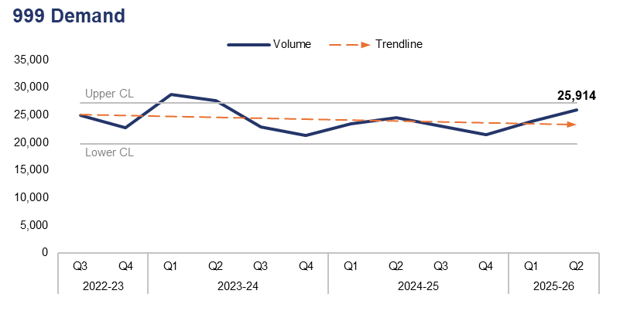
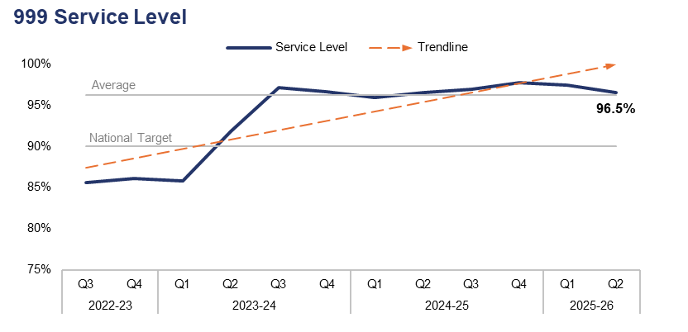
1. 999 Demand
Financial Year | 21-22 | 22-23 | 23-24 | 24-25 |  | FYTD | 25-26 |  | Quarter | Q1 25-26 | Q2 24-25
Volume | 87,259 | 99,891 | 100,469 | 92,275 |  | Volume | 49,706 |  | % Change | 8.9% | 6.0%
Financial Year | 21-22 | 22-23 | 23-24 | 24-25 |  | FYTD | 25-26 |  | Quarter | Q1 25-26 | Q2 24-25
Service Level | 89.5% | 85.7% | 92.4% | 97.0% |  | Service Level | 96.9% |  | PP Change | -0.9 | 0.0
Operational Overview
999 demand has risen by 8.9% during Q2 2025-26 when compared to the quarter prior, with 2,122 additional calls received for a total of 25,914. A rise of 6.0% (1,461 additional calls) can be observed when comparing Q2 2025-26 to the same quarter during the previous financial year.
999 service level (the percentage of 999 calls answered within 10 seconds) stands at 96.5% for Q2 2025-26. This represents a reduction of 0.9 percentage points when compared to the quarter prior, likely due in part to the increase in 999 demand recorded over the same period. 999 service level is equal to that recorded during same quarter of the previous financial year, and has remained above the national target of 90% for the last nine consecutive quarters.
Following an inspection by His Majesty’s Inspectorate of Constabulary and Fire & Rescue Services (HMICFRS) during 2022, Gwent has improved and maintained it’s position as one of the best and most consistently performing forces in the country in terms of 999 service level.

Slide 15
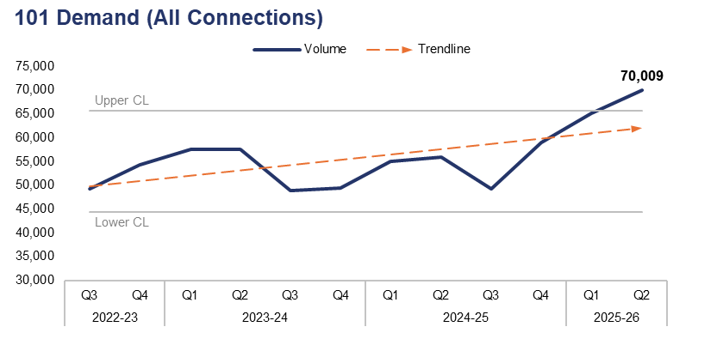
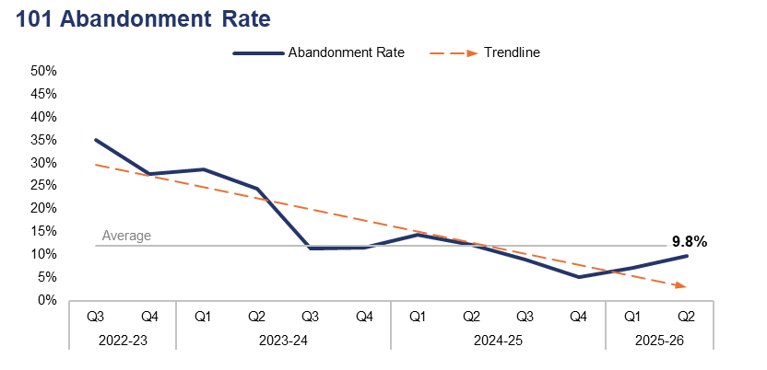
2. 101 Demand
Financial Year | 21-22 | 22-23 | 23-24 | 24-25 |  | FYTD | 25-26 |  | Quarter | Q1 25-26 | Q2 24-25
Volume | 241,738 | 220,342 | 213,356 | 219,010 |  | Volume | 135,222 |  | % Change | 7.4% | 25.3%
Financial Year | 21-22 | 22-23 | 23-24 | 24-25 |  | FYTD | 25-26 |  | Quarter | Q1 25-26 | Q2 24-25
Abandonment Rate | 26.7% | 36.3% | 19.5% | 9.1% |  | Abandonment Rate | 8.5% |  | PP Change | 2.6 | -2.4
Operational Overview
101 demand (all connections) has risen by 7.4% during Q2 2025-26 when compared to the quarter prior, with 4,796 additional calls received for a total of 70,009. This represents the highest quarterly figure within the three-year timeframe, exceeding the upper control limit. A more prominent increase of 25.3% (14,117 additional calls) can be observed when comparing Q2 2025-26 to the same quarter during the previous financial year.
The abandonment rate for 101 calls during Q2 2025-26 was 9.8%. This is an increase of 2.6 percentage points when compared to the quarter prior, but represents a reduction of 2.4 percentage points when compared to the same quarter during the previous financial year.
Although 101 demand has adhered to the seasonal trend of increasing during the second quarter of the financial year, the rise recorded during Q2 2025-26 is significantly higher than has been experienced previously. This has been a contributing factor to the increase in abandonment rate during the quarter. Plans are being developed to increase the usage of alternative reporting methods, such as digital, to release capacity from the 101 system in order to better prepare for this period during the next financial year.
The 101 abandonment rate figure is calculated based on call options one and two only, which pertain to new incidents and incident updates respectively.

Slide 16
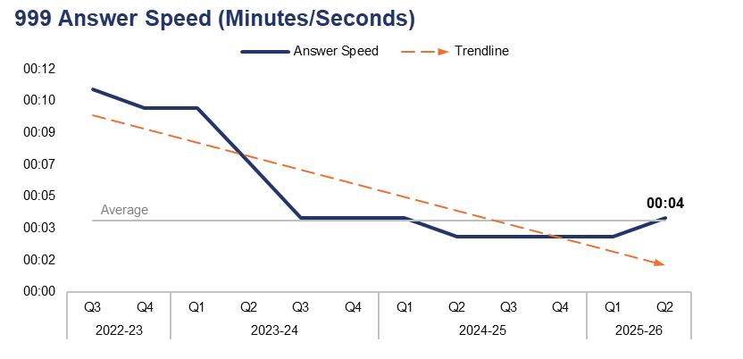
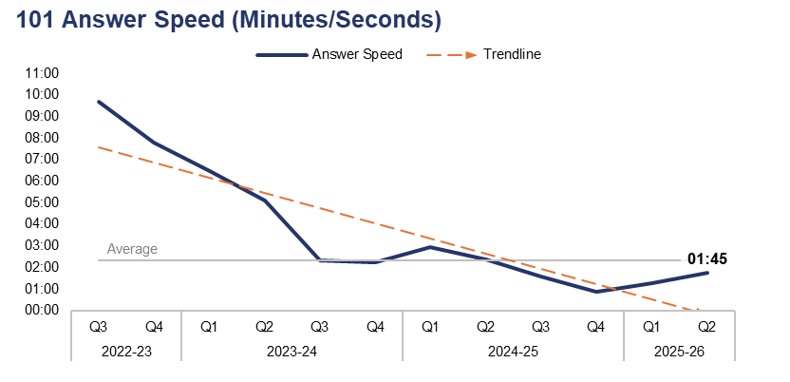
3. 999 and 101 Average Answer Speed
Financial Year | 21-22 | 22-23 | 23-24 | 24-25 |  | Financial Year | 25-26 |  | Quarter | Q1 25-26 | Q2 24-25
Answer Speed | 00:09 | 00:11 | 00:06 | 00:04 |  | Answer Speed | 00:03 |  | Change | 00:01 | 00:01
Financial Year | 21-22 | 22-23 | 23-24 | 24-25 |  | FYTD | 25-26 |  | Quarter | Q1 25-26 | Q2 24-25
Answer Speed | 05:45 | 08:01 | 03:59 | 01:43 |  | Answer Speed | 01:31 |  | Change | 00:30 | -00:37
Operational Overview
The average answer speed for 999 calls during Q2 2025-26 was four seconds. This is a deterioration of one second when compared to both the quarter prior and the same quarter during the previous financial year.
The average answer speed for 101 calls during Q2 2025-26 was one minute and 45 seconds. This is a deterioration of 30 seconds when compared to the quarter prior, but represents an improvement of 37 seconds when compared to the same quarter during the previous financial year.
The 101 average answer speed figure is calculated based on call options one and two only, which pertain to new incidents and incident updates respectively.

Slide 17
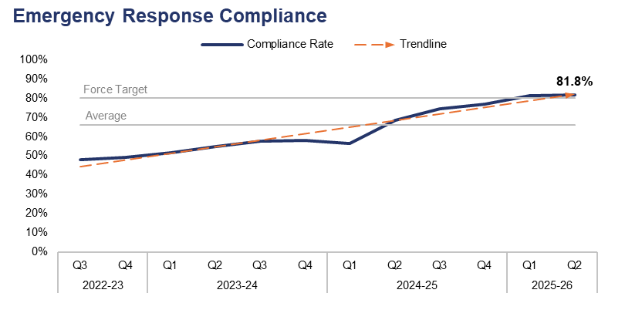
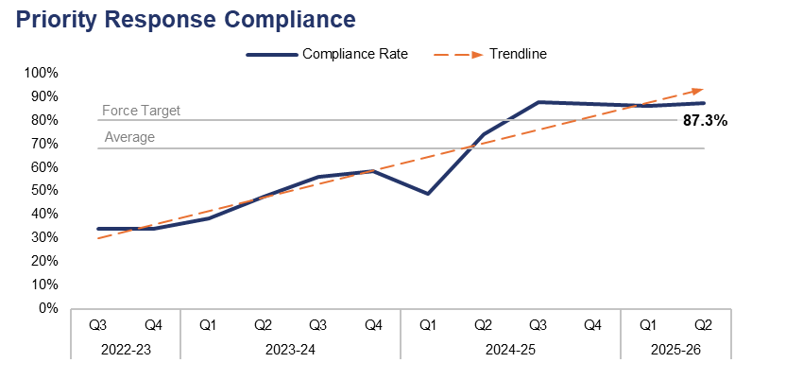
4. Response Times
Financial Year | 21-22 | 22-23 | 23-24 | 24-25 |  | FYTD | 25-26 |  | Quarter | Q1 25-26 | Q2 24-25
Compliance Rate | 47.5% | 47.0% | 55.4% | 68.7% |  | Compliance Rate | 81.6% |  | PP Change | 0.4 | 13.5
Financial Year | 21-22 | 22-23 | 23-24 | 24-25 |  | FYTD | 25-26 |  | Quarter | Q1 25-26 | Q2 24-25
Compliance Rate | 33.2% | 32.3% | 50.0% | 74.5% |  | Compliance Rate | 86.8% |  | PP Change | 1.1 | 13.3
Operational Overview
Based on the target arrival time of 15 minutes, the emergency create-to-arrival compliance rate for Q2 2025-26 stands at 81.8%. This is the highest value within the three-year timeframe, representing an increase of 0.4 percentage points when compared to the quarter prior, and a notable increase of 13.5 percentage points when compared to the same quarter during the previous financial year. The compliance rate has now exceeded the force target of 80.0% for a second consecutive quarter.
Based on the target arrival time of 60 minutes, the priority create-to-arrival compliance rate for Q2 2025-26 stands at 87.3%. This represents an increase of 1.1 percentage points when compared to the quarter prior, and a significant increase of 13.3 percentage points when compared to the same quarter during the previous financial year. Compliance has now exceeded the force target of 80.0% for four consecutive quarters.
Response times have improved significantly over the last 12 months due the functionalising of a number of roles across the force and the enhancement of internal processes, in addition to senior leadership focus on this area. Challenges are expected to arise regarding the management of the demand created as a result of these improvements. A project is being designed within the Force Contact and Control Centre to assist in handling and reducing the demand experienced by response officers.
In this context, ‘create-to-arrival’ refers to the time elapsed between the creation of a Storm Log for a given incident, and the arrival of officers at the scene.

Slide 18
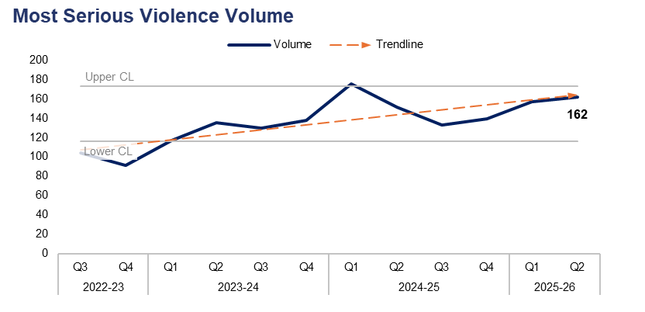
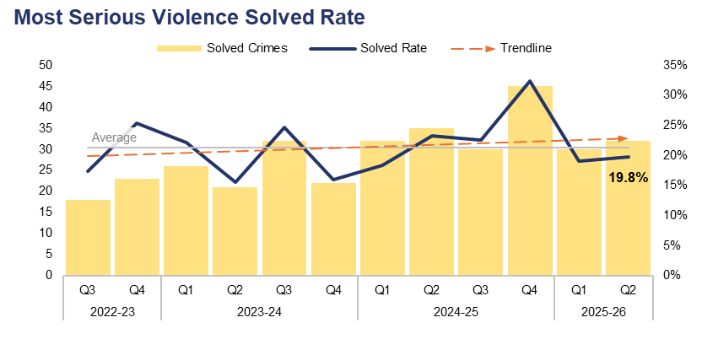
5. Most Serious Violence
Financial Year | 21-22 | 22-23 | 23-24 | 24-25 |  | FYTD | 25-26 |  | Quarter | Q1 25-26 | Q2 24-25
Volume | 435 | 474 | 520 | 598 |  | Volume | 319 |  | % Change | 3.2% | 7.3%
Financial Year | 21-22 | 22-23 | 23-24 | 24-25 |  | FYTD | 25-26 |  | Quarter | Q1 25-26 | Q2 24-25
Solved Rate | 16.1% | 18.8% | 19.4% | 23.7% |  | Solved Rate | 19.4% |  | PP Change | 0.7 | -3.4
Operational Overview
A total of 162 crimes classified as Most Serious Violence were recorded during Q2 2025-26. This represents an increase of 3.2% (five additional offences) when compared to the quarter prior, and a further increase of 7.3% (11 additional offences) when compared to the same quarter during the previous financial year.
The solved rate for Q2 2025-26 stands at 19.8%, with 32 crimes solved. This is an increase of 0.7 percentage points when compared to the quarter prior, with two additional crimes solved. Conversely, a reduction of 3.4 percentage points can be observed when comparing Q2 2025-26 to the same quarter during the previous financial year, with three fewer crimes solved.
The Homicide and Serious Violence meeting ensures appropriate oversight of investigations and is able to identify any changes in performance. Most Serious Violence is investigated by the Reactive Criminal Investigation Department (CID) who operate as part of the Crime Pillar. Scrutiny and the identification of patterns in offending allow for predicted demand analysis and the assignment of appropriate resources from the Crime Pillar. The management and oversight of meetings has seen strong relationships forged between the three pillars, with problem solving plans devised to prevent and detect Most Serious Violence.
Most Serious Violence offences consist of homicide, grievous bodily harm with intent, and causing death by dangerous driving.

Slide 19
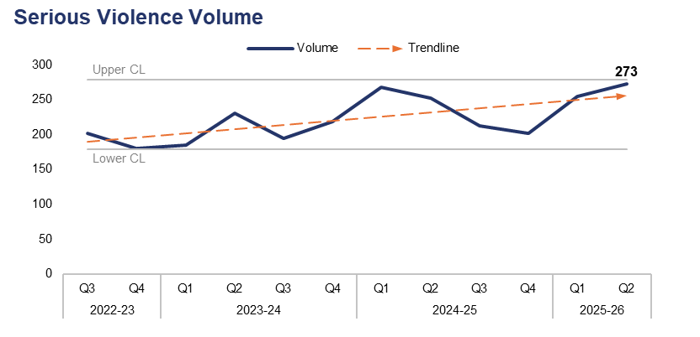
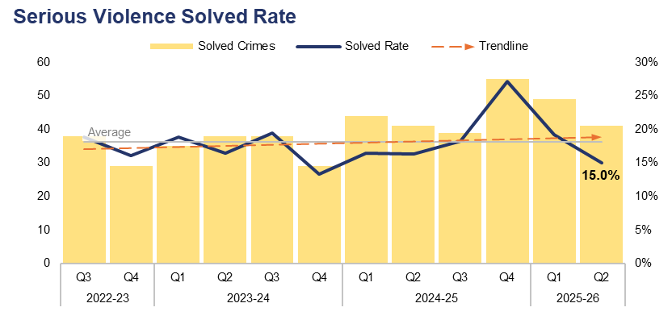
6. Serious Violence
Financial Year | 21-22 | 22-23 | 23-24 | 24-25 |  | FYTD | 25-26 |  | Quarter | Q1 25-26 | Q2 24-25
Volume | 729 | 843 | 829 | 935 |  | Volume | 528 |  | % Change | 7.1% | 8.3%
Financial Year | 21-22 | 22-23 | 23-24 | 24-25 |  | FYTD | 25-26 |  | Quarter | Q1 25-26 | Q2 24-25
Solved Rate | 15.8% | 15.5% | 16.9% | 19.1% |  | Solved Rate | 17.0% |  | PP Change | -4.2 | -1.3
Operational Overview
The volume of offences classified as Serious Violence approached the upper control limit during Q2 2025-26, with 273 crimes recorded. This is the highest quarterly figure within the three-year timeframe, representing an increase of 7.1% (18 additional offences) when compared to the quarter prior, and a similar increase of 8.3% (21 additional offences) when compared to the same quarter during the previous financial year.
The solved rate for Q2 2025-26 stands at 15.0%, with 41 crimes solved. This represents a reduction of 4.2 percentage points when compared to the quarter prior, with eight fewer crimes solved. A less prominent reduction of 1.3 percentage points can be observed when comparing Q2 2025-26 to the same quarter during the previous financial year, with an equal number of crimes solved.
Although Serious Violence is discussed in the Homicide and Serious Violence meeting, an element of this also features in the Serious Organised Crime (SOC) meeting. Organised Crime Group (OCG) nominals involved in Serious Violence are identified within this meeting, in order to explore opportunities under a ‘4Ps’ approach (Pursue, Prevent, Protect, and Prepare).
Services have been commissioned via Serious Violence Duty funding which aim to prevent violent crime and promote early intervention through the identification of effective local practices and prevention programmes. This is aligned to the Government’s Safer Streets mission, with interventions being delivered through the five CSPs.
Serious Violence offences consist of section 18 grievous bodily harm with intent, section 20 malicious wounding without intent, and personal robbery.

Slide 20
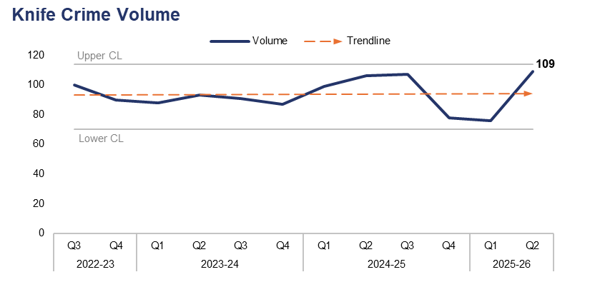
7. Knife Crime
Financial Year | 21-22 | 22-23 | 23-24 | 24-25 |  | FYTD | 25-26 |  | Quarter | Q1 25-26 | Q2 24-25
Volume | 283 | 370 | 359 | 390 |  | Volume | 185 |  | % Change | 43.4% | 2.8%
Operational Overview
During Q2 2025-26 109 offences were recorded which met the criteria of a knife crime, as defined by the Home Office’s National Data Quality Improvement Service (NDQIS) reporting system. This is the highest quarterly figure within the three-year timeframe, representing a significant increase of 43.4% (33 additional offences) when compared to the quarter prior. A less prominent increase of 2.8% (three additional offences) can be observed when comparing Q2 2025-26 to the same quarter during the previous financial year.
The force continually encourages the appropriate use of stop and search as a proactive tactic to limit access to knives for criminals. Appropriate performance and oversight meetings ensure that stop and search is used proportionately, with accurate and reliable grounds for each search recorded.
Local SOC profiles have recently been developed which have identified the top three wards in each local authority area based on Crime Severity Score. Within these wards, knife crimes and those linked to SOC have been highlighted. A Knife Crime Problem Profile has also been completed, which is due for presentation in November's violence meeting.
The Virtual Decisions programmes have been refreshed, with meetings convened to discuss an extension of the licence. This innovative practise was highlighted in the recent HMICFRS SOC inspection debrief.
In accordance with NDQIS reporting criteria, Possession of a Weapon and Homicide offences have been excluded from this dataset.

Slide 21
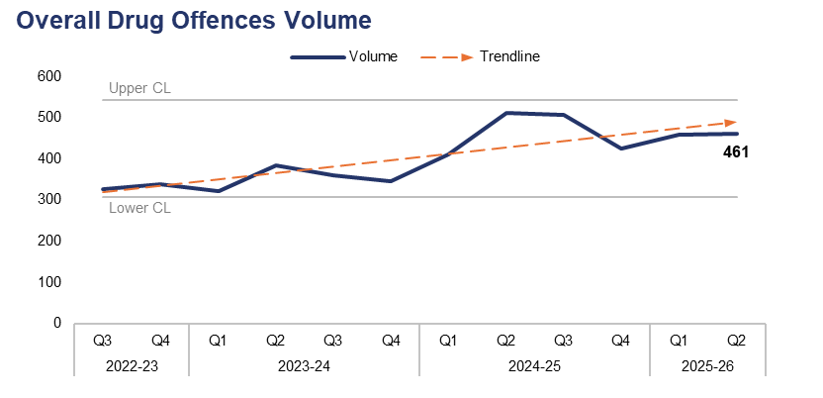
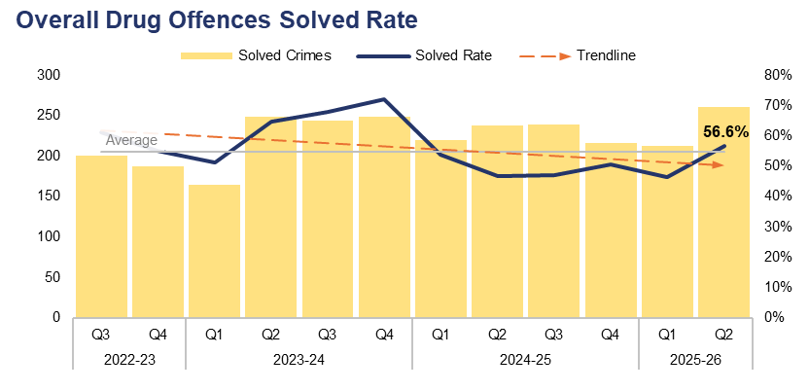
8. Overall Drug Offences
Financial Year | 21-22 | 22-23 | 23-24 | 24-25 |  | FYTD | 25-26 |  | Quarter | Q1 25-26 | Q2 24-25
Volume | 1,328 | 1,296 | 1,413 | 1,853 |  | Volume | 919 |  | % Change | 0.7% | -9.8%
Financial Year | 21-22 | 22-23 | 23-24 | 24-25 |  | FYTD | 25-26 |  | Quarter | Q1 25-26 | Q2 24-25
Solved Rate | 67.5% | 54.6% | 64.2% | 49.3% |  | Solved Rate | 51.5% |  | PP Change | 10.3 | 10.0
Operational Overview
A total of 461 crimes classified as Drug Offences were recorded during Q2 2025-26. This represents a slight increase of 0.7% (three additional offences) when compared to the quarter prior, but a reduction of 9.8% (50 fewer offences) when compared to the same quarter during the previous financial year.
The solved rate for Q2 2025-26 stands at 56.6%, with 261 crimes solved. This is an increase of 10.3 percentage points when compared to the quarter prior, with 49 additional crimes solved. A similar increase of 10.0 percentage points can be observed when comparing Q2 2025-26 to the same quarter during the previous financial year, with 23 additional crimes solved.
An increase in seizures by the UK Border Force relating to drug commodities destined for Gwent postal addresses was identified as a key driver of the rise in Drug Offences observed during the previous quarter. The number of these offences has almost halved during Q2 2025-26 when compared to the quarter prior, falling by 48.2% (40 fewer offences) for a total of 43.

Slide 22
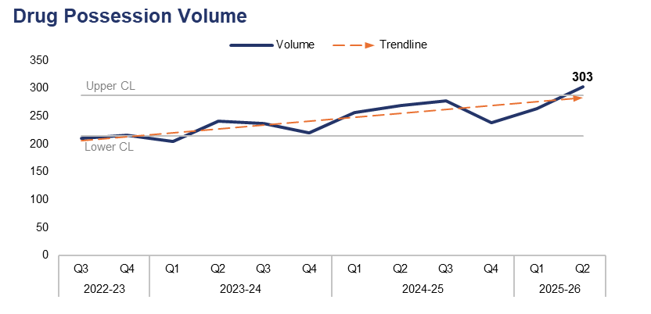
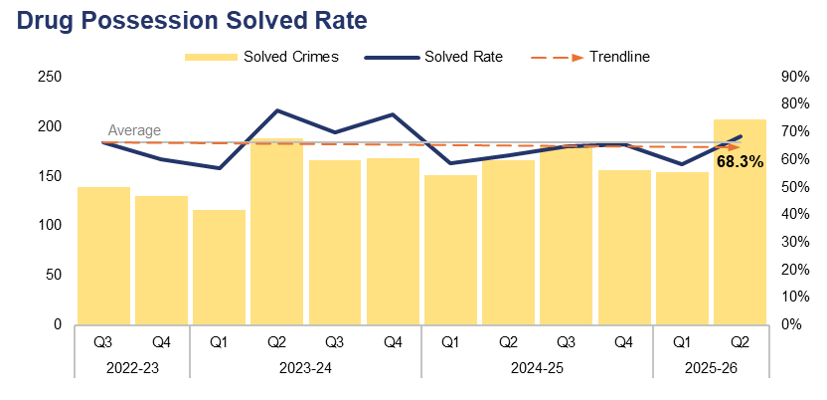
9. Drug Possession
Financial Year | 21-22 | 22-23 | 23-24 | 24-25 |  | FYTD | 25-26 |  | Quarter | Q1 25-26 | Q2 24-25
Volume | 948 | 827 | 902 | 1,042 |  | Volume | 567 |  | % Change | 14.8% | 12.6%
Financial Year | 21-22 | 22-23 | 23-24 | 24-25 |  | FYTD | 25-26 |  | Quarter | Q1 25-26 | Q2 24-25
Solved Rate | 69.9% | 60.8% | 70.7% | 62.7% |  | Solved Rate | 63.7% |  | PP Change | 10.0 | 6.6
Operational Overview
The volume of drug possession offences exceeded the upper control limit during Q2 2025-26, with 303 crimes recorded. This is the highest quarterly figure within the three-year timeframe, representing an increase of 14.8% (39 additional offences) when compared to the quarter prior, and a similar increase of 12.6% (34 additional offences) when compared to the same quarter during the previous financial year.
The solved rate for Q2 2025-26 stands at 68.3%, with 207 crimes solved. This is an increase of 10.0 percentage points when compared to the quarter prior, with 53 additional crimes solved. An increase 6.6 percentage points can be observed when comparing Q2 2025-26 to the same quarter during the previous financial year, with 41 additional crimes solved.
This slide pertains to possession offences for all controlled drugs, including Cannabis.

Slide 23
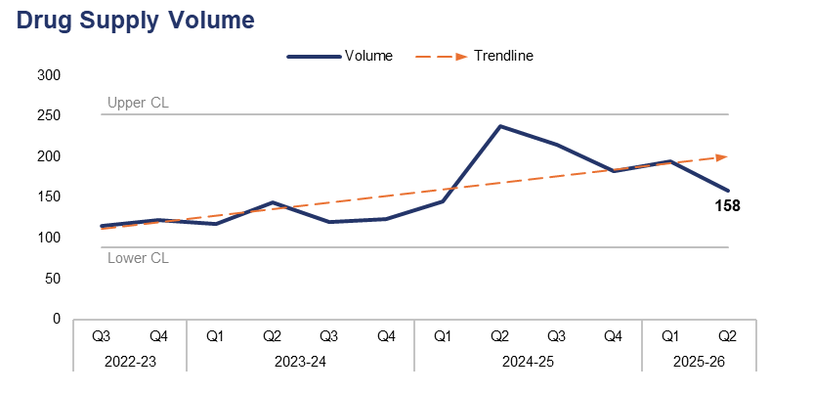
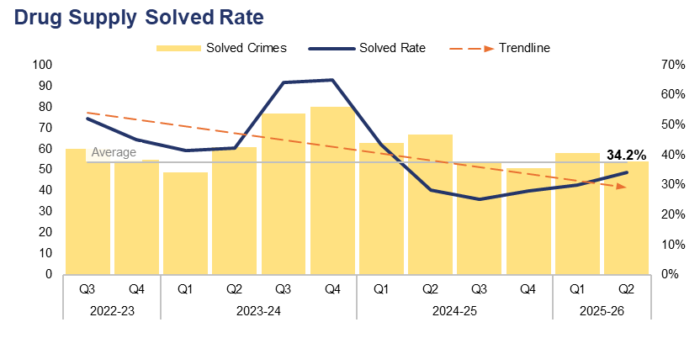
10. Drug Supply
Financial Year | 21-22 | 22-23 | 23-24 | 24-25 |  | FYTD | 25-26 |  | Quarter | Q1 25-26 | Q2 24-25
Volume | 378 | 462 | 505 | 780 |  | Volume | 352 |  | % Change | -18.6% | -33.6%
Financial Year | 21-22 | 22-23 | 23-24 | 24-25 |  | FYTD | 25-26 |  | Quarter | Q1 25-26 | Q2 24-25
Solved Rate | 61.4% | 43.5% | 52.9% | 30.1% |  | Solved Rate | 31.8% |  | PP Change | 4.3 | 6.0
Operational Overview
Overall, 158 drug supply offences were recorded during Q2 2025-26. This represents a reduction of 18.6% (36 fewer offences) when compared to the quarter prior, and a further reduction of 33.6% (80 fewer offences) when compared to the same quarter during the previous financial year.
The solved rate for Q2 2025-26 stands at 34.2%, with 54 crimes solved. This is an increase of 4.3 percentage points when compared to the quarter prior, albeit with four fewer crimes solved. A similar increase of 6.0 percentage points can be observed when comparing Q2 2025-26 to the same quarter during the previous financial year, although with 13 fewer crimes solved.
The increase in the use of synthetic opioids is a national priority led by the National Crime Agency as part of Project Housebuilder. A cluster of drug-related deaths caused by synthetic opioids have been recorded by South Wales Police. Whilst a similar cluster has not been recorded in Gwent, there have been isolated deaths linked to synthetic opioids and increases in near misses reported by partners in the Newport area. The force’s Organised Crime Unit have been targeting an OCG distributing large amounts of heroin, with over 17kg seized. This included the largest seizure nationally of one form of synthetic opioid, preventing hundreds of drug users from being exposed to this commodity.
Gwent Police have well established processes to share intelligence relating to harmful substances and drug related deaths with partners, as well as the ability to fast track the examination of seized drugs so that intelligence can be shared with partners in order to protect drug users.
This slide includes all offences pertaining to the supply, importation, or production of controlled drugs.

Slide 24
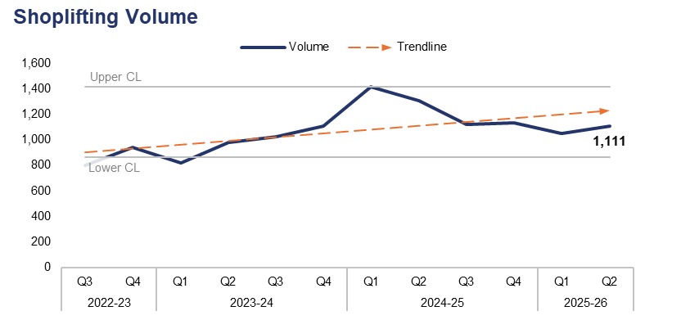
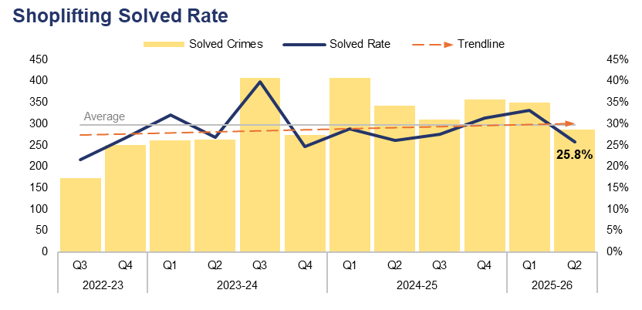
11. Shoplifting
Financial Year | 21-22 | 22-23 | 23-24 | 24-25 |  | FYTD | 25-26 |  | Quarter | Q1 25-26 | Q2 24-25
Volume | 2,186 | 2,973 | 3,925 | 4,980 |  | Volume | 2,161 |  | % Change | 5.8% | -15.1%
Financial Year | 21-22 | 22-23 | 23-24 | 24-25 |  | FYTD | 25-26 |  | Quarter | Q1 25-26 | Q2 24-25
Solved Rate | 27.7% | 23.7% | 30.7% | 28.4% |  | Solved Rate | 29.4% |  | PP Change | -7.4 | -0.3
Operational Overview
During Q2 2025-26, 1,111 Shoplifting offences were recorded. This represents an increase of 5.8% (61 additional offences) when compared to the quarter prior, but a reduction of 15.1% (198 fewer offences) when compared to the same quarter during the previous financial year.
The solved rate for Q2 2025-26 stands at 25.8%, with 287 crimes solved. This is a reduction of 7.4 percentage points when compared to the quarter prior, with 62 fewer crimes solved. A less prominent reduction of 0.3 percentage points can be observed when comparing Q2 2025-26 to the same quarter during the previous financial year, with 55 fewer crimes solved.
The force has improved the way it identifies and manages its most prolific offenders. Prior to the point of charge, Crime and Disorder Reduction Officers are successfully attaching Criminal Behaviour Orders to casefiles, which are effective in managing and restricting individuals' movements post conviction. The force has also been involved in the Safer Streets Summer Initiative which focuses on retail crime, in addition to street crime and ASB. This initiative also involves partners from within the five CSPs, which have received OPCC funding with an emphasis on intervention and diversion programmes.

Slide 25
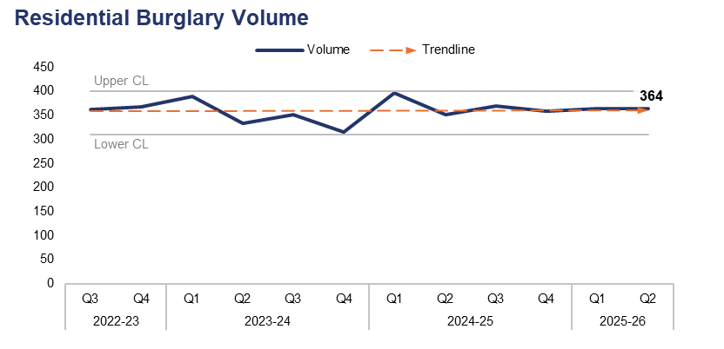
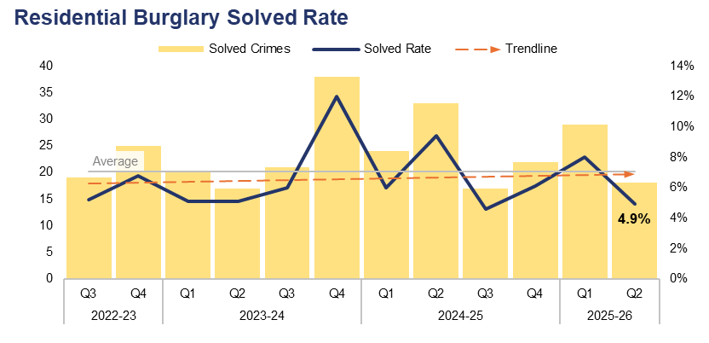
12. Residential Burglary
Financial Year | 21-22 | 22-23 | 23-24 | 24-25 |  | FYTD | 25-26 |  | Quarter | Q1 25-26 | Q2 24-25
Volume | 1,755 | 1,616 | 1,390 | 1,475 |  | Volume | 728 |  | % Change | 0.0% | 3.7%
Financial Year | 21-22 | 22-23 | 23-24 | 24-25 |  | FYTD | 25-26 |  | Quarter | Q1 25-26 | Q2 24-25
Solved Rate | 6.2% | 5.1% | 6.9% | 6.5% |  | Solved Rate | 6.5% |  | PP Change | -3.1 | -4.5
Operational Overview
A total of 364 Residential Burglary offences were recorded during Q2 2025-26. This is equal to the quarter prior, but an increase of 3.7% (13 additional offences) when compared to the same quarter during the previous financial year.
The solved rate for Q2 2025-26 stands at 4.9%, with 18 crimes solved. This represents a reduction of 3.1 percentage points when compared to the quarter prior, with 11 fewer crimes solved. A similar reduction of 4.5 percentage points can be observed when comparing Q2 2025-26 to the same quarter during the previous financial year, with 15 fewer crimes solved.
During Q2 2025-26, 89.3% of Residential Burglary of a Home incidents were attended by officers, with 60.7% of these attended within 60 minutes. There has been an incremental improvement in solved rate for Residential Burglary of a Home offences over the last three consecutive quarters, with the Criminal Investigation Department focusing on this as a core area of business.
There is a notable disparity in solved rate between crimes classified as residential burglaries of homes and those classified as residential burglaries of unconnected buildings. The solved rate for residential burglaries of homes stands at 8.6% for the FYTD, whereas the solved rate for residential burglaries of unconnected buildings is lower, at 1.6%.
A second phase of the burglary app trial has been undertaken by officers. The app has seen limited use across the force, with fresh messaging planned in order to increase its uptake and subsequent use.

Slide 26
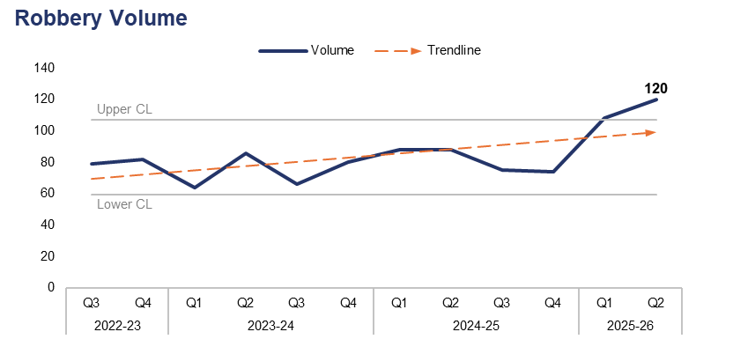
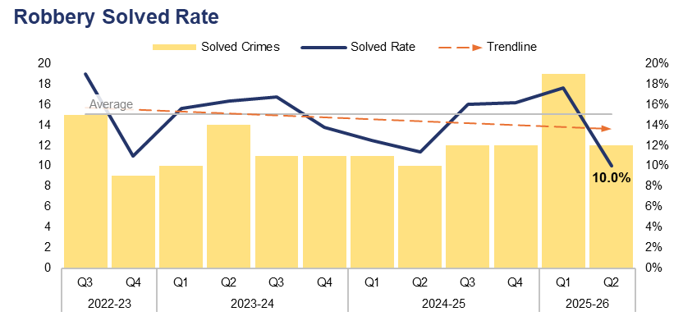
13. Robbery
Financial Year | 21-22 | 22-23 | 23-24 | 24-25 |  | FYTD | 25-26 |  | Quarter | Q1 25-26 | Q2 24-25
Volume | 266 | 332 | 296 | 325 |  | Volume | 228 |  | % Change | 11.1% | 36.4%
Financial Year | 21-22 | 22-23 | 23-24 | 24-25 |  | FYTD | 25-26 |  | Quarter | Q1 25-26 | Q2 24-25
Solved Rate | 18.0% | 12.3% | 15.5% | 13.8% |  | Solved Rate | 13.6% |  | PP Change | -7.6 | -1.4
Operational Overview
The volume of Robbery offences exceeded the upper control limit during Q2 2025-26, with 120 crimes recorded. This is the highest quarterly figure within the three-year timeframe, representing an increase of 11.1% (12 additional offences) when compared to the quarter prior, and a more prominent increase of 36.4% (32 additional offences) when compared to the same quarter during the previous financial year.
The solved rate for Q2 2025-26 stands at 10.0%, with 12 crimes solved. This represents a reduction of 7.6 percentage points when compared the the quarter prior, with seven fewer crimes solved. A less prominent reduction of 1.4 percentage points can be observed when comparing Q2 2025-26 to the same quarter during the previous financial year, with two additional crimes solved.
The data on this slide includes both personal and commercial Robbery offences.

Slide 27
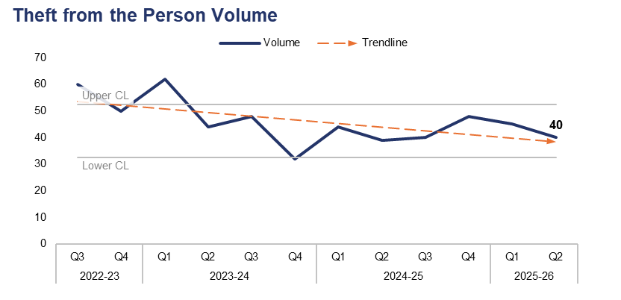
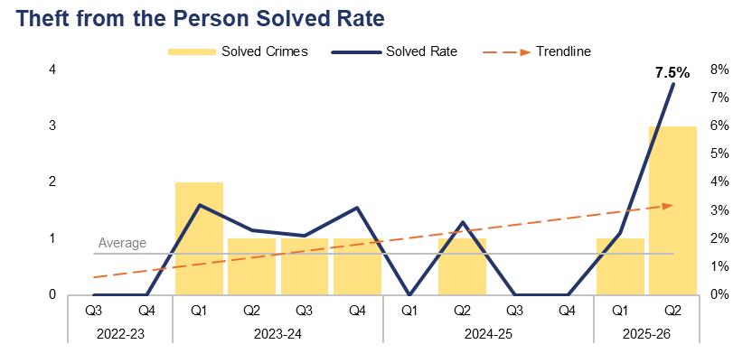
14. Theft from the Person
Financial Year | 21-22 | 22-23 | 23-24 | 24-25 |  | FYTD | 25-26 |  | Quarter | Q1 25-26 | Q2 24-25
Volume | 166 | 208 | 186 | 171 |  | Volume | 85 |  | % Change | -11.1% | 2.6%
Financial Year | 21-22 | 22-23 | 23-24 | 24-25 |  | FYTD | 25-26 |  | Quarter | Q1 25-26 | Q2 24-25
Solved Rate | 5.4% | 0.5% | 2.7% | 0.6% |  | Solved Rate | 4.7% |  | PP Change | 5.3 | 4.9
Operational Overview
During Q2 2025-26, 40 Theft from the Person offences were recorded. This represents a reduction of 11.1% (five fewer offences) when compared to the quarter prior, but an increase of 2.6% (one additional offence) when compared to the same quarter during the previous financial year.
The solved rate for Q2 2025-26 stands at 7.5%, with three crimes solved. This is the highest solved rate within the three-year timeframe, representing an increase of 5.3 percentage points when compared to the quarter prior and a similar increase of 4.9 percentage points when compared to the same quarter during the previous financial year, with two additional crimes solved in both instances.
Over half of the outcomes recorded for Theft from the Person offences during Q2 2025-26 were classified as Outcome 18: Investigation complete – no suspect identified. This is likely due in part to the nature of these offences, which include pickpocketing and ‘snatch thefts’, in which the victim typically has very little (if any) direct interaction with the offender.

Slide 28
15. Making our Communities Safer – Emerging Issues
Operational Overview
Crimes and incidents relating to dangerous dogs have seen a reduction during Q2 2025-26, but continue to place demand on local policing teams whilst presenting an ongoing risk within communities. A total of 119 dangerous dog crimes were recorded during Q2 2025-26. This represents a reduction of 22.7% (35 fewer offences) when compared to the quarter prior, and a similar reduction of 18.5% (27 fewer offences) when compared to the same quarter during the previous financial year.

Slide 29
Pillar Three – Protecting the Vulnerable
Violence Against Women and Girls
Domestic Offences
Rape
Serious Sexual Offences
Stalking
Harassment
Hate Crime
Child Criminal and Sexual Exploitation
Missing Children
Action Fraud
Cybercrime
Protecting the Vulnerable – Emerging Issues

Slide 30
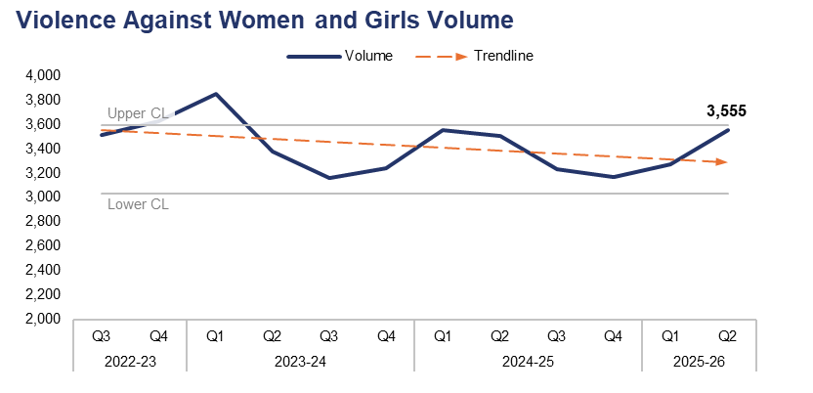
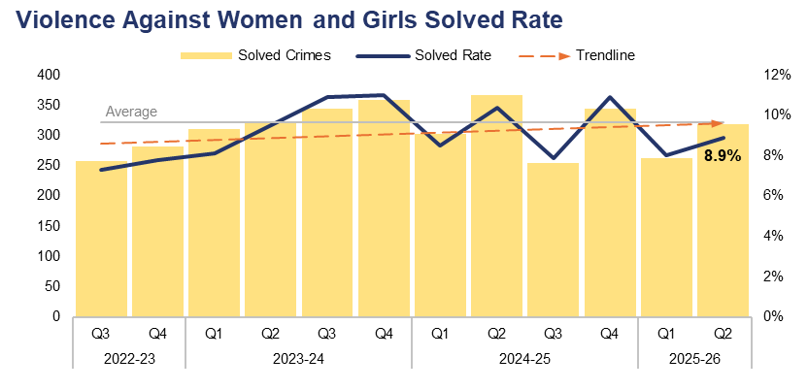
1. Violence Against Women and Girls
Financial Year | 21-22 | 22-23 | 23-24 | 24-25 |  | FYTD | 25-26 |  | Quarter | Q1 25-26 | Q2 24-25
Volume | 13,088 | 14,928 | 13,625 | 13,463 |  | Volume | 6,830 |  | % Change | 8.5% | 1.4%
Financial Year | 21-22 | 22-23 | 23-24 | 24-25 |  | FYTD | 25-26 |  | Quarter | Q1 25-26 | Q2 24-25
Solved Rate | 8.3% | 6.9% | 9.8% | 9.4% |  | Solved Rate | 8.5% |  | PP Change | 0.9 | -1.5
Operational Overview
A total of 3,555 crimes classified as Violence Against Women and Girls (VAWG) offences were recorded during Q2 2025-26, nearing the upper control limit. This represents an increase of 8.5% (280 additional offences) when compared to the quarter prior, and a less prominent increase 1.4% (50 additional offences) when compared to the same quarter during the previous financial year.
The solved rate for Q2 2025-26 stands at 8.9%, with 318 crimes solved. This is an increase of 0.9 percentage points when compared to the quarter prior, with 55 additional crimes solved. Conversely, a reduction of 1.5 percentage points can be observed when comparing Q2 2025-26 to the same quarter during the previous financial year, with 48 fewer crimes solved.
Gwent Police are key partners in the Welsh Government’s Violence Against Women, Domestic Abuse & Sexual Violence (VAWDASV) strategy. As such, the force sits on the Gwent VAWDASV Strategy multi-agency subgroups in areas including protected communities and characteristics, communications, and tackling perpetration.

Slide 31
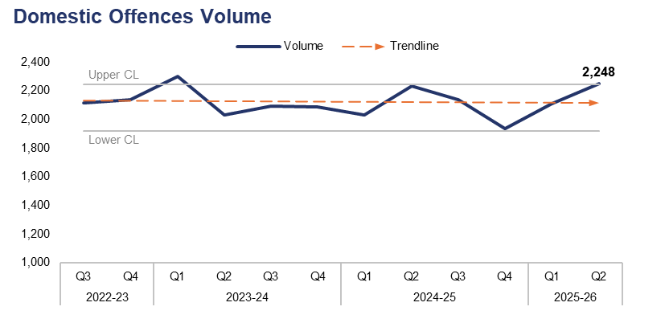
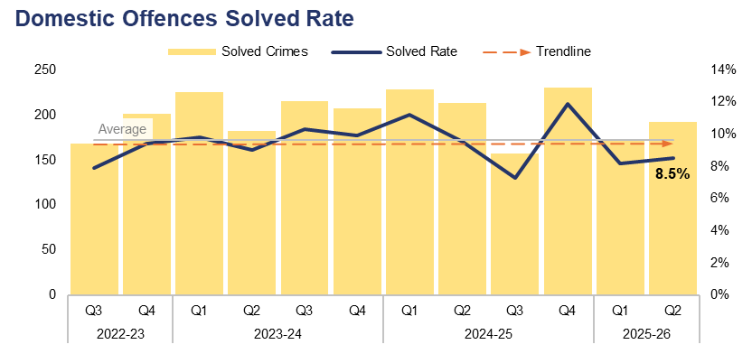
2. Domestic Offences
Financial Year | 21-22 | 22-23 | 23-24 | 24-25 |  | FYTD | 25-26 |  | Quarter | Q1 25-26 | Q2 24-25
Volume | 8,940 | 8,531 | 8,513 | 8,339 |  | Volume | 4,359 |  | % Change | 6.5% | 0.6%
Financial Year | 21-22 | 22-23 | 23-24 | 24-25 |  | FYTD | 25-26 |  | Quarter | Q1 25-26 | Q2 24-25
Solved Rate | 9.1% | 9.3% | 9.7% | 9.9% |  | Solved Rate | 8.4% |  | PP Change | 0.3 | -1.0
Operational Overview
The volume of crimes classified as domestic offences exceeded the upper control limit during Q2 2025-26, with 2,248 crimes recorded. This represents an increase of 6.5% (137 additional offences) when compared to the quarter prior, and a less prominent increase of 0.6% (14 additional offences) when compared to the same quarter during the previous financial year.
The solved rate for Q2 2025-26 stands at 8.5%, with 192 crimes solved. This represents an increase of 0.3 percentage points when compared to the quarter prior, with 19 additional crimes solved. Conversely, a reduction of 1.0 percentage point can be observed when comparing Q2 2025-26 to the same quarter during the previous financial year, with 21 fewer crimes solved.
For the purposes of this report, a domestic offence is defined as a crime which has been assigned a domestic abuse local qualifier and in which the victim and offender are both over 16 years of age, in accordance with the Domestic Abuse Act 2021. Offences assigned the qualifier but in which the age of the victim or offender has not been recorded have also been included, in order to prevent under-reporting.

Slide 32
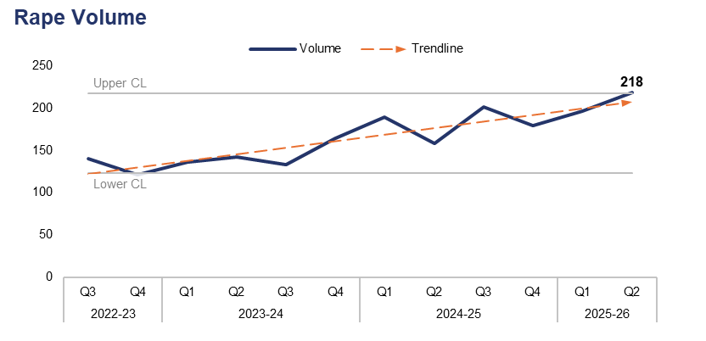
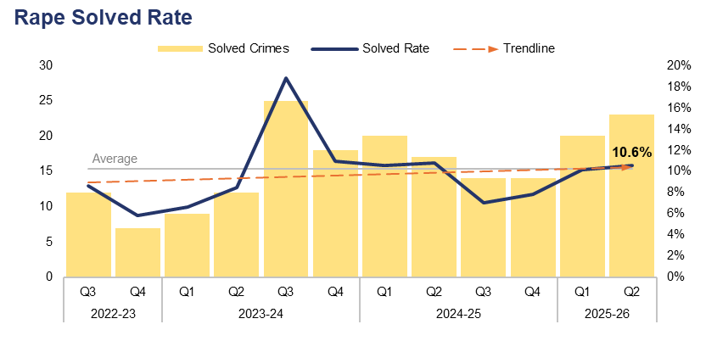
3. Rape
Financial Year | 21-22 | 22-23 | 23-24 | 24-25 |  | FYTD | 25-26 |  | Quarter | Q1 25-26 | Q2 24-25
Volume | 574 | 582 | 575 | 727 |  | Volume | 414 |  | % Change | 11.2% | 38.0%
Financial Year | 21-22 | 22-23 | 23-24 | 24-25 |  | FYTD | 25-26 |  | Quarter | Q1 25-26 | Q2 24-25
Solved Rate | 5.4% | 6.5% | 11.1% | 8.9% |  | Solved Rate | 10.4% |  | PP Change | 0.4 | -0.2
Operational Overview
During Q2 2025-26, 218 Rape offences were recorded. This exceeds the upper control limit, representing an increase of 11.2% (22 additional offences) when compared to the quarter prior, and a further increase of 38.0% (60 additional offences) when compared to the same quarter during the previous financial year.
The solved rate for Q2 2025-26 stands at 10.6%, with 23 crimes solved. This is an increase of 0.4 percentage points when compared to the quarter prior, with three additional crimes solved. A slight reduction of 0.2 percentage points can be observed when comparing Q2 2025-26 to the same quarter during the previous financial year, although six additional crimes have been solved.
Whilst there is a recent upward trend in the reporting of Rape, analysis and operational oversight indicates that much of this increase is due to the reporting of non-recent crimes. These reports often involve a single offender and multiple victims, or a single victim and multiple offences. This inflates the number of offences recorded, despite them being contained within a single investigation. The analyst team are working on a more nuanced performance product to readily identify this trend, or deviation from it.
There has been a consistent increase in Rape reports and investigative requirements nationally. Despite this, the force continues to improve outcomes. A Police Initial Recruitment has taken place in order to sustain this improvement and ensure effective service delivery, recognising the increase in demand and need for additional resources. This is particularly important if investigation timeliness is to be maintained or improved.

Slide 33
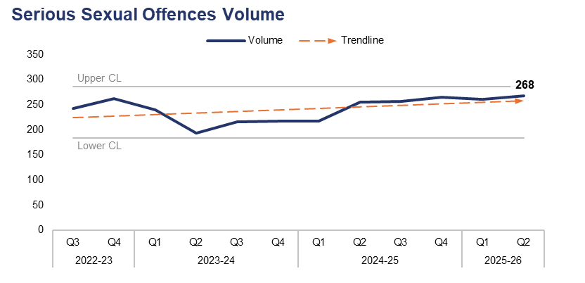
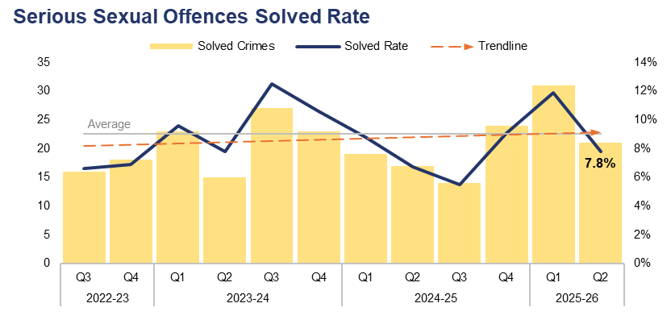
4. Serious Sexual Offences
Financial Year | 21-22 | 22-23 | 23-24 | 24-25 |  | FYTD | 25-26 |  | Quarter | Q1 25-26 | Q2 24-25
Volume | 924 | 1,002 | 866 | 993 |  | Volume | 529 |  | % Change | 2.7% | 5.1%
Financial Year | 21-22 | 22-23 | 23-24 | 24-25 |  | FYTD | 25-26 |  | Quarter | Q1 25-26 | Q2 24-25
Solved Rate | 6.3% | 6.2% | 10.2% | 7.5% |  | Solved Rate | 9.8% |  | PP Change | -4.1 | 1.1
Operational Overview
A total of 268 crimes classified as serious sexual offences were recorded during Q2 2025-26. This represents an increase of 2.7% (seven additional offences) when compared to the quarter prior, and a further increase of 5.1% (13 additional offences) when compared to the same quarter during the previous financial year.
The solved rate for Q2 2025-26 stands at 7.8%, with 21 crimes solved. This is a reduction of 4.1 percentage points when compared to the quarter prior, with ten fewer crimes solved. However, an increase of 1.1 percentage points can be observed when comparing Q2 2025-26 to the same quarter during the previous financial year, with four additional crimes solved.
The Rape and Serious Sexual Offences Scrutiny Panel reviews serious sexual offence investigations, identifying themes and areas of best practice within the force. In light of the Angiolini enquiry, Gwent Police has adopted a daily measure to identify non-contact sexual offending and ensure appropriate ownership based on risk. This is in recognition that non-contact offending can lead to more serious and harmful criminal sexual behaviours. This sustained focus on non-contact offending and increased training relating to stalking offences may have had an impact on the level of offences recorded during Q2 2025-26.
Rape offences have been excluded from this dataset.

Slide 34
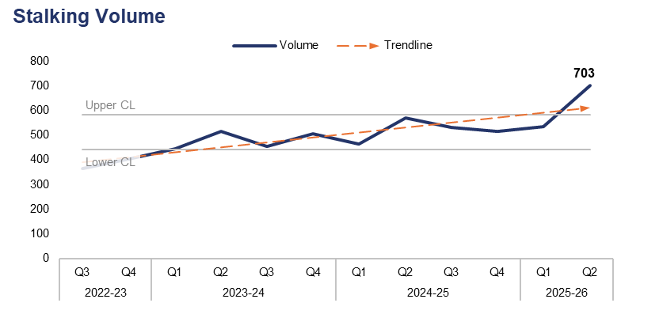
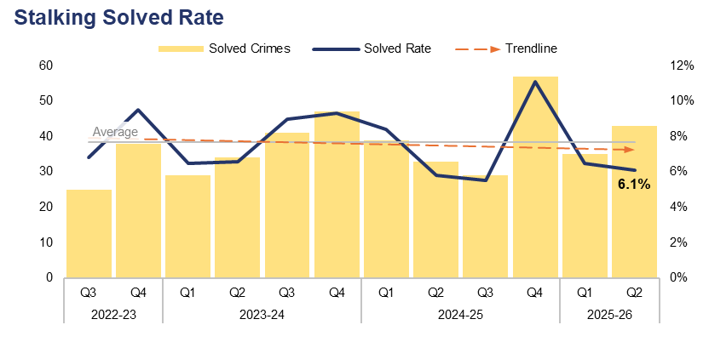
5. Stalking
Financial Year | 21-22 | 22-23 | 23-24 | 24-25 |  | FYTD | 25-26 |  | Quarter | Q1 25-26 | Q2 24-25
Volume | 1,440 | 1,551 | 1,923 | 2,081 |  | Volume | 1,239 |  | % Change | 31.2% | 23.1%
Financial Year | 21-22 | 22-23 | 23-24 | 24-25 |  | FYTD | 25-26 |  | Quarter | Q1 25-26 | Q2 24-25
Solved Rate | 7.6% | 8.0% | 7.9% | 7.6% |  | Solved Rate | 6.3% |  | PP Change | -0.4 | 0.3
Operational Overview
Overall, 703 offences classified as stalking were recorded during Q2 2025-26. This exceeds the upper control limit, representing a significant increase of 31.2% (167 additional offences) when compared to the quarter prior, and an increase of 23.1% (132 additional offences) when compared to the same quarter during the previous financial year.
The solved rate for Q2 2025-26 stands at 6.1%, with 43 crimes solved. This is a reduction of 0.4 percentage points when compared to the quarter prior, albeit with eight additional crimes solved. An increase of 0.3 percentage points can be observed when comparing Q2 2025-26 to the same quarter during the previous financial year, with ten additional crimes solved.
Further training around stalking offences has been rolled out. This is likely to have contributed to the significant increase in offence volume recorded during Q2 2025-26, as officers are now better able to identify these crimes.
The force is no longer conflating the offences of stalking and harassment, which are now reported on as separate entities. This is to recognise the gravity of both offences and the nuances of each with regards to investigation and prevention opportunities.

Slide 35
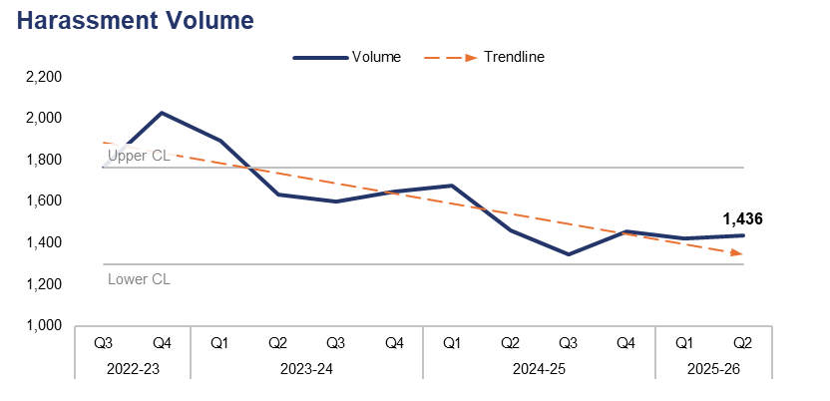
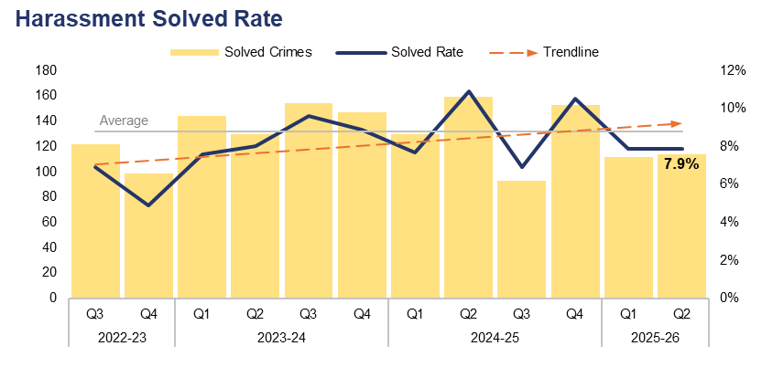
6. Harassment
Financial Year | 21-22 | 22-23 | 23-24 | 24-25 |  | FYTD | 25-26 |  | Quarter | Q1 25-26 | Q2 24-25
Volume | 6,512 | 7,502 | 6,780 | 5,943 |  | Volume | 2,858 |  | % Change | 1.0% | -1.7%
Financial Year | 21-22 | 22-23 | 23-24 | 24-25 |  | FYTD | 25-26 |  | Quarter | Q1 25-26 | Q2 24-25
Solved Rate | 7.8% | 5.5% | 8.5% | 9.0% |  | Solved Rate | 7.9% |  | PP Change | 0.0 | -3.0
Operational Overview
A total of 1,436 offences classified as harassment were recorded during Q2 2025-26. This represents a slight increase of 1.0% (14 additional offences) when compared to the quarter prior, but a reduction of 1.7% (25 fewer offences) when compared to the same quarter during the previous financial year.
The solved rate for Q2 2025-26 stands at 7.9%, with 114 crimes solved. This is equal to the quarter prior, albeit with two additional crimes solved. A reduction of 3.0 percentage points can be observed when comparing Q2 2025-26 to the same quarter during the previous financial year, with 45 fewer crimes solved.

Slide 36
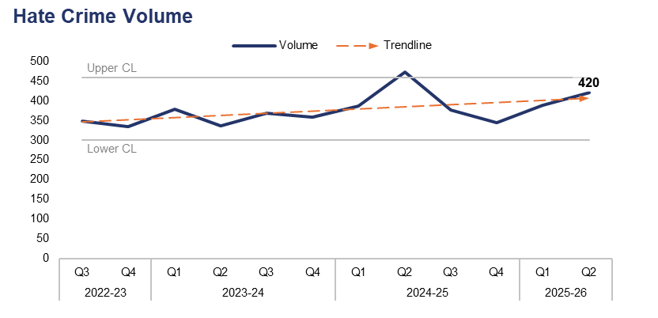
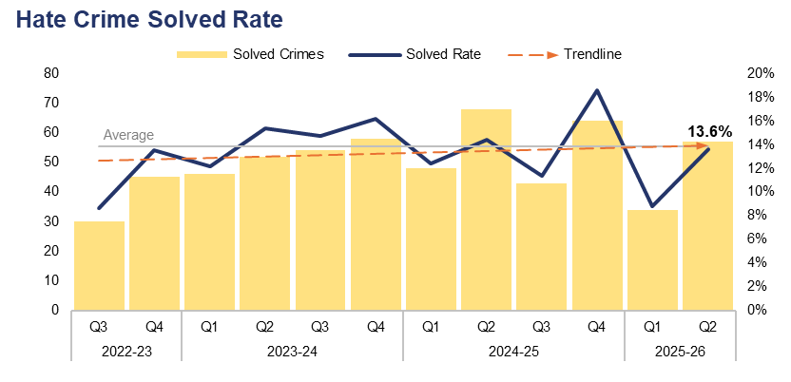
7. Hate Crime
Financial Year | 21-22 | 22-23 | 23-24 | 24-25 |  | FYTD | 25-26 |  | Quarter | Q1 25-26 | Q2 24-25
Volume | 1,416 | 1,442 | 1,442 | 1,580 |  | Volume | 808 |  | % Change | 8.2% | -11.2%
Financial Year | 21-22 | 22-23 | 23-24 | 24-25 |  | FYTD | 25-26 |  | Quarter | Q1 25-26 | Q2 24-25
Solved Rate | 11.5% | 9.2% | 14.6% | 14.1% |  | Solved Rate | 11.3% |  | PP Change | 4.8 | -0.8
Operational Overview
A total of 420 offences which met the definition of a hate crime were recorded during Q2 2025-26. This represents an increase of 8.2% (32 additional offences) when compared to the quarter prior, but a reduction of 11.2% (53 fewer offences) when compared to the same quarter during the previous financial year. Crimes assigned the racial hate strand were the most prevalent during Q2 2025-26, with 243 such offences recorded. Conversely, crimes assigned the religious hate strand were the least common, with 23 offences recorded.
The solved rate for Q2 2025-26 stands at 13.6%, with 57 crimes solved. This represents an increase of 4.8 percentage points when compared to the quarter prior, with 23 additional crimes solved. However, a reduction of 0.8 percentage points can be observed when comparing Q2 2025-26 to the same quarter during the previous financial year, with 11 fewer crimes solved.
Hate crimes are scrutinised internally through dip-sampling by neighbourhood inspectors using a best practice checklist. Hate crime data and trends are also discussed in the VAWG and Vulnerability meeting. The views of local communities on how safe they feel and how hate crime affects them are captured in the quarterly Hate Crime Scrutiny Panel and monthly Community Tensions Group, via representatives from an Independent Advisory Group. Hate crime data is also scrutinised at the Welsh Government’s Hate Crime and Community Tensions Board.
It is recognised that the force requires a refreshed list of Hate Crime Support Officers (HCSOs), who can provide a face-to-face support service for victims and advice to investigating officers on suggested lines of enquiry. An options paper is being prepared by the Operational Hate Crime Lead which will present various options for recruiting and training the HCSOs.
A single crime can be assigned multiple hate strands. The crime trend is based on recorded crimes, whilst the assessment of hate strands is based on the volume of each individual strand.

Slide 37
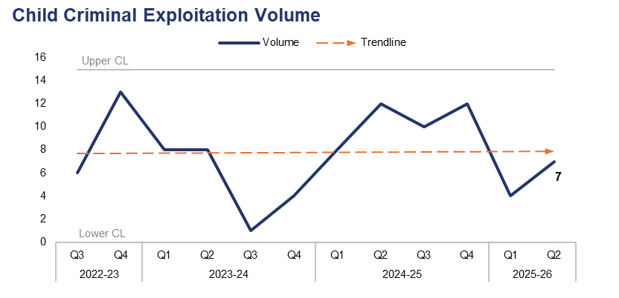

8. Child Criminal and Sexual Exploitation
Financial Year | 21-22 | 22-23 | 23-24 | 24-25 |  | FYTD | 25-26 |  | Quarter | Q1 25-26 | Q2 24-25
Volume | 1 | 20 | 21 | 42 |  | Volume | 11 |  | % Change | 75.0% | -41.7%
Financial Year | 21-22 | 22-23 | 23-24 | 24-25 |  | FYTD | 25-26 |  | Quarter | Q1 25-26 | Q2 24-25
Volume | 227 | 171 | 65 | 176 |  | Volume | 55 |  | % Change | -62.5% | -58.3%
Operational Overview
During Q2 2025-26, seven offences were assigned a child criminal exploitation local qualifier. This represents an increase of 75.0% (three additional offences) when compared to the quarter prior, but a reduction of 41.7% (five fewer offences) when compared to the same quarter during the previous financial year.
A total of 15 offences were assigned a child sexual exploitation local qualifier during Q2 2025-26. This is a reduction of 62.5% (25 fewer offences) when compared to the quarter prior, and a reduction of 58.3% (21 fewer offences) when compared to the same quarter during the previous financial year. It has been identified that this qualifier may have been over-used in the past.
The force is working to review Equality, Diversity, and Inclusion, data recording, and the use of flags and qualifiers, given that these factors have a significant impact on our understanding of this area of risk. The force is engaged with the National Child Sexual Exploitation Taskforce (formerly Operation Hydrant) and the National Crime Agency, following the government response and the Cassey Audit Review, whilst they develop an approach for the review of non-recent child sexual exploitation investigations – notably group-based offending.
The force is also reviewing its own data and risk recognition in this area, with the data quality issue for this crime category forming part of the Chief Superintendent led force data quality meeting. There is also governance and reporting on child sexual abuse and exploitation through the Regional Threat Group and Strategic Governance Group in order to provide a regional overview and understanding, as these patterns and issues are reflected nationally.
Use of the Child Criminal Exploitation local qualifier commenced during 2022, limiting the scope of the currently available dataset.

Slide 38

9. Missing Children
Financial Year | 21-22 | 22-23 | 23-24 | 24-25 |  | FYTD | 25-26 |  | Quarter | Q1 25-26 | Q2 24-25
Volume | 2,780 | 3,276 | 4,359 | 4,386 |  | Volume | 2,481 |  | % Change | 15.0% | 13.9%
Operational Overview
During Q2 2025-26, 1,327 missing person reports were created which pertained to a child. This is the highest quarterly figure within the three-year timeframe, exceeding the upper control limit and representing an increase of 15.0% (173 additional reports) when compared to the quarter prior. A similar increase of 13.9% (162 additional reports) can be observed when comparing Q2 2025-26 to the same quarter during the previous financial year. Seasonality appears to have a prominent impact on the volume of these reports.
A missing person report is created each time an individual is reported as missing. Several reports can be created for the same individual if they are reported as missing on multiple occasions.

Slide 39

10. Action Fraud
Financial Year | 21-22 | 22-23 | 23-24 | 24-25 |  | FYTD | 25-26 |  | Quarter | Q1 25-26 | Q2 24-25
Volume | 788 | 923 | 968 | 870 |  | Volume | 440 |  | % Change | 30.4% | 14.7%
Operational Overview
Overall, 249 action fraud occurrences were reported to Gwent Police via the National Fraud Intelligence Bureau during Q2 2025-26. This represents a significant increase of 30.4% (58 additional occurrences) when compared to the quarter prior, and a less prominent increase of 14.7% (32 additional occurrences) when compared to the same quarter during the previous financial year.
During Q2 2025-26, £44,300 of victim’s money was safeguarded by fraud investigations in Gwent. The total for the current FYTD stands at £240,840.
Financial investigators have utilised both criminal and civil asset orders to seize £1,114,731 during the current FYTD.
Vulnerable victims are identified and supported by the force’s dedicated financial abuse safeguarding officer, with a focus on those who are likely to be repeat victims. Safeguarding work is undertaken alongside partners to protect these individuals.

Slide 40

11. Cybercrime
Offences Most Commonly Classified as Cybercrime by Volume – Q2 2025-26
Offence Title | Volume | % of Total
Protection from Harassment Act Section 2 | 292 | 17.1%
Pursue course of conduct which amounts to stalking | 291 | 17.0%
Putting people in fear of violence | 180 | 10.5%
Section 4A POA Causing intentional harassment, alarm or distress | 114 | 6.7%
Take/make indecent photographs/ pseudo-photographs of children | 93 | 5.4%
Quarter | Q2 24-25 | Q3 24-25 | Q4 24-25 | Q1 25-26 | Q2 25-26 |  | Quarter | Q1 25-26 | Q2 24-25
Volume | 1,234 | 1,201 | 1,422 | 1,538 | 1,711 |  | % Change | 11.2% | 38.7%
Operational Overview
A total of 1,711 offences recorded during Q2 2025-26 were classified as cybercrime, as defined by the NDQIS reporting system. This represents an increase of 11.2% (173 additional offences) when compared to the quarter prior, and a significant increase of 38.7% (477 additional offences) when compared to the same quarter during the previous financial year.
During Q2 2025-26, two of the five offence types which were most commonly classified as cybercrime can be defined as harassment offences, with a third defined as a stalking offence. Overall, crimes classified as either a harassment offence or a stalking offence accounted for 59.0% of all cybercrime recorded during the quarter, with 1,009 offences reported. This is an increase of 0.4 percentage points when compared to the quarter prior (107 additional offences).
The Cyber Crime Unit continue to work with the region, businesses, and public services to protect communities from cyber crime. This involves working with schools to educate young people, and with businesses to increase their understanding of the risks and strengthen their cyber security. As a result, there has been a significant increase in the number of disruptions recorded by the Cyber Crime Unit, with 195 reported in the last six months. This represents an increase of 214.5% (133 additional disruptions) when compared to the six months prior.
Cybercrime reporting via the NDQIS system was first adopted by the force during June 2024, limiting the scope of the currently available dataset.

Slide 41
12. Protecting the Vulnerable – Emerging Issues
Operational Overview
The force participated in research in conjunction with the University of the West of England regarding the role of the Sex Worker Liaison Officer, and is looking to develop this to improve engagement with this hard-to-reach community. There is an intention to build on this further by developing a risk assessment tool for sex workers, to ensure a bespoke risk recognition approach to this high-harm area of vulnerability and VAWG.

Slide 42
Pillar Four – Putting Victims First
Investigation Timeliness
Victims and Repeat Victims
Victim Satisfaction
Putting Victims First – Emerging Issues

Slide 43

1. Investigation Timeliness
Financial Year | 21-22 | 22-23 | 23-24 | 24-25 |  | FYTD | 25-26 |  | Quarter | Q1 25-26 | Q2 24-25
Median Timeliness | 25 | 41 | 22 | 31 |  | Median Timeliness | 34 |  | % Change | 86.4% | 64.0%
Operational Overview
During Q2 2025-26, the median investigation length was 41 days. This is the highest quarterly figure within the three-year timeframe, representing a significant increase of 86.4% (19 additional days) when compared to the quarter prior, and an increase of 64.0% (16 additional days) when compared to the same quarter during the previous financial year.
It is recognised that whilst investigation timeliness is key for victims, an investigation also has to be proportionate and effective. A balance must be struck between investigation quality and timeliness. This messaging will form part of the quality of investigation framework going forward.
Gwent Police are participating in the Domestic Abuse Charging Pilot, which is intended to improve investigation timeliness by allowing police to charge non-remand guilty anticipated plea domestic abuse cases. The earlier charging process is designed to enable immediate safeguarding measures, secure quicker access to protective orders, and potentially reduce victim attrition, supporting a more efficient investigative procedure and faster case progression within the justice system.

Slide 44


2. Victims & Repeat Victims
Financial Year | 21-22 | 22-23 | 23-24 | 24-25 |  | FYTD | 25-26 |  | Quarter | Q1 25-26 | Q2 24-25
Volume | 35,982 | 37,784 | 38,790 | 39,271 |  | Volume | 19,926 |  | % Change | 5.9% | 1.4%
Financial Year* | 21-22 | 22-23 | 23-24 | 24-25 |  | FYTD* | 25-26 |  | Quarter | Q1 25-26 | Q2 24-25
Volume | 7,480 | 8,267 | 7,281 | 7,252 |  | Volume | 7,167 |  | % Change | 1.2% | -0.2%
Operational Overview
Overall, 10,249 unique victims were linked to crimes recorded during Q2 2025-26. This is the highest quarterly figure within the three-year timeframe, representing an increase of 5.9% (572 additional victims) when compared to the quarter prior, and a less prominent increase of 1.4% (142 additional victims) when compared to the same quarter during the previous financial year.
During the 12 months to the end of Q2 2025-26, 7,167 victims were linked in this capacity to two or more separate offences, classifying them as repeat victims. This is an increase of 1.2% (85 additional repeat victims) when compared to the 12 months to the of end of the quarter prior, but a slight reduction of 0.2% (14 fewer repeat victims) when compared to the 12 months to the end of the same quarter during the previous financial year.
The ‘Victim Care’ guiding principle of the Quality of Investigations and Victim Care Change Programme aims to improve understanding and recording principles, to ensure that appropriate and tailored services are delivered to victims of crime.
Gwent Police Victim Care Unit continue to work collaboratively alongside Victim Support, a service commissioned by the OPCC to deliver ongoing assistance to victims.
For the purposes of this report, a repeat victim is defined as an individual who has been linked in this capacity to two or more separate offences within a 12-month period.
*In this case the FYTD and current quarter figures both refer to the 12 months to the end of Q2 2025-26. Financial year totals are based on the 12 months to the end of their fourth quarters.

Slide 45
3. Victim Satisfaction
Victim Satisfaction Survey Data: Q1 2024-25 – Q2 2025-26
Survey Question | Percentage of Respondents Satisfied | Quarter-on-Quarter Difference |  | Number of Respondents Satisfied | Total Responses Received
How satisfied are you with the ease of initial contact with the Police? | 78% | - | à | 344 | 443
How satisfied are you with the response time to your contact? (e.g. how long it took for your call to be answered) | 76% | +1% | á | 337 | 445
Overall, how satisfied are you with your experience of the first point of contact with the police? | 75% | +1% | á | 333 | 446
If an officer attended, how satisfied are you with the time it took for them to arrive? | 85% | - | à | 200 | 234
How satisfied are you with the actions taken by the attending officer/s? | 75% | -1% | â | 182 | 244
Thinking about your overall experience, how satisfied are you with the treatment you have received from Gwent Police? | 65% | - | à | 287 | 443
Overview
A total of 448 respondents have engaged with the victim satisfaction survey between Q1 2024-25 and Q2 2025-26 inclusive. Of those who replied to the given question, 85% of respondents were satisfied with officer attendance times, whereas only 65% of respondents were satisfied with the overall treatment they received from Gwent Police. When compared to the quarter prior, the percentage of satisfied respondents has either increased or remained steady for all but one of the above metrics.
Improving the trust and confidence of victims is a core part of how Gwent Police seeks to deliver its services. It is recognised that the initial satisfaction rates regarding contact and attendance are much higher than overall satisfaction rates following interaction with investigators. This will serve as a benchmark of performance for the Quality of Investigations and Victim Care Change Programme and is an area of business that is likely to see improvements through the delivery of this programme. The victim satisfaction survey is currently under review, with the support of Victim Services and the OPCC. This review aims to determine the efficacy of the survey and create a tool that improves feedback and associated insights into Police and Partnership practice.
All questions within the survey are optional, which may result in a disparity between the number of responses received for each question.

Slide 46
4. Putting Victims First – Emerging Issues
Operational Overview
The change programme seeks to implement improvements in how all investigators care for victims, seeking to embed meaningful and purposeful interactions with victims at every stage of the investigation. Work is progressing to fully understand operational practices and seek feedback from frontline practitioners. This not only puts victim care at the forefront of everything we do but ensures that those who deliver the service continue to improve the trust and confidence of our communities by delivering a connected service that cares about getting it right and doing the right thing.
Governance arrangements in the force ensure that victim’s voices are at the forefront of the priorities of policy makers, investigators and Victim Services. The Survivor Engagement Coordinator brings together the collective voices of a committed advisory group, acting as a stakeholder group who are willing to advise and challenge Gwent Police on the services it delivers.
The Head of Victim Services has worked with other Welsh leads to deliver consistent Victims' Code of Practice reporting metrics, in order to create a common language and performance framework for all Welsh forces. The Head of Victim Services and an analyst are also engaged with the Ministry of Justice Analytical Working Group, a forum to provide insights to help develop the national framework for the Victims’ Code compliance metrics.

Slide 47
Pillar Five – Reducing Reoffending
Offenders and Repeat Offenders
Young Offenders and First-Time Entrants
Children in Police Custody
Reducing Reoffending – Emerging Issues

Slide 48


1. Offenders & Repeat Offenders
Financial Year | 21-22 | 22-23 | 23-24 | 24-25 |  | FYTD | 25-26 |  | Quarter | Q1 25-26 | Q2 24-25
Volume | 25,098 | 25,538 | 26,444 | 27,047 |  | Volume | 13,442 |  | % Change | 0.4% | -3.6%
Financial Year* | 21-22 | 22-23 | 23-24 | 24-25 |  | FYTD* | 25-26 |  | Quarter | Q1 25-26 | Q2 24-25
Volume | 6,471 | 7,056 | 7,466 | 7,062 |  | Volume | 6,880 |  | % Change | -1.1% | -1.5%
Operational Overview
Overall, 6,736 unique offenders were linked to crimes recorded during Q2 2025-26. This represents a slight increase of 0.4% (30 additional offenders) when compared to the quarter prior, but a reduction of 3.6% (249 fewer offenders) when compared to the same quarter during the previous financial year.
During the 12 months to the end of Q2 2025-26, 6,880 offenders were linked in this capacity to two or more separate offences, classifying them as repeat offenders. This is the lowest quarterly figure within the three-year timeframe, representing a reduction of 1.1% (78 fewer repeat offenders) when compared to the 12 months to the of end of the quarter prior, and a similar reduction of 1.5% (102 fewer repeat offenders) when compared to the 12 months to the of end of the same quarter during the previous financial year.
For the purposes of this report, a repeat offender is defined as an individual who has been linked in this capacity to two or more separate offences within a 12-month period. This does not necessarily mean that they have been charged with or found guilty of the offence in question.
*In this case the FYTD and current quarter figures both refer to the 12 months to the end of Q2 2025-26. Financial year totals are based on the 12 months to the end of their fourth quarters.

Slide 49


2. Young Offenders and First-Time Entrants
Financial Year | 21-22 | 22-23 | 23-24 | 24-25 |  | FYTD | 25-26 |  | Quarter | Q1 25-26 | Q2 24-25
Volume | 4,253 | 4,717 | 4,994 | 4,908 |  | Volume | 2,177 |  | % Change | -7.3% | -9.2%
Financial Year | 21-22 | 22-23 | 23-24 | 24-25 |  | FYTD | 25-26 |  | Quarter | Q1 25-26 | Q2 24-25
Volume | 2,101 | 2,110 | 2,054 | 2,018 |  | Volume | 885 |  | % Change | -17.5% | -10.5%
Operational Overview
A total of 1,047 unique offenders under the age of 18 were linked to crimes recorded during Q2 2025-26. This is the lowest quarterly figure within the three-year timeframe, a reduction of 7.3% (83 fewer young offenders) when compared to the quarter prior, and a reduction of 9.2% (106 fewer young offenders) when compared to the same quarter during the previous financial year.
Of these young offenders, 400 (38.2% of the quarterly total) have been identified as first-time entrants into the criminal justice system within Gwent. This is also the lowest quarterly figure within the timeframe, representing a reduction of 17.5% (85 fewer entrants) when compared to the quarter prior, and a less prominent reduction of 10.5% (47 fewer entrants) when compared to the same quarter during the previous financial year.
The force is striving to ensure that young offenders are seen as children and dealt with appropriately, with a focus on restorative processes to divert them from future offending and the criminal justice process. The force is currently leading an all-Wales approach to standardising processes between the four Welsh forces and their corresponding Youth Justice Services, focusing on child-centric procedures and out of court disposals. Governance arrangements into the Wales Youth Justice Advisory Panel and the Criminal Justice Board provide accountability for service delivery. This is supported by the Youth Justice Board as part of a collaborative improvement programme.
The age of the offenders included in this dataset has been calculated based on the committed date of the offence they were linked to. This does not necessarily mean that they have been charged with or found guilty of the offence in question. The dataset used to identify first-time entrants is limited to offences committed within Gwent from 2018 onwards. Offences committed outside of Gwent or prior to 2018 are not included in this calculation.

Slide 50

3. Children in Police Custody
Financial Year | 21-22 | 22-23 | 23-24 | 24-25 |  | FYTD | 25-26 |  | Quarter | Q1 25-26 | Q2 24-25
Volume | 520 | 541 | 613 | 751 |  | Volume | 290 |  | % Change | 0.0% | -28.9%
Operational Overview
During Q2 2025-26, 145 custody records were created which had a juvenile subject. This is equal to the quarter prior but represents a significant reduction of 28.9% (59 fewer custody records) when compared to the same quarter during the previous financial year.
Where juvenile suspects are involved, greater focus has been placed on avoiding contact with custody processes and units in which the adverse experience is heightened. Voluntary attendance and available diversion outside of the criminal justice system ensures positive outcomes for both victims and children who have offended.
Significant daily scrutiny is in place around children in custody, to ensure that any time spent in custody is necessary and proportionate to the offences being investigated. There is also now governance in place regarding the Children and Young Persons Strategy published by the National Police Chiefs Council. ‘Children as Offenders’ and ‘Children and Coercive Police Powers’ comprise two of the four strands of this strategy, ensuring that any issues in relation to diversion and reducing offending are properly managed. Children in police custody also features as a theme in the Local Criminal Justice Board, chaired by the OPCC.
The above figures are based on custody footfall, which is the number of custody records with an arrival time within the specified timeframe. As such, if a subject came into custody on multiple occasions, they will be counted upon each arrival.

Slide 51
4. Reducing Reoffending – Emerging Issues
Operational Overview
Legislative changes allowing for eligible offenders to be released after serving one third of their sentence represent an emerging issue for policing, specifically the Integrated Offender Management (IOM) team and probation services. This is currently being reviewed by statutory agencies in order to understand the impact and scale of the additional demand that could be placed on services. The independent sentencing review is likely to gain royal assent in February 2026. The IOM team are working towards a multi-agency plan to manage the incoming demand and are seeking to improve processes for identifying individuals who are suitable for removal from the cohort due to consistent positive qualifiers, as per the IOM doctrine.

