Slide 1
Strategy Performance Board
Summary Document
Quarter 3 2023-24
Notes:
Operational Performance Board

Slide 2
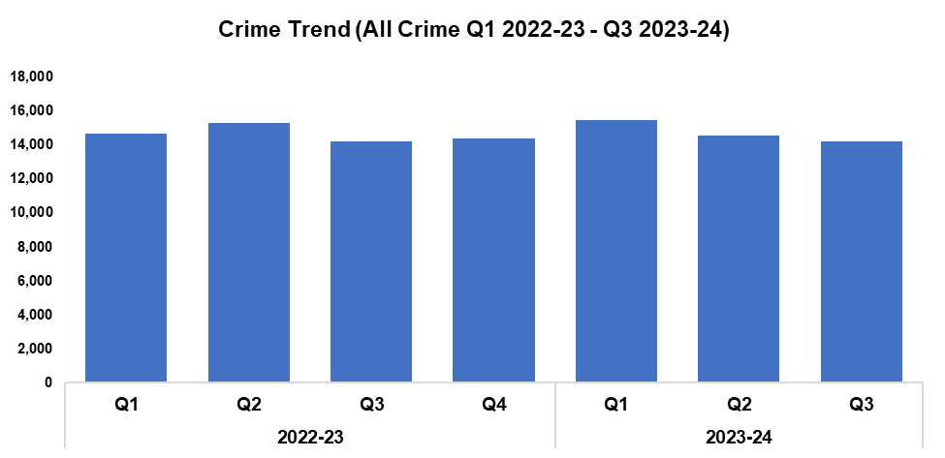
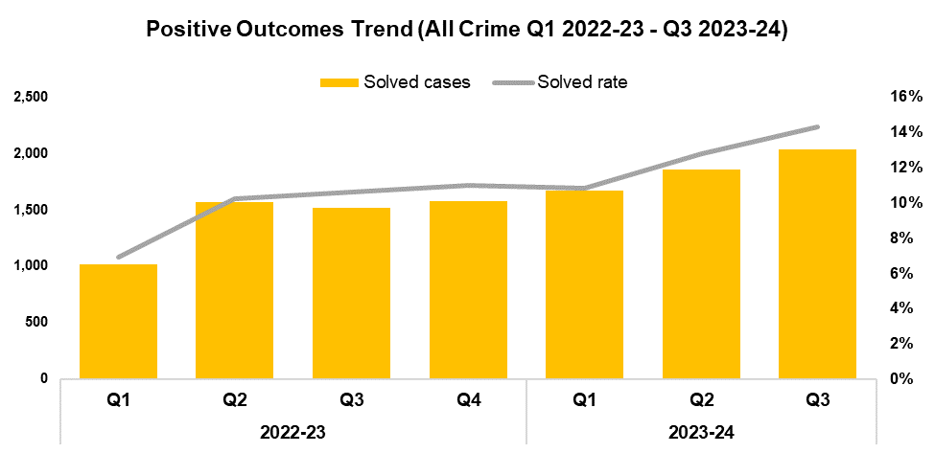


All Crime
Overview
Overall crime levels have fallen by 2.1% during the third quarter of the 2023-24 financial year (Q3 2023-24) when compared the quarter prior, with 312 fewer offences recorded for a total of 14,229. A slight increase of 0.1% (nine additional offences) can be observed when comparing Q3 2023-24 against the same quarter during the previous financial year. A minor increase of less than 0.1% (nine additional offences) has been recorded when comparing the current financial year to date (FYTD) against FYTD 2022-23.
The timeframe presented in this report has been limited to Q1 2022-23 onwards, excluding the financial years of 2020-21 and 2021-22 as they were anomalous due to the influence of COVID-19.
When compared to the previous quarter, the overall solved rate has risen by 1.5 percentage points to 14.3%, the highest quarterly figure within the timeframe. With the exception of Q1 2023-24, a quarter-on-quarter increase in solved rate can be observed throughout the recording period. The number of solved crimes has also increased when compared to the quarter prior, rising by 9.6% (179 additional solved crimes) for a total of 2,034. This represents the highest quarterly total within the timeframe, continuing the upward trend for this metric observed following Q3 2022-23.
The solved rate for Q3 2023-24 is 3.7 percentage points above that recorded for the same quarter during the previous financial year, with an additional 520 crimes solved. Similarly, the solved rate for the current FYTD is 3.3 percentage points higher than that observed during FYTD 2022-23, with an additional 1,463 crimes solved.

Slide 3
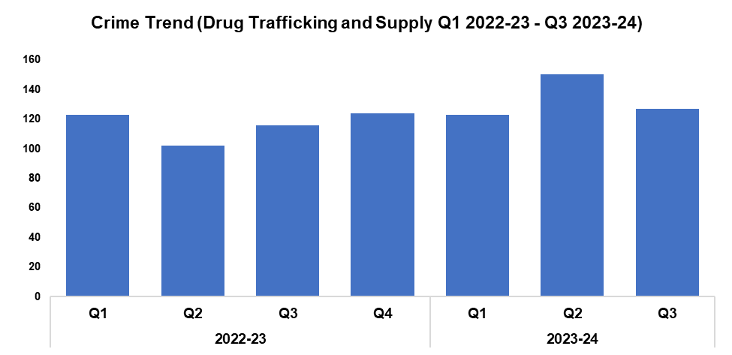

Drug Supply and Organised Crime
Overview
Drug Trafficking and Supply offences have seen a reduction of 15.3% when compared to the quarter prior, with 23 fewer offences recorded for a total of 127.
Conversely, an increase of 9.5% (11 additional offences) can be observed when comparing Q3 2023-24 against the same quarter during the previous financial year. A more prominent increase of 17.3% (59 additional offences) has been recorded when comparing the current FYTD against FYTD 2022-23, owing to the elevated levels reported during Q2 2023-24.
2,073 Drug Supply and Dealing intelligence logs were submitted during Q3 2023-24. This is an increase of 29.0% (466 additional logs) when compared to the quarter prior, and represents the highest quarterly total within the timeframe.
An increase of 44.8% (641 additional logs) can be observed when comparing Q3 2023-24 against the same quarter during the previous financial year, with a less prominent increase of 15.9% (721 additional logs) recorded when comparing the current FYTD against FYTD 2022-23.
Operation Forester commenced in the East Local Policing Area (LPA), following the discovery of several cannabis cultivations within disused buildings in Newport City Centre. To date, 14 cannabis cultivations have been located, which are estimated to have caused the National Grid a loss of £1.5 million. Nine investigations are currently ongoing, and 17 arrests have been made. 11,400 plants have been recovered so far, with the total value of recovered assets estimated to be between £2.5 million and £7.5 million.
A warrant was executed in Ringland, Newport, which resulted in two arrests and the seizure of a large amount of heroin. Both suspects have since been charged and remanded for drug offences. Another warrant under the Misuse of Drugs Act was executed at an address in Caldicot, Monmouthshire, resulting in the location of a cannabis cultivation. A male was arrested, charged, and has pleaded guilty to drug production offences. On the 18th of January he was sentenced to 28 months imprisonment.
The Organised Crime Unit have conducted a number of robust investigations over the the last quarter, resulting in significant seizures of controlled drugs and assets. These include:
Operation Silver, the dismantling of an OCG which was completed during December 2023. A total of 13 suspects were charged in relation to the supply of heroin, cocaine and MDMA from several addresses across Gwent, with nine suspects being placed on remand. One suspect was arrested in Cambodia for an unconnected matter, with arrangements in hand to extradite them back to the UK.
Operation Mayland, a large-scale enforcement operation which took place on the 5th of December 2023. This resulted in four men being charged and remanded for conspiracy to supply wholesale quantities of cocaine, along with the seizure of £242,000 in cash. The principal offender was also charged with being concerned in the supply of 28kg of cocaine and 17kg of heroin.

Slide 4
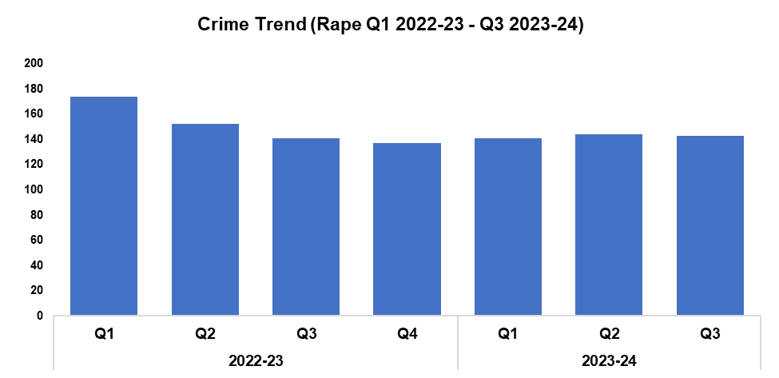
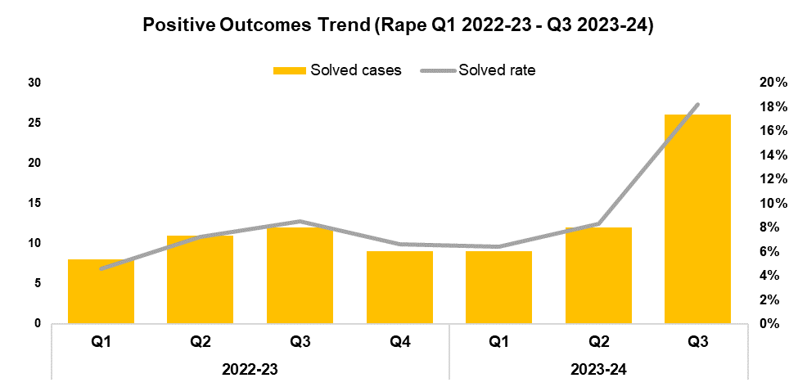


Rape
Overview
Rape offences have seen a reduction of 0.7% when compared to the quarter prior, with one fewer offence recorded for a total of 143. Whilst minor, this reduction disrupts the upward trend in offence volume observed following Q4 2022-23, and runs counter to the goal of increased reporting stipulated in the government’s Beating Crime Plan. An increase of 1.4% (two additional offences) can be observed when comparing Q3 2023-24 against the same quarter during the previous financial year. Conversely, a reduction of 8.4% (39 fewer offences) has been recorded when comparing the current FYTD against FYTD 2022-23, owing to the elevated levels observed during Q1 2022-23.
When compared to the previous quarter the solved rate for Rape offences has risen by 9.9 percentage points to 18.2%, with 14 additional crimes solved for a total of 26. This represents the highest quarterly solved rate within the timeframe by a significant margin. A similar increase of 9.7 percentage points (14 additional crimes solved) can be observed when comparing Q3 2023-24 against the same quarter during the previous financial year, with a less prominent increase of 4.4 percentage points recorded when comparing the current FYTD against FYTD 2022-23 (16 additional crimes solved).

Slide 5
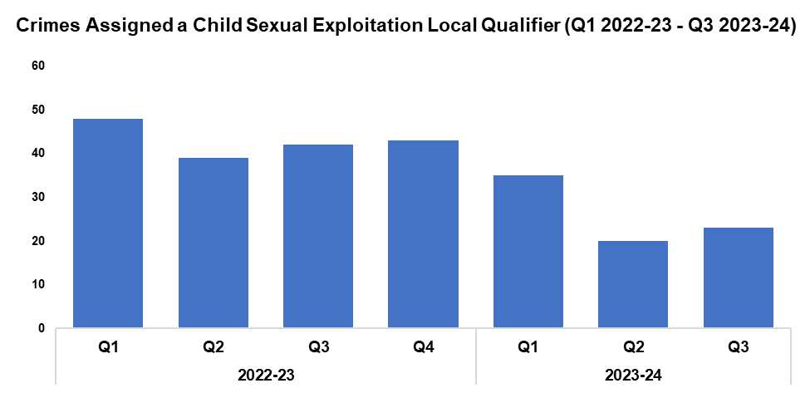

6. Child Sexual Exploitation/Child Criminal Exploitation
Overview
The number of crimes assigned a Child Sexual Exploitation (CSE) local qualifier has increased by 15.0% when compared to the quarter prior, with three additional crimes recorded for a total of 23. Whilst this disrupts the downward trend in offence volume observed following Q4 2022-23, it remains the second-lowest quarterly figure within the timeframe. A substantial reduction of 45.2% (19 fewer crimes) can be observed when comparing Q3 2023-24 against the same quarter during the previous financial year, with a similar reduction of 39.5% (51 fewer crimes) recorded when comparing the current FYTD against FYTD 2022-23.
The offence most commonly assigned a CSE local qualifier during Q3 2023-24 was Take/make indecent photographs/pseudo-photographs of children, with 11 instances. This accounts for 47.8% of all crimes assigned a CSE local qualifier during the quarter.
As with other forces, Gwent Police have seen an increase in reports of students vaping tetrahydrocannabinol (THC) in an education establishment. This has resulted in sickness, and on occasion loss of consciousness and hospitalisation. The majority of reports have indicated that the child has had no knowledge of the vape containing any form of illegal substance. In light of this the spiking protocol has been followed, with positive action taken against the offender.
Gwent Police are aware that these vapes are being utilised as a tool for exploitation. As such, all recent cases of spiking via vape have been brought to the attention of the Exploitation Team. Operation Quartz has sought to ensure that urgent action has been taken to safeguard children against the risks associated with obtaining controlled drugs, with disruption tactics being utilised against offenders to remove their capability to supply these drugs to children. In addition to this, school liaison officers have been tasked with identifying a single point of contact within education establishments, in order to assist in delivering a Prevent/Protect/Prepare response to any suspected drug supply.
During Operation Chestnut the Public Protection Unit worked alongside the Serious Organised Crime Team to disrupt criminal exploitation, following an incident in which a 12-year-old was admitted to hospital after suffering adverse effects from a THC-laced vape in an education establishment. The ensuing investigation was led by the Exploitation Team and highlighted a drugs line, along with the exploitation of other children, with links throughout the West LPA and Newport. As a result, two adults were arrested and a warrant was executed at their home address. Both subjects were subsequently charged with 19 drug related offences, with one offender being remanded in custody.

Slide 6
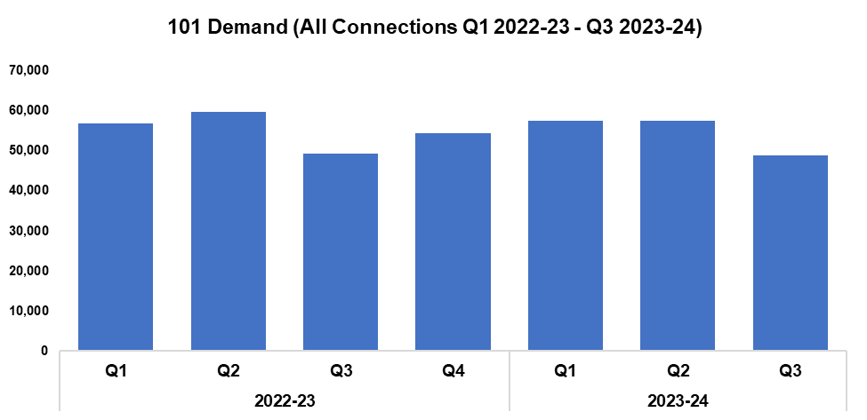
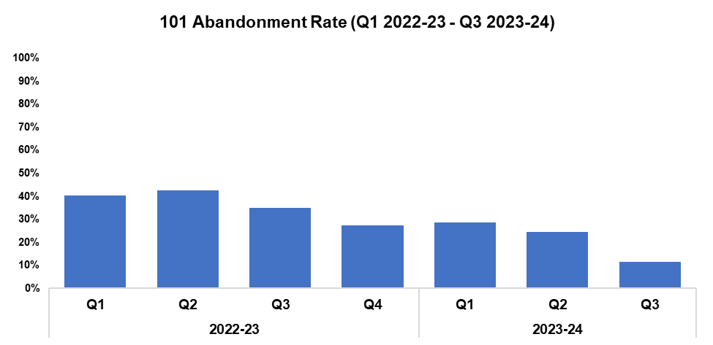



101 Demand
Overview
101 demand (all connections) has decreased by 14.9% when compared to the quarter prior, with 8,585 fewer calls received for a total of 48,881. This represents the lowest quarterly figure within the timeframe. A less prominent reduction of 0.9% (433 fewer calls) can be observed when comparing Q3 2023-24 against the same quarter during the previous financial year, with demand falling by 1.2% (2,061 fewer calls) when comparing the current FYTD against FYTD 2022-23.
The 101 abandonment rate has decreased by 13.0 percentage points when compared to the quarter prior, and currently stands at 11.4%. This represents the lowest quarterly figure within the timeframe. The 101 abandonment rate has also improved significantly when comparing Q3 2023-24 against the same quarter during the previous financial year (down 23.6 percentage points), and when comparing the current FYTD against FYTD 2022-23 (down 17.5 percentage points to 21.9%).
101 Average Answer Speed
(Minutes/Seconds)
The average answer speed for 101 calls during Q3 2023-24 was two minutes and 20 seconds, an improvement of two minutes and 45 seconds when compared to the quarter prior. This represents the fourth consecutive improvement in performance, and the lowest quarterly figure with the timeframe.
The average speed of answer has improved by seven minutes and 21 seconds when comparing Q3 2023-24 against the same quarter during the previous financial year. When comparing the current FYTD against FYTD 2022-23, the average answer speed has improved by three minutes and 18 seconds, down to four minutes and 35 seconds.

