Slide 1
Strategy Performance Board
Quarter 2 2023-24

Slide 2
Keeping Neighbourhoods Safe
All Crime
Beating Crime Plan
Residential Burglary
Neighbourhood Crime
Public Order
Anti-Social Behaviour
Roads Policing
Key Commitments
Reduce public order offences and anti-social behaviour, and the number of people who repeatedly carry out these acts.
Reduce acquisitive crime and repeat offenders.
Improve the safety of roads throughout Gwent.
Commission and invest in effective crime prevention initiatives.

Slide 3
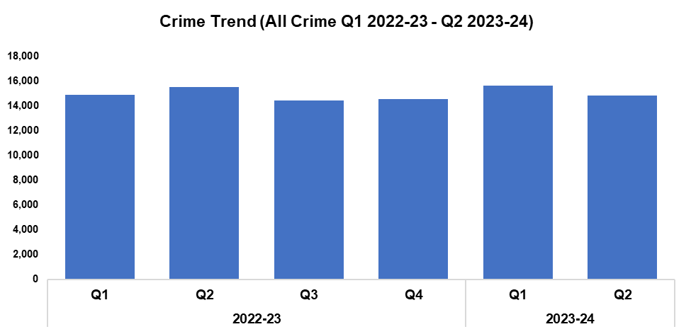
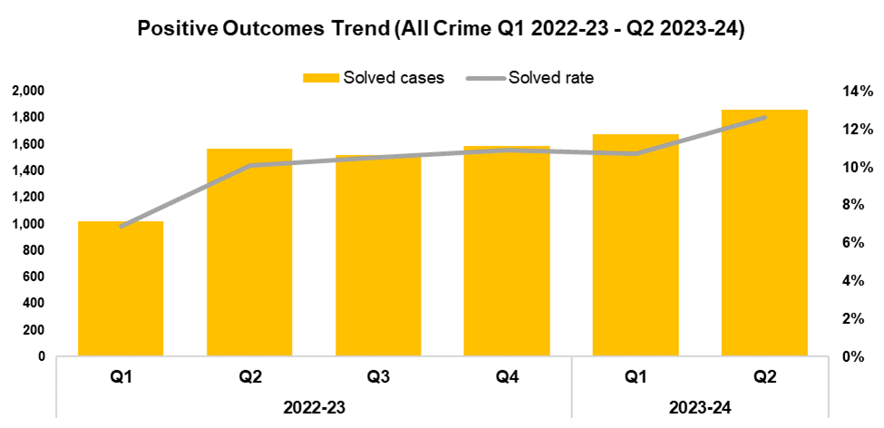


1. All Crime
Overview
Overall crime levels have fallen by 5.4% during the second quarter of the 2023-24 financial year (Q2 2023-24) when compared the quarter prior, with 847 fewer offences recorded for a total of 14,790. A reduction of 4.7% (723 fewer offences) can be observed when comparing Q2 2023-24 against the same quarter during the previous financial year. Conversely, a slight increase of 0.1% (23 additional offences) has been recorded when comparing the current financial year to date (FYTD) against FYTD 2022-23.
The timeframe presented in this report has been limited to Q1 2022-23 onwards, excluding the financial years of 2020-21 and 2021-22 as they were anomalous due to the influence of COVID-19.
When compared to the previous quarter, the overall solved rate has risen by 1.9 percentage points to 12.6%. This increase resumes the upward trend which had been observed following Q1 2022-23, after it was disrupted by the decline recorded during Q1 2023-24. The number of solved crimes has continued to increase, rising by 10.8% (181 additional crimes solved) when compared to the quarter prior. This is despite the reduction in overall crime volume observed during Q2 2023-24.
The solved rate for Q2 2023-24 is 2.5 percentage points above that recorded for the same quarter during the previous financial year, with an additional 288 crimes solved. Similarly, the solved rate for the current FYTD is 3.1 percentage points higher than that observed during FYTD 2022-23 (with an additional 942 crimes solved), influenced by the reduced solve rate recorded during Q1 2022-23.

Slide 4
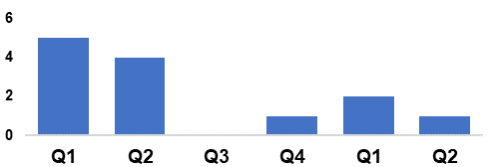
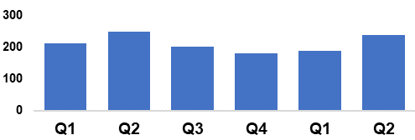
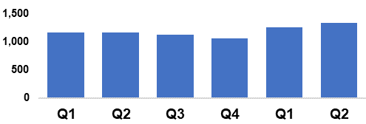
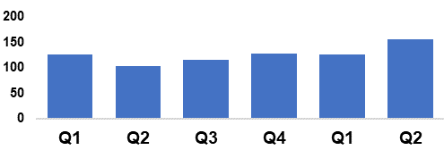
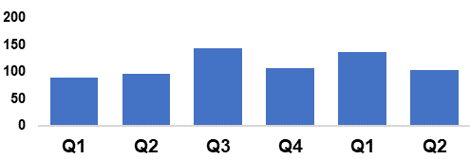
2. Beating Crime Plan
Crime Trend (Homicide Q1 2022-23 – Q2 2023-24)
A three year Homicide Prevention Strategy is in place, supported by a delivery plan, with the goal of furthering our understanding of the national and local themes and drivers that are likely to be precursors to Homicide.
The plan includes an examination of the enabling factors that contribute to Homicide (such as mental health, alcohol misuse, and weapons), with a view to early intervention and prevention. The links between Homicide and serious organised crime, domestic abuse, and the night-time economy have also been recognised.
This will be facilitated in part by improving our joint working and information sharing with partner agencies.
Homicide
Crime Trend (Serious Violence Q1 2022-23 – Q2 2023-24)
Gwent Police utilises a problem-solving, partnership-based approach to preventing Serious Violence.
This approach is supported by a Serious Violence prevention strategy and delivery plan, which aim to reduce and where possible prevent harm to members of the community.
Particular focus has been placed on night-time economy related violence, knife related violence, robbery, drug related gang violence, and acid/corrosive substance attacks.
Tasking structures are in place to monitor active Organised Crime Groups (OCGs) and high-harm offenders.
Serious Violence
Crime Trend (Neighbourhood Crime Q1 2022-23 – Q2 2023-24)
The Neighbourhood Policing model is undergoing a review to improve its effectiveness and efficiency.
All officers working within neighbourhood policing are receiving a one day input on problem solving and prevention as part of the Gwent version of the All Wales Neighbourhood Policing Programme.
All response officers are having a training day input on problem solving and prevention. This has been adapted to include situational prevention and community prevention.
The Gwent Community Link (a police messaging service) launched in September.
Neighbourhood Crime
Crime Trend (Drugs Trafficking and Supply Q1 2022-23 – Q2 2023-24)
Proactive specialist support is available via the Drug Focus Desk.
We are working closely with partner agencies to provide signposting and treatment to help reduce the number of repeat offenders.
An intelligence led approach is being used to identify and disrupt the crime groups presenting the highest risk.
We have a close working relationship with the Regional Organised Crime Unit and the National County Lines Coordinator, facilitating the early identification of offenders involved in the supply of drugs.
Drugs Trafficking
50/N Fraud Occurrences with a Cyber-Enabled Local Qualifier (Q1 2022-23 – Q2 2023-24)
A dedicated cyber ‘Digital Media Investigator’ has been provided to assist frontline officers, increasing the opportunities to identify and investigate cybercrimes.
Protect advice has been provided to all identified victims of cybercrime and cyber-enabled fraud, in an effort to prevent repeat victimisation.
Cyber-volunteers have been recruited to increase specialist knowledge and boost community engagement.
Cyber training was provided to all frontline officers, force control room operators and neighbourhood staff.
Cyber Crime

Slide 5
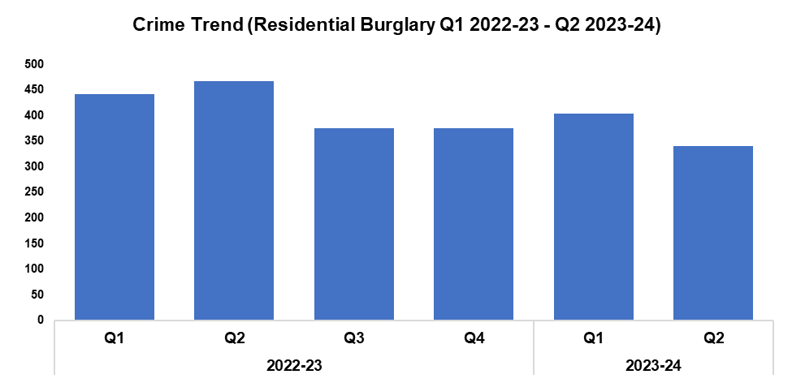
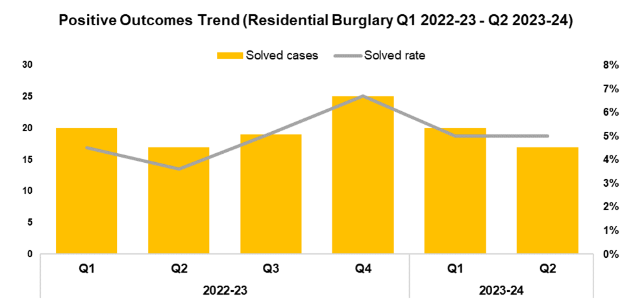


3. Residential Burglary
Overview
Residential Burglary offences have seen a reduction of 15.6% during Q2 2023-24 when compared to the quarter prior, with 63 fewer offences recorded for a total of 340. This conforms with the aims of the government’s Beating Crime Plan, and represents the lowest quarterly total within the timeframe. A significant reduction of 27.2% (127 fewer offences) can be observed when comparing Q2 2023-24 against the same quarter during the previous financial year, with a less prominent reduction of 18.3% (166 fewer offences) recorded when comparing the current FYTD against FYTD 2022-23.
The reduction in crime volume observed during Q2 2023-24 appears to run counter to seasonal trends, which may indicate the long-term efficacy of the deterrence strategies employed as part of the ‘We Don’t Buy Crime’ initiative.
When compared to the previous quarter, the solved rate for Residential Burglary offences remained steady at 5.0%, albeit with three fewer crimes solved. This reduction in solved crimes may have been influenced by the decline in offence volume over the same period. The solved rate has risen by 1.4 percentage points when comparing Q2 2023-24 against the same quarter during the previous financial year, and by 0.9 percentage points when comparing the current FYTD against FYTD 2022-23. In both cases an equal number of crimes were solved within each period.
August 2022 marked the commencement of the Burglary Response Improvement Pilot, an effort to increase the Residential Burglary solved rate via actions such as the consistent allocation of Crime Scene Investigators, as well as a focus on Golden Hour enquiries. January 2023 saw the implementation of a second Burglary Pilot, focused around improving service to burglary victims and further increasing investigation quality. These pilots appear to have met with success, with attendance at Residential Burglaries rising to 94.9%, up from the 61.5% baseline.

Slide 6
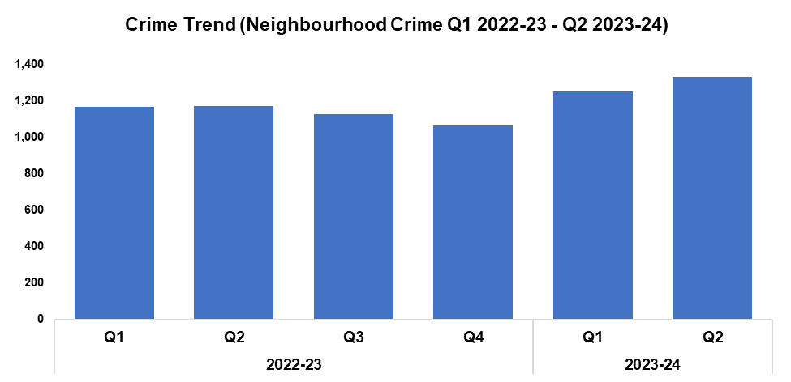
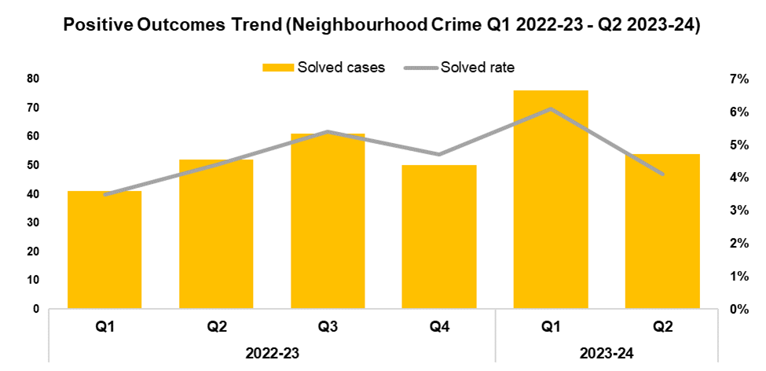


4. Neighbourhood Crime
Overview
Neighbourhood Crime offences have seen an increase of 6.3% when compared to the quarter prior, with 79 additional offences recorded for a total of 1,331 This increase runs counter to the aims of the government’s Beating Crime Plan, in which it is a focus area for reduction, and represents the highest quarterly total within the timeframe. An increase of 13.6% (159 additional offences) can be observed when comparing Q2 2023-24 against the same quarter during the previous financial year, with a less prominent increase of 10.5% (245 additional offences) recorded when comparing the current FYTD against FYTD 2022-23.
When assessed by crime category, Vehicle Crime offences appear to be the primary contributor to the rise observed during Q2 2023-24, increasing by 18.9% when compared to the quarter prior (136 additional offences for a total of 854). This is the highest quarterly total within the timeframe, and accounts for 64.2% of all Neighbourhood Crime offences recorded during Q2 2023-24.
When compared to the previous quarter, the solved rate for Neighbourhood Crime offences has fallen by 2.0 percentage points to 4.1%, with 22 fewer crimes solved for a total of 54. This continues the trend of peaks and troughs observed for this metric following Q2 2022-23. The solved rate for Q2 2023-24 is 0.3 percentage points below that recorded for the same quarter during the previous financial year, albeit with two additional crimes solved. Conversely, an increase of 1.0 percentage point can be observed when comparing the solved rate for the current FYTD against FYTD 2022-23, with an additional 37 crimes solved. This rise was influenced by the elevated solved rate recorded during Q1 2023-24.
Notes:
Neighbourhood crime consists of personal robbery, residential burglary, theft from a vehicle, theft of a vehicle and theft from the person offences combined

Slide 7
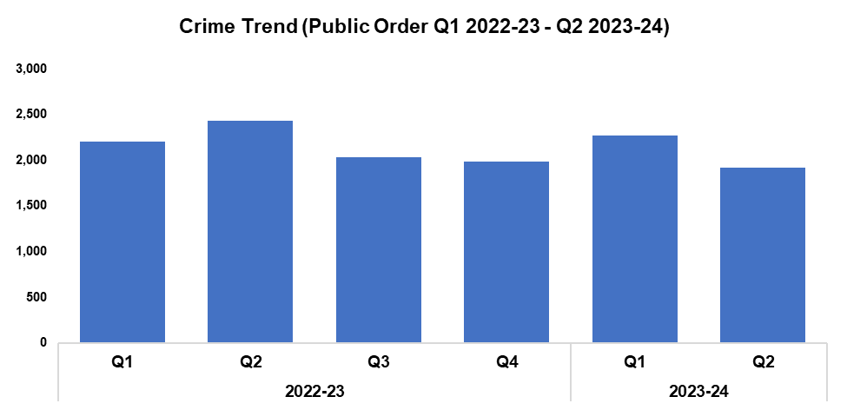
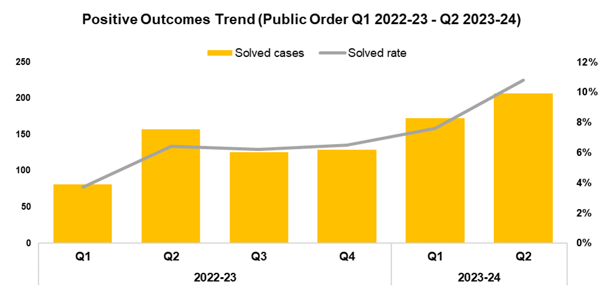


5. Public Order
Overview
Public Order offences have seen a reduction of 15.6% when compared to the quarter prior, with 354 fewer offences recorded for a total of 1,916. This represents the lowest quarterly total within the timeframe, and appears to run counter to seasonal trends. The reduced levels recorded during Q2 2023-24 resume the downward trend which had been observed following Q2 2022-23, after it was disrupted by the increase recorded during Q1 2023-24. A significant reduction of 21.3% (520 fewer offences) can be observed when comparing Q2 2023-24 against the same quarter during the previous financial year, with a less prominent reduction of 9.7% (451 fewer offences) recorded when comparing the current FYTD against FYTD 2022-23.
As offences under Section 5 of the Public Order Act 1986 have been classified as non-notifiable by the Home Office, they have been retroactively removed from this dataset to facilitate the accurate monitoring of long-term trends.
When compared to the previous quarter, the solved rate for Public Order Offences has increased by 3.2 percentage points to 10.8%, with 34 additional crimes solved for a total of 207. This continues the upward trend observed following Q3 2022-23. The solved rate for Q2 2023-24 is 4.4 percentage points above that recorded for the same quarter during the previous financial year, with 50 additional crimes solved. A similar increase of 4.0 percentage points can be observed when comparing the current FYTD against FYTD 2022-23, with 142 additional crimes solved.

Slide 8
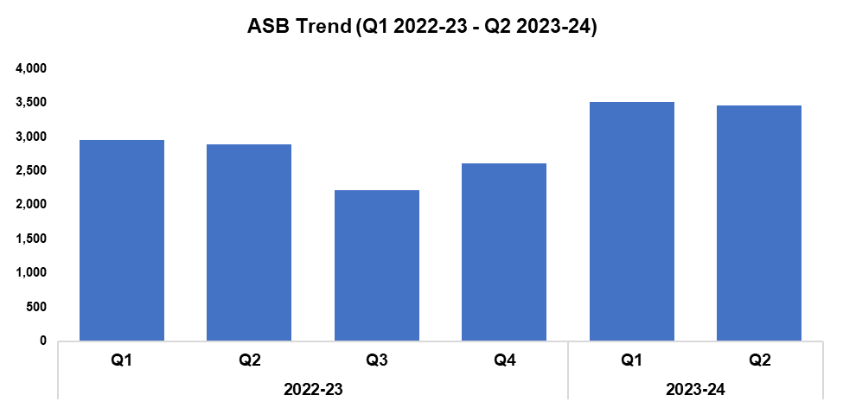

6. Anti-Social Behaviour
Overview
Levels of anti-social behaviour (ASB) in Gwent have fallen by 1.4% when compared to the quarter prior, with 48 fewer incidents recorded for a total of 3,461. This disrupts the upward trend which began following Q3 2022-23, whilst appearing to conform to seasonal trends. An increase of 20.1% (580 additional incidents) can be observed when comparing Q2 2023-24 against the same quarter during the previous financial year, with a similar increase of 19.6% (1,141 additional incidents) observed when comparing the current FYTD against FYTD 2022-23.
When assessed by closing category, a decline in incidents classified as ‘ASB - Environmental’ appears to be the primary driver behind the overall reduction in ASB volume, with levels falling by 27.6% (101 fewer incidents) when compared to the quarter prior.
A portion of the £750,000 granted by the Home Office as a result last year’s successful Safer Streets bid last year has been utilised to deter ASB through a range of diversionary tactics, such as educational youth outreach programmes delivered from new or refurbished youth shelters.
A Public Spaces Protection Order enforcement operation was carried out in the Pillgwenlly area of Newport, relating to street drinking other and other intoxicants. A total of 56 warnings were issued over the span of four weeks.
The data presented in this slide does not include incidents classified as ‘ASB – COVID 19’.

Slide 9
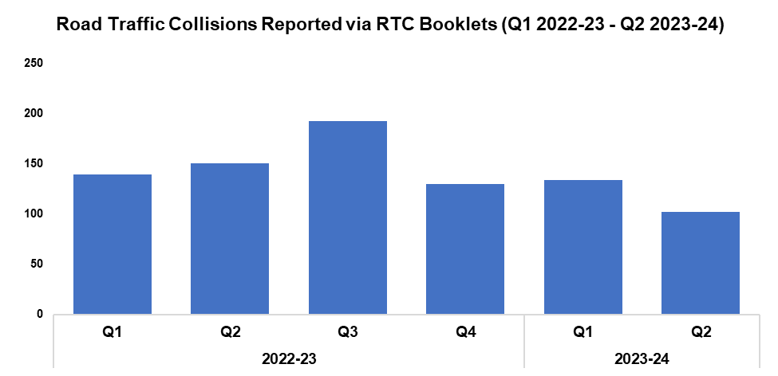

7. Roads Policing
Overview
During Q2 2023-24, 102 Road Traffic Collisions (RTCs) were reported via RTC booklets, a reduction of 23.9% (32 fewer incidents) when compared to the quarter prior. These reduced levels are likely influenced by a lag time between the incidents occurring and the RTC booklets being submitted, with 54 booklets currently marked as outstanding for the quarter. As such, the number of RTCs recorded for Q2 2023-24 is expected to increase going forward, which will be reflected in future reporting.
A total of 530 individuals were reported for one of the ‘Fatal Five’* factors during Q2 2023-24, a reduction of 40.5% (361 fewer reports) when compared to the previous quarter. The most commonly reported factor during Q2 2023-24 was drink/drug driving, with 199 instances reported (37.5% of all reports). This was followed by not wearing a seatbelt, with 97 instances reported (18.3% of all reports).
*The ‘Fatal Five’ refer to the five main causes of serious injury and death in RTCs. They consist of: careless driving, drink/drug driving, not wearing a seatbelt, using a mobile phone, and excessive speed.
Maindee was chosen as the pilot for an Operation Harley initiative specifically targeting electric vehicles and off-road bikes. Three operations have taken place and a total of 10 bikes have been seized, with one male arrested for drug related offences.
On the 17th of September Wales saw the biggest change of speed limits in a generation, with a general blanket reduction from 30 mph to 20 mph. Since the start of this year there have been 23 fatalities on Gwent roads, with a large proportion of fatalities occurring on lower speed roads. Any reduction in vehicular speeds within heavily urbanised areas, reducing the risk of serious injury or death, is welcomed. GoSafe and Roads Policing Specialist Operations (RPSO) teams are concentrating their efforts on speeding motorists within all speed limit settings, including 20 mph. However, in support of the transition from 30 mph to 20 mph, emphasis will be to provide education rather than enforcement in these cases. Gwent Police continue to work closely with the South Wales Fire & Rescue Service in delivering educational talks to motorists, in an effort to change minds and save lives.
On the 9th of October BBC One commenced series four of Crash Detectives, with four episodes. The programme showcases the significant amount of teamwork involved in investigating a road death, as well as the expertise required to achieve justice for victims and answers for the families involved. It also highlights the efforts made to safeguard the community by obtaining a guilty plea or verdict for the defendants where applicable.
In September 2023 the Serious Collison Investigation Unit received the Force’s first on fleet electric vehicle. This Vauxhall van enables the unit to deliver a greener service when conducting enquiries.

Slide 10
  Combat Serious Crime
Combat Serious Crime
Most Serious Violence
Serious Violence
VAWG Domestic Priority Offences
VAWG Non-Domestic Priority Offences
Drug Supply and Organised Crime
Key Commitments
Reduce the number of repeat victims of child criminal and sexual exploitation.
Increase disruption of serious organised crime, and reinvest assets seized back into communities.
Improve the overall criminal justice response to violence against women, domestic abuse and sexual violence.
Commission and invest in services that work with perpetrators of serious crime to prevent and reduce re-offending.

Slide 11
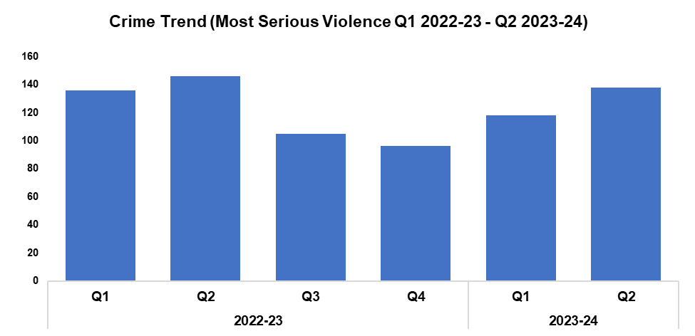
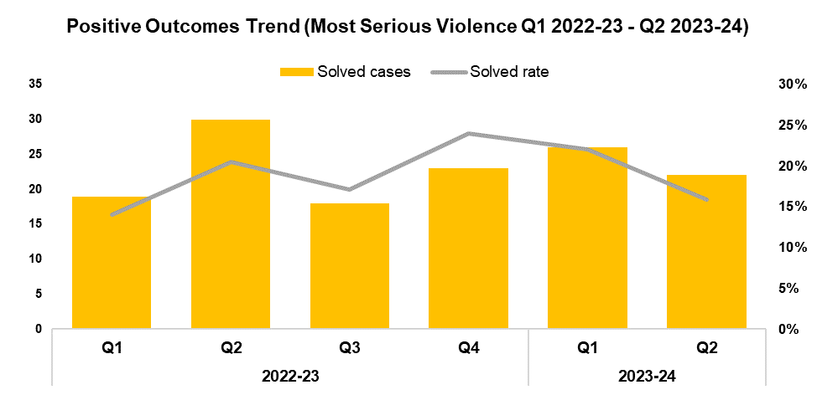


1. Most Serious Violence
Overview
Most Serious Violence offences consist of Homicide, Grievous Bodily Harm with Intent, and Causing Death by Dangerous Driving. Q1 2023-24 saw these offences increase in volume by 16.9% when compared to the quarter prior, with 20 additional offences recorded for a total of 138. Despite continuing the upward trend in crime volume observed following Q4 2022-23, a reduction of 5.8% (eight fewer offences) can be observed when comparing Q2 2023-24 against the same quarter in the previous financial year, with a further reduction of 9.2% (26 fewer offences) recorded when comparing the current FYTD against FYTD 2022-23.
When compared to the previous quarter, the solved rate for Most Serious Violence fell by 6.1 percentage points to 15.9%, with four fewer crimes solved for a total of 22. The increased volume of offences recorded during Q2 2023-24 also contributed to this decline in solved rate. When comparing Q2 2023-24 against the same quarter during the previous financial year, the solved rate has fallen by 4.6 percentage points, with eight fewer solved crimes. Conversely, the solved rate for the current FYTD is 1.4 percentage points higher than that observed during FYTD 2022-23, with 48 crimes solved.

Slide 12
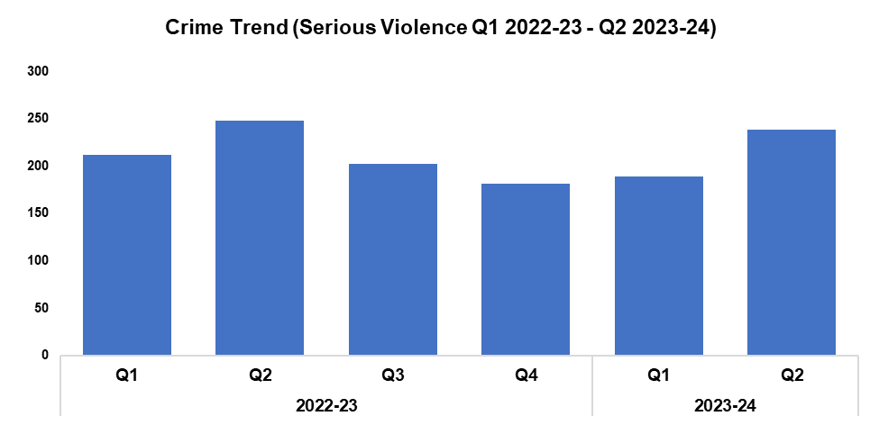
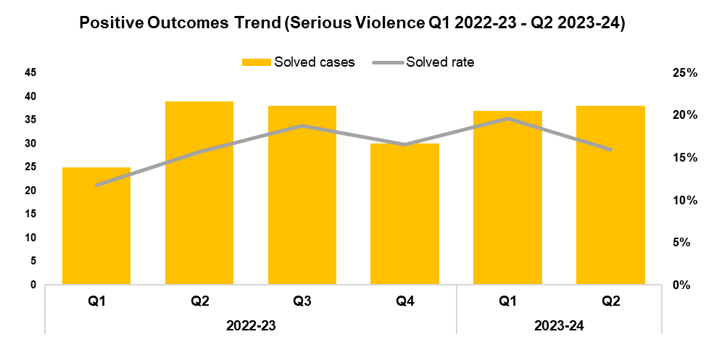


2. Serious Violence
Overview
Serious Violence crimes consist of Section 18 Grievous Bodily Harm with Intent, Section 20 Malicious Wounding without Intent, and Personal Robbery offences. Q2 2023-24 saw the volume of these offences increase by 25.9% when compared to the quarter prior, with 49 additional offences recorded for a total of 238. This continues the upward trend in offence volume observed following Q4 2022-23, with seasonality likely playing a role in this increase. A reduction of 4.2% (10 fewer offences) can be observed when comparing Q2 2023-24 against the same quarter during the previous financial year, with a further reduction of 7.2% (33 fewer offences) recorded when comparing the current FYTD against FYTD 2022-23.
When compared to the previous quarter, the solved rate for Serious Violence has reduced by 3.6 percentage points to 16.0%, albeit with one additional crime solved for a total of 38. When compared to the same quarter in the previous financial year, solved rate has increased 0.3 percentage points, with one fewer crime solved. A further increase of 3.7 percentage points can be observed when comparing the current FYTD against FYTD 2022-23, with 11 additional crimes solved.

Slide 13
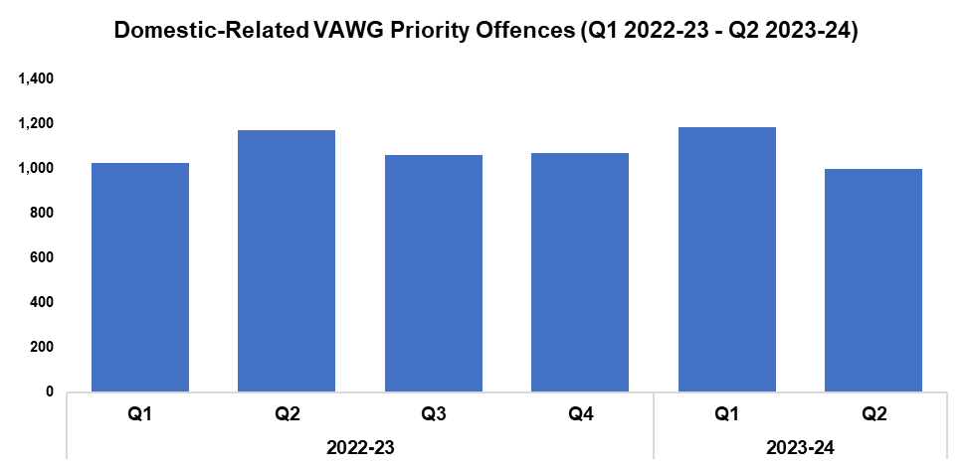

3. VAWG Domestic Priority Offences
Overview
The adjacent chart displays the number of combined Violence against Women and Girls (VAWG) priority offences with a domestic abuse qualifier, and which have at least one female victim linked.*
During Q2 2023-24, 999 of these offences were recorded. This represents a reduction of 15.6% (184 fewer offences) when compared to the quarter prior.
A reduction of 14.8% (173 fewer offences) can be observed when comparing Q2 2023-24 against the same quarter during the previous financial year, with a slight decrease of 0.6% (14 fewer offences) recorded when comparing the current FYTD against FYTD 2022-23
807 females have been a victim in more than one VAWG domestic priority offence within the last 12 months (up to the end of Q2 2023-24). 57 women and girls have been a victim in five or more separate offences.
In the last 12 months, there were 419 female offenders linked to domestic priority offences against females, of which 18.3% (77 individuals) were repeat offenders. One female was linked as an offender in more than five of these offences.
During the same period there were 2,631 male offenders linked to domestic priority offences against females, of which 27.1% (714 individuals) were repeat offenders. 15 males were linked as an offender in more than five of these offences.
*Domestic priority areas combined cover Homicide, Violence with Injury, Stalking and Harassment, Public Fear , Alarm or Distress, Rape, Other Sexual Offences, and Modern Slavery.

Slide 14
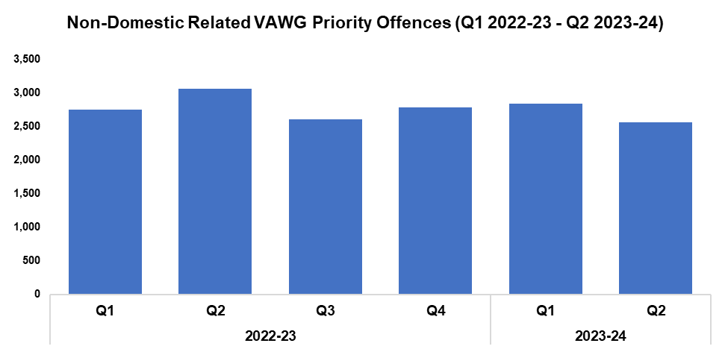

4. VAWG Non-Domestic Priority Offences
Overview
The adjacent chart shows the number of combined VAWG priority offences that do not have a domestic abuse qualifier, and which have at least one female victim linked.*
During Q2 2023-24, 2,562 of these offences were recorded. This represents a reduction of 9.8% (279 fewer offences) when compared to the quarter prior.
A reduction of 16.3% (499 fewer offences) can be observed when comparing Q2 2023-24 against the same quarter during the previous financial year, with a less prominent decrease of 7.0% (407 fewer offences) recorded when comparing the current FYTD against FYTD 2022-23.
1,764 females have been a victim in more than one VAWG non-domestic priority offence within the last 12 months (up to the end of Q2 2023-24). 90 women and girls have been a victim in five or more separate offences.
In the last 12 months, there were 2,554 female offenders linked to non-domestic priority offences against females, of which 28.4% (726 individuals) were repeat offenders. 44 females were linked as an offender in more than five of these offences.
During the same period there were 3,316 male offenders linked to non-domestic priority offences against females, of which 22.0% (728 individuals) were repeat offenders. 43 males were linked as an offender in more than five of these offences.
*Non-domestic priority areas combined cover Homicide, Violence with Injury, Stalking and Harassment, Public Fear , Alarm or Distress, Rape, Other Sexual Offences, Modern Slavery, and Exploitation of Prostitution.

Slide 15
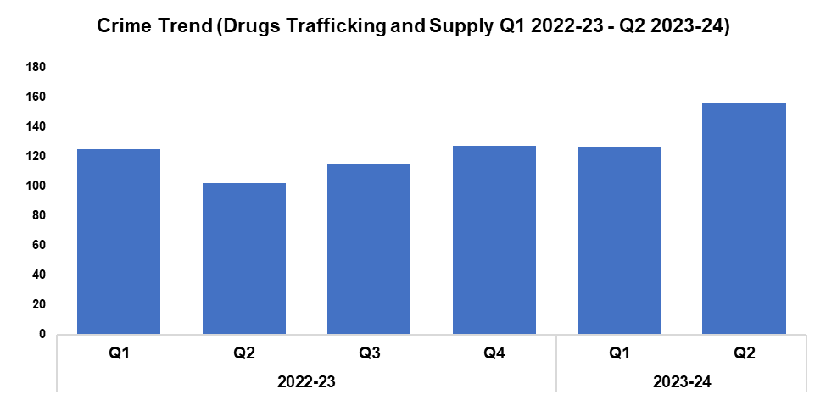

5. Drug Supply and Organised Crime
Overview
Drug Trafficking and Supply offences have seen an increase of 23.8% when compared to the quarter prior, with 30 additional offences recorded for a total of 156. This represents the highest quarterly total within the timeframe.
An increase of 52.9% (54 additional offences) can be observed when comparing Q2 2023-24 against the same quarter during the previous financial year, with a less prominent increase of 24.2% (55 additional offences) recorded when comparing the current FYTD against FYTD 2022-23.
1,607 Drug Supply and Dealing intelligence logs were submitted during Q2 2023-24. This is an increase of 1.3% (21 additional logs) when compared to the quarter prior, and represents the highest quarterly total within the timeframe. An increase of 2.0% (31 additional logs) can be observed when comparing Q2 2023-24 against the same quarter during the previous financial year, with a further increase of 2.6% (80 additional logs for a total of 3,193) recorded when comparing the current FYTD against FYTD 2022-23.
A total of six cannabis factories have been dismantled after being located within disused premises in Newport City Centre. The street value of the growths is currently believed to be in excess of £5 million. Five arrests have been made, with all subjects remanded into custody. Going forward, plans are in place to work alongside key partners including Newport City Council to identify disused or abandoned buildings and public houses. Preventative measures are also being considered when dealing with the landlords and tenants, including arranged visits and educational awareness. Gwent is collaborating with other forces that have experienced similar incidents, in order to learn and share information. Local interdepartmental meetings are also ongoing, with input from the leads of the Serious Organised Crime and Modern Day Slavery teams.
On the 13th of October the RPSO team arrested a known Newport male with links to organised drug criminality, following a pursuit and subsequent foot chase wherein £3,000 in cash was recovered from his person. A subsequent search of his address resulted in the recovery of controlled drugs and a further £3,000 in cash. This male will now be subject to the criminal justice process, with all illegal assets subject to confiscation orders.
Enforcement for Operation Silver took place during the early hours of the 13th of September. This is an investigation into an organised crime group involved in the supply of Class A drugs. 80 firearms officers and over 100 unarmed officers were involved in synchronised warrants at five addresses in Newport and Cardiff. Three men were charged and remanded for conspiring to supply cocaine, heroin and MDMA. The investigation remains ongoing.
A series of operations took place between the 9th and 15th of October as part of a national County Lines Intensification Week. As a result: two cannabis farms were dismantled; 4,500 cannabis plants were seized; 18 kilograms of amphetamine was recovered; 14 people were arrested; two people at risk of exploitation were safeguarded; and £1,400 in cash was seized.

Slide 16
Support Victims and Protect the Vulnerable
Hate Crime
Rape
Domestic Related Crime
Domestic Abuse Repeat Victims/Offenders
Modern Day Slavery and Human Trafficking
Child Sexual Exploitation/Child Criminal Exploitation
Cyber Fraud
Victim Support/Repeat Victims
Key Commitments
Improve victim services and ensure that the needs of victims are identified and responded to appropriately through Connect Gwent and the Victim Care Unit.
Further improve our work with partners to protect those most vulnerable.
Increase the timeliness of police investigation updates provided to victims.
Commission and invest in specialist services to support victims throughout the criminal justice process.

Slide 17
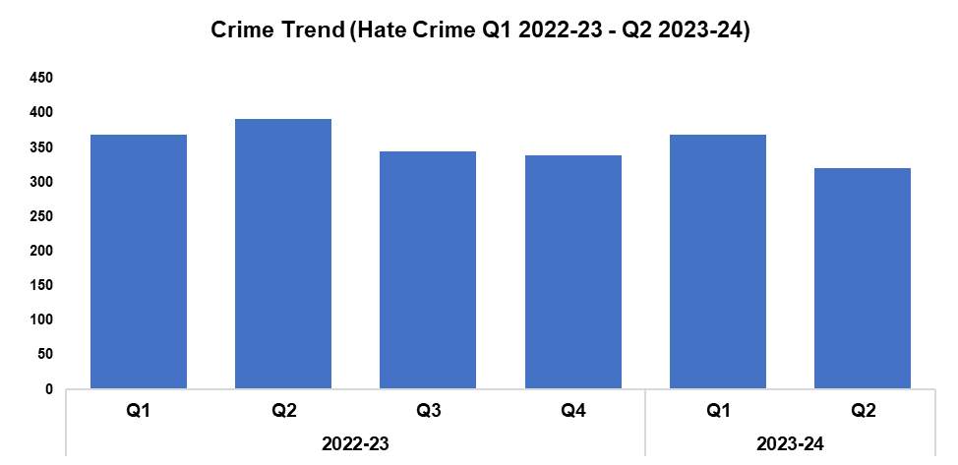
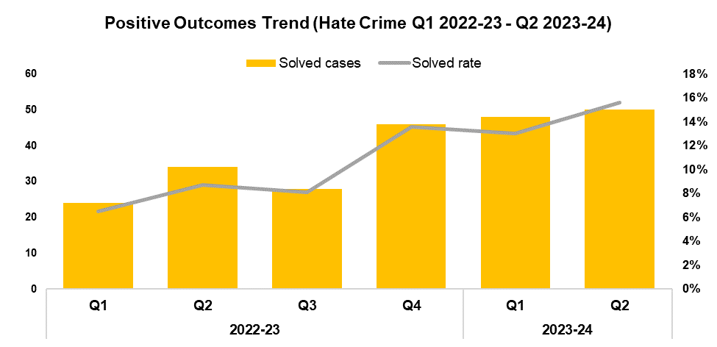


1. Hate Crime
Overview
The volume of offences classified as hate crimes has fallen by 13.3% when compared to the quarter prior, with 49 fewer offences recorded for a total of 320. A reduction of 18.2% (71 fewer offences) can be observed when comparing Q2 2023-24 against the same quarter during the previous financial year, with a less prominent reduction of 9.2% (70 fewer crimes) recorded when comparing the current FYTD against FYTD 2022-23.
Offences containing the disability hate strand decreased by 30.1% when compared to the quarter prior, with 25 fewer crimes recorded for a total of 58.
Offences containing the racial hate strand have decreased by 12.4% when compared to the quarter prior, with 27 fewer crimes recorded for a total of 190.
Offences containing the religious hate strand increased by 9.1% when compared to the quarter prior, with one additional crime recorded for a total of 12.
Offences containing the transphobic hate strand decreased by 25.0% when compared to the quarter prior, with four fewer crimes recorded for a total of 12.
The solved rate for offences classified as hate crimes has increased by 2.6 percentage points to 15.6% when compared to quarter prior, with two additional crimes solved. This represents the highest quarterly solved rate within the timeframe. The solved rate for Q2 2023-24 is 6.9 percentage points above that recorded for the same quarter during the previous financial year, with an additional 16 crimes solved. A similar rise of 6.6 percentage points can be observed when comparing the current FYTD against FYTD 2022-23, with 40 additional crimes solved.
Please note that one crime can have multiple hate strands. The overall hate crime trend is based on recorded crimes, whilst the breakdown by hate strand is based on the volume of each individual strand.

Slide 18
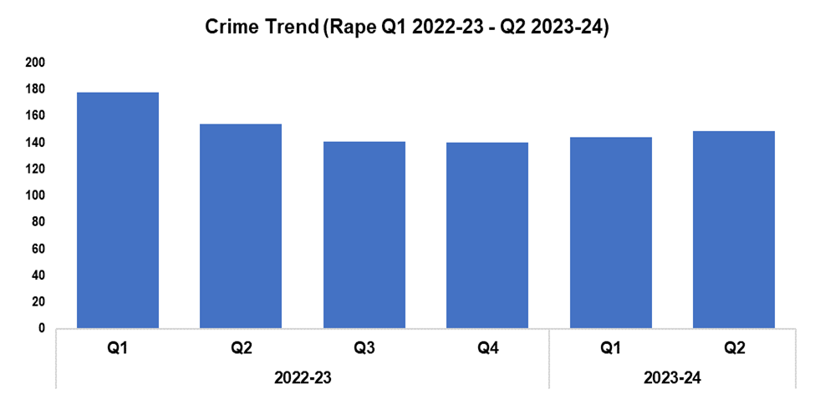
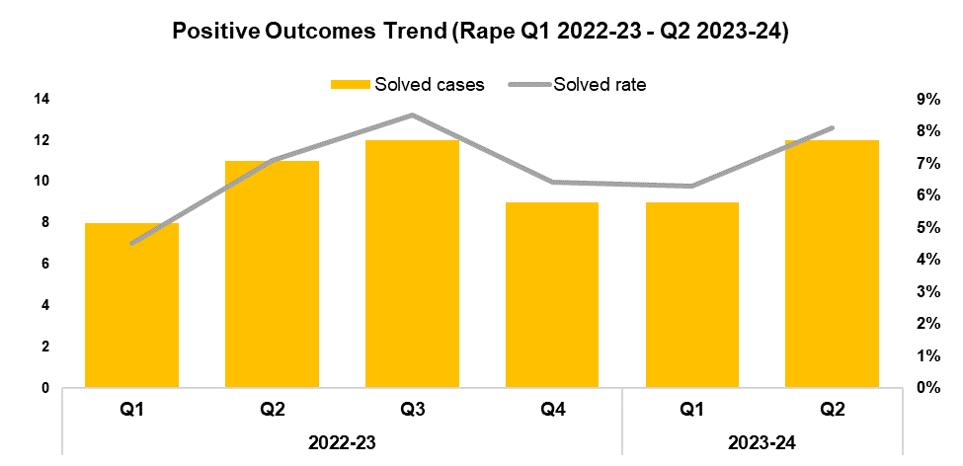


2. Rape
Overview
Rape offences have seen an increase of 3.5% (five additional offences) during Q2 2023-24 when compared to the quarter prior, continuing the upward trend in offence volume observed following Q4 2022-23. This rise is in line with the increased reporting required as part of the government’s Beating Crime Plan, and consistent with the local priority to actively increase reporting for this historically under-reported offence category. When comparing Q2 2023-24 against the same quarter during the previous financial year, there has been a 3.2% reduction in offence volume (five fewer offences). A more prominent reduction of 11.7% (39 fewer offences) can be observed when comparing the current FYTD against FYTD 2022-23
The solved rate for Rape offences during Q2 2023-24 stands at 8.1%, an increase of 1.8 percentage points when compared to the quarter prior, with three additional crimes solved. This disrupts the downward trend in solved rate observed following Q3 2022-23. An increase of 1.0 percentage point (one additional crime solved) can be observed when comparing Q2 2023-24 against the same quarter during the previous financial year, with a further increase of 1.5 percentage points recorded when comparing the current FYTD against FYTD 2022-23 (two additional crimes solved).

Slide 19
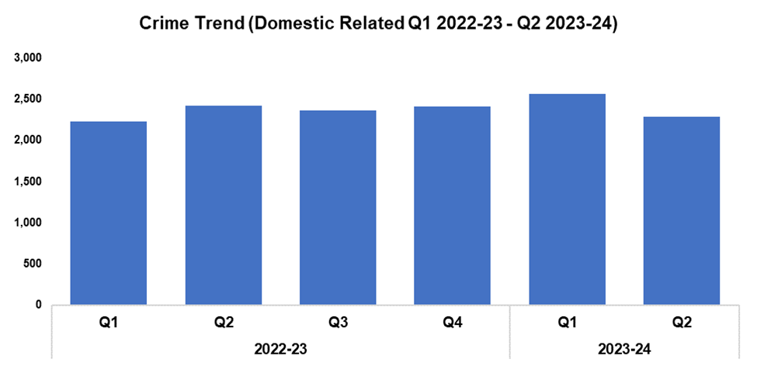
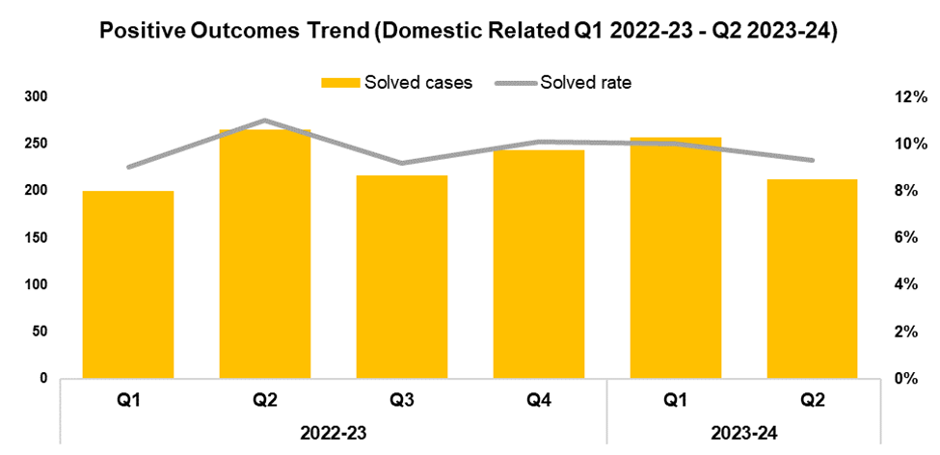


3. Domestic Related Crime
Overview
Domestic related offences have seen a reduction of 10.7% when compared to the quarter prior, with 274 fewer offences recorded for a total of 2,290. When comparing Q2 2023-24 to the same quarter during the previous financial year, a reduction of 5.4% (130 fewer offences) can be observed. Conversely, an increase of 4.4% (204 additional offences) has been recorded when comparing the current FYTD against FYTD 2022-23, owing to the elevated levels seen during Q1 2023-24. This increase could be attributed in part to ongoing improvements in crime data integrity.
The solved rate for domestic related offences has fallen by 0.7 percentage points to 9.3% when compared to the quarter prior, with 45 fewer crimes solved. A reduction of 1.7 percentage points (53 fewer crimes solved) can be observed when comparing Q2 2023-24 against the same quarter during the previous financial year, with a less prominent reduction of 0.3 percentage points (four additional crimes solved) recorded when comparing the current FYTD against FYTD 2022-23.

Slide 20
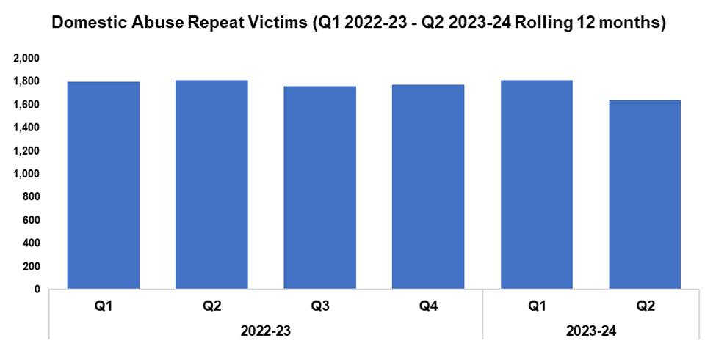
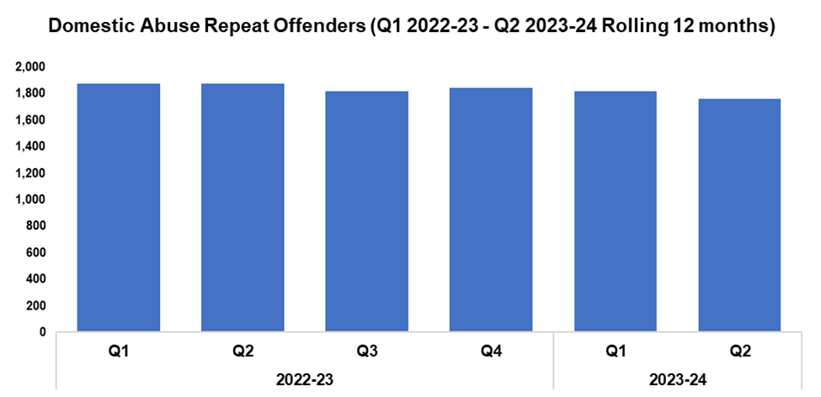


4. Domestic Abuse Repeat Victims/Offenders
Repeat Victims Overview
The number of repeat domestic abuse victims* has decreased by 9.6% when compared to the quarter prior, with 175 fewer repeat victims recorded for a total of 1,641. This represents the lowest quarterly total within the timeframe. When comparing Q2 2023-24 against the same quarter during the previous financial year, a reduction of 9.5% (172 fewer repeat victims) can be observed, with a less prominent reduction of 4.3% (155 fewer repeat victims) recorded when comparing the current FYTD against FYTD 2022-23.
*Based on rolling 12 months to the end of each quarter, where persons are linked to two or more crimes within this period.
Repeat Offenders Overview
The number of repeat domestic abuse offenders* has decreased by 3.1% when compared to the quarter prior, with 57 fewer repeat offenders recorded for a total of 1,761. This marks a second consecutive reduction in repeat offender volume. When comparing Q2 2023-24 against the same quarter during the previous financial year, a reduction of 6.3% (118 fewer repeat offenders) can be observed. A less prominent reduction of 4.7% (176 fewer repeat offenders) has been recorded when comparing the current FYTD against FYTD 2022-23.
There is a Multi-Agency Tasking and Coordination (MATAC) process in place which focuses on identifying serial perpetrators of domestic abuse, in order to limit the risk of them reoffending. A range of interventions can be delivered via MATAC to safeguard victims and families, including support, prevention, diversion, disruption, and enforcement.
*Based on rolling 12 months to the end of each quarter, where persons are linked to two or more crimes within this period.

Slide 21
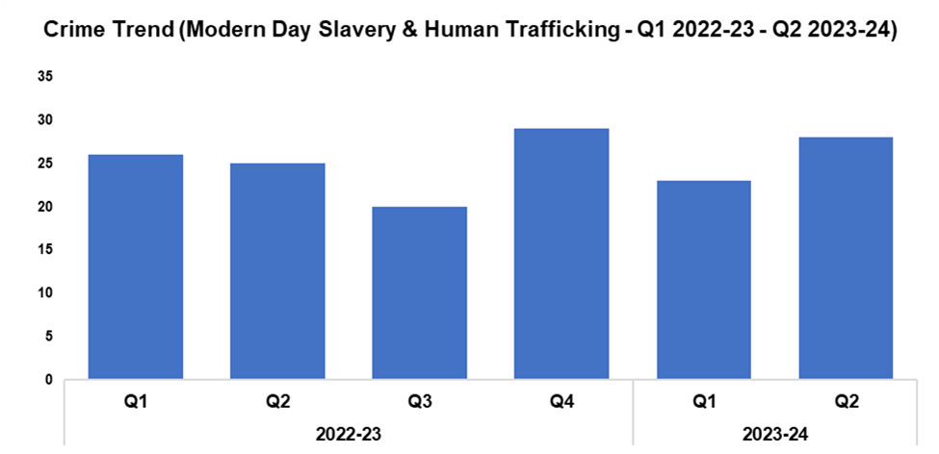

5. Modern Day Slavery and Human Trafficking
Overview
Modern Day Slavery and Human Trafficking (MDSHT) offences have seen an increase of 21.7% when compared to the quarter prior, with five additional offences recorded for a total of 28. An increase of 12.0% (three additional offences) can be observed when comparing Q2 2023-24 against the same quarter during the previous financial year, whereas offence volumes have remained steady when comparing the current FYTD against FYTD 2022-23, at 51 offences.
Continued awareness training has been delivered to new starters, new community support officers, and trainee detectives.
The number of National Referral Mechanisms submitted has risen by 38.1% during Q2 2023-24 when compared to the quarter prior, with eight additional referrals submitted for a total of 29. Conversely, a reduction of 9.1% (five fewer referrals to 50) can be observed when comparing the current FYTD against FYTD 2022-23.

Slide 22
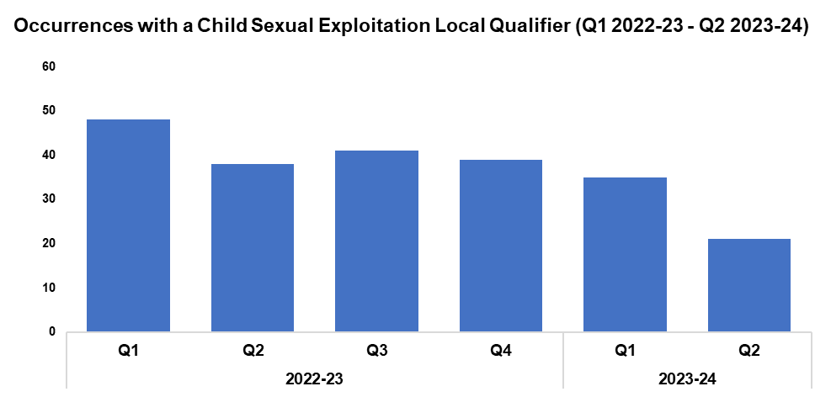

6. Child Sexual Exploitation/Child Criminal Exploitation
Overview
The number of crimes assigned a Child Sexual Exploitation (CSE) local qualifier has decreased by 40.0% during Q2 2023-24 when compared to the quarter prior, with 14 fewer crimes recorded for a total of 21. This represents the lowest quarterly total within the timeframe, continuing the downward trend which began following Q3 2022-23. A reduction of 44.7% (17 fewer crimes) can be observed when comparing Q2 2023-24 against the same month during the previous financial year, whilst a less prominent reduction of 34.9% (thirty fewer crimes) has been recorded when comparing the current FYTD against FYTD 2022-23.
The offence most commonly assigned a CSE local qualifier during Q2 2023-24 was ‘Take/make indecent photographs/pseudo-photographs of children’, with seven instances. This accounts for 33.3% of all crimes assigned a CSE local qualifier during the quarter.
On the 24th of October Terrence Hulme (87) was handed an eighteen-year custodial sentence for the offences of Rape and Sexual Assault. This followed a protracted and complex investigation conducted by Detective Constable (DC) Roberts. The two victims in this matter were subjected to prolonged sexual abuse from Hulme throughout their childhood, with one victim being subjected to penetrative sexual offences between the ages of two and seventeen. Originally reported in August 2021 to South Yorkshire Police, the Officer in the Case (OIC) has shown great professionalism in gathering evidence from the victims and witnesses, which is particularly difficult in cases of historic sexual abuse. Furthermore, the OIC made sure that the victims received help and support throughout, providing the best possible service and ensuring that the offender received the appropriate justice outcome.
On the 5th of September officers from the Management of Sexual Offenders and Violent Offenders team worked in collaboration with Digital Media Investigators to target a registered sex offender. Officers suspected that he was utilising covert means to hide his online offending against children. Advanced technical solutions were employed to identify multiple hidden internet-enabled devices within his property that were installed with encryption software. The subject was arrested and charged with breaching his Sexual Harm Prevention Order by communicating with a child under 16, possession of encryption software, and possession of unregistered devices. He has pleaded guilty and is awaiting sentence.

Slide 23
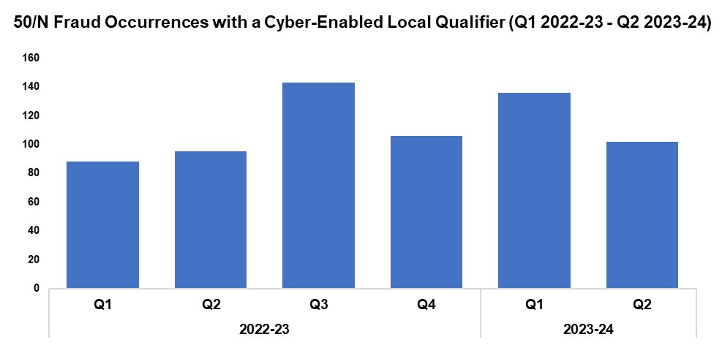

7. Cyber Fraud
Overview
Of the 1,316 fraud occurrences under 50/N recorded since Q1 2022-23, 50.9% (670 occurrences) have been assigned a cyber-enabled local qualifier.
Q2 2023-24 saw 102 50/N fraud occurrences assigned a cyber-enabled local qualifier, a reduction of 25.0% (34 fewer occurrences) when compared to the quarter prior. Conversely, an increase of 7.4% (seven additional occurrences) can be observed when comparing Q2 2023-24 against the same quarter during the previous financial year. A further increase of 30.1% (55 additional occurrences) has been recorded when comparing the current FYTD against FYTD 2022-23, owing to the elevated levels recorded during Q1 2023-24.

Slide 24
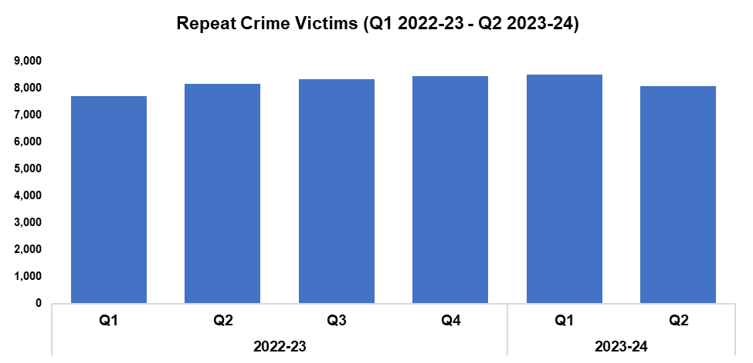

8. Victim Support/Repeat Victims
Overview
In this context, a repeat crime victim refers to an individual who has been linked as a victim in two or more crimes within a 12-month rolling period.
The number of repeat crime victims has fallen by 5.1% during Q2 2023-24* when compared to the quarter prior, with 434 fewer repeat victims recorded for a total of 8,057. This disrupts the upward trend in repeat crime victims which had previously been observed throughout the timeframe.
A reduction of 1.1% (90 fewer repeat victims) can be observed when comparing Q2 2023-24 against the same quarter during the previous financial year. Conversely, an increase of 4.4% (702 additional repeat victims) has been recorded when comparing the current FYTD against FYTD 2022-23, influenced by the reduced levels recorded during Q1 2022-23.
The decline in repeat victims observed during Q2 2023-24 may have been influenced by a comparable reduction in overall crime volume during the same period (falling by 5.1% and 5.4% respectively). However, prior to this the number of repeat crime victims had risen consistently, despite fluctuations in crime levels throughout the timeframe. This may indicate that factors other than raw crime volume have influenced the reduction seen during Q2 2023-24.
On the 16th of October, the Newport Criminal Investigation Department (CID) had cause to investigate a drugs related kidnap and assault. The victim was subjected to a dreadful ordeal and the offenders remained at large. Through a co-ordinated response between multiple workstreams the victim was located, and the offenders detained. This ongoing investigation made effective use of internal and external partners, and demonstrated the value of collaboration. The victim was afforded extensive safeguarding and felt supported, the main offender was apprehended and recalled to prison whilst the investigation continues, and other suspects were identified and arrested.
*Based on the rolling 12 months to the end of the quarter.

Slide 25
Increase Community Confidence in Policing
Perceptions Survey: Local Concerns and Overall
Victim Satisfaction
Representative Workforce
Investigation Timeliness
Response Rates
999 Demand
101 Demand
Social Media and Single Online Home
Initiatives & Events
Key Commitments
Increase the effectiveness of officer and staff engagement with residents in their communities, and community confidence and trust in Gwent Police.
Improve the accessibility of neighbourhood police teams through a variety of contact channels that meet the needs of the public.
Increase reporting of crime by communities that are less likely to engage with the police.
Further increase officer and staff diversity to ensure our police service reflects the communities that we serve.

Slide 26
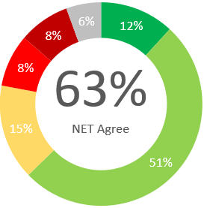
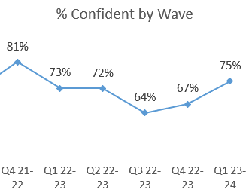
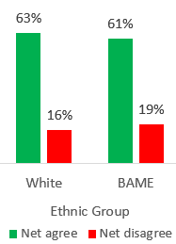
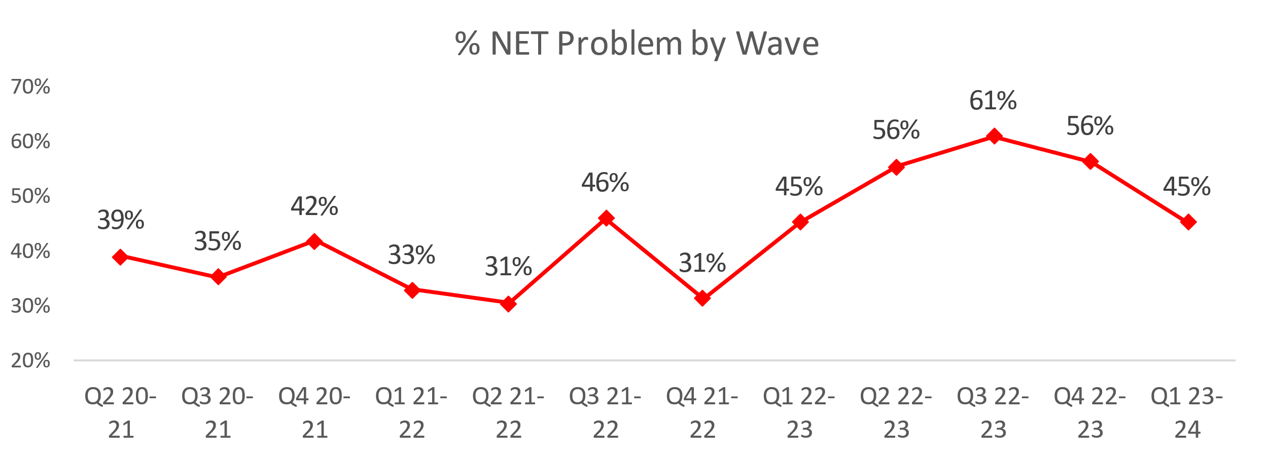


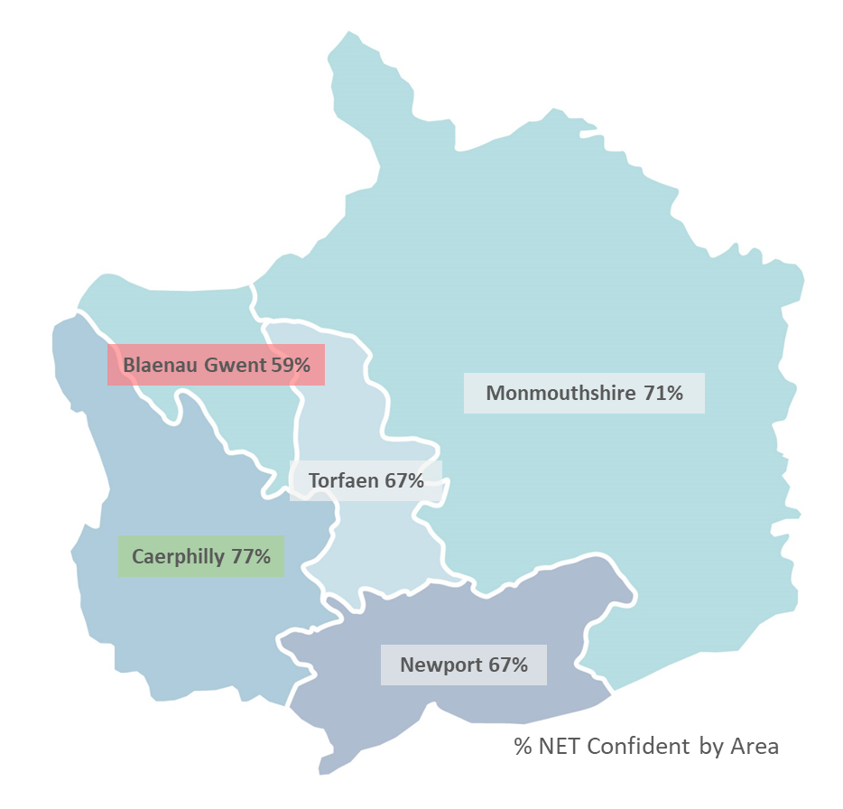
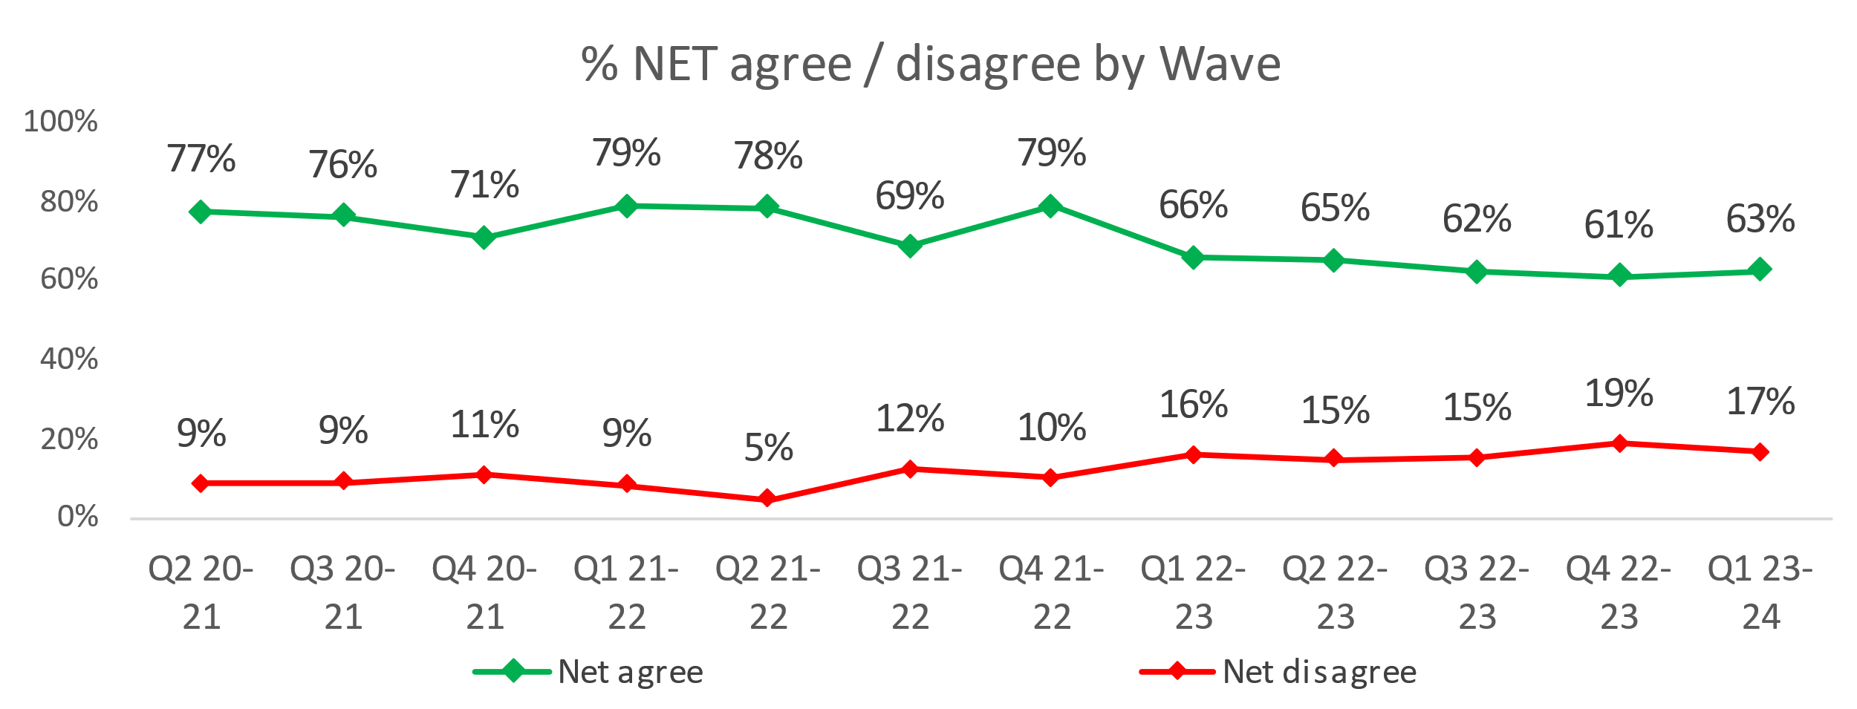
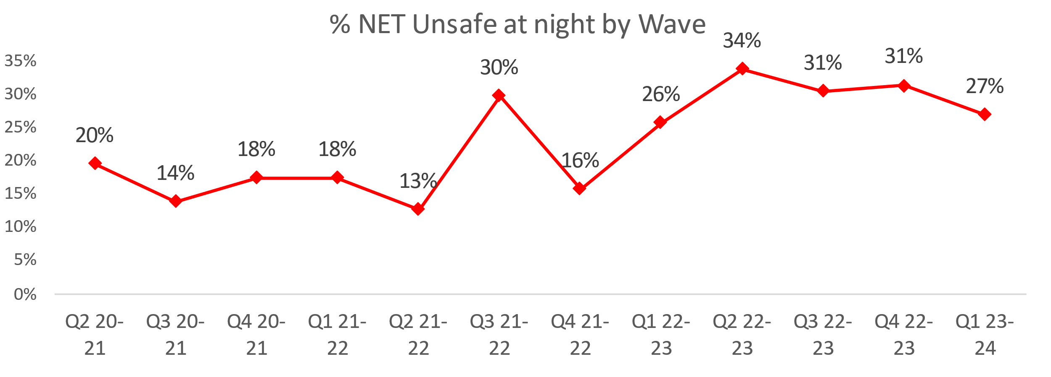
1. Perceptions Survey: Local Concerns and Overall
Overall Confidence in the Police
Local Concerns
Positive Experiences
“From what I have personally witnessed, I can see the police are dealing with the issues and also from what I can see on social media. However, anti-social behaviour is not being dealt with quite as well.”
“I have witnessed cases where the police deal with incidents straight away.”
“As far as I am concerned whenever I have dealt with them, they have been polite and are doing a good job especially tackling drugs.”
Nearly two thirds (63%) of people agree they have confidence in the police in their area. This is lowest in Blaenau Gwent (50%) and highest in Monmouthshire (68%).
Just under half of residents (45%) feel that crime and ASB are a problem in their area.
This metric has seen a reduction across two consecutive quarters following a rise for the preceding three quarters. Caerphilly (64%) is the area of highest concern whereas Monmouthshire (25%) has the lowest perceived concern.
Three quarters of residents are confident they could easily speak to police in their area, increasing to levels previously seen in Q1 2022-23.
Ethnic minority groups have less confidence in this statement, with 61% agreeing they have confidence in police in their area.
Lack of action
“I can see in my local area that the anti-social behaviour, drug misuse, vandalism and littering are not taken seriously.“
“Nothing is being done in the area about the issues, every week there is something going on.”
“They don't seem to do anything about anti-social behaviour and issues in the area.”
“We have all reported things, but it goes no further just falls on deaf ears, so we now look after each other.”
Minority
27% of residents felt unsafe at night. Caerphilly (36%) felt the most unsafe, whereas Monmouthshire (14%) felt the safest. This geographic trend is similar to the level of concern regarding ASB and Crime.
A downward trend is apparent with overall confidence dropping from 79% in Q4 2021-22 through to 63% in Q1 2023-24.
17% disagree that they have confidence in the police in their area.
For the above statement, Blaenau Gwent had the lowest confidence (59%) whilst Caerphilly had the highest confidence (77%).
3.0% have been a victim of crime and did not report to Gwent Police. If applied across the population of Gwent, this would equate to 17,631 individuals.
“Things got stolen and broken into, but I think why bother when nothing gets done.”

Slide 27


2. Victim Satisfaction
Percentage | Measure
Survey Number | Survey One | Survey Two |  |  |  | Survey Three
Metric | Satisfied with Initial Contact | Satisfied with Follow Up & Investigation | Satisfied with the service from the Victim Care Officer | Satisfied with the service from the officer dealing with your case | Satisfied with being kept informed about your case | Satisfied with Post Charge
General Crime | 58% | 56% | 87% | 76% | 76% | 40%
Domestic Violence | 75% | 81% | 96% | 84% | 82% | 100%
Hate Crime | 100% | 67% | 100% | 100% | 100% | No Data
Sexual Violence | 100% | 80% | 100% | 80% | 100% | No Data
Baseline | N/A | N/A | 85% | 85% | 74% | N/A
Numeric | Measure
Survey Number | Survey One | Survey Two |  |  |  | Survey Three
Metric | Satisfied with Initial Contact | Satisfied with Follow Up & Investigation | Satisfied with the service from the Victim Care Officer | Satisfied with the service from the officer dealing with your case | Satisfied with being kept informed about your case | Satisfied with Post Charge
General Crime | 591/1011 | 56/100 | 48/55 | 38/50 | 39/51 | 2/5
Domestic Violence | 44/59 | 25/31 | 25/26 | 21/25 | 18/22 | 7/7
Hate Crime | 11/11 | 2/3 | 3/3 | 3/3 | 3/3 | No Data
Sexual Violence | 9/9 | 4/5 | 5/5 | 4/5 | 4/4 | No Data
Sample Size | 1,090 | 139 | The above questions can be answered with ‘N/A’. These responses have been removed from both the percentage and numeric calculations. As a result, the sample size will differ from that for ‘Satisfied with Follow Up & Investigation’. |  |  | 12

Slide 28
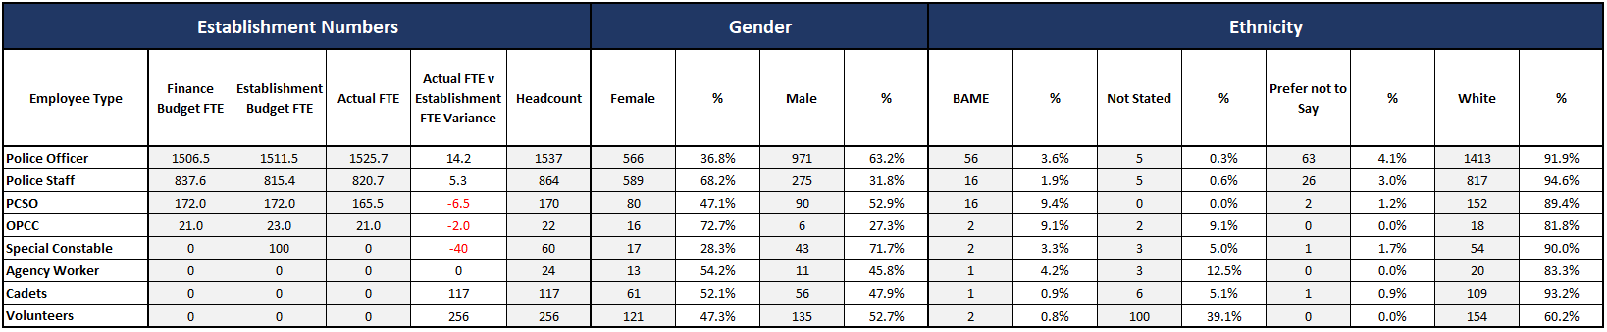
3. Representative Workforce
The following data is correct as of 30 September 2023
Actual FTE vs Establishment FTE Variance is calculated by subtracting the Actual FTE From the Establishment Budget FTE, except for Special Constable, Agency Worker, Cadets and Volunteers which is calculated by subtracting Headcount from Establishment Budget FTE.
Overview
There is a gender disparity evident in the workforce for both officers and staff. For officers, females are underrepresented by approximately 14 percentage points (females account for 51% of the population in Gwent based on the 2021 Census). However, females are overrepresented in the staff workstream area by approximately 17 percentage points.
There is also a disparity in the minority ethnic representation within the workforce. In Census 2021, 8.6% of the Gwent population (5.6% in Census 2011) are from an ethnic minority background, which includes individuals in the following ethnic groups: Asian, black, mixed, other, and white minorities. The above table groups this differently, with white including white minorities (Gypsy, Roma and Irish Traveller groups, Irish and any other white background). In Census 2021, 5.8% of the Gwent population (3.9% in Census 2011) are from an ethnic background other than white. For police officers, currently 3.6% are from an ethnic group other than white. Ethnic minority representation in staff is lower at 1.9%.
Gwent has achieved a Police Constable establishment baseline of 1,506, as well as the 21 additional officers agreed as part of the Over Recruitment Scheme. The current recruitment focus for officers is on increasing detective capacity. Two DCs have transferred to Gwent, and the intake in March 2024 will further support the force in meeting detective strength.
76 Positive Action candidates have been supported in their progression through to the final stages of recruitment. The geofencing tool Crooton has been implemented, in order to increase applications from diverse groups. In addition, a structured delivery programme of Positive Action awareness has been delivered to frontline officers and staff across the force.
A retention roadmap has been put in place to support the retention of skills and experience within the force. Stay Interviews have been introduced, with four interviews conducted to date. These have supported three individuals in remaining with the force. An exit interview feedback form has also been created to inform business areas of any issues, and to capture feedback.

Slide 29
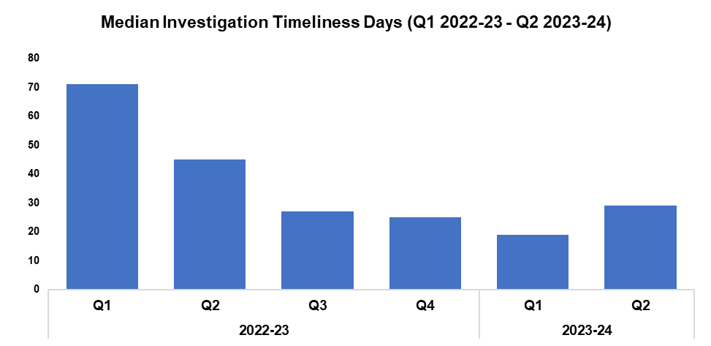

4. Investigation Timeliness
Overview
The median number of days within which an investigation is completed has seen an increase of 52.6% when compared to the previous quarter, rising by 10 days to 29. This disrupts the downward trend which had previously been observed throughout the timeframe.
The median investigation length has fallen by 35.6% (16 fewer days) when comparing Q2 2023-24 against the same quarter during the previous financial year, with an additional reduction of 58.6% (68 fewer days) recorded when comparing the current FYTD against FYTD 2022-23. These reductions are due to the elevated investigation times observed during quarter one and quarter two of 2022-23, on account of a backlog of occurrences which were awaiting finalisation by the Crime Management Unit.
As of Q2 2023-24, there are 15,256 crimes classified as open and unfinalised (excluding pending finalisation), representing a reduction of 6.6%, (1,071 fewer crimes) when compared to the quarter prior. Of those currently unfinalised, 9,221 crimes have been open for less than six months, 3,606 have been open for between six and 12 months, and 2,429 have been for open for over 12 months.
Of those crimes which have been for open for over 12 months, Violence without Injury offences are the most common, accounting for 22.1% of the total (537 crimes), followed by Rape offences, which account for 13.7 % of the total (332 crimes).

Slide 30
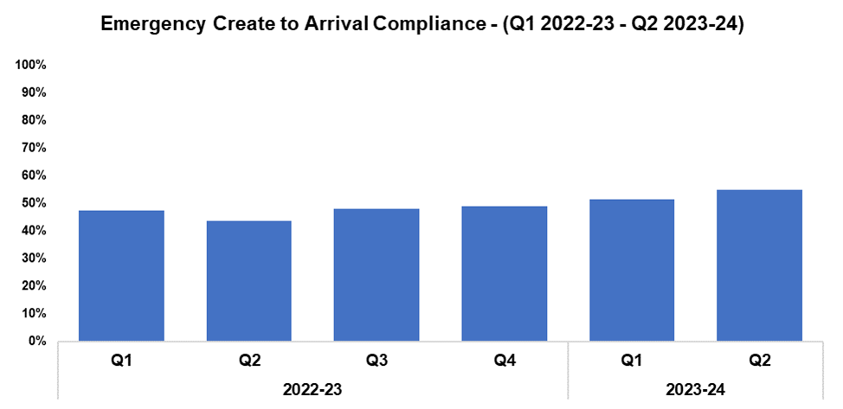
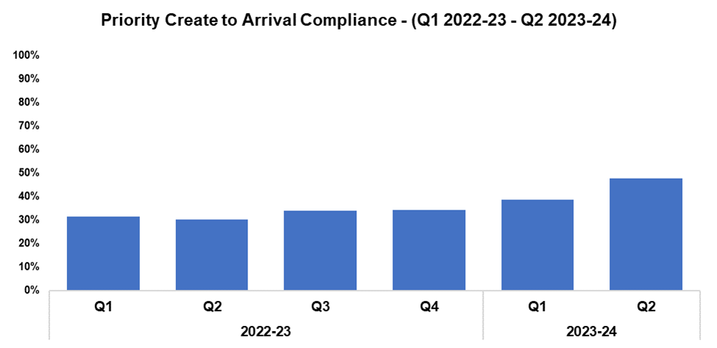


5. Response Rates
Overview
Based on the target arrival time of 15 minutes, emergency create to arrival compliance has increased by 3.5 percentage points during Q2 2023-24 when compared to the quarter prior, and currently stands at 54.9%. All sectors recorded improvements in compliance when compared to the previous quarter. Emergency response compliance has increased by 11.2 percentage points when comparing Q2 2023-24 against the same quarter during the previous financial year, and by 7.8 percentage points to 53.2% when comparing the FYTD against FYTD 2022-23.
The median create to arrival time for emergency graded incidents during Q2 2023-24 was 13 minutes and 59 seconds, an improvement when compared to the 14 minutes and 43 seconds recorded during the quarter prior. Timings also improved when comparing Q2 2023-34 against the same quarter during the previous financial year, during which the figure stood at 16 minutes and 33 seconds.
Based on the target arrival time of one hour, priority create to arrival compliance has increased by 9.2 percentage points during Q2 2023-24 when compared to the quarter prior, and currently stands at 47.7%. All sectors recorded improvements in compliance when compared to the previous quarter. Priority response compliance has increased by 17.6 percentage points when comparing Q2 2023-24 against the same quarter during the previous financial year, and by 12.4 percentage points to 43.2% when comparing the current FYTD against FYTD 2022-23.
The median create to arrival time for priority graded incidents during Q2 2023-24 was one hour, three minutes and 40 seconds, an improvement when compared to the one hour, 23 minutes and 44 seconds recorded during the quarter prior. Timings also improved when comparing Q2 2023-34 against the same quarter during the previous financial year, during which the figure stood at two hours, 17 minutes and 35 seconds.

Slide 31
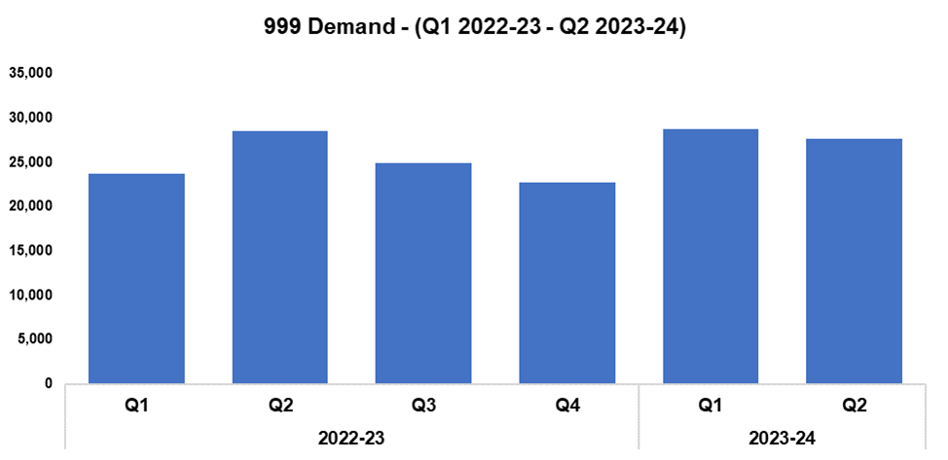
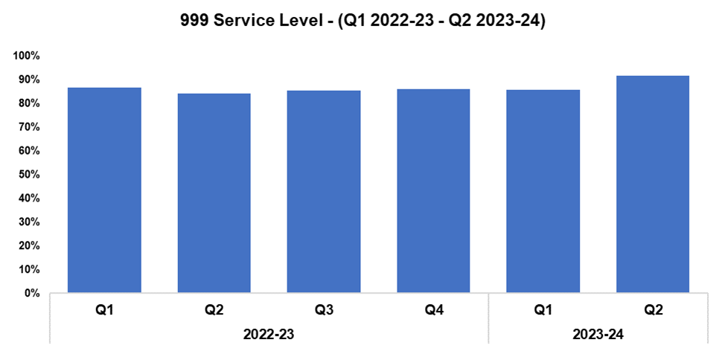



6. 999 Demand
Overview
999 demand decreased during Q2 2023-24 when compared to the quarter prior, declining by 4.0% (1,137 fewer calls) for a total of 27,600. A similar reduction of 3.4% (957 fewer calls) can be observed when comparing Q2 2023-24 against the same quarter during the previous financial year. Conversely, an increase of 7.8% (4,060 additional calls) has been recorded when comparing the current FYTD against FYTD 2022-23.
999 service level (the percentage of calls answered within 10 seconds) improved during Q2 2023-24 when compared against the quarter prior, rising by 5.9 percentage points to 91.8%, the highest quarterly figure within the timeframe. An increase of 3.3 percentage points can be observed when comparing the current FYTD against FYTD 2022-23.
The average answer speed for 999 calls during Q2 2023-24 was seven seconds, an improvement of three seconds when compared to the quarter prior and the lowest figure within the timeframe. 999 average answer speed has also improved when comparing the current FYTD against FYTD 2022-23, down from 12 seconds to eight seconds.
999 Average Answer Speed
(Minutes/Seconds)
Following a Victim Services Assessment conducted by His Majesty's Inspectorate of Constabulary and Fire & Rescue Services, a Threat, Harm, Risk, Investigation, Vulnerability and Engagement (THRIVE) script was introduced as a requirement for every call within the force. Since its introduction, THRIVE script performance and THRIVE compliance have improved significantly. At the end of Q2 2023-24 (September 2023), 84.5% of eligible calls had a THRIVE script, with the THRIVE compliance rate standing at 90.9% (5,764 completed and 601 aborted). The THRIVE completion rate was positioned at 77.0%.

Slide 32
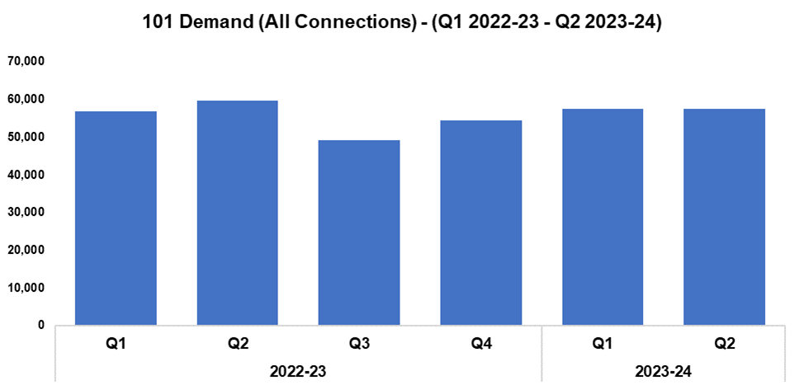
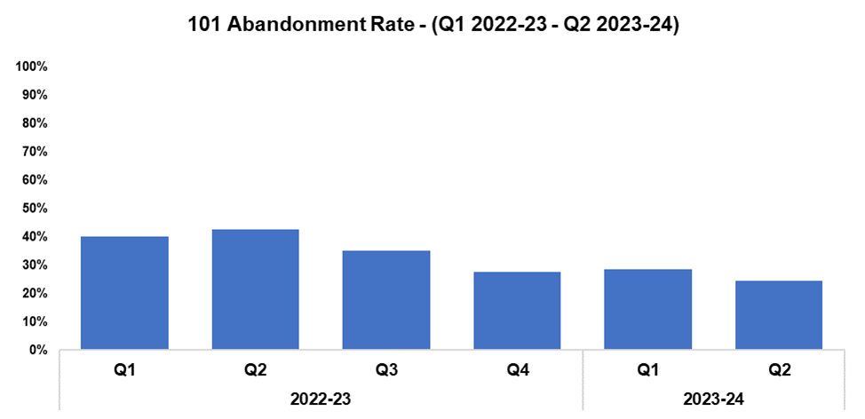



7. 101 Demand
Overview
101 demand (all connections) decreased slightly during Q2 2023-24 when compared to the quarter prior, declining by 0.1% (86 fewer calls) for a total of 57,466. This disrupts the upward trend in 101 demand observed following Q3 2022-23. A more prominent reduction of 3.8% (2,294 fewer calls) can be observed when comparing Q2 2023-24 against the same quarter during the previous financial year, with demand falling by 1.4% (1,628 fewer calls) when comparing the current FYTD against FYTD 2022-23.
The 101 abandonment rate decreased by 4.2 percentage points during Q2 2023-24 when compared to the quarter prior, and currently stands at 24.4%. This represents the lowest quarterly figure within the timeframe. 101 abandonment rate has also improved significantly when comparing Q2 2023-24 against the same quarter during the previous financial year (down 18.1 percentage points), and when comparing the current FYTD against FYTD 2022-23 (down 14.8 percentage points to 26.5%).
101 Average Answer Speed
(Minutes/Seconds)
The average answer speed for 101 calls decreased by one minute and 24 seconds to five minutes and five seconds during Q2 2023-24 when compared to the quarter prior. This represents the third consecutive improvement in average answer speed performance, and the lowest quarterly figure with the timeframe. This reduction was influenced by the average answer speed of four minutes and 11 seconds recorded during July 2023, the strongest monthly performance within the timeframe.
The average speed of answer has decreased by two minutes and 40 seconds when comparing Q2 2023-24 against the same quarter during the previous financial year, and by one minute and 34 seconds when comparing the current FYTD against FYTD 2022-23.

Slide 33
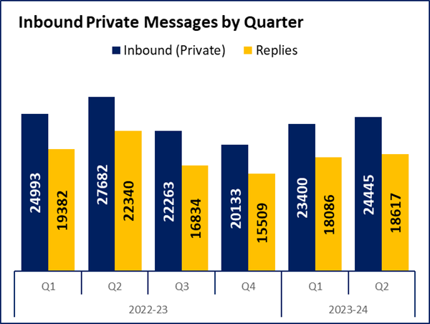


8. Social Media and Single Online Home
Overview
Inbound private messages received via Gwent Police’s social media platforms increased by 4.5% during Q2 2023-24 when compared to the quarter prior, with 1,045 additional messages received for a total of 24,445. In terms of inbound private message sources, 93.2% (22,773 messages) were received via Facebook platforms. Sundays saw the highest volume of inbound private messages (3,737 messages).
Inbound public messages received via Gwent Police’s social media platforms increased by 13.1% during Q2 2023-24 when compared to the quarter prior, with 1,170 additional messages received for a total of 10,107. In terms of inbound public message sources, 79.1% (7,996 messages) were received via Facebook platforms. Thursdays saw the highest volume of inbound public messages (1,788 messages).
This digital contact data includes our English and Welsh Facebook and X accounts.
3,046 Single Online Home (SOH) forms were submitted during Q2 2023-24, a reduction of 14.1% (502 fewer forms) when compared to the quarter prior.
The adjacent chart presents these forms by category, with the most numerous being crime reports (44.5% or 1,356 forms), followed by general ‘contact us’ messages (21.6% or 659 forms), and firearm licensing (10.6% or 324 forms). ‘Other’ includes forms with low volume, including events and processions, filming, fingerprints and IP licensing.
Notes:
Additional Demands
Next slide – Emergency and Priority Call Performance

Slide 34
9. Initiatives & Events
Overview
September saw the launch of an initiative aiming to encourage responsible dog ownership across the Caerphilly. The Local Environmental Awareness on Dogs (LEAD) is a partnership initiative involving Gwent Police, Caerphilly County Borough Council and various other partners from the Community Safety Partnership. The initiative aims to provide advice to the public on dog-related issues, improve dog safety and welfare, and protect the public from anti-social or dangerous behaviour by individuals with dogs. LEAD has been recognised nationally as best practice for promoting responsible ownership, providing a structured and coordinated approach to encourage responsible dog ownership and increase safety in our communities. In the last 12 months, the force has seized 15 dogs believed to be prohibited breeds under the Dangerous Dogs Act. These dogs are no longer on the streets, and Gwent Police will continue to enforce the legislation on dangerous dogs and those dangerously out of control.
The ‘All Together Better’ initiative has been launched, supporting advocacy for diversity and highlighting how positive action by leaders can help achieve this through a number of means. These include continuing conversations with their teams, dispelling myths and misconceptions, promoting advocacy within the community, and ensuring that their teams are aware that Positive Action is available to support under-represented groups.
The Wellbeing Team won the mental health category at the National Police Wellbeing Service Awards Ceremony for their initiatives that were developed to assist specific departments in supporting mental health. Mental health first aid training has also been rolled out, with initial inputs for Professional Standards Department and Dedicated Source Unit officers.
Two wellbeing drop-in sessions were created, which ran each week during the summer to support officers and staff during this period of high demand.
Focus Groups have been run to help understand the reasons for stress in the Force, with the aim of mitigating stressors in order reduce sickness absence. 23 Departments and 160 individuals have been contacted. Stress resilience inputs have been being delivered to CID. These incorporate Cognitive Behaviour Therapy techniques to break the vicious cycle of stress, and to challenge negative thinking with balanced thoughts.
A benchmarking request with the support of the National Police Chiefs Council was sent out, with 24 forces providing information in return. This data will be analysed to allow for an enhanced understanding of local and national wellbeing issues, facilitating a better focus on areas which require improvement or additional support. National working group invites will be sent to other forces regarding those areas identified as national concerns.
The flu campaign is 75% complete, with 573 vaccinations given.
Health Surveillance programmes have been set up in the new patient management system to provide compliance data, and all vision tests are now uploaded to Business World to aid other departments, such as Driver Training.
The force has achieved silver status within the Armed Forces Covenant, which aims to ensure that serving personnel, veterans, and their families are treated fairly.

Slide 35
Professional Standards Department
PSD Total Recorded Complaint Allegations
PSD Schedule 3 and Non-Schedule 3 Complaint Cases
PSD Misconduct Cases
Vetting
Quarterly Update

Slide 36


1. PSD Total Recorded Complaint Allegations
Overview
There has been a 33.1% increase in complaint allegations received in Q2 2023-24 (n=426) when compared to Q1 2023-24 (n=320). This is a significant increase in complaint allegations recorded for this quarter. This is attributable to the cleansing of data and administration/recording of Non-Schedule 3 complaints. This is displayed in the next slide.
The three categories of complaint with the greatest volume are as follows:
A1. Police action following contact 201
H3. Unprofessional attitude and disrespect 44
A3. Information 33
There has been an increase in A1. Police action following contact (n=201) when compared with the quarter prior (n=122).
There has been an increase in H3. Unprofessional attitude and disrespect (n=44) when compared with the quarter prior (n=32).
There has been an increase in A3. Information (n=33), which did not make the top three categories during the quarter prior (n=27).
There has been a reduction in A4. General level of service (n=10) when compared with the quarter prior (n=33).
Although the rise is attributable to Non-Schedule 3, the increases in these areas are being monitored to establish any localised or departmental issues.
Please note that multiple allegations can be recorded by one complainant.

Slide 37




2. PSD Schedule 3 and Non-Schedule 3 Complaint Cases
Overview
1) Schedule 3 - which relate to complaints dealt with under the Police Reform Act 2002, whereby the complainant can request a review if they are not satisfied.
2) Non-Schedule 3 - This allows complaints to be dealt with outside of the Police Reform Act 2002, previously regarded as ‘dissatisfaction’.
There is only a slight increase in Schedule 3 cases during Q2 2023-24 (n=39) compared with the quarter prior (n=34). In contrast the Non-Schedule 3 cases show a significant increase (n=260) when compared with the previous quarter (n=131) due to data cleansing and administration.
At the time the data was extracted there were 54 live Schedule 3 complaints and one live Non-Schedule 3 complaint. This is comparable to the common live workload and further supports the observation that the rise in cases is driven by Non-schedule 3 administration.
Figures will contain cases with multiple allegations.

Slide 38


3. PSD Misconduct Cases
Overview
The upward trend in misconduct cases is consistent with the pattern within policing in England and Wales.
A more proactive approach to misconduct and counter corruption intelligence gathering and investigation, coupled with more confidence in the workforce to report, has been the catalyst for this increase.
Gwent PSD have invested resources into both preventive work and support for victims and witnesses to police misconduct.
Q2 2023-24 Misconduct Outcomes
Within quarter two, there was an accelerated misconduct hearing held for a former detective constable relating to a conviction for failing to provide a specimen of blood when arrested for failing a roadside breath test. The officer resigned before proceedings were held, however Chief Constable Kelly determined that the allegation was proven as gross misconduct, and that they would have been dismissed had they remained a serving officer.
There was a further accelerated hearing held for a former police constable for allegations concerning inappropriate, sexualised behaviour towards a colleague on a night out in Cardiff. The officer resigned shortly before proceedings were held, however Chief Constable Kelly determined that the allegations were proven as gross misconduct, and that they would have been dismissed had they remained a serving officer.
A misconduct hearing was held for a police staff member. The allegation was proven as gross misconduct, and the individual was issued with a final written warning due to mitigation.
A misconduct appeal meeting was held for a police staff member who attended a misconduct meeting during Q1 2023-24. The chair of the panel upheld two of the original four allegations and sanctioned the individual with a lower outcome of a written warning as opposed to the original final written warning.

Slide 39




4. Vetting
Overview
Vetting figures are available from Q1 2021-22 onwards. Data is submitted a quarter behind, therefore figures for Q2 2023-24 are not currently included.
Please note the new national categories for Vetting refusals that will allow all forces to benchmark data and performance.

Slide 40
5. Quarterly Update
Overview
The Professional Standards Department continue to proactively promote the importance of high professional standards and an ethical culture within the organisation. They continue to provide a bespoke input to all new starters within the organisation, covering current themes in police complaints and misconduct.
The team recently received an additional resource to act as a point of contact for all witnesses and victims of police misconduct. This has significantly improved the department’s scope to deal with sensitive intelligence and disclosures from internal and external sources. This, along with a new Prevent officer within Counter Corruption, has allowed the department to take an early action and intervention approach to sub-optimal performance, behaviour, and conduct.
Subject matter leads within the department remain engaged on a national level, with the proposed changes to the Police Complaint and Misconduct legislation/procedure and Vetting Authorised Professional Practice due within the next 12 months.
There continues to be significant demand within misconduct investigations, including a number of complex and sensitive cases.

Slide 41


