Slide 1
Victims Code of Compliance Framework
2023 - 2024

Slide 2
Overview
What is it?
The Victims Code of Practice 2020 (VCOP) sets out the minimum level of service a victim should receive throughout their criminal justice journey from Policing, CPS, HMCTS and Probation.

Slide 3
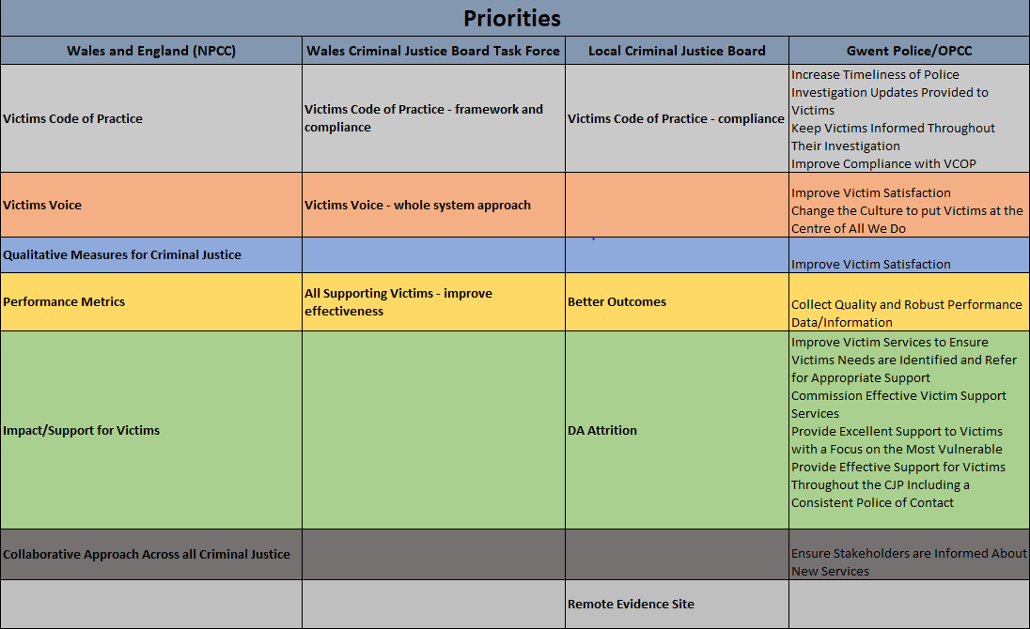
Victims and Prisoners Bill
The Victim and Prisoners bill has been introduced into Parliament with Royal Assent expected in 2024. The bill aims to enshrine the principles of the Victims Code in law and increase transparency and oversight throughout the criminal justice process.
This work remains a national priority within the victim and witness workstreams and we continue to collaborate with the Ministry of Justice around how all agencies will report compliance, with the implementation of collecting the metrics planned for 2025.

Slide 4
Our Responsibilities
Measure | Requirements | Who
Right 1 To be able to understand and be understood | Support by person of choice where appropriate and if required | All
 | Interpreter and/or option to converse in Welsh | All
 | Translation of any written documents | All
Right 2 To have the details of the crime recorded without delay | Crime should be recorded within 24 hours | Officer
 | Access to an intermediary where required | All
Right 3 To be provided with information when reporting the crime | Written confirmation of allegation, occurrence number and contact details (where no risk) | VCO
 | Information on rights as a victim | VCO
Right 4 To be referred to services that support victims and have services tailored to your needs | Assessed for Enhanced or Standard service | Officer
 | Referred into a support service withing 2 working days | VCO
 | Needs assessment for tailored support and continually reassessed | VCO
 | Needs assessed for court (Special Measures) | WCO/Officer/SMA
Right 5 Right to be provided with information about compensation | Information provided on The Criminal Injuries Compensation Scheme and how to make a claim | VCO
 | Respond to CICA requests in 30 days | Disclosure Team
Right 6 To be provided with information about the investigation | Provide key stage updates in 1 or 5 days (enhanced/standard) | Officer
 | Agree and provide regular updates | VCO
 | Provide a VRR for eligible applications | VRR Officer
Right 7 To make a victim personal statement | Offered to make a VPS at time of taking witness statement | Officer
 | Continually offered throughout CJP | Officer
 | If agreed the VPS should be taken and submitted with case file | Officer
Right 8 To be given information about the trial, process and your role as a witness | Provided with key stage updates throughout the court process | WCO
 | Needs assessed and offered referral to the Witness Service | WCO
Right 9 To be given the outcome of the case and any appeals | To be informed of the court outcome including sentencing information | WCO
Right 10 To be paid expenses (CPS) and have property returned | Have any property seized returned by the police as soon as it is no longer needed | Officer/Property Services

Slide 5
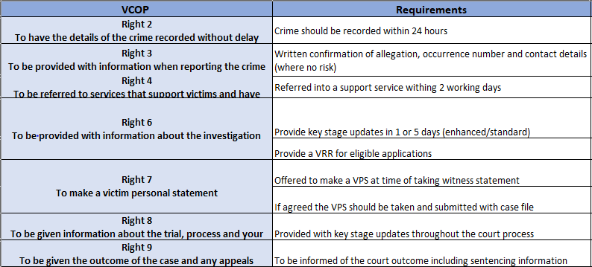
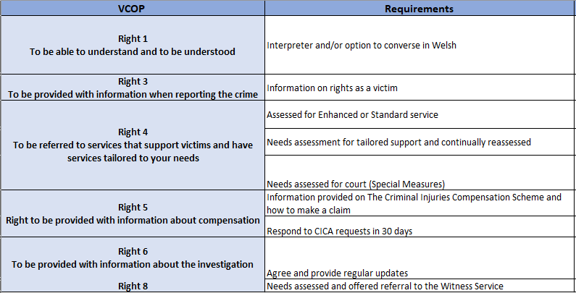
Compliance Metrics
While the official reporting may not commence until 2025, the MOJ have provided a draft of metrics they will likely expect which allows us the opportunity to review and improve our compliance as a force and put us in good standing for ‘go live’. The innovation of the Victim Care Unit has provided the organisation with further opportunity to report outside of these metrics to ensure we are providing a well rounded and victim centred service. There is a further 9 metrics we can capture additional to the MOJ draft, enabling 18 of the 23 code requirements to be measured.
MOJ
Additional

Slide 6
How will we measure
In order to capture compliance we will need to use a mixture of mass data collection through Qlikview and the Victim Care Unit along with DIP sampling for those area’s where more detail is needed from NICHE.
Volume Crime (inc DA and hate crime)
Mass data collected from Qlikview and Victim Care Unit.
A further DIP sample of 30 per quarter will be completed to quality assure the areas of responsibility that sit outside the VCU; key stage updates, VPS and special measures
RASSO
While some of the compliance for RASSO will be captured in mass data, a DIP Sample of 20 (15 adults 5 children) will be completed every quarter.
The majority of these cases will be from the scrutiny panel allowing effective review of the investigation, VCOP and survivor feedback all in one forum.
Post Charge
Cases that have been through the court system will be DIP sampled 30 per quarter to measure the compliance of responsibilities owned by the Witness Care Unit.

Slide 7
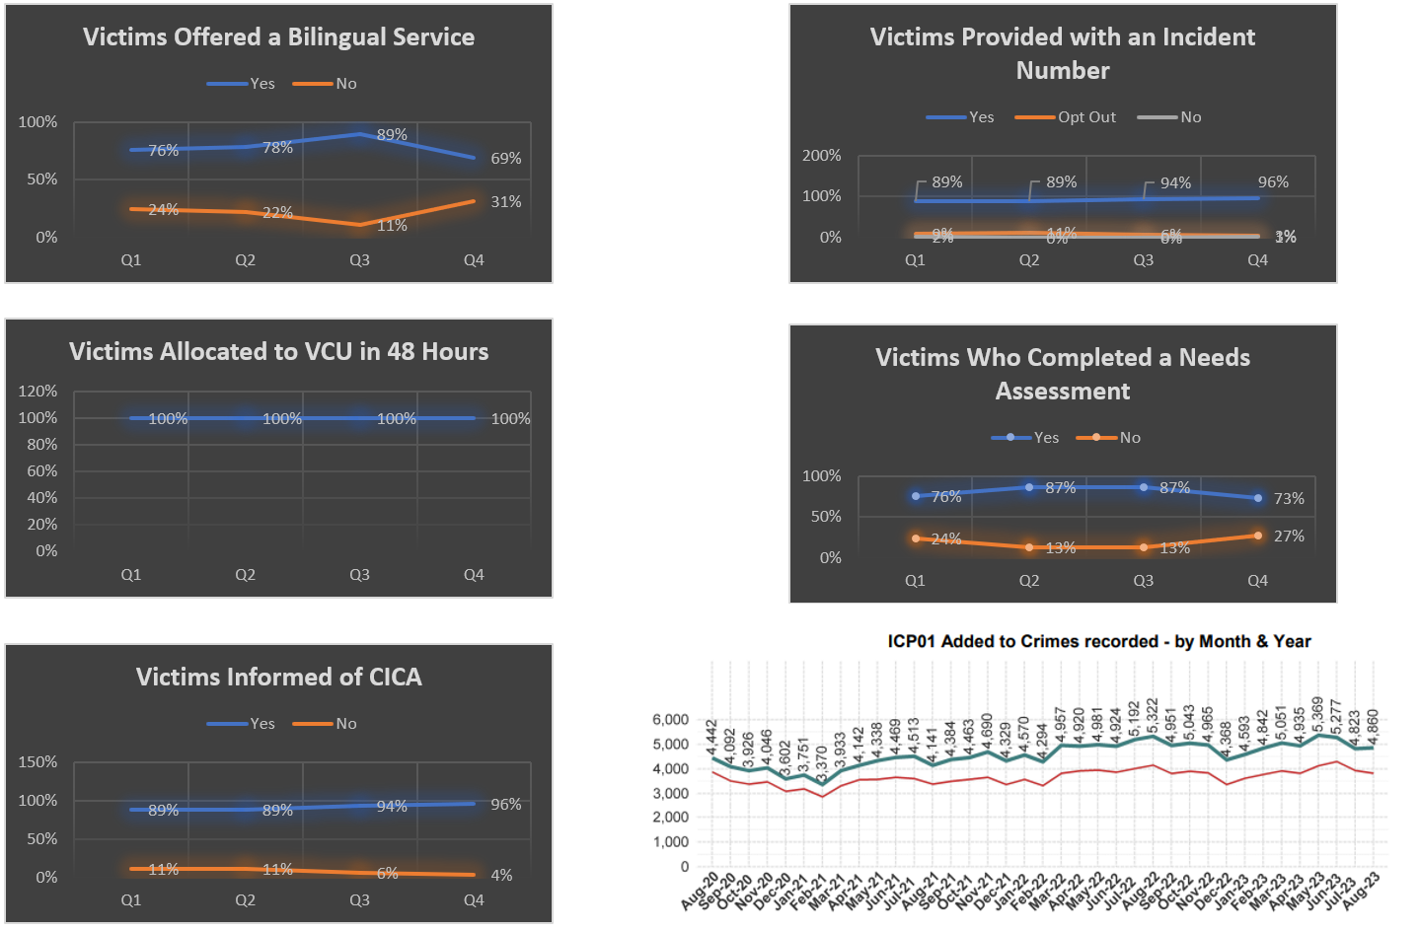
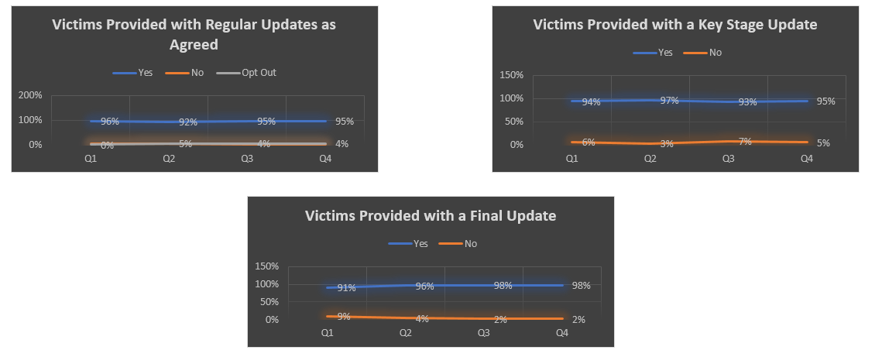
What will this look like?
Mass Data and VCU Quality Assurance

Slide 8
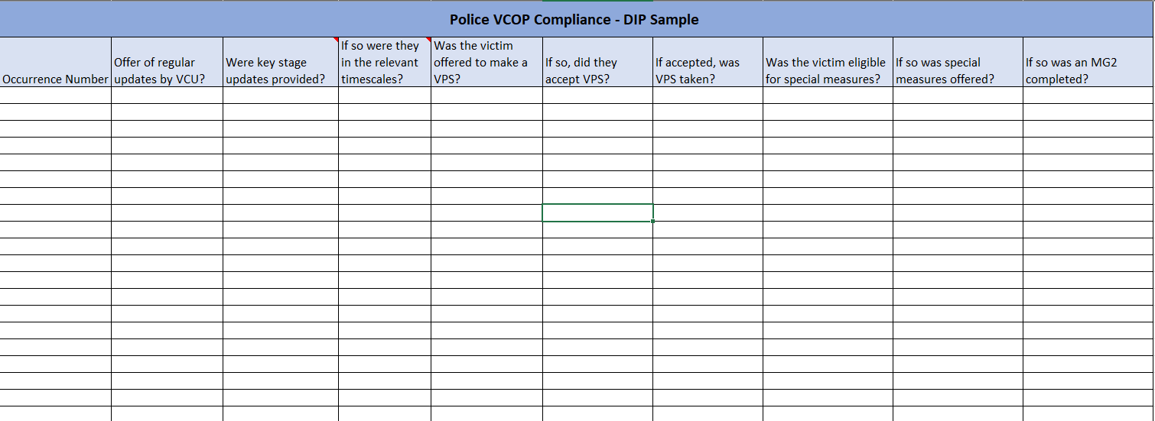
What will this look like?
Volume Crime DIP Sample

Slide 9
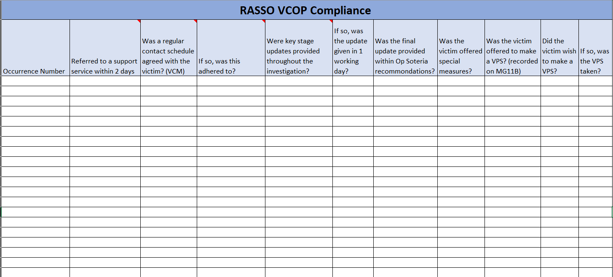
What will this look like?
RASSO DIP Sample

Slide 10
Victims Voice – Satisfaction Surveys
Survey Crime Types
General crime/ASB
Hate Crime
Domestic Abuse
Non-penetrative sexual offences
Survey Content
The general crime survey has been built and designed around the Victims Code of Practice, internal and national reporting requirements and has used victim feedback about what are important elements of service delivery when engaging with the Police and the wider criminal justice system.
Hate crime, domestic abuse and non-penetrative sexual offences surveys are an extension of the original survey with additional questions to measure the performance of the enhanced services they may receive.
Survey One
Offered to all victims who are contacted by the Victim Care Unit to measure satisfaction of their experience at first point of contact and the initial response of officers/staff where applicable
Survey Two
The purpose is to measure victim satisfaction relating to the investigation process and the communication provided throughout the investigation stage. This will be offered to victims following a charging or NFA decision during their next contact with the VCO.
Survey Three
This survey will be sent at the very end of the criminal justice journey to capture the judicial element of the journey and the communication provided by the Witness Care Unit.

Slide 11
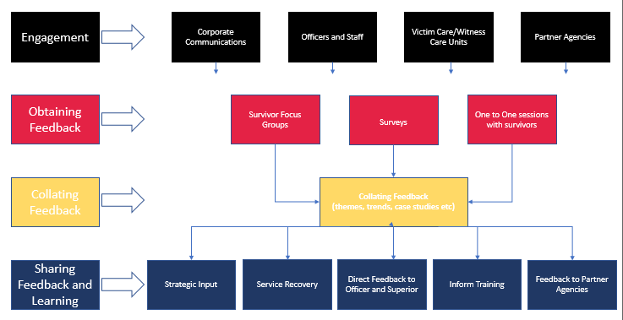
Victims Voice – SEC
The role of the Survivor Engagement Co-Ordinator is to engage with survivors of sexual and domestic offences, using their lived experiences and feedback to improve the forces response to these offences.

Slide 12
Governance
Quarterly compliance will be collated and monitored by the HoVS, with area’s of improvement added to the force wide Victim and Witness action plan/tracker.
Compliance will be discussed in the victim meetings highlighted and fed through the governance structure.

