Slide 1



Appendix 1

Slide 2
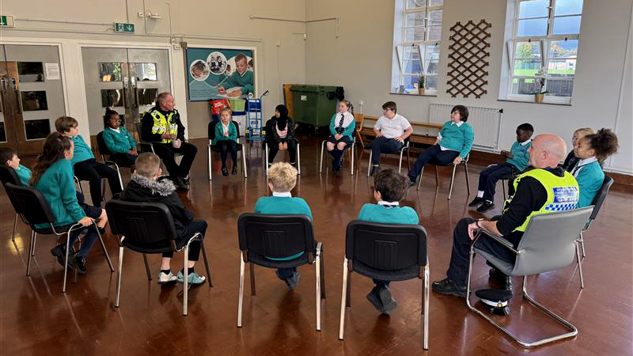

Slide 3
My Commitment & Contract
Shared vision with Police and Crime Commissioner –
A Safer Gwent
Giving Gwent Police back to Gwent’s people
Hearing Your Voices
Notes:
Truly Listening
Evidence supports the concern
Visible, interested & present leader = CONNECTION
Policing Crime Panel & Key Stakeholders -
mirror Home Office & Welsh Government priorities
Gwent’s journey so far = A defensive approach
MAKE EVERY CONTACT COUNT
Acknowledge the evidence – Survey results – evidence supports the concern
Being a visible interested and present leader – first values ‘’Active listening & understanding’’ = improved connection and leadership
International to local influence factors – Gwent’s journey so far - a defensive approach
BLM/Everard & Carrick/Poor detection rates nationally/Numerous forces in HMI engage
Spoken to Policing Crime Panel and key stakeholders. Concerns mirror Home Office and Welsh Government priorities :–
Online crime and fraud;
Knife crime;
Violence Against Women and Girls;
Anti Social Behaviour (drugs, dangerous dogs, shoplifting, off road and e-bikes, scooters);
Visibility of Police.
Crime statistics – perception versus reality
Procedural justice link to Legitimacy
The mission is progressing………….THIS IS EVOLUTION NOT REVOLUTION

Slide 4
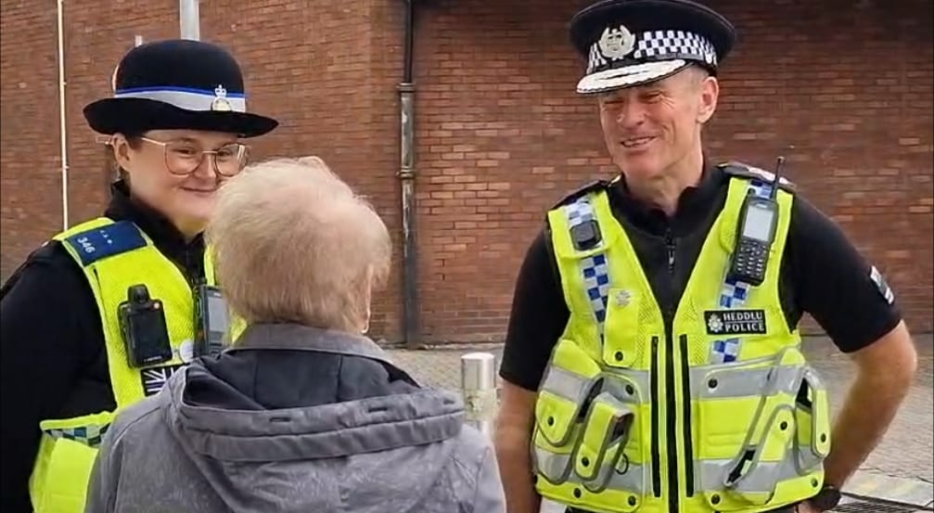

Slide 5
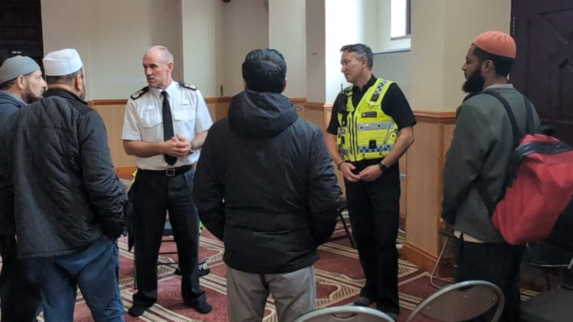
Commitment to Improving Public Confidence
Operational Effectiveness – Crime & Anti-Social Behaviour
Perception of Organisational Conduct & Culture
Engagement - Neighbourhood Policing Style
Embedded by a workforce with standards, values & ethics
Notes:
HMIC – Victim Service Assessment – reality check/Op Rhone/Kelly Pitt
High profile cases – Pitch/Tower/Outlier Force/Convictions & Dismissals
Internal Empoyer Opinion Survey/Networks
External - OPCC Survey/Blaenau Gwent stats

Slide 7

Strategic Intentions & Challenges
Redesign ‘Inclusive’ Gwent Police
Community at the heart of everything
Increase capacity & capability - evidence-based transformation
Micro communities – tailored approaches
Effective Partnerships & Collaborations
Future focussed – technology/innovation/early adopters
Global policing
Austerity - Value for money - Environmentally sustainable

Slide 8
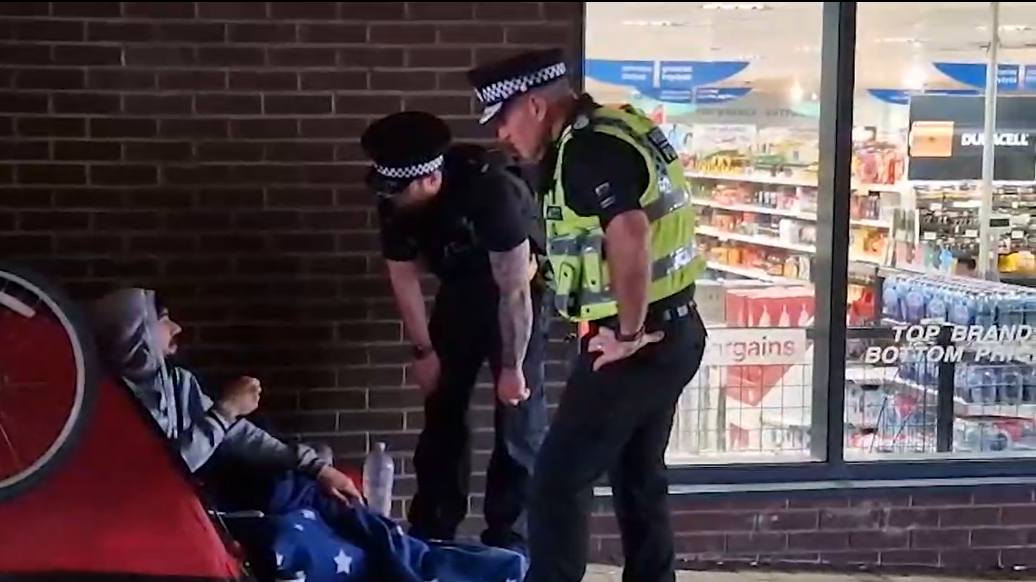

Slide 9
The Methodology
‘’Improving Trust & Confidence’’ – Be Clear & consistent
Governance - Strategies - Delivery Plans
Leadership & ‘’My Team’’
The most important partnership with the PCC - maximising commissioning, funding opportunities & local social value
A Public Health approach/Marmot principles/RCRP
Staff Associations/Networks – Wellbeing focus
Bringing The People With Me

Slide 10
Backdrop of a Challenging Landscape
Increasingly complexities of the changing face of policing
Peel Inspection 2024, Crime Data Integrity, Custody reviews
The National Vulnerability Action Plan, The Beating Crime Plan, The Race Action Plan, The Strategic Policing Requirement
NPCC Police Reform
The Policing Productivity Review stages 1,2 and 3
Public Service and public services funding pressures
Home Office Review: The process of police officer dismissals
Culture, strategy and delivery plan in place culture board introduced
Impact of social factors including change in government, the cost-of-living crisis, inflation, interest rates and estates pressures

Slide 11


Our Mission / PCC Plan
Improving Trust and Confidence
Inclusive, caring, connected organisation providing outstanding service for the communities of Gwent
To deliver the Police and Crime Plan
Effective Partnerships and Collaborations
Future Focused

Slide 12
Operating Model
The move to a functional model of Policing

Slide 13
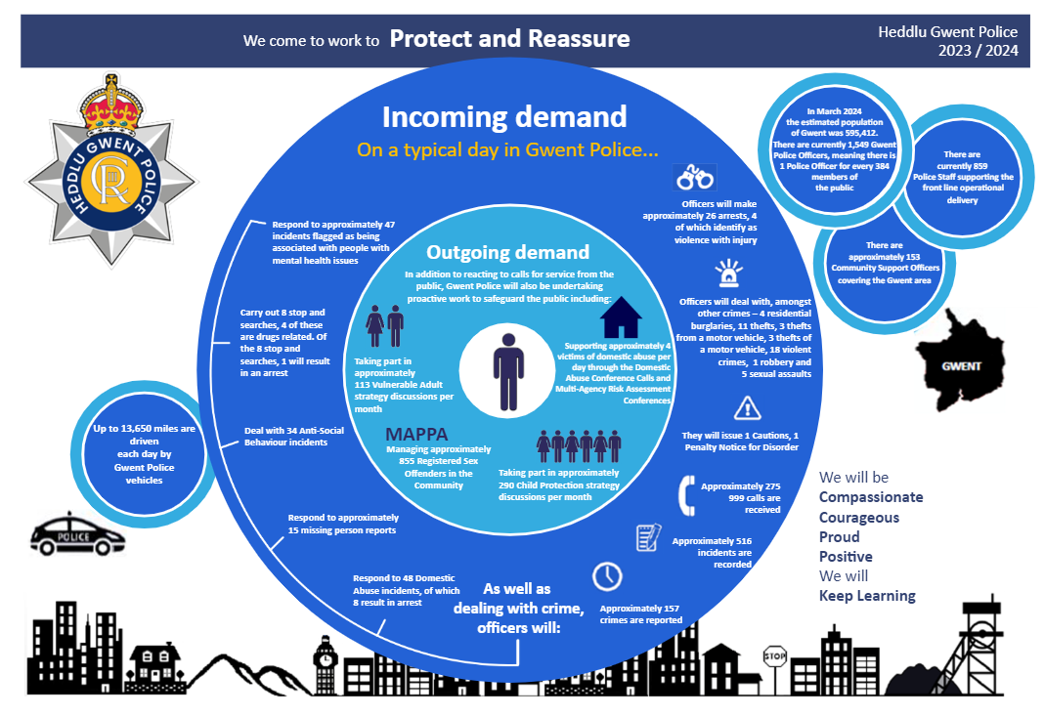
2022/23

Slide 14
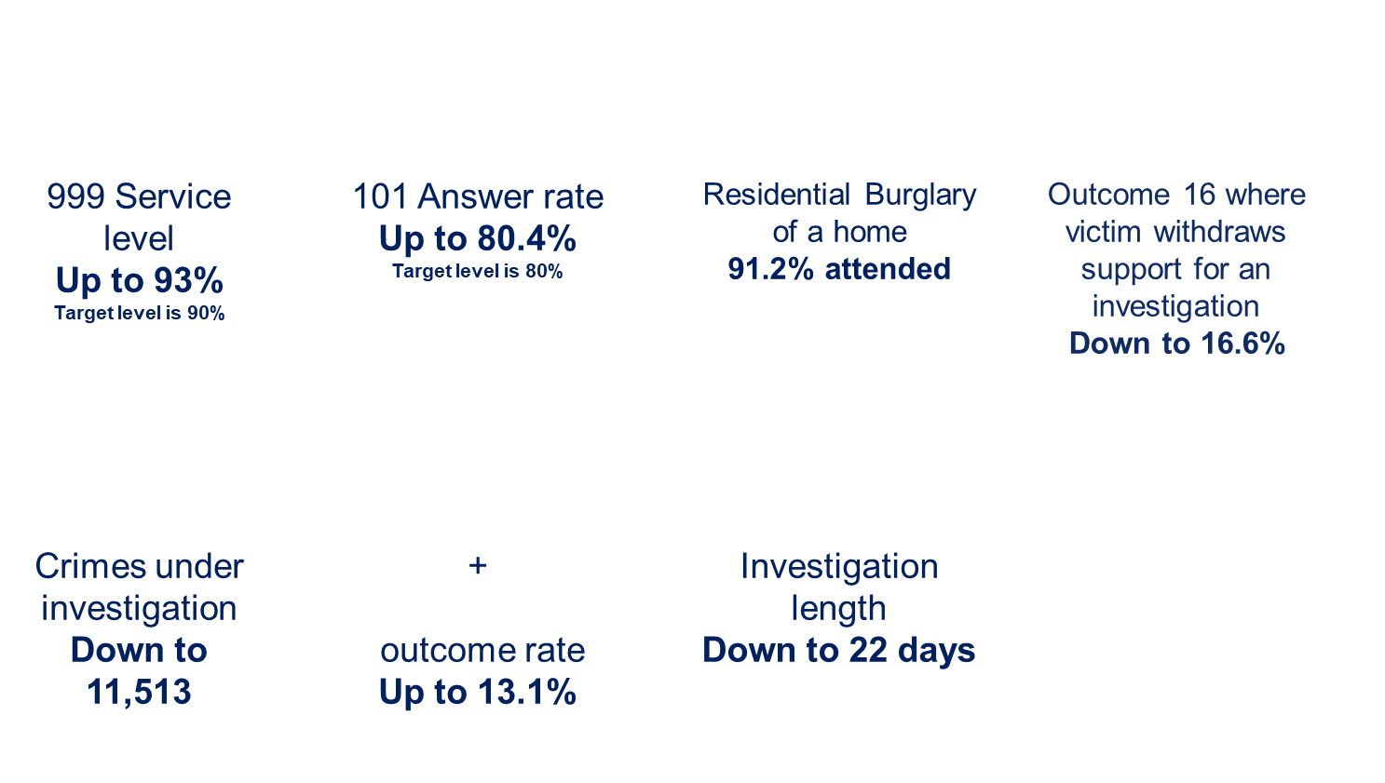
WE HAVE: Made communities safer by

Slide 15
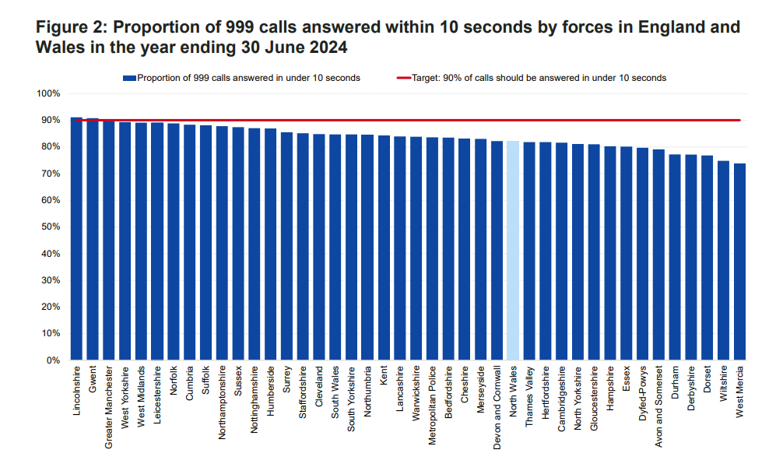
OUR FOCUS: Operational Delivery

Slide 16
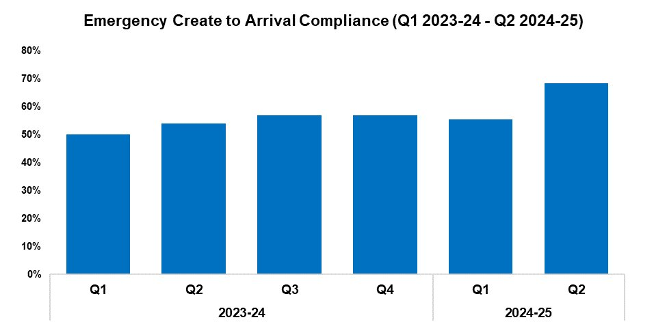
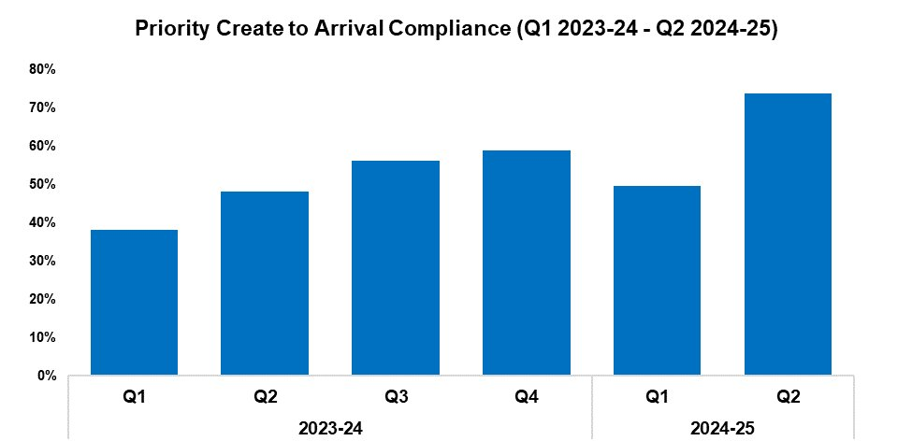
OUR FOCUS: Operational Delivery
Response Rates
2023-24​ |  |  |  | 2024-25​
Q1​ | Q2​ | Q3​ | Q4​ | Q1​ | Q2​ | Q3​ | Q4​
50.0%​ | 54.1%​ | 56.9%​ | 57.0%​ | 55.5%​ | 68.3%​ | -​ | -​
2023-24​ |  |  |  | 2024-25​
Q1​ | Q2​ | Q3​ | Q4​ | Q1​ | Q2​ | Q3​ | Q4​
38.0%​ | 48.1%​ | 56.1%​ | 58.8%​ | 49.7%​ | 73.7%​ | -​ | -​
Benchmarking Visit
Problem Solving workshop
Changes to Daily governance - pacesetter meetings
Changes to performance pack
Improved log management

Slide 17
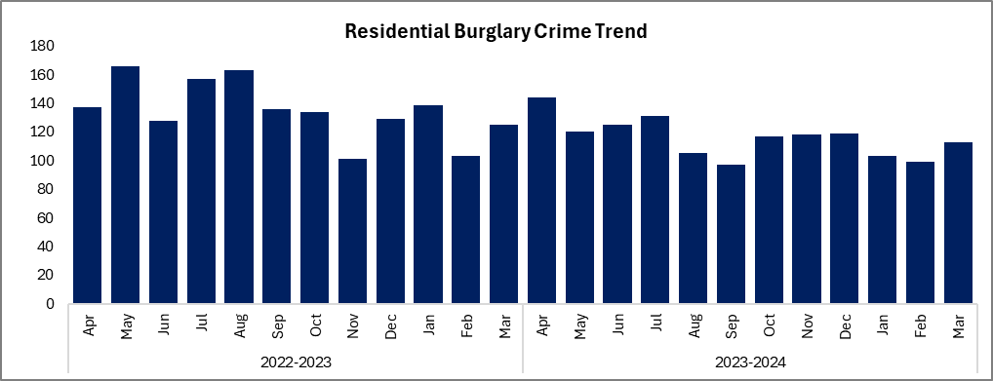
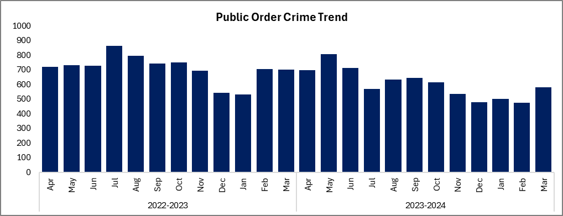
Residential Burglary improvement project
Reduced residential burglaries by 14.0% when compared against FYTD 2022/23. The solved rate for these offences has risen by 2.0 percentage points.
Reduced public order offences by 14.7% when compared against FYTD 2022/23. The solved rate for these offences has risen by 4.2 percentage points.

Slide 18

Crime Data Integrity 95.59 % compliance
2021 Risk identified and improvement plan put in place, included renewed focus on quality, uplift in resourcing, process improvement activity and improved training from staff across the organisation
2021 CDI Compliance was 76% this has improved to 95.59% following the 2024 HMICFRS Inspection.
Crime recorded within 24 hours also sits at 95%

Slide 19
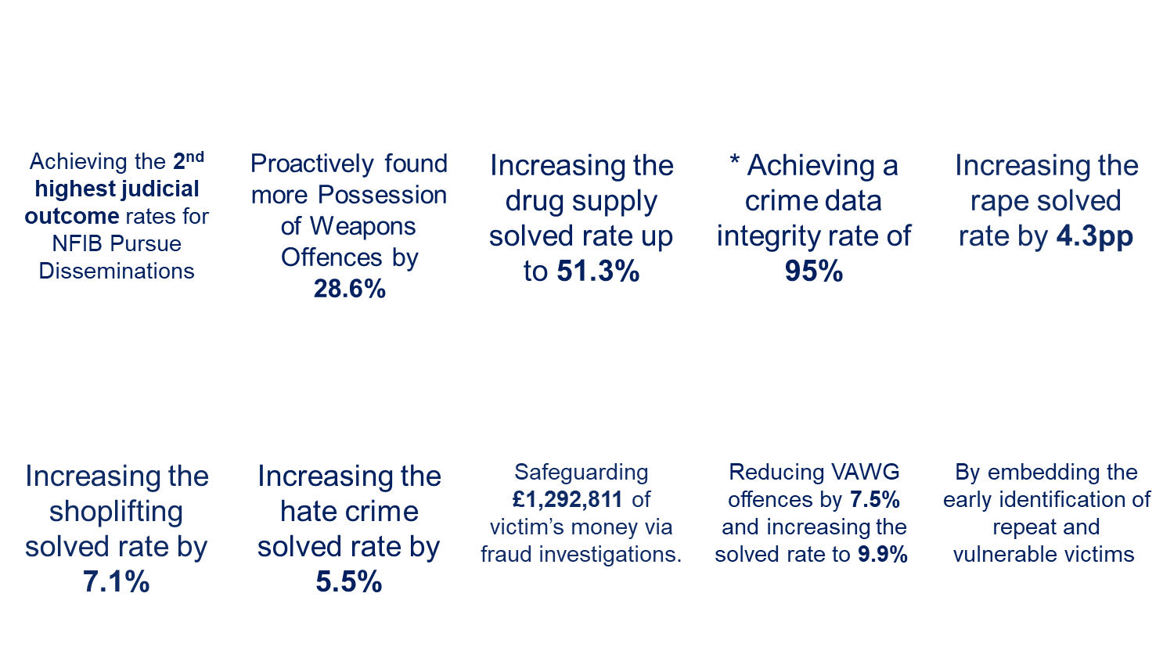


We have also, Investigated crime and brought offenders to justice resulting in

Slide 20
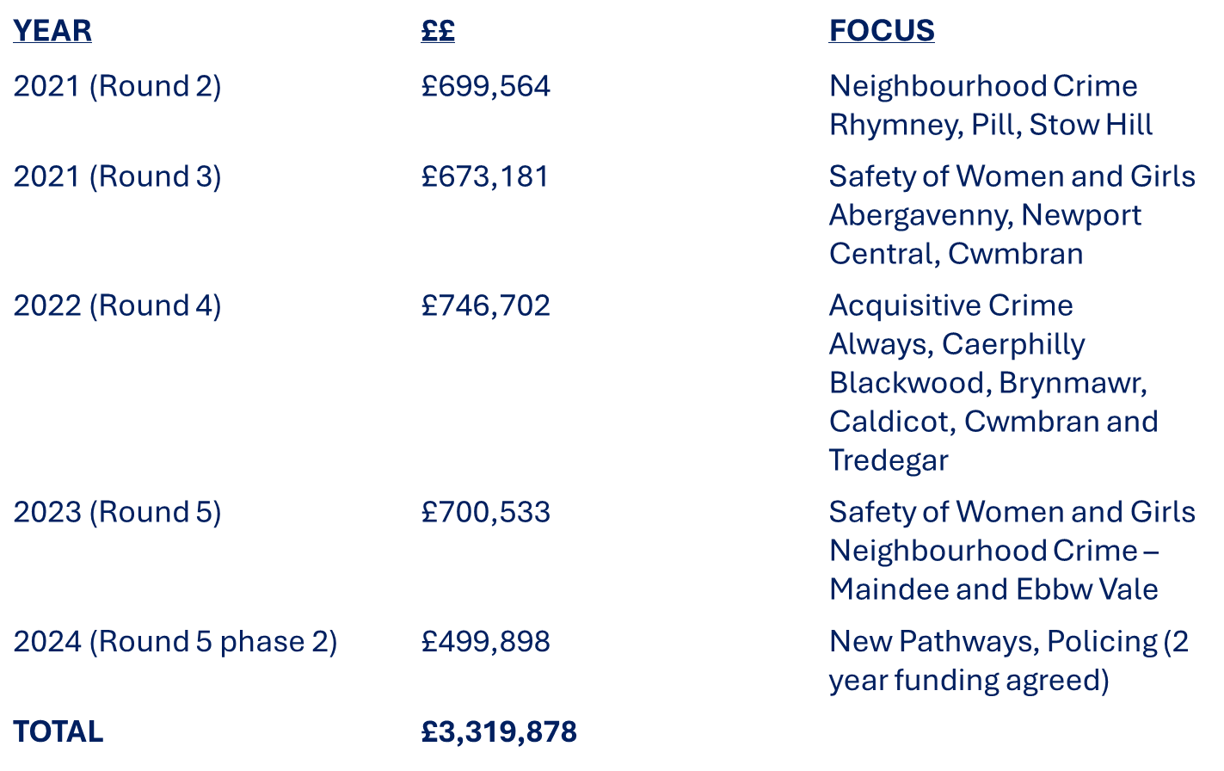
We have: Kept the peace by..
Continually working with partners to secure Safer Streets funding

Slide 21
We Have: Kept the peace by.
Home Office Hot Spot Policing Project – Operation Lumley
Funding approved at £999,388 following successful Home Office bidding process.
£622,080 - Uniformed Operational Patrol Plan
£33,069 - Supervision and co-ordination
£11,000 - Analyst (10%)
£10,176 - Communications and Media Officer (20%)
£120,000 - Partnership Allocation – £24,000 to each Local Authority
£203,063 - Digital Media Campaign

Slide 22
Key Areas: Operational Delivery
TECHNOLOGY: M365 Power platform, Automation project, Voice analytics, Share-point, Co-Pilot, Centre of excellence, AI and Innovation, Niche property, facial recognition, redaction software
ESTABLISHMENT PRIORITISATION: DC Recruitment, Rape investigation team, Public Protection, Custody and Force Contact and Control Centre
STALKING AND HARRASSMENT: Suzy Lamplugh peer review
ESTABLISHMENT EFFICIENCIES: I-Hub, File Management Unit, Operational Model Board
NEIGHBOURHOODS: Neighborhood Strategy agreed, performance framework in draft, embedded problem-solving approach, safer schools approach, CSO powers increased

Slide 23

Our Focus: Science, Research and Innovation
UNIVERSITY OF SOUTH WALES & HYDRA – Technology Enhanced Learning Collaboration (Gwent Police and South Wales University)
  10,000 volt sessions
  Hydra simulation centre
CPRL (Open University Centre for Police Research and Learning): A focus with South Wales University on Police perpetrators of domestic violence
AWPAC (All Wales Police Academic Collaboration): Focus of funding in Year 3 and 4 is Improving Public Confidence –
COLLEGE OF POLICING – Leading Inclusive Teams Pilot
STAR: Expressions of interest submitted -
  DSD Bids : Virtual Reality Wellbeing initiative
  Robotic dog for entry to location of danger
  ULEZ Compliant Electric Powered FRT Van

Slide 24
Our Focus: Our People
WELLBEING STRATEGY: Embedded in organisational delivery at all levels.
OSCAR KILO: Embedded psychological screening programme and wellbeing ambassadors
TRIM Process (available to all staff following a traumatic incident)
LEADERSHIP FOCUS: A comprehensive leadership programme from core leadership and first-line management to ethical and inclusive, mid-line and senior leadership development
Culture – refreshed strategy, delivery plan and 10,000 volt exercise
Control room stress monitors – Bio Stress Research
College of Policing Strategic Workforce Planning Matrix

Slide 25

Sustainability
CYCLICAL ESTATE REVIEWS
Cwmbran, Operational Training, Short Term Property Stores, Ystrad Mynch expansion, Joint Firearms Range, Tredegar Refurbishment
LED LIGHTING: Installed in 95% of the estate
SOLAR PANEL INSTALLATION: Estimated investment payback between 2 and 7 years
EV VEHICLE PURCHASE: Charging infrastructure

Slide 26
Process efficiency through technology
  Automation of processes using M365 technology
  CoPilot efficiency project
  Continuous Improvement reviews of HR, L&D, Information Governance, Offender Services, Criminal Justice, Victim Services with an aim to automate processes and release efficiency
  Investment in redaction software
  Rapid SOS
  Robotic Process Automation
  Power BI Training Plan
Focus on benefits realisation

Slide 27
Our Challenges
Managing increasing demand Serious & Organised Crime (S.O.C.) and Cyber anticipated demand increased and vulnerability; Increases in partnership demand; Increases in disclosure requests
Demand of R.I.T. (Rape Investigation Team) National Programme of Improvement
Data Analytics the need/want for increased data to inform decisions and direction and the issues of data quality and supporting systems
Continuing the building of successful equal collaborative partnerships

Slide 28
Our Challenges
NPAS (National Police Air Support)
Drones, replacement programme, licencing
Dangerous Dogs Legislation changes
Police Race Action Plan
Airwave / ESN replacement programme and timeline
IT Convergence
National Litigation challenges

Slide 29
Risks:
Limited opportunities for savings- Police officer numbers are protected by Op Uplift (Plus the additional Neighbourhood Uplift)
Ongoing Cost of Living Crisis; On our communities and our people
Continued pressure on Overtime budgets from ongoing demand and vacant posts.
No Funding Formula introduction built into the projections.
Assumption we will have an establishment of 1506 officers, 135 CSOs and 827.62 staff (including 3 apprenticeships) for the full year.

Slide 30



