Slide 1
Strategy Performance Board
Quarter 2 2024-25

Slide 2
Keeping Neighbourhoods Safe
All Crime
Beating Crime Plan
Residential Burglary
Neighbourhood Crime
Public Order
Anti-Social Behaviour
Roads Policing
Key Commitments
Reduce public order offences and anti-social behaviour, and the number of people who repeatedly carry out these acts.
Reduce acquisitive crime and repeat offenders.
Improve the safety of roads throughout Gwent.
Commission and invest in effective crime prevention initiatives.

Slide 3
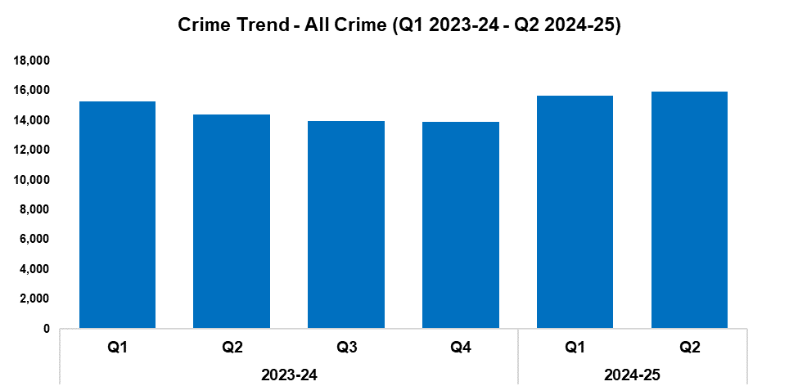
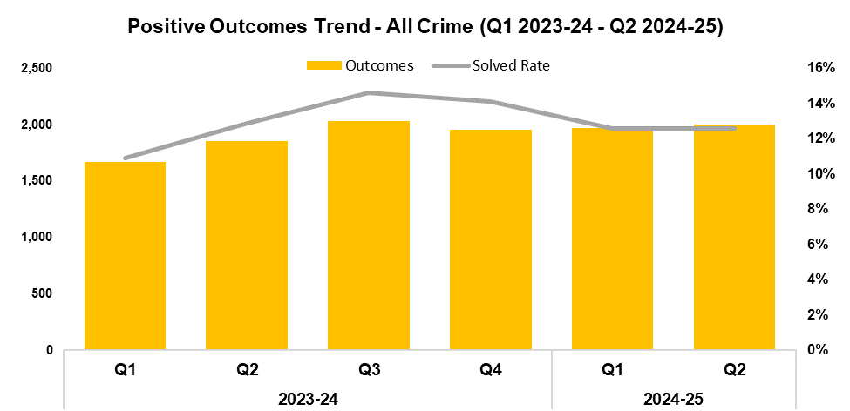
1. All Crime
2023-24 |  |  |  | 2024-25
Q1 | Q2 | Q3 | Q4 | Q1 | Q2 | Q3 | Q4
15,300 | 14,375 | 13,947 | 13,905 | 15,685 | 15,950 | - | -
2023-24 |  |  |  | 2024-25
Q1 | Q2 | Q3 | Q4 | Q1 | Q2 | Q3 | Q4
10.9% | 12.9% | 14.6% | 14.1% | 12.6% | 12.6% | - | -
Overview
Overall crime levels have risen by 1.7% during the second quarter of the 2024-25 financial year (Q2 2024-25) when compared the quarter prior, with 265 additional offences recorded for a total of 15,950. This represents the largest quarterly total within the timeframe, continuing the upward trend observed following Q4 2023-24. A more prominent increase of 11.0% (1,575 additional offences) can be observed when comparing Q2 2024-25 against the same quarter during the previous financial year. In total, 31,635 offences have been recorded during the current financial year to date (FYTD). This represents an increase of 6.6% (1,960 additional offences) when compared to the previous FYTD.
The overall solved rate has remained steady at 12.6% when compared to the quarter prior, although 36 additional crimes have been solved for a total of 2,005. A reduction of 0.3 percentage points can be observed when comparing the solved rate for Q2 2024-25 against the same quarter during the previous financial year, albeit with 153 additional crimes solved. This indicates that the decline in solved rate between these two quarters may have been influenced by the rise in overall crime volume. Conversely, the solved rate for the current FYTD stands at 12.6%, 0.7 percentage points above that recorded during the previous FYTD, with 455 additional crimes solved for a total of 3,974.

Slide 4
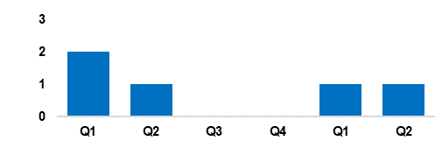
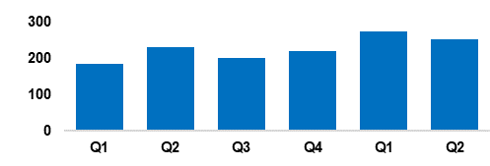
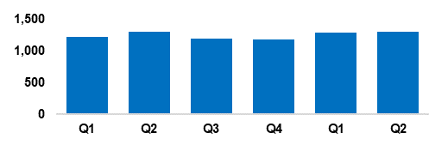
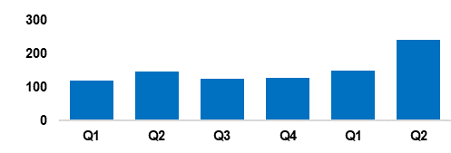
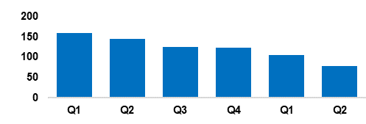
2. Beating Crime Plan
Crime Trend - Homicide (Q1 2023-24 – Q2 2024-25)
The Homicide Prevention Strategy is in place, supported by a delivery plan, and has been aligned to a refresh of the force’s Serious Violence Strategy.
The Homicide and Serious Violence Meeting is focussing on intervention and prevention opportunities, with the aspiration of bringing in closer partners and commissioning mechanisms to align to deliver desired outcomes.
Serious Violence is now aligned to the Serious Organised Crime (SOC) portfolio, and the crossover between the portfolios and governance.
Homicide
Crime Trend - Serious Violence (Q1 2023-24 – Q2 2024-25)
Gwent Police utilises a problem-solving, partnership-based approach to preventing Serious Violence.
The force’s Serious Violence governance and delivery is embedding, in order to integrate it with Homicide, and intervention and prevention.
Particular focus has been placed on night-time economy related violence and knife crime, with recent ‘knife sweeps’, partnerships, and amnesties receiving positive feedback from the public.
Greater focus on intervention and prevention, working with Neighbourhood Policing Teams, and problem solving.
Serious Violence
Crime Trend - Neighbourhood Crime (Q1 2023-24 – Q2 2024-25)
Residential Burglary is an area of focus, particularly regarding attendance times and forensics.
The new burglary app is being piloted to maximise golden hour and investigative opportunities, at the scene of and in response to burglary. Burglary outcome rates have improved, with dedicated Criminal Investigation Department resource daily for burglary response and review.
Focus has been placed on Shoplifting through business crime prevention, seasonal demand predictions, and resourcing and offender management.
Neighbourhood Crime
Crime Trend - Drug Trafficking and Supply (Q1 2023-24 – Q2 2024-25)
The SOC Local Profile has been rolled out and delivered through partnership forums to set local SOC priorities, driving our 4P’s (pursue, protect, prevent and prepare) approach to drug supply.
Project Adder is being successfully delivered, particularly for cases of suspected synthetic opioid deaths.
Continued roll out of internal communications strategy regarding awareness of SOC, County Lines, and Drugs.
Strong focus has been placed on publicising operational drug enforcement activity to provide public confidence in Gwent Police.
Drug Trafficking
Action Fraud Occurrences Assigned a Cyber-Enabled Local Qualifier (Q1 2023-24 – Q2 2024-25)
The fraud and cyber teams have been working closely together to prevent online fraud and provide education.
Cyber-volunteers are being embedded to increase specialist knowledge and boost community engagement relating to cyber crime.
The Digital Media Investigator role has been expanded, and they have been made more accessible.
Cyber awareness training has been provided to all frontline officers, force control room operators and neighbourhood staff.
Cyber Crime

Slide 5
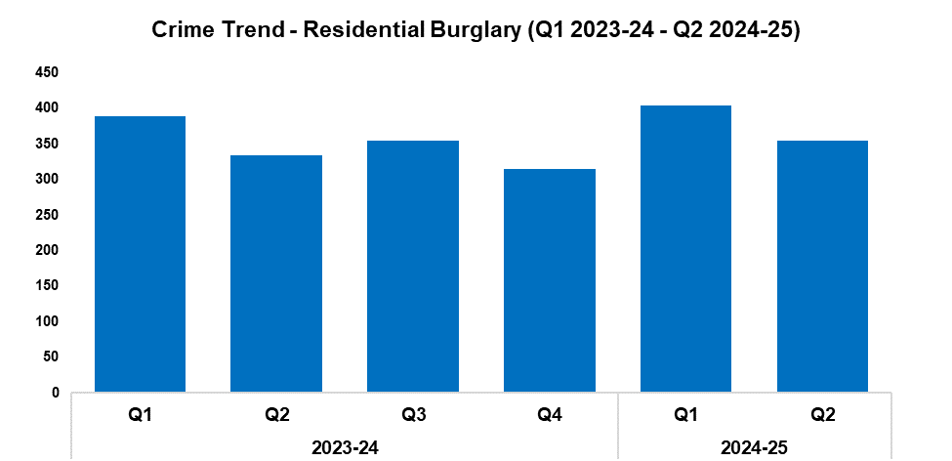
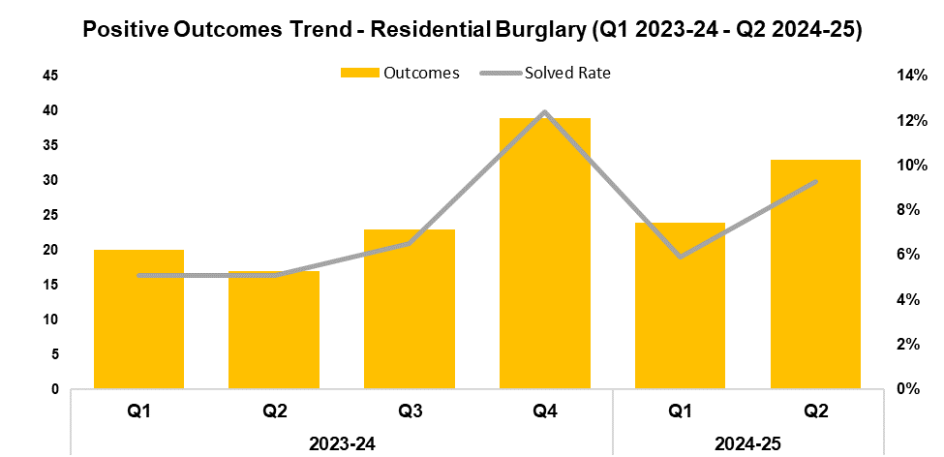
3. Residential Burglary
2023-24 |  |  |  | 2024-25
Q1 | Q2 | Q3 | Q4 | Q1 | Q2 | Q3 | Q4
389 | 334 | 354 | 315 | 404 | 354 | - | -
2023-24 |  |  |  | 2024-25
Q1 | Q2 | Q3 | Q4 | Q1 | Q2 | Q3 | Q4
5.1% | 5.1% | 6.5% | 12.4% | 5.9% | 9.3% | - | -
Overview
Residential Burglary offences have seen a reduction of 12.4% when compared to the quarter prior, with 50 fewer offences recorded for a total of 354. This continues the trend of quarterly fluctuations observed for this metric throughout the timeframe. An increase of 6.0% (20 additional offences) can be observed when comparing Q2 2024-25 against the same quarter during the previous financial year. In total, 758 offences have been recorded during the current FYTD. This represents an increase of 4.8% (35 additional offences) when compared to the previous FYTD.
When compared to the quarter prior, the solved rate for Residential Burglary offences has risen by 3.4 percentage points to 9.3%, with nine additional crimes solved for a total of 33. This represents the second-highest quarterly figure within the timeframe. A further increase of 4.2 percentage points can be observed when comparing Q2 2024-25 against the same quarter during the previous financial year, with 16 additional crimes solved. When comparing the current FYTD against the previous FYTD, the solved rate has risen by 2.4 percentage points to to 7.5%, with 20 additional crimes solved for a total of 57.
During Q2 2024-25, 93.0% of all incidents classified as Residential Burglary of a Home were attended. Of these incidents, 47.5% were attended within 60 minutes.

Slide 6
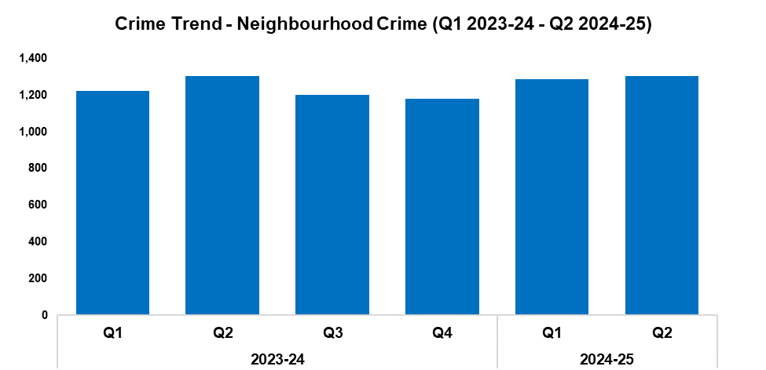
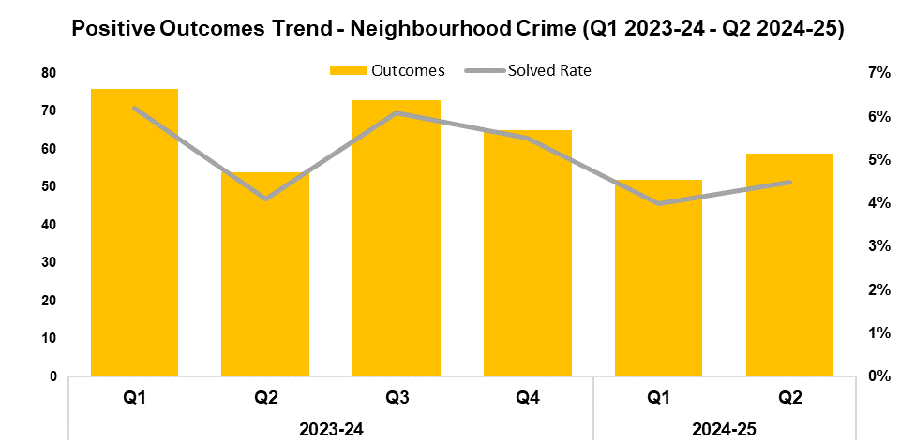
4. Neighbourhood Crime
2023-24 |  |  |  | 2024-25
Q1 | Q2 | Q3 | Q4 | Q1 | Q2 | Q3 | Q4
1,224 | 1,303 | 1,202 | 1,180 | 1,286 | 1,303 | - | -
2023-24 |  |  |  | 2024-25
Q1 | Q2 | Q3 | Q4 | Q1 | Q2 | Q3 | Q4
6.2% | 4.1% | 6.1% | 5.5% | 4.0% | 4.5% | - | -
Overview
Neighbourhood Crime offences have seen a slight increase of 1.3% when compared to the quarter prior, with 17 additional offences recorded for a total of 1,303. This continues the upward trend observed following Q4 2023-24. The volume of offences has remained steady when comparing Q2 2024-25 against the same quarter during the previous financial year. In total, 2,589 offences have been recorded during the current FYTD. This represents an increase of 2.5% (62 additional offences) when compared to the previous FYTD.
Vehicle Crime offences continued to account for the majority of Neighbourhood Crime during Q2 2024-25, comprising 64.1% of the quarterly total with 835 offences recorded.
When compared to the quarter prior, the solved rate for Neighbourhood Crime offences has risen by 0.5 percentage points to 4.5%, with seven additional crimes solved for a total of 59. This disrupts the downward trend observed following Q3 2023-24. A similar increase of 0.4 percentage points can be observed when comparing Q2 2024-25 against the same quarter during the previous financial year, with five additional crimes solved. Conversely, the solved rate for the current FYTD stands at 4.3%. This represents a reduction of 0.8 percentage points when compared to the previous FYTD, with 19 fewer crimes solved for a total of 111. This reduction has been influenced by the elevated solved rate recorded during Q1 2023-24.

Slide 7
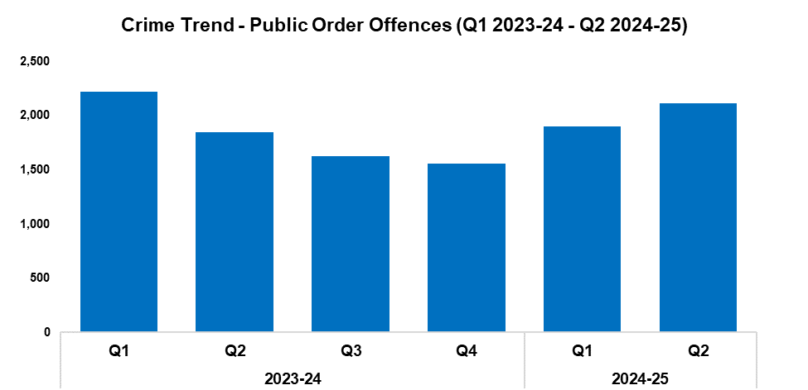
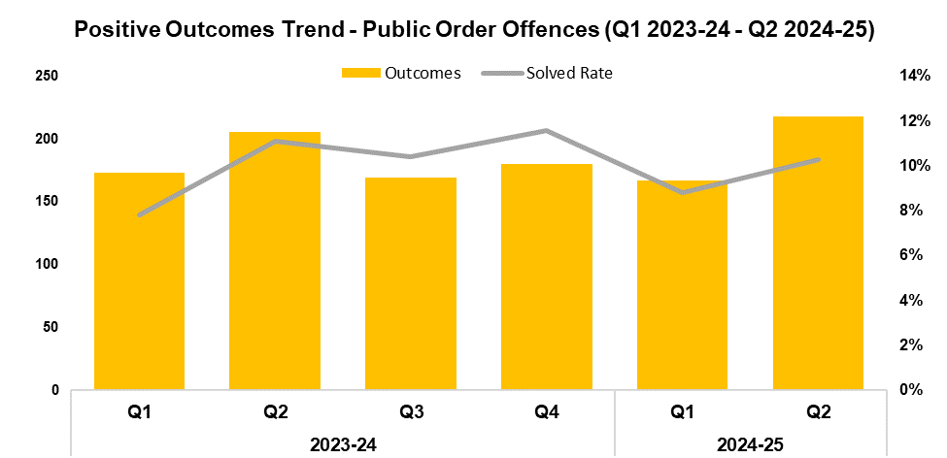
5. Public Order
2023-24 |  |  |  | 2024-25
Q1 | Q2 | Q3 | Q4 | Q1 | Q2 | Q3 | Q4
2,219 | 1,850 | 1,629 | 1,558 | 1,901 | 2,115 | - | -
2023-24 |  |  |  | 2024-25
Q1 | Q2 | Q3 | Q4 | Q1 | Q2 | Q3 | Q4
7.8% | 11.1% | 10.4% | 11.6% | 8.8% | 10.3% | - | -
Overview
Public Order Offences have seen an increase of 11.3% when compared to the quarter prior, with 214 additional offences recorded for a total of 2,115. This continues the upward trend observed following Q4 2023-24. A similar increase of 14.3% (265 additional offences) can be observed when comparing Q2 2024-25 against the same quarter during the previous financial year. Conversely, a total of 4,016 offences have been recorded during the current FYTD, representing a slight reduction of 1.3% (53 fewer offences) when compared to the previous FYTD.
As offences under Section 5 of the Public Order Act 1986 have been classified as non-notifiable by the Home Office, they have been retroactively removed from this dataset to facilitate the accurate monitoring of long-term trends.
When compared to the quarter prior, the solved rate for Public Order Offences has risen by 1.5 percentage points to 10.3%, with 51 additional crimes solved for a total of 218. This represents the highest number of crimes solved within any quarter of the timeframe. Conversely, a reduction of 0.8 percentage points can be observed when comparing Q2 2024-25 against the same quarter during the previous financial year, albeit with 12 additional crimes solved. The solved rate for the current FYTD stands at 9.6%, 0.3 percentage points above that recorded during the previous FYTD, with six additional crimes solved for a total of 385.

Slide 8
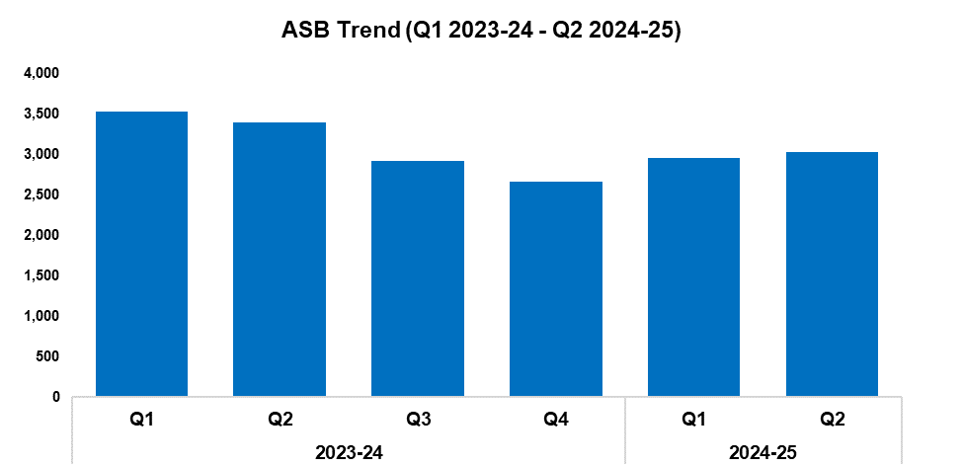
6. Anti-Social Behaviour
Overview
Levels of anti-social behaviour (ASB) in Gwent have risen by 2.7% during Q2 2024-25 when compared to the quarter prior, with 79 additional incidents recorded for a total of 3,029. This continues the upward trend observed following Q4 2023-24.
Conversely, a reduction of 10.8% (368 fewer incidents) can be observed when comparing Q2 2024-25 against the same quarter during the previous financial year. A similar reduction of 13.6% has been recorded when comparing the current FYTD against the previous FYTD, with 943 fewer incidents recorded for a total of 5,979.
When assessed by closing category, incidents classified as ‘ASB - Environmental’ and ‘ASB - Personal’ saw similar reductions of 8.6% and 7.3% respectively when compared to the quarter prior. Incidents classified as ‘ASB - Nuisance’ instead saw an increase of 7.8%.
2023-24 |  |  |  | 2024-25
Q1 | Q2 | Q3 | Q4 | Q1 | Q2 | Q3 | Q4
3,525 | 3,397 | 2,918 | 2,659 | 2,950 | 3,029 | - | -

Slide 9
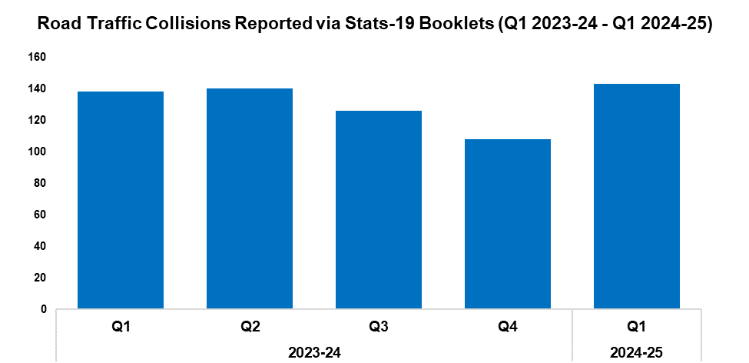
7. Roads Policing
Overview
During Q1 2024-25, 143 Road Traffic Collisions (RTCs) were reported via Stats-19 RTC booklets, an increase of 32.4% (35 additional RTCs) when compared to the quarter prior. A less prominent increase of 3.6% (five additional RTCs) can be observed when comparing Q1 2024-25 against the same quarter during the previous financial year. Please note that this metric is now being reported a quarter in arrears, due to the lag time between incidents occurring and the corresponding Stats-19 booklets being submitted by officers. At present, 24 booklets are marked as outstanding for Q1 2024-25.
A total of 558 individuals were reported for one of the ‘Fatal Five’* factors during Q2 2024-25, an increase of 2.6% (14 additional reports) when compared to the quarter prior. The most commonly reported factor during Q2 2024-25 was drink/drug driving, which accounted for 33.7% of all Fatal Five reports with 188 instances recorded. This was followed by excessive speed, comprising 19.4% of all Fatal Five reports with 108 instances recorded.
*The ‘Fatal Five’ refer to the five main causes of serious injury and death in RTCs. They consist of: careless driving; drink/drug driving; not wearing a seatbelt; using a mobile phone; and excessive speed.
2023-24 |  |  |  | 2024-25
Q1 | Q2 | Q3 | Q4 | Q1 | Q2 | Q3 | Q4
138 | 140 | 126 | 108 | 143 | - | - | -
Gwent Roads Policing and Specialist Operations (RPSO) officers participated in Operation Spotlight during July. This nationwide roads policing operation was organised by the National Police Chiefs’ Council, with the aim of counteracting the seasonal spike in road safety violations recorded during July across a five-year period. Officers in Gwent primarily utilised static stops to conduct roadside breath tests, whilst simultaneously performing basic vehicle checks (such as inspecting lights and tyres) on each stopped vehicle. A total of 783 breath tests were administered over the course of the operation, with 39 of these returning a positive result. A further 88 drug tests were performed, 44 of which resulted in a positive reading. Driving bans have been issued to these individuals, with this early intervention potentially contributing to a reduction in serious collisions going forward.
Corporate Communications have worked with Rhiannon Lucas, and her father, Jason, to raise awareness of the dangers of drink and drug driving after her two children were killed by a motorist who was driving under the influence on the M4 in February 2022. An RPSO inspector was interviewed by Wales Online and the South Wales Argus as part of this initiative. The resulting articles highlighted the dangers posed by drink and drug driving, and emphasised Gwent Police’s zero tolerance approach to these offences. It is estimated that the articles have reached approximately 742,000 people.

Slide 10
  Combat Serious Crime
Combat Serious Crime
Most Serious Violence
Serious Violence
VAWG Domestic Priority Offences
Drug Supply and Organised Crime
Key Commitments
Reduce the number of repeat victims of child criminal and sexual exploitation.
Increase disruption of serious organised crime, and reinvest assets seized back into communities.
Improve the overall criminal justice response to violence against women, domestic abuse and sexual violence.
Commission and invest in services that work with perpetrators of serious crime to prevent and reduce re-offending.

Slide 11
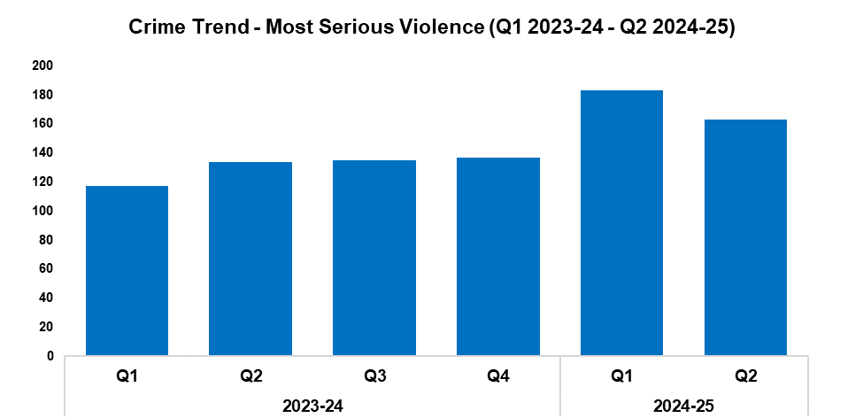
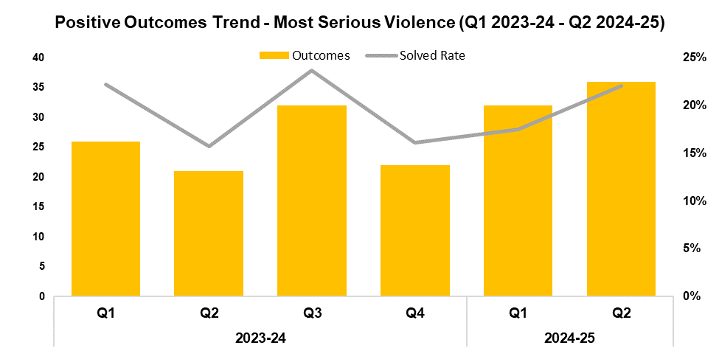
1. Most Serious Violence
2023-24 |  |  |  | 2024-25
Q1 | Q2 | Q3 | Q4 | Q1 | Q2 | Q3 | Q4
117 | 134 | 135 | 137 | 183 | 163 | - | -
2023-24 |  |  |  | 2024-25
Q1 | Q2 | Q3 | Q4 | Q1 | Q2 | Q3 | Q4
22.2% | 15.7% | 23.7% | 16.1% | 17.5% | 22.1% | - | -
Overview
Most Serious Violence offences consist of homicide, grievous bodily harm with intent, and causing death by dangerous driving. These offences have seen a reduction of 10.9% during Q2 2024-25 when compared to the quarter prior, with 20 fewer offences recorded for a total of 163. Whilst this disrupts the upward trend that had previously been observed throughout the timeframe, it remains the second-highest quarterly total within this period. An increase of 21.6% (29 additional offences) can be observed when comparing Q2 2024-25 against the same quarter during the previous financial year. A further increase of 37.8% has been recorded when comparing the current FYTD against the previous FYTD, with 95 additional offences reported for a total of 346.
When compared to the quarter prior, the solved rate for Most Serious Violence offences has risen by 4.6 percentage points to 22.1%, with four additional crimes solved for a total of 36. This represents the highest number of crimes solved within any quarter of the timeframe, disrupting the previous trend of quarterly fluctuations and instead establishing an upward trend following Q4 2023-24. A more prominent increase of 6.4 percentage points can be observed when comparing Q2 2024-25 against the same quarter during the previous financial year, with fifteen additional crimes solved. The solved rate for the current FYTD stands at 19.7%, 1.0 percentage point above that recorded during the previous FYTD, with 21 additional crimes solved for a total of 68.

Slide 12
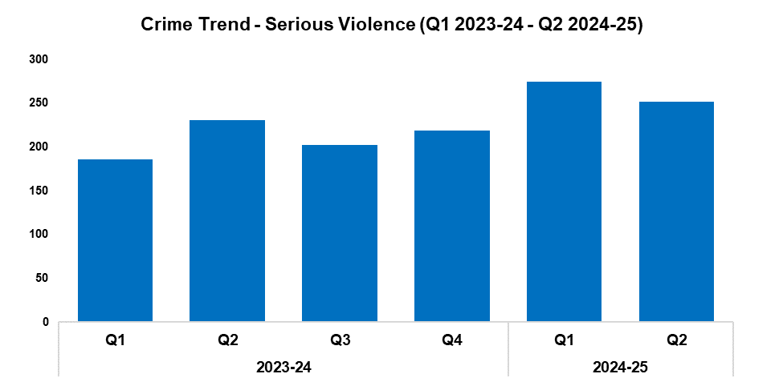
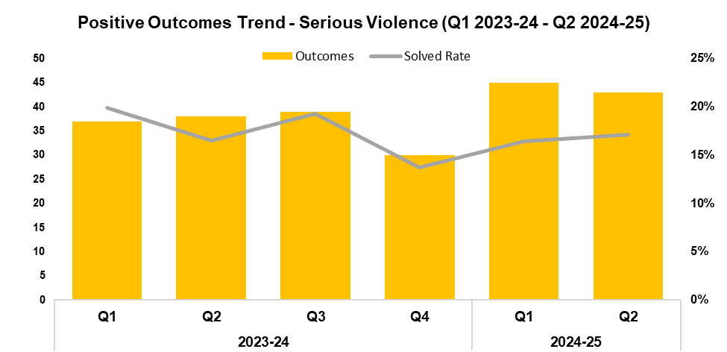
2. Serious Violence
2023-24 |  |  |  | 2024-25
Q1 | Q2 | Q3 | Q4 | Q1 | Q2 | Q3 | Q4
186 | 231 | 202 | 219 | 275 | 252 | - | -
2023-24 |  |  |  | 2024-25
Q1 | Q2 | Q3 | Q4 | Q1 | Q2 | Q3 | Q4
19.9% | 16.5% | 19.3% | 13.7% | 16.4% | 17.1% | - | -
Overview
Serious Violence offences consist of section 18 grievous bodily harm with intent, section 20 malicious wounding without intent, and personal robbery. These offences have seen a reduction of 8.4% during Q2 2024-25 when compared to the quarter prior, with 23 fewer offences recorded for a total of 252. This disrupts the upward trend observed following Q3 2023-24, but remains the second-highest quarterly total within the timeframe. An increase of 9.1% (21 additional offences) can be observed when comparing Q2 2024-25 against the same quarter during the previous financial year. A further increase of 26.4% has been recorded when comparing the current FYTD against the previous FYTD, with 110 additional offences recorded for a total of 527.
When compared to the quarter prior, the solved rate for Serious Violence offences has risen by 0.7 percentage points to 17.1%, albeit with two fewer crimes solved for a total of 43. A similar increase of 0.6 percentage points can be observed when comparing Q2 2024-25 against the same quarter during the previous financial year, with five additional crimes solved. Conversely, the solved rate for the current FYTD stands at 16.7%, 1.3 percentage points below that recorded during the previous FYTD. Despite this reduction in solved rate, 13 additional crimes have been solved during the current FYTD for a total of 88.

Slide 13
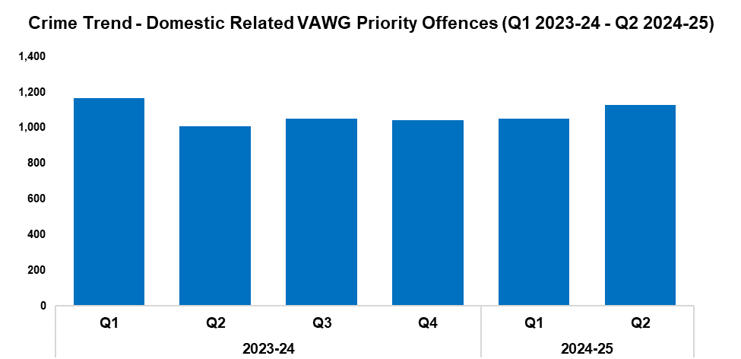
3. VAWG Domestic Priority Offences
Overview
The adjacent graph displays the number of Violence against Women and Girls (VAWG) priority offences which have been assigned a domestic abuse qualifier, have at least one female victim linked, and in which the victim and offender were both aged 16 years or over.*
During Q2 2024-25 1,111 of these offences were recorded, representing an increase of 8.6% (88 additional offences) when compared to the quarter prior. This continues the upward trend observed following Q4 2023-24. A more prominent increase of 13.0% (128 additional offences) can be observed when comparing Q2 2024-25 against the same quarter during the previous financial year. In total, 2,134 offences have been recorded during the current FYTD. This represents a slight increase of 0.7% (14 additional offences) when compared to the previous FYTD.
645 females have been linked as a victim in more than one VAWG domestic priority offence within the last 12 months,** whereas 21 females have been linked as a victim in more than five separate offences.
During the last 12 months,** there were 456 female offenders and 2,687 male offenders linked to domestic priority offences against females.
*Domestic priority areas include Homicide, Violence with Injury, Stalking and Harassment, Public Fear, Alarm or Distress, Rape, Other Sexual Offences, and Modern Slavery.
**Up to the end of Q2 2024-25
2023-24 |  |  |  | 2024-25
Q1 | Q2 | Q3 | Q4 | Q1 | Q2 | Q3 | Q4
1,137 | 983 | 1,019 | 1,017 | 1,023 | 1,111 | - | -

Slide 14
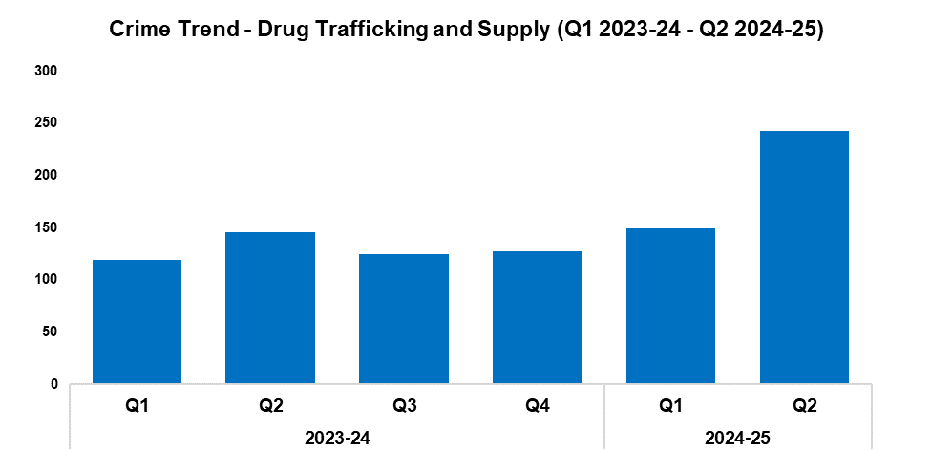
4. Drug Supply and Organised Crime
Overview
Drug Trafficking and Supply offences have seen a significant increase of 63.1% during Q2 2024-25 when compared to the quarter prior, with 94 additional offences recorded for a total of 243. This represents the highest quarterly figure within the timeframe, continuing the upward trend observed following Q3 2023-24. Almost half of these offences related to drugs importation and border force seizures, accounting for 49.0% of the quarterly total with 119 offences reported. This represents an increase of 120.4% when compared to the quarter prior, which may account for the rise during Q2 2024-25. An increase of 66.4% (97 additional offences) can be observed when comparing Q2 2024-25 against the same quarter during the previous financial year. In total, 392 offences have been recorded during the current FYTD, an increase of 47.9% (127 additional offences) when compared to the previous FYTD.
2,335 Drug Supply and Dealing intelligence logs were submitted during Q2 2024-25. This is an increase of 19.0% (373 additional logs) when compared to the quarter prior, and represents the highest quarterly total within the timeframe. A more prominent increase of 45.3% (728 additional logs) can be observed when comparing Q2 2024-25 against the same quarter during the previous financial year. In total, 4,297 logs have been submitted during the current FYTD, an increase of 34.6% (1,104 additional logs) over the previous FYTD.
2023-24 |  |  |  | 2024-25
Q1 | Q2 | Q3 | Q4 | Q1 | Q2 | Q3 | Q4
119 | 146 | 125 | 127 | 149 | 243 | - | -
During July, warrants were carried out at four properties in Bettws, Newport in order to disrupt an Organised Crime Group (OCG) as part of Operation Wellsted. Three individuals were arrested and two vehicles were seized in these early-morning raids. Cash, property and mobile phones were also recovered. The OCG has subsequently been dismantled, with all members arrested, charged and remanded to custody. All the defendants have submitted early guilty pleas and are awaiting sentencing by the Crown Court for conspiracy to supply Class A drugs.
A second OCG operating in Bettws was targeted as part of Operation Diadem. Five individuals were arrested and charged on suspicion of conspiracy to supply controlled drugs and possession of criminal property. They have now been remanded. A number of items were also seized, including three cars, three Sur-Ron electric bikes, two electric scooters, and an off-road bike. Three men have pleaded guilty to drugs conspiracy charges, following police raids in which a large amount of cannabis was seized.
An individual was stopped by officers whilst riding a Sur-Ron electric bike during a crackdown on illegal vehicles in Newport City Centre. Multiple wraps of cocaine with a potential street value of £2,740 were subsequently recovered by officers, along with a Rolex watch and £2,434.36 in cash. The offender was sentenced to 40 months in custody, and will serve half of this before being released on licence. The recovered cash will be granted to Gwent Police to help fund the force’s continued efforts against organised criminality.
During September, an individual drove an electric bike at a plain-clothed officer, before assaulting another who attempted to arrest him. He was quickly stopped by officers, who seized the electric bike and a Nokia mobile phone, which contained drugs-related text messages. Officers then searched the offender and recovered 22 bags of white powder, which analysis revealed to be 18.7g of cocaine, as well as 33.1g of cannabis (with a combined street value of roughly £1,600). The offender was sentenced to 24 months in prison, after admitting possession with intent to supply controlled Class A and Class B drugs, assaulting a police officer, dangerous driving, driving otherwise than in accordance with a licence, and driving a vehicle without insurance.

Slide 15
Support Victims and Protect the Vulnerable
Hate Crime
Rape
Domestic Related Crime
Domestic Abuse Repeat Victims/Offenders
Modern Day Slavery and Human Trafficking
Child Sexual Exploitation/Child Criminal Exploitation
Cyber Fraud
Victim Support/Repeat Victims
Key Commitments
Improve victim services and ensure that the needs of victims are identified and responded to appropriately through Connect Gwent and the Victim Care Unit.
Further improve our work with partners to protect those most vulnerable.
Increase the timeliness of police investigation updates provided to victims.
Commission and invest in specialist services to support victims throughout the criminal justice process.

Slide 16
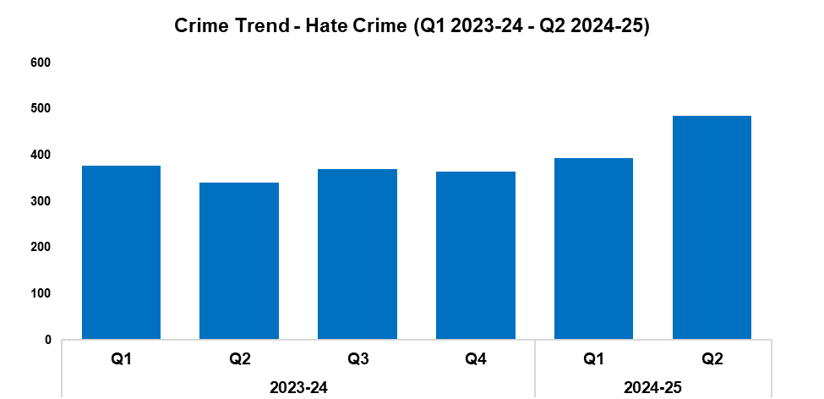
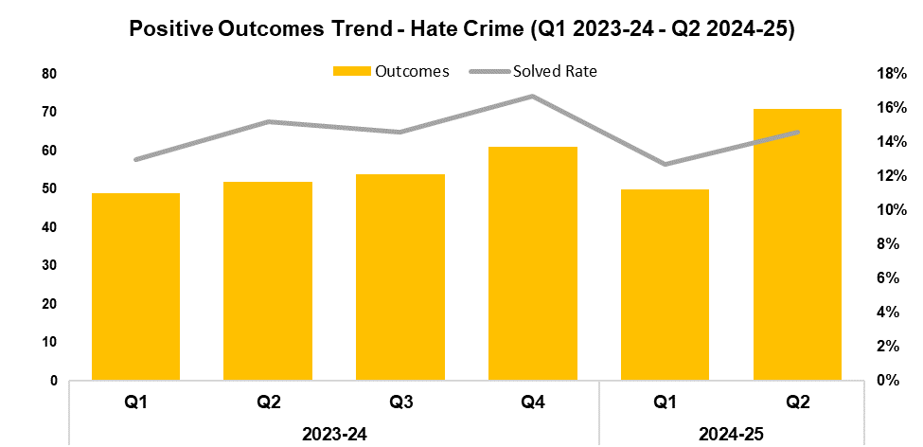
1. Hate Crime
2023-24 |  |  |  | 2024-25
Q1 | Q2 | Q3 | Q4 | Q1 | Q2 | Q3 | Q4
378 | 341 | 370 | 365 | 394 | 486 | - | -
2023-24 |  |  |  | 2024-25
Q1 | Q2 | Q3 | Q4 | Q1 | Q2 | Q3 | Q4
13.0% | 15.2% | 14.6% | 16.7% | 12.7% | 14.6% | - | -
Overview
The volume of offences classified as hate crimes has risen by 23.4% during Q2 2024-25 when compared to the quarter prior, with 92 additional offences recorded for a total of 486. This represents the highest quarterly total within the timeframe, continuing the upward trend observed following Q4 2023-24. Offences containing the racial hate strand saw the largest increase when compared to the quarter prior, rising by 46.2% (102 additional offences for a total of 323). Conversely, offences containing the disability hate strand saw the largest reduction, falling by 26.9% (25 fewer offences for a total of 68). An increase of 42.5% (145 additional offences) can be observed when comparing Q2 2024-25 against the same quarter during the previous financial year. In total, 880 offences have been recorded during the current FYTD. This represents an increase of 22.4% (161 additional offences) when compared to the previous FYTD.
When compared to the quarter prior, the solved rate for hate crime offences has risen by 1.9 percentage points to 14.6%, with 21 additional crimes solved for a total of 71. This represents the highest number of crimes solved within any quarter of the timeframe. Conversely, a reduction of 0.6 percentage points can be observed when comparing Q2 2024-25 against the same quarter during the previous financial year, albeit with 19 additional crimes solved. The solved rate for the current FYTD stands at 13.8%. Whilst this represents a reduction of 0.2 percentage points when compared to the previous FYTD, 20 additional crimes have been solved for a total of 121.
The Hate Crime Scrutiny Panel has been re-established. This panel scrutinises hate crime data trends and investigations to ensure that the force is delivering a quality service.
A single crime can have multiple hate strands. The crime trend is based on recorded crimes, whilst the assessment of hate strands is based on the volume of each individual strand.

Slide 17
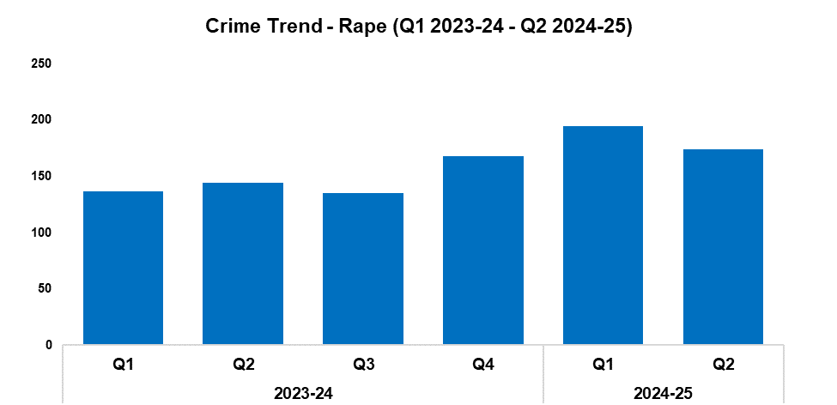
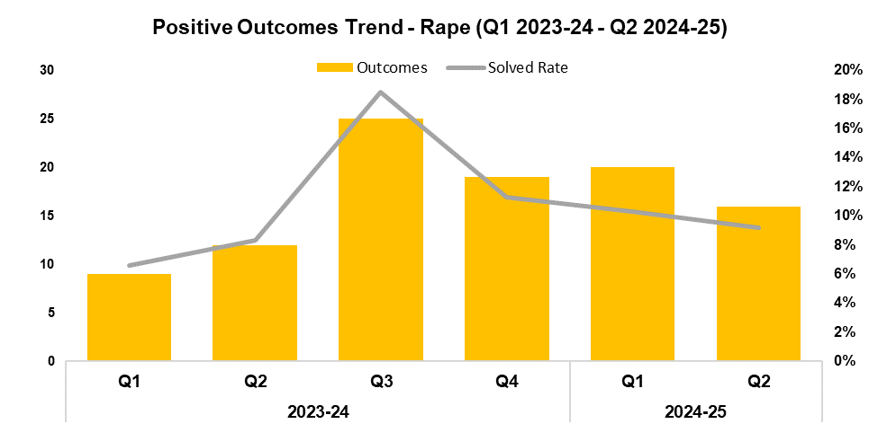
2. Rape
2023-24 |  |  |  | 2024-25
Q1 | Q2 | Q3 | Q4 | Q1 | Q2 | Q3 | Q4
137 | 144 | 135 | 168 | 195 | 174 | - | -
2023-24 |  |  |  | 2024-25
Q1 | Q2 | Q3 | Q4 | Q1 | Q2 | Q3 | Q4
6.6% | 8.3% | 18.5% | 11.3% | 10.3% | 9.2% | - | -
Overview
The number of recorded Rape offences has fallen by 10.8% during Q2 2024-25 when compared to the quarter prior, with 21 fewer offences recorded for a total of 174. Whilst this disrupts the upward trend recorded following Q3 2023-24, it remains the second-highest quarterly figure within the timeframe for this historically under-reported crime category. An increase of 20.8% (30 additional offences) can be observed when comparing Q2 2024-25 against the same quarter during the previous financial year. A further increase of 31.3% has been recorded when comparing the current FYTD against the previous FYTD, with 88 additional offences recorded for a total of 369.
When compared to the quarter prior, the solved rate for Rape offences has fallen by 1.1 percentage points to 9.2%, with four fewer crimes solved for a total of 16. This continues the downward trend observed following Q3 2023-24. Conversely, an increase of 0.9 percentage points can be observed when comparing Q2 2024-25 against the same quarter during the previous financial year, with four additional crimes solved. The solved rate for the current FYTD stands at 9.8%, a further increase of 2.3 percentage points when compared to the previous FYTD, with 15 additional crimes solved for a total of 36.
The Rape Investigation Team (RIT) secured several convictions this quarter, including the conviction of a male for stranger rape, which resulted in an eight-year custodial sentence. Another male was convicted for historic interfamilial rapes and sexual offences against two victims. He was charged with 18 rape and non-penetrative offences, and found guilty on all counts. He is now awaiting sentencing. A third male was convicted of rape and oral rape. He attempted to escape the country, but was located and arrested. He was found guilty and is awaiting sentencing.
A new forensic medical examination service has been made available via sexual assault referral centres, provided by Nurture Health and Care.

Slide 18
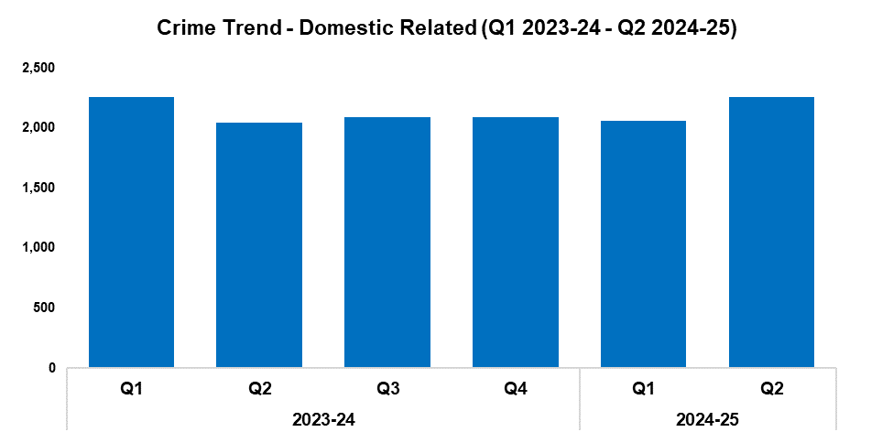
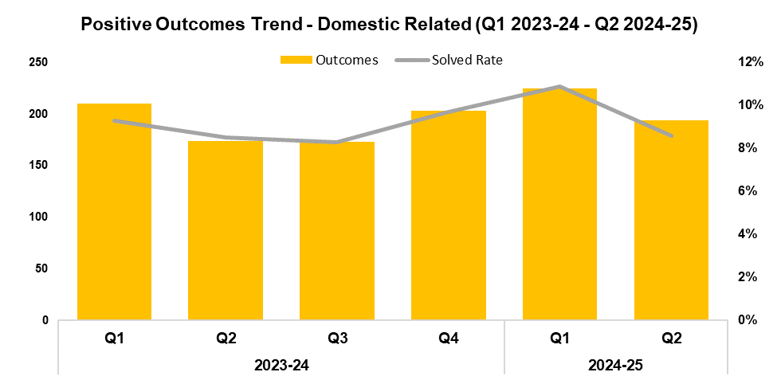
3. Domestic Related Crime
2023-24 |  |  |  | 2024-25
Q1 | Q2 | Q3 | Q4 | Q1 | Q2 | Q3 | Q4
2,260 | 2,044 | 2,094 | 2,087 | 2,059 | 2,259 | - | -
2023-24 |  |  |  | 2024-25
Q1 | Q2 | Q3 | Q4 | Q1 | Q2 | Q3 | Q4
9.3% | 8.5% | 8.3% | 9.7% | 10.9% | 8.6% | - | -
Overview
Domestic related offences have seen an increase of 9.7% when compared to the quarter prior, with 200 additional offences recorded for a total of 2,259. This disrupts the slight downward trend observed following Q3 2023-24. A similar increase of 10.5% (215 additional offences) can be observed when comparing Q2 2024-25 against the same quarter during the previous financial year. In total, 4,318 offences have been recorded during the current FYTD, a slight increase of 0.3% (14 additional offences) when compared to the previous FYTD.
When compared to the quarter prior, the solved rate for domestic related offences has fallen by 2.3 percentage points to 8.6%, with 31 fewer crimes solved for a total of 194. This disrupts the upward trend observed following Q3 2023-24. Conversely, a slight increase of 0.1 percentage points can be observed can comparing Q2 2024-25 against the same quarter during the previous financial year, with 20 additional crimes solved. The solved rate for the current FYTD stands at 9.7%, an increase of 0.8 percentage points when compared to the previous FYTD, with 35 additional crimes solved for a total of 419.
Victim Services are working collaboratively with the Professional Standards Department to establish confidential advisors who will provide initial support, advice, and pathways to women who are experiencing issues in the workplace and/or Police Perpetrated Domestic Abuse (PPDA). In addition, the Survivor Engagement Co-ordinator is setting up an internal Survivor Reference Group to better understand the complexities of PPDA, ensuring that change and improvement are informed by the feedback and lived experiences of victims.
This data only includes offences in which the victim and offender were both aged 16 or over at the time of the offence, as specified in the Domestic Abuse Act 2021, or where the victim or offender do not have a determined age.

Slide 19
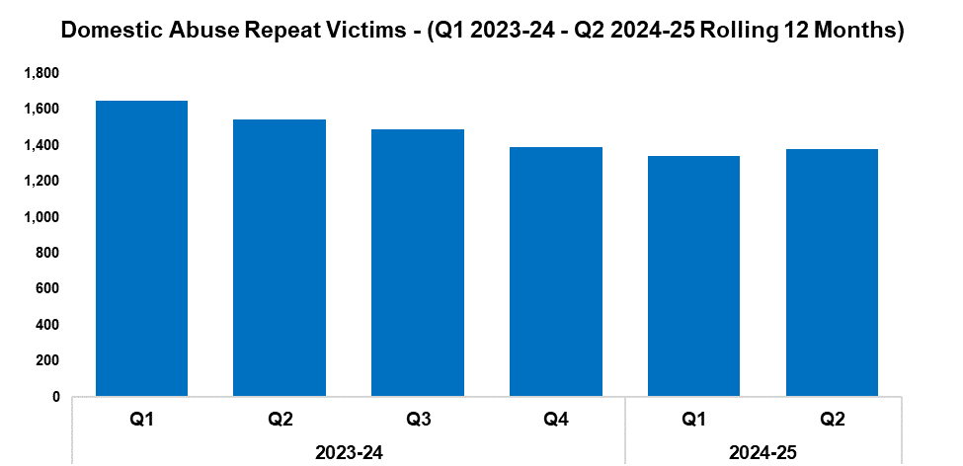
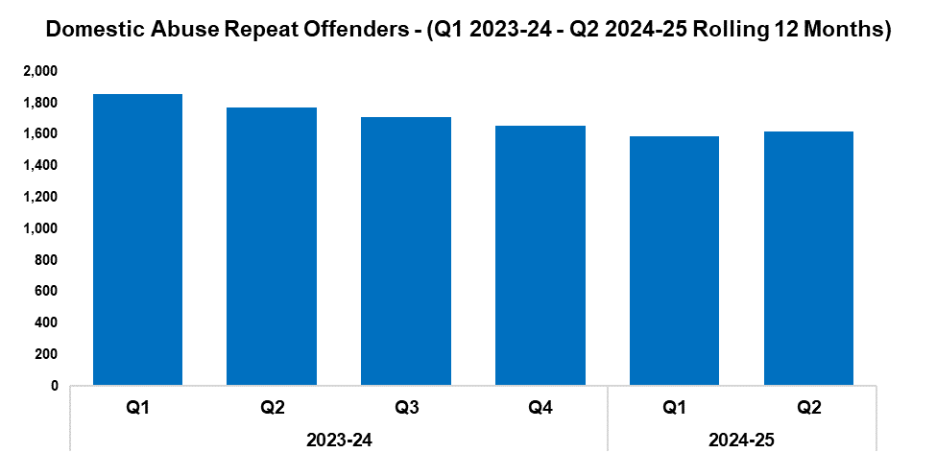
4. Domestic Abuse Repeat Victims/Offenders
2023-24 |  |  |  | 2024-25
Q1 | Q2 | Q3 | Q4 | Q1 | Q2 | Q3 | Q4
1,647 | 1,543 | 1,489 | 1,393 | 1,340 | 1,378 | - | -
2023-24 |  |  |  | 2024-25
Q1 | Q2 | Q3 | Q4 | Q1 | Q2 | Q3 | Q4
1,854 | 1,772 | 1,708 | 1,652 | 1,588 | 1,619 | - | -
Overview
The number of repeat domestic abuse victims* has increased by 2.8% when comparing Q2 2024-25 against the quarter prior, with 38 additional repeat victims recorded for a total of 1,378. This disrupts the downward trend which had previously been observed throughout the timeframe. Conversely, a reduction of 10.7% (165 fewer repeat victims) can be observed when comparing Q2 2024-25 against the same quarter during the previous financial year. A total of 2,718 repeat victims have been recorded when combining the quarterly figures for the current FYTD, a reduction of 14.8% (472 fewer repeat victims) when compared to the previous FYTD.
The number of repeat domestic abuse offenders* has risen by 2.0% when comparing Q2 2024-25 against the quarter prior, with 31 additional repeat offenders recorded for a total of 1,619. As with repeat victims, this disrupts the downward trend which had previously been observed throughout the timeframe. Conversely, a reduction of 8.6% (153 fewer repeat offenders) can be observed when comparing Q2 2024-25 against the same quarter during the previous financial year. A total of 3,207 repeat offenders have been recorded when combining the quarterly figures for the current FYTD, a reduction of 11.6% (419 fewer repeat offenders) when compared to the previous FYTD.
There is a Multi-Agency Tasking and Coordination (MATAC) process in place which focuses on identifying serial perpetrators of domestic abuse, in order to limit the risk of them reoffending. A range of interventions can be delivered via MATAC to safeguard victims and families, including support, prevention, diversion, disruption, and enforcement.
This data only includes offences in which the victim and offender were both aged 16 or over at the time of the offence, as specified in the Domestic Abuse Act 2021.
*Based on rolling 12 months to the end of each quarter, where persons are linked in this capacity to two or more crimes within this period.

Slide 20
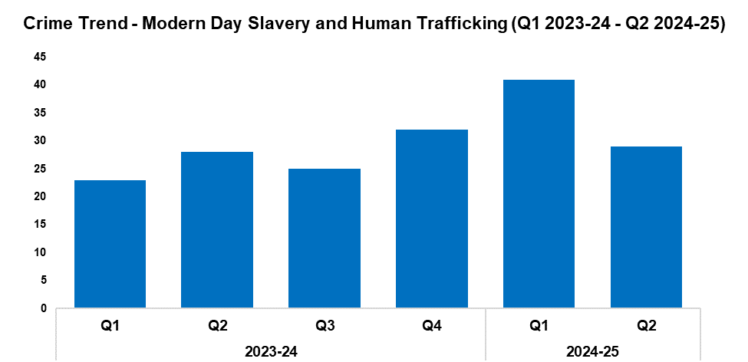
5. Modern Day Slavery and Human Trafficking
Overview
Modern Day Slavery and Human Trafficking offences have seen a reduction of 29.3% during Q2 2024-25 when compared to the quarter prior, with 12 fewer offences recorded for a total of 29. This disrupts the upward trend observed following Q3 2023-24. Conversely, an increase of 3.6% (one additional offence) can be observed when comparing Q2 2024-25 against the same quarter during the previous financial year. A more prominent increase of 37.3% has been recorded when comparing the current FYTD against the previous FYTD, with 19 additional offences reported for a total of 70. This increase has been influenced by the elevated volume of offences recorded during Q1 2024-25.
Awareness training is being delivered to new starters, new community support officers, and trainee detectives.
The number of National Referral Mechanisms (NRMs) submitted has fallen by 30.1% during Q2 2024-25 when compared to the quarter prior, with 13 fewer referrals submitted for a total of 29. NRM submissions have remained steady when comparing Q2 2024-25 against the same quarter during the previous financial year. An increase of 42.0% has been recorded when comparing the current FYTD against the previous FYTD, with an additional 21 NRMs submitted for a total of 71.
2023-24 |  |  |  | 2024-25
Q1 | Q2 | Q3 | Q4 | Q1 | Q2 | Q3 | Q4
23 | 28 | 25 | 32 | 41 | 29 | - | -

Slide 21
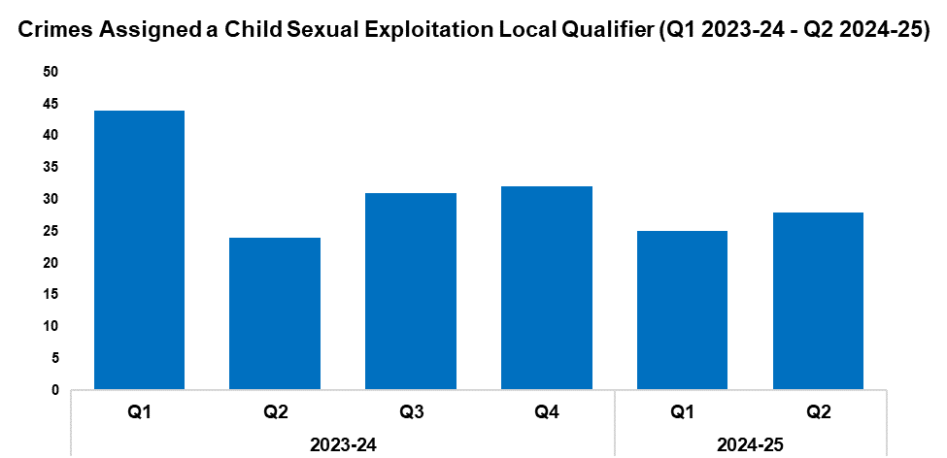
6. Child Sexual Exploitation/Child Criminal Exploitation
Overview
The number of crimes assigned a Child Sexual Exploitation (CSE) local qualifier has increased by 12.0% during Q2 2024-25 when compared to the quarter prior, with three additional crimes recorded for a total of 28. A similar increase of 16.7% (four additional crimes) can be observed when comparing Q2 2024-25 against the same quarter during the previous financial year. Conversely, a reduction of 22.1% has been recorded when comparing the current FYTD against the previous FYTD, with 15 fewer crimes reported for a total of 53. This reduction has been influenced by the elevated levels of crime recorded during Q1 2023-24.
The offence most commonly assigned a CSE local qualifier during Q2 2024-25 was ‘take/make indecent photographs/pseudo-photographs of children’, with eight instances recorded. This accounts for 28.6% of all crimes assigned a CSE local qualifier during the quarter.
2023-24 |  |  |  | 2024-25
Q1 | Q2 | Q3 | Q4 | Q1 | Q2 | Q3 | Q4
44 | 24 | 31 | 32 | 25 | 28 | - | -
During September, reports were received that a nine-year-old child had been sexually assaulted by an adult male in a park. Officers responded quickly, identifying and arresting the suspect. The Public Protection Unit completed several enquires over the following day, which included speaking with the victim and numerous child witnesses. The suspect was also interviewed, and subsequently charged with sexual assault of a boy under 13 years old. He was remanded to court where he entered a guilty plea, and is currently awaiting sentencing. The victim is receiving the appropriate support from partner agencies.
The Public Protection Unit have implemented an exit strategy for use by exploitation teams when ending interventions with children and families. It has been recognised that better outcomes can be achieved when the withdrawal of police resources is strategically planned with partner organisations and discussed with the individuals involved. This strategy also incorporates the recording of key information, including the initial reason for police intervention, the nature and efficacy of the intervention provided, and the safety plan at the point of closure. The recorded information will be used to continue the development of these processes, ensuring that they remain relevant and efficient.
Following a lengthy investigation, a male has been charged with the following seven offences against a 14-year-old child: Engage in sexual activity in the presence of a child 13 to 15 (three counts); voyeurism – recording a private act (one count); incite a girl 13-15 to engage in sexual activity – no penetration (two counts); and engage in penetrative sexual activity with a girl 13-15 (one count). The male is due to appear in court later this year.
The RIT has secured the conviction of a male for interfamilial sexual offences involving a child. He was found guilty on all counts and is awaiting sentencing.

Slide 22
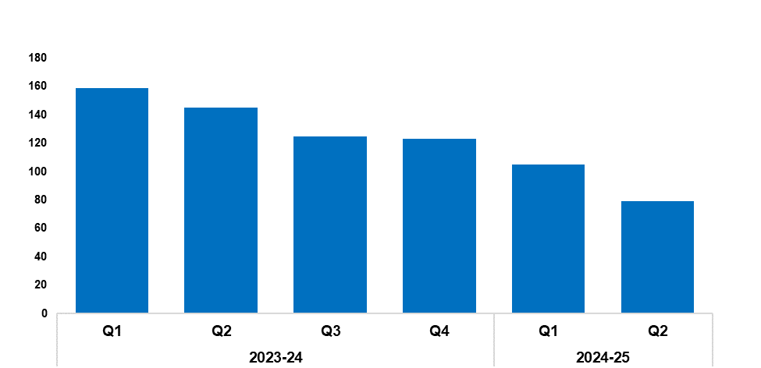
7. Cyber Fraud
Overview
Since Q1 2023-24, a total of 1,274 Action Fraud occurrences have been reported to Gwent Police via the National Fraud Intelligence Bureau. Of these, 57.8% (736 occurrences) have been assigned a cyber-enabled local qualifier.
The number of Action Fraud occurrences assigned a cyber-enabled local qualifier has fallen by 24.8% during Q2 2024-25 when compared to the quarter prior, with 26 fewer occurrences reported for a total of 79. This continues the downward trend that has been observed for this metric throughout the timeframe. A more prominent reduction of 45.5% (66 fewer occurrences) can be observed when comparing Q2 2024-25 against the same quarter during the previous financial year.
In total, 184 Action Fraud occurrences with a cyber-enabled local qualifier have been recorded during the current FYTD, a reduction of 39.5% (120 fewer occurrences) when compared to the previous FYTD.
2023-24 |  |  |  | 2024-25
Q1 | Q2 | Q3 | Q4 | Q1 | Q2 | Q3 | Q4
159 | 145 | 125 | 123 | 105 | 79 | - | -

Slide 23
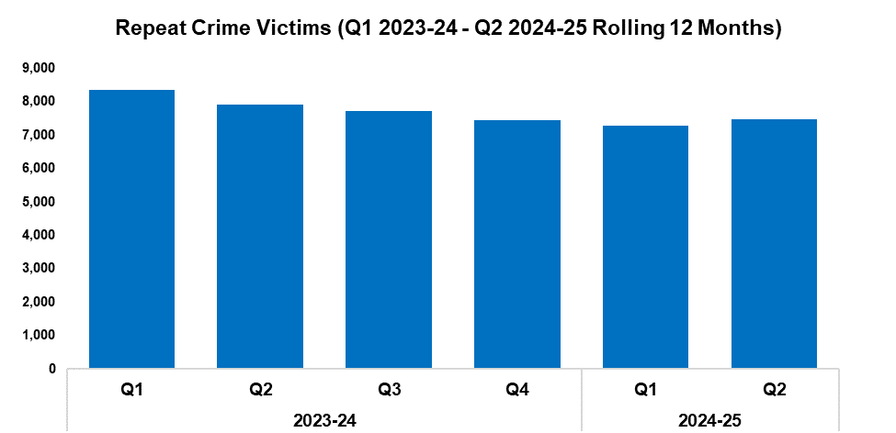
8. Victim Support/Repeat Victims
Overview
In this context, a repeat crime victim refers to an individual who has been linked as a victim in two or more crimes within a 12-month rolling period.
The number of repeat crime victims has risen by 2.4% during Q2 2024-25* when compared to the quarter prior, with 178 additional repeat victims recorded for a total of 7,467. This increase disrupts the downward trend that had previously been observed for this metric throughout the timeframe.
A reduction of 5.5% (435 fewer repeat victims) can be observed when comparing Q2 2024-25 against the same quarter during the previous financial year. A total of 14,756 repeat victims have been recorded when combining the quarterly figures for the current FYTD, representing a reduction of 9.2% (1,500 fewer repeat victims) when compared to the previous FYTD.
*Based on the rolling 12 months to the end of the quarter.
2023-24 |  |  |  | 2024-25
Q1 | Q2 | Q3 | Q4 | Q1 | Q2 | Q3 | Q4
8,354 | 7,902 | 7,729 | 7,442 | 7,289 | 7,467 | - | -
An officer displayed excellent communication skills whilst responding to a report of a suicidal male on the wrong side of the Millennium Footbridge in Newport. After 30 minutes of negotiation, the officer was able to convince the male to return to safety.
Three officers successfully performed CPR on a member of the public who had collapsed outside of the Green Dragon Public House in Monmouth, buying time for an ambulance to arrive and convey them to hospital.
A family member of a high-risk missing person contacted Gwent Police after locating the individual in a remote area of woodland, having seemingly overdosed. Three officers rapidly attended and commenced CPR, whilst others contacted ambulance triage and utilised What3Words to ensure the timely arrival of paramedics. They also provided reassurance to the members of the individual’s family who were at the scene. The attending paramedics have praised the quality of the initial care that officers provided to the individual, who is now recovering.
The West Safeguarding Hub have completed 745 strategy discussions throughout the quarter. Amongst these were 473 relating to child protection, 197 relating to the protection of vulnerable adults, and 24 relating to CSE or Child Criminal Exploitation. Collaborative work has been undertaken with partners to assess and investigate criminal offences against vulnerable children and adults, and to address safeguarding concerns. This has resulted in 95 joint visits by police and social services.
Following a report of domestic assault, the officer in case took the time to engage with the 18-year-old victim, gaining her trust and giving her the confidence to make a statement. This led to an emergency charge for non-fatal strangulation and controlling/coercive behaviour against the offender, who was remanded by the court the following day. In light of this positive result, work has been undertaken internally to promote the importance of building trust and rapport with victims, as well as recognising the risk posed by non-fatal strangulation offences.

Slide 24
Increase Community Confidence in Policing
Perceptions Survey: Levels of Policing
Perceptions Survey: Police Effectiveness
Perceptions Survey: Fairness
Perceptions Survey: Engagement
Perceptions Survey: Local Concerns and Overall
Victim Satisfaction
Representative Workforce
Investigation Timeliness
Response Rates
999 Demand
101 Demand
Social Media and Single Online Home
Initiatives & Events
Key Commitments
Increase the effectiveness of officer and staff engagement with residents in their communities, and community confidence and trust in Gwent Police.
Improve the accessibility of neighbourhood police teams through a variety of contact channels that meet the needs of the public.
Increase reporting of crime by communities that are less likely to engage with the police.
Further increase officer and staff diversity to ensure our police service reflects the communities that we serve.

Slide 25
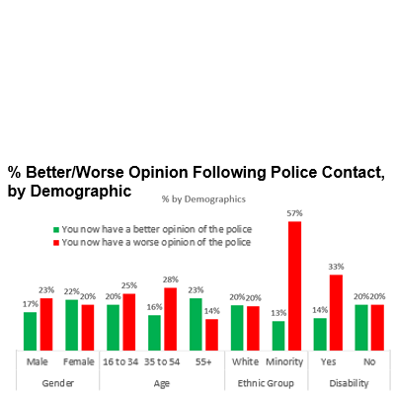
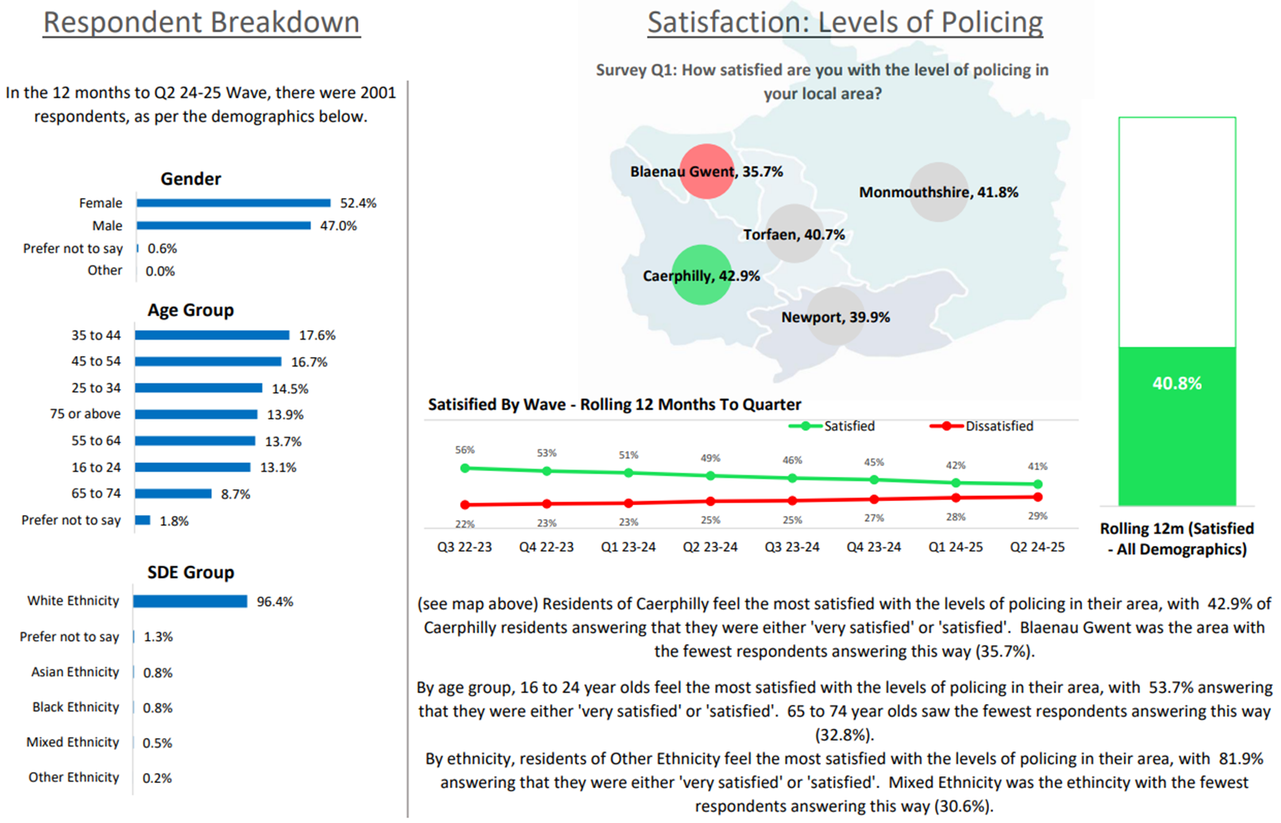
1. Perceptions Survey: Levels of Policing

Slide 26
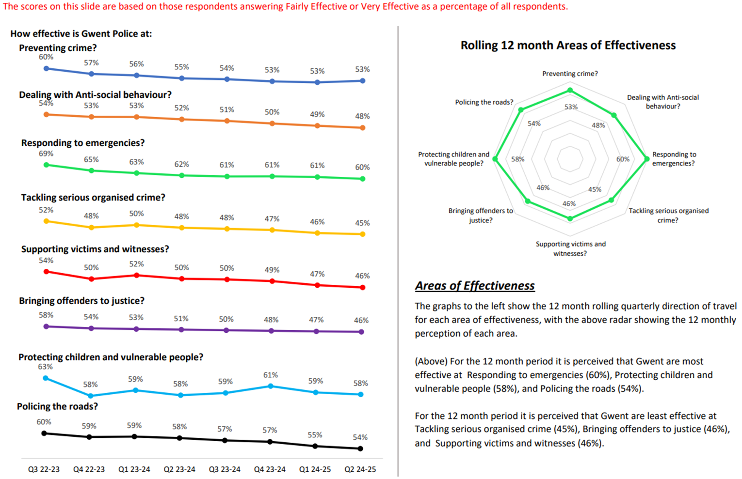
2. Perceptions Survey: Police Effectiveness

Slide 27
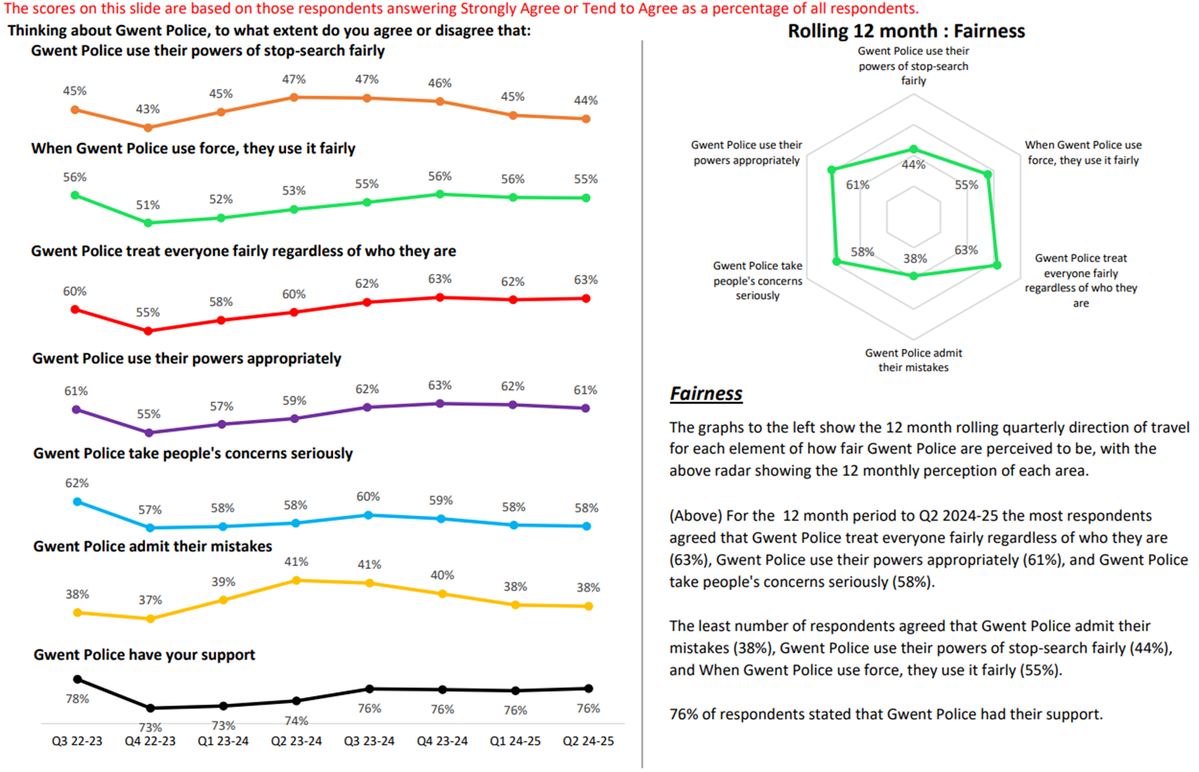
3. Perceptions Survey: Fairness

Slide 28
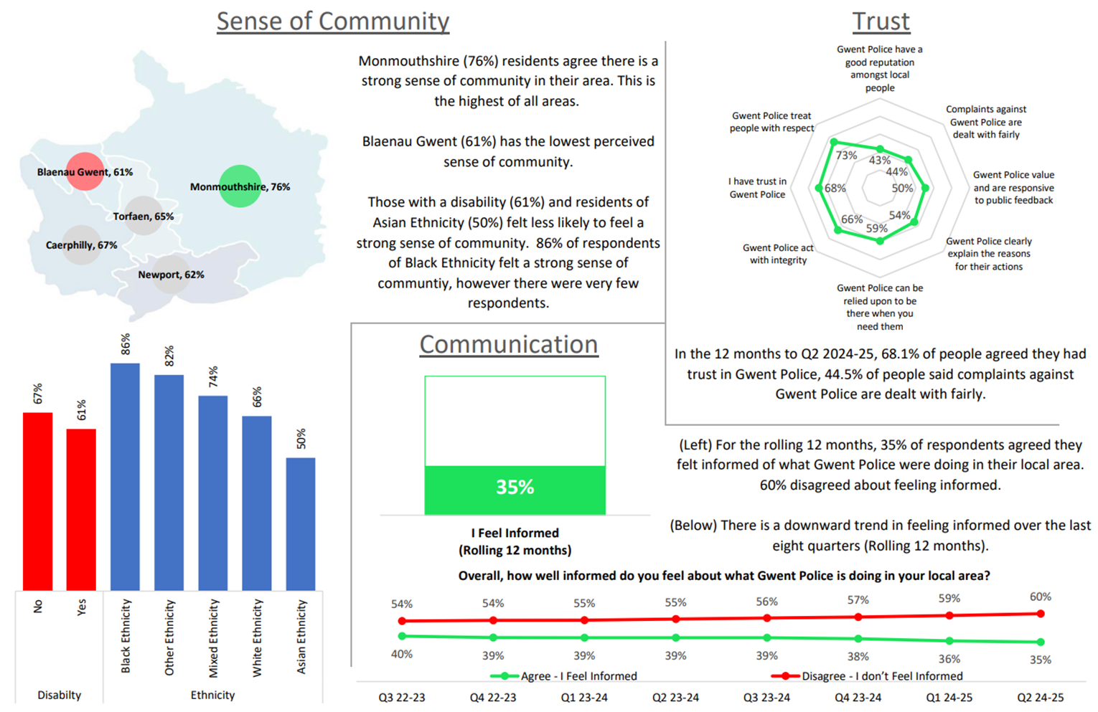
4. Perceptions Survey: Engagement

Slide 29
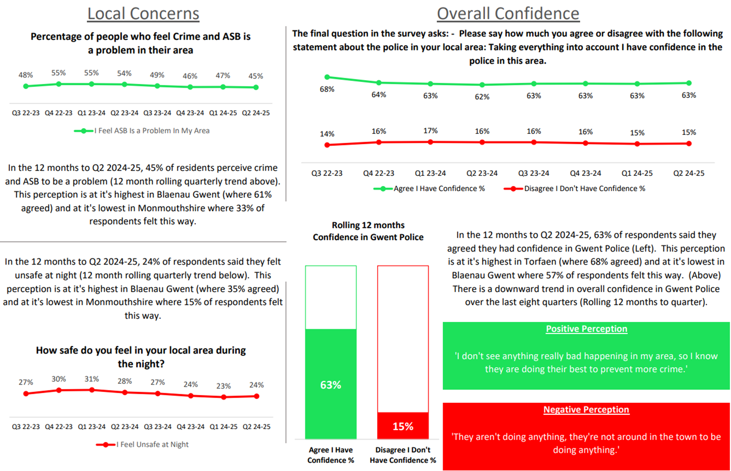
5. Perceptions Survey: Local Concerns and Overall

Slide 30
6. Victim Satisfaction
Victim Satisfaction Survey Data for FYTD 2024-25
Survey Question | Percentage of Respondents Satisfied | Number of Respondents Satisfied | Total Responses Received
How satisfied are you with the ease of initial contact with the Police? | 80% | 129 | 161
How satisfied are you with the response time to your contact? (e.g. how long it took for your call to be answered) | 75% | 120 | 160
Overall, how satisfied are you with your experience of the first point of contact with the police? | 72% | 118 | 163
If an officer attended, how satisfied are you with the time it took for them to arrive? | 86% | 74 | 86
How satisfied are you with the actions taken by the attending officer/s? | 78% | 69 | 88
Thinking about your overall experience, how satisfied are you with the treatment you have received from Gwent Police? | 65% | 106 | 162
Overview
Alterations have been made to the victim satisfaction survey model, following an internal review. Going forward, a single survey will be provided to victims with the aim of assessing their satisfaction with the initial response provided by Gwent Police, as it is recognised that the force’s first interactions with victims can often be the most impactful. Whilst the value of surveys assessing all stages of the criminal justice journey has been acknowledged, the volume of responses received for these subsequent surveys was unfortunately insufficient to constitute a meaningful dataset.
A total of 163 respondents have engaged with the victim satisfaction survey during the current FYTD. Of those who replied to the given question, 86% of respondents were satisfied with officer attendance times, whereas only 65% of respondents were satisfied with the overall treatment they received from Gwent Police.
Data accurate as of 30/09/2024. All questions within the survey are optional, which may result in a disparity between the number of responses received for each question.

Slide 31
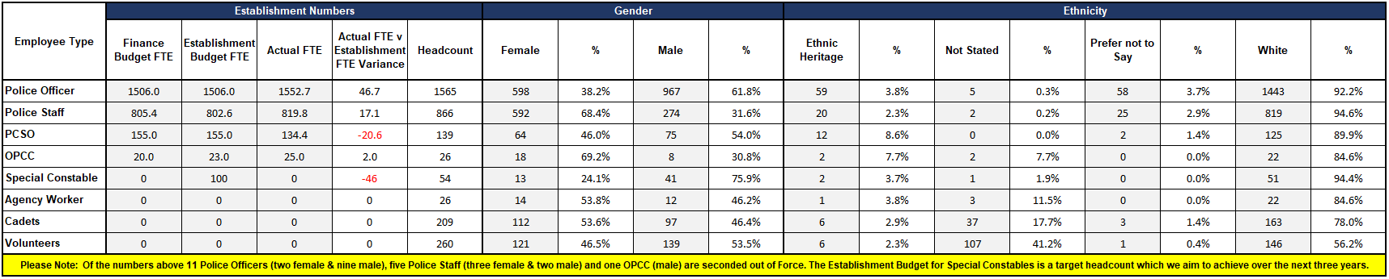
7. Representative Workforce
The below table is correct as of the 30th of September 2024
Overview
There is a gender disparity evident in the workforce for both officers and staff. For officers, females are underrepresented by approximately 13 percentage points (females account for 51% of the population in Gwent based on the 2021 Census). However, females are overrepresented in the staff workstream area by approximately 17 percentage points.
There is also a disparity in ethnic heritage representation within the workforce. In Census 2021, 5.8% of the Gwent population are people of ethnic heritage. Currently 3.8% of police officers are of ethnic heritage, whereas ethnic heritage representation in the staff workstream is lower, at 2.3%.
Nine transferees commenced employment with the force during August, five of which are working within the Criminal Investigation Department. In addition to this, 51 probationers commenced their employment during September, including 21 Direct Entry Detectives.
A series of workshops were run during September as part of the High Performance Teams initiative. The aim of these workshops was to inform line managers of resources and techniques that could be used to assist them in managing absence and supporting colleagues within their teams.
The head of the Equality, Diversity and Inclusion (EDI) team has worked alongside colleagues to support the force’s Disability Confident employer scheme reaccreditation to level 3 standard.

Slide 32
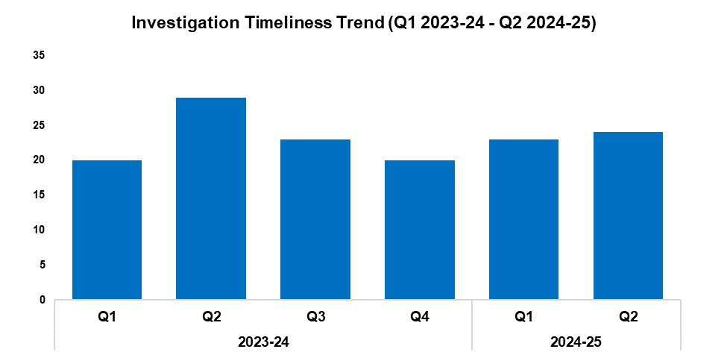
8. Investigation Timeliness
Overview
The median number of days within which an investigation is completed has risen by 4.3% when compared to the previous quarter, up by one day to 24. This continues the upward trend observed for this metric following Q4 2023-24. Conversely, a reduction of 17.2% (five fewer days) can be observed when comparing Q2 2024-25 against the same quarter during the previous financial year. When comparing the current FYTD against the previous FYTD, the figure has remained steady at 24 days.
As of Q2 2024-25, there are 19,770 crimes classified as unfinalised. Of these, 12,351 are marked as under investigation, with the remaining 7,419 either pending finalisation or subject to an administrative process.
Of the 12,351 crimes currently under investigation, 8,590 have been under investigation for less than six months. A further 1,818 have been under investigation for between six and 12 months, whereas 1,943 have been under investigation for over 12 months.
Of those crimes which have been under investigation for over 12 months, Violence without Injury offences are the most common, accounting for 19.9% of the total with 386 crimes. This is followed by Rape offences, which comprise 15.7% of the total with 306 crimes.
2023-24 |  |  |  | 2024-25
Q1 | Q2 | Q3 | Q4 | Q1 | Q2 | Q3 | Q4
20 | 29 | 23 | 20 | 23 | 24 | - | -

Slide 33
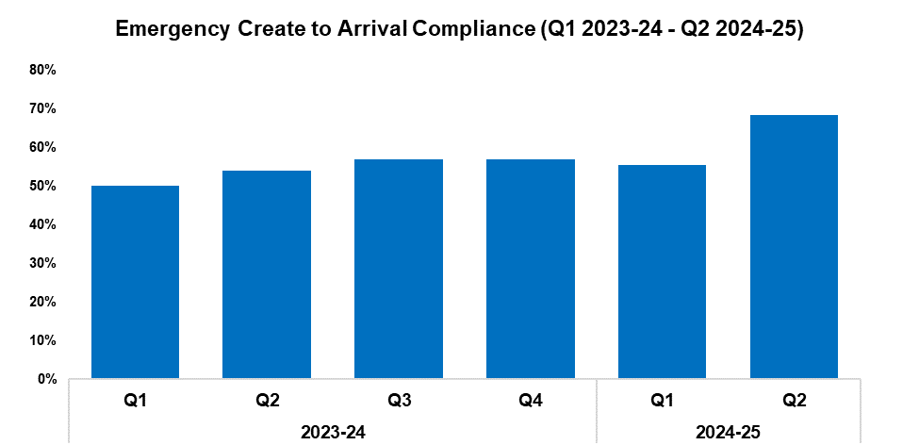
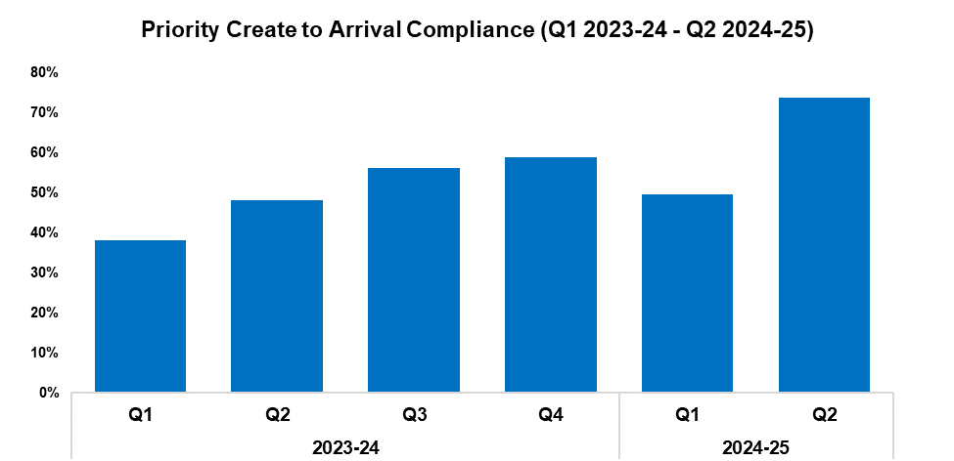
9. Response Rates
2023-24 |  |  |  | 2024-25
Q1 | Q2 | Q3 | Q4 | Q1 | Q2 | Q3 | Q4
50.0% | 54.1% | 56.9% | 57.0% | 55.5% | 68.3% | - | -
2023-24 |  |  |  | 2024-25
Q1 | Q2 | Q3 | Q4 | Q1 | Q2 | Q3 | Q4
38.0% | 48.1% | 56.1% | 58.8% | 49.7% | 73.7% | - | -
Overview
Based on the target arrival time of 15 minutes, emergency create to arrival compliance has increased by 12.8 percentage points during Q2 2024-25 when compared to the quarter prior, and currently stands at 68.3%. This represents the highest quarterly figure within the timeframe by a significant margin. A similar increase of 14.2 percentage points can be observed when comparing Q2 2024-25 against the same quarter during the previous financial year. Emergency compliance for the current FYTD stands at 62.4%, an increase of 9.3 percentage points when compared to the previous FYTD.
Based on the target arrival time of one hour, priority create to arrival compliance has increased by 24.0 percentage points during Q2 2024-25 when compared to the quarter prior, and currently stands at 73.7%. As with emergency compliance, this represents the highest quarterly figure within the timeframe by a significant margin. A similar increase of 25.6 percentage points can be observed when comparing Q2 2024-25 against the same quarter during the previous financial year. Priority compliance for the current FYTD stands at 61.4%, an increase of 18.2 percentage points when compared to the previous FYTD.
The force has trialled free technology via Rapid SOS which provides call handlers with the GPS location of individuals who call 999 via smart devices. This information can be utilised in a number of circumstances. For instance, it allows call handlers to provide response officers with the precise location of a person in crisis, facilitating more expedient attendance. It also allows them to accurately determine the location of an incident, even if the caller themselves is unaware of their current location whilst reporting it. In addition, this technology has assisted in the early resolution of a reported kidnapping, by enabling staff to determine that the caller was an inpatient at a mental health facility. This prevented a significant deployment of specialist resources.

Slide 34
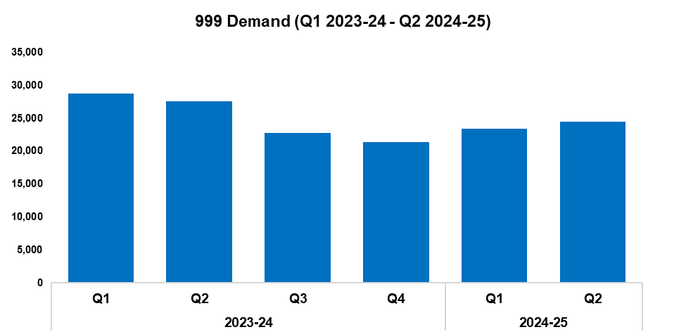
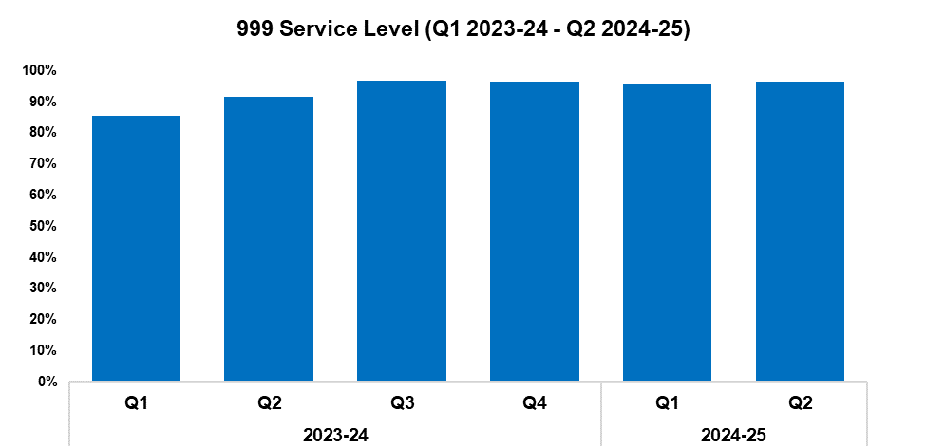
10. 999 Demand
2023-24 |  |  |  | 2024-25
Q1 | Q2 | Q3 | Q4 | Q1 | Q2 | Q3 | Q4
28,737 | 27,600 | 22,806 | 21,326 | 23,412 | 24,453 | - | -
2023-24 |  |  |  | 2024-25
Q1 | Q2 | Q3 | Q4 | Q1 | Q2 | Q3 | Q4
85.5% | 91.5% | 96.9% | 96.4% | 95.9% | 96.5% | - | -
Overview
999 demand has increased by 4.4% during Q2 2024-25 when compared to the quarter prior, with 1,041 additional calls received for a total of 24,453. This continues the upward trend observed following Q4 2023-24. Conversely, a reduction of 11.4% (3,147 fewer calls) can be observed when comparing Q2 2024-25 against the same quarter during the previous financial year. A similar reduction of 15.0% has been recorded when comparing the current FYTD against the previous FYTD, with 8,472 fewer calls received for a total of 47,865.
999 service level (the percentage of 999 calls answered within 10 seconds) has increased during Q2 2024-25 when compared to the quarter prior, rising by 0.6 percentage points to 96.5%. This disrupts the slight downward trend observed following Q3 2023-24. A more prominent increase of 5.0 percentage points can be observed when comparing Q2 2024-25 against the same quarter during the previous financial year. A further increase of 7.4 percentage points has been recorded when comparing the current FYTD against the previous FYTD, with the service level for this period currently standing at 96.2%.
999 Average Answer Speed
(Minutes/Seconds)
2023-24 |  |  |  | 2024-25
Q1 | Q2 | Q3 | Q4 | Q1 | Q2 | Q3 | Q4
00:10 | 00:07 | 00:04 | 00:04 | 00:04 | 00:03 | - | -
The average answer speed for 999 calls during Q2 2024-25 was three seconds. This is an improvement of one second over the figure recorded for the preceding three quarters, and represents the lowest value within the timeframe. 999 average answer speed has improved by four seconds when comparing Q2 2024-25 against the same quarter during the previous financial year. The average answer speed has also improved by four seconds when comparing the current FYTD against the previous FYTD, falling from eight seconds to four.
During September, Force Contact and Control managed 74.0% of the force’s incoming demand (across all contact methods), with only 21.8% being passed on to response officers. This helped increase the availability of these officers to attend incidents when required.

Slide 35
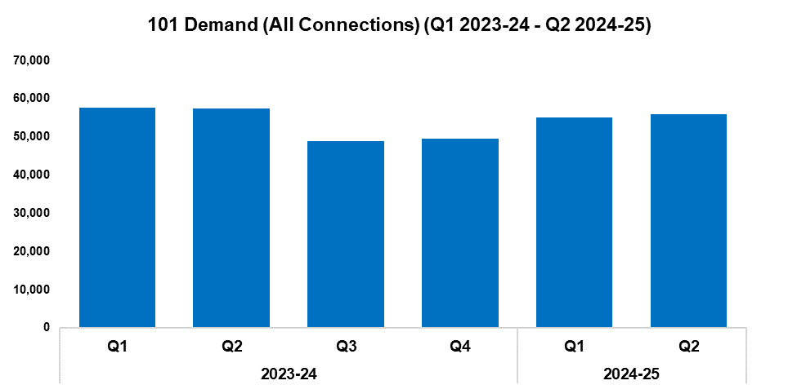
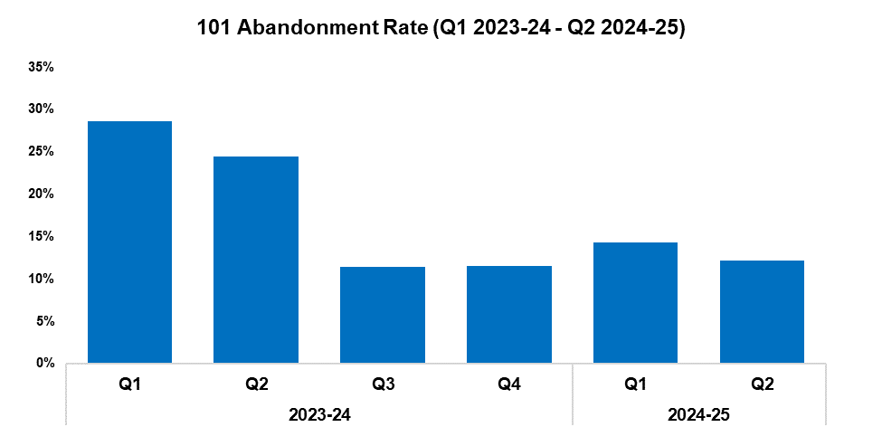
11. 101 Demand
2023-24 |  |  |  | 2024-25
Q1 | Q2 | Q3 | Q4 | Q1 | Q2 | Q3 | Q4
57,552 | 57,466 | 48,881 | 49,457 | 54,969 | 55,892 | - | -
2023-24 |  |  |  | 2024-25
Q1 | Q2 | Q3 | Q4 | Q1 | Q2 | Q3 | Q4
28.6% | 24.4% | 11.4% | 11.5% | 14.3% | 12.2% | - | -
Overview
101 demand (all connections) has increased by 1.7% during Q2 2024-25 when compared to the quarter prior, with 923 additional calls received for a total of 55,892. This continues the upward trend observed following Q3 2023-24. Conversely, a reduction of 2.7% (1,574 fewer calls) can be observed when comparing Q2 2024-25 against the same quarter during the previous financial year. A reduction of 3.6% has been recorded when comparing the current FYTD against the previous FYTD, with 4,157 fewer calls received for a total of 110,861.
The 101 abandonment rate (for options one & two) has fallen by 2.1 percentage points during Q2 2024-25 when compared to the quarter prior, and currently stands at 12.2%. This disrupts the upward trend observed following Q3 2023-24. A substantial reduction of 12.2 percentage points can be observed when comparing Q2 2024-25 against the same quarter during the previous financial year. A further reduction of 13.3 percentage points has been recorded when comparing the current FYTD against the previous FYTD, with the abandonment rate for this period currently standing at 13.2%.
101 Average Answer Speed
(Minutes/Seconds)
2023-24 |  |  |  | 2024-25
Q1 | Q2 | Q3 | Q4 | Q1 | Q2 | Q3 | Q4
06:29 | 05:05 | 02:20 | 02:14 | 02:57 | 02:22 | - | -
The average answer speed for 101 calls during Q2 2024-25 was two minutes and 22 seconds, a reduction of 35 seconds when compared to the quarter prior. A more prominent improvement of two minutes and 43 seconds can be observed when comparing Q2 2024-25 against the same quarter during the previous financial year. A further improvement of three minutes and one second has been recorded when comparing the current FYTD against the previous FYTD, with the average answer speed for this period currently standing at two minutes and 40 seconds.

Slide 36
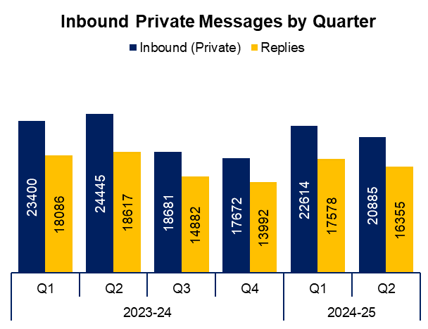
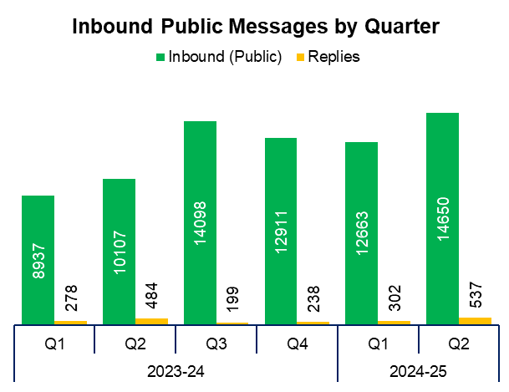
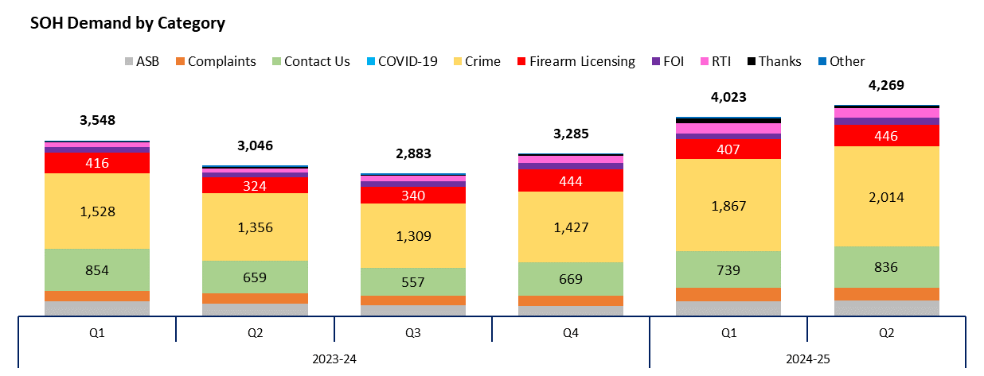
12. Social Media and Single Online Home
Overview
The volume of inbound private messages received via Gwent Police’s social media platforms has reduced by 7.6% during Q2 2024-25 when compared to the quarter prior, with 1,729 fewer messages received for a total of 20,885. Of these, 94.1% (19,660 messages) were received via Facebook platforms.
The volume of inbound public messages received via Gwent Police’s social media platforms increased by 15.7% during Q2 2024-25 when compared to the quarter prior, with 1,987 additional messages received for a total of 14,650. This represents the highest quarterly figure within the timeframe, disrupting the downward trend observed following Q3 2024-24. Of these messages, 92.8% (13,592 messages) were received via Facebook platforms.
This digital contact data includes Gwent Police’s English and Welsh Facebook and X accounts.
4,269 Single Online Home (SOH) forms were submitted during Q2 2024-25, an increase of 6.1% (246 additional forms) when compared to the quarter prior. This represents the highest quarterly figure within the timeframe, continuing the upward trend observed for this metric following Q3 2023-24.
The adjacent chart presents these forms by category, with the most numerous being crime reports. These account for 47.2% of the quarterly total, with 2,014 forms submitted. They are followed by general ‘contact us’ messages (accounting for 19.6% of the total with 836 forms submitted), and firearms licensing (accounting for 10.4% of the total with 446 forms submitted). ‘Other’ includes forms with low volume, including events and processions, filming, fingerprints and IP licensing.

Slide 37
13. Initiatives & Events
Overview
During the period of national disorder caused by far-right riots, the EDI team convened bi-weekly Gold groups as part of Operation Navette. These Gold groups brought together community leaders, representatives from independent advisory groups, key local authority partners, and senior Gwent Police officers. This regular communication allowed the force to better understand and manage community tensions. An extraordinary meeting of the Mosque Leaders group was convened, and visits to each mosque in the Newport area were arranged. This resulted in an effective exchange of information between Gwent Police and local communities, allowing the force to assuage the concerns of Muslim communities in particular, who experienced heightened anxiety during this time.
Following this work, it was identified that the voices of women and young people were potentially under-represented in the force’s community engagement initiatives. In light of this, a women’s voices group has been established in order to bring together women from diverse communities in Gwent. The inaugural meeting of this group was held in September, and involved a presentation on stop and search and a visit to Force Contact and Control. Whilst the specifics are still under development, it is likely that meetings will be held quarterly going forward.
The quarterly Mosque Leaders Meeting was convened, during which a Chief Superintendent gave a presentation and subsequently took questions on stop and search. The quarterly independent advisory group meeting also took place, wherein the new Police and Crime Commissioner was introduced, and two Superintendents delivered updates on community policing.
The EDI team attended a number of community engagement activities during the quarter, including the Kerala Community’s harvest festival celebrations, Pride Cymru, Newport Pride, and Age Alive’s Windrush celebration event at the Riverfront in Newport. They also facilitated a Windrush celebration event at Monmouth County Council, where the Assistant Chief Constable spoke about the force’s commitment to equality.
During a monthly meeting between the EDI team and partners in the local authority areas, intelligence was received which indicated that racist stickers had been placed around Caerleon. This information was fed back to the local inspector, who worked alongside the local council to have the stickers removed in a timely manner.
The former Chief Constable was interviewed in the studio on ITV News Wales at Six to raise awareness of assaults on emergency workers and NHS staff as part of the national ‘With Us, Not Against Us’ campaign.
The first episodes of Rookie Cops were broadcast on BBC One Wales during September, with all episodes also available on the BBC iPlayer. This eight-part documentary series follows several Gwent trainee officers during their first months with the force. A raft of positive feedback has been received following the broadcast.
Gwent Police took part in the Government’s surrender and compensation scheme for zombie-style knives and machetes, ahead of these weapons becoming illegal to own during September due to a change in legislation. This allowed members of the public to safely hand in these weapons at police stations, where they could then apply for compensation in return.

Slide 38
Professional Standards Department
PSD Total Recorded Complaint Allegations
PSD Schedule 3 and Non-Schedule 3 Complaint Cases
PSD Misconduct Cases
Vetting
Disproportionality

Slide 39

1. PSD Total Recorded Complaint Allegations
Overview
There has been reduction of 18.5% in complaint allegations received during Q2 2024-25 when compared to the quarter prior, with 53 fewer complaints received for a total of 233.
The three categories of complaint with the greatest volume are as follows:
A1. Police action following contact 111
A4. General level of service 26
H3. Unprofessional attitude and disrespect 17
Within these sub-categories, the following changes have been observed:
There has been a minor reduction in A1. Police action following contact when compared to the quarter prior, with three fewer complaints recorded.
A4. General level of service has become the second most prevalent category, with 14 additional complaints recorded when compared to the quarter prior. This displaces A3. Information.
There has been a reduction in H3. Unprofessional attitude and disrespect when compared with the quarter prior, with eight fewer complaints recorded.
As a result of increased demand and complexity there is currently an accrued backlog for incoming complaints. These are matters awaiting an assessment on how they will be recorded and dealt with. Complainants do receive immediate acknowledgement of their complaint, and the backlog is monitored daily for risk/evidential issues that require immediate action. An additional assessor post has been approved following resourcing options through a Project Implementation Review to address this demand and improve timeliness.
Please note that multiple allegations can be recorded by one complainant.
2022-23 |  |  |  | 2023-24 |  |  |  | 2024-25
Q1 | Q2 | Q3 | Q4 | Q1 | Q2 | Q3 | Q4 | Q1 | Q2 | Q3 | Q4
296 | 256 | 268 | 311 | 320 | 426 | 326 | 291 | 286 | 233 | - | -

Slide 40


2. PSD Schedule 3 and Non-Schedule 3 Complaint Cases
2022-23 |  |  |  | 2023-24 |  |  |  | 2024-25
Q1 | Q2 | Q3 | Q4 | Q1 | Q2 | Q3 | Q4 | Q1 | Q2 | Q3 | Q4
43 | 41 | 37 | 45 | 34 | 39 | 37 | 34 | 32 | 19 | - | -
2022-23 |  |  |  | 2023-24 |  |  |  | 2024-25
Q1 | Q2 | Q3 | Q4 | Q1 | Q2 | Q3 | Q4 | Q1 | Q2 | Q3 | Q4
73 | 89 | 59 | 125 | 131 | 260 | 149 | 124 | 155 | 86 | - | -
Overview
Schedule 3 relates to complaints dealt with under the Police Reform Act 2002, whereby the complainant can request a review if they are not satisfied.
Non-Schedule 3 allows complaints to be dealt with outside of the Police Reform Act 2002, previously regarded as ‘dissatisfaction’.
There has been a reduction of 40.6% in Schedule 3 cases during Q2 2024-25 when compared to the quarter prior, with 13 fewer complaints recorded for a total of 19. A similar reduction of 44.5% can be observed for Non-Schedule 3 cases, with 69 fewer complaints recorded for a total of 86.
At the time that the data was extracted there were 52 live Schedule 3 complaint cases and four live Non-Schedule 3 complaint cases.
Figures will contain cases with multiple allegations.

Slide 41

3. PSD Misconduct Cases
Overview
Misconduct cases have seen an increase of 6.7% during Q2 2024-25 when compared to the quarter prior, with one additional case recorded for a total of 16.
2022-23 |  |  |  | 2023-24 |  |  |  | 2024-25
Q1 | Q2 | Q3 | Q4 | Q1 | Q2 | Q3 | Q4 | Q1 | Q2 | Q3 | Q4
12 | 14 | 16 | 28 | 22 | 25 | 23 | 22 | 15 | 16 | - | -
Q2 2024-25 Misconduct Outcomes
One accelerated hearing was held on the 8th of July. The officer would have been dismissed had he not resigned, for sending messages to vulnerable sex workers on and off duty.
There were eight misconduct meetings heard within Q2 2024-25:
The first was held for an officer, following a call from a member of the public stating that they had found an inappropriate term used on Facebook that was deemed racist. The allegation was not proven, and the officer was referred to reflective practice.
The second was for an officer who had shared an inappropriate comment on his private Facebook that ridiculed people who identify as a different sex to their birth sex. It was reported via safe call. The officer accepted upon reflection that the post breached the standards of professional behaviour in relation to equality and diversity, and a written warning was imposed (18 months).
The third meeting was for an officer who shared information at a party which pertained to firearms. The officer received a final written warning.
The final four meetings were regarding four officers serving in the same station, whereby body warn video was left on and derogatory comments were made towards a vulnerable female that they had previously dealt with. Two officers received a final written warning, and two received a written warning. An appeal has been received from one officer.

Slide 42


4. Vetting
Vetting Checks | 2022-23 |  |  |  | 2023-24 |  |  |  | 2024-25
Q1 | Q1 | Q2 | Q3 | Q4 | Q1 | Q2 | Q3 | Q4 | Q1
Police Staff/Officers | 165 | 173 | 148 | 162 | 132 | 107 | 136 | 54 | 111
Contractors/Outside Agency | 260 | 166 | 245 | 217 | 195 | 230 | 240 | 205 | 148
Vetting Health Checks | 35 | 42 | 47 | 45 | 39 | 49 | 45 | 47 | 37
National Security Vetting | 0 | 0 | 0 | 0 | 21 | 20 | 10 | 11 | 16
Total | 460 | 381 | 440 | 424 | 387 | 406 | 431 | 317 | 312
Vetting Refusals | 2022-23 |  |  |  | 2023-24 |  |  |  | 2024-25
Q1 | Q1 | Q2 | Q3 | Q4 | Q1 | Q2 | Q3 | Q4 | Q1
Residency | 0 | 0 | 0 | 0 | 0 | 0 | 0 | 0 | 0
PSD | 0 | 0 | 0 | 0 | 2 | 0 | 3 | 1 | 2
Convictions, Cautions & Impending Cases | 13 | 3 | 8 | 13 | 7 | 5 | 12 | 3 | 10
TAINT | 0 | 0 | 0 | 0 | 1 | 3 | 1 | 0 | 1
Intelligence & Non-conviction Data | 11 | 5 | 6 | 11 | 17 | 18 | 20 | 12 | 24
Open Source | 0 | 0 | 0 | 0 | 1 | 1 | 0 | 0 | 0
Associations | 1 | 2 | 7 | 8 | 2 | 3 | 4 | 3 | 5
Financial Integrity | 0 | 4 | 11 | 6 | 5 | 6 | 8 | 2 | 4
Integrity | 0 | 0 | 0 | 0 | 2 | 4 | 8 | 4 | 5
National Security and Terrorism | 0 | 0 | 0 | 0 | 0 | 0 | 0 | 0 | 0
Abuse of Position | 0 | 0 | 0 | 0 | 1 | 0 | 0 | 0 | 0
Total Vetting Refusals (There can be multiple reasons per refusal) | 28 | 16 | 32 | 42 | 32 | 25 | 35 | 17 | 32
Overview
Data is submitted a quarter behind, therefore Q2 2024-25 is not currently included.
Please note the new national categories for vetting refusals that will allow all forces to benchmark data and performance.

Slide 43
5. Disproportionality
Vetting Refusals Protected Characteristics Data (OLEEO cases only) |  | 2023-24 |  |  |  | 2024-25
 |  | Q1 | Q2 | Q3 | Q4 | Q1
Ethnic Heritage | Received | 3 | 10 | 6 | 3 | 4
 | Refused | 0 | 2 | 1 | 0 | 1
Sexual Orientation | Received | 11 | 15 | 8 | 3 | 31
 | Refused | 1 | 1 | 1 | 0 | 2
Disability | Received | 0 | 9 | 0 | 5 | 7
 | Refused | 0 | 1 | 0 | 0 | 0
Gender Reassignment | Received | 0 | 1 | 0 | 0 | 0
 | Refused | 0 | 0 | 0 | 0 | 0
Male | Received | 70 | 89 | 62 | 42 | 61
 | Refused | 7 | 10 | 2 | 4 | 10
Female | Received | 47 | 63 | 54 | 36 | 101
 | Refused | 5 | 2 | 2 | 1 | 4
Total Cases on OLEEO (There can be multiple protected characteristics per refusal) |  | 117 | 152 | 116 | 78 | 162
Appeal Panels Protected Characteristics Data |  | 2023-24 |  |  |  | 2024-25
 |  | Q1 | Q2 | Q3 | Q4 | Q1
Ethnic Heritage | Received | 0 | 0 | 0 | 0 | 5
 | Overturned | 0 | 0 | 0 | 0 | 1
Sexual Orientation | Received | 0 | 0 | 0 | 0 | 1
 | Overturned | 0 | 0 | 0 | 0 | 0
Disability | Received | 0 | 0 | 0 | 0 | 0
 | Overturned | 0 | 0 | 0 | 0 | 0
Gender Reassignment | Received | 0 | 0 | 0 | 0 | 0
 | Overturned | 0 | 0 | 0 | 0 | 0
Male | Received | 10 | 0 | 3 | 4 | 5
 | Overturned | 1 | 0 | 0 | 0 | 0
Female | Received | 3 | 0 | 1 | 1 | 8
 | Overturned | 1 | 0 | TBD | 1 | 1
Total Cases Heard at Appeal (There can be multiple protected characteristics per appeal) |  | 13 | 0 | 4 | 5 | 13
Overview
The vetting disproportionality data is a new measure that will allow the force to track vetting refusals and appeal panel decisions across all areas of protected characteristics. As more data is gathered this will allow us to benchmark our figures against other Home Office forces.

