Slide 1
Organisational Performance against the PCC Priorities Report to the Assurance and Accountability Board
Quarter 4 2024-25

Slide 2
Glossary of Terms
Common Terms:
Percentage Points – Percentage points are used to indicate the numeric difference between two percentages. For instance, moving from 10.0% to 12.0% is an increase of two percentage points.
Solved Crimes – For the purposes of this report, a crime is considered ‘solved’ if it has been resulted with a criminal justice outcome. This includes out-of-court outcomes such as community resolutions and cautions, in addition to formal charges.
Solved Rate – The solved rate for a given quarter is calculated by dividing the number of crimes which were assigned a criminal justice outcome during that quarter by the number of crimes recorded during the quarter.
Graph Elements:
Average – For the purposes of this report, this graph element is calculated based on the mean value of the eight quarters preceding quarter 4 2024-25.
Trendline – This graph element indicates the overall direction of the data within the graph. For the purposes of this report all 12 quarters represented within the graph.
Upper and Lower Control Limits (Upper CL and Lower CL) – These graph elements mark the points beyond which a value is considered a special case, often implying the influence of one or more an abnormal external factors. The upper control limit indicates that a value is higher than would be expected, whereas the lower control control limit indicates that the given value is below the expected level.

Slide 3
Pillar One - Preventing Crime and ASB
Representative Workforce
Quarterly Summary
Perceptions Survey - Engagement
Perceptions Survey – Local Concerns and Confidence
Overall Crime
Overall Incidents
Anti-Social Behaviour

Slide 4
1. Representative Workforce
Employee Type | Establishment Numbers |  |  |  |  |  | Gender |  |  |  |  | Ethnicity
 | Finance Budget FTE | Establishment Budget FTE | Actual FTE | Actual FTE v Establishment FTE Variance | Headcount |  | Female | % | Male | % |  | Ethnic Heritage | % | Not Stated | % | Prefer Not to Say | % | White | %
Police Officer | 1506.0 | 1506.0 | 1525.8 | 19.8 | 1538 |  | 585 | 38.0% | 953 | 62.0% |  | 59 | 3.8% | 5 | 0.3% | 56 | 3.6% | 1,418 | 92.2%
Police Staff | 805.4 | 801.8 | 823.2 | 21.4 | 867 |  | 593 | 68.4% | 274 | 31.6% |  | 22 | 2.5% | 4 | 0.5% | 25 | 2.9% | 816 | 94.1%
PCSO | 155.0 | 155.0 | 130.6 | -24.4 | 135 |  | 63 | 46.7% | 72 | 53.3% |  | 12 | 8.9% | 0 | 0.0% | 2 | 1.5% | 121 | 89.6%
OPCC | 20.0 | 23.0 | 22.8 | -0.2 | 24 |  | 16 | 66.7% | 8 | 33.3% |  | 2 | 8.3% | 2 | 8.3% | 0 | 0.0% | 20 | 83.3%
Special Constable | 0 | 100.0 | 0 | -48 | 52 |  | 13 | 25.0% | 39 | 75.0% |  | 2 | 3.8% | 1 | 1.9% | 0 | 0.0% | 49 | 94.2%
Agency Worker | 0 | 0 | 0 | 0 | 28 |  | 15 | 53.6% | 13 | 46.4% |  | 2 | 7.1% | 3 | 10.7% | 0 | 0.0% | 23 | 82.1%
Cadets | 0 | 0 | 0 | 0 | 145 |  | 75 | 51.7% | 70 | 48.3% |  | 10 | 6.9% | 5 | 3.4% | 2 | 1.4% | 128 | 88.3%
Volunteers | 0 | 0 | 0 | 0 | 272 |  | 129 | 47.4% | 143 | 52.6% |  | 6 | 2.2% | 120 | 44.1% | 1 | 0.4% | 145 | 53.3%
Operational Overview
There is a gender disparity evident in the workforce for both officers and staff. For officers, females are under-represented by approximately 13 percentage points (females account for 51% of the population in Gwent based on the 2021 Census). However, females are overrepresented in the staff workstream area by approximately 17 percentage points.
There is also a disparity in ethnic heritage representation within the workforce. According to the 2021 Census, 5.8% of the Gwent population are people of ethnic heritage. Currently 3.8% of police officers are of ethnic heritage, whereas ethnic heritage representation in the staff workstream is lower, at 2.5%.
The Establishment Budget for Special Constables is a target headcount, aimed to be achieved over the next three years.

Slide 5
2. Quarterly Summary
Quarter 4 2024-25 - Crime Volume and Solved Rate by Crime Category
Crime Category | Volume | Solved Rate
- | 14 | 14.3%
All Other Theft | 887 | 3.8%
Bicycle Theft | 58 | 1.7%
Commercial Burglary | 135 | 18.5%
Criminal Damage & Arson | 1,700 | 10.8%
Drug Offences | 431 | 53.6%
Fraud | 1 | 0.0%
Homicide | 0 | 0.0%
Misc Crimes Against Society | 518 | 18.1%
Non-Notifiable Offences | 38 | 0.0%
Other Sexual Offences | 354 | 10.5%
Possession Of Weapons | 140 | 32.1%
Public Order Offences | 1,728 | 10.1%
Rape | 185 | 6.5%
Residential Burglary | 362 | 6.1%
Robbery | 76 | 15.8%
Shoplifting | 1,140 | 31.0%
Theft From The Person | 50 | 0.0%
Vehicle Crime | 548 | 1.1%
Violence With Injury | 1,462 | 18.3%
Violence Without Injury | 4,321 | 11.1%
Total | 14,148 | 14.0%
Figures in Red are above the eight-quarter rolling average.

Slide 6
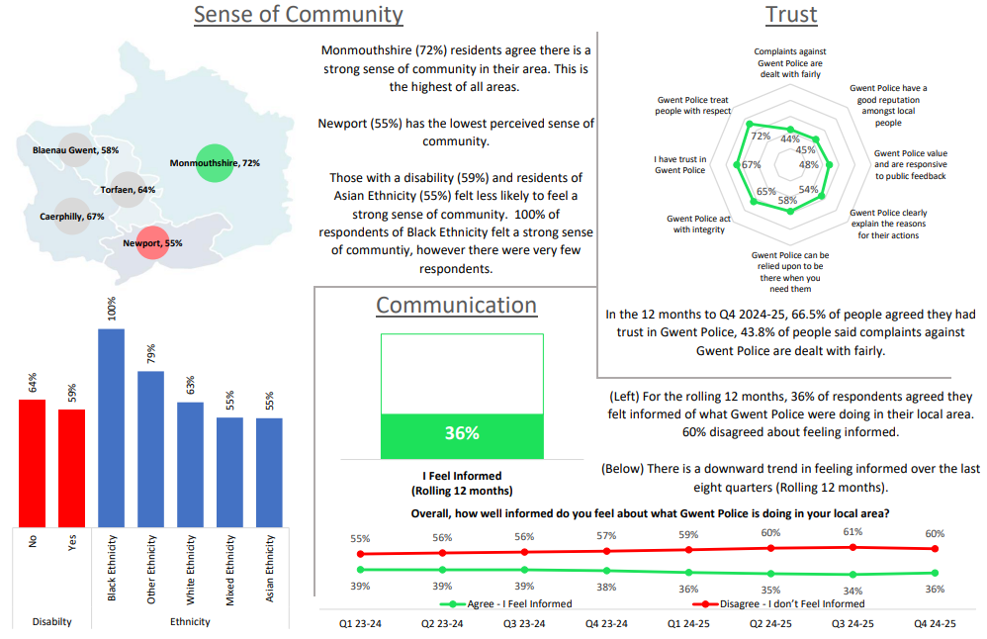
3. Perceptions Survey – Engagement

Slide 7
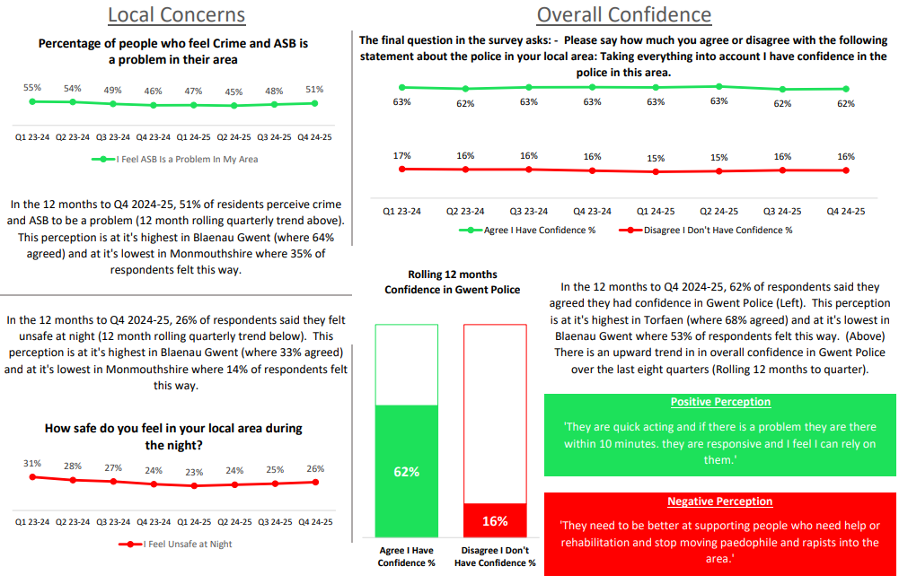
4. Perceptions Survey – Local Concerns and Confidence

Slide 8
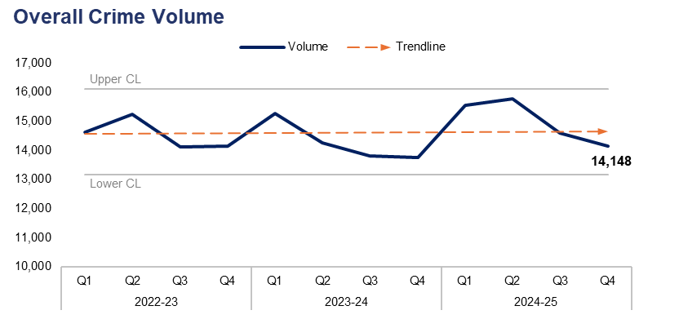
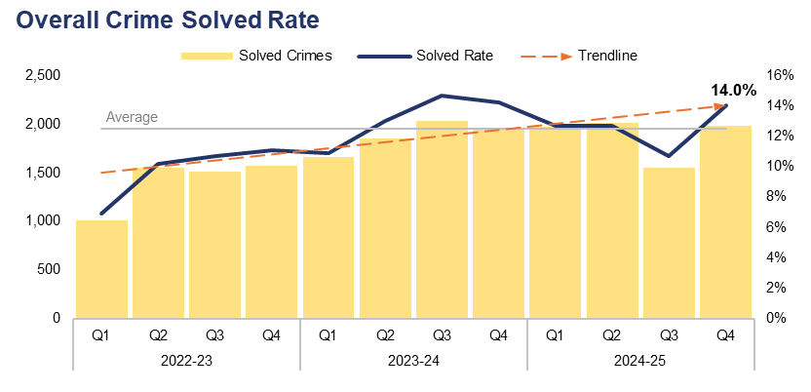
5. Overall Crime
Financial Year | 20-21 | 21-22 | 22-23 | 23-24 | 24-25 |  | Quarter | Q3 24-25 | Q4 23-24
Volume | 47,970 | 53,007 | 58,155 | 57,093 | 60,053 |  | % Change | -3.0% | 2.9%
Financial Year | 20-21 | 21-22 | 22-23 | 23-24 | 24-25 |  | Quarter | Q3 24-25 | Q4 23-24
Solved Rate | 15.7% | 11.0% | 9.7% | 13.1% | 12.5% |  | PP Change | 3.3 | -0.2
Operational Overview
Overall, 14,148 crimes were recorded in Gwent during the fourth quarter of the 2024-25 financial year (Q4 2024-25). This represents a reduction of 3.0% (438 fewer offences) when compared to the quarter prior, but an increase of 2.9% (396 additional offences) when compared to the same quarter during the previous financial year.
The overall solved rate for Q4 2024-25 stands at 14.0%, with 1,979 crimes solved. This is an increase of 3.3 percentage points when compared to the previous quarter, with 424 additional crimes solved. However, the solved rate has fallen by 0.2 percentage points when compared to the same quarter during the previous financial year, albeit with 23 additional crimes solved.
A programme of work is being designed which will focus on the improving the quality of investigations, with the aim of increasing the positive outcome rate and improving the service provided to victims, as well as procedural justice. This is aligned with the Chief Constable's vision for improving public trust and confidence in the force.

Slide 9
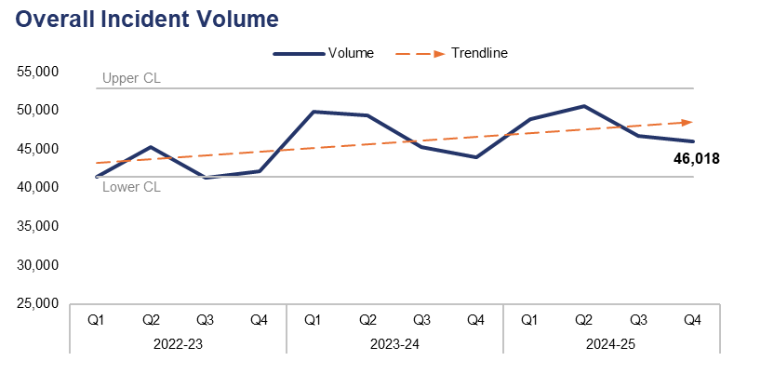
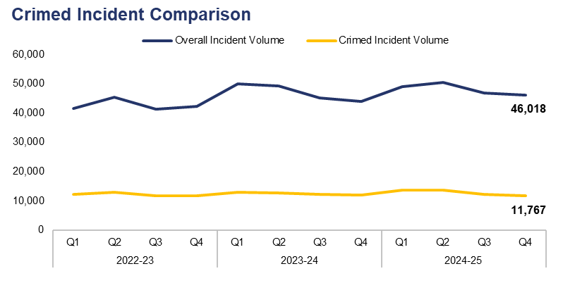
6. Overall Incidents
Financial Year | 20-21 | 21-22 | 22-23 | 23-24 | 24-25 |  | Quarter | Q3 24-25 | Q4 23-24
Volume | 177,702 | 170,178 | 170,358 | 188,434 | 192,242 |  | % Change | -1.6% | 4.6%
Financial Year | 20-21 | 21-22 | 22-23 | 23-24 | 24-25 |  | Quarter | Q3 24-25 | Q4 23-24
% Crimed | 23.3% | 26.3% | 28.4% | 26.4% | 26.7% |  | PP Change | -0.5 | -1.7
Operational Overview
Overall, 46,018 incidents were recorded during Q4 2024-25. This represents a reduction of 1.6% (741 fewer incidents) when compared to the quarter prior, but an increase of 4.6% (2,028 additional incidents) when compared to the same quarter during the previous financial year.
Of the 46,018 incidents recorded during Q4 2024-25, 11,767 were ‘crimed’ (assigned a crime category). This accounts for 25.6% of the overall incident volume during the quarter, with the remaining 74.4% (34,251 incidents) recorded as non-crime incidents.
Additional crimes can be created independently of incidents, accounting for the difference between the number of crimed incidents and the overall crime volume for the quarter.

Slide 10
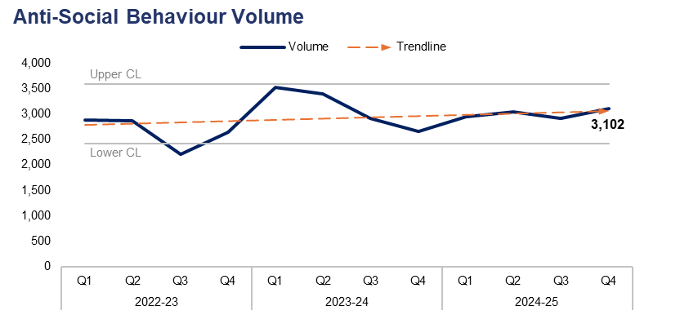
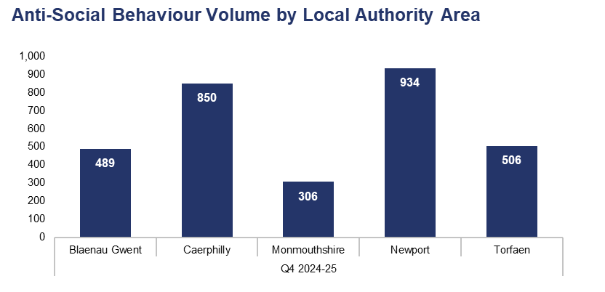
7. Anti-Social Behaviour
Financial Year | 20-21 | 21-22 | 22-23 | 23-24 | 24-25 |  | Quarter | Q3 24-25 | Q4 23-24
Volume | 27,543 | 12,747 | 10,594 | 12,499 | 11,998 |  | % Change | 6.6% | 16.7%
Sector | Blaenau Gwent | Caerphilly | Monmouthshire | Newport | Torfaen
% of Total | 15.8% | 27.4% | 9.9% | 30.1% | 16.3%
Operational Overview
A total of 3,102 incidents classified as Anti-Social Behaviour (ASB) were recorded during Q4 2024-25. This represents an increase of 6.6% (191 additional incidents) when compared to the quarter prior, and a more prominent increase of 16.7% (443 additional incidents) when compared to the same quarter during the previous financial year.
When assessed by Local Authority Area (LAA), the highest volume of ASB incidents were recorded in Newport during Q4 2024-25, accounting for 30.1% of the force-wide total with 934 incidents reported. Conversely, Monmouthshire recorded the lowest incident volume of any LAA, comprising 9.9% of the force-wide total with 306 incidents reported.
During Q4 2024-25, 17 ASB incidents were recorded as having taken place outside of the force area, and have therefore been omitted from the LAA comparison.

Slide 11
Pillar Two - Making Our Communities Safer
999 Demand
101 Demand
999 and 101 Average Answer Speed
Response Times
Most Serious Violence
Serious Violence
Knife Crime
Drug Offences
Shoplifting
Residential Burglary
Robbery
Theft from the Person

Slide 12
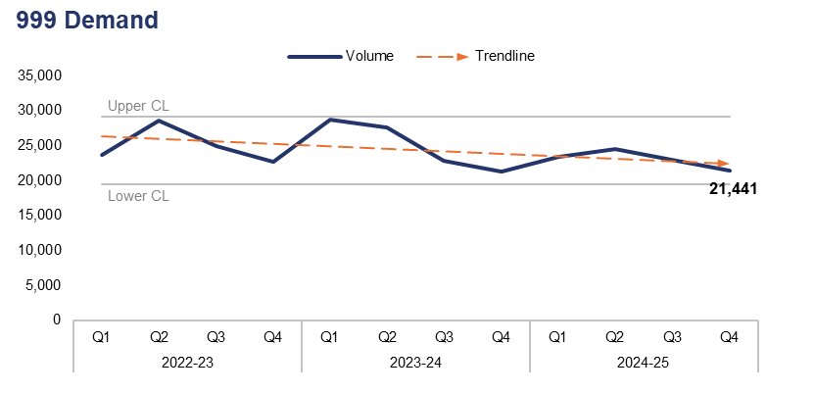
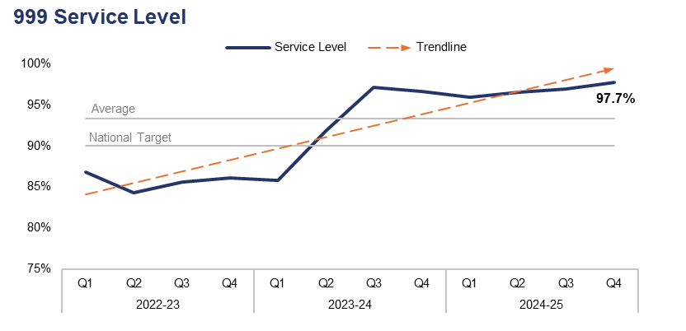
1. 999 Demand
Financial Year | 20-21 | 21-22 | 22-23 | 23-24 | 24-25 |  | Quarter | Q3 24-25 | Q4 23-24
Volume | 73,396 | 87,259 | 99,891 | 100,469 | 92,275 |  | % Change | -6.7% | 0.6%
Financial Year | 20-21 | 21-22 | 22-23 | 23-24 | 24-25 |  | Quarter | Q3 24-25 | Q4 23-24
Service Level | 87.9% | 89.5% | 85.7% | 92.4% | 97.0% |  | PP Change | 0.8 | 1.1
Operational Overview
999 demand has fallen by 6.7% during Q4 2024-25 when compared to the quarter prior, with 1,528 fewer calls received for a total of 21,441. Conversely, a slight rise of 0.6% (132 additional calls) can be observed when comparing Q4 2024-25 to the same quarter during the previous financial year.
999 service level (the percentage of 999 calls answered within 10 seconds) was recorded at 97.7% during Q4 2024-25. This is the highest value within the three-year timeframe, representing an increase of 0.8 percentage points when compared to the quarter prior. A similar increase of 1.1 percentage points can be observed when comparing Q4 2024-25 to the same quarter during the previous financial year. 999 service level has remained above the national target of 90% for the last seven consecutive quarters.

Slide 13
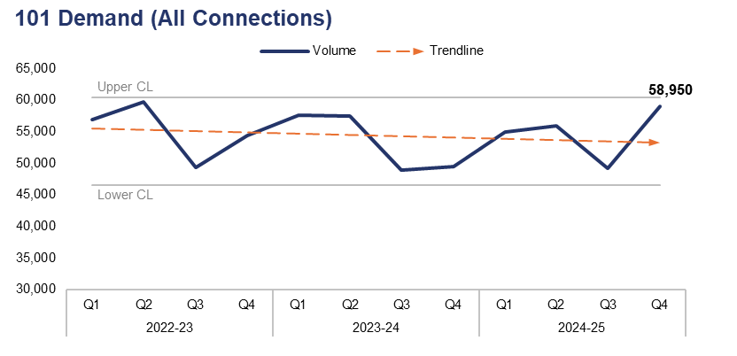
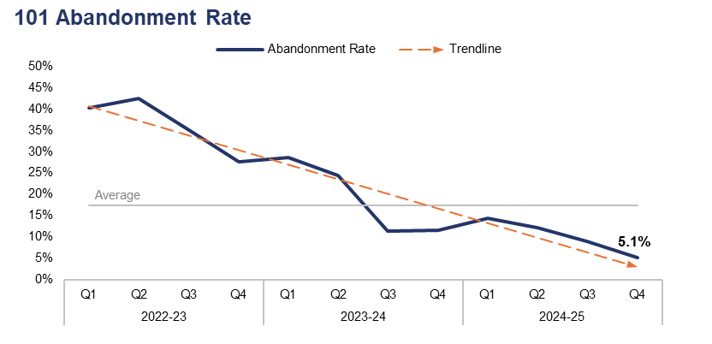
2. 101 Demand
Financial Year | 20-21 | 21-22 | 22-23 | 23-24 | 24-25 |  | Quarter | Q3 24-25 | Q4 23-24
Volume | 225,942 | 241,738 | 220,342 | 213,356 | 219,010 |  | % Change | 19.8% | 19.2%
Financial Year | 20-21 | 21-22 | 22-23 | 23-24 | 24-25 |  | Quarter | Q3 24-25 | Q4 23-24
Abandonment Rate | 11.6% | 26.7% | 36.3% | 19.5% | 9.1% |  | PP Change | -3.9 | -6.4
Operational Overview
101 demand (all connections) has risen by 19.8% during Q4 2024-25 when compared to the quarter prior, with 9,751 additional calls received for a total of 58,950. A similar increase of 19.2% (9,493 additional calls) can be observed when comparing Q4 2024-25 to the same quarter during the previous financial year.
The abandonment rate for 101 calls during Q4 2024-25 was 5.1%. This is the lowest value within the three-year timeframe, and represents a reduction of 3.9 percentage points when compared to the quarter prior. A further reduction of 6.4 percentage points can be observed when comparing Q4 2024-25 to the same quarter during the previous financial year.
The 101 abandonment rate figure is calculated based on call options one and two only, which pertain to new incidents and incident updates respectively.

Slide 14
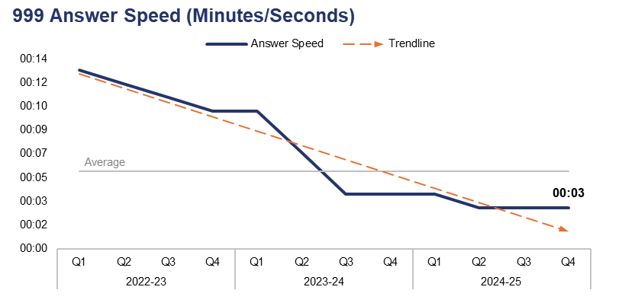
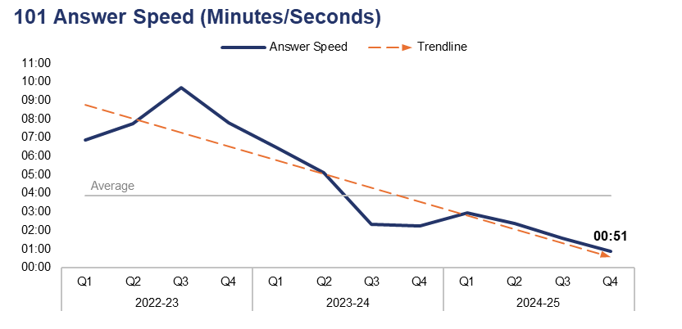
3. 999 and 101 Average Answer Speed
Financial Year | 20-21 | 21-22 | 22-23 | 23-24 | 24-25 |  | Quarter | Q3 24-25 | Q4 23-24
Answer Speed | 00:07 | 00:09 | 00:11 | 00:06 | 00:04 |  | Change | 00:00 | -00:01
Financial Year | 20-21 | 21-22 | 22-23 | 23-24 | 24-25 |  | Quarter | Q3 24-25 | Q4 23-24
Answer Speed | 02:15 | 05:45 | 08:01 | 03:59 | 01:43 |  | Change | -00:44 | -01:23
Operational Overview
The average answer speed for 999 calls during Q4 2024-25 was three seconds. This is the joint-lowest value within the three-year timeframe (remaining consistent with the two previous quarters) ,and represents an improvement of one second when compared to the same quarter during the previous financial year.
The average answer speed for 101 calls during Q4 2024-25 was 51 seconds, again representing the lowest value within the timeframe. This is a reduction of 44 seconds when compared to the quarter prior, and a further reduction of one minute and 23 seconds when compared to the same quarter during the previous financial year.
The 101 average answer speed figure is calculated based on call options one and two only, which pertain to new incidents and incident updates respectively.

Slide 15
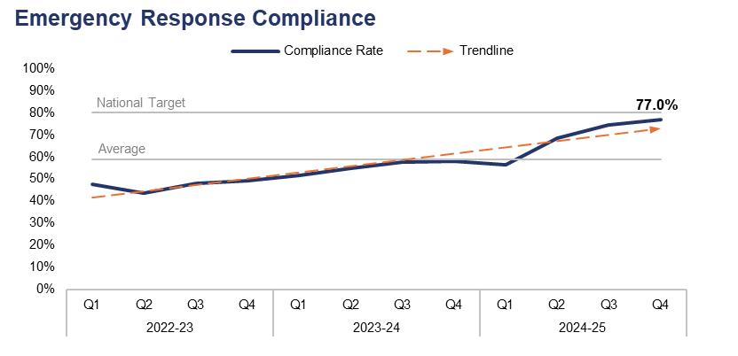
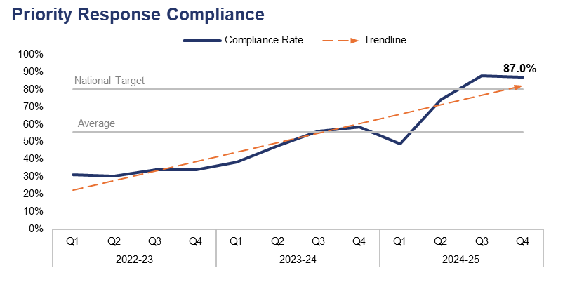
4. Response Times
Financial Year | 20-21 | 21-22 | 22-23 | 23-24 | 24-25 |  | Quarter | Q3 24-25 | Q4 23-24
Compliance Rate | 53.0% | 47.5% | 47.0% | 55.4% | 68.7% |  | PP Change | 2.4 | 19.2
Financial Year | 20-21 | 21-22 | 22-23 | 23-24 | 24-25 |  | Quarter | Q3 24-25 | Q4 23-24
Compliance Rate | 38.4% | 33.2% | 32.3% | 50.0% | 74.5% |  | PP Change | -0.6 | 28.6
Operational Overview
Based on the target arrival time of 15 minutes, emergency create-to-arrival compliance during Q4 2024-25 stands at 77.0%. This is the highest value within the three-year timeframe, representing an increase of 2.4 percentage points when compared to the quarter prior, and a more prominent increase of 19.2 percentage points when compared to the same quarter during the previous financial year. Despite this, compliance remains three percentage points below the national target of 80.0%.
Based on the target arrival time of 60 minutes, priority create-to-arrival compliance during Q4 2024-25 stands at 87.0%. Whilst this represents a slight reduction of 0.6 percentage points when compared to the quarter prior, it remains the second-highest value within the timeframe, and a significant increase of 28.6 percentage points when compared to the same quarter during the previous financial year. This exceeds the national compliance target of 80.0%.
In this context, ‘create to arrival’ refers to the time elapsed between the creation of a Storm Log for a given incident, and the arrival of officers at the scene.

Slide 16
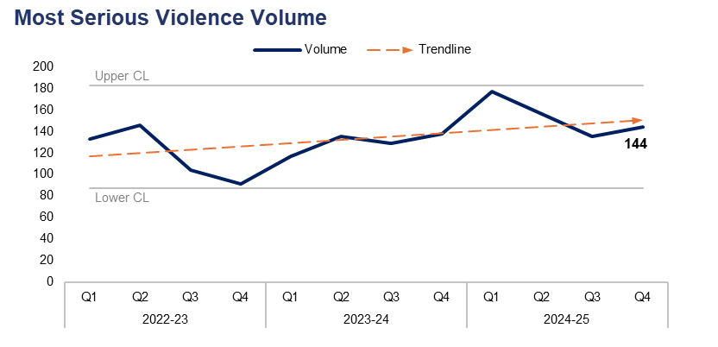
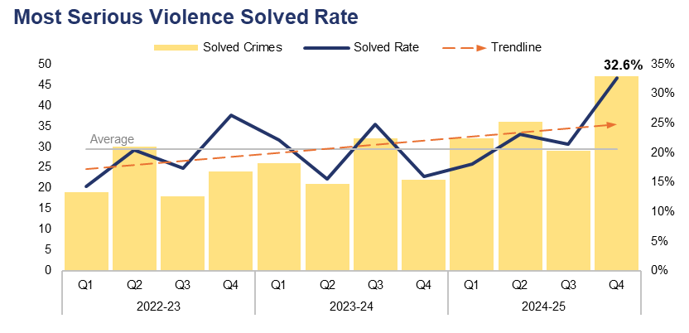
5. Most Serious Violence
Financial Year | 20-21 | 21-22 | 22-23 | 23-24 | 24-25 |  | Quarter | Q3 24-25 | Q4 23-24
Volume | 359 | 435 | 474 | 519 | 612 |  | % Change | 6.7% | 4.3%
Financial Year | 20-21 | 21-22 | 22-23 | 23-24 | 24-25 |  | Quarter | Q3 24-25 | Q4 23-24
Solved Rate | 27.9% | 16.3% | 19.2% | 19.5% | 23.5% |  | PP Change | 11.1 | 16.7
Operational Overview
A total of 144 crimes classified as Most Serious Violence were recorded during Q4 2024-25. This represents an increase of 6.7% (nine additional offences) when compared to the quarter prior, and an increase of 4.3% (six additional offences) when compared to the same quarter during the previous financial year.
The solved rate for Q4 2024-25 stands at 32.6%, with 47 crimes solved. This is the highest solved rate within the three-year timeframe, representing an increase of 11.1 percentage points when compared to the quarter prior, with 18 additional crimes solved. A further increase of 16.7 percentage points can be observed when comparing Q4 2024-25 to the same quarter during the previous financial year, with 25 additional crimes solved.
The force continues to utilise a problem-solving, partnership-based approach to preventing Serious Violence. Investment has been made within the neighbourhood pillar for an officer with knife crime reduction as an integral part of their role. The force’s Most Serious Violence governance and delivery has been reviewed, with recent meetings seeing focused discussions around youth violence and knife crime.
Most Serious Violence offences consist of homicide, grievous bodily harm with intent, and causing death by dangerous driving.

Slide 17
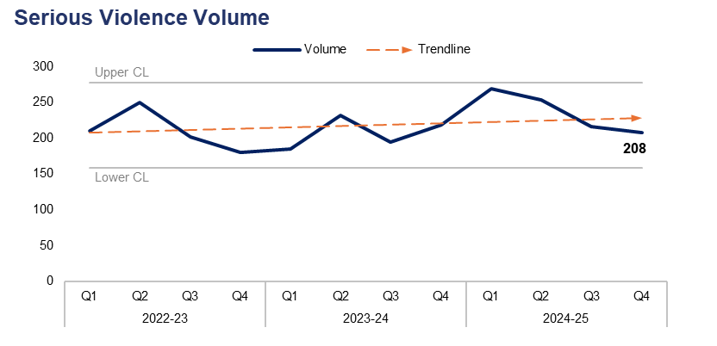
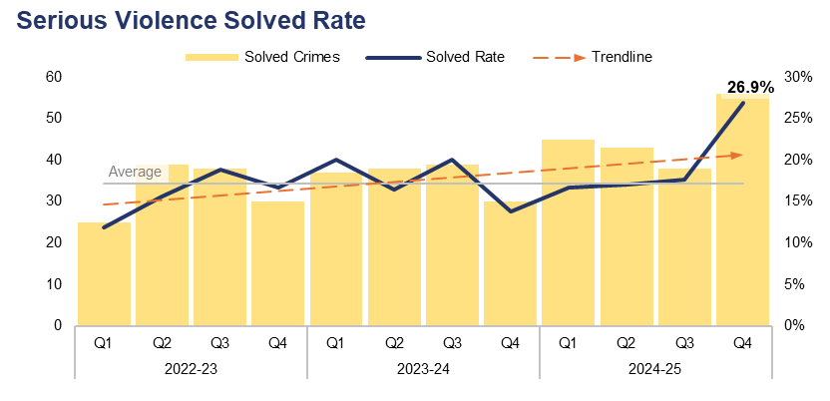
6. Serious Violence
Financial Year | 20-21 | 21-22 | 22-23 | 23-24 | 24-25 |  | Quarter | Q3 24-25 | Q4 23-24
Volume | 657 | 729 | 842 | 830 | 946 |  | % Change | -3.7% | -4.6%
Financial Year | 20-21 | 21-22 | 22-23 | 23-24 | 24-25 |  | Quarter | Q3 24-25 | Q4 23-24
Solved Rate | 22.2% | 16.2% | 15.7% | 17.3% | 19.2% |  | PP Change | 9.3 | 13.1
Operational Overview
As displayed in the upper-left graph, 208 crimes classified as Serious Violence were recorded during Q4 2024-25. This represents a reduction of 3.7% (eight fewer offences) when compared to the quarter prior, and a further reduction of 4.6% (10 fewer offences) when compared to the same quarter during the previous financial year.
The solved rate for Q4 2024-25 stands at 26.9%, with 56 crimes solved. This is the highest solved rate within the three-year timeframe, and represents an increase of 9.3 percentage points when compared to the quarter prior, with 18 additional crimes solved. A more prominent increase of 13.1 percentage points can be observed when comparing Q4 2024-25 to the same quarter during the previous financial year, with 26 additional crimes solved.
The force continues to hold a homicide prevention and Serious Violence meeting, in which the levels of Serious Violence offences are considered and monitored. The meeting has a specific focus on intervention and prevention, with themes in violence being assessed in order to support this. A recent initiative involved securing national funding to develop an education programme for children on the dangers of violence and knife crime using virtual reality gaming equipment.
Serious Violence offences consist of section 18 grievous bodily harm with intent, section 20 malicious wounding without intent, and personal robbery.

Slide 18
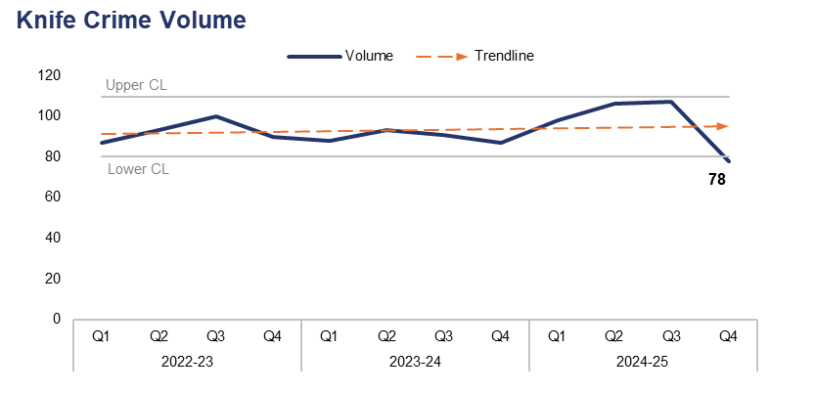
7. Knife Crime
Financial Year | 20-21 | 21-22 | 22-23 | 23-24 | 24-25 |  | Quarter | Q3 24-25 | Q4 23-24
Volume | 321 | 283 | 370 | 359 | 389 |  | % Change | -27.1% | -10.3%
Operational Overview
During Q4 2024-25, 78 offences were recorded which met the criteria of a knife crime as defined by the Home Office’s National Data Quality Improvement Service (NDQIS) reporting system. This is the lowest value within the three-year timeframe, falling below the lower control limit and representing a reduction of 27.1% (29 fewer offences) when compared to the quarter prior. A less prominent reduction of 10.3% (nine fewer offences) can be observed when comparing Q4 2024-25 to the same quarter during the previous financial year.
The force actively engages with initiatives which aim to reduce knife crime, such as Operation Sceptre. Sweeps of areas are also conducted, in order to locate concealed or abandoned knives and weapons. In addition, diversionary schemes and education are provided for young people, highlighting the dangers and consequences of carrying and/or using a knife.
In accordance with NDQIS reporting criteria, Possession of a Weapon and Homicide offences have been excluded from this dataset.

Slide 19
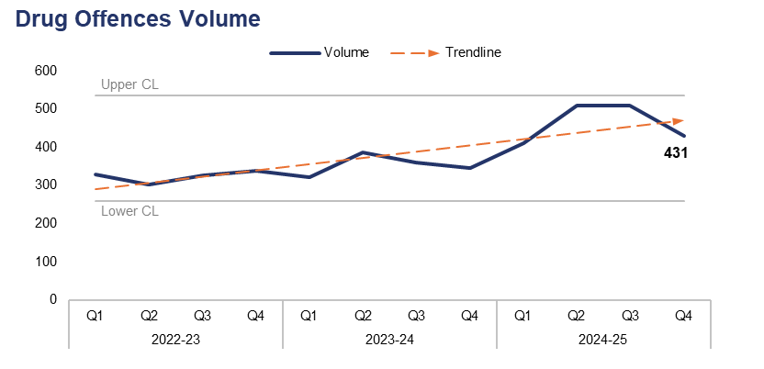
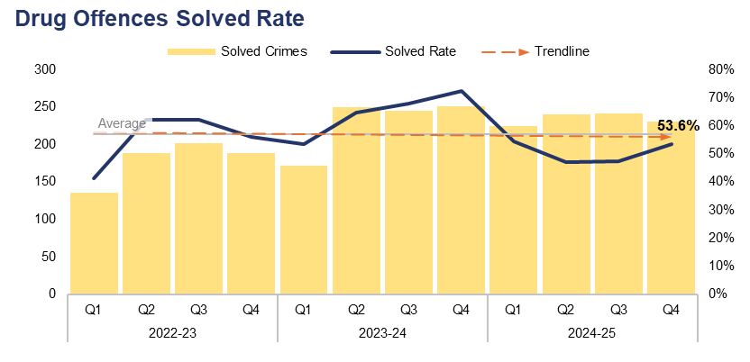
8. Drug Offences
Financial Year | 20-21 | 21-22 | 22-23 | 23-24 | 24-25 |  | Quarter | Q3 24-25 | Q4 23-24
Volume | 1,839 | 1,328 | 1,295 | 1,415 | 1,861 |  | % Change | -15.3% | 24.6%
Financial Year | 20-21 | 21-22 | 22-23 | 23-24 | 24-25 |  | Quarter | Q3 24-25 | Q4 23-24
Solved Rate | 79.0% | 67.5% | 55.1% | 64.9% | 50.3% |  | PP Change | 6.1 | -18.9
Operational Overview
A total of 431 crimes classified as Drug Offences were recorded during Q4 2024-25. This represents a reduction of 15.3% (78 fewer offences) when compared to the quarter prior, but an increase of 24.6% (85 additional offences) when compared to the same quarter during the previous financial year.
The solved rate for Drug Offences during Q4 2024-25 stands at 53.6%, with 231 crimes solved. This is an increase of 6.1 percentage points when compared to the quarter prior, albeit with 11 fewer crimes solved. However, the solved rate has fallen by 18.9 percentage points when compared to the same quarter during the previous financial year, with 20 fewer crimes solved.
An increase in Drug Offences has been recorded over the last 12 months. Analysis has identified that a key driver of this increase is seizures by the UK Border Force relating to drug commodities that were destined for Gwent postal addresses. The force is working with the Regional Organised Crime Unit and other partners to understand the impact of this increase, strengthening intelligence sharing mechanisms and developing solutions. During Q4 2024-25, 19.2% of all Drug Offences related to drugs importation and border force seizures, with 82 offences recorded. This represents a reduction of 32.8% (40 fewer offences) when compared to the quarter prior.

Slide 20
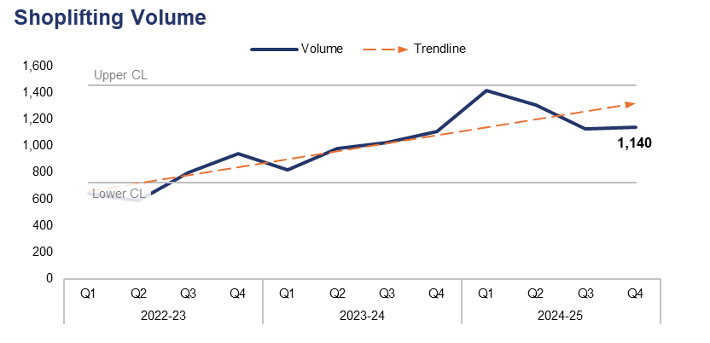
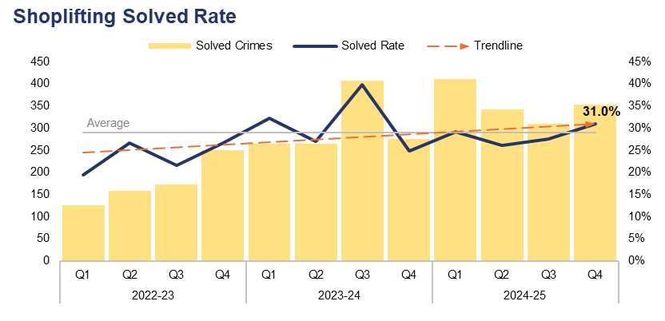
9. Shoplifting
Financial Year | 20-21 | 21-22 | 22-23 | 23-24 | 24-25 |  | Quarter | Q3 24-25 | Q4 23-24
Volume | 2,064 | 2,186 | 2,974 | 3,926 | 4,989 |  | % Change | 1.3% | 3.1%
Financial Year | 20-21 | 21-22 | 22-23 | 23-24 | 24-25 |  | Quarter | Q3 24-25 | Q4 23-24
Solved Rate | 35.3% | 27.7% | 23.7% | 30.8% | 28.4% |  | PP Change | 3.5 | 6.1
Operational Overview
During Q4 2024-25, 1,140 Shoplifting offences were recorded. This represents an increase of 1.3% (15 additional offences) when compared to the quarter prior, and a similar increase of 3.1% (34 additional offences) when compared to the same quarter during the previous financial year.
The solved rate for Q4 2024-25 stands at 31.0%, with 353 crimes solved. This represents an increase of 3.5 percentage points when compared to the quarter prior, with 44 additional crimes solved, and a further increase of 6.1 percentage points when compared to the same quarter during the previous financial year, with 78 additional crimes solved.

Slide 21
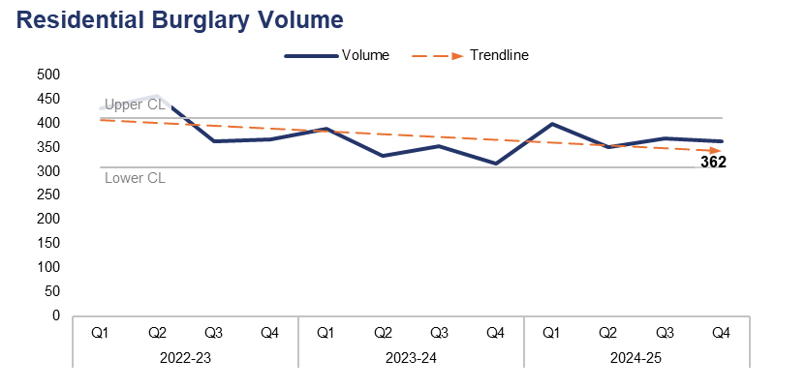
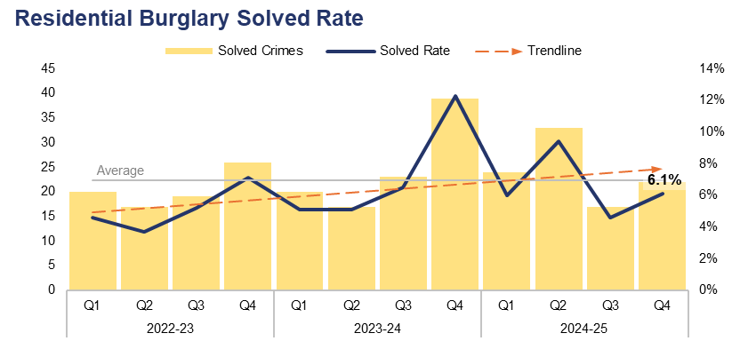
10. Residential Burglary
Financial Year | 20-21 | 21-22 | 22-23 | 23-24 | 24-25 |  | Quarter | Q3 24-25 | Q4 23-24
Volume | 1,951 | 1,755 | 1,616 | 1,389 | 1,481 |  | % Change | -1.9% | 14.6%
Financial Year | 20-21 | 21-22 | 22-23 | 23-24 | 24-25 |  | Quarter | Q3 24-25 | Q4 23-24
Solved Rate | 7.5% | 6.3% | 5.1% | 7.1% | 6.5% |  | PP Change | 1.5 | -6.2
Operational Overview
As displayed in the upper-left graph, 362 Residential Burglary offences were recorded during Q4 2024-25. This represents a reduction of 1.9% (seven fewer offences) when compared to the quarter prior, but an increase of 14.6% (46 additional offences) when compared to the same quarter during the previous financial year.
The solved rate for Q4 2024-25 stands at 6.1%, with 22 crimes solved. This represents an increase of 1.5 percentage points when compared to the quarter prior, with five additional crimes solved. However, the solved rate has fallen by 6.2 percentage points when compared to the same quarter during the previous financial year, with 17 fewer crimes solved.
During Q4 2024-25, 92.2% of Residential Burglary of a Home incidents were attended by officers, with 58.2% of these attended within 60 minutes.
Following changes to the operating model, the Criminal Investigation Department has retained ownership of this crime category. Daily reviews are conducted by detective sergeants, and Residential Burglary remains a focus of the proactive team, who are working more closely with offender management teams and other partners to address these offences.

Slide 22
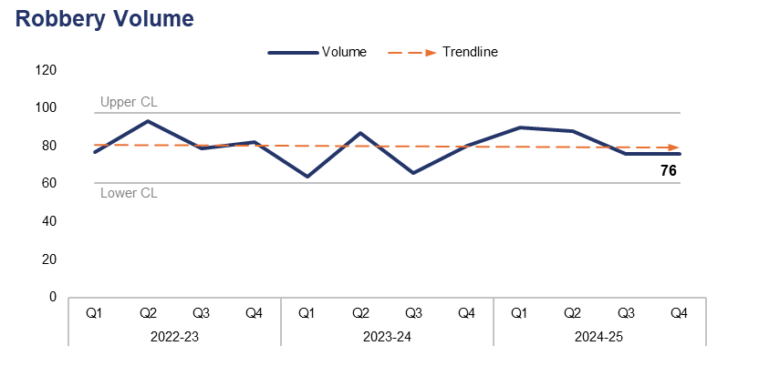
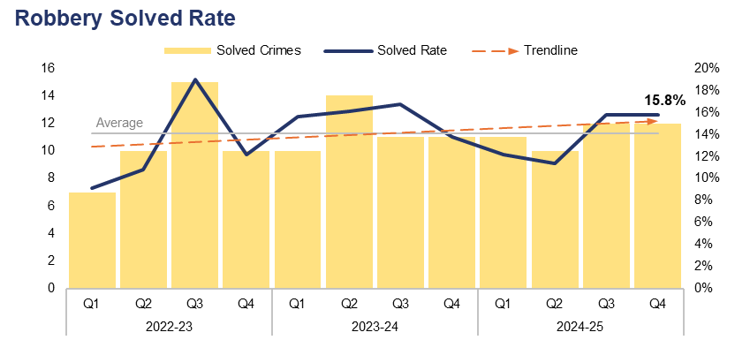
11. Robbery
Financial Year | 20-21 | 21-22 | 22-23 | 23-24 | 24-25 |  | Quarter | Q3 24-25 | Q4 23-24
Volume | 243 | 267 | 331 | 297 | 330 |  | % Change | 0.0% | -5.0%
Financial Year | 20-21 | 21-22 | 22-23 | 23-24 | 24-25 |  | Quarter | Q3 24-25 | Q4 23-24
Solved Rate | 15.2% | 18.7% | 12.7% | 15.5% | 13.6% |  | PP Change | 0.0 | 2.0
Operational Overview
A total of 76 Robbery offences were recorded during Q4 2024-25. Levels have remained steady when compared to the quarter prior, but have fallen by 5.0% (four fewer offences) when compared to the same quarter during the previous financial year.
The solved rate for Q4 2024-25 stands at 15.8%, with 12 crimes solved. As with offence volume, this has remained steady when compared to the quarter prior. The solved rate has risen by 2.0 percentage points when compared to the same quarter during the previous financial year, with one additional crime solved.
Robbery levels remain comparatively low in Gwent, with trends identified around the taking of electronic scooters and bikes. Proactive teams will be working alongside neighbourhood policing and enforcement teams to target offenders via intelligence, as well as combatting the illegal use of electronic conveyances and providing safety advice to those using them legally.
The data on this slide includes both personal and commercial Robbery offences

Slide 23
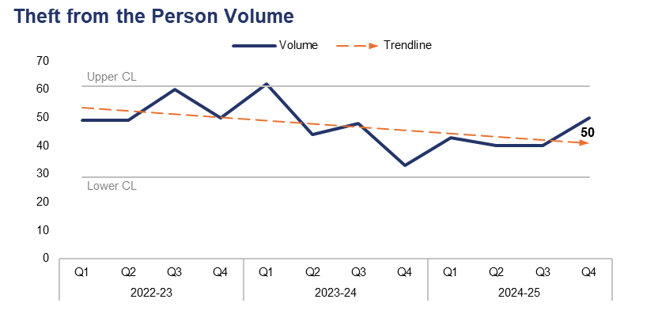
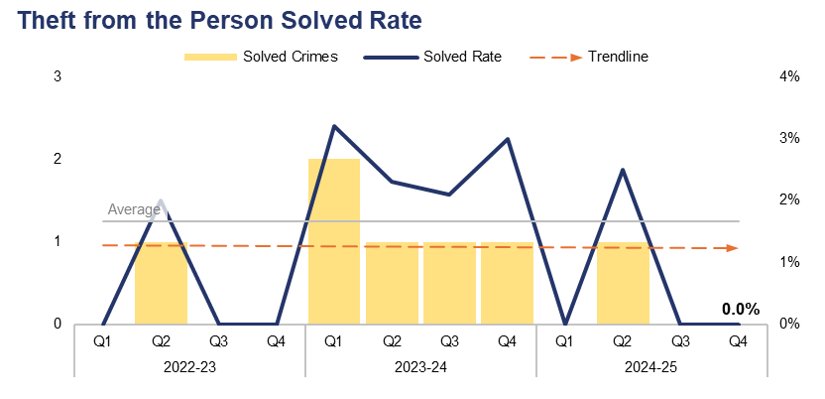
12. Theft from the Person
Financial Year | 20-21 | 21-22 | 22-23 | 23-24 | 24-25 |  | Quarter | Q3 24-25 | Q4 23-24
Volume | 153 | 166 | 208 | 187 | 173 |  | % Change | 25.0% | 51.5%
Financial Year | 20-21 | 21-22 | 22-23 | 23-24 | 24-25 |  | Quarter | Q3 24-25 | Q4 23-24
Solved Rate | 7.2% | 5.4% | 0.5% | 2.7% | 0.6% |  | PP Change | 0.0 | -3.0
Operational Overview
During Q4 2024-25, 50 Theft from the Person offences were recorded. This represents an increase of 25.0% (10 additional offences) when compared to the quarter prior, and a more prominent increase of 51.5% (17 additional offences) when compared to the same quarter during the previous financial year.
The solved rate for Q4 2024-25 stands at 0.0%, with no crimes solved. This remains consistent with the quarter prior. The solved rate has fallen by 3.0 percentage points when compared to the same quarter during the previous financial year, with one fewer crime solved.

Slide 24
Pillar Three – Protecting the Vulnerable
Violence Against Women and Girls
Domestic Offences
Rape
Serious Sexual Offences
Stalking and Harassment
Hate Crime
Child Criminal and Sexual Exploitation
Missing Children
Action Fraud
Cybercrime

Slide 25
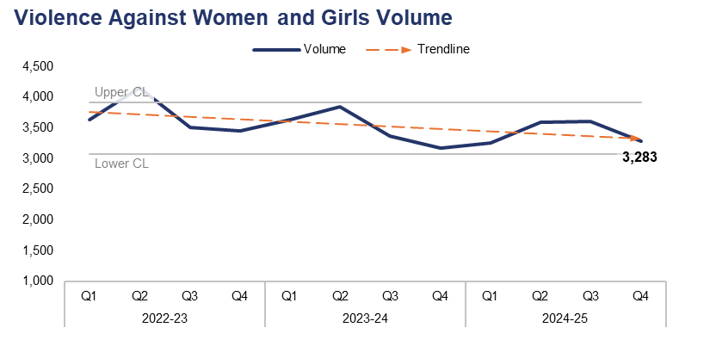
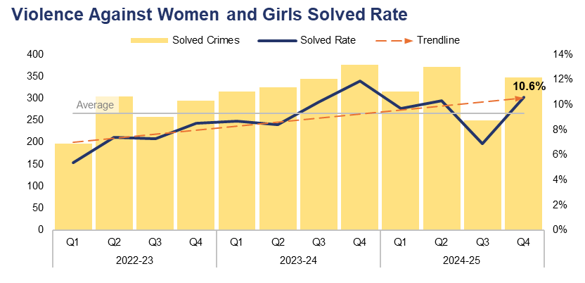
1. Violence Against Women and Girls
Financial Year | 20-21 | 21-22 | 22-23 | 23-24 | 24-25 |  | Quarter | Q3 24-25 | Q4 23-24
Volume | 10,584 | 12,520 | 14,749 | 14,024 | 13,732 |  | % Change | -8.9% | 3.7%
Financial Year | 20-21 | 21-22 | 22-23 | 23-24 | 24-25 |  | Quarter | Q3 24-25 | Q4 23-24
Solved Rate | 11.6% | 8.8% | 7.1% | 9.7% | 9.3% |  | PP Change | 3.7 | -1.3
Operational Overview
Overall, 3,283 crimes classified as Violence Against Women and Girls (VAWG) offences were recorded during Q4 2024-25. This represents a reduction of 8.9% (320 fewer offences) when compared to the quarter prior, but an increase of 3.7% (116 additional offences) when compared to the same quarter during the previous financial year.
The solved rate for Q4 2024-25 stands at 10.6%, with 347 crimes solved. The is the second-highest value within the three-year timeframe, representing an increase of 3.7 percentage points when compared to the quarter prior, with 97 additional crimes solved. However, the solved rate has fallen by 1.3 percentage points when compared to the same quarter during the previous financial year, with 29 fewer crimes solved.
A VAWG and Vulnerability meeting is held on a monthly basis, with a focus on vulnerability crimes and incidents. Within this meeting the disparity in offending and victimisation for women and girls is examined closely, with a distinct focus on domestic abuse. This allows any disproportionality in crimes affecting women and girls to be identified and acted upon. The force has a Chief Superintendent VAWG lead, who is developing and moving to deliver the VAWG framework and delivery plan for Gwent.

Slide 26
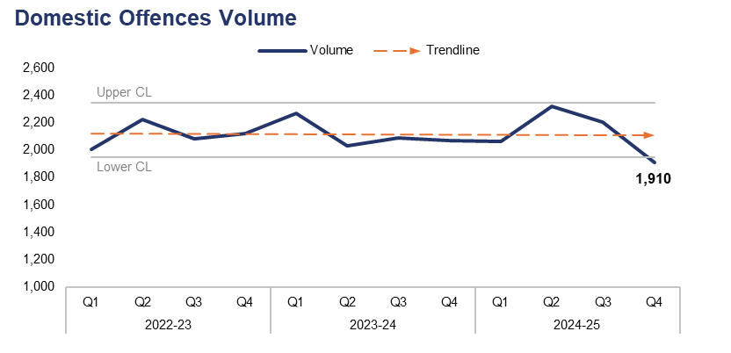
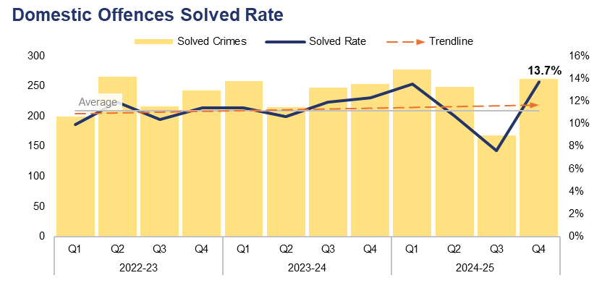
2. Domestic Offences
Financial Year | 20-21 | 21-22 | 22-23 | 23-24 | 24-25 |  | Quarter | Q3 24-25 | Q4 23-24
Volume | 8,054 | 8,842 | 8,436 | 8,458 | 8,500 |  | % Change | -13.3% | -7.8%
Financial Year | 20-21 | 21-22 | 22-23 | 23-24 | 24-25 |  | Quarter | Q3 24-25 | Q4 23-24
Solved Rate | 14.2% | 10.7% | 10.9% | 11.5% | 11.3% |  | PP Change | 6.1 | 1.4
Operational Overview
Overall, 1,910 crimes classified as domestic offences were recorded during Q4 2024-25. This is the lowest value within the three-year timeframe, falling below the lower control limit and representing a reduction of 13.3% (294 fewer offences) when compared to the quarter prior. A less prominent reduction of 7.8% (162 fewer offences) can be observed when comparing Q4 2024-25 to the same quarter during the previous financial year.
The solved rate for Q4 2024-25 stands at 13.7%, with 262 crimes solved. This is the highest solved rate within the timeframe, representing an increase of 6.1 percentage points when compared to the quarter prior, with 94 additional crimes solved. A less prominent increase of 1.4 percentage points an be observed when comparing Q4 2024-25 to the same quarter during the previous financial year, with eight additional crimes solved.

Slide 27
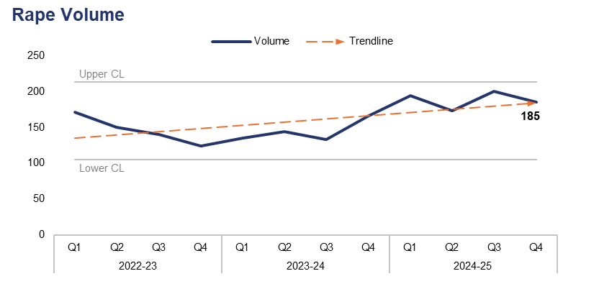
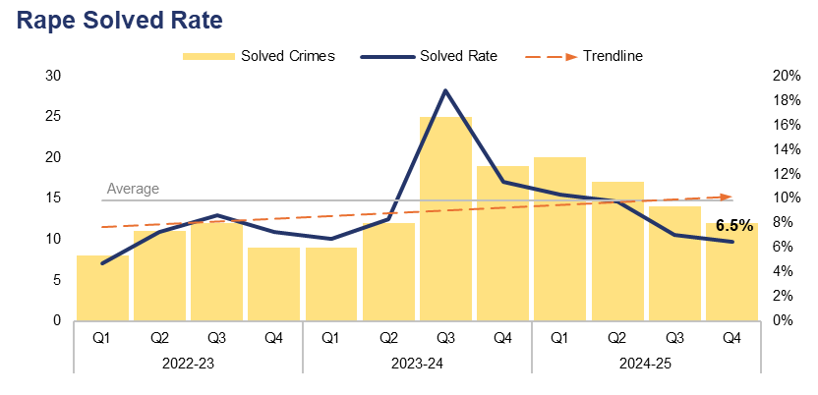
3. Rape
Financial Year | 20-21 | 21-22 | 22-23 | 23-24 | 24-25 |  | Quarter | Q3 24-25 | Q4 23-24
Volume | 424 | 572 | 585 | 578 | 752 |  | % Change | -7.5% | 11.4%
Financial Year | 20-21 | 21-22 | 22-23 | 23-24 | 24-25 |  | Quarter | Q3 24-25 | Q4 23-24
Solved Rate | 10.4% | 5.4% | 6.8% | 11.2% | 8.4% |  | PP Change | -0.5 | -4.9
Operational Overview
During Q4 2024-25, 185 Rape offences were recorded. This represents a reduction of 7.5% (15 fewer offences) when compared to the quarter prior, but an increase of 11.4% (19 additional offences) when compared to the same quarter during the previous financial year.
The solved rate for Q4 2024-25 stands at 6.5%, with 12 crimes solved. This is a reduction of 0.5 percentage points when compared to the quarter prior, with two fewer crimes solved. A further reduction of 4.9 percentage points can be observed when comparing Q4 2024-25 to the same quarter during the previous financial year, with seven fewer crimes solved.
Through the delivery of the Operation Soteria programme, the force has one of the best victim attrition rates in England and Wales. This is due in particular to the work of the sexual offences liaison officers within the Rape Investigation Team, as well as the survivor engagement coordinator. In recent months, Gwent has seen a high number of ‘non-recent’ reports of rape, implying that individuals feel confident in reporting such crimes to Gwent Police.

Slide 28
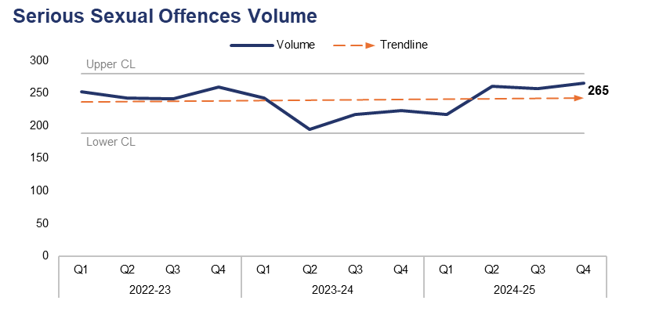
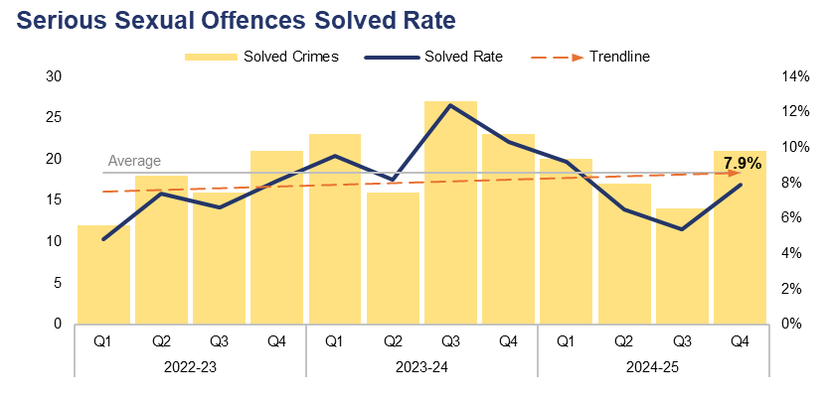
4. Serious Sexual Offences
Financial Year | 20-21 | 21-22 | 22-23 | 23-24 | 24-25 |  | Quarter | Q3 24-25 | Q4 23-24
Volume | 671 | 925 | 997 | 878 | 1,000 |  | % Change | 3.1% | 18.8%
Financial Year | 20-21 | 21-22 | 22-23 | 23-24 | 24-25 |  | Quarter | Q3 24-25 | Q4 23-24
Solved Rate | 9.4% | 6.3% | 6.7% | 10.1% | 7.2% |  | PP Change | 2.5 | -2.4
Operational Overview
A total of 265 crimes classified as serious sexual offences were recorded during Q4 2024-25. This is the highest value within the three-year timeframe, representing an increase of 3.1% (eight additional offences) when compared to the quarter prior. A further increase of 18.8% (42 additional offences) can be observed when comparing Q4 2024-25 to the same quarter during the previous financial year.
The solved rate for Q4 2024-25 stands at 7.9%, with 21 crimes solved. This represents an increase of 2.5 percentage points when compared to the quarter prior, with seven additional crimes solved. However, the solved rate has fallen by 2.4 percentage points when compared to the same quarter during the previous financial year, with two fewer crimes solved.
Rape offences have been excluded from this dataset.

Slide 29
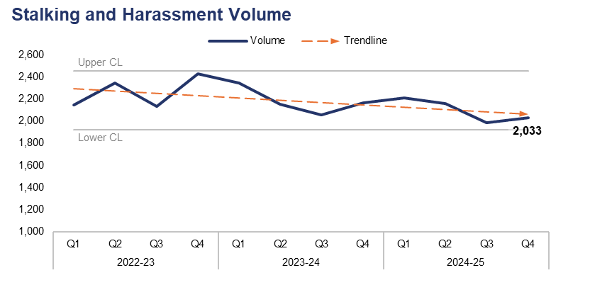
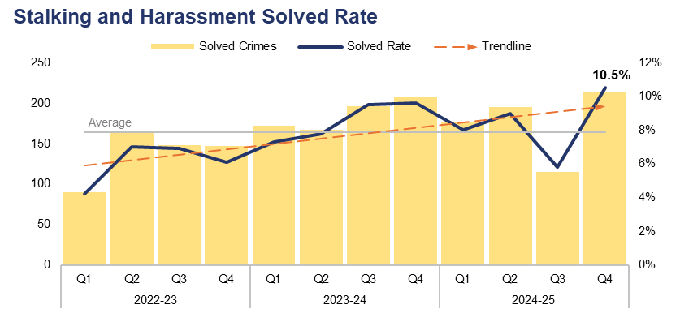
5. Stalking and Harassment
Financial Year | 20-21 | 21-22 | 22-23 | 23-24 | 24-25 |  | Quarter | Q3 24-25 | Q4 23-24
Volume | 7,741 | 7,954 | 9,052 | 8,723 | 8,385 |  | % Change | 2.4% | -6.2%
Financial Year | 20-21 | 21-22 | 22-23 | 23-24 | 24-25 |  | Quarter | Q3 24-25 | Q4 23-24
Solved Rate | 9.7% | 7.8% | 6.1% | 8.5% | 8.4% |  | PP Change | 4.7 | 0.9
Operational Overview
Overall, 2,033 stalking and harassment offences were recorded during Q4 2024-25. This represents an increase of 2.4% (47 additional offences) when compared to the quarter prior, but a reduction of 6.2% (135 fewer offences) when compared to the same quarter during the previous financial year.
The solved rate for Q4 2024-25 stands at 10.5%, with 214 crimes solved. This represents the highest solved rate within the three-year timeframe and an increase of 4.7 percentage points when compared to the quarter prior, with 99 additional crimes solved. A less prominent increase of 0.9 percentage points can be observed when comparing Q4 2024-25 to the same quarter during the previous financial year, with six additional crimes solved.
The force has commissioned a review of our stalking response by the Suzy Lamplugh Trust and will develop a delivery plan from these findings, as well as those from internal reviews and national guidance.

Slide 30
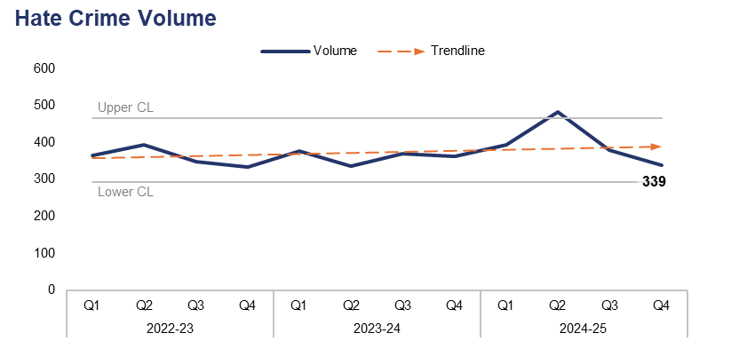
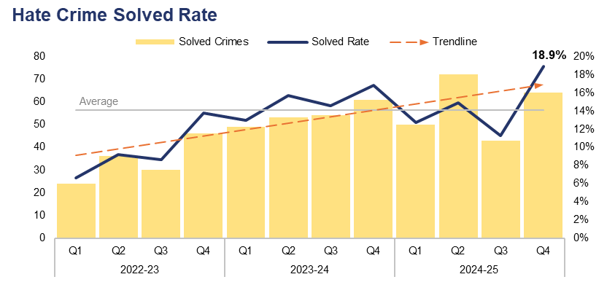
6. Hate Crime
Financial Year | 20-21 | 21-22 | 22-23 | 23-24 | 24-25 |  | Quarter | Q3 24-25 | Q4 23-24
Volume | 953 | 1,413 | 1,441 | 1,447 | 1,595 |  | % Change | -10.6% | -6.6%
Financial Year | 20-21 | 21-22 | 22-23 | 23-24 | 24-25 |  | Quarter | Q3 24-25 | Q4 23-24
Solved Rate | 15.2% | 11.6% | 9.4% | 15.0% | 14.4% |  | PP Change | 7.6 | 2.1
Operational Overview
A total of 339 offences which met the definition of a hate crime were recorded during Q4 2024-25. This represents a reduction of 10.6% (40 fewer offences) when compared to the quarter prior, and a less prominent reduction of 6.6% (24 fewer offences) when compared to the same quarter during the previous financial year. Crimes assigned the racial hate strand were the most prevalent during Q4 2024-25, with 238 such offences recorded. Conversely, crimes assigned the religious and transphobic hate strands were the least common, with 12 offences recorded for each.
The solved rate for Q4 2024-25 stands at 18.9%, with 64 crimes solved. This represents the highest solved rate within the three-year timeframe and an increase of 7.6 percentage points when compared to the quarter prior, with 21 additional crimes solved. A less prominent increase of 2.1 percentage points can be observed when comparing Q4 2024-25 to the same quarter during the previous financial year, with three additional crimes solved.
A single crime can be assigned multiple hate strands. The crime trend is based on recorded crimes, whilst the assessment of hate strands is based on the volume of each individual strand.

Slide 31
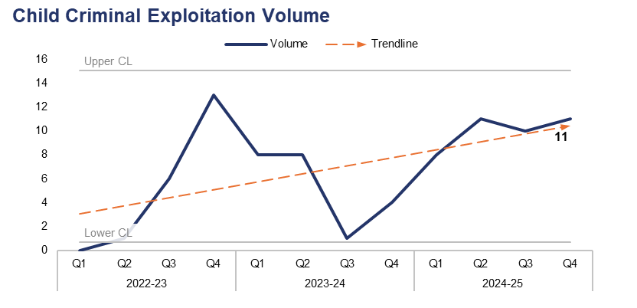
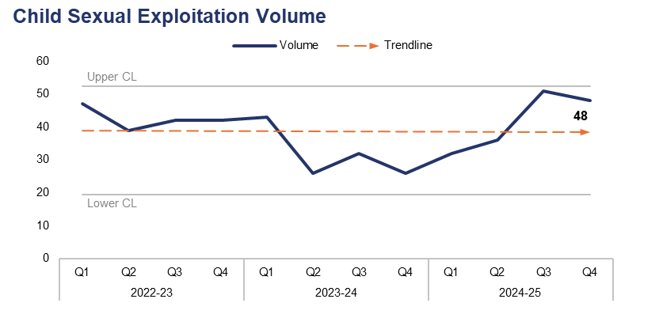
7. Child Criminal and Sexual Exploitation
Financial Year | 20-21 | 21-22 | 22-23 | 23-24 | 24-25 |  | Quarter | Q3 24-25 | Q4 23-24
Volume | - | - | 20 | 21 | 40 |  | % Change | 10.0% | 175.0%
Financial Year | 20-21 | 21-22 | 22-23 | 23-24 | 24-25 |  | Quarter | Q3 24-25 | Q4 23-24
Volume | 172 | 226 | 170 | 127 | 167 |  | % Change | -5.9% | 84.6%
Operational Overview
During Q4 2024-25, 11 offences were assigned a child criminal exploitation local qualifier. This represents an increase of 10.0% (one additional offence) when compared to the quarter prior, and a significant increase of 175.0% (seven additional offences) when compared to the same quarter during the previous financial year.
A total of 48 offences were assigned a child sexual exploitation local qualifier during Q4 2024-25. This is the second-highest value within the three-year timeframe, representing a reduction of 5.9% (three fewer offences) when compared to the quarter prior, but a substantial increase of 84.6% (22 additional offences) when compared to the same quarter during the previous financial year.
The force has recently produced a problem profile for Child Criminal and Sexual Exploitation, and continues to invest in the Modern-Day Slavery and Human Trafficking Team with a focus on combatting drug dealing by children. Recent action was taken as part of Operation Tarran in the Torfaen area, wherein a 30-year-old male was arrested for exploiting children to supply drugs.
Use of the Child Criminal Exploitation local qualifier commenced during 2022, limiting the scope of the currently available dataset.

Slide 32
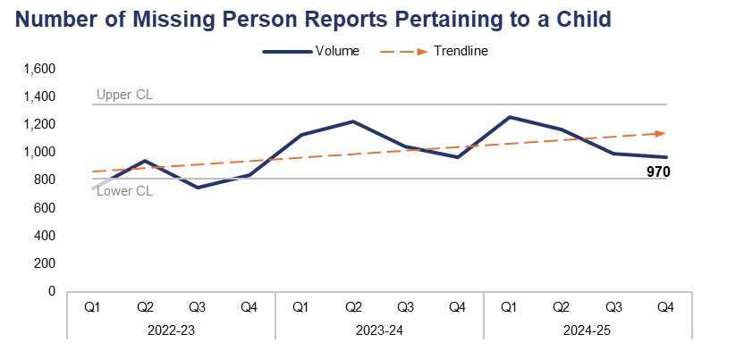
8. Missing Children
Financial Year | 20-21 | 21-22 | 22-23 | 23-24 | 24-25 |  | Quarter | Q3 24-25 | Q4 23-24
Volume | 2,058 | 2,779 | 3,274 | 4,357 | 4,385 |  | % Change | -2.2% | 0.4%
Operational Overview
During Q4 2024-25, 970 missing person reports were created which pertained to a child. This represents a reduction of 2.2% (22 fewer reports) when compared to the quarter prior, but a slight increase of 0.4% (four additional reports) when compared to the same quarter during the previous financial year.
A missing person report is created each time an individual is reported as missing. Several reports can be created for the same individual if they are reported as missing on multiple occasions.

Slide 33
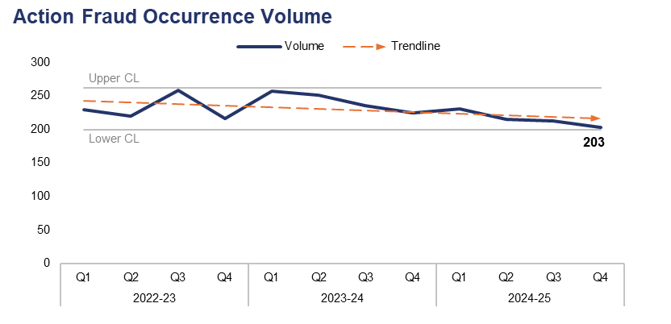
9. Action Fraud
Financial Year | 20-21 | 21-22 | 22-23 | 23-24 | 24-25 |  | Quarter | Q3 24-25 | Q4 23-24
Volume | 828 | 788 | 923 | 969 | 861 |  | % Change | -4.7% | -9.8%
Operational Overview
A total of 203 action fraud occurrences were reported to Gwent Police via the National Fraud Intelligence Bureau during Q4 2024-25. This is the lowest value within the three-year timeframe, representing a reduction of 4.7% (10 fewer occurrences) when compared to the quarter prior. A further reduction of 9.8% (22 fewer occurrences) can be observed when comparing Q4 2024-25 to the same quarter during the previous financial year.
During Q4 2024-25, £174,331 of victim’s money was safeguarded by fraud investigations in Gwent. A total of £721,082 has been safeguarded across the 2024-25 financial year.

Slide 34
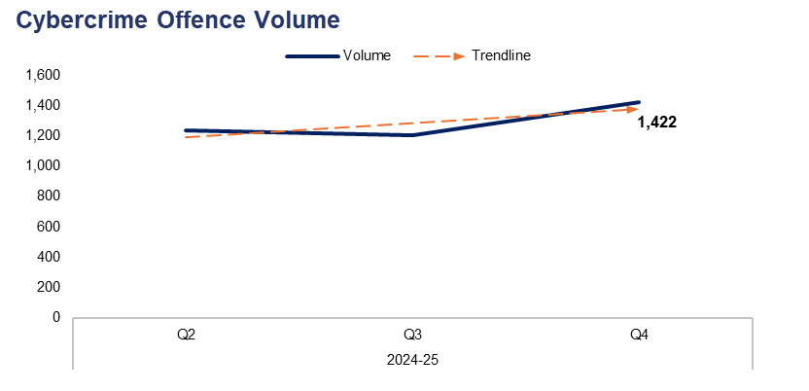
10. Cybercrime
Offences Classified as Cybercrime by Volume – Q4 2024-25
Offence Title | Volume | % of Total
Protection from Harassment Act Section 2 | 294 | 20.7%
Pursue course of conduct which amounts to stalking | 188 | 13.2%
Putting people in fear of violence | 172 | 12.1%
Take/make indecent photographs/ pseudo-photographs of children | 115 | 8.1%
Stalking involving fear of violence | 77 | 5.4%
Quarter | Q2 24-25 | Q3 24-25 | Q4 24-25 |  | Quarter | Q3 24-25
Volume | 1,234 | 1,201 | 1,422 |  | % Change | 18.4%
Operational Overview
A total of 1,422 offences recorded during Q4 2024-25 were classified as cybercrime, as defined by the NDQIS reporting system. This represents an increase of 18.4% (221 additional offences) when compared to the quarter prior.
During Q4 2024-25, four of the five offences which were most commonly classified as cybercrime can also be defined as stalking and harassment offences. Overall, stalking and harassment offences accounted for 61.5% of all cybercrime recorded during the quarter, with 875 such offences recorded.
Cybercrime reporting via the NDQIS system was first adopted by the force during June 2024, limiting the scope of the currently available dataset.

Slide 35
Pillar Four – Putting Victims First
Investigation Timeliness
Victims and Repeat Victims
Victim Satisfaction

Slide 36
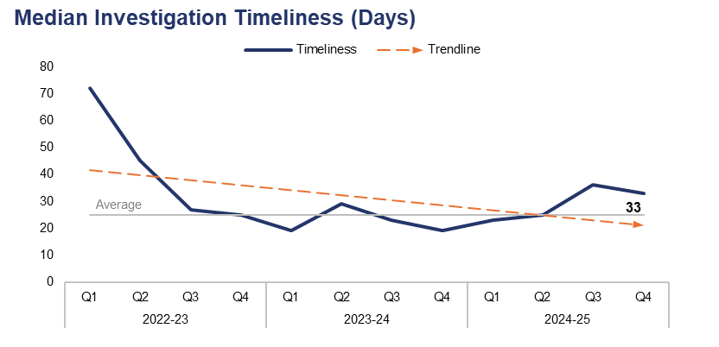
1. Investigation Timeliness
Financial Year | 20-21 | 21-22 | 22-23 | 23-24 | 24-25 |  | Quarter | Q3 24-25 | Q4 23-24
Median Timeliness | 36 | 25 | 41 | 22 | 29 |  | % Change | -8.3% | 73.7%
Operational Overview
During Q4 2024-25, the median investigation length was 33 days. This represents a reduction of 8.3% when compared to the quarter prior (three fewer days), but a substantial increase of 73.7% (14 additional days) when compared to the same quarter during the previous financial year.

Slide 37
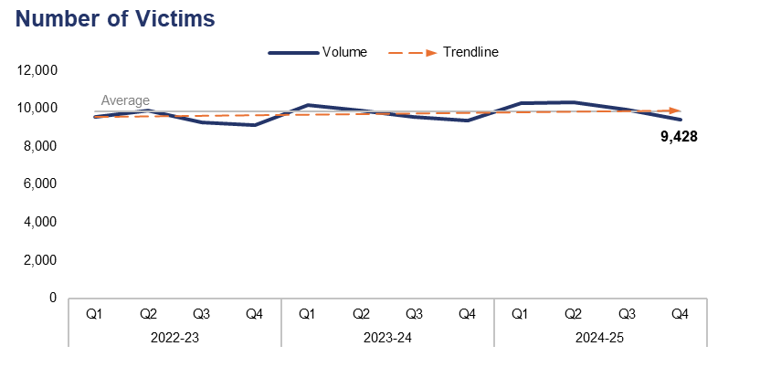
2. Victims & Repeat Victims
Financial Year | 20-21 | 21-22 | 22-23 | 23-24 | 24-25 |  | Quarter | Q3 24-25 | Q4 23-24
Volume | 32,497 | 36,058 | 37,870 | 38,948 | 39,977 |  | % Change | -5.1% | 0.8%
Financial Year | 20-21 | 21-22 | 22-23 | 23-24 | 24-25 |  | Quarter | Q3 24-25 | Q4 23-24
Volume | 28,106 | 27,908 | 32,543 | 31,168 | 29,388 |  | % Change | 0.3% | 1.9%
Operational Overview
Overall, 9,428 victims were linked to crimes recorded during Q4 2024-25. This represents a reduction of 5.1% (502 fewer victims) when compared to the quarter prior, but a slight increase of 0.8% (79 additional victims) when compared to the same quarter during the previous financial year.
During the 12 months to the end of Q4 2024-25, 7,467 victims were linked in this capacity to two or more separate offences, classifying them as repeat victims. This represents a slight increase of 0.3% (21 additional repeat victims) when compared to the quarter prior, and a further increase of 1.9% (137 additional repeat victims) when compared to the same quarter during the previous financial year.
The understanding of repeat victims and the subsequent safeguarding, support and problem solving provided to these individuals is part of the force performance mechanism. Work is ongoing to enhance this support via the use of technology to better identify potential vulnerable victims.

Slide 38
3. Victim Satisfaction
Victim Satisfaction Survey Data for Financial Year 2024-25
Survey Question | Percentage of Respondents Satisfied | Quarter-on-Quarter Difference |  | Number of Respondents Satisfied | Total Responses Received
How satisfied are you with the ease of initial contact with the Police? | 77% | -2% | â | 252 | 326
How satisfied are you with the response time to your contact? (e.g. how long it took for your call to be answered) | 75% | +1% | á | 246 | 328
Overall, how satisfied are you with your experience of the first point of contact with the police? | 73% | 0% | à | 241 | 329
If an officer attended, how satisfied are you with the time it took for them to arrive? | 84% | -1% | â | 147 | 174
How satisfied are you with the actions taken by the attending officer/s? | 75% | -2% | â | 133 | 178
Thinking about your overall experience, how satisfied are you with the treatment you have received from Gwent Police? | 64% | -1% | â | 211 | 328
Overview
A total of 330 respondents engaged with the victim satisfaction survey during the 2024-25 financial year. Of those who replied to the given question, 84% of respondents were satisfied with officer attendance times, whereas only 64% of respondents were satisfied with the overall treatment they received from Gwent Police.
All questions within the survey are optional, which may result in a disparity between the number of responses received for each question.

Slide 39
Pillar Five – Reducing Reoffending
Offenders and Repeat Offenders
Young Offenders and First-Time Entrants
Children in Police Custody

Slide 40
1. Offenders & Repeat Offenders
Financial Year | 20-21 | 21-22 | 22-23 | 23-24 | 24-25 |  | Quarter | Q3 24-25 | Q4 23-24
Volume | 23,049 | 24,594 | 25,135 | 26,132 | 27,039 |  | % Change | -6.6% | -2.3%
Financial Year | 20-21 | 21-22 | 22-23 | 23-24 | 24-25 |  | Quarter | Q3 24-25 | Q4 23-24
Volume | 26,351 | 26,022 | 29,136 | 28,717 | 27,794 |  | % Change | 0.1% | 2.1%
Operational Overview
Overall, 6,278 offenders were linked to crimes recorded during Q4 2024-25. This represents a reduction of 6.6% (441 fewer offenders) when compared to the quarter prior, and a reduction of 2.3% (151 fewer offenders) when compared to the same quarter during the previous financial year.
During the 12 months to the end of Q4 2024-25, 7,034 offenders were linked in this capacity to two or more separate offences, classifying them as repeat offenders. This represents a slight increase of 0.1% (five additional repeat offenders) when compared to the quarter prior, and a further increase of 2.1% (146 additional repeat offenders) when compared to the same quarter during the previous financial year.

Slide 41
2. Young Offenders and First-Time Entrants
Financial Year | 20-21 | 21-22 | 22-23 | 23-24 | 24-25 |  | Quarter | Q3 24-25 | Q4 23-24
Volume | 2,870 | 4,228 | 4,682 | 4,968 | 4,880 |  | % Change | -3.3% | 4.1%
Financial Year | 20-21 | 21-22 | 22-23 | 23-24 | 24-25 |  | Quarter | Q3 24-25 | Q4 23-24
Volume | 1,279 | 2,091 | 2,110 | 2,051 | 2,007 |  | % Change | -7.6% | 3.3%
Operational Overview
A total of 1,202 offenders under the age of 18 were linked to crimes recorded during Q4 2024-25. This represents a reduction of 3.3% (41 fewer young offenders) when compared to the quarter prior, but an increase of 4.1% (47 additional young offenders) when compared to the same quarter during the previous financial year.
Of these young offenders, 499 (25.2% of the quarterly total) have been identified as first-time entrants into the criminal justice system within Gwent. This represents a reduction of 7.6% (41 fewer entrants) when compared to the quarter prior, but an increase of 3.3% (16 additional entrants) when compared to the same quarter during the previous financial year.
The dataset used to identify first-time entrants is limited to offences committed within Gwent from 2018 onwards. Offences committed outside of Gwent or prior to 2018 are not included in this calculation.

Slide 42
3. Children in Police Custody
Financial Year | 20-21 | 21-22 | 22-23 | 23-24 | 24-25 |  | Quarter | Q3 24-25 | Q4 23-24
Volume | 599 | 527 | 715 | 628 | 754 |  | % Change | 4.7% | 32.1%
Operational Overview
During Q4 2024-25, 177 custody records were created with a juvenile subject. This represents an increase of 4.7% (eight additional custody records) when compared to the quarter prior, and a further increase of 32.1% (43 additional custody records) when compared to the same quarter during the previous financial year.
The above figures are based on custody footfall, which is the number of custody records with an arrival time within the specified timeframe. As such, if a subject came into custody on multiple occasions, they will be counted upon each arrival.

