Slide 1
Strategy Performance Board
Quarter 2 2022/23

Slide 2
Keeping Neighbourhoods Safe
All Crime
Residential Burglary
Neighbourhood Crime
Public Order
ASB
Roads Policing
Key Commitments
• Reduce public order offences and anti-social
behaviour, and the number of people who
repeatedly carry out these acts
• Reduce acquisitive crime and repeat offenders
• Improve the safety of roads throughout Gwent
• Commission and invest in effective crime
prevention initiatives

Slide 3
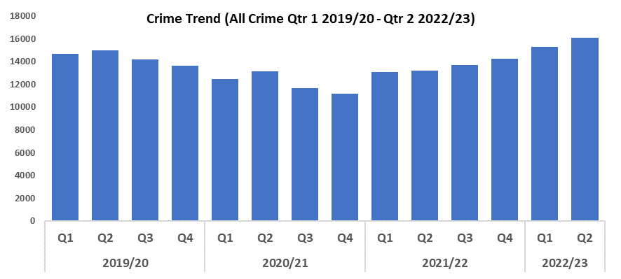

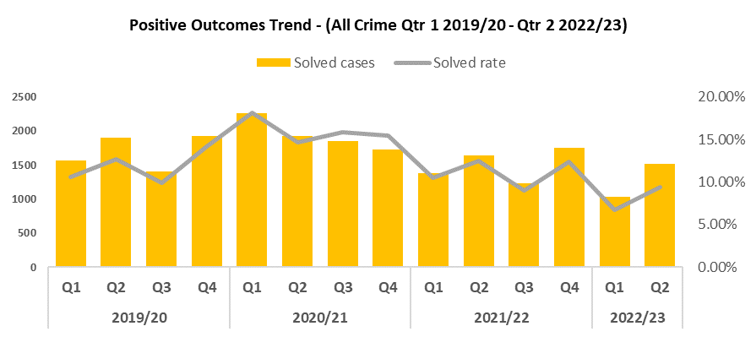
1. All Crime
Overview
Quarter 2 2022/23 has recorded a 7.6% increase in all crime (1,132 more offences to 16,093) when compared to Quarter 2 2019/20 (Pre-Covid year). Quarter 2 2022/23 has also seen an increase of 5.1% (784 additional crimes) when compared to the previous quarter.
Although included throughout this presentation, direct comparisons with 2020/21 are not practical due to the exceptional circumstances of the Covid lockdown across the country.
Compared to last quarter, positive outcomes increased by 2.6 percentage points (to 9.4%).
2020/21 and to a lesser extent 2021/22 were exceptional due to Covid lockdowns; the reduced amount of crime coupled with a purge on a backlog of outcomes led to inflated levels of positive outcomes. Therefore, it is more appropriate to compare positive outcome levels for 2022/23 against those seen in 2019/20.
It should be noted there is ongoing work to improve Gwent Police Crime Data Integrity which has influenced overall crime numbers within the past 12 months.

Slide 4
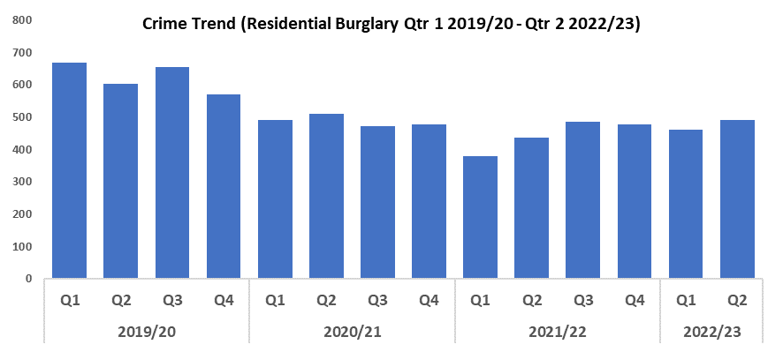
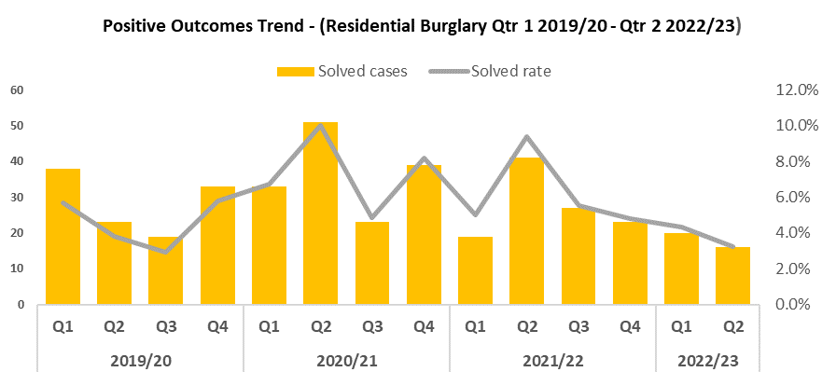
2. Residential Burglary
Overview
When compared to the previous quarter, Residential Burglary offences have risen to 492, an increase of 6.5%. When comparing Quarter 2 2022/23 to Quarter 2 2019/20, a reduction in offence volume of 18.5% can be observed.
The rise in Residential Burglary offences recorded this quarter is not unexpected, as it conforms with the trend seen during this period of the past two financial years. Despite the higher volume of offences, the quarterly increase this year is less pronounced than that seen during 2021/22 (6.5% as opposed to 15.6%), and crime volume remains well below levels seen during the pre-Covid year (2019/20). This may indicate the efficacy of the deterrence strategies employed as part of the ‘We Don’t Buy Crime’ initiative, such as the distribution of SmartWater.
Compared to the previous quarter, positive outcomes for Residential Burglary fell by 1.0 percentage point to 3.3%. The decline in solved rate observed during this quarter may be influenced by the rise in the overall crime trend, and its effect on officer’s workloads. When compared to Quarter 2 2019/20, a reduction of 0.5 percentage points was recorded.
August marked the commencement of the Burglary Response Improvement Pilot, which represents an effort to increase the Residential Burglary solved rate via actions such as the consistent allocation of Crime Scene Investigators, as well as a focus on golden hour enquiries. If successful, this should result in an increased solved rate during the following quarters.
Following a spike in both Commercial and Residential Burglaries in September a suspect was identified and arrested. A local male from Rhymney was charged with 10 burglary offences and remanded to prison for sentencing.

Slide 5
Residential Burglary continued
Burglary operations have been undertaken across Torfaen which resulted in a number of arrests and remands. The teams have also deployed covert assets to catch offenders, utilising smart grease that captures DNA and assists with tracking property.
Within the Newport LPA a repeat offender was identified who had committed more than 25 dwelling burglaries. The offender had previously utilised the Section 45 slavery defence and this had resulted in the Crown Prosecution Service (CPS) declining charge, which was identified through tasking mechanisms. As a result, experts from the Modern Day Slavery team, a specialist tier 5 interview advisor, local investigators and the neighbourhood team were brought together to problem solve the issue, which included tactical advice from the National Crime Agency. This has resulted in the offender being charged with multiple burglary offences, resulting in strong victim satisfaction.
Thanks to the Digital Services Division, members of the public and businesses can now register their CCTV for a direct link to NICE investigate. This removes the necessity to collect CCTV in person as well as building a registry of available CCTV locations (both local authority owned and private).

Slide 6
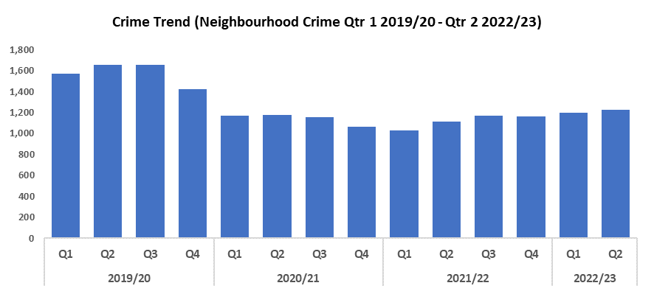

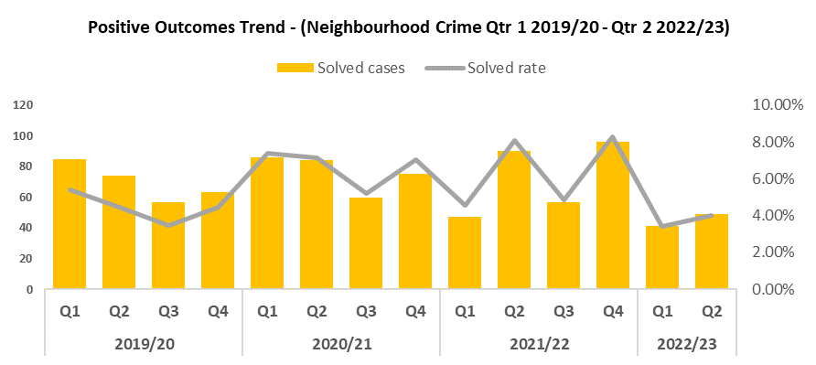
3. Neighbourhood Crime
Overview
Neighbourhood Crime has seen a 2.2% increase when compared to the previous quarter (26 additional crimes). Conversely, when comparing the current quarter to Quarter 2 2019/2020 a reduction of 26.1% (433 fewer offences) can be observed.
When compared to the previous quarter, positive outcomes for Neighbourhood Crime increased by 0.6 percentage points to 4.0%. This continues the trend seen since Quarter 2 2020/21 of alternating peaks and troughs, albeit to a much lesser degree than previously. When compared to Quarter 2 2019/20, a reduction of 0.5 percentage points can be observed.
As part of the Safer Streets initiative, preparations are now underway to deliver target hardening materials to residents and businesses in the areas of Brynmawr and Tredegar which will reduce the opportunity for acquisitive crimes to be committed. Furthermore, a youth shelter will be erected in the Brynmawr area which will benefit the younger community as they will have a safe space in which to socialise. This space will also allow Youth Services to engage with and signpost younger persons to other associations/educational departments.
Facial recognition and the Police National Database have been used as an investigative tool. Through the use of facial recognition technology, a previously prolific offender was convicted of a Robbery in which the victim was tied up.
Neighbourhood Police Sergeants and Community Support Officers in Torfaen are undergoing driver training that will allow them to deploy the mobile police station – this will be available at their surgeries.

Slide 7
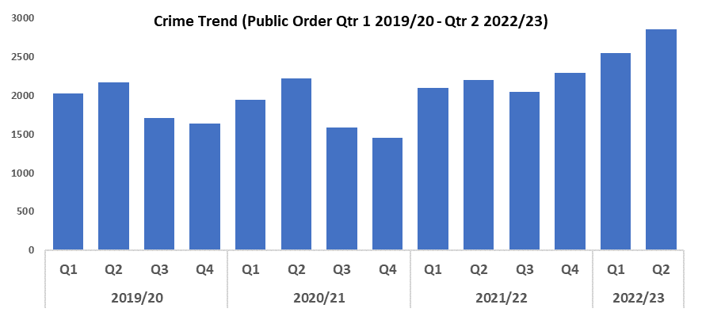

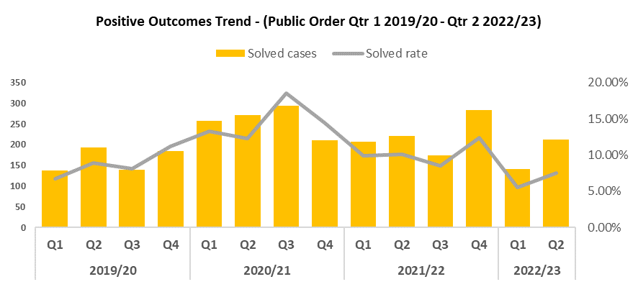
4. Public Order
Overview
Quarter 2 2022/23 has recorded the highest number of Public Order Offences in the timeframe, increasing by 11.8% when compared to the previous quarter, and by 31.2% when compared to Quarter 2 2019/20.
During Quarter 2 2022/23 positive outcomes for Public Order Offences increased by two percentage points to 7.5% when compared to the previous quarter. When compared to Quarter 2 2019/20 positive outcomes decreased by 1.4 percentage points.
The volume of Public Order Offences resolved via community resolutions saw a sharp decline in Quarter 1 2022/23, but this figure has increased during Quarter 2 2022/23.

Slide 8
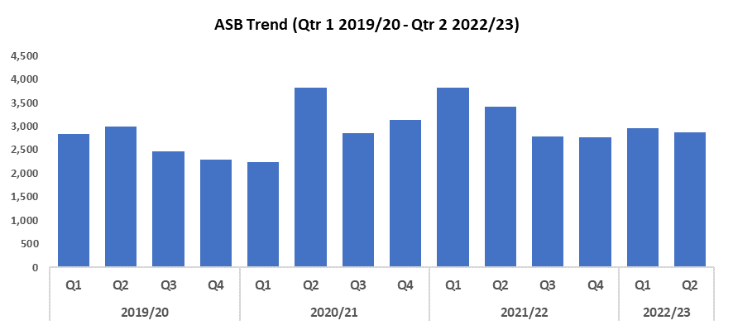
5. ASB
Overview
Levels of anti-social behaviour in Gwent have decreased when compared to the previous quarter, by 2.7% (80 fewer incidents). When compared to Quarter 2 2019/20, ASB fell by 3.8%.
The reduction seen during this quarter may speak to the efficacy of several initiatives put in place to curb ASB levels, such as Operation Ashton, which aims to prevent re-offending via intervention courses. It may also indicate the impact of the £750,000 granted by the Home Office as a result of the force’s successful Safer Streets bid. A portion of this funding is being used to deter ASB through a range of diversionary tactics, such as educational youth outreach programmes delivered from new or refurbished youth shelters.
Anti-social driving and motoring offences have been raised consistently across police surgeries in Caerphilly North. To tackle this issue the team have led local operations in September and October, achieving the following results to date: Five off road bikes seized for Anti-social driving, three stolen vehicles recovered (including suspect arrests and with live investigations ongoing), and two persons arrested for drug driving, with their vehicles seized for Road Traffic Offences.

Slide 9
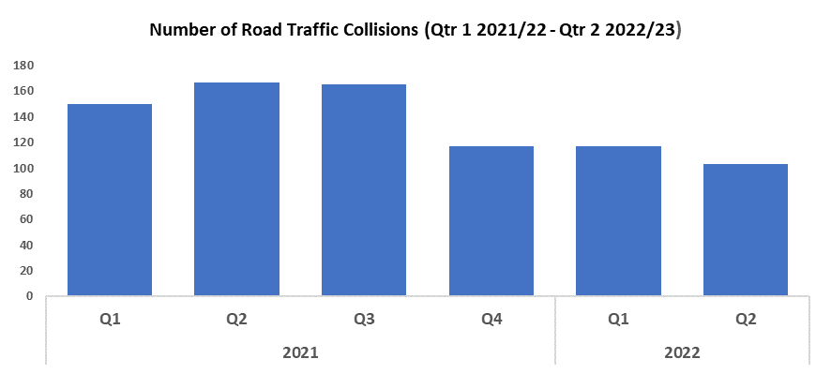
6. Roads Policing
Overview
During Quarter 2 2022/23, 103 Road Traffic Collisions (RTCs) were reported via RTC booklets. This represents a reduction of 12.0%, or 14 fewer incidents, when compared to the previous quarter.
A total of 347 persons were reported for one of the ‘Fatal Five’* factors during Quarter 2 2022/23, 30 more than during Quarter 1 2022/23. The most commonly reported factor during both quarters was drink/drug driving, with 154 instances reported during Quarter 1 2022/23 (48.6%), and 159 instances reported during Quarter 2 2022/23 (45.8%).
Work has been carried out with DSD e-Services over recent months, with digital traffic offence reporting being introduced as a result. Officers can now complete and submit Traffic Offence Reports (TOR) through their Samsung device which eliminates the need for books of tickets and hard copy documents.
*’The Fatal Five’ refer to the five main causes of serious injury and death in RTCs. They are: careless driving, drink/drug driving, not wearing a seatbelt, using a mobile phone, and excessive speed.
The electronic submission of TORs eliminates the need for hard copy documentation to be produced and transferred around the Force to the Central Ticket Office. This reduces the possibility of data breaches that may result from the loss of hard copy documents ‘in transit’. Electronic submission of TORs minimises delays in information reaching the Central Ticket Office and so reduces the end-to-end time cycle of the process, from issuing of the notice to successful outcomes through driver rehabilitation or court disposals. Swifter access to driver rehabilitation training will reduce the risk to road users within the Force area, as well as the number of court outcomes.
The creation of electronic TORs removes the need for hard copy printed booklets which amount to around £6,000 per year. As the TOR submission is electronic and accessible via handheld devices carried by officers they are always available to be ‘issued’ which eliminates the need for stocks of booklets to be kept in reserve, as well as the logistic element of these booklets being conveyed to areas within the Force where they are requested or by officers travelling into the Central Ticket Office to collect them. The implementation of the electronic solution also eliminates the cost element in respect of the hard copy notices being collated, collected and transferred to the Central Ticket Office.
Gwent Police took part in the national summer Drink/Drug drive campaign between 22/08/2022 and 28/08/2022. The campaign was supported by a victim of a drink driver which featured as a lead story on the BBC Drink driving: My husband of 54 years was killed by drink-driver. During the weeklong operation, the force conducted over 300 breath alcohol tests and approximately 150 drug wipe tests. Over 60 drivers were arrested as a result of failing tests.
In addition to this, a joint Seat Belt campaign was held with South Wales Fire and Rescue Service on 11/08/2022.

Slide 10
Roads Policing continued
A number of road safety operations were undertaken during the last quarter, including:
Operation Louis, as part of Vulnerable User Month, which focused on speed and eyesight. This resulted in 10 drivers being issued with TORs for exceeding the speed limit next to a school, nine drivers being stopped, checked and given words of advice for very low-level excess speed, and 22 eyesight tests being conducted (each with a discussion with an optometrist). One driver was dealt with for driving without due care and attention, and one heavy goods vehicle (HGV) was stop checked (including tachographs) at the Usk site due to the 7.5 tonne weight limit and recent HGV damage to the Usk historic bridge. This has been identified as a high priority for local residents.
Operation Utah, a multi-agency road safety operation on 10/10/22, which identified (amongst others), 82 speeding offences, four drug driving offences, nine insecure load offences, four no insurance offences, two no driving licence offences, two number plate offences, and six no seatbelt offences.
Operation Overload, the first abnormal loads operation undertaken by Gwent Police, taking place at J22 of the M4 on 14/10/22, alongside the DVSA and Highways England. An abnormal load was identified travelling on the M4 Eastbound. This vehicle was escorted into the abnormal load bay at J22. It was prohibited on the day for the following reasons: Incorrect details on MO (overall length of vehicle, rear projection, weight, category), incorrect details on the Special Order, the driver admitting to deviating from the route on the MO, incorrect weight submitted on the MO (submitted as 80 tonnes , or category 2, weighed at roadside 95 tonnes, or category 3), incorrect drawing vehicle used (for this weight DVSA have requested minimum of 8 axles), and lack of load security.
This prohibition has been identified as one of the highest-level prohibitions in the UK and has been raised to the highest levels in the DVSA, Highways England and Health and Safety. It is estimated the incurred costs to the company will be upwards of £250,000, before any prosecutions and Traffic Commissioner hearings.
A car cruising operation, which took place in Newport on 23/10/22. As a result, 17 TORs were issued for excess speed, the majority being on the A4810, the recent site of the RTC involving racing. In addition, 10 drivers were warned for excess speed, and four TORs were issued for an insecure load, a vehicle condition likely to cause injury, defective tyres, and illegal number plates respectively. A further three PG9s (roadworthiness prohibitions) were issued for an insecure load, exposed ply cords, and a vehicle in dangerous condition (modified spoiler). Two drivers were summoned to court for driving without due care, two persons were arrested for S.5A Drug Drive offences, and a Section 165 seizure was carried out for no insurance. Finally, four vehicles were seized for anti-social driving under Section 59 of the Road Traffic Act.
A joint DVLA/Police road safety operation on 25/10/2022 resulted in: Two arrests for being unfit to drive through drugs, one vehicle seized for a no insurance offence, 17 vehicles identified with no valid road tax, (with fine notices issued by the DVLA), 11 fixed penalties issued for no valid road tax, and 13 Illegal number plates, with 1st stage letters sent to the registered keepers of the vehicles.

Slide 11
  Combat Serious Crime
Combat Serious Crime
Key commitments
• Reduce the number of repeat victims of child
criminal and sexual exploitation
• Increase disruption of serious organised crime,
and reinvest assets seized back into communities
• Improve the overall criminal justice response
to violence against women, domestic abuse and
sexual violence
• Commission and invest in services that work
with perpetrators of serious crime to prevent
and reduce re-offending
Serious Violence
VAWG Domestic and Non-Domestic Priority Offences
VAWG Repeat Victims and Offenders
Drugs Supply and Organised Crime

Slide 12
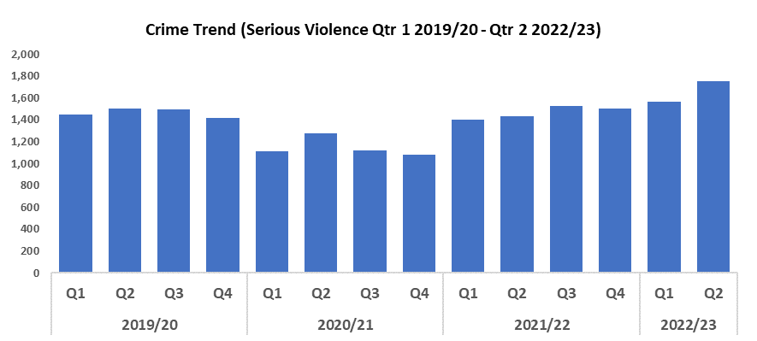
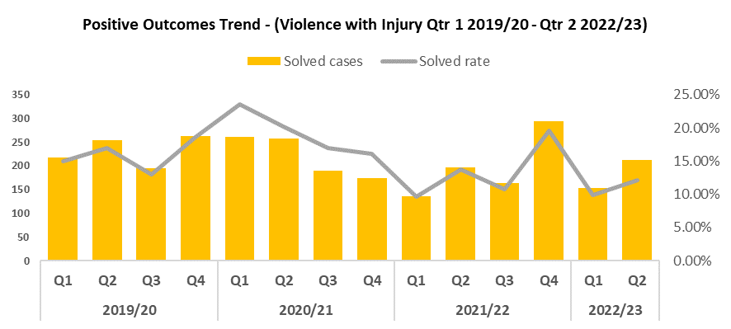
1. Serious Violence
Overview
An upwards trend in serious violence offences can be observed from Quarter 4 2020/21, with numbers having increased this quarter to 1,752, an 11.9% increase over the quarter prior. Quarter 2 2022/23 has seen a 16.6% increase when compared to Quarter 2 2019/20 (Pre-Covid year).
A rise in Grievous Bodily Harm with Intent offences is a contributing factor to the overall increase this quarter.
Compared to the previous quarter positive outcomes for serious violence have seen an increase of 2.4 percentage points to 12.2%. This represents a 4.7% reduction in solved rate when compared with Quarter 2 2019/20 (Pre-Covid year).
Senior officers have been in contact with the Metropolitan Police in order to study how they make practical use of social media in relation to violent crime. These lessons will be disseminated throughout the force in an effort to improve our own practises.
Operation Fortune entailed the investigation into a domestic murder in the Bettws area. As a result of the investigation the suspect has pleaded guilty and will be sentenced later this month.

Slide 13
Financial Investigation Unit
Overview
During the past quarter, the Financial Investigation Unit issued confiscation orders totalling £67,039, in addition to £147,266 in civil detention of assets. 274 Suspicious Activity Reports were also reviewed. Gwent is currently ranked 4th in the country for asset recovery, despite the small size of the force.

Slide 14
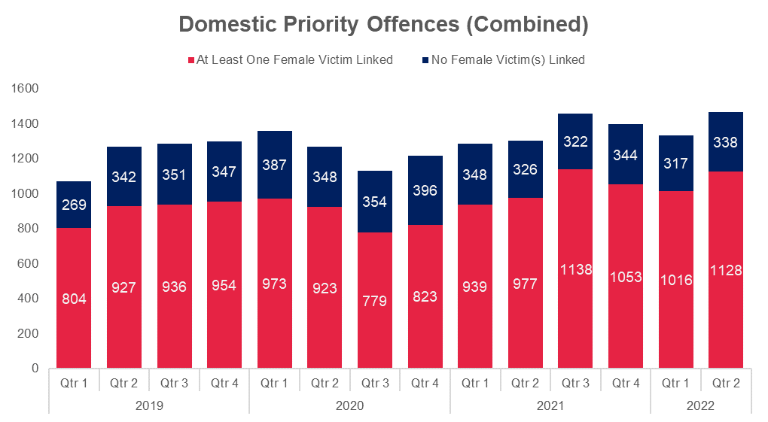
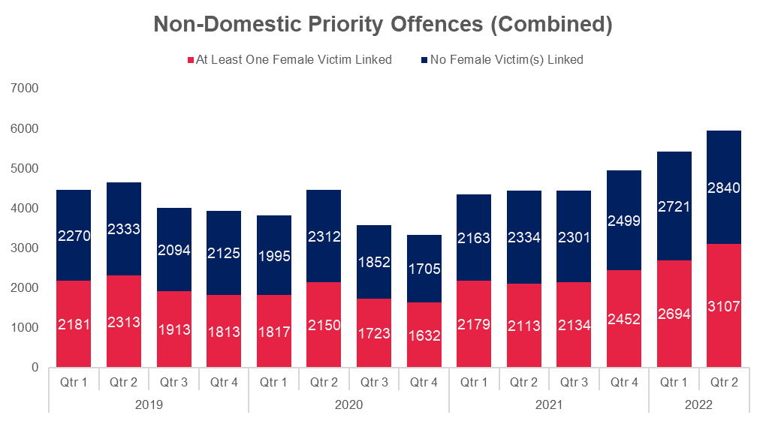
2. VAWG Domestic and Non-Domestic Priority Offences
Domestic Priority Offences
The adjacent chart shows the number of combined VAWG priority offences~ with a domestic abuse qualifier and the number of crimes that have at least one female victim linked.
Compared with the previous quarter there were 112 more Domestic Priority Offences with at least one female victim linked, which represents an increase of 11.0 percentage points.
In Quarter 2 2019/20, 73.0% (n=927) of offences had at least one female victim.
In Quarter 2 2022/23, 76.9% (n=1128) of offences had at least one female victim.
The biggest contributor to Domestic Priority Offences is Stalking and Harassment which accounts for over 54.6% of offences with at least one female victim linked (n=616) during Quarter 2 2022/23.
Non-Domestic Priority Offences
The chart below shows the number of combined VAWG priority offences+ with no domestic abuse qualifier and the number of crimes that have at least one female victim linked.
Compared with previous quarter an increase of 413 Non-Domestic Priority Offences with at least one female victim linked was observed, which represents an 8.6 percentage point increase.
In Quarter 2 2019/20, 49.8% (n=2313) of offences had at least one female victim.
In Quarter 2 2022/23, 52.2% (n=3107) of offences had at least one female victim.
The biggest contributors to Non-Domestic Priority Offences are Stalking and Harassment (37.0%), and Public Fear, Alarm and Distress (37.5%), which between them accounted for 74.5% (n=2316) of offences with at least one female victim linked in Quarter 2 2022/23.
~Domestic Priority Areas Combined covers Homicide, Violence with Injury, Stalking and Harassment, Public Fear , Alarm or Distress, Rape, Other Sexual Offences, and Modern Slavery.
+Non-Domestic Priority Areas Combined covers Homicide, Violence with Injury, Stalking and Harassment, Public Fear , Alarm or Distress, Rape, Other Sexual Offences, and Modern Slavery and Exploitation of Prostitution.
Notes:
Violence Against Women and Girls
Sections are based on the scope provided by the NPCC Violence Against Women and Girls (VAWG) Taskforce
Next slide - Methodology

Slide 15
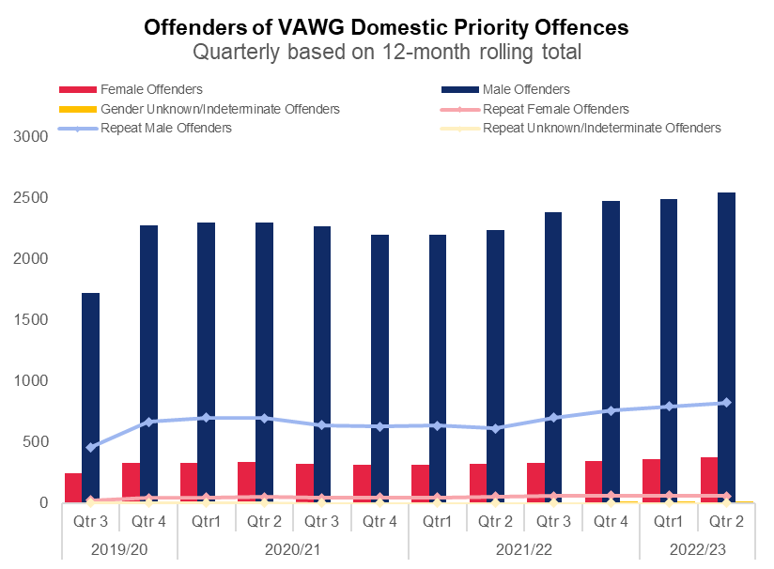
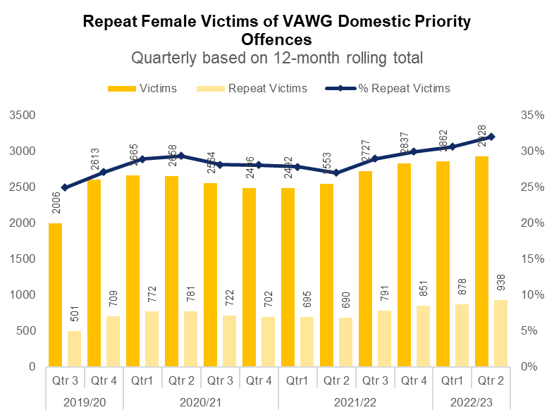
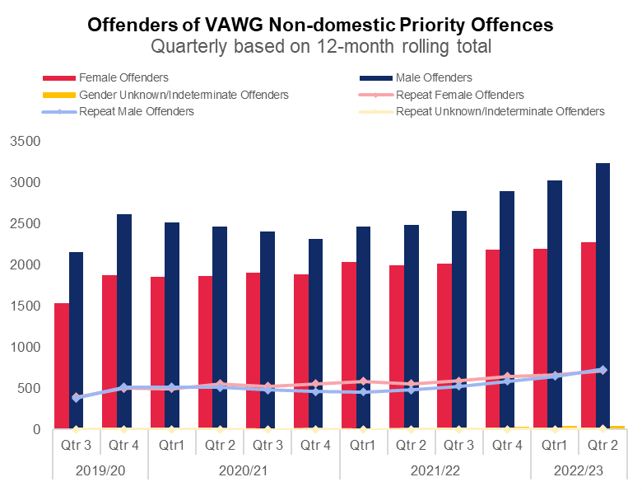
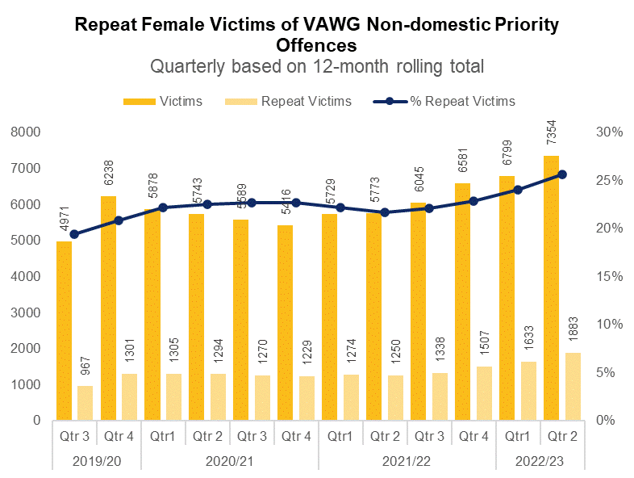
3. VAWG Repeat Victims and Offenders
Repeat Victims and Offenders Domestic Priority Offences
Repeat Victims
938 females have been a victim of more than one VAWG Domestic priority offence~ in the last 12 months to end Quarter 2 2022/23. 18 women and girls have been the victim in more than five separate offences.
Repeat Offenders
In the 12 months to end Quarter 2 2022/23, there were 376 female offenders of domestic crimes~ against females, 15.7% (n=59) of which committed more than one offence in the most recent 12-month period.
There were 2,542 male offenders of domestic crimes~ against females, 32.5% (n=825) of which are repeats. 24 males were linked as the offender in more than five VAWG offences~ in the most recent 12 month period.
Repeat Victims and Offenders Non-Domestic Priority Offences
Repeat Victims
1,883 females have been a victim of more than one VAWG Non-Domestic priority offence+ in the most recent 12 months. 87 women and girls have been the victim in more than five separate offences.
Repeat Offenders
In the 12 months to end Quarter 2 2022/23, there are 2,276 female offenders of non-domestic crimes+ against females, 31.5% (n=716) of which committed more than one offence in the last year.
There were 3,235 male offenders of non-domestic crimes+ against females, 22.6% (n=732) of which are repeats. 22 males were linked as the offender in more than five VAWG offences+ in the last year.
Please note all charts do not include crimes without a linked offender.
~Domestic Priority Areas Combined covers Homicide, Violence with Injury, Stalking and Harassment, Public Fear , Alarm or Distress, Rape, Other Sexual Offences, and Modern Slavery.
+Non-Domestic Priority Areas Combined covers Homicide, Violence with Injury, Stalking and Harassment, Public Fear , Alarm or Distress, Rape, Other Sexual Offences, and Modern Slavery and Exploitation of Prostitution.
Notes:
Violence Against Women and Girls
Sections are based on the scope provided by the NPCC Violence Against Women and Girls (VAWG) Taskforce
Next slide - Methodology

Slide 16
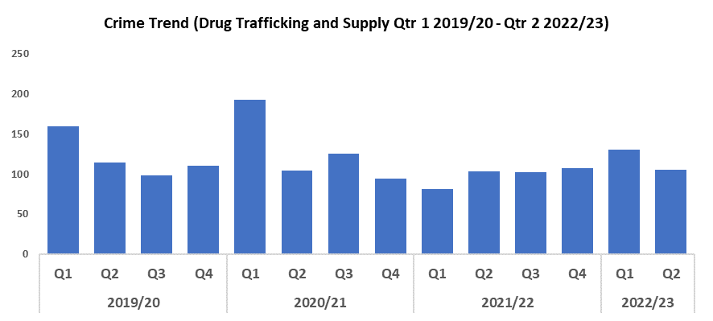
4. Drug Supply & Organised Crime
Overview
Quarter 2 2022/23 has recorded a 19.2% decrease in Drug Trafficking and Supply offences (25 fewer offences to 105) when compared to the previous quarter, and a reduction of 7.9% (9 fewer offences) when compared to Quarter 2 2019/20 (Pre-Covid year).
1,576 Drug Supply and Dealing intelligence logs were submitted during Quarter 2 2022/23. This is an increase of 39 logs when compared to Quarter 1 2022/23, which saw 1,537 logs submitted, and a decrease of 88 logs when compared to Quarter 2 of 2021/22, during which 1,664 logs were submitted (data for 2019/20 is currently unavailable).
Two offenders were convicted of conspiracy to supply cocaine and money laundering, with one sentenced to nine years imprisonment, and the other five years. Both were based in the Tredegar area and were suspected of supplying Class A drugs. They have previously been linked to unlawfully possessing imitation firearms. Both will now be the subject of a Proceeds of Crime Act (POCA) hearing.
The Neighbourhood Enforcement Team in Torfaen have executed a number of drugs and firearms warrants, with drugs money and high value vehicles being seized. They have also worked with community safety and social landlords to re-home potential vulnerable victims targeted by these groups.
The Gwent Organised Crime Unit carried out Operation Bothwell to combat the large scale supply of controlled drugs across Southern Wales. This resulted in the seizure of 11 kilos of cocaine with a street value of in excess of £60,000. This is the largest ever seizure of cocaine by Gwent Police.
Operation Merida, a joint Gwent Police and Regional Organised Crime Unit investigation saw the seizure of £100,000 in cash and 1.5 kilos of Cocaine, with two individuals charged
Drug testing on arrest is now in place and embedded in the team working with partners (Gwent Drugs and Alcohol Service), to develop referral pathways and services for cocaine use as a driver for crime. In addition work with an app and video production agency is underway to support and educate officers in recognising and responding to crime driven by substance misuse.
In October the Drugs Focus Desk officially launched after a period of awareness and education for front line officers. It has shown early signs of success, with officers seeking specialist support on controlled drug cases. A number of charges have already been secured and there are early signs of a reduction in people being released under investigation for drug offences.
During the past quarter, the Financial Investigation Unit issued confiscation orders totalling £67,039, in addition to £147,266 in civil detention of assets. 274 Suspicious Activity Reports were also reviewed. Gwent is currently ranked 4th in the country for asset recovery, despite the small size of the force.

Slide 17
Support Victims and Protect the Vulnerable
Hate Crime
Rape Crime
Domestic Related Crime
Domestic Abuse Repeat Victims/Offenders
Modern Day Slavery and Human Trafficking
Child Sexual Exploitation/Child Criminal Exploitation
Cyber Fraud
Victim Support/Repeat Victims
Key commitments
• Improve victim services and ensure that the
needs of victims are identified and responded to
appropriately through Connect Gwent and the
Victim Care Unit
• Further improve our work with partners to
protect those most vulnerable
• Increase the timeliness of police investigation
updates provided to victims
• Commission and invest in specialist services to
support victims throughout the criminal justice
process

Slide 18
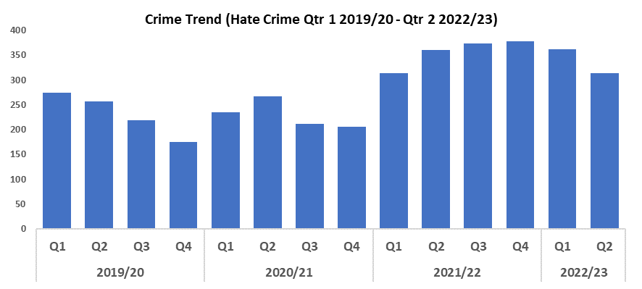
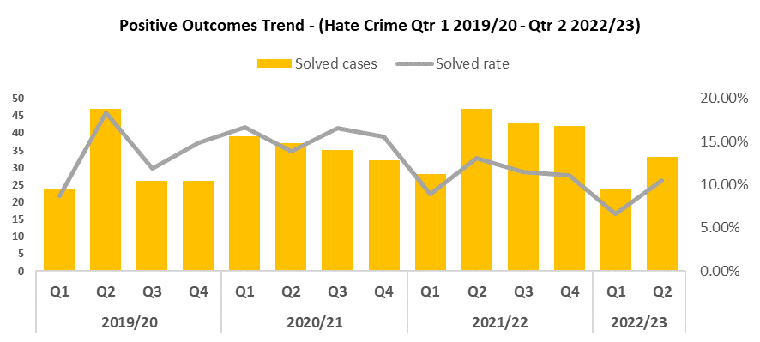
1. Hate Crime
Overview
A downward trend in hate crime offences has been observed from Quarter 4 2021/22 to 313 crimes this quarter, a reduction of 13.5% compared to the quarter prior. However, when compared to Quarter 2 2019/20, hate crime increased by 22.3%.
Disability hate crime has recorded 48 crimes this quarter, a reduction on the most recent four quarters.
Homophobic hate crime saw a reduction to 71 offences this quarter compared to the raised levels seen in the previous two quarters.
Racial hate crime remained consistent with last quarter, at 188 offences.
Religious hate crime fell to four in this quarter, a reduction on the raised levels seen in the previous two quarters.
Transphobic hate crime reduced to 11, the lowest level seen since Quarter 3 2020/21.
Positive outcomes rose by 3.9 percentage points to 10.5% when compared to the previous quarter. When compared to Quarter 2 2019/20 (Pre-Covid year), a reduction of 7.9 percentage points was recorded.

Slide 19
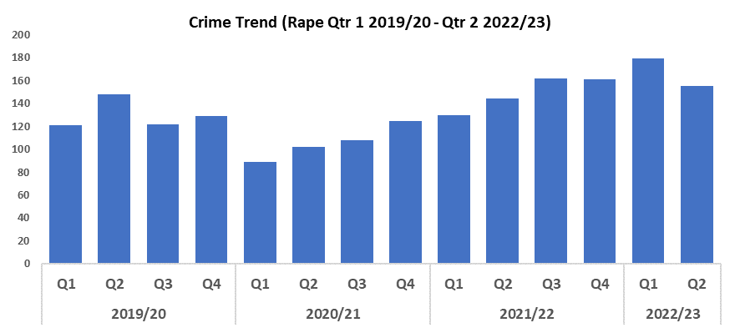
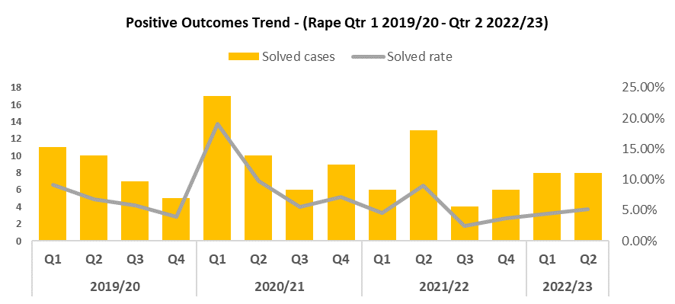
2. Rape
Overview
During this quarter Rape offences reduced by 13.4% to 155. This reduction runs counter to the increased reporting required as part of the government’s Beating Crime Plan, and the local priority to actively increase reporting in this historically under-reported offence category. Rape Offences have increased by 4.7% compared to Quarter 2 2019/20 (Pre-Covid year), however.
Rape positive outcome rates have seen an upward trend from Quarter 3 2021/22 to 5.2% this quarter, an increase of 0.7 percentage points over the quarter prior. When compared to Quarter 2 2019/20 a reduction of 1.6 percentage points can be observed.
The Rape Investigation Team (RIT) commenced in September 2022 and Operation Soteria Bluestone began in October, which will improve the police response to RASSO offences. This should increase the positive outcome rate going forward. Workload reviews have been carried out within the RIT with the assistance of inspectors and sergeants from other teams, in order to streamline their allocated tasks and reduce backlogs.
An offender was convicted of rape and sentenced to 12 years imprisonment. He had stupefied his victim with the drug GHB and subjected her to a number of degrading sexual assaults, which were recorded on a mobile phone. The victim was unaware of what had happened to her until she saw footage on his mobile phone. Excellent victim support and investigation skills were shown by a Detective Constable to achieve a conviction and lengthy custodial sentence.

Slide 20
Rape continued
The newly formed Rape Investigation Team commenced an operation to investigate three males who were attending nightclubs late at night, preying on and raping females who were isolated and vulnerable through intoxication. A large investigation with Criminal Investigation Department support resulted in the three being charged and remanded to court.

Slide 21
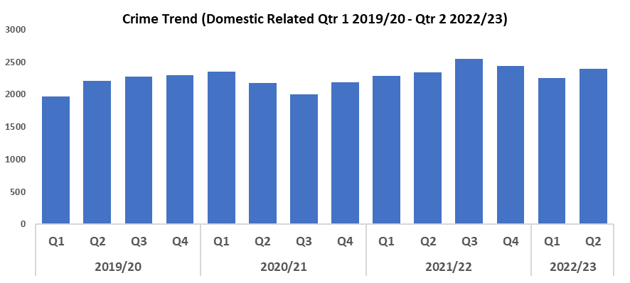

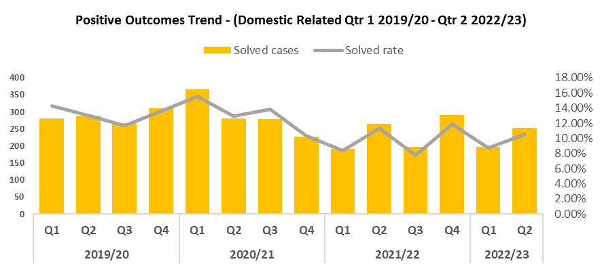
3. Domestic Related Crime
Overview
Domestic related offences rose by 6.1% during Quarter 2 2022/23 when compared to the quarter prior, up to 2,394. When compared to Quarter 2 2019/20, domestic related offences increased by 8.2%.
Positive outcomes for domestic related crime have risen by 1.8 percentage points to 10.5% when compared to the previous quarter. When compared to Quarter 2 2019/20, a reduction of 2.6 percentage points was recorded.
A change in the format of the DAC02 and IQC01 templates have allowed Police Sergeants and Inspectors to provide rationales around Evidence Led Prosecutions (ELP) and Domestic Violence Protection Notice (DVPN) considerations respectively to Domestic Abuse cases. This has already yielded dividends in an increase in DVPNs but most importantly has captured decision making around ELP and DVPN considerations.

Slide 22
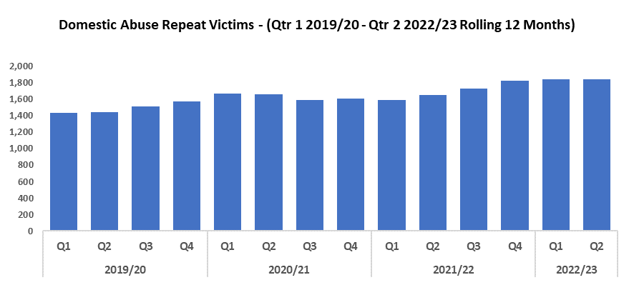

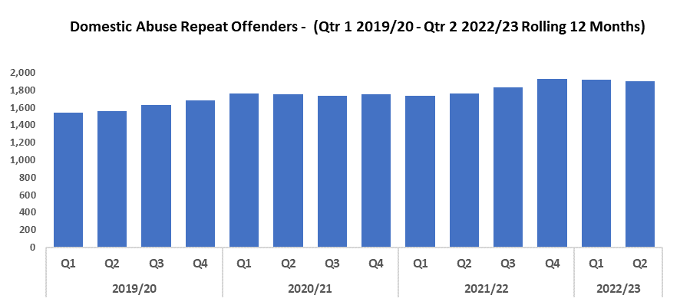
4. Domestic Abuse Repeat Victims/Offenders
Repeat Victims Overview
The amount of repeat domestic abuse victims (based on rolling 12 months) remains high this quarter with 1,841 repeat victims, the second highest in the timeframe and just three fewer than the previous quarter.
Compared to Quarter 2 2019/20, there were 394 more repeat victims, an increase of 27.2%.
It may be that increased scrutiny on correctly recording crime has led to an increase in repeat victims in this crime area. It may also indicate that victims are increasingly willing to report subsequent offences, implying a certain level of victim satisfaction following their initial contact with Gwent Police.
Repeat Offenders Overview
The amount of repeat domestic crime offenders (based on rolling 12 months) has decreased marginally this quarter by 14 when compared to the quarter prior.
Compared to Quarter 2 2019/20, there were 342 more repeat offenders (an increase of 22.0%).
There is a Multi-Agency Tasking and Coordination (MATAC) process in place which aims to identify serial perpetrators of domestic abuse in order to reduce reoffending and safeguard victims and families. A range of interventions can be delivered via MATAC, including support, prevention, diversion, disruption and enforcement, in order to reduce harm.

Slide 23
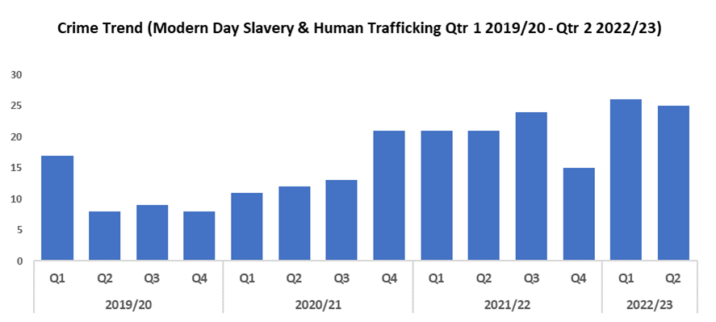
5. Modern Day Slavery and Human Trafficking
Overview
The number of Modern Day Slavery and Human Trafficking (MDSHT) crimes reduced by one when compared to the previous quarter, to 25 offences.
Compared to Quarter 2 2019/20, MDSHT crimes increased by 212.5% (an additional 17 offences).
There has been proactive work ongoing in the MDSHT team around carwashes. Continued awareness training has also been delivered to new starters, new CSOs, and trainee detectives. The number of National Referral Mechanism referrals submitted has also increased during the last two quarters, in line with the rise in crime.

Slide 24
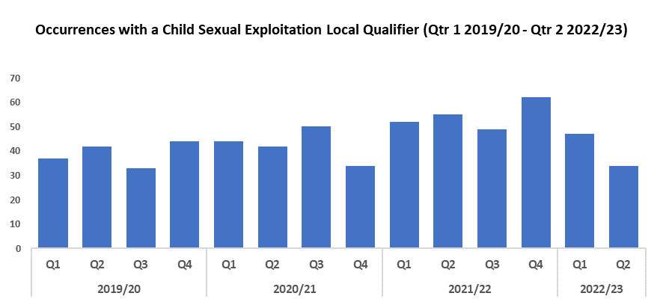
6. Child Sexual Exploitation/Child Criminal Exploitation
Overview
Quarter 2 2022/23 has recorded a 27.7% decrease in crimes with a Child Sexual Exploitation (CSE) local qualifier when compared to the previous quarter, down to 34 offences. A reduction of 19.0% has been observed when compared to Quarter 2 2019/20 (Pre-Covid year).
The offence most commonly assigned a CSE local qualifier in Quarter 2 of 2022/23 was ‘Take/make indecent photographs/pseudo-photographs of children’, with 4 instances. This is followed by Sexual Assault on a Female, and Rape of a Female Child Under 13 by a Male, with three instances each.

Slide 25
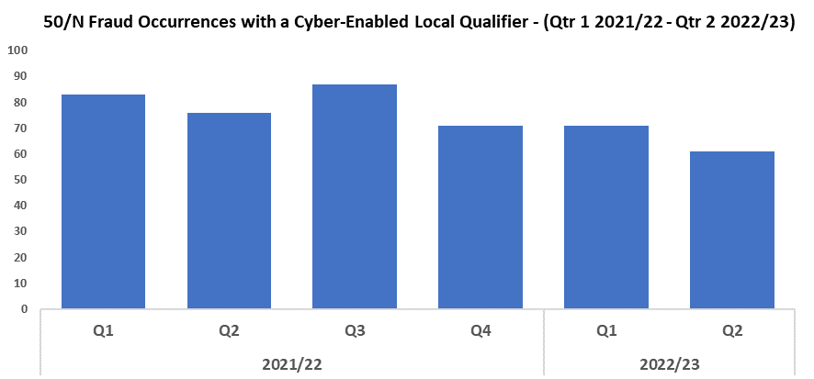
7. Cyber Fraud
Overview
Of the 1,117 fraud occurrences under 50/N, 40.2% (449) have a cyber-enabled local qualifier.

Slide 26
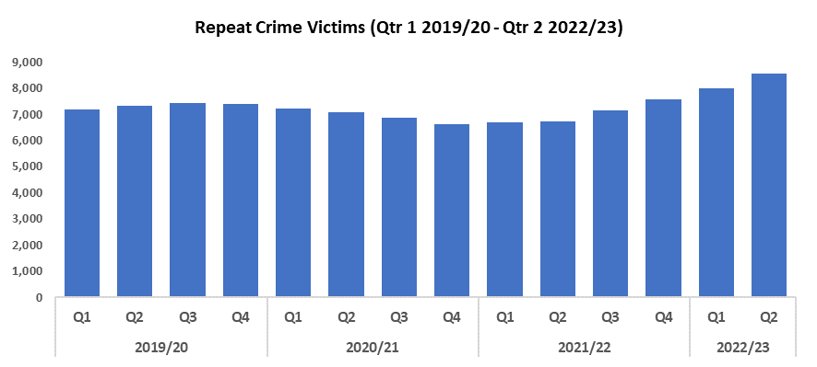
8. Victim Support/Repeat Victims
Overview
The number of repeat crime victims (those a victim of two or more crimes in a 12 month rolling period) has increased by 7.0% during Quarter 2 2022/23, to 8,558. This is the highest level within the timeframe, indicative of the rising crime trend. An increase of of 16.9% was recorded when comparing this quarter to Quarter 2 2019/20.
These increases may be due in part to increased confidence in reporting by these repeat victims, potentially indicating an improvement in victim satisfaction in their initial contact with Gwent Police.
During the last quarter 14,294 victims have been referred to the Victim Care Unit.
Continuous improvements are being made to ensure victims of crime:
• Are assessed/referred for specialised support – 1,459 detailed needs assessments have been completed.
• Kept updated throughout the criminal justice process – the unit is currently providing regular updates to 2,759 victims.
• Receive their entitlements under the Victims Code of Practice – 7,108 victims have been informed of their rights.
The Witness Care Unit continue to guide victims and witnesses through the final part of their criminal justice journey. The unit are currently supporting 6,837 victims and witnesses, with an average attendance rate of 91% for Magistrates Court and 94% for Crown Court.
The Survivor Engagement Co-Ordinator (SEC) continues to engage with survivors of sexual and domestic offences in order to gather feedback on their experience of reporting to Gwent Police, with themes and trends being reported through the governance structure to enable change. Recent improvements have been made to gather feedback from cases within the Domestic Abuse (DA) and Rape and Serious Sexual Offences (RASSO) Scrutiny Panels to ensure a well-rounded and victim centred approach. Both the SEC and Victim Reference Group consulted on the DA review and the subsequent DA toolkit to ensure victims remain at the heart of all we do. The Victim Reference Group continues to grow from strength to strength with their knowledge and input being used right across the Violence Against Women/Domestic Abuse/Sexual Violence (VAWDASV) sector to ensure whole service improvement.
The Special Measures Advisor role is now up and running and provides quality assurance for the force by running a search for DA and RASSO court cases in which a ‘not guilty’ plea is anticipated. Victims and witnesses are then contacted to complete a tailored needs assessment that helps determine if special measures are required and which are most appropriate for them. The role is raising awareness of the Remote Evidence Site and already there has been a significant increase in MG2s requesting this being submitted.

Slide 27
Victim Support/Repeat Victims continued
The Public Protection Unit has been supporting victims and protecting vulnerable people within the hubs. Over the past month they have received and processed 232 referrals for the West LPA, broken down as follows: 167 child protection referrals, 57 Protection of Vulnerable Adults (POVA) referrals, four Professional Strategies (allegations against professionals), and four Child Sexual Exploitation (CSE) and Child Criminal Exploitation (CCE) referrals.
As a result of these meetings, 87 investigations and joint visits have been undertaken. All of these matters refer to vulnerable people that live within the west of Gwent. They have had contact with specialist officers to deal with the matters from the outset, offering support and advice along with partner agencies to assist in the safeguarding and welfare of the victims and their families.

Slide 28
Increase Community Confidence in Policing
Perceptions Survey
Victim Satisfaction
Representative Workforce
999 Demand
101 Demand
Initiatives & Events
Key commitments
• Increase the effectiveness of officer and staff
engagement with residents in their communities,
and community confidence and trust in Gwent
Police
• Improve the accessibility of neighbourhood
police teams through a variety of contact
channels that meet the needs of the public
• Increase reporting of crime by communities
that are less likely to engage with the police
• Further increase officer and staff diversity
to ensure our police service reflects the
communities that we serve

Slide 29
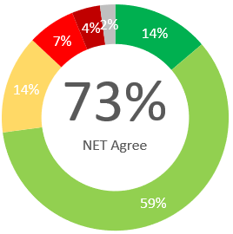
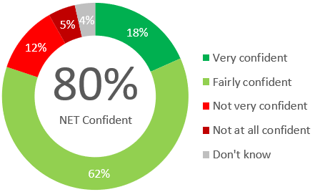
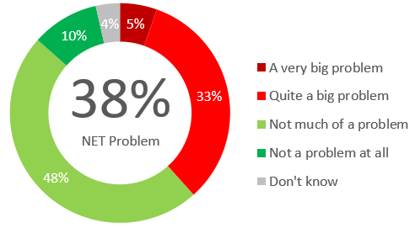




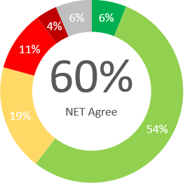
1. Perceptions Survey
Confidence in the Police
Service Levels
Local Concerns
Positive Experiences
“Just because of what happened where I live a few weeks ago and they came out and did nightly patrols - I can't fault them on that aspect.”
“Based on how they reacted when the neighbour was causing problems, I think they understand what goes on well enough.”
“On media says what's happing and how it’s dealt with so do get some insight into how it works.”
Almost Three-quarters (73%) of people agree they have confidence in the police in their area. This is lowest in Newport (68%) and highest in Monmouthshire (79%).
More than a third (35%) feel that crime and ASB are a problem in their area.
From the last quarter, this is an increase of three percentage points. Newport (49%) is the area of highest concern whereas Monmouthshire (24%) has the lowest perceived concern.
Eight in 10 residents are confident they would receive a good service from Gwent Police if they had to report a crime or incident.
Ethnic minority groups have less confidence in this statement, with 49% agreeing they have confidence in police in their area.
Three-fifths (60%) agree that Gwent Police are dealing with important issues in their community. This reduced by 3 percentage points from Q4 2021-22. All sectors have similar individual perceptions with the highest being Monmouth (65%) and the lowest Newport (56%) in agreement.
Lack of action
“I have said this because there is a fairly high level of crime and anti-social behaviour in my local area.”
“Nothing done too many electric scooter and bike on pavement.”
“A lot of problems with children out late at night, there's drugs about too, it seems that the police are doing very little about it, but it's a constant problem.”
Minority
Overview: The neighbourhood policing teams in Caerphilly North have held 23 Police Surgeries and a number for community-based engagement activities, including a MacMillan coffee morning in September which was attended by over 100 members of the public and raised £450 for the charity. The event provided an opportunity to discuss community policing, provide crime prevention materials and offer community reassurance about the teams work across the section
Minority
32% of individuals in a minority ethnic group surveyed disagree with this statement, higher than white individuals at 16%.
3.0% have been a victim of crime and did not report to Gwent Police. Applying this to the population of Gwent, this would equate to 17,631 individuals.
“Didn't feel confident enough that they would help.”
Notes:
Perceptions Survey: Local Concerns and Overall
Next slide – Victim Satisfaction

Slide 30
2. Victim Satisfaction
Percentage | Measure
Survey Number | Survey One | Survey Two |  |  |  | Survey Three
Metric | Satisfied with Initial Contact | Satisfied with Follow Up & Investigation | Satisfied with the service from the VCO | Satisfied with the service from the officer dealing with your case | Satisfied with being kept informed about your case | Satisfied with Post Charge
General Crime | 60% | 58% | 88% | 78% | 83% | 40%
Domestic Violence | 76% | 88% | 100% | 91% | 89% | 100%
Hate Crime | 100% | 67% | 100% | 100% | 100% | No Data
Sexual Violence | 100% | 67% | 100% | 67% | 100% | No Data
Baseline | N/A | N/A | 85% | 85% | 74% | N/A
Numeric | Measure
Survey Number | Survey One | Survey Two |  |  |  | Survey Three
Metric | Satisfied with Initial Contact | Satisfied with Follow Up & Investigation | Satisfied with the service from the VCO | Satisfied with the service from the officer dealing with your case | Satisfied with being kept informed about your case | Satisfied with Post Charge
General Crime | 287/477 | 33/57 | 30/34 | 25/32 | 24/29 | 2/5
Domestic Violence | 39/51 | 22/25 | 23/23 | 20/22 | 16/18 | 5/5
Hate Crime | 10/10 | 2/3 | 3/3 | 3/3 | 3/3 | No Data
Sexual Violence | 9/9 | 2/3 | 3/3 | 2/3 | 2/2 | No Data
Sample Size | 547 | 88 | The above questions can be answered with ‘N/A’. These responses have been removed from both the percentage and numeric calculations. As a result, the sample size will differ from that for ‘Satisfied with Follow Up & Investigation’. |  |  | 10
Notes:
Victim Satisfaction Survey
Next section – Criminal Justice

Slide 31
3. Representative workforce
The following table is correct as of 31 September 2022
Overview
There is a gender disparity evident in the workforce for both officers and staff. For officers, females are underrepresented by approximately 16 percentage points (current census data reveals that females make up 51% of the population in Gwent). However, females are overrepresented in the staff workstream area (by approximately 16 percentage points).
There is also disparity in the minority ethnic representation within the workforce. For police officers, currently 3.4% are persons from an ethnic minority (3.9% 2011 Census, 4.9% StatsWales). Ethnic minority representation in staff is even lower at 2.1%.
The Professional Standards Department (PSD) continues to proactively promote the importance of professional standards and ethical culture within the organisation. The PSD provides detailed inputs to all new starters within the organisation including updated content on Abuse of Position for a Sexual Purpose. The PSD has recently presented to departmental leads a Financial Vulnerability Awareness session focusing attention on the key indicators and support available for staff. The PSD will continue to work alongside Corporate Communications to produce the next edition of the PSD Times, with November’s edition focussing on counter corruption and vetting. The July edition of PSD Times was one of the most popular internal articles by volume viewed and received positive feedback across all ranks and staff grades.
People Services network leads will have one protected day each month, during which they will be allocated to one of the executive boards in order to support them with the aims of the network. Monthly meetings have also been set up with the PSD to review feedback from exit interviews and fairness at work.
Retention procedure has been drafted and submitted for consultation, which includes retention discussions and exit interviews. A review of the attrition of student officers has been undertaken, along with supportive actions.
Gwent Police are on target to achieve operational uplift. 59 probationers joined on the 26th of September (the largest cohort to date), and 22 CSOs started on the 24th of October to bring the force in line with our Welsh Government funded CSOs

Slide 32
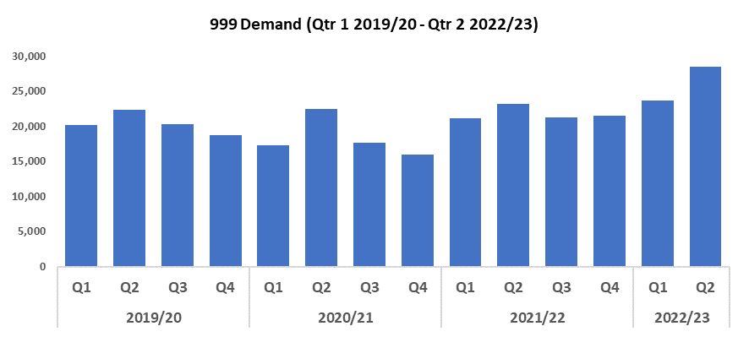

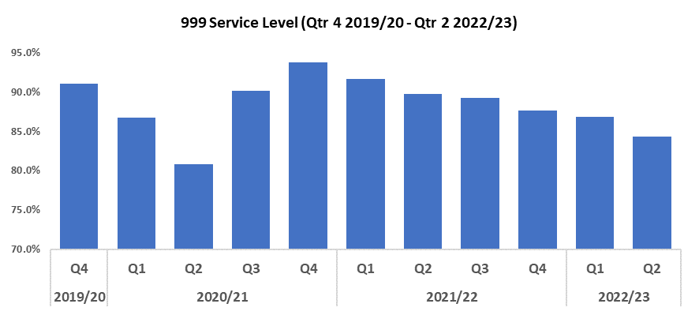
4. 999 Demand
Overview
999 demand has risen by 20.4% (4,837 calls) when compared to the previous quarter, and currently stands at 28,557. This is the highest level seen within the timeframe. 999 demand has also increased in comparison to Quarter 2 2019/20 (by 28.0%, or 6,247 additional calls).
During this quarter there has been a notable increase in 999 demand nationwide, with high volumes of calls being recorded across the country. In addition to this, the rise seen in Gwent could be linked in part to the increase in 101 abandonment rate, with callers from that service potentially becoming frustrated with lengthy wait times and instead electing to call 999.
The percentage of 999 calls answered within 10 seconds has deteriorated when compared to the previous quarter (by 2.5 percentage points to 84.3%), remaining below the national benchmark of 90%. This represents a continuation of the downward trend which began following Quarter 4 2020/21.
The average speed of answer has fallen to 12 seconds during the most recent quarter, but remains above the 10 second national benchmark. This improvement disrupts the upward trend observed following Quarter 4 2020/21, despite the continued decline of 999 service level during this time.
Unlike 101 calls, there does not appear to be a strong correlation between 999 demand and 999 service level or answer speed during the previous six quarters. This indicates that factors beyond call volume may be contributing to these trends.

Slide 33
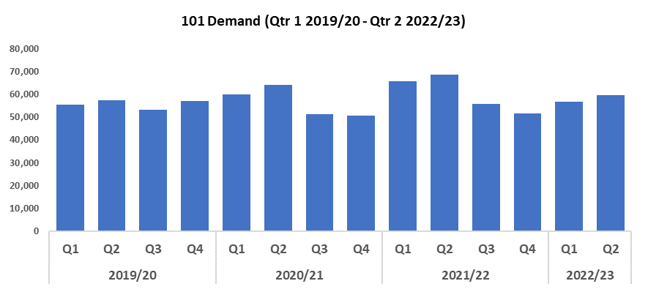
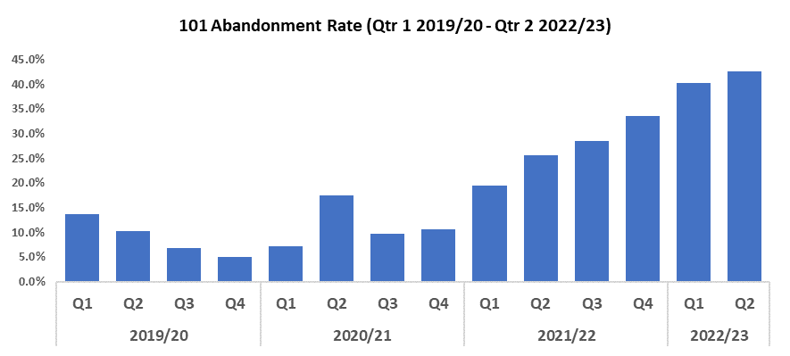

5. 101 Demand
Overview
101 demand (all connections) has increased when compared to the previous quarter by 5.1% (2,874 additional calls) to 59,760. Demand has also increased when compared to Quarter 2 2019/20 (up 4.1%, 2,378 additional calls).
When looking at the past three financial years, 101 demand appears to be greater during quarter one and quarter two of a given year than in subsequent quarters (with Quarter 4 2019/20 standing as an exception). As such, the rise in 101 demand observed during this quarter does not appear to be anomalous and conforms to seasonal trends.
The 101 abandonment rate has increased by 2.3 percentage points when compared to the previous quarter, and now stands at 42.5%. This marks the continuation of an upward trend which began in Quarter 4 2020/21, and represents the highest value within the timeframe. Abandonment rate has also increased when compared to Quarter 2 2019/20 (by 32.3 percentage points).
The average answer speed for 101 calls has increased by fifty-two seconds (12.6%) when compared to the previous quarter, and now stands at seven minutes and forty-five seconds.

Slide 34
6. Initiatives & Events
Overview
Gwent Police supported the national policing operation for the funeral of HRH Her Majesty Queen Elizabeth. This significant mutual aid operation involved deploying 143 police officers to events in Cardiff and London. The Force Planning Department carefully planned this operation, working long and unsociable hours to ensure the force fully contributed to the national operation whilst maintaining local business continuity. This was the largest mutual aid deployment the force has experienced.
Over the past three months the Corporate Communications team has secured positive coverage for our roads policing operations including drink/drug driving and roads operations. They have also shared court outcomes on the successful prosecution of organised crime drug dealers and perpetrators of sexual offences against adults and children.
The team secured a positive piece on Modern Day Slavery in partnership with the Office of the Police and Crime Commissioner comms team. The journalist spent a day visiting premises with officers, which resulted in a positive feature piece.
Recruitment for Operation Uplift has been a major tranche of work and the Corporate Communications team’s digital campaign has supported our recruitment team to meet the uplift numbers. They have also welcomed new cohorts of officers and PCSOs to the force including the first cohort pledging allegiance to His Majesty King Charles. The team managed the public and internal communications around the death of Queen Elizabeth in line with protocol to ensure an appropriate and dignified response.
The team launched the most recent funding round from Safer Streets focussing on theft, burglary and anti-social behaviour. Internally they saw the successful sharing of the Ethics Conference, and the launch of the Gwent Babies support network. They have also worked with the project team to ensure the successful implementation of Kay’s Law,which sees changes to pre-charge bail putting victims at the heart of decision-making.

