Slide 1
Compliance With Safeguarding
Detective Chief Superintendent
Andrew Tuck
January 2025

Slide 2
Compliance with Safeguarding
The purpose of the presentation is to provide update to the OPCC in relation to how we are meeting statutory obligation to safeguard children and promote their welfare under Sections 10 & 11 Children Act 2004. Child Protection does not occur in isolation and there are several avenues within policing by which we achieve this objective.
The presentation will seek to show what is working well, developing areas and future aspirations.
Many developments have sought to ensure that the voice of the child is at the heart of all that we do and that there is a clear focus on professional curiosity across all agencies.
Child Protection comes in many forms and keeping these two elements central to our service delivery and partnership working is essential to the successful operational implementation of measures to protect children.

Slide 3























Working Together to Safeguard Children

Slide 4
Child Protection
What is working well? | Developing areas | Future aspirations
Training for PPU(Public Protection Unit) Staff are SCADIP(Specialist Child Abuse Investigators Development Investigation Plan) and ABE 9Achieving Best Evidence) interviewing is continuing and working well. | RASSO(Rape and Serious Sexual Offences) DS’s to complete the SSAIDP(Specialist Sexual Assault Investigators Development Investigations Plan) and PPU teams to be RISDIP(Rape and Serious Sexual Offences Investigation Development Programme) trained. This continues as SSAIDP has been reviewed and amended. Nationally the NPCC ( National Police Chiefs Council) are developing the Professionalisation of Public Protection curriculum, and this will be rolled out nationally for all areas of policing not just PPU. | All staff in all workstreams to be ABE trained and all front staff to undertake relevant RISDIP training and basic Child Protection awareness. National consistency for PP training.
Full dip sampling policy continues to be embedded and covers all vulnerability strands. PPU have a performance framework and public protection investigations are dip sampled. | Improved methods of monitoring workloads and better supervisory support to prevent staff burn out and ensure that there is a focus on staff wellbeing . Workloads have been reduced and there have been additional staff within PPU’s to fill vacancies in the last year. | To have full capacity and capability within PPU’s to manage demand, provide effective and timely service delivery and improved safeguarding and prevent staff burn out.
Missing children team are now integrated in the Safeguarding Hubs to enhance communication with exploitation teams and improve intelligence sharing. There has been a reduction is missing episodes and repeats. | Embedded attachments for all frontline staff within Public Protection Teams to improve awareness, skills and risk recognition. This will result in more children protected and improved partnership working. This has been fully established. | Future aspirations would be to broaden the knowledge of exploitation with attachments by front line staff and supervisors to Exploitation Teams. This was an aspiration last year but remains a running aspiration due to recruitment and CPD (Continuous Professional Development).
Monitoring and escalation processes in place for strategy discussion research. This has resulted in eradicating backlogs and highlighting where pinch points may arise so that mitigation can be put in place. | Under new operating model processes and staffing are going to be demand focused rather than geographically based. | Mandated Stop Search PPN’s (Public Protection Notice) for children will be reviewed and impact assessed – working in collaboration with partners and operational support.
PRUDIC (Procedural Response Unexplained Death in Children) Process continues to work well and there are quarterly meetings with Health to discuss themes. | PPU staff to be upskilled and undertaken FLO (Family Liaison Officer) training to support family. | Bespoke family bereavement training has been developed and arranged to be delivered by 2 Wish Upon a Star.
Voice of the Child embedded into niche – focus on professional curiosity across all agencies – continues to be a feature. This forms part of dip sampling and working practices. | Multi-agency transitioning to adulthood work has been agreed and there are processes developing. | Review of the demand analysis and provision to identify and mitigate risks for children who are transitioning to adulthood – particularly in cases of child death and circles of vulnerability .

Slide 5
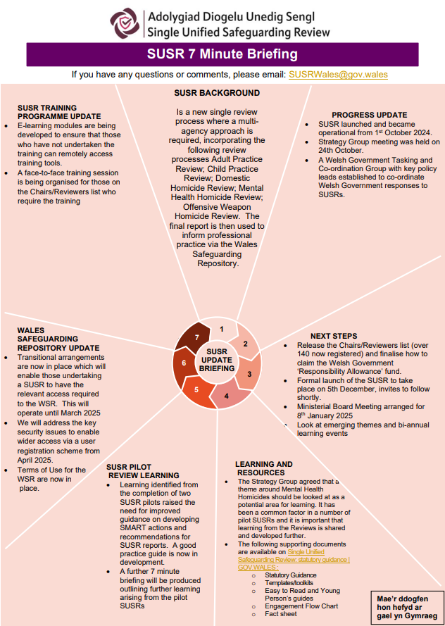
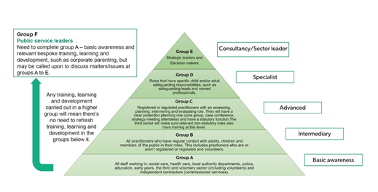
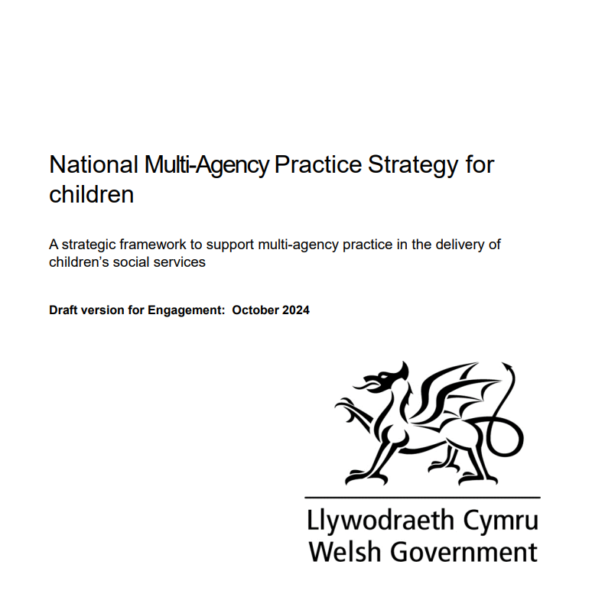
Working Together to share learning
Social Care Wales has been leading on the development of the national safeguarding training, learning and development standards.
How the standards have been set out
The purpose of these standards is to make sure everyone in Wales gets consistent and good quality training, learning and development that’s relevant to their role and responsibilities, and that we, as practitioners, can safeguard people to the best of our ability.

Slide 6
CSE/CCE
What is working well? | Developing areas | Future aspirations
All LA’s(Local Authorities) using the exploitation toolkit and exploitation strategy meetings. This continues to work well. | The Exploitation Teams, staff have been developing an ‘exit strategy,’ where when a child is moving from the cohort as the risks have been mitigated that confusion to the child is reduced and they are engaged with the next steps and agencies review the end-to-end process with that child – with an onwards management plan. | Better communication with education is still a priority this year to improve intelligence, risk recognition and contextual safeguarding opportunities. However, this is much improved since last year.
Philomena Protocol and trigger plan has been developed for all exploited children on the cohort. | Better investigative links with MDS (Modern Day Slavery) and the MDS tram moving to Exploitation Governance,
MACE (Mulit Agency Child Exploitation) meetings chaired by Police under new terms of reference for all exploitation types and attendance is good from agencies. This continues to work well and in the East the age has increased to 25 years old to align with transitioning children. | Developing Regional partnerships continues, and agencies are developing better information sharing processes.
The internal SOC(Serious Organised Crime) partnership working has yielded benefits in focusing on the links of exploitation with SOC and engage staff outside of PPU’s to identify and proactively tackle exploitation. As shown by SOC Meeting. | Development of a CSE (inc group based Child Sexual Exploitation) problem profile. This has been an area of focus for the force and it is recognised that whilst p[practitioners have a good understanding, the analytical capacity needs further development. | Development of Force analytical capacity remains an area for improvement within CSE/CCE (Child Criminal Exploitation) and the force is reviewing how this is achieved.

Slide 7
ONLINE OFFENDING
What is working well? | Developing areas | Future aspirations
Investing in triage software which enables digital devices to be examined at the scene. This has reduced the number of devices being seized, improved the timeliness of investigations and assists with eliminating third party devices from the investigation. | Due to other demand it has been identified that front line police officers do not always have the capacity to carry out bail checks on those suspected of indecent imagery offences. To address this gap, the Police On-Line Investigation team will now complete their own bails checks on suspects. This will ensure that those checks are completed in a timely manner and that the officer completing has knowledge of the case and the right skills to enforce any conditions imposed.
Expanding on Operation Encompass to include children who may be adversely affected by child abuse imagery investigations, but who are not technically defined as ‘victims’ or at immediate risk of harm. This has improved information sharing with the local authority and education safeguarding teams, ensuring that safeguarding partners are aware of warrants, arrests or conditions that could impact a child’s wellbeing. | Where it is known that that there is likely to be a delay between initial action and a criminal justice outcome, the use of civil orders will now be considered as an alternative to bail. A process has been agreed with legal services and orders such as a Sexual Risk Order [SRO] will now be applied for where a risk is identified and management via a Court Order is more appropriate than bail conditions. | To have an uplift in civil orders in respect of this area of offending.
Recent uplift in supervision [to 2 Detective Sergeants] which supports the force in completing regular reviews and enhanced oversight of investigations.

Slide 8
Missing Children
What is working well? | Developing areas | Future aspirations
Established and embedded Multi-Agency Hubs. Better partnership communication and willingness to try new ways of working. | Relationship CIW (Care Inspectorate Wales)- working with police and partners. Will include daily updates from MCT (Missing Childrens Team) to CIW. Care homes registered with CIW requested to register on online portal and required to update with any missing/risk incident for looked after children. This will ensure care homes are working to the regulations. This is working well from last year but continues to develop. | It remains an aspiration that all agencies to become fully embedded in safeguarding hubs: Including third sector, education and health to ensure timely intervention, disruption, support and diversion and improved risk recognition and early intervention for children and reduce missing episodes and risk.
The new Missing meetings are working well and there has been a reduction in both missing children, repeat missing and an improvement in partnership engagement and risk management. The Philomena Protocol and Trigger plans have also been embedded for those children most at risk. | Improved scrutiny over missing children reports to ensure risks identified and low and no risk assessment are not used for missing children. This is in Daily DMM (Daily Management Meetings), and the revised Missing Children debrief processes. It also forms part of RCRP (Right Care Right Person). | Following the Missing Children report about black and ethnic minority children being reported missing the force is developing a dip sample process to mitigate against any unconscious bias or adultification of black and ethnic minority children. This is going to be reviewed, and it is hoped that this will ensure that this is not present within Gwent and that all children receive a quality service.

Slide 9
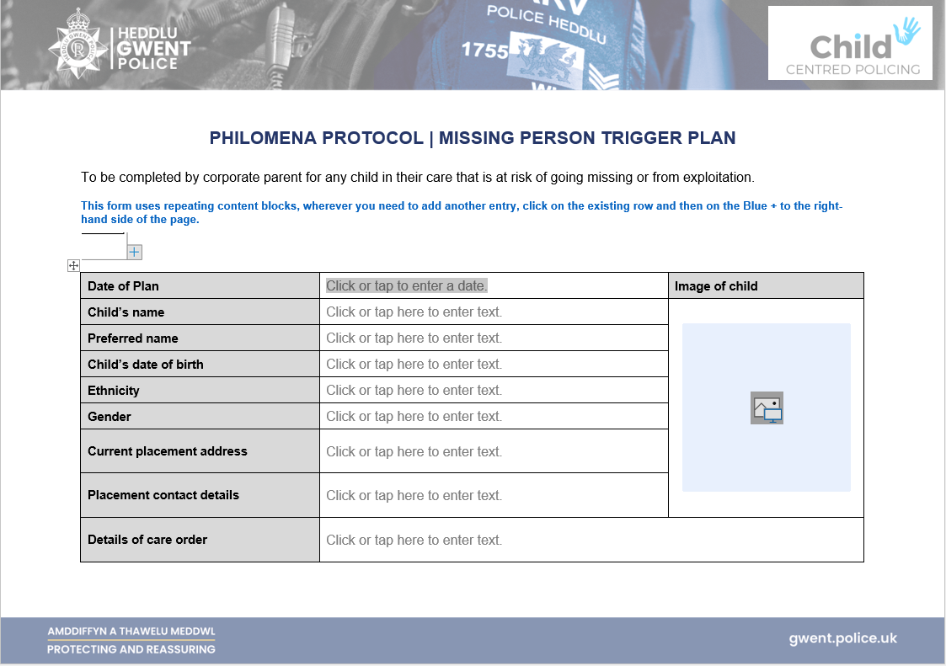
Missing children and CSE

Slide 10
Domestic Abuse
What is working well? | Developing areas | Future aspirations
Operation Encompass has been further embedded and there are established links to Social Services for dissemination of relevant information to education for safeguarding | Barnardo's are commencing work to review this area and the support given to children to improve service delivery from all agencies following an Encompass Alert. | Children in colleges, nurseries and private/independent schools to be included in Encompass is still an aspiration, but some progress has been made with the inclusion of some private schools.
Voice of the child is now embedded within the niche templates and risk assessment forms. With children recognised as victims in their own right. | Training continues to ensure that Child as Victims In Their Own Right as outlined in the Domestic Abuse Act 2021 is embedded in training to front line staff. | Better use of commissioned services to support child victims and to compliment statutory services.
The pilot of independent MARAC (Multi Agency Risk Assessment Conference) Chairs has been working really effectively and it is hoped will be built into the future MARAC partnership sustainability plans. | DAST (Domestic Abuse Support Team) governance is moving to align with Safeguarding hubs, to have a more holistic safeguarding footprint. | DVDs (Domestic Violence Disclosure Scheme) demand continues to increase showing greater public confidence. The force is reviewing processes and resources to meet these and it is hoped that in doing so timescales will be reduced.
DA (Domestic Abuse) matters Training has been embedded force wide and is now being embedded within Tier 2 interview training. There has also been a significant rise in DA champions as suggested by the force in the previous Force Management Statement – this has improved recognition of DA especially stalking and coercive control. | Further training in DA Matters and rolling programme of DA Champions to improve service delivery – including recognition of risks to children. There is also training being delivery around stalking and use of civil orders. | The force has committed to employing a Civil Orders Officer and part of this will be around SPO (Stalking Protection Orders), DVPO’s )Domestice Violence Protection Orders) and SHPO (serious Harm Protection Orders).

Slide 11
Children in custody
What is working well? | Developing areas | Future aspirations
HMIC(His Majesty Inspectorate Constabulary) have reviewed custody and have made mention of the positive management of children in custody and the focus by GWP (Gwent Police) to divert children away from CJ ( Criminal Justice ) processes. Staff have now been trained in neuro diversity, there are distraction tactics, and the force has invested in a bespoke booking in area for children. | The force is developing processes to monitor availability local authority and secure accommodation and to highlight this to WG (Welsh Government) via the CCP (Child Centred Policing) Regional Meeting. Custody Sergeants are being encouraged to reduce overnight detentions for children through robust safety planning and bail. | To have sufficient secure accommodation locally to prevent children being detained in police custody or being moved far from home.
The established Monitoring and Review Panel continues to work well and provide external Multi-agency scrutiny. | work is on ging to monitor and reduce duplication in the submission of PPNs – as Custody currently submit, as do OIC’s and this may be compounded through the mandated stop search requirement and the force is looking at how custody can engage with demand reduction. | Improved provision for child with MH (Mental Health) issues as this is present for adults but there is a need this for children and the facilities are not available for children. The MOU (Memorandum of Understanding) with Mental Health is currently being reviewed and access to services for children with specific needs is being monitored.
There continues to be increased scrutiny of the detention of children in custody by sergeants and improved use of professional curiosity to ensure arrests and detentions are necessary, proportionate and lawful. These are reviewed during the custody morning DMM. | DA Matters training for custody staff to provide improved awareness of DA signs and increased recognition of children of victims in their own right. There is a development of bespoke custody CPD underway to cover vulnerability and signs or risks to children. | It continues to be an aim to reduce the length of time that children are kept in custody and GWP are seeking to work with partners and police to ensure robust police and timely investigations take place and the partners do not delay provision of appropriate adults and accommodation.

Slide 12
HMIC and Review Learning
What is working well? | Developing areas | Future aspirations
Following last year’s update as regards the AFIs (Area For Improvement) relating to safeguarding hub back logs, processes were amended to streamline processes and ensure that backlogs were eradicated. An escalation process was implemented to prevent backlogs building and provide a contingency plan, should they arise. This continues to be effective and has resulted in no backlogs and effective management in the cases where it does. | Improved recognition of CSE/CCE- Data is still not centrally available but the force is reviewing this and working hard to ensure consistency. | To have easy access data on the vulnerability app to assist in pattern identification and offender profiling to assist front line especially in DA and exploitation.
Missing children and appropriate gradings and oversight of risk gradings was highlighted as a concern. There has been a reduction in missing and repeat missing and there are no NAR’s (No Apparent Risk) being applied and there are processes to monitor and address. | Missing Children Debrief has evolved with education and other agencies being involved to better support children. This continues to be improved as outlined in the relevant slide.
Multi-agency meetings and governance to identify shared learning opportunities – continues examples being embedding recommendations from DHR’s ( Domestic Homicide Review) | Better use of flags to identify group based CSE and use of problem profiles.
It should be noted that an amount of the learning and HMIC/Review Recommendations have been referenced throughout the presentation.

Slide 13
Questions?
Questions?

